Slide 1
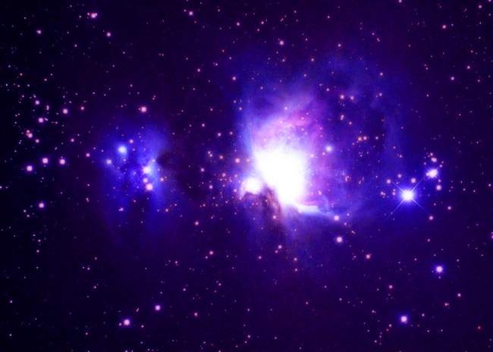
TO INFINITY…
BEYOND!
AND

Slide 2
LIGHT YEARS!
A light-year is a unit of distance. It is the distance that light can travel in one year…
Light moves at a velocity of about 300,000 kilometers (km) each second.
SO…
in ONE YEAR, it can travel about 10 trillion km!!
More precisely, one light-year is equal to 9,500,000,000,000 kilometers!!
With materials from http://starchild.gsfc.nasa.gov/docs/StarChild/questions/question19.html

Slide 3
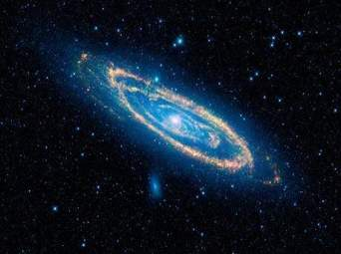
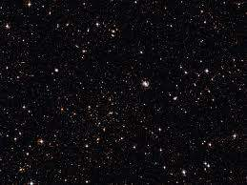
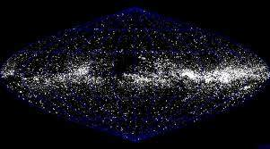
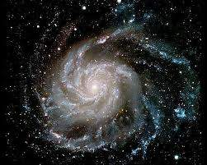
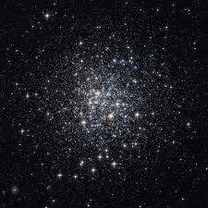
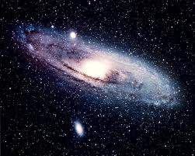
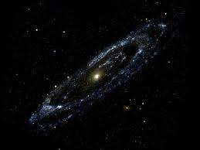
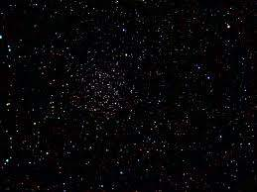
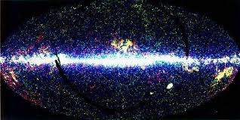
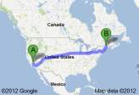
Why would you want
such a big unit of distance?
Well, on Earth, a kilometer may be just fine…
It is a few hundred kilometers from New York City to
Washington, DC
It is a few thousand kilometers from California to
Maine.
With materials from http://starchild.gsfc.nasa.gov/docs/StarChild/questions/question19.html

Slide 4
For example, the distance from our galaxy
(the Milky Way)
to the next nearest big galaxy,
the Andromeda Galaxy,
Is 21 Quintillion km.
That's 21,000,000,000,000,000,000 km!!!
With materials from http://starchild.gsfc.nasa.gov/docs/StarChild/questions/question19.html

Slide 5
This is a number that is so large that it becomes hard to write and hard to interpret. So astronomers use other units of distance...
With materials from http://starchild.gsfc.nasa.gov/docs/StarChild/questions/question19.html

Slide 6
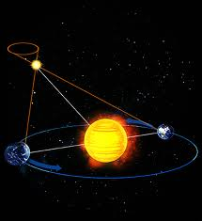
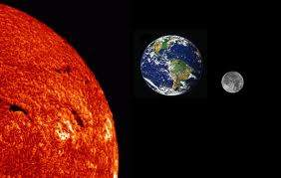
Astronomical Units
In our solar system, we tend to
describe distances in terms of the
Astronomical Unit (AU).
The AU is defined as
the average distance between the Earth and the Sun.
It is approximately 150 million km
(93 million miles)
With materials from http://starchild.gsfc.nasa.gov/docs/StarChild/questions/question19.html

Slide 7
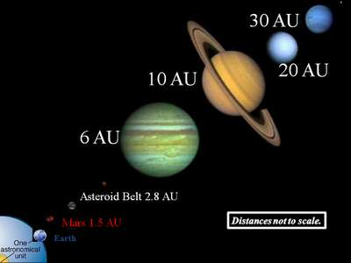
Astronomical Units
Mercury can be said to be about 1/3 of an AU from the Sun
Pluto averages about 40 AU from the Sun.
With materials from http://starchild.gsfc.nasa.gov/docs/StarChild/questions/question19.html

Slide 8
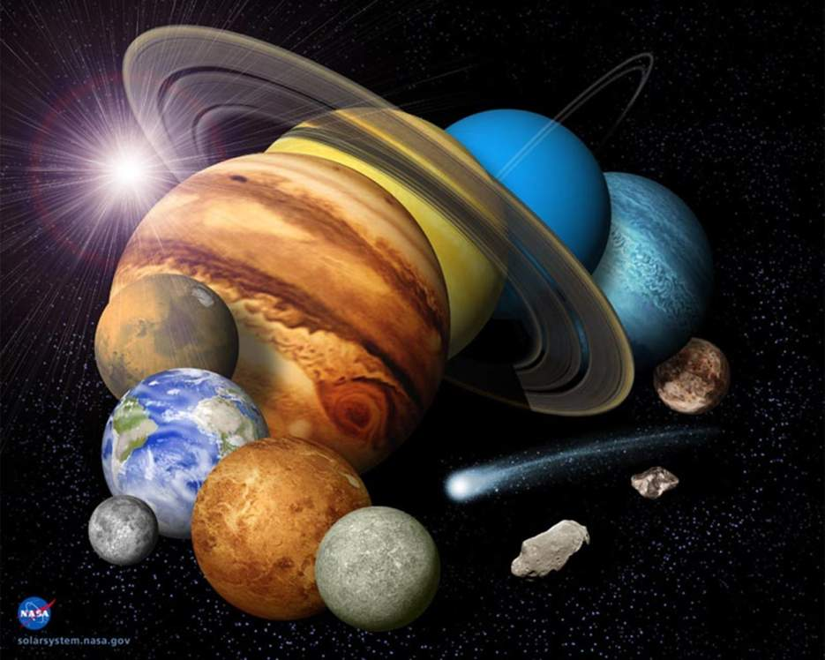
Astronomical Units
The AU, however, is not big enough of a unit when we start talking about distances to objects outside our solar system...
With materials from http://starchild.gsfc.nasa.gov/docs/StarChild/questions/question19.html

Slide 9
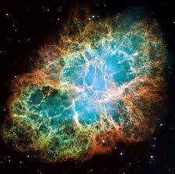
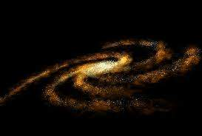
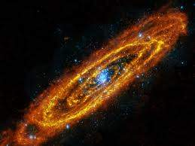
For distances to other parts of the Milky Way Galaxy (or even further), astronomers use units of the
light-year or the parsec.
The light-year we have already defined. The parsec is equal to 3.3 light-years.
Using the light-year, we can say that:
•The Crab supernova remnant is about 4,000 light-years away.
•The Milky Way Galaxy is
about 150,000 light-years across.
•The Andromeda Galaxy is 2.3 million light-years away
With materials from http://starchild.gsfc.nasa.gov/docs/StarChild/questions/question19.html

Slide 10
Pop Quiz!!
1. A light year is a unit of time or distance?
2. A light year is equal to about
a. 10 million kilometers
b. 10 billion kilometers
c. 10 trillion kilometers
3. In our solar system, we tend to describe distances in terms of
a. light years
b. Astronomical Units
c. parsecs
4. True or False? Light years must be used for measuring distances outside of our solar system because the AU is not big enough

