Slide 1
What Livestock, Commodity Markets, Feed, and Genetics Have in Common

Slide 2
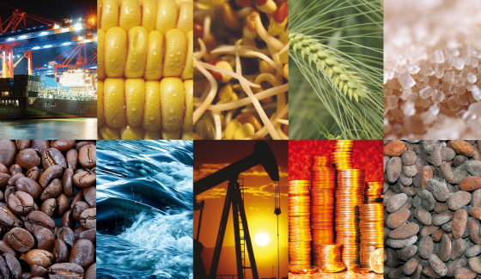
Commodity Markets
What is it?
A physical or virtual marketplace where raw or primary products are bought, traded, and sold.
Raw materials - the basic material from which a product is made
Example: oil or wood
Hard commodity
Primary Products - goods that are available from cultivating raw materials without a manufacturing process
Examples Agricultural, forestry, or fishery products
Soft commodity

Slide 3
Types of Commodities
Hard: Products that are mined or extracted: natural resources that require to be mined or extracted
Example: gold, oil,
Soft: Products that are grown: agriculture products or livestock
Example: corn, soybeans, beef

Slide 4
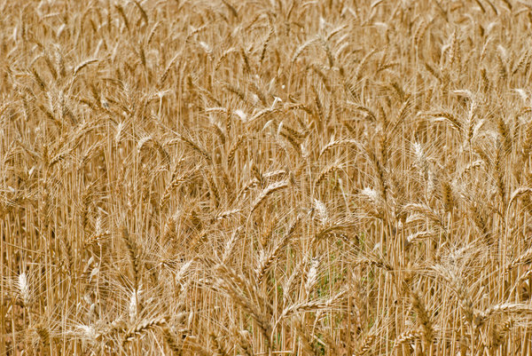
Current Commodity Markets
Hard Vs. Soft Commodities
Hard commodities dominate over soft commodities because they are easier to handle and have less unpredictable factors that could affect the investment
Soft commodities are most affected by weather and seasons and therefore most likely to have changing values

Slide 5
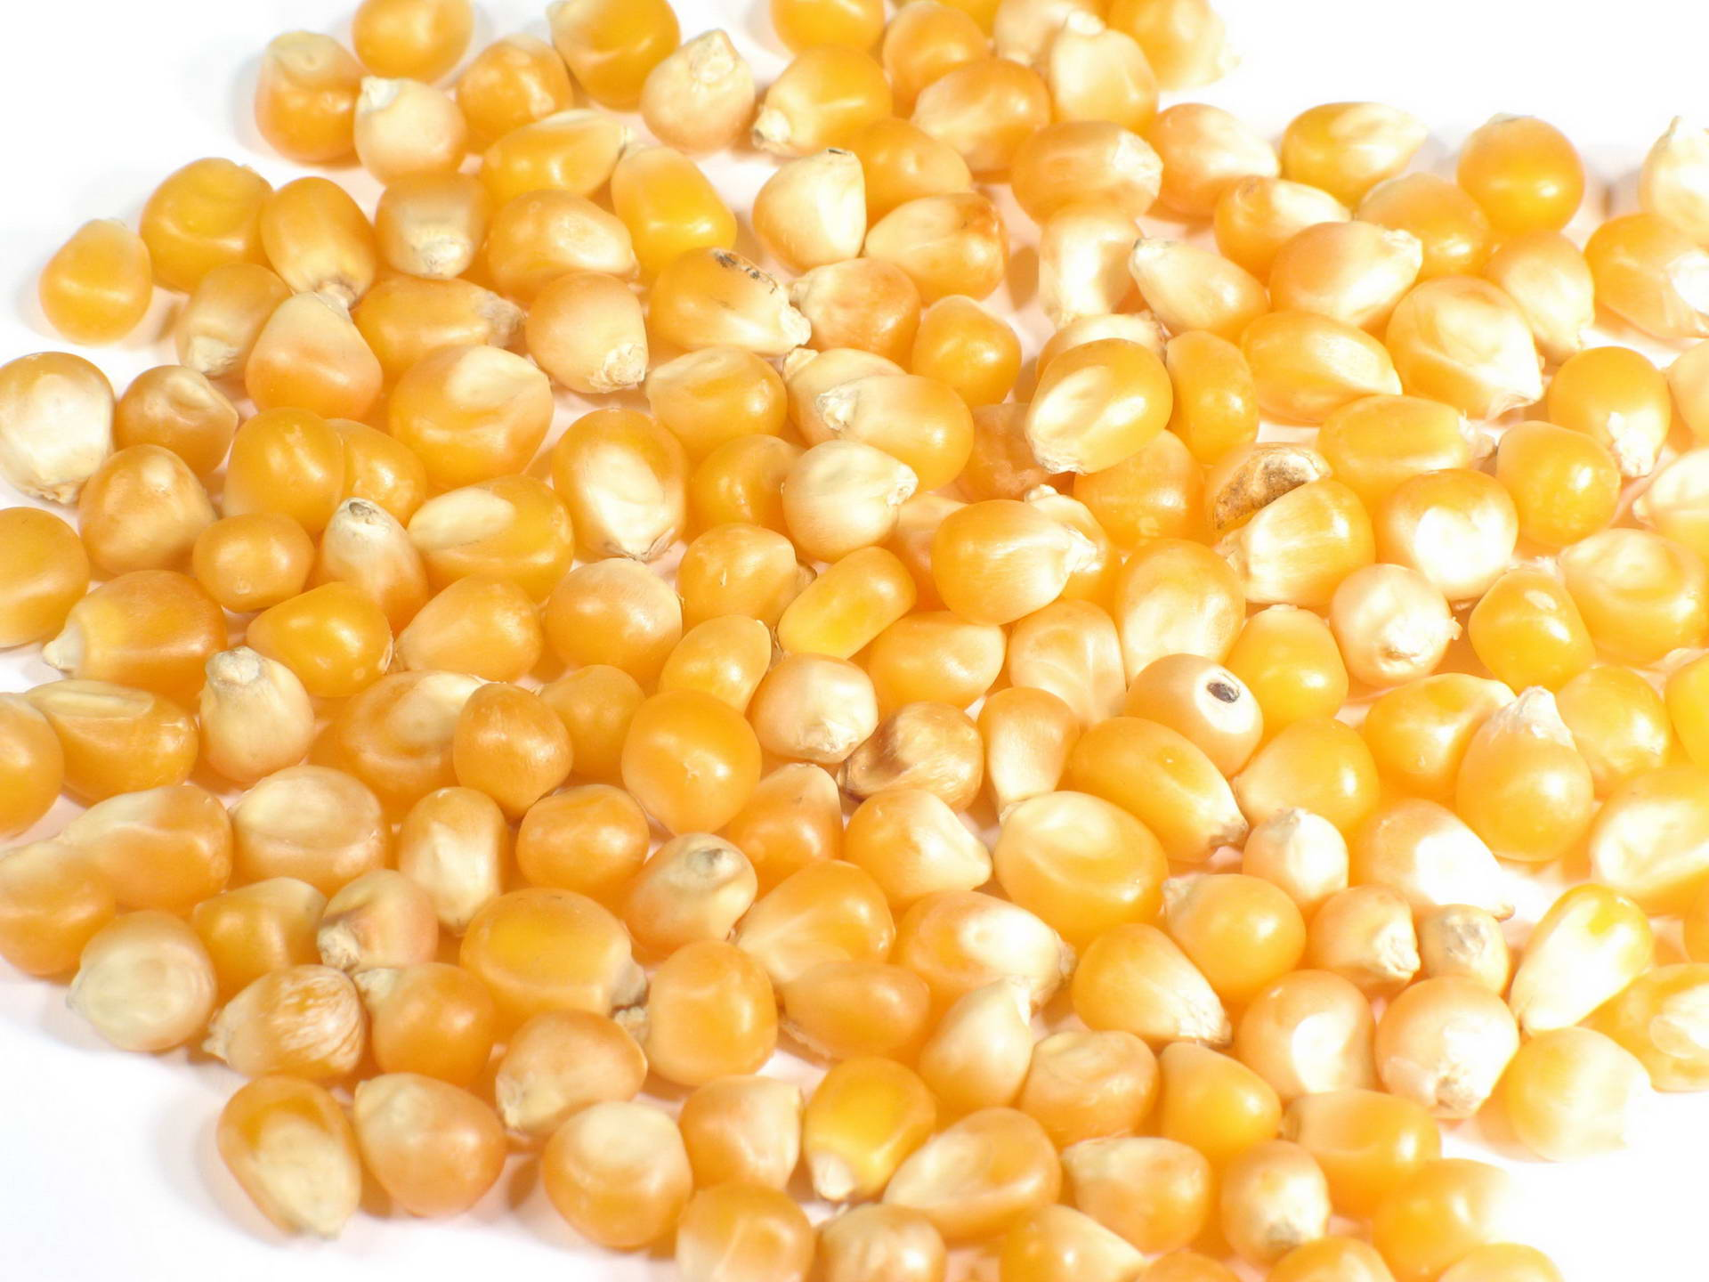
Livestock and Commodities
Soft Commodities
Meat:
Example: Lean Hogs, Live Cattle, Feeder Cattle, Milk
Crops:
Corn, Soybeans, and Wheat
Corn: typically the largest revenue-generating crop
Soybeans: second largest revenue-generating crop

Slide 6
Current Commodity Markets
Futures Contracts
Selling a future commodity
Finite life (must be sold at agreed upon price on designated date)
Takes advantage of price fluctuations
Contract's price changes relative to fixed trade price creating profits or losses
Changing market
Weather plays a huge factor in productivity
Drought, heat, extreme cold
Seasons play a big part in livestock production
Market value is dependent on the supply level

Slide 7
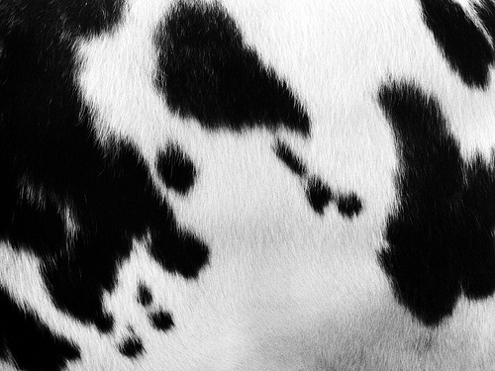
Cattle and Commodity Markets
The supply level will determine the market value
Supply level given by the USDA
Unpredictable market
Population of cattle available throughout the year affected by different factors
Low reproduction
Cow: 1 calf per year= 1 calf year/cow
Sow: 9-10 piglets 2 times a year = 20 piglets a year/sow
When corn prices are high
Cattle stay in the pasture longer to avoid increase feed costs
Weather causes cattle to be sent to the feedlot at a lighter weight
Drought
Extreme heat
Live Cattle:
All cattle that are finished and ready to harvest
1200-1250 pounds
Feeder Cattle:
All cattle that are ready to go to the feedlot
6-8 months old
600-800 pounds

Slide 8
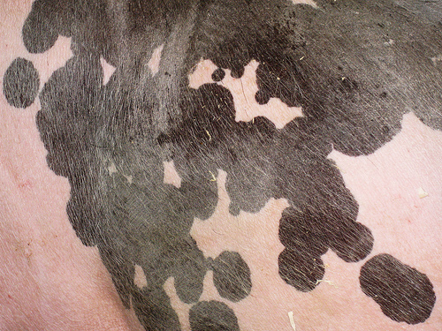
Lean Hogs and Commodity Markets
Pro: Less over or underproduction of hogs because:
More commonly raised in a farrow to finish setting
Sows produce 9-10 piglets twice a year
Predictable market
Pigs are harvested at 6 months of age
If pig birth numbers are low its predictable harvest numbers will be low in 6 months
Lifespan from farrow to finish is shorter than cattle
Feeder Hogs:
40-60 pounds
Lean Hogs:
250 pounds
Approximately 6 months old

Slide 9
Feed Costs
Over 50% of beef cattle production costs are made up of feed costs
Feed Costs vary because of:
Type of ingredients used in the feed
The amount of feed fed per day
Amount of wasted feed
USDA Grain Database
Above website looks at different prices of grains in the United States

Slide 10
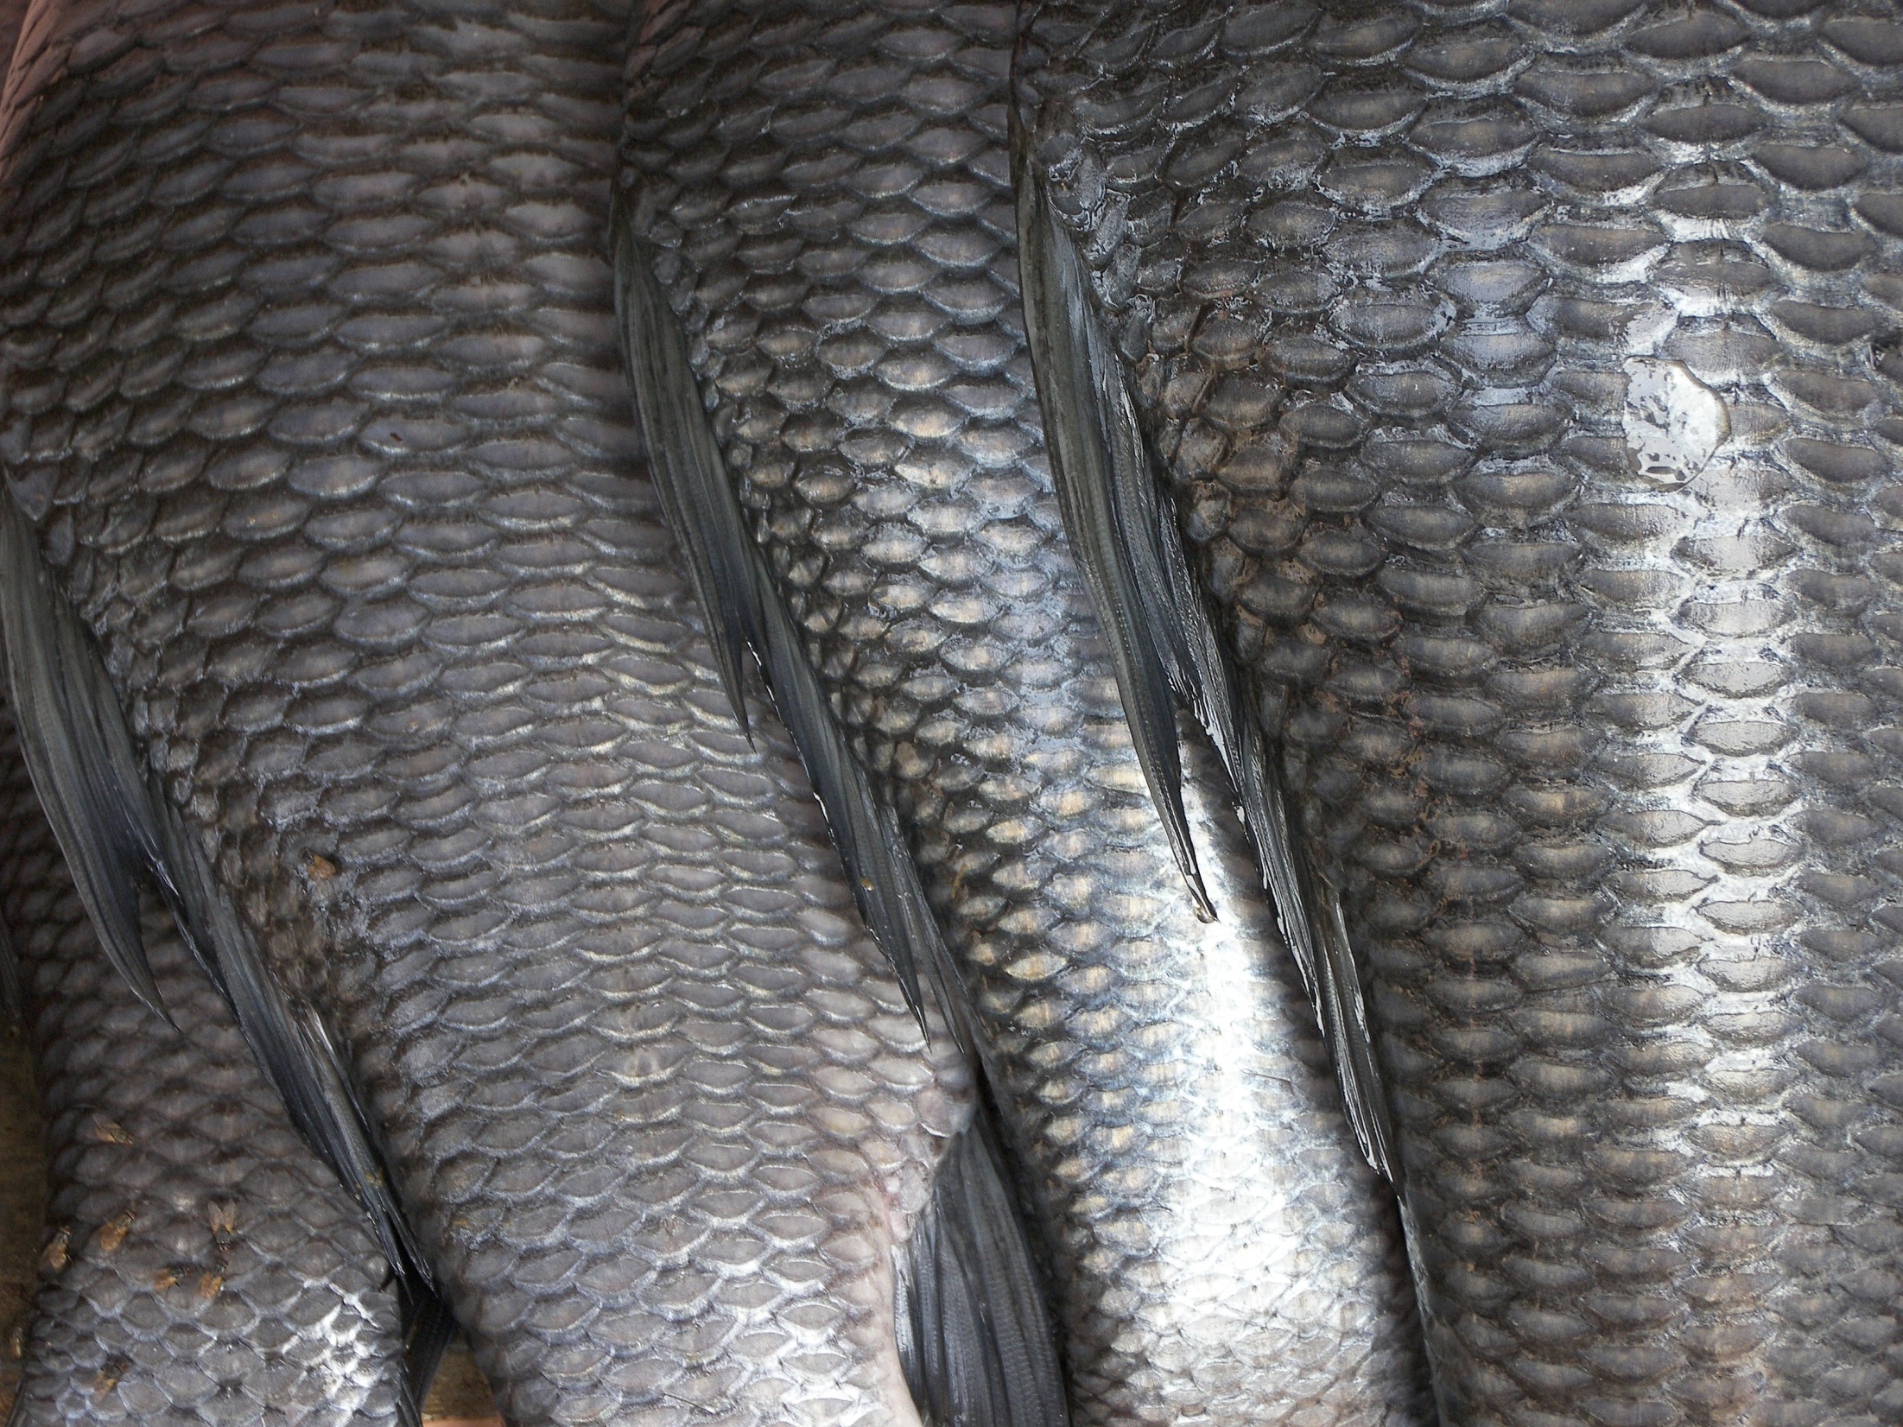
Feed Efficiency of Livestock Species
What is feed efficiency?
Definition: measurement between feed consumed by the animal and per pound of live weight put on by the animal
Feed conversion and efficiency is genetic and heritable!

Slide 11
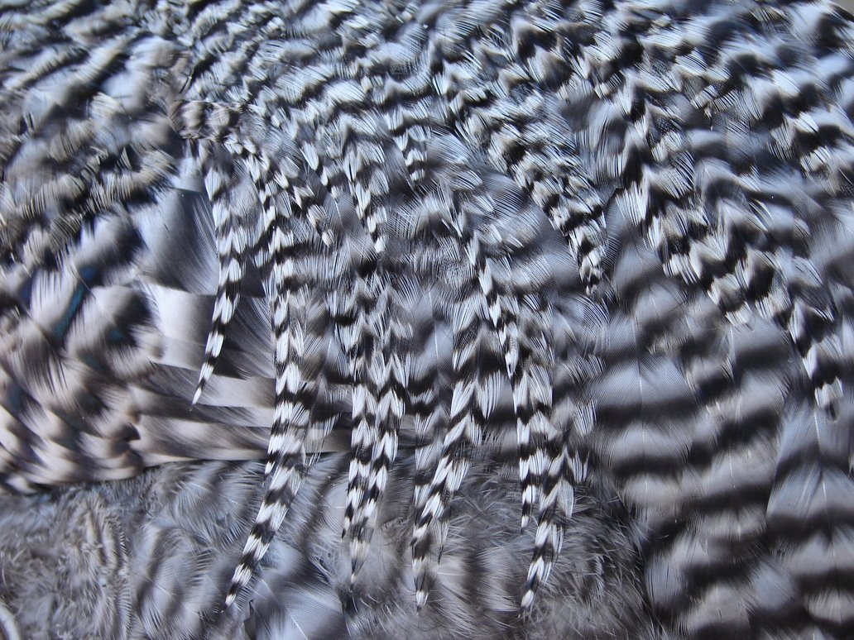
Average Daily Gain
Definition: Rate at which an animal gains weight
Goal: Want the animal to gain the most weight per one pound of feed
Calculated By Average Daily Gain
You want a HIGH average
because you want a large number of pounds gained in the least amount of time
Avg Daily Gain =
Weight gained (lbs)
Number of days fed (days)

Slide 12
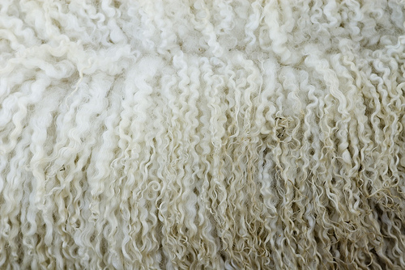
Average Daily Gain Example
A lamb’s first weigh-in is 35lbs. After 100 days on feed the lamb weighs 102lbs.
Average daily gain = Weight Gained ÷ Number of Days Fed
Weight gained: 102- 35 = 67 lbs
Average Daily Gain: 67 ÷ 100 = 1.5 lbs/day
ANSWER: Over the 100 days the lamb gained 1.5 pounds a day

Slide 13
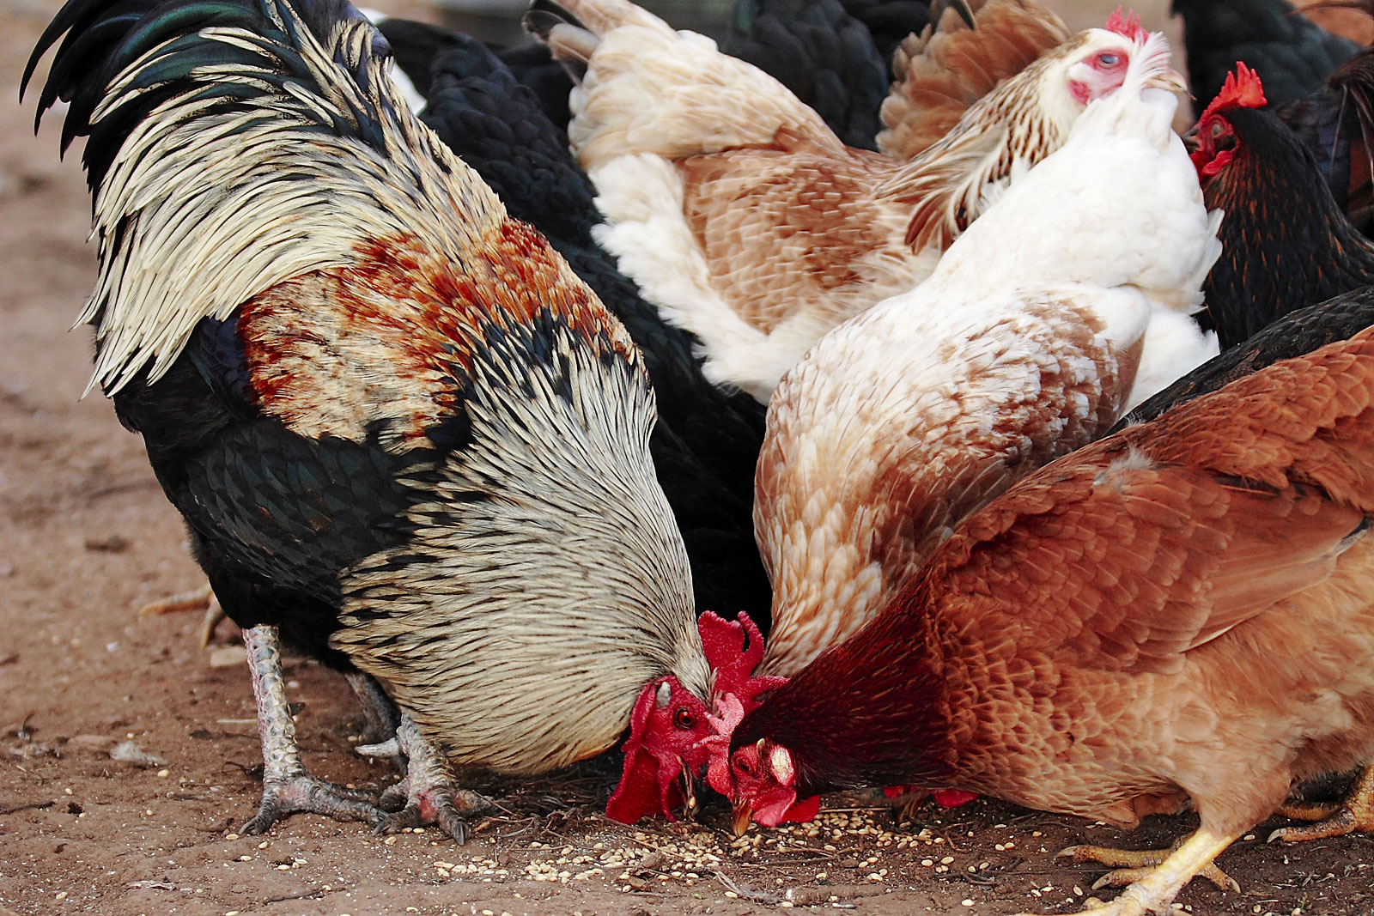
Feed Conversion Ratio
Goal: (1:1) animal gains one pound per one pound of feed intake
Do NOT want to have to feed a higher number of pounds of feed for 1 pound of weight gain
Feed Intake (lbs)
Gained Weight (lbs)
Feed Conversion Ratio
=

Slide 14
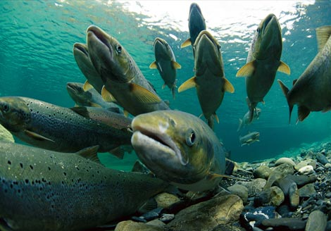
Feed Efficiency of Different Species
Which species is the most efficient?
Cattle(7.0:1)
Swine(3.5:1)
Sheep(4.0-6.0:1)
Poultry(2.0:1)
Fish (1.1:1)
For every 1.1 pounds fed to a fish they will gain 1 pound
Why are fish so efficient?
Expend less energy on maintaining bodily processes than mammals i.e., temperature, gravity, excretion
FISH!

Slide 15
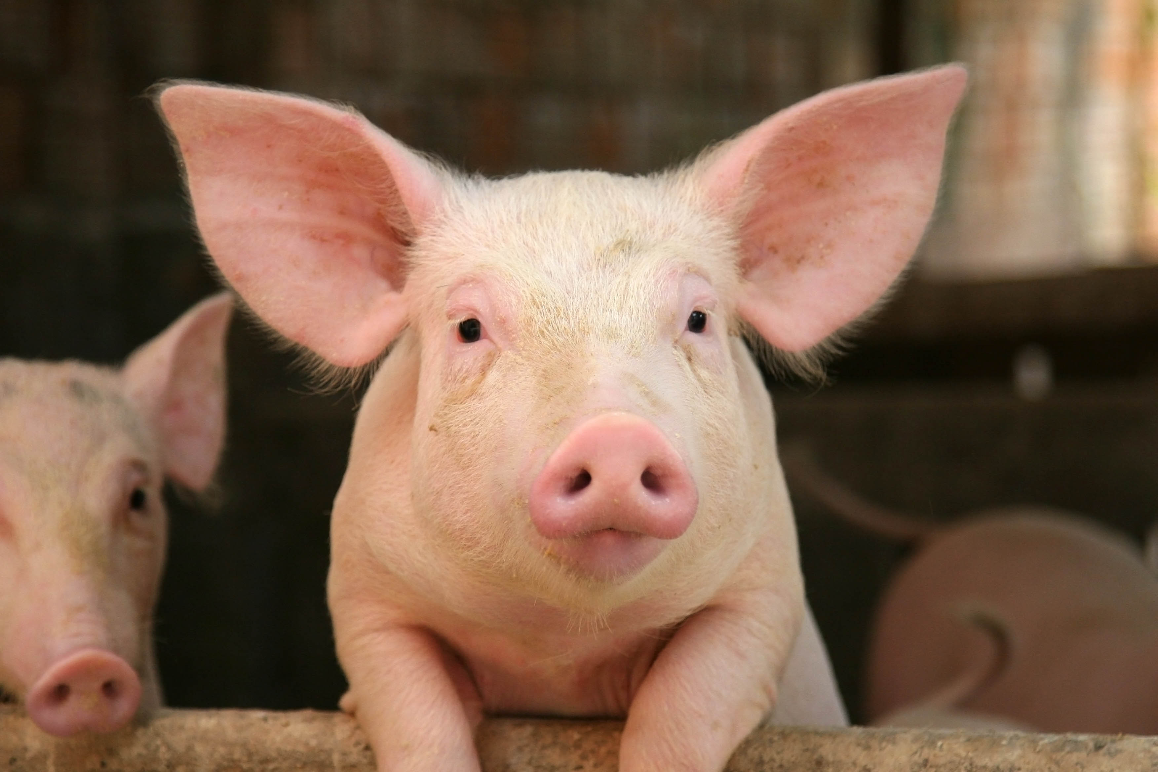
Feed Conversion Ratio Example
A pig is fed 35 pounds of feed and gained 11 pounds. What is the feed conversion ratio of this pig?
Feed Intake = 35lbs
Weight Gained = 11 lbs
35lbs ÷ 11 lbs = 3.2 lbs
ANSWER: FCR = 3.2:1 (The pig gained 3.2 pounds per 1 pound of feed)
Feed Conversion Ratio
=
Feed Intake (lbs)
Gained Weight (lbs)

Slide 16
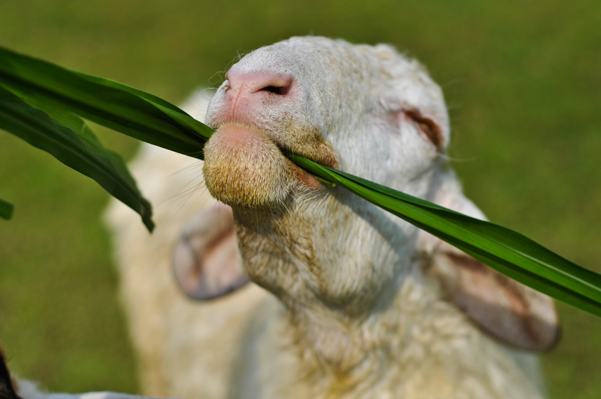
Saving Feed!
How is feed wasted:
Urine
Feces
Fermentation gases
Use of energy that causes growth
Waste can not be 100% avoided but we can minimize it by:
Feed highly digestible feeds
Feeding supplements that increase production
Improve health and environment conditions
Formulate livestock rations to include low cost feeds or grains

Slide 17
Formulate Rations
Modified algebraic method – works for two unknowns and one nutrient
Step 1: list ingredients on line 1 and the % nutrient on line 2
Step 2: list amounts of each ingredient on line 3
Amounts must add up to the amount of diet given in the problem (100lbs)
Step 3: set up the equation (multiple line 2 by line 3)
Step 4: solve the equation for x
Step 5: check your answer
Example: Formulate 100 lb of a cattle ration containing 16% CP (crude protein) using corn (8.9% CP) and a commercial supplement (36% CP).
(1) ingredient corn supplement diet
(2) % CP 8.9 36.0 16.0
(3) Amount (lb) x (100 – x) 100.0
(4) equation: 8.9x + 3600 – 36x = 1600
ANSWER: x = 73.8 lb corn, 100 – x = 26.2 lb supplement
(73.8 + 26.2 = 100lbs)
(100 lbs of Feed/Ration)
Notes:
Math Breakdown:
8.9 x X = 8.9X
36(100-x) = 3600 – 36x
16 X 100 = 1600
8.9x + 3600 =1600 + 36X
3600 = 1600 + 27.1X
2000= 27.1 X
2000/27.1 = X
X= 73.8 Corn
100- 73.8 = 26.2 (supplement)

Slide 18
Example of Formulating Rations
Formulate 100 lb of a cattle ration containing 20% CP (crude protein) using sorghum(10% CP) and a commercial supplement (38% CP).
(1) ingredient Sorghum supplement diet
(2) % CP 10 38.0 20.0
(3) Amount (lb) x (100 – x) 100.0
(4) equation: 10x + 3800 – 38x = 2000
ANSWER x = 64.3 lb sorghum, 100 – x = 35.7 lb supplement
Notes:
Math Breakdown:
10X + 3800 – 38X = 2000
10X + 3800 = 2000 + 38X
3800 = 2000 + 28X
1800 = 28X
1800/28 = X
64.3 = X (sorghum)
100-64.3 = 35.7 (supplement)

Slide 19
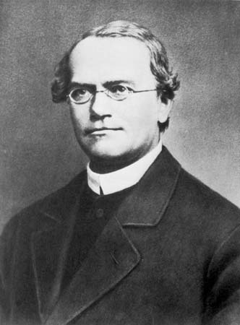
The Beginning of Genetics
Genetics Definition: The study of heredity or how traits pass from parents to their offspring
Gregor Mendel: “Father” of modern genetics
Came up with the terms “recessive” and “dominant” genes
Worked with pea plants
Allowing them to crossbreed (creating hybrids)
Studying:
Plant height, color, and pod shape
Gregor Mendel Inheritance Video
Law of inheritance

Slide 20
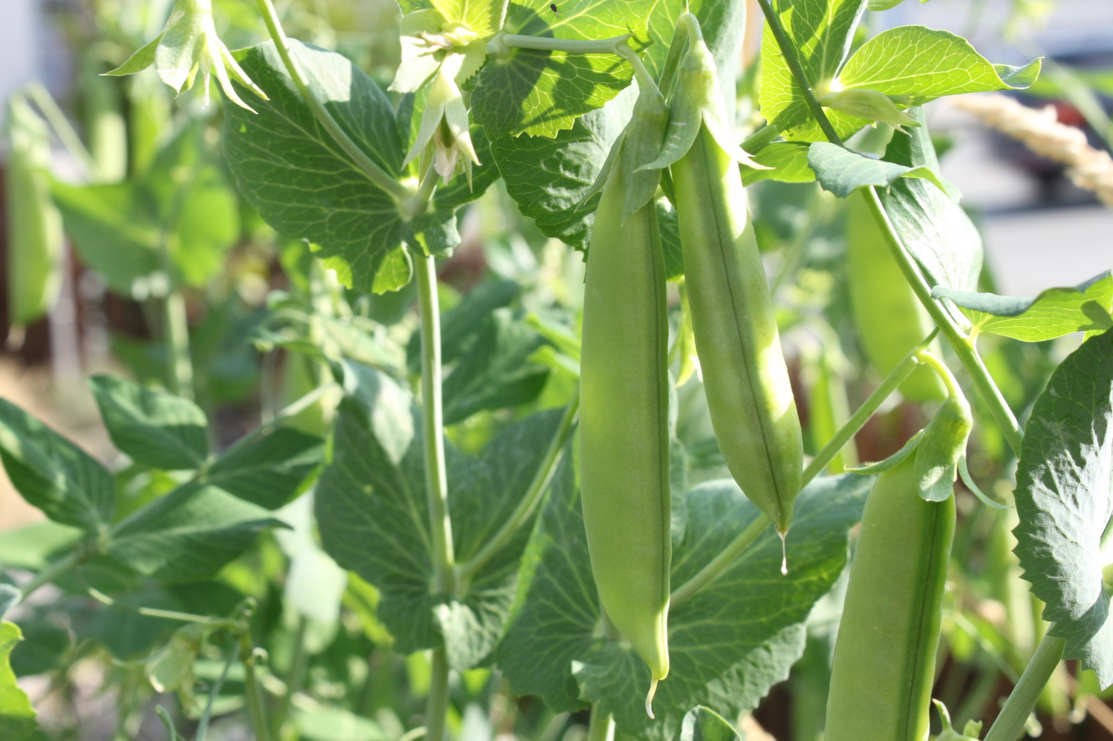
Gregor Mendel’s Laws
Law of Inheritance
Law of Segregation
Each parent gives the offspring an allele (total: of 2 alleles) when the offspring creates its own gametes the offspring will randomly receive one of the two alleles
In order for the offspring to express the recessive trait, both alleles MUST both be recessive
Law of Independent Assortment
Different genes are passed down independently from each other
Example: Pea Pod size and Color are independent genes that do not affect each other

Slide 21
Where do Genes come from?
Chromosome:
Rod shaped structure in the nucleus of the cell consisting of genes
DNA: Deoxyribonucleic acid
Nucleic acid containing the genetic information for all living cells
Gene:
Segment of DNA that occupies a specific place on a chromosome that is the basic unit of heredity
Allele:
One form of a gene that has many alternative forms of the same gene in a group of genes

Slide 22
Genetics Breakdown
Research shows that feed efficiency is a moderate to highly heritable trait.
Trait: characteristic passed from parents to offspring
Heredity: capacity of a trait to be passed down from a parent to offspring
Example of High Heritable traits
Scrotal circumference and marbling in meat
Example of Low Heritable traits
Weaning weight and conception rate

Slide 23
Important Terms of Genetics
Dominant Gene: One allele (of the two passed from the parents) that covers the expression of the other allele
A capital letter on the Punnett Square (ex: AA or Aa)
Recessive Gene: An allele whose expression is covered by the dominant allele
Only appears in the offspring if both of the parents give acopy
A lower case letter on the Punnett square
Requires both lower case letters to be expressed by the organism (ex: aa)
Homozygous: two alleles are the same
Either both capital (AA) or both lower case (aa)
Heterozygous: two different Alleles code for the same gene
1 capital and 1 lower case (Aa)

Slide 24
Important Terms of Genetics
Phenotype: a description of your actual physical characteristics
Coat color, height, milking production
Genotype: the particular the combination of alleles for a particular gene
Example: AA, Aa, or aa
May be homozygous or heterozygous

Slide 25
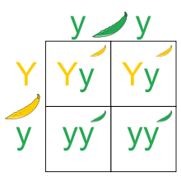
The Punnett Square
Reginald Punnett
Founder of the Punnett Square
Compares parent genotypes
Used to determine the percentage outcome of characteristics in the offspring
Example: The angus father is heterozygous black (Aa) and the mother angus is homozygous red (aa) what is the percentage that the offspring could be black and what is the percentage the offspring could be red?
a
a
A
Aa
Aa
a
aa
aa
Offspring Percentages
50% Dominant Black
50% Recessive Red

Slide 26
Genetics and Commodities
Animal geneticists help meet demand with animals that are healthy and vigorous as they grow and reproduce and that use nutrients efficiently
Increase production while reducing excess nutrients escaping to the environment
Genes that can enhance animal growth, health, and ability to utilize nutrients

Slide 27
Think It Through
The modern broiler chicken market weight has increased nearly 23 percent compared to the same bird in 1950.
Discuss the possible role genetics has played in this increase.
How might this impact the poultry market?

Slide 28
Think It Through
The number of cattle has decreased over the past decade, yet the total production of beef and milk has increased.
Discuss the possible role genetics has played in this increase.
How might this impact the beef or dairy markets?

Slide 29
References
http://www.youtube.com/watch?v=0vAAf4g5iF8
http://www.investopedia.com/terms/c/commodity-market.asp
http://www.hardassetsinvestor.com/hard-assets-university/18-hard-assets-101-an-introduction-to-commodities/431-types-of-commodities.html?Itemid=4
http://www.journalofanimalscience.org/content/22/2/486.abstract
http://www.omafra.gov.on.ca/english/livestock/sheep/facts/03-015.htm
http://anthro.palomar.edu/mendel/mendel_1.htm
http://history.nih.gov/exhibits/nirenberg/HS1_mendel.htm
http://www.wvbeef.org/wbt/wbtfe.html
http://www.rjofutures.com/market-news/2012/08/23/understanding-the-agricultural-livestock-commodity-markets/
https://www.boundless.com/biology/mendelian-inheritance/mendel-s-laws-of-inheritance/law-of-segregation--2/

