Slide 1
Matter and Energy
It’s elemental!

Slide 2
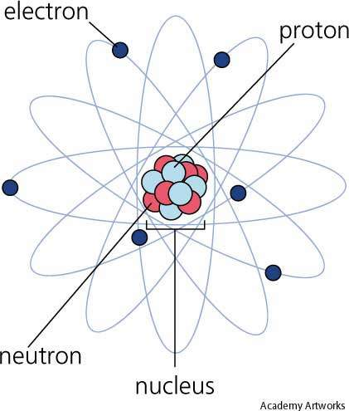
Atoms
The most basic component of all matter.
The smallest particle of an element that has ALL the chemical properties of that element.
Made of a nucleus of protons and neutrons surrounded by electrons.

Slide 3
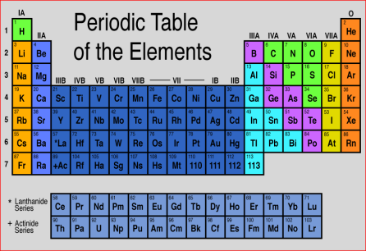
Elements
Matter made of a SINGLE type of atom.
They CANNOT be broken down into different kinds of matter.
Quick Facts:
118 Elements known or predicted
90 formed by nature, 28 created in laboratories
All are classified in the Periodic Table of the Elements

Slide 4
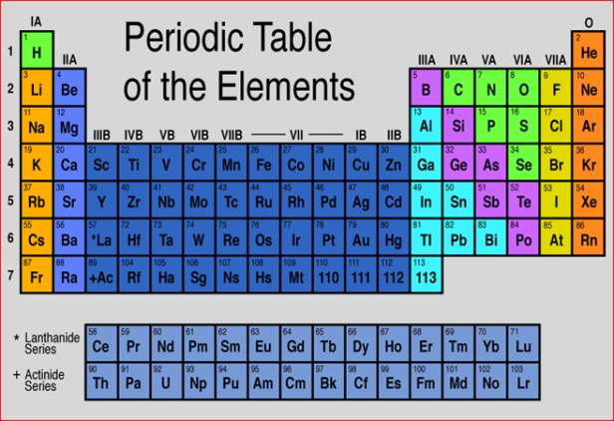
Periodic Table
H = Hydrogen
He = Helium
Elements are written as symbols
Usually represented by 1-2 letters
The first letter is always capitalized
The second letter is lower case

Slide 5
Periodic Table
Columns
Elements are arranged by atomic number
18 columns
Represent families
7 Rows
Represent periods
Rows

Slide 6
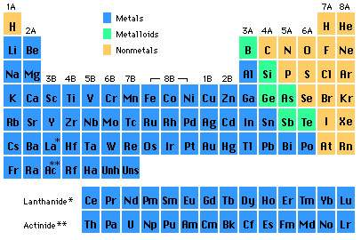
Periodic Table
Elements are divided by properties
Metals on the left
Shiny, conductors, malleable
Nonmetals on the right
Dull, not conductors, brittle
Metalloids are the dotted stair step
They have characteristics of both metals and nonmetals

Slide 7
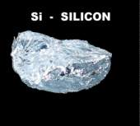
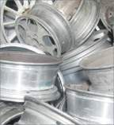
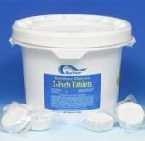
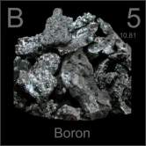
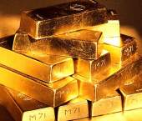
Metals, Nonmetals, and Metalloids
Metals | Nonmetals | Metalloids
Shiny Malleable Good conductors of heat and electricity Why?: They have the ability to easily move electrons to their outer shells. Ex: Al – Aluminum Au – Gold | Dull Brittle Poor conductors of heat and electricity Why?: They gain electrons easily. Ex: Cl – Chlorine Ne - Neon | Have properties of both metals and nonmetals Good semiconductors Boiling points, melting points, and densities vary Ex: Si – Silicon B - Boron

Slide 8
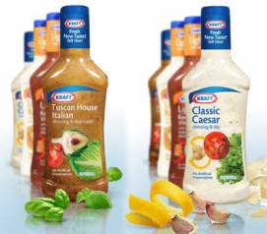
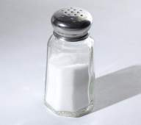
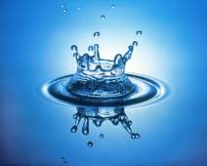
Compounds and mixtures
Mixture
A substance containing two or more substances MIXED together.
Can be separated by mechanical means.
The two or more substances are mixed in a way that each remains UNCHANGED.
Example: Salad Dressing
Compound
A substance formed from two or more elements with a fixed ration determining the composition.
The elements lose their individual properties and the new compound has new properties.
Examples: Water (Hydrogen and Oxygen)
Salt (Sodium and Chlorine)

Slide 9
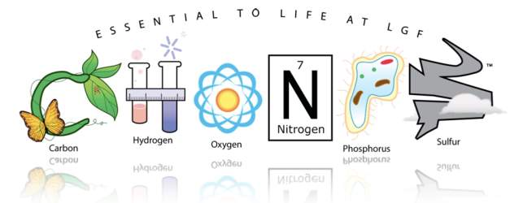
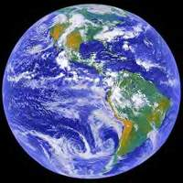
Elements essential to life
CHONPS:
C
H
O
N
P
S
arbon
ydrogen
xygen
itrogen
hosphorus
ulfur
These elements are found in abundance on solid Earth, in the atmosphere, and in the oceans.

Slide 10
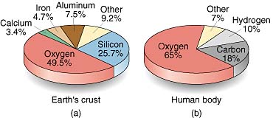
The Earth’s Crust
Notice how the same element, oxygen, makes up the majority of both the Earth’s crust and the human body.
This displays how essential oxygen is to both life and Earth.

Slide 11
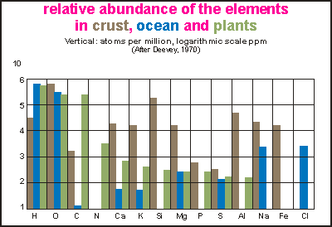
Abundance of Elements in soil, Sea, and Plant Life
The bar graph shows the abundance of elements in the Earth’s crust, ocean, and plants.
This graph shows that in addition to CHONPS there are other elements that occur frequently in the composition of life and earth.
Can you name one of these elements besides CHONPS?

Slide 12
Now it’s your turn to test your knowledge!
On the next few slides you will see a series of pictures, on your “Matter and Energy” student worksheet write if the picture represents an element, compound, or mixture.
Remember:
An element contains just one type of atom.
A compound contains two or more different atoms joined together.
A mixture contains two or more different substances physically joined together.
Element?
Compound?

Slide 13
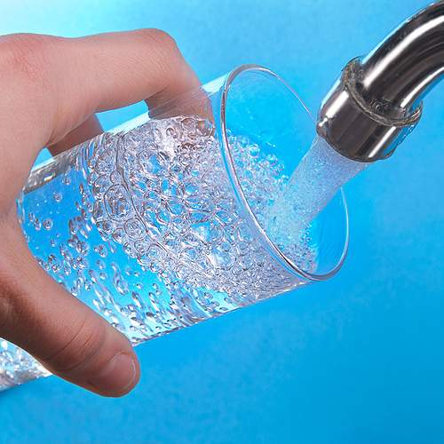
Element, Compound, or Mixture?
Pure Water

Slide 14
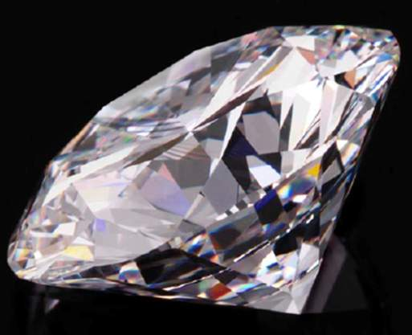
Element, Compound, or Mixture?
Diamond

Slide 15
Element, Compound, or Mixture?
Gold

Slide 16
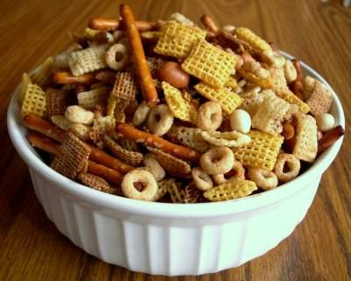
Element, Compound, or Mixture?
Chex Mix

Slide 17
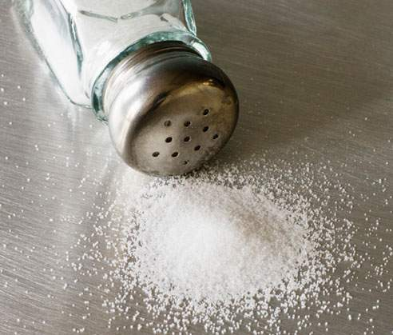
Element, Compound, or Mixture?
Salt

Slide 18
Element, Compound, or Mixture?
Neon

Slide 19
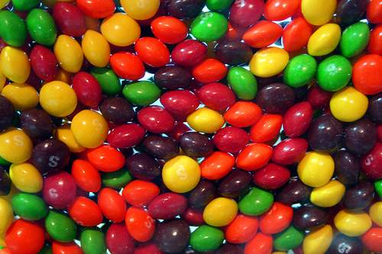
Element, Compound, or Mixture?
Skittles

Slide 20
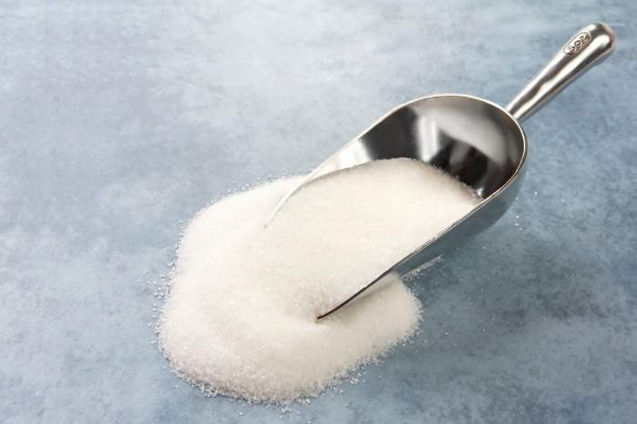
Element, Compound, or Mixture?
Sugar

Slide 21
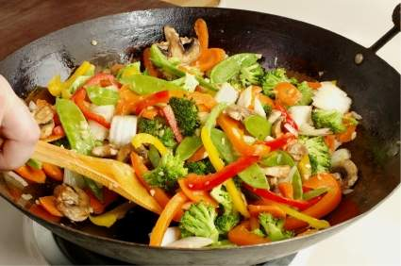
Element, Compound, or Mixture?
Stir-Fry

Slide 22
Element, Compound, or Mixture?
Sand

