Slide 1
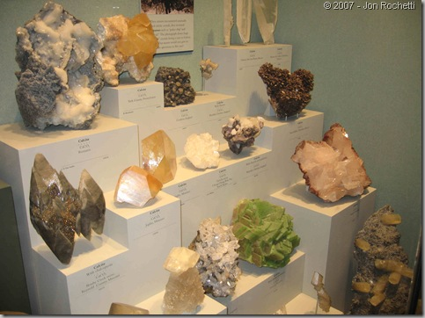
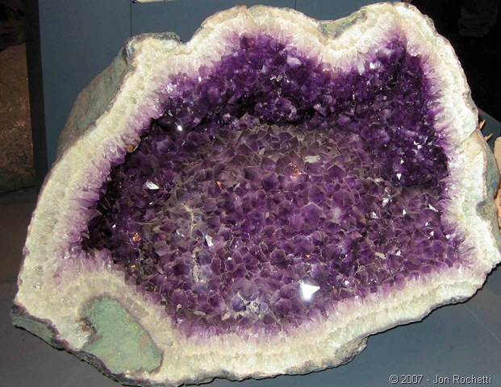
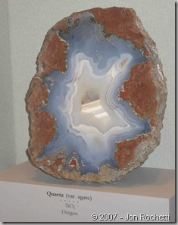
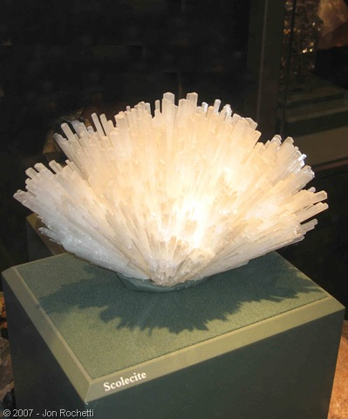
Minerals 101
An easy guide to understanding minerals

Slide 2
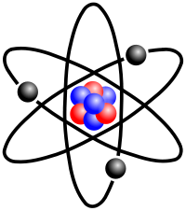
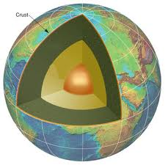
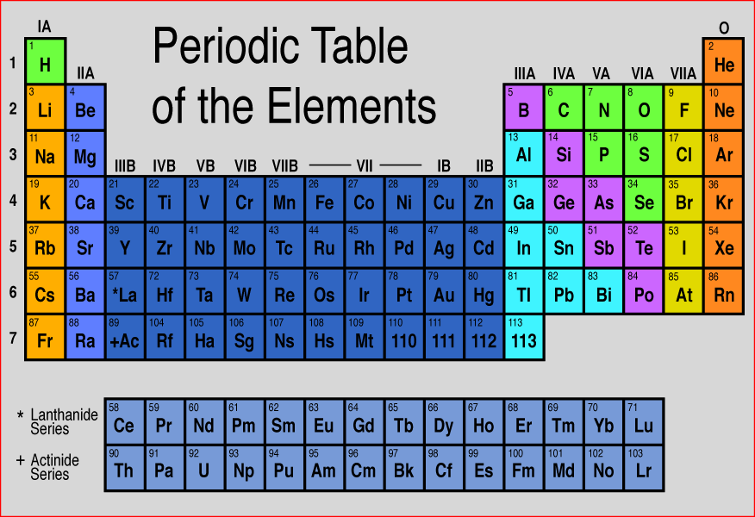
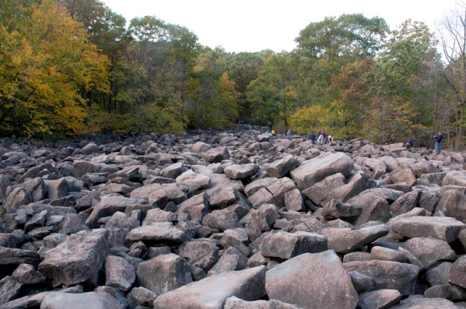
Background Information!
The Earth’s crust is made of mostly rocks and soil.
  The rocks are made of different combinations of minerals.
    Minerals are made of elements. (Remember an element is any substance that cannot be broken down into simpler substances. The smallest unit of an element is an atom.)
    There are over 100 chemical elements, which are the building blocks of all matter in the universe.
    Atoms may be bonded together into molecules; when two or more kinds of atoms bind together chemically, a compound is formed.

Slide 3
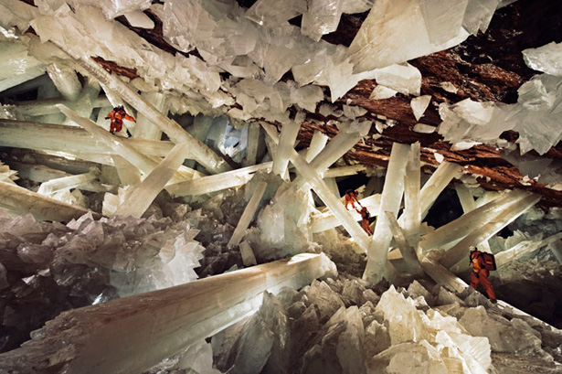
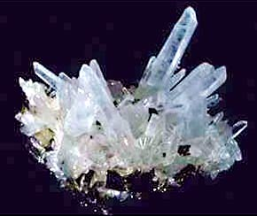
What is a mineral?
A mineral is a naturally occurring, inorganic, solid which possesses a characteristic internal atomic structure and a definite chemical composition.

Slide 4
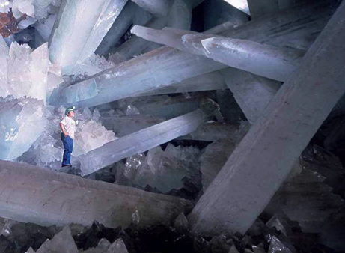
Properties
Solid
  Not a liquid or a gas
Naturally Occurring
  Found in nature, not man made
Inorganic
  Not living, not formed by living processes
Fixed Composition
  Has a chemical formula, most are formed from compounds of two or more elements, some minerals consist of one element ex. Au (Gold)
Crystal Form
  A structure where atoms are in an orderly and repeated pattern.

Slide 5
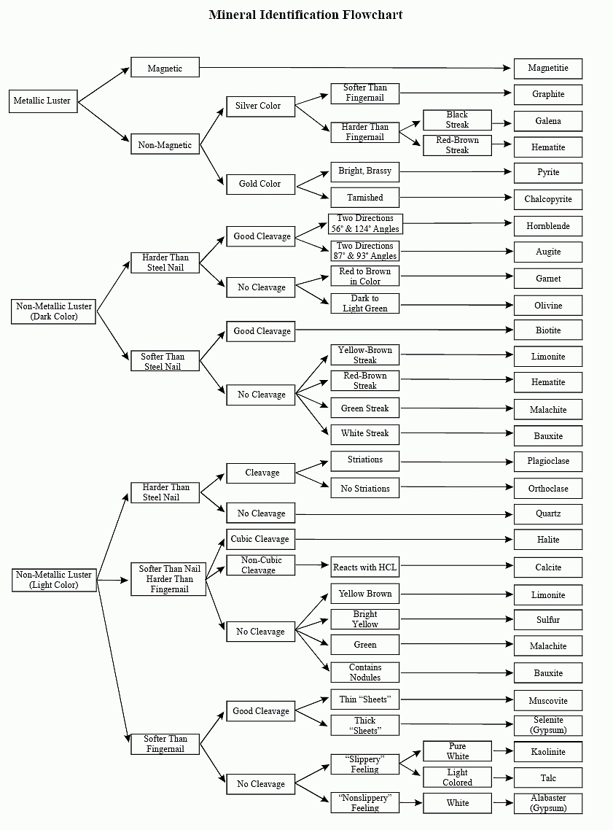
Identification
5 steps for mineral identification. Determine:
  Luster
  Hardness
  Color (Light or Dark)
  Cleavage?
  Streak?
After your choices have been narrowed down, use the mineral identification chart!

Slide 6
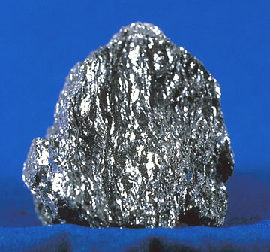
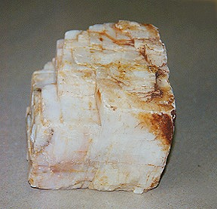
Luster
Luster refers to how light is reflected from the surface of a mineral.
Classified as Metallic or Nonmetallic?
  If metallic, skip color (light or dark) step.
Metallic
Non-Metallic

Slide 7
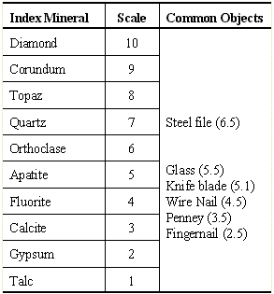
Hardness
The hardness of a mineral is its ability to resist scratching.
Where did the hardness scale originate?
  Friedrich Mohs, a German mineralogist, developed a hardness scale over 100 years ago. The hardest mineral known, diamond, was assigned the number 10.
The Mohs Hardness Scale ranks the order of hardness of minerals and some common objects. For example, your fingernail can scratch the minerals talc and gypsum, with a hardness of 2 or lower. A copper penny can scratch calcite, gypsum, and talc.
Fun Fact!: The hardness of a mineral is known as its “scratchability!”

Slide 8
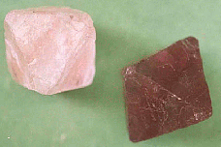
Color
Minerals are colored because certain wavelengths of light are absorbed, and the color results from a combination of those wave lengths that reach the eye.
The color of a mineral is the first thing most people notice. But it can also be the least useful in identifying a mineral. Most minerals occur in more than one color. Fluorite can be clear, white, yellow, blue, purple, or green. The other properties, such as hardness, cleavage, and luster, must be used instead.
Both samples in the picture are the mineral fluorite, note that color is different but the crystal shape is the same.

Slide 9
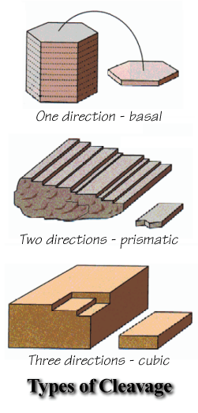
Cleavage
Cleavage is the ability of a mineral to break along preferred planes.
Planes of weakness exist in some minerals because of their atomic structure. Atomic bonds may be weaker in some directions than in others, so the mineral will tend to break, or cleave, in that direction.
Minerals may have cleavage in only one direction, in only two directions, or in three or more directions. The cleavage angles at which these planes intersect may be distinctive.
Minerals that have "perfect" cleavage almost always break in a preferred direction. Minerals that have "good" cleavage sometimes will break in a particular direction, and other times they may not.
Fun Fact!: Gemstones are “cut” along cleavage planes!

Slide 10
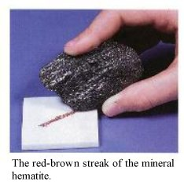
Streak
The streak of a mineral is the color of the powder left on a streak plate (piece of unglazed porcelain) when the mineral is scraped across it. The streak plate has a hardness of glass, so minerals with a Mohs Hardness >7 will scratch the streak plate and won't powder the mineral.
Streak can be useful for identifying metallic and earthy minerals.
  Nonmetallic minerals usually give a white streak because they are very light-colored.
  Other minerals may have very distinctive streaks; hematite, for example, always gives a reddish brown streak no matter what type of luster it displays.

Slide 11

Test Yourself!
As a class categorize the next few slides as “Minerals” or “Non-minerals”.
  Remember a mineral is:
    Solid
    Naturally Occurring
    Inorganic
    Fixed Composition
    Crystal Form

Slide 12
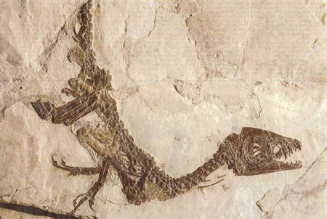
Fossil

Slide 13
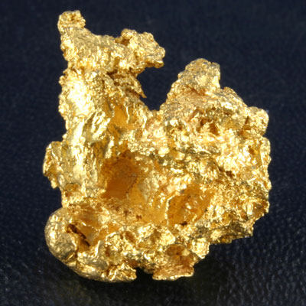
GOLD

Slide 14
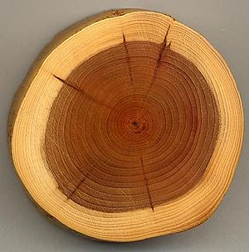
WOOD

Slide 15
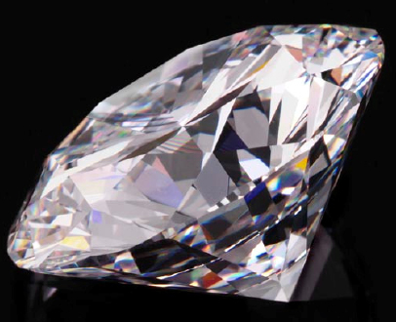
Diamond

Slide 16
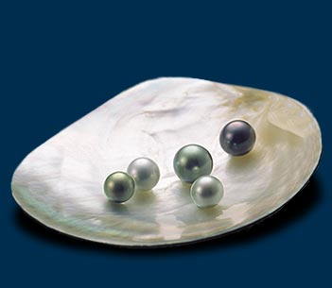
Pearls

Slide 17
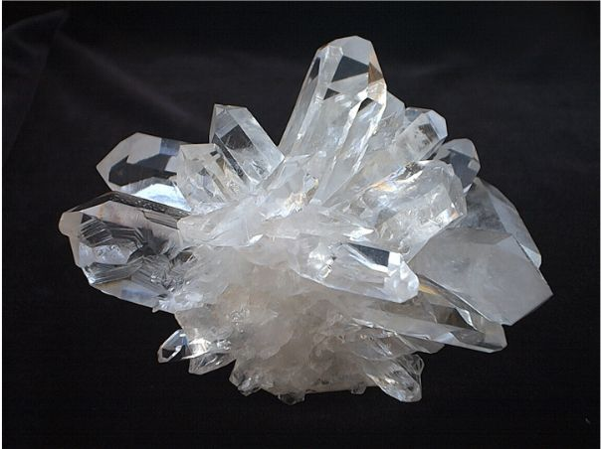
Quartz

Slide 18
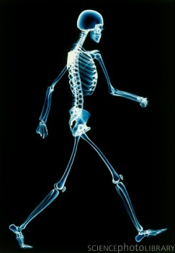
Bone

Slide 19
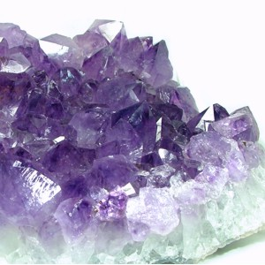
Amethyst

Slide 20
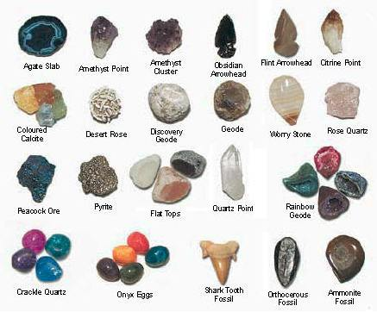
Results -
Minerals
  Gold
  Diamond
  Quartz
  Amethyst
Non-minerals
  Fossil
  Wood
  Pearls
  Bone

