Slide 1
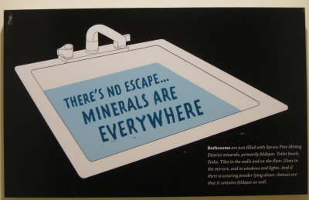

Minerals Are Everywhere!
You may not be aware, but minerals are in our kitchens, bathrooms, cars, etc. Continue to see what minerals you probably encounter everyday!

Slide 2
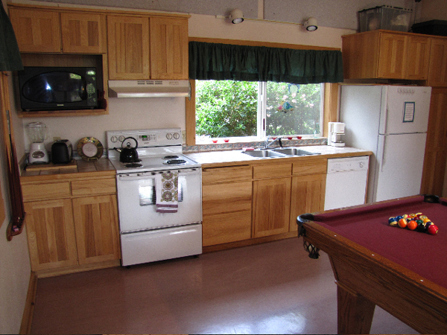
Kitchen
Microwave includes copper, gold, iron, nickel, and silica.
Refrigerator includes copper, aluminum, iron, nickel, and zinc.
Plates include clay, feldspar, and silica.
Stove includes aluminum, copper, iron, nickel, and silica.

Slide 3
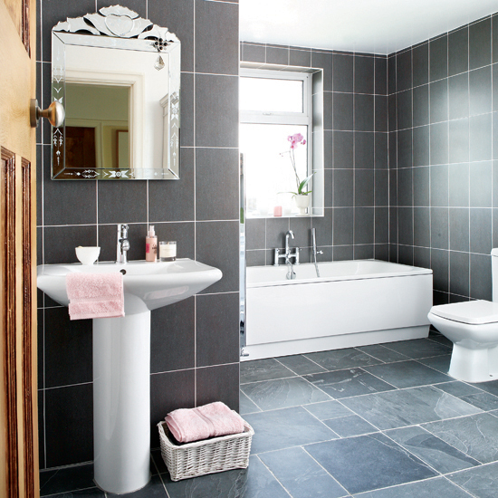
Bathroom
Flower pot: includes clay, and metallic minerals for pigments in glaze.
Mirror: includes feldspar, silica, and silver.
Faucet: includes nickel, iron, and chromium.
Tile: includes clay, talc, and mineral pigments.

