Slide 1
Genetics & Punnett Squares
Multiple Traits

Slide 2
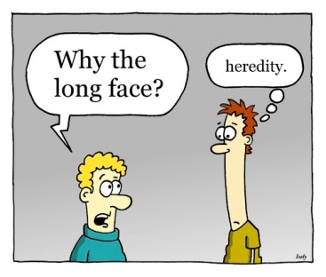
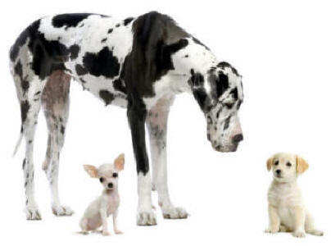
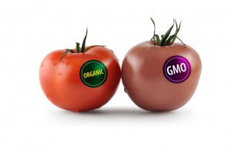
Why Study Heredity?
To determine inheritance patterns
Trace lineage of traits or diseases
Selective breeding
Genetically modified foods

Slide 3
Dihybrid Crosses
A How-to

Slide 4
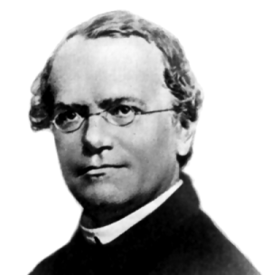
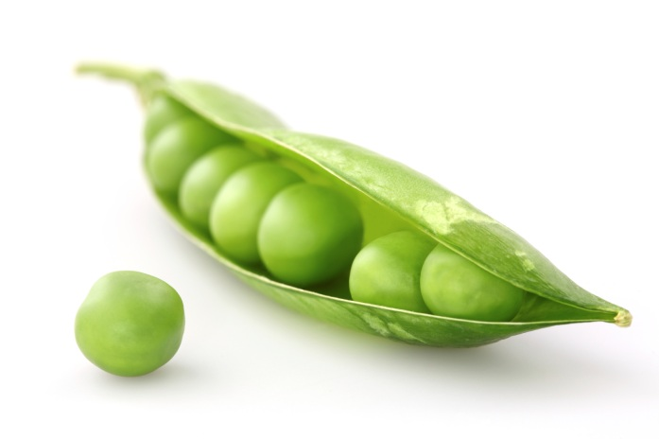
Dihybrid Crosses
When you want to see the inheritance pattern for two different traits it is known as a dihybrid cross.
  Gregor Mendel created this cross to find out if traits were inherited independently of one another or to determine if they were dependent on another trait.
Using Mendels’ famous pea plants, lets cross a heterozygous tall (Tt), homozygous yellow seed (YY) with a short (tt) heterozygous yellow seed plant (Yy).
Notes:
Dihybrid = crossing two different traits (skin and eye color, hair color and height, attached ear lobes and cleft chin, etc) to see if their inheritance is independent of eachother
Heterozygous = having both a dominant and a recessive allele
Homozygous = have both alleles be either both dominant, or both recessive

Slide 5

Independent Assortment
Independent Assortment = genes segregate independently during the formation of gametes.
  This is similar to the process of a monohybrid cross, we are determining all the possible outcomes of just one parent at a time.
Parent Plant : TtYy
Parent Plant : ttYy
 | T | t
Y | TY | tY
y | Ty | ty
 | t | t
Y | tY | tY
y | ty | ty
Notes:
Genes = in our example we have TtYy and ttYy, these are our genotypes, the code that determines phenotype
Gametes = eggs and sperm in animals, pollen in plants

Slide 6
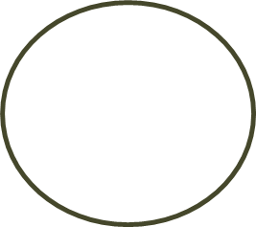
Independent Assortment
Independent Assortment = genes segregate independently during the formation of gametes
  This is similar to the process of a monohybrid cross, we are determining all the possible outcomes of just one parent at a time
Parent Plant : TtYy
Parent Plant : ttYy
 | T | t
Y | TY | tY
y | Ty | ty
 | t | t
Y | tY | tY
y | ty | ty
These become the gametes that we will cross
Notes:
Genes = in our example we have TtYy and ttYy, these are our genotypes, the code that determines phenotype
Gametes = eggs and sperm in animals, pollen in plants

Slide 7
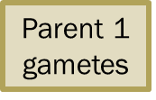
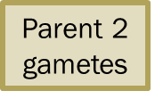
Dihybrid Punnett Square
 | TY | Ty | tY | tY
tY
ty
tY
ty
Set up the square so that the gametes from the first parent are across the top, while the gametes for the second parent are in the first column.

Slide 8
Dihybrid Punnett Square
 | TY | Ty | tY | tY
tY | T | T | t | t
ty | T | T | t | t
tY | T | T | t | t
ty | T | T | t | t
To fill in the square, work column by column, starting with the first trait listed.

Slide 9
Dihybrid Punnett Square
 | TY | Ty | tY | tY
tY | Tt | Tt | tt | tt
ty | Tt | Tt | tt | tt
tY | Tt | Tt | tt | tt
ty | Tt | Tt | tt | tt
Now we work row by row across the columns to keep like traits together.
Remember that the dominant trait must be listed first!
Notes:
Second step : fill in all the t’s across the columns

Slide 10
Dihybrid Punnett Square
 | TY | Ty | tY | tY
tY | TtY | Tty | ttY | ttY
ty | TtY | Tty | ttY | ttY
tY | TtY | Tty | ttY | ttY
ty | TtY | Tty | ttY | tty
Next, fill in the rows for the second trait of the parent generation.
Notes:
When you pair up the gametes from the two plants, always put like letters together and within the like letters, put the capital letter in front of the lowercase letter to show dominance

Slide 11
Dihybrid Punnett Square
 | TY | Ty | tY | tY
tY | TtYY | TtYy | ttYY | ttYY
ty | TtYy | Ttyy | ttYy | ttYy
tY | TtYY | TtYy | ttYY | ttYY
ty | TtYy | Ttyy | ttYy | ttyy
Finally, the second parent trait is filled in across the columns.
The Punnett Square is now completed.
Notes:
Fourth step : fill in all the Y/y’s across the columns

Slide 12
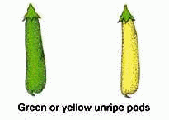
Genotype and Phenotype Ratio
Genotype
Phenotype
TtYY –
TtYy –
Ttyy –
ttYY –
ttYy –
ttyy –
2/16 -> 12.5%
4/16 -> 25%
2/16 -> 12.5%
4/16 -> 25%
3/16 -> 18.75%
1/16 -> 6.25%
Tall and yellow –
Tall and green –
Short and yellow –
Short and green –
6/16
2/16
7/16
1/16
Genotype Ratio = 2:4:2:4:3:1
Phenotype Ratio = 6:2:7:1
Notes:
What can we tell from these ratios?
Number of genotypes produced -> amount of genotypic variation within a cross
Number of phenotypes produced -> all the different ways a plant can look based off of one cross

Slide 13
Trihybrid Crosses
A How-to

Slide 14
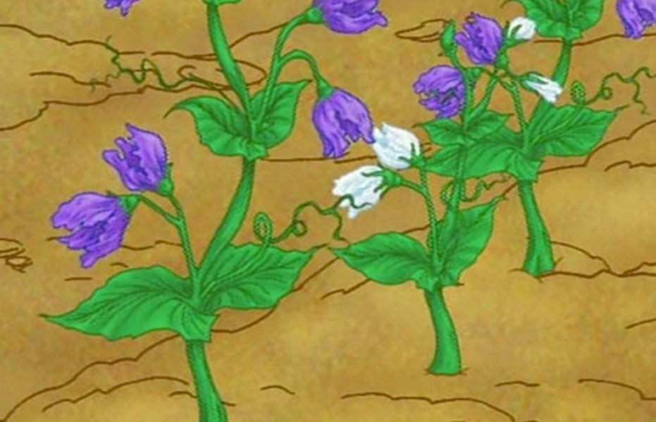

Trihybrid Crosses
A trihybrid cross involves the same steps as a dihybrid cross, but instead of looking at the inheritance pattern of two specific traits, it is possible to look at three different traits and the probability of their combination showing up in the genotype.
In the case of the pea plants, we could also look at the inheritance pattern of the color of the pod, the height of the plants, and color of their flowers (white or purple).

Slide 15

Parent Generation Genotype
Flower color in the pea plants is purple dominant (PP) or (Pp) while white flowers are recessive (pp).
In the original parent plant generation, one plant was heterozygous for height and for pod color, and is homozygous dominant for flower color (PP).
  What is the genotype for this parent plant?
    TtYyPp
The second plant in the original parent plant generation was homozygous recessive for height, and heterozygous for pod color, and now we know that it is recessive for flower color (pp).
  What is the genotype for this parent plant?
    ttYypp

Slide 16
Independent Assortment
In a similar fashion as sorting the alleles for a dihybrid cross, we must form the gametes for each parent. To do this we create all possible combinations of each allele.
T t Y y P p
TYP
Notes:
1

Slide 17
Independent Assortment
In a similar fashion as sorting the alleles for a dihybrid cross, we must form the gametes for each parent. To do this we create all possible combinations of each allele.
T t Y y P p
TYP
TYp
Notes:
2

Slide 18
Independent Assortment
In a similar fashion as sorting the alleles for a dihybrid cross, we must form the gametes for each parent. To do this we create all possible combinations of each allele.
T t Y y P p
TYP
TYp
TyP
Notes:
3

Slide 19
Independent Assortment
In a similar fashion as sorting the alleles for a dihybrid cross, we must form the gametes for each parent. To do this we create all possible combinations of each allele.
T t Y y P p
TYP
TYp
TyP
Typ
Notes:
4

Slide 20
Independent Assortment
In a similar fashion as sorting the alleles for a dihybrid cross, we must form the gametes for each parent. To do this we create all possible combinations of each allele.
T t Y y P p
TYP
TYp
TyP
Typ
tYP
Notes:
5 – move onto sorting the combinations of t

Slide 21
Independent Assortment
In a similar fashion as sorting the alleles for a dihybrid cross, we must form the gametes for each parent. To do this we create all possible combinations of each allele.
T t Y y P p
TYP
TYp
TyP
Typ
tYP
tyP
Notes:
6

Slide 22
Independent Assortment
In a similar fashion as sorting the alleles for a dihybrid cross, we must form the gametes for each parent. To do this we create all possible combinations of each allele.
T t Y y P p
TYP
TYp
TyP
Typ
tYP
tyP
tYp
Notes:
7

Slide 23
Independent Assortment
In a similar fashion as sorting the alleles for a dihybrid cross, we must form the gametes for each parent. To do this we create all possible combinations of each allele.
T t Y y P p
TYP
TYp
TyP
Typ
tYP
tyP
tYp
typ
Notes:
7 – once this step has been completed, repeat the process for the second parent plant. Results on following table

Slide 24
Trihybrid Punnett Square
 | TYP | TYp | TyP | Typ | tYP | tyP | tYp | typ
tYp
typ
typ
typ
tYp
tYp
typ
typ
Parent 2 gametes

Slide 25
Trihybrid Punnett Square
 | TYP | TYp | TyP | Typ | tYP | tyP | tYp | typ
tYp | tYP | tYP | tYP | tYP | tYP | tYP | tYP | tYP
typ
typ
typ
tYp
tYp
typ
typ
Again, it is easier to work either row by row or column by column to avoid any mistakes.
In this example the Punnett Square is worked row by row.

Slide 26
Trihybrid Punnett Square
 | TYP | TYp | TyP | Typ | tYP | tyP | tYp | typ
tYp | TtYYPp | TtYYpp | TtYyPp | TtYypp | ttYYPp | ttYyPp | ttYYpp | ttYypp
typ
typ
typ
tYp
tYp
typ
typ
Here the gametes for the columns were added to gametes from the rows.
Now it is your turn to solve the rest of the Punnett Square!
Make sure to combine like letters with the dominant trait listed first!
Notes:
Have students practice on the overhead projector or a white-erase board. Each selected student can fill in the information for an entire row or the entire column.

Slide 27
Trihybrid Punnett Square
 | TYP | TYp | TyP | Typ | tYP | tyP | tYp | typ
tYp | TtYYPp | TtYYpp | TtYyPp | TtYypp | ttYYPp | ttYyPp | ttYYpp | ttYypp
typ | TtYyPp | TtYypp | TtyyPp | Ttyypp | ttYyPp | ttyyPp | ttYypp | ttyypp
typ | TtYyPp | TtYypp | TtyyPp | Ttyypp | ttYyPp | ttyyPp | ttYypp | ttyypp
typ | TtYyPp | TtYypp | TtyyPp | Ttyypp | ttYyPp | ttyyPp | ttYypp | ttyypp
tYp | TtYYPp | TtYYpp | TtYyPp | TtYypp | ttYYPp | ttYyPp | ttYYpp | ttYypp
tYp | TtYYPp | TtYYpp | TtYyPp | TtYypp | ttYYPp | ttYyPp | ttYypp | ttyypp
typ | TtYyPp | TtYypp | TtyyPp | Ttyypp | ttYyPp | ttyyPp | ttYypp | ttyypp
typ | TtYyPp | TtYypp | TtyyPp | Ttyypp | ttYyPp | ttyyPp | ttYypp | ttyypp

Slide 28

Genotype and Phenotype Ratio
For our purposes, completing a genotypic ratio is unnecessary, due to the number of different genotypes.
We are mainly looking for the phenotypic results form a trihybrid cross.
Height | Pod Color | Flower Color | Phenotypic Ratio
Tall | Green | Purple | 5/64
Tall | Green | White | 13/64
Tall | Yellow | Purple | 11/64
Tall | Yellow | White | 3/64
Short | Green | Purple | 5/64
Short | Green | White | 6/64
Short | Yellow | Purple | 12/64
Short | Yellow | White | 9/64

Slide 29
Genotype and Phenotype Ratio
For our purposes, completing a genotypic ratio is unnecessary, due to the number of different genotypes.
We are mainly looking for the phenotypic results form a trihybrid cross.
What can we conclude
about this cross?
Height | Pod Color | Flower Color | Phenotypic Ratio
Tall | Green | Purple | 5/64
Tall | Green | White | 13/64
Tall | Yellow | Purple | 11/64
Tall | Yellow | White | 3/64
Short | Green | Purple | 5/64
Short | Green | White | 6/64
Short | Yellow | Purple | 12/64
Short | Yellow | White | 9/64
Notes:
W/ speech bubble

