Slide 1
Nervous System
How does your body talk to your brain?
Hey I feel cold, go grab a sweater!
How does your brain talk to your body?
Move your arm to grab the sweater.

Slide 2
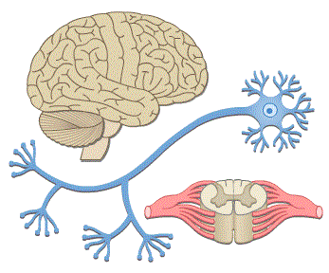
Nervous System
You accidentally step on a nail
Your skin feels the pain and sends
a message up to your brain – OUCH
Your brain sends a message back down
to your leg muscles that says – MOVE
and your leg steps back off the nail.
Your nervous system is how your body communicates with your brain and your brain communicates with your body.
Notes:
Note: By the end of this presentation students should be able to name these three structures: brain, neuron, spinal cord slice

Slide 3
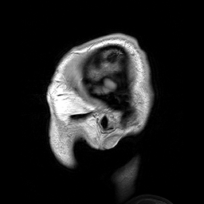
To unlock the secretes of the brain there are special scientists who research Neuroscience
- the scientific study of the nervous system
Neuroscientists want to understand how the nervous system works to develop treatments for nervous system disorders and diseases.
Notes:
Note: the gif on the bottom left is of an MRI scanning a patient’s entire head to look at the brain, taken from wikipedia.com’s neuroscience page
Question: Can anyone name any nervous system disorders/diseases? Dementia, Alzheimer’s disease, multiple sclerosis, Parkinson’s, etc.

Slide 4
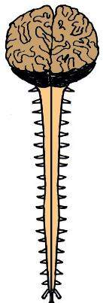
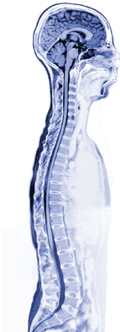
The Nervous System has two parts:
1. Central Nervous System
Brain
&
Spinal Cord
2. Peripheral Nervous System
Nerves in the body

Slide 5
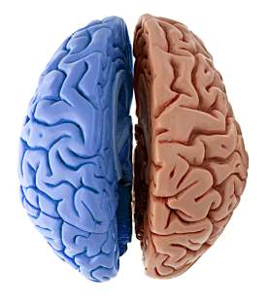
The Brain
Central Nervous
System:
Your brain is divided into two hemispheres (or halves)
that have contralaterality = contra – opposite, lateral – side
Left half
Right half
The left half of your brain controls the right side of your body…
and the right half of your brain controls the left side of your body.
Notes:
Question: If you use your right hand to write, which side of your brain controls that?

Slide 6
The brain is divided into four lobes
Each lobe has specific functions
1. Frontal Lobe
Personality
Speaking
Making plans
Reasoning / Logic
2. Parietal Lobe
Sense of touch
Map of the body
Movement
Sense of where you are in your environment
4. Occipital Lobe
Vision
3. Temporal Lobe
Hearing
Understanding language
Cerebellum
Planning movements
Balance
Together the lobes are called the
cerebrum
Notes:
To orient yourself: the frontal lobe is in the front of the head above our face, the occipital lobe is in the back of the head above our spine, the temporal lobe is above our ears which is why it is involved with hearing
Note: the Cerebellum is not a lobe part of the cerebrum but it does have special functions

Slide 7
How do we know which lobe does what?
When you damage a certain part of your brain, the damage can stop the functions that normally occur.
This man is Phineas Gage.
While working on a railroad construction site, an explosion shot this iron rod straight through his head damaging most of his frontal lobe. Amazingly, he lived. However, his personality was said to have drastically changed, his friends stated he was “no longer Gage.”
Notes:
Note: Phineas Gage is holding the iron rod that went through his skull in the picture. He went on tours at universities and fairs to show his iron rod.

Slide 8
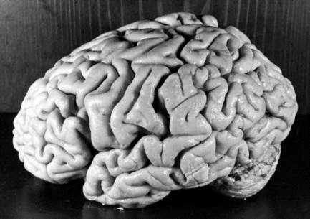
Your Brain
Is home to your:
Thoughts
Memories
Decisions
Dreams
Critical thinking (like math problems)
Language center
& much more! The brain is still a mystery!
Notes:
Note: this picture is of Albert Einstein’s brain
Quick activity: Squeeze both your hands into fists and press them together – this is about the size of your brain!

Slide 9
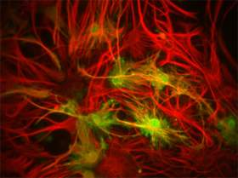
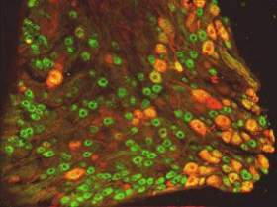
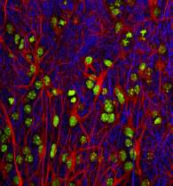
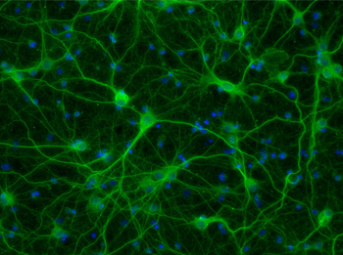
Neurons are the cells of the brain
The neurons’ job is to receive and transmit messages throughout your brain and body
There are over 100 billion neurons in your brain, that’s 100,000,000,000!
Neurons are so small you need a microscope and special coloring to see them
Neurons do not undergo mitosis – implications?
Notes:
Note: The images along the top are of neurons. To see neurons they are stained with immunofluorescence (hence the bright, brilliant colors) and viewed with an electron microscope because they are so small.
Question: what are the implications of neurons not undergoing mitosis? – what you got is what you got! Your brain does not grow larger. As you get older you lose brain cells but do not grow new ones.

Slide 10
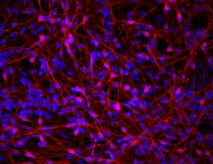
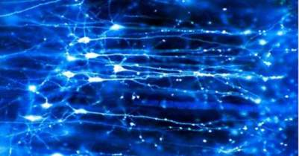
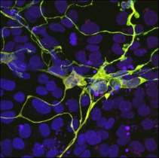
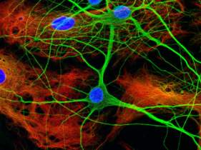
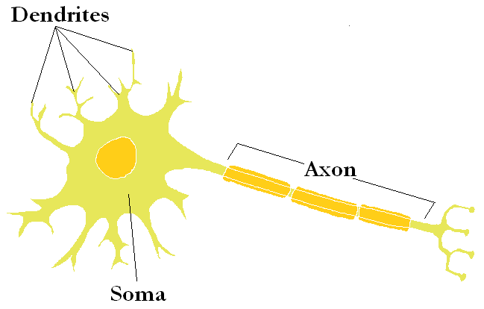
Neurons look like a tangled web
Neurons have three
parts
1. Dendrites
2. Soma (cell body)
3. Axon
Notes:
Note: the soma (means body) holds the nucleus (seen in the picture as a dark yellow circle) and all the other organelles of the cell necessary for life

Slide 11
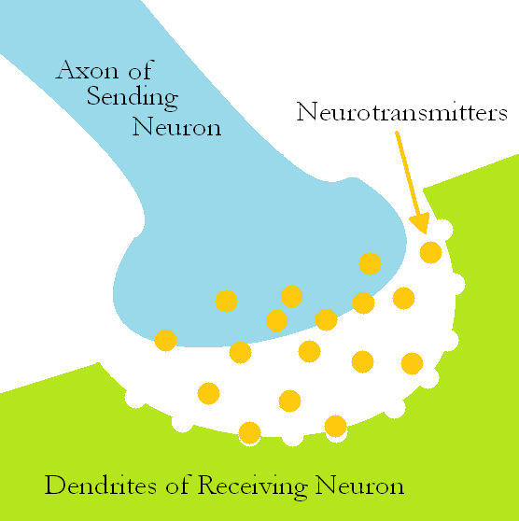
Neurotransmitters
Neurotransmitters are chemical messages made by neurons.
They are stored in the axon
Neurons release their
neurotransmitters across
the gap between neurons
Dendrites have special
receptors for each
neurotransmitter
Notes:
Note: the dendrite receptors here are portrayed as dips that fit the shape of the neurotransmitter, this is an example of receptor specificity – each receptor “fits” a specific neurotransmitter

Slide 12
How do neurons talk to each other ?
They send messages electrically and chemically
The thin dendrites are like branches receiving chemical messages, called neurotransmitters, from neighboring neurons
The long axon is like a telephone wire transmitting electrical messages, called action potentials, onwards to other neurons
Notes:
Note: animation on the slide, click to see the direction of the flow of neuronal communication: the first, yellow axon sends an electrical message action potential down to signal the release of chemical message neurotransmitters that are received by the dendrites of the next, blue neuron who sends an action potential down it’s axon to signal the release of it’s neurotransmitters to the next, red neuron who sends an action potential down it’s axon and so on
Question: 1) In this animation what are the neurotransmitters? The orange circles. 2) What are the action potentials? The black arrows.

Slide 13
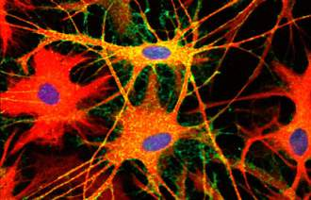
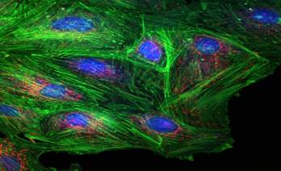
How The Brain Works
Notes:
Note: this Youtube clip How The Brain Works is 8:10 minutes long – you can stop at 4:30, up until then is how neurons work but after that 4:30 is a motivational pep talk.

Slide 14
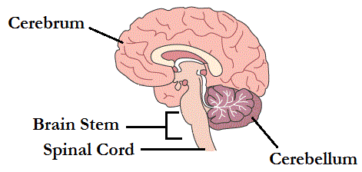
Brain to Spinal Cord
Your cerebrum and cerebellum are attached to the spinal cord at the
brain stem.
The brain stem controls involuntary body functions or functions that we don’t have to think about: breathing, making your heart beat, digesting your lunch…
Notes:
Question: Try to think about making your stomach digest food faster, you can’t! Because it’s an involuntary function – one you do not have to think about to control.

Slide 15
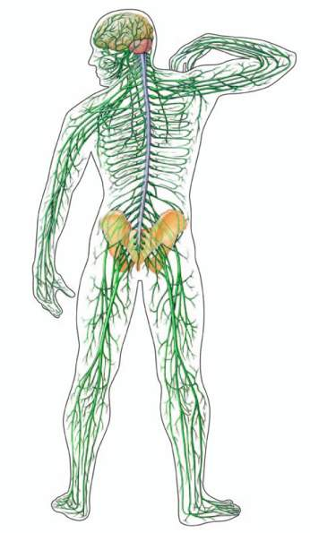
Spinal Cord
Central Nervous
System:
The spinal cord is the main information pathway.
Our body sends sensory messages up to the brain via the spinal cord…
and the brain sends movement messages down the spinal cord to the body.
Notes:
Question: 1) What kind of messages could the peripheral nerves be telling the brain? – Sensory information about our environment: I’m cold, it’s dark outside, something smells delicious, etc.
2) What kind of messages could the brain be sending down to the body? – The brain tells our voluntary muscles to move: lift your right foot, flap your elbows, etc.

Slide 16
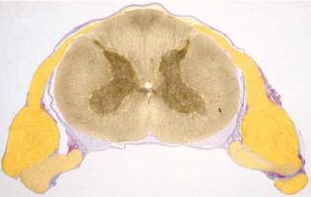
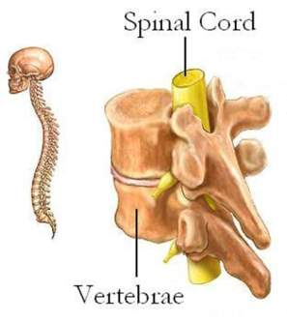
Spinal Cord
The spinal cord is made of long bundles of axons
The spinal cord is surrounded by bones for protection
Spinal cord slice
These bones are called vertebrae
Notes:
Note: the spinal cord slice has no vertebrae, just the spinal cord and the peripheral nerves

Slide 17
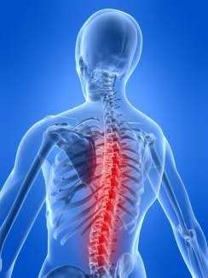
Spinal Cord Damage
Damage to the spinal cord can result in paralysis – where you can not move the muscles in your arms or legs.
Why?
Because when the spinal cord is severed,
the ‘move’ messages from your brain are not being sent to their destination in your arms and legs.
Notes:
Note: Animation – click to make answer appear

Slide 18
Did you know?
During your sleep, while you are dreaming, your body undergoes temporary paralysis.
Notes:
Note: Animation – clip art pulses

Slide 19
Spinal Cord Damage Today
Our neurons are special because they have the ability to make new connections with neighboring neurons.
This is how we can keep learning new things, the number of connections our neurons can make is endless!
Recent neuroscience advances in spinal cord damage are working to teach the spinal cord’s neurons to make new connections so the patients can relearn movements.
Using the Wii to Help Neurons Relearn Movements
Notes:
Note: The Youtube clip is based mainly on stroke patients, but the Dr. McNulty does say this therapy can and has been applied to various movement disorders such as Spinal Cord injury, Parkinson’s, Cerebal Palsy, etc.
The clip is 4:06 minutes long; you can stop it at 1:58 which includes one full example of the Wii therapy if the clip is too long.

Slide 20
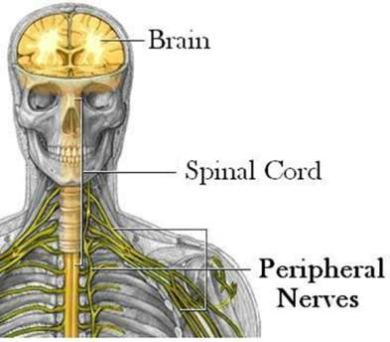
Peripheral Nervous System
The peripheral nervous system (PNS) is made up of nerves that run throughout our body.
Nerves tell our brain about our environment with information gathered from our senses.
Nerves have special receptors for each sense:
Thermoreceptors
Mechanoreceptors
Photoreceptors
Nociceptors & more
Notes:
Note: the nerves are in yellow branching off the spinal cord
Question: Can you guess what each receptor feels?
Thermoreceptors – temperature; Mechanoreceptors – pressure; photoreceptors – light; nociceptors – pain

Slide 21
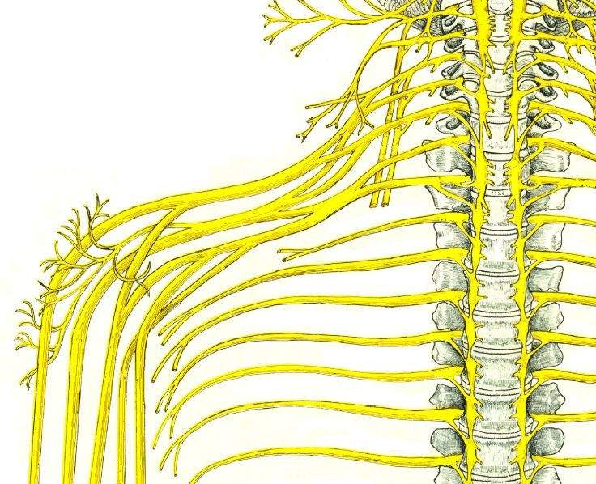
Nerves
Nerves are bundles of neuron axons
Nerves carry two types of information
Movement
Sensory
Notes:
Note: the nerves are yellow
Question: Which direction do the sensory nerves send their information? – Up to the brain from the body
Which direction do the movement messages go? – Down from the brain to the body

Slide 22
Nervous System Information Pathway
Our sense receptors pick up information about our environment, i.e. it’s cold
Nerves carry that information up the spinal cord to the brain
Your brain’s neurons fire and decide to get a jacket
Your cerebellum plans out the movement to pick up a jacket
Nerves carry the movement message down the spinal cord to your arm
Your arm reaches down to pick up the jacket
Notes:
Note: For Assessment/Evaluation of Lesson, leave this slide up as an model for students to come up with their own example of the information pathway – directions in the lesson plan.

Slide 23
Careers in Neuroscience
Neuroscientist – study the nervous system
Neurosurgeon – operate on the brain
Neurophysiologist – study brain behavior
Neuroradiologist – image
the nervous system
& many more!

