Slide 1
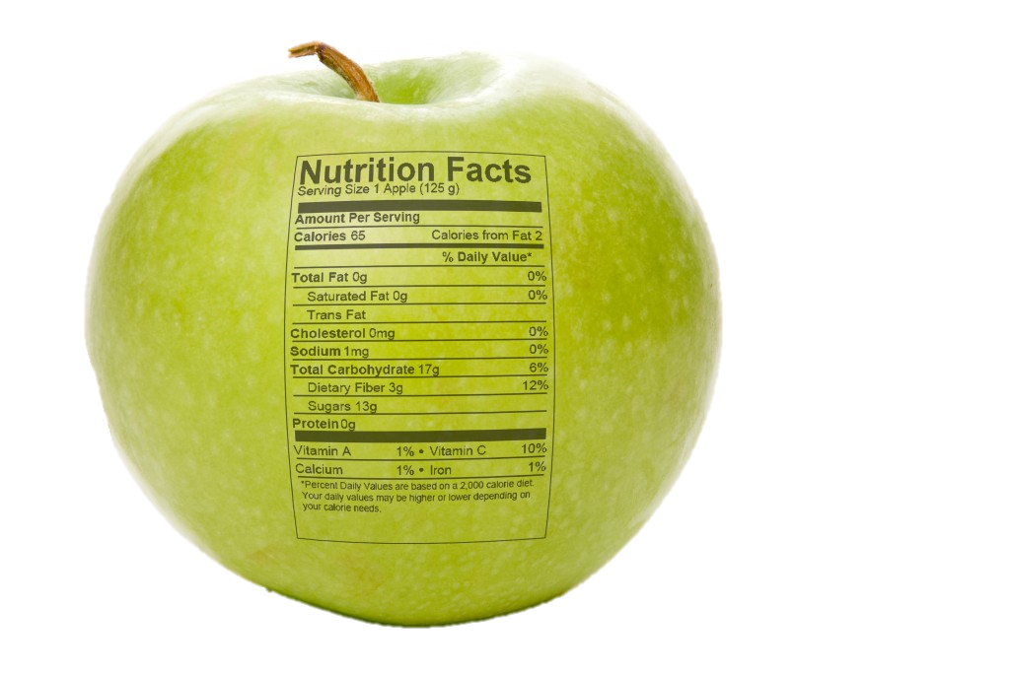
Nutrient Digestion
Notes:
Image Credit: http://creatingahealthylifestyle.files.wordpress.com/2012/08/apple-nutrition-facts-1024x685.jpg

Slide 2
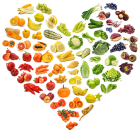
What Are Nutrients?
Nutrients are the components in food that provide materials and energy the body needs for it to function.
Notes:
Image Credit: http://www.ihs.gov/nutrition/images/food_heart.png

Slide 3
During Digestion…
our body breaks down large molecules of food, mechanically and chemically, into small molecules that the body needs for maintenance, growth, and energy!
Notes:
Add slide after this for what is mechanical breakdown

Slide 4
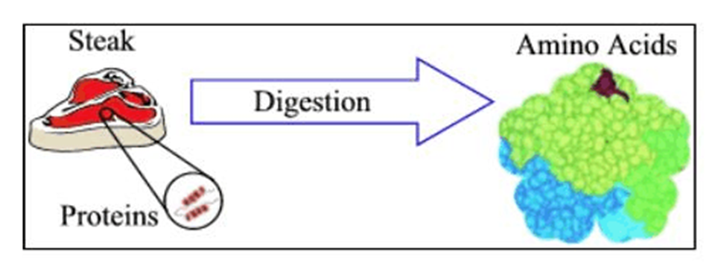
In order for our bodies to absorb the nutrients, the large molecules of carbohydrates, fat, and protein must be broken down.
Notes:
Image Credit: http://peer.tamu.edu/curriculum_modules/cell_Biology/module_5/digestion.gif

Slide 5
How Does The Breakdown Occur?
Our bodies use special protein molecules called enzymes to break the larger molecules into smaller pieces.
Enzymes are catalysts.
[Catalysts are chemicals that quicken a chemical reaction without undergoing any change themselves]

Slide 6
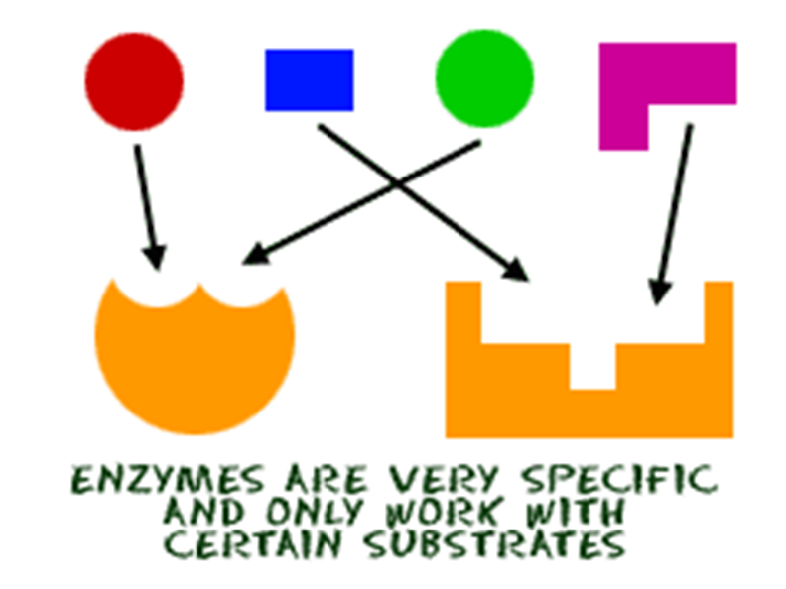
Each enzyme is very specific and only attaches to one type of molecule.
The molecule the enzyme acts upon is called its substrate.
There are different enzymes that breakdown each type of nutrient.
Notes:
Image Credit: http://www.chem4kids.com/files/art/bio_enzyme1.gif

Slide 7
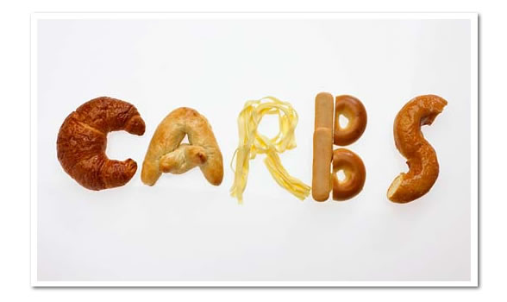
Carbohydrates are the main energy source of the body.
Carbohydrates are formed of carbon, hydrogen, and oxygen atoms.
The two categories of carbohydrates include sugar and starch.
Notes:
Image Credit: http://justingrinnell.files.wordpress.com/2012/11/carbs.jpg

Slide 8
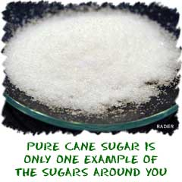
Carbohydrate Breakdown
Enzymes in the mouth, stomach, and small intestine, breakdown the carbohydrate molecules.
These large complex sugar and starch molecules breakdown into small simple sugars.
There are many enzymes that breakdown carbohydrates, some are amylase, maltase, sucrase and lactase.
Notice “ase” is a common ending for enzyme names.
Notes:
Image Credit: http://www.chem4kids.com/files/bio_carbos.html

Slide 9
Proteins
Proteins are nutrients which contain materials the body uses for growth and repair.
Proteins are made of Carbon, Hydrogen, Oxygen and Nitrogen.
Proteins are large molecules made up of combinations of amino acids.

Slide 10
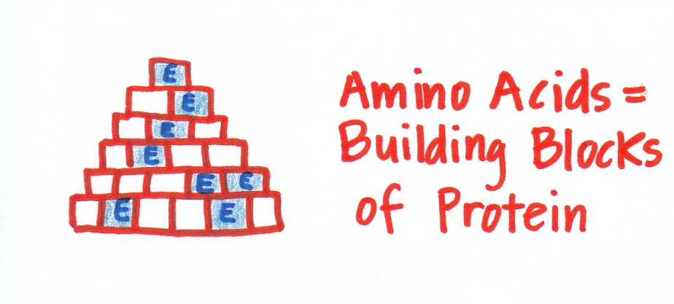
Proteins → Amino Acids
Amino acids are the building blocks of proteins.
These building blocks bond together to form chains that are called peptides.
Proteins are formed of combinations of large peptides chains, this is referred to as polypeptides.
Notes:
Image Credit: http://vibrantsexystrong.com/wp-content/uploads/2011/02/amino-acids.jpg

Slide 11
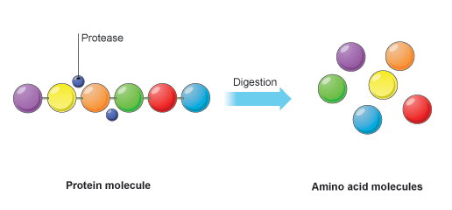
In order for the body to use protein, enzymes in the stomach and small intestine break the polypeptides down into individual amino acids.
Some protein enzymes are chymotrypsin and carboxypeptidase.
Notes:
Image Credit: http://www.bbc.co.uk/bitesize/ks3/science/images/protein_molecules.gif

Slide 12
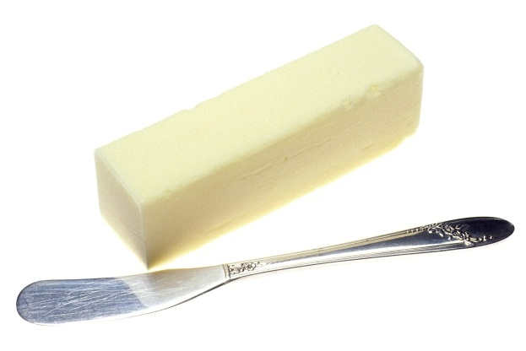
Lipids
Lipids are important nutrients for energy and absorption of certain vitamins.
Lipids are large molecules that can be categorized as fats or oils.
These molecules are made up of carbon, hydrogen, and oxygen atoms.

Slide 13
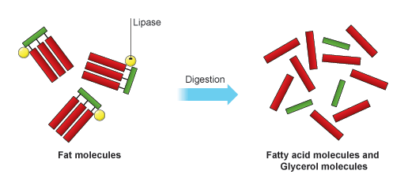
Lipid Breakdown
Bile and enzymes in the small intestine break lipids down into small molecules of fatty acids or glycerol.
These enzymes are called lipase.
Notes:
Image Credit: http://www.bbc.co.uk/bitesize/ks3/science/images/fat_molecules.gif

Slide 14
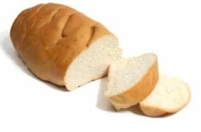

Review
Carbohydrates
(Starch and Sugar)
Digestion
Simple Sugars
Proteins
Digestion
Amino Acids
Lipids
(Fats and Oils)
Digestion
Fatty Acids or Glycerol

