Slide 1
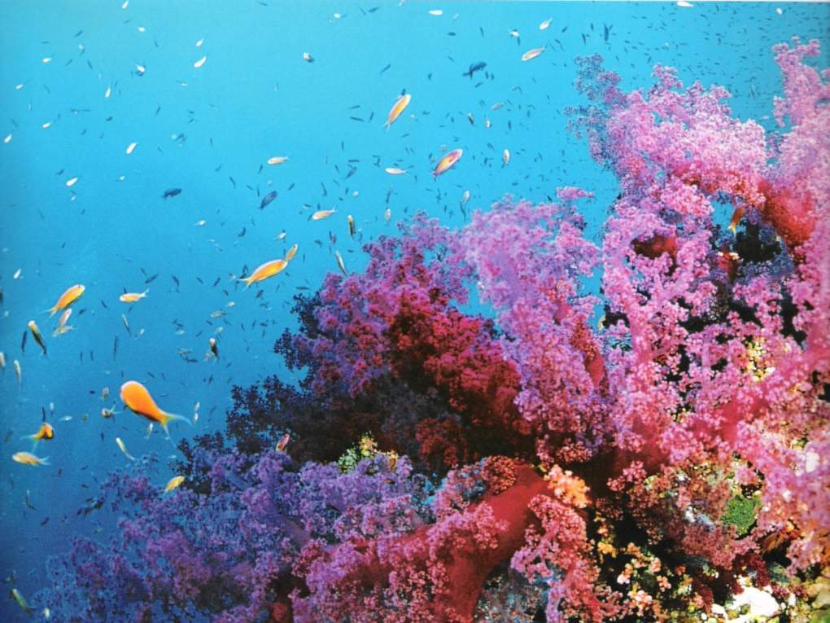
Ocean Systems

Slide 2
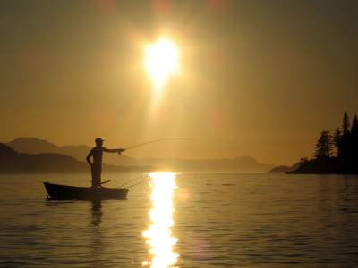
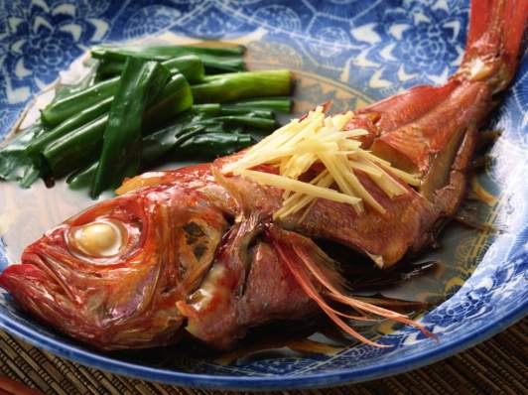
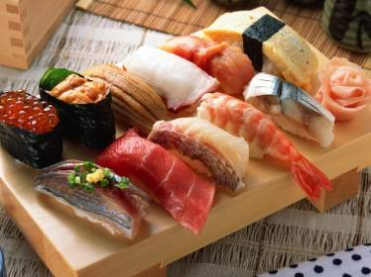
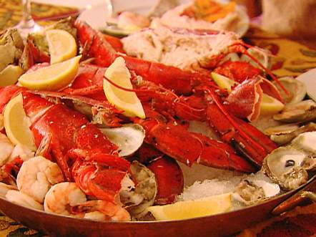
We Depend on the Ocean for Food

Slide 3
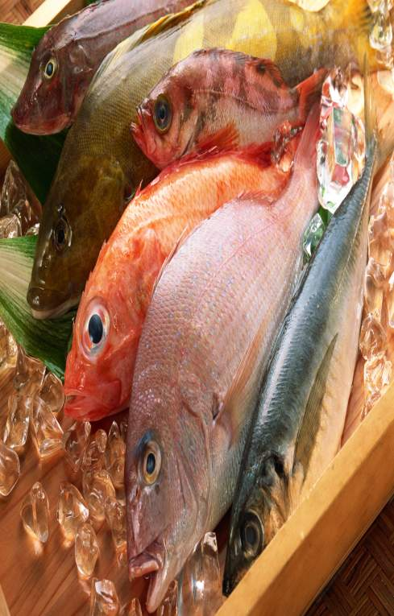
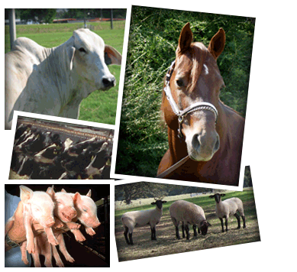
We Get Our Food from the Ocean
We Do this both directly and indirectly
We eat fish that is harvested from the ocean
We also process harvested fish for livestock feed.

Slide 4
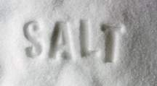
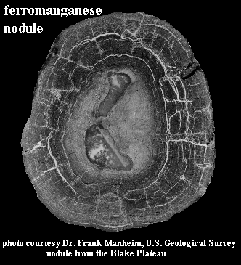
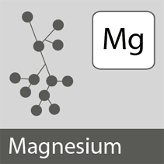
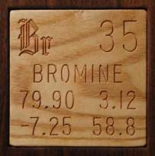
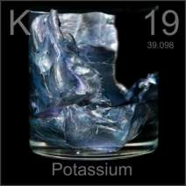
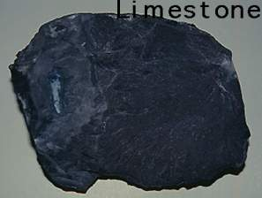
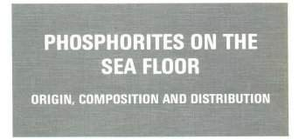
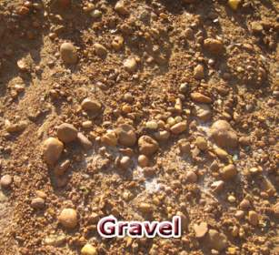
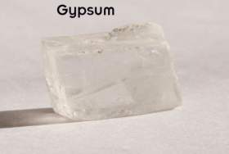
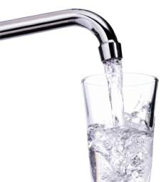
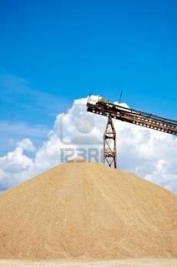
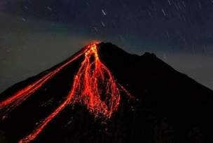
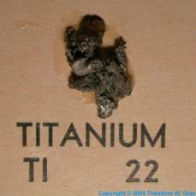
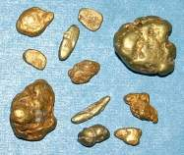
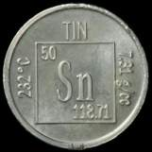
We get Valuable Minerals from the Ocean
Metal Deposits from Volcanoes and Seafloor Vents
Sand

Slide 5
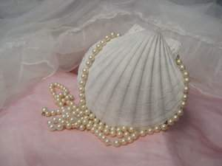
We use the Ocean as a Highway for Commerce
The shallow continental shelves have been exploited as a source of sands and gravels.
Expensive deposits of petroleum-bearing sands have been exploited in offshore areas.

Slide 6
We use the Ocean as a Highway for Commerce
Manganese nodules represent a potentially rich and extensive resource.
Pearls are taken from oysters to make jewelry and shells and coral have been used as a source of building material.

Slide 7
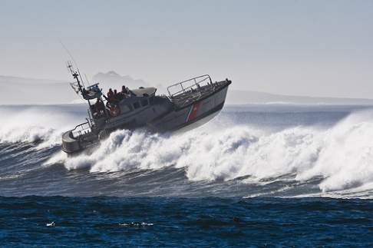
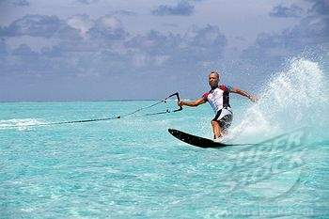
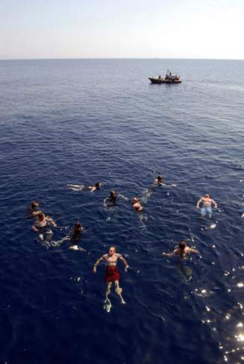
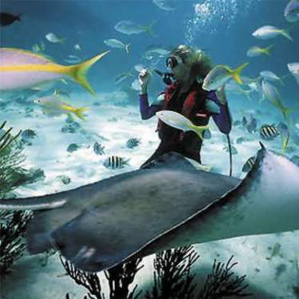
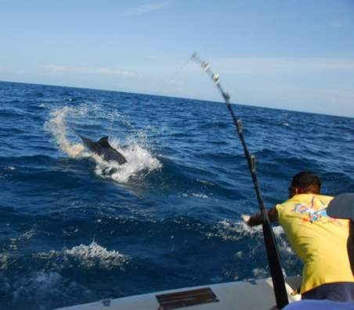
The Ocean is a Place for Recreation

Slide 8
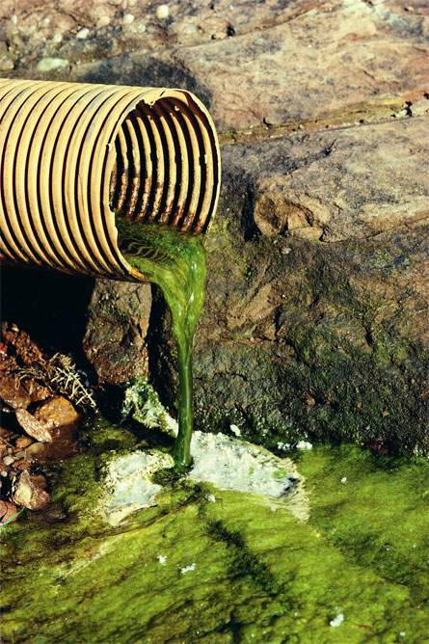
The Ocean is a Place of Waste Disposal
Water pollution is the contamination of water resources by harmful wastes.
Ocean pollution has escalated dramatically as those who use the oceans for recreational and commercial purposes, as well as those who live nearby, have disposed of more and more wastes there.
United States industry is the greatest source of pollution. It accounts for more than half the volume of all water pollution and for the most deadly pollutants.

Slide 9
The Ocean is a Place of Waste Disposal
Waste-bearing water, or effluent, is discharged into streams, lakes, or oceans, which in turn disperse the polluting substances.
Along with domestic waste, sewage carries industrial contaminants and a growing tonnage of paper and plastic refuse.
Rain drainage is another major polluting agent because it carries such substances as highway debris, sediments from highway and building construction, and acids and radioactive wastes form mining operations into freshwater systems as well as into the ocean.

Slide 10
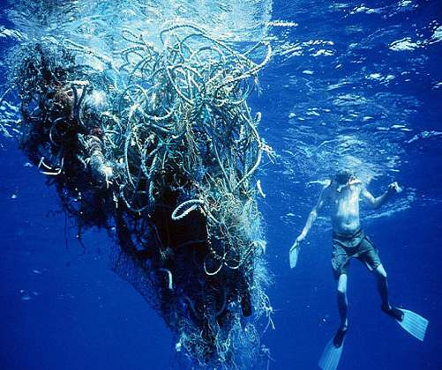
The Ocean is a Place Waste Disposal
Some examples of waste disposal include:
Manufacturing plants pouring off undiluted corrosives, poisons, and other noxious byproducts
The construction industry discharges slurries of gypsum, cement, abrasives, metals, and poisonous solvents.

Slide 11
The Ocean is a Place Waste Disposal
Some examples of waste disposal include:
A group of contaminants entering the food chain is the polychlorinated biphenyl (PCB) compounds
These include components of lubricants, plastic wrappers, and adhesives
Another type of pollution is the discharge of hot water by factories and power plants. This causes thermal pollution by increasing water temperatures. This causes a change in the level of oxygen dissolved by water.

Slide 12
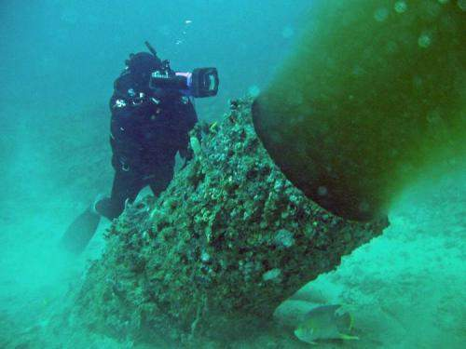
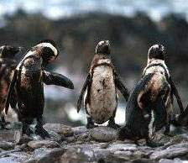
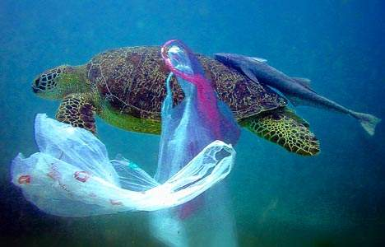
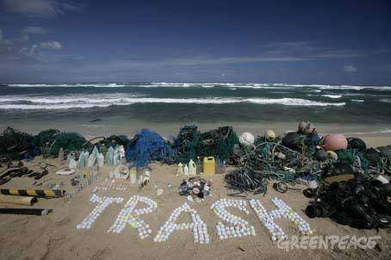
This is What Pollution Does to the Ocean

Slide 13
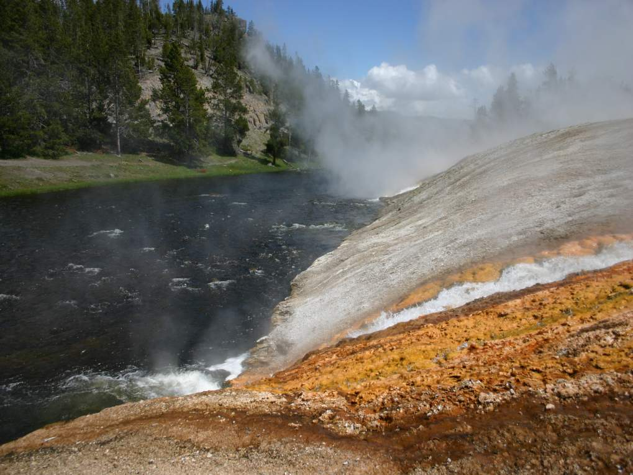
Runoff
When rain or snow falls onto the earth it starts moving according to the laws of gravity.
A portion of the precipitation seeps into the ground to replenish the groundwater.
Most of it flows downhill as runoff.

Slide 14
Runoff
Runoff is extremely important in that it keeps rivers and lakes full of water and that is also changes the landscape by the action of erosion.
Runoff occurs during storms so much more water flows into rivers during storms.

Slide 15
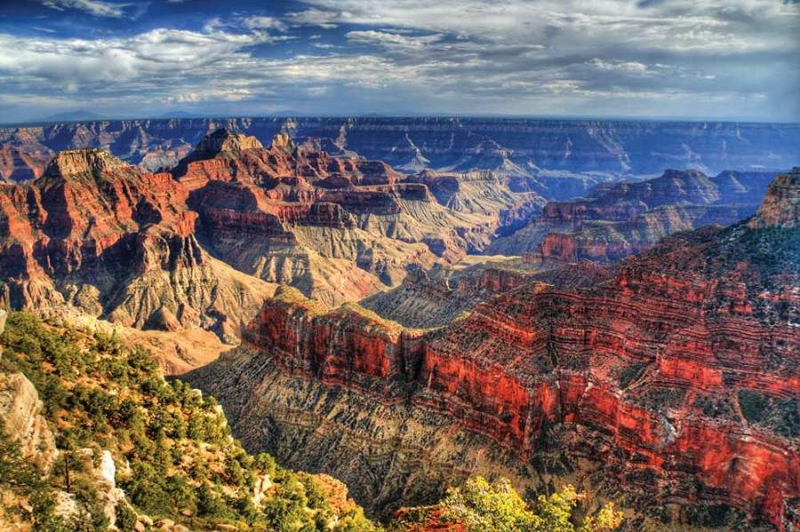
Flowing water has tremendous power—it can move boulders and carve out canyons

Slide 16
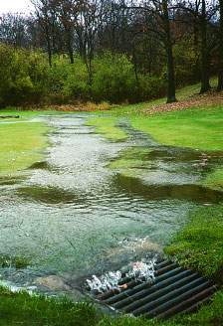
Definitions of Runoff
Runoff is the part of precipitation, snow melt, or irrigation water that appears in uncontrolled surface streams, rivers, drains or sewers. Runoff may be classified according to speed of appearance after rainfall or melting snow as direct runoff or base runoff, and according to source as surface runoff, storm interflow, or ground-water runoff.
Notes:
http://ga.water.usgs.gov/edu/runoff.html

Slide 17
Definitions of Runoff
The sum of total discharges described in definition 1 during a specified period of time.
The depth to which a watershed (drainage area) would be covered if all of the runoff for a given period of time were uniformly distributed over it.
Notes:
http://ga.water.usgs.gov/edu/runoff.html

Slide 18
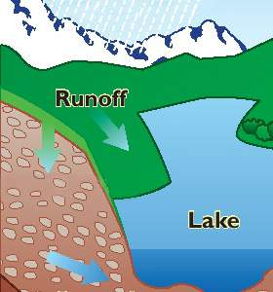
Meteorological Factors Affecting Runoff
Type of precipitation
Rainfall activity
Rainfall amount
Rainfall duration
Distribution of rainfall over the watersheds
Direction of storm movement
Antecedent precipitation and resulting solid moisture
Other meteorological and climatic conditions that affect evapotranspiration, such as temperature, wind, relative humidity, and season

Slide 19
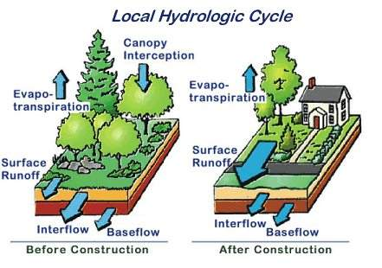
Physical Characteristics Affecting Runoff
Land use
Vegetation
Soil type
Drainage area
Basin shape
Elevation
Slope
Topography
Direction of orientation
Drainage network patterns
Ponds, lakes, reservoirs, sinks, etc. in the basin, which prevent or alter runoff from continuing downstream

Slide 20
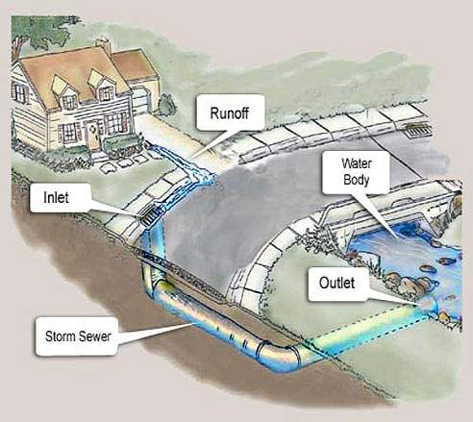
Runoff and Water Quality
Most rainfall in forested watersheds is absorbed into the soil (infiltration), is stored as ground water, and is slowly discharged into steams through seeps and springs.
Flooding is less significant in these conditions because some of the runoff during a storm is absorbed into the ground, thus lessening the amount of runoff into a stream during the storm.

Slide 21
Runoff and Water Quality
In urbanized areas, much of the vegetation is replaced by impervious surfaces. This reduces the area where infiltration can occur. This causes more runoff which must be collected by extensive drainage systems which carry the storm water runoff to the streams.
This causes more water to arrive in streams more quickly, resulting in an increased likelihood of more frequent and more severe flooding

Slide 22
Runoff and Water Quality
Drainage ditches carry storm water runoff to storage ponds. These are often built to hold runoff and collect excess sediment in order to keep it out of streams.
Runoff from agricultural land can carry excess nutrients into streams, lakes, and ground-water supplies. These nutrients have the potential to degrade water quality.

Slide 23
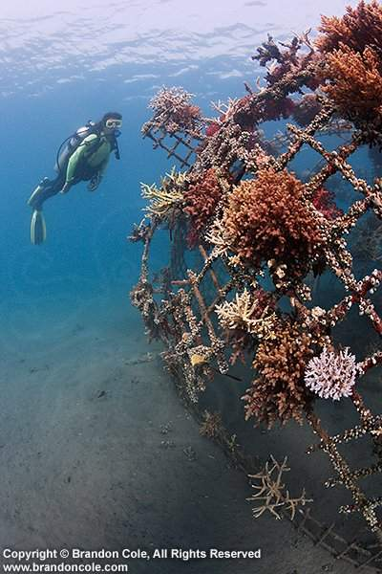
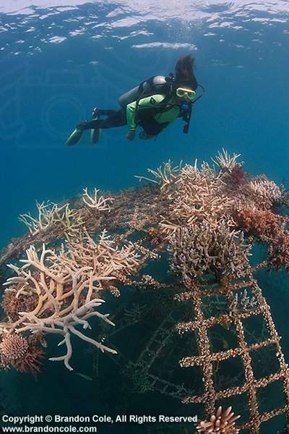
Artificial Reefs
Notes:
http://www.pbcgov.com/erm/coastal/reef/

Slide 24
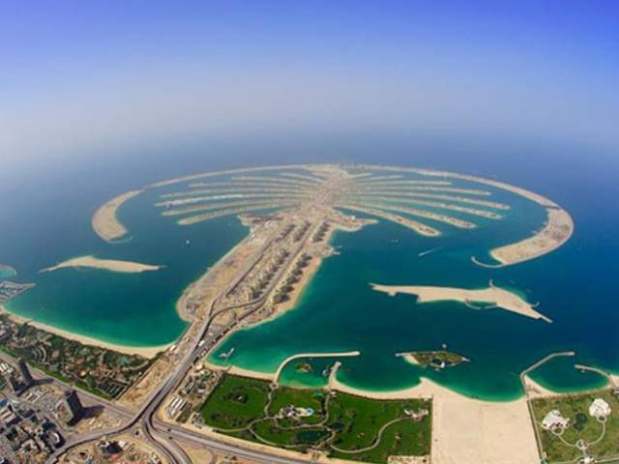
Artificial Reefs: The Problem
Marine habitats have been significantly impacted by coastal development, user pressures, and hurricanes.
The reduction of habitats has led to the decline of many marine organisms.

Slide 25
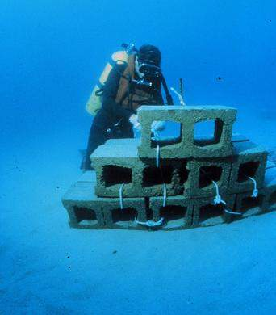
Artificial Reefs: A Remedy
Construct artificial reefs to function as natural reef systems providing habitats for hundreds of species of fish and other marine life.

Slide 26
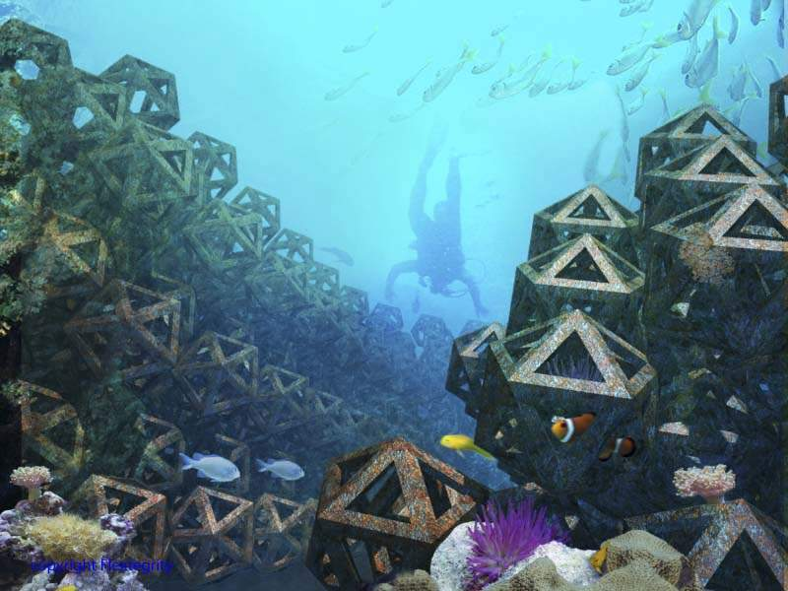
Artificial Reefs: Benefits
Provide food, shelter, protection, and spawning areas for fish and marine life.
Relieve user pressure form natural reefs by providing alternative recreational areas.

Slide 27
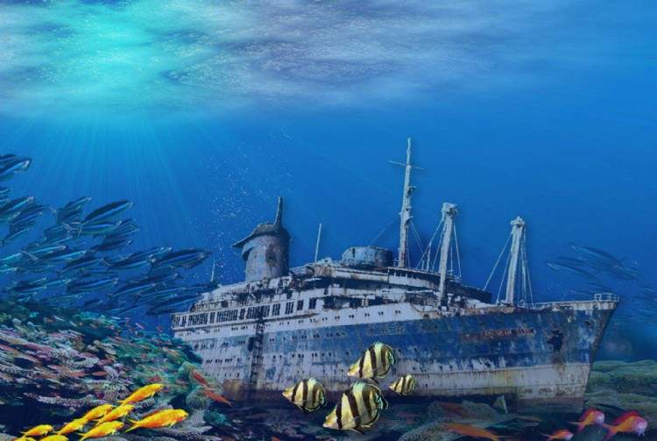
What is an Artificial Reef?
Artificial reefs are man-made habitats placed in areas away from natural reefs that provide a framework for new hard bottom communities to develop.
Artificial reefs use materials that mimic natural reef systems such as concrete and limestone.
Sometimes ships are deployed, but usually in combination with concrete and limestone to increase habitat diversity.

Slide 28
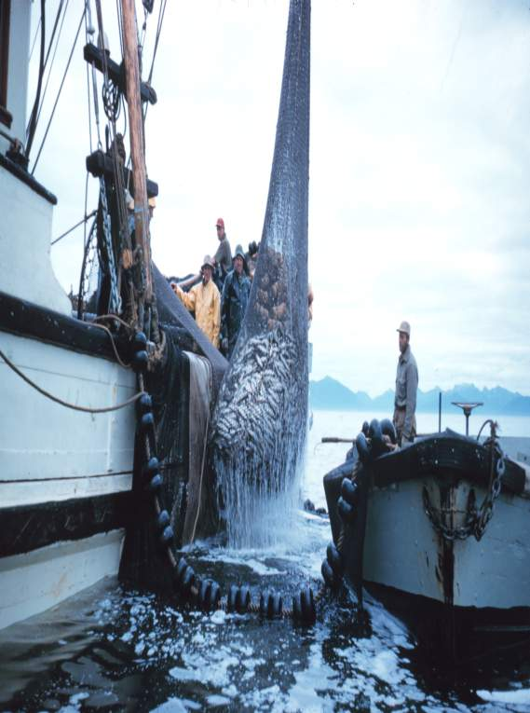
Use of Resources
Fishing
The increase in technological fishing methods has allowed more fish to be caught each year.
If the commercial fishing industry continues to grow without regulation, global fish stocks will rapidly decrease.
This can severely disrupt the balance of ecosystems and eventually, there will not be any fish left in the sea

Slide 29
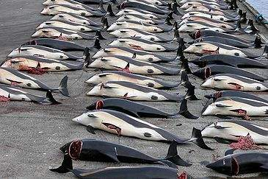
Use of Resources
Whaling
Exploitation of this industry has led to a severe reduction in whale numbers. International commercial whaling was banned in 1986, but scientific whaling is still allowed.

Slide 30
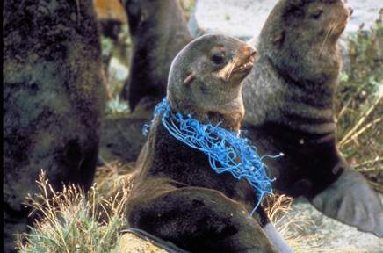
Use of Resources
Pollution and waste dumping
This includes agricultural , urban and industrial run-off, nuclear waste, dredged (dug-up) materials, air pollution, oil, and general rubbish
It is a huge threat to the sustainability of the ocean
Ocean currents circulate pollution around the world. Currents , fish, and the pollutants and waste within the ocean are in constant motion.

Slide 31
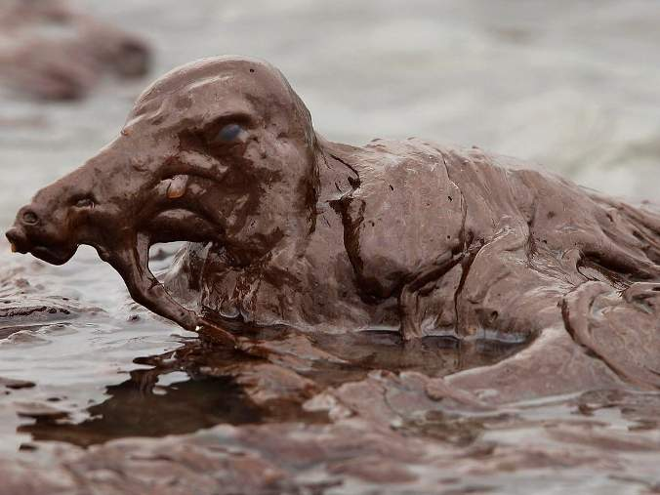
Use of Resources
Mining: Oil, gas, minerals
The mining of these resources has a direct negative impact on the ocean environment.
One method used to find these deposits uses sound waves that can kill certain types of fish.
Drilling for oil churns up the sea bed, killing ecosystems.
Oil spills are detrimental to animals, especially birds because it weighs them down so they are no longer buoyant and are unable to fly.

Slide 32
Sources
http://ga.water.usgs.gov/edu/runoff.html
http://www.pbcgov.com/erm/coastal/reef/
http://encyclopedia2.thefreedictionary.com/Use+of+ocean+resourses
http://www.waterencyclopedia.com/Mi-Oc/Mineral-Resources-from-the-Ocean.html
http://wiki.nsdl.org/index.php/MSP:MiddleSchoolPortal/Ocean_Systems
http://www.skwirk.com.au/p-c_s-57_u-186_t-502_c-1851/SA/7/The-global-issue-and-differing-perspectives/The-use-of-ocean-resources/Geographical-issues-and-global-citizenship-physical-elements/SOSE-Geography/

