Slide 1
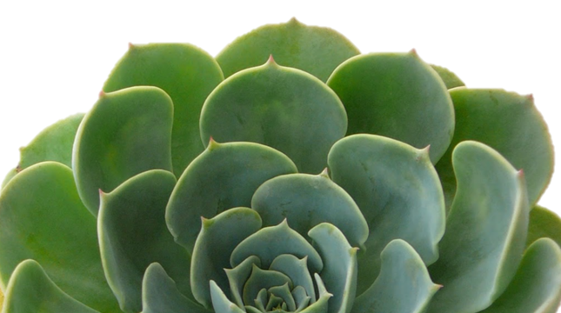
Plant Hormones
and plant growth
Notes:
© Partnership for Environmental Education and Rural Health at
College of Veterinary Medicine & Biomedical Sciences, Texas A&M University
Funding support from the National Institutes of Health Office of Research Infrastructure Programs (ORIP)

Slide 2
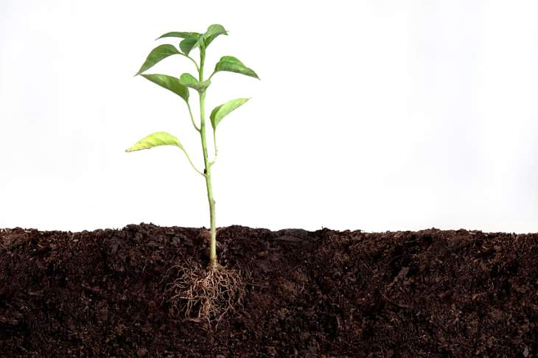
Plant Growth and Development
Hormones diffuse throughout the plant to promote growth and development.

Slide 3
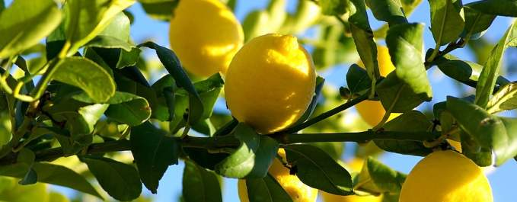
What is a Plant Hormone?
A naturally-occurring compound which regulates change in physiology, growth or development of the plant.

Slide 4
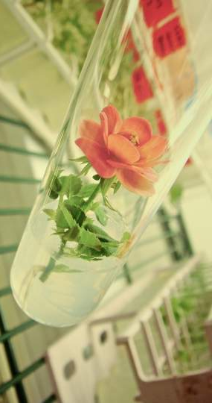
5 Types of Plant Hormones
Auxin
Cytokinin
Gibberellin
Abscisic Acid
Ethylene

Slide 5
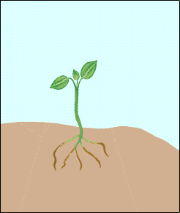
Auxin
Role of Hormone | Cell elongation (increase cell size)
Site of Production | Shoot Tips
Effect of Hormone | Growth of plant in response to the environment, production of roots.
Tropism: a plant’s response to environment
Phototropism- response to light
Geotropism-response to gravity
Thigmotropism-response to touch

Slide 6
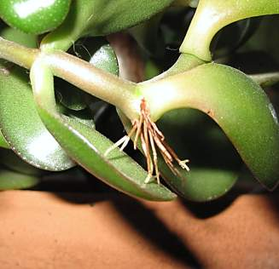
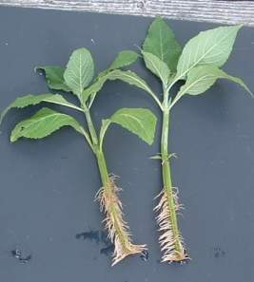
Auxin Growth Effects
Stimulates Adventitious Root Formation.
Adventitious roots grow from stems or leaves rather than from the original root system of the plants.
This is especially useful when cutting and transplanting plants.

Slide 7
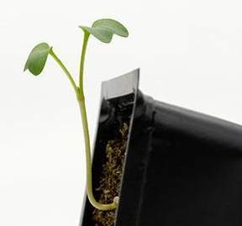
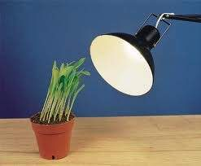
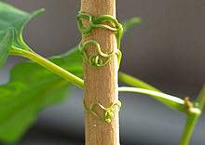
Auxin Growth Effects
Tropisms-How a plant grows in response to the environment
Geotropism-gravity
Phototropism-light
Thigmotropism-touch

Slide 8
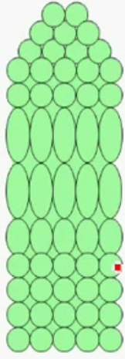
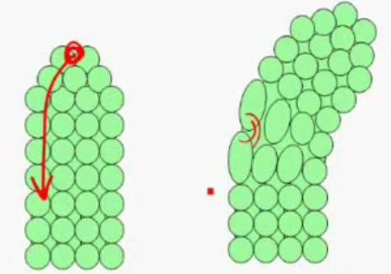
Auxin
How does this hormone stimulate tropism?
Cell Elongation
Auxin travels away from the sunlight and expands the cells

Slide 9
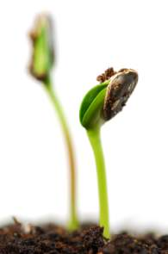
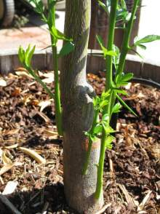
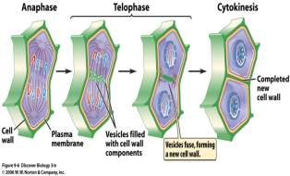
Cytokinin
Role of Hormone | Cell division (increase number of cells)
Site of Production | Root Tips
Effect of Hormone | Mitosis of new cells; Stimulates seed germination and new shoot growth

Slide 10
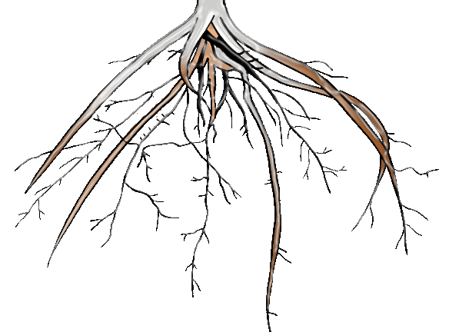
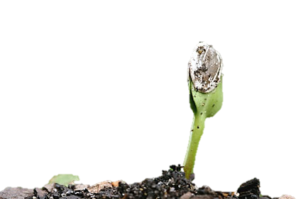
AUXIN stimulates the production of roots.
CYTOKININ stimulates the production of shoots.

Slide 11
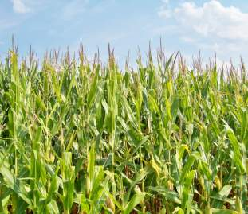
Gibberellin
Role of Hormone | Internode Elongation (height)
Site of Production | Root and Shoot Tips
Effect of Hormone | Controls yearly cycles (flowering/bolting, seeding and dormancy exiting) Rapid growth of stems and seeds.

Slide 12
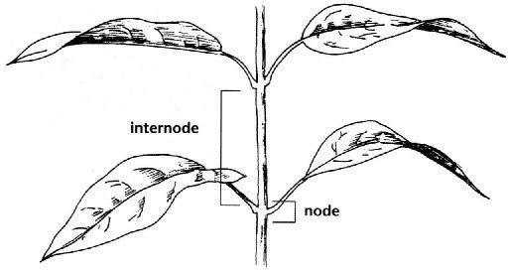
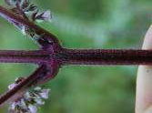
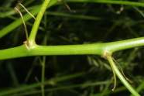
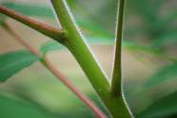
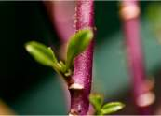
Internode Elongation
Internode: the part of the plant between two nodes or joints.
Node: the part of the stem where stems leaves and buds emerge; point at which stems intersect and branch.

Slide 13
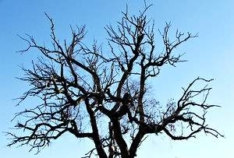
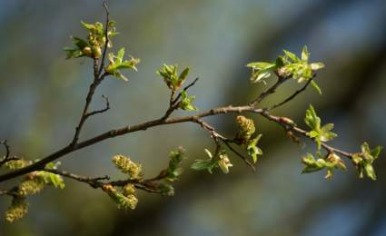
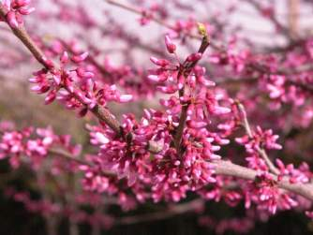
Gibberellin and Cycle Control
How gibberellin in a plant recognizes seasonal changes
Photoperiod: a plant’s recognition of daylight length in a 24 hour period.
As daylight increases in the spring, the plant recognizes a longer photoperiod. Gibberellin triggers the plant to exit dormancy.

Slide 14
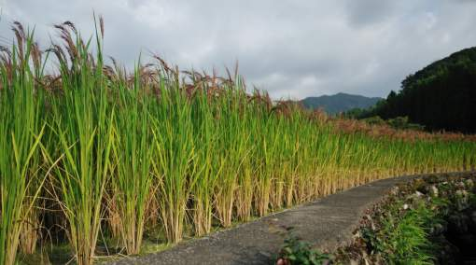
Why is it called Gibberellin?
Japanese rice farmers discovered a fungus (Gibberella fujikuroi) that caused an increase in this hormone.
From this, they learned that plants have a hormone that causes shoot and seed growth.
They named this hormone, “Gibberellin”,
after the fungus.

Slide 15
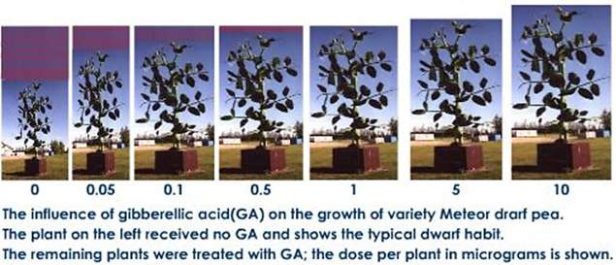
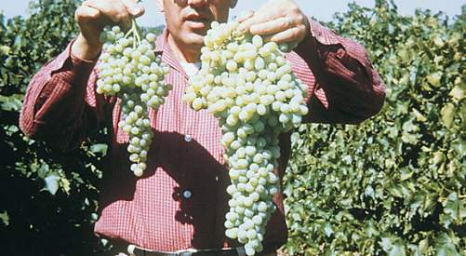
Gibberellin Growth Effects
Increases plant height
Increases fruit size

Slide 16
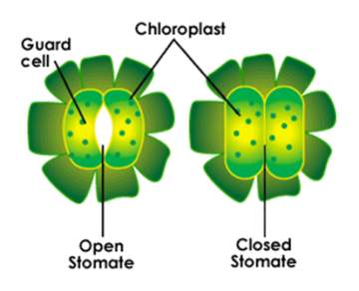
Abscisic Acid
Role of Hormone | Dormancy
Site of Production | Chloroplasts
Effect of Hormone | Enters dormancy: (leaves drop off trees, seeds fall, the stomata close to reduce water loss during drought stress)

Slide 17
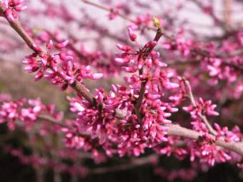
Abscisic Acid
Abscisic Acid in a plant recognizes seasonal changes
Dormancy: a period of no growth
As daylight decreases in the winter, the chloroplasts in the plant recognize a shorter
photoperiod.
Abscisic Acid triggers the plant
to enter dormancy.
The flowers, seeds and leaves fall from the trees

Slide 18
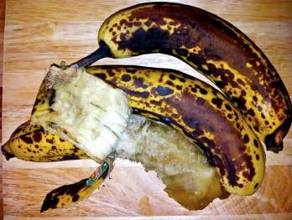
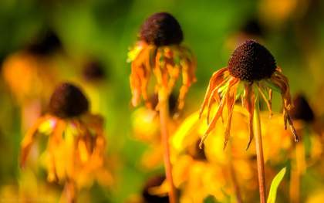
Ethylene
Role of Hormone | Ripening and Death
Site of Production | Ripening fruits, aging flowers, germinating seeds and wounded tissues
Effect of Hormone | Stimulates fruits to ripen, flowers to enter senescence (to grow old and die)

Slide 19
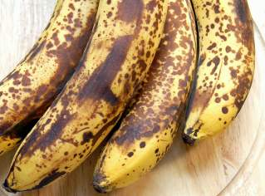
What causes my fruits and veggies to go bad?
The answer is ETHYLENE!
Ethylene is the only plant hormone that exists in a gas form.
It can be synthesized from anywhere in the plant. It can even diffuse outside the origin plant and affect another plant nearby.

Slide 20
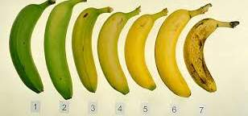
Is Ethylene good or bad?
A gas that speeds up plant death?!! How is this good news?!
Examples: flowers or fruit that are not “ripe” need ethylene to reach their peak

Slide 21
If the amount of Auxin is greater than Cytokinins…
How do these Hormones Work Together?
Auxin
Cytokinis
Shoots grow less rapidly, while root growth is dramatically increased

Slide 22
If the amount of Cytokinins is greater than Auxin…
How do these Hormones Work Together?
Cytokinin
Auxin
Shoot growth is dramatically increased,
while roots grow is less rapidly.

Slide 23
If the amount of Cytokinins is greater than Auxin…
How do these Hormones Work Together?
Abscisic Acid
Gibberellin
Flowers are no longer blooming and leaves begin to fall from the trees.

Slide 24
If the amount of Cytokinins is greater than Auxin…
How do these Hormones Work Together?
Gibberellin
Abscisic Acid
Green leaves and flowers begin to regrow. This usually occurs in the spring time.

Slide 25
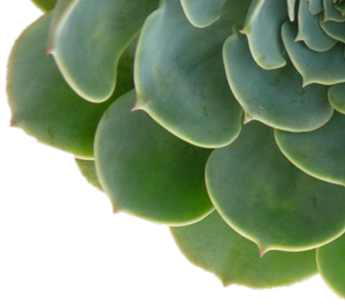
In summary…
Auxin | Produces Roots Cell elongation Acts through tropism responses
Cytokinin | Produces new Shoots Mitosis of new cells Seed Germination
Gibberellin | Promotes Internode elongation Controls yearly cycles
Abscisic Acid | “Dormancy hormone” Causes leaves to drop and stomatas to close
Ethylene | “Death Hormone” Speeds up ripening and senescence
Notes:
© Partnership for Environmental Education and Rural Health at
College of Veterinary Medicine & Biomedical Sciences, Texas A&M University
Funding support from the National Institutes of Health Office of Research Infrastructure Programs (ORIP)

