Slide 1
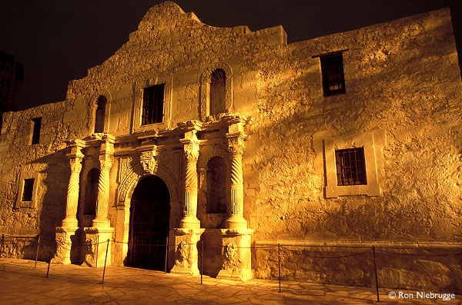
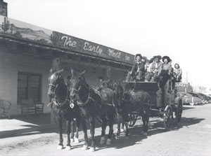
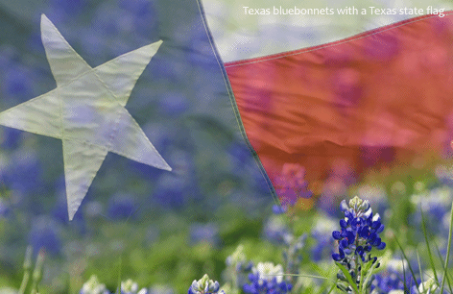
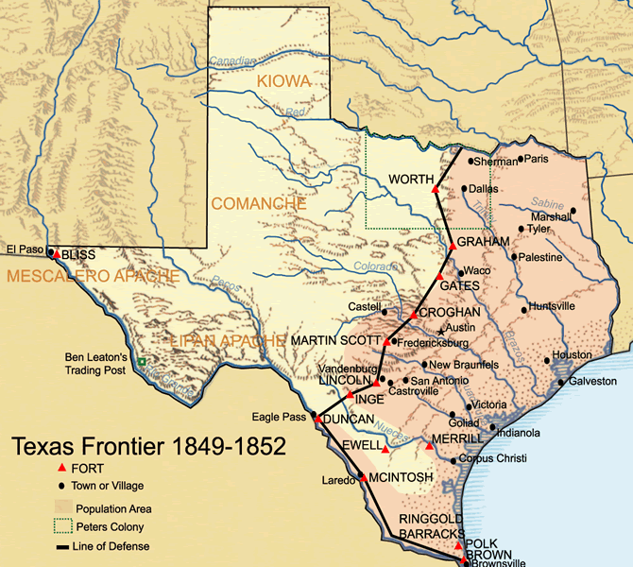
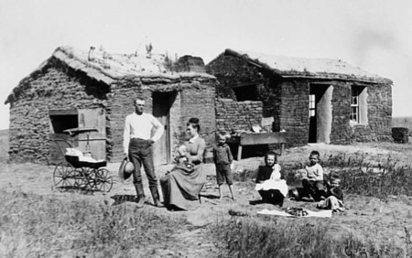
Settlers in Texas
Diane Tomlinson 2009/2010

Slide 2
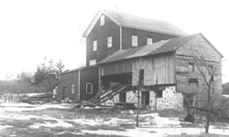
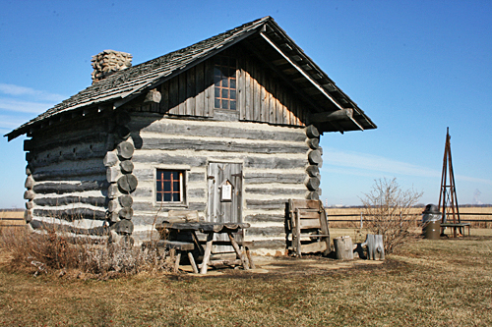
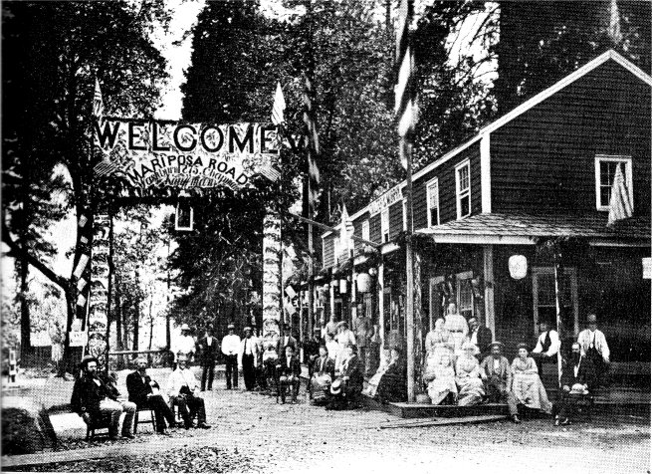
Everyday Settler Life
Growing, collecting, preserving, and capturing food.
Building and maintaining a homestead.
Journeys to the mill or a trading town.
Celebration of life occurrences.
SAWMILL
HOMESTEAD
TOWN CELEBRATION

Slide 3
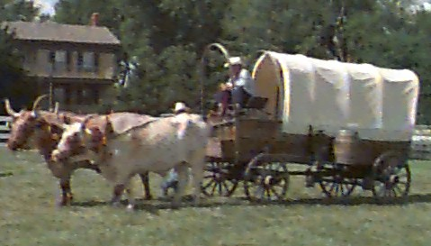
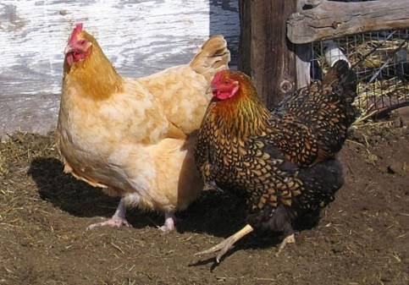
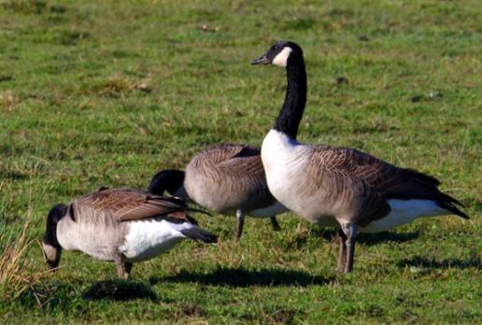
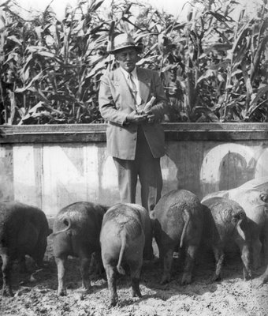
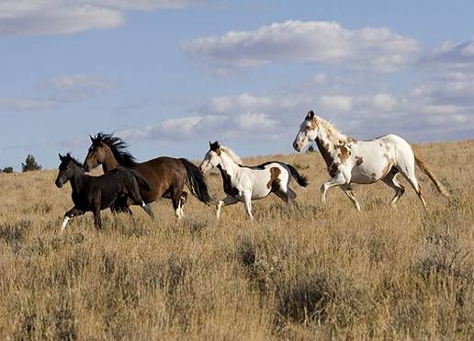
Farm Animals
Animals were very important to settlers. Pioneers relied on animals for food, clothing, and manual labor.
Oxen
Chickens
Geese
Horses
Pigs

Slide 4
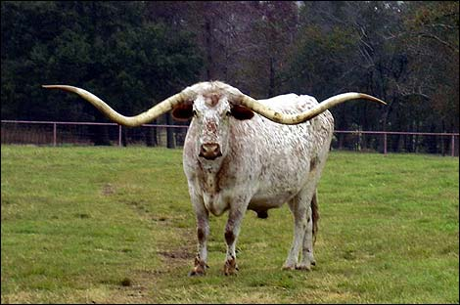
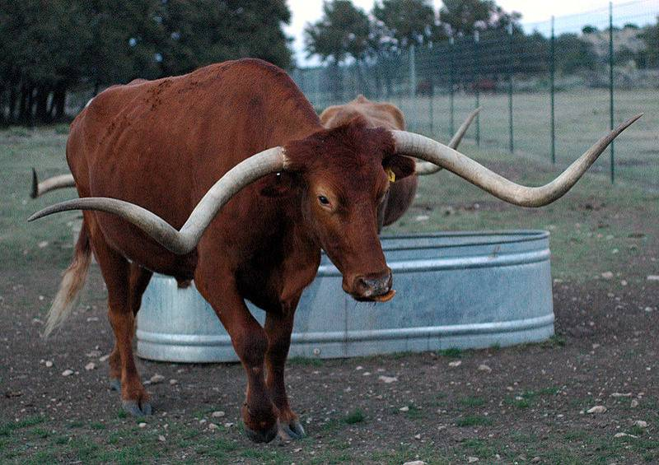
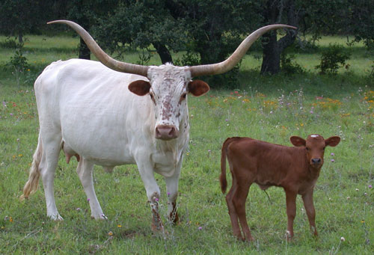
The Texas Longhorn
Brought to Texas near the Sabine River in 1690 from Mexico
Only breed of Cattle to have adapted in the Americas without human intervention
Saved Texas’ economy after the Civil War
Largely replaced by other breeds on ranches and thus approached Extinction by early 1900s
Very lean and healthy meat with less calories and cholesterol than chicken!
Very hardy and robust animal for extreme cold and heat.
High fertility rate.

Slide 5
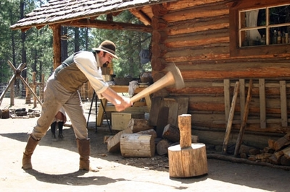
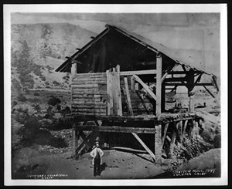
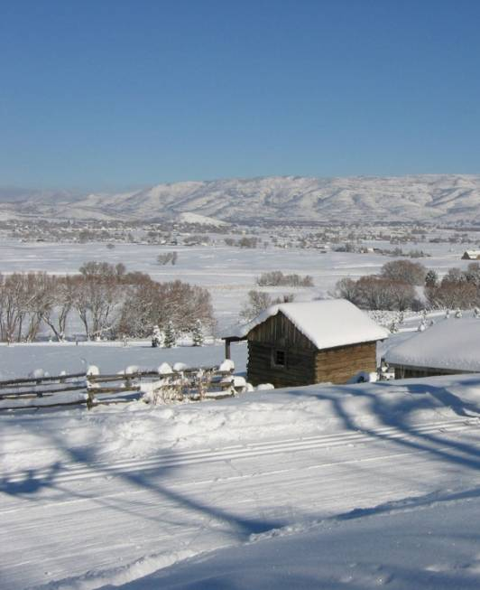
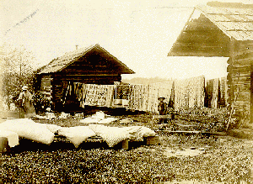
Agriculture
Break down the forest with an axe.
Build dams, mills, and homes using the logs from the forest.
Prepare your fields and your family for harsh, barren winters.
Store and preserve what you harvest and kill for these colder, less fruitful months. Meat can often be stored by smoking it and salting it.

Slide 6
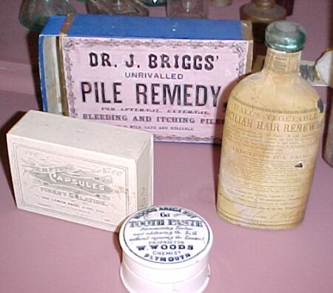
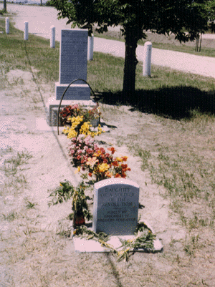
Illness
Along the journey to the frontier of America, many young children perished from famine or disease…
Even once a community was established, life expectancy during this time period was very low (mid 30s).
Due to lack of sanitary, intelligent medical care, the infant mortality rate remained high through this period.

Slide 7
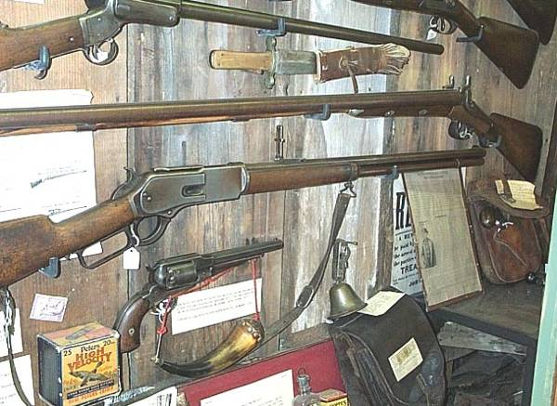
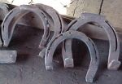
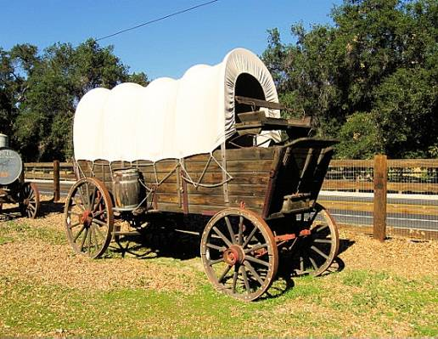
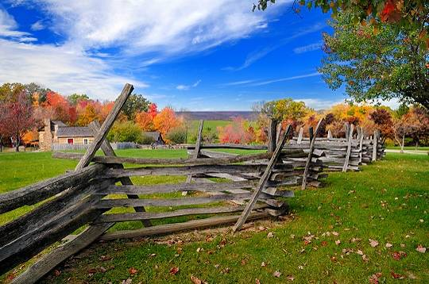
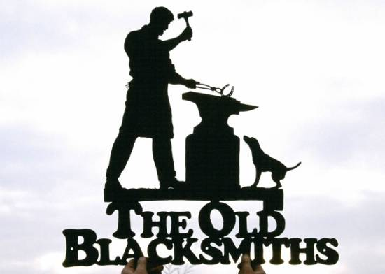
Daily Tools & Other Inventions
AXE
BLACKSMITHS
PIONEER FIREARMS
CONESTOGA WAGONS
FENCING

Slide 8
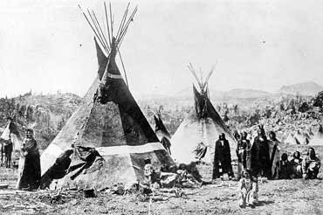
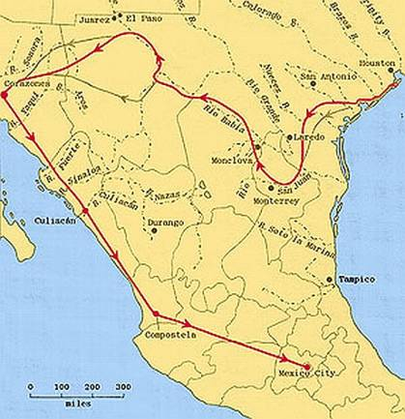
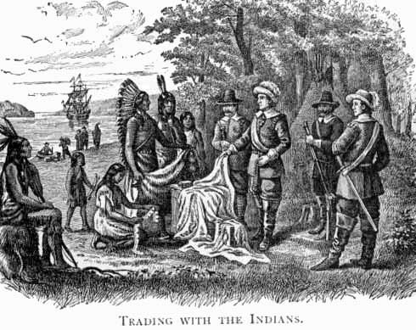
The Texas Timeline!
1500: Indian Tribes occupy the region between the Rio Grande and the Red River.
1528: Cabeza de Vaca shipwrecks on Galveston Island, and later explores the Texas coastline.
Late 1500s and 1600s: Several explorers make their way across Texas. This includes La Salle, Coronado, Cavelier, de Leon, and many others.
1700s: Spain is establishing missions across
Texas to colonize and “civilize” the Indians.

Slide 9
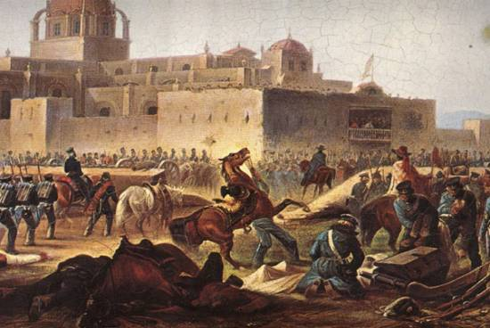
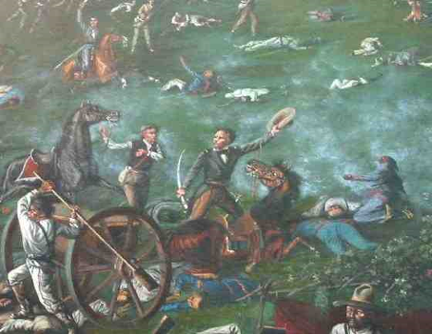
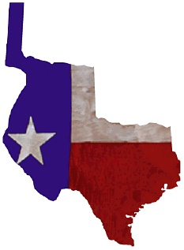
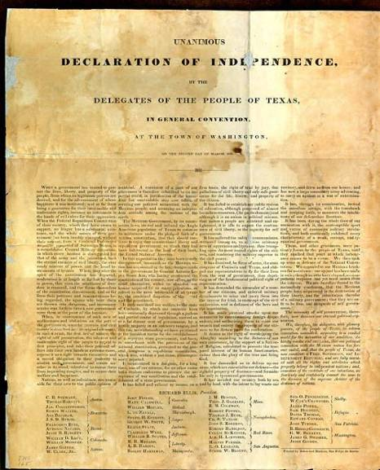
1800-1834: Relations between Texas and Mexico are deteriorating and becoming violent. (Battle of Velasco, 1832)
1835: THE REVOLUTION BEGINS with the Battle of Gonzales, and later that year, the Battle of Goliad.
March 2, 1836: The Texas Declaration of Independence is signed!
The Republic of Texas

