Slide 1
Small Animal
Skeletal Systems

Slide 2
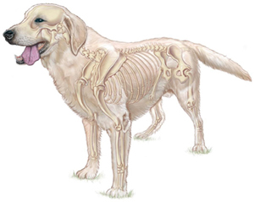
Functions of the Skeletal System
Form
Protection
Support
Strength

Slide 3
How does it work?
Bone- Hard tissue that supports and protects other organs
  Cartilage- Firm, flexible tissues that are not as hard as bone
Ligaments- Tissue that connects bone to bone
Tendons- Tissue that connects bone to muscle
Joints- Where bones meet and allows for movement

Slide 4
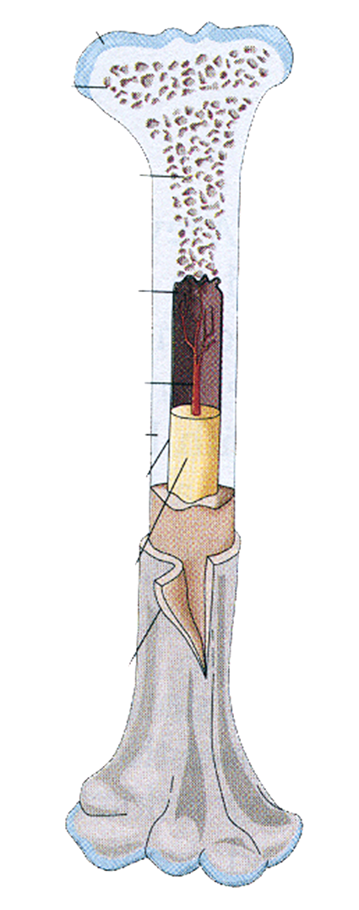
Bones
Spongy bone
  Fills ends of bones and lines hollow portions
Red marrow
  Inside cavities of spongy bone, formation of red blood cells
Yellow marrow
  Fat and energy storage
Compact bone
  Layer of hard mineral matter, Calcium, gives bones strength
Periosteum
  Outer most layer, Cushions the hard portion of the bone, Repair of broken bones

Slide 5
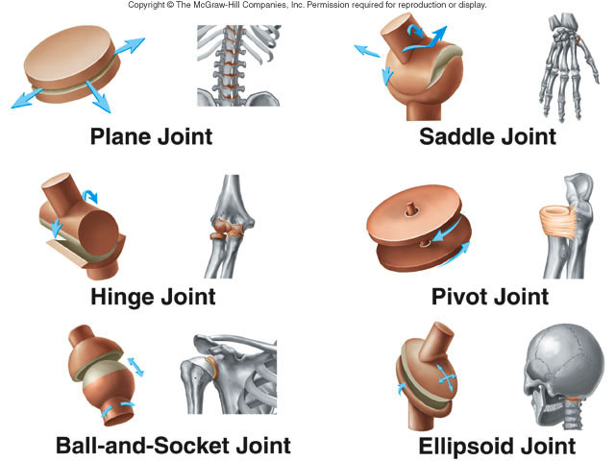
Joints

Slide 6
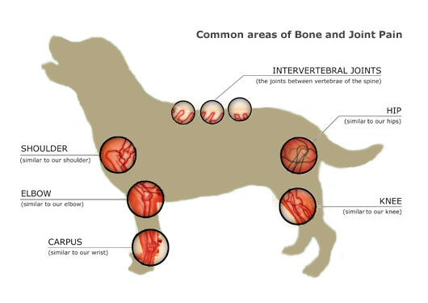
Joints
Plane Joint
Ball&Socket Joint
Ball&Socket Joint
Hinge Joint
Hinge Joint
Ellipsoid Joint

Slide 7
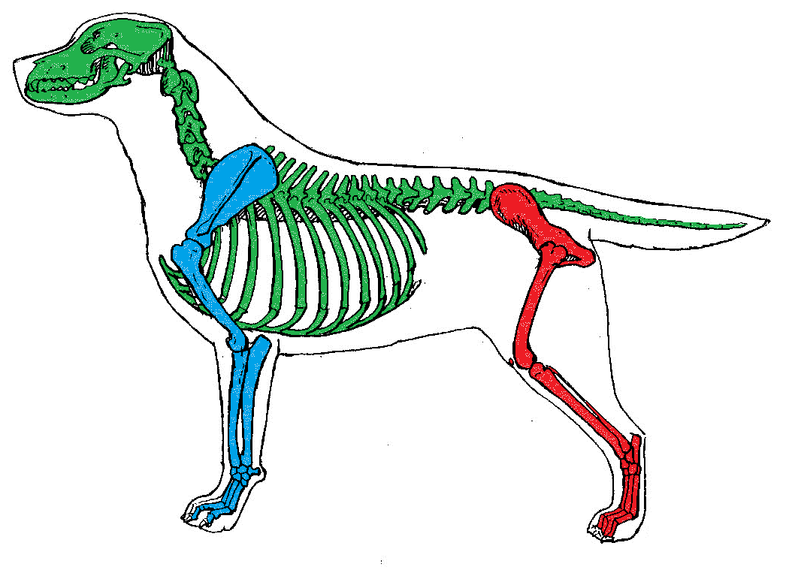
Parts of the Skeleton
  Axial - central axis bones
  Pectoral - bones of the fore limbs
  Pelvic - bones of the hind limbs

Slide 8
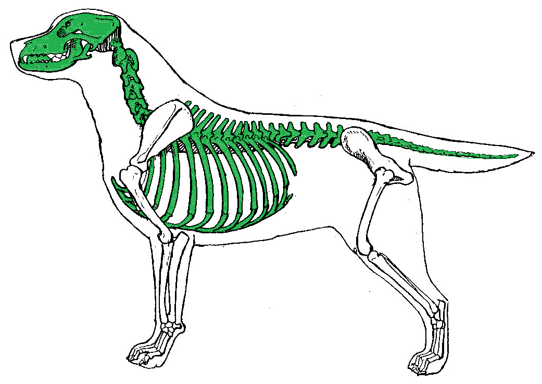
Bones of the Axial Skeleton
Skull
  Maxilla
  Mandible
Vertebrae
  Cervical Vertebrae
  Thoracic Vertebrae
  Lumbar Vertebrae
  Sacrum
  Caudal Vertebrae
Ribs
Sternum

Slide 9
Maxilla
Cervical
Thoracic
Lumbar
Caudal
Mandible
Sacrum
Ribs
Sternum
Notes:
Note: the Sacrum is three, small fused vertebrae in between the lumbar and caudal vertebrae not well seen in this picture but there!

Slide 10
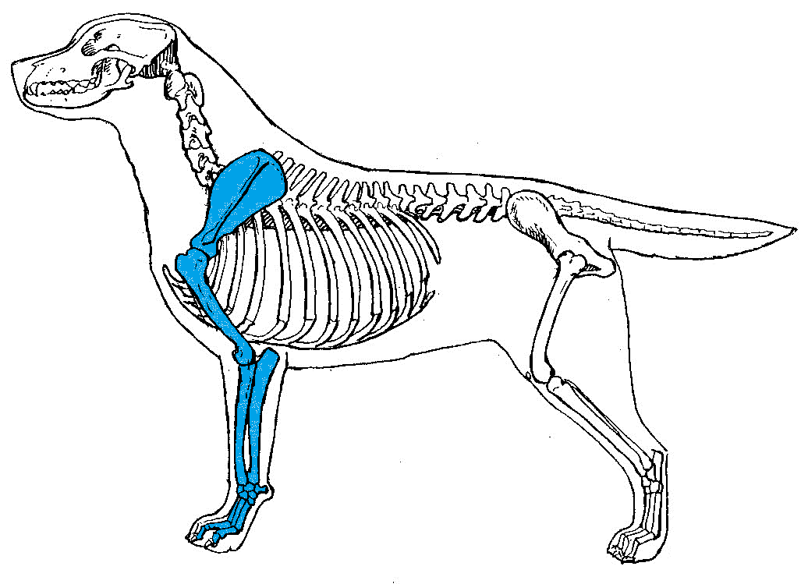
Bones of the Pectoral Skeleton
Scapula
Humerus
Radius
Ulna
Carpus
Metacarpus
Phalange

Slide 11
Scapula
Humerus
Radius
Carpus
Ulna
Metacarpus
Phalange

Slide 12
Bones of the Pelvic Skeleton
Pelvis
  Ilium
  Ischium
Femur
Patella/Rotula
Tibia
Fibula
Tarsus
Metatarsus
Phalange

Slide 13
Ilium
Pelvis
Ischium
Femur
Patella
Tibia
Fibula
Metatarsus
Tarsus
Phalange

Slide 14
Lets look at the
Skeletal Systems of different Small Animals!!

Slide 15
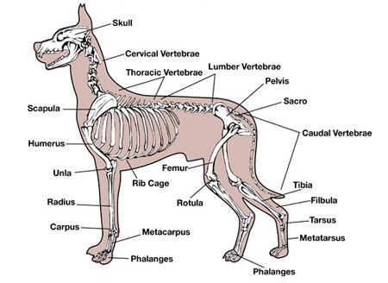
Dog

Slide 16

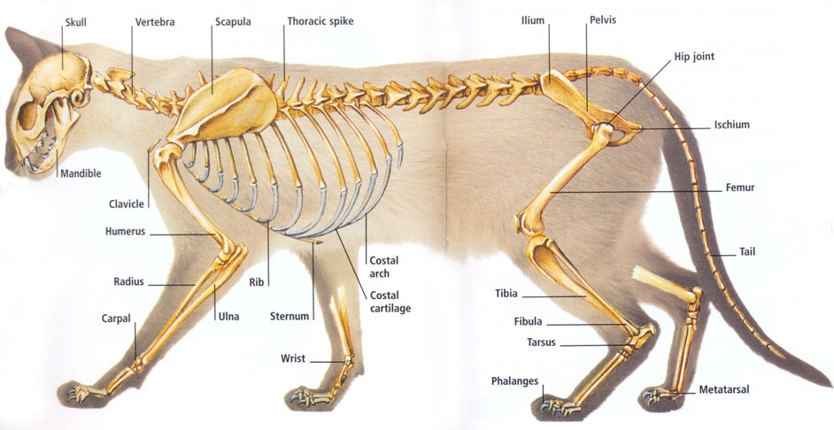
Cat

Slide 17
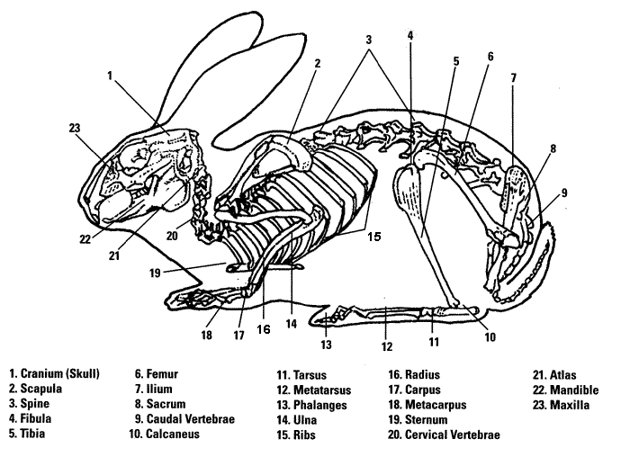
Rabbit

Slide 18
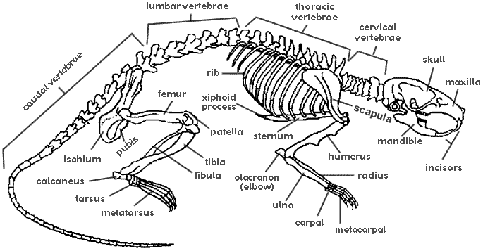
Rat

Slide 19
Can you Name the bones?

Slide 20
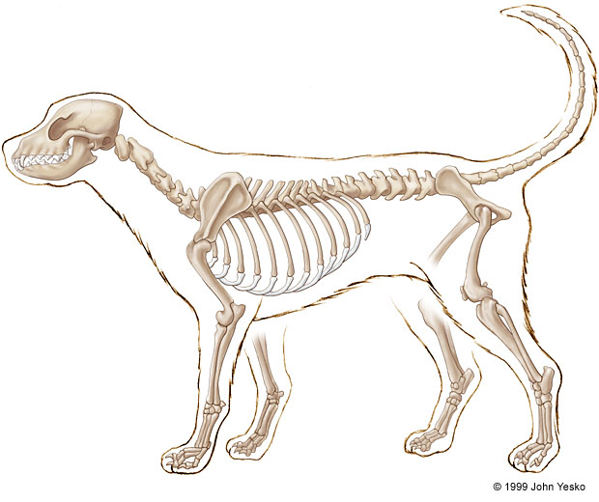
Dog
1
2
5
3
4
Notes:
Maxilla
Scapula
Ulna
Radius
Tarsus

Slide 21
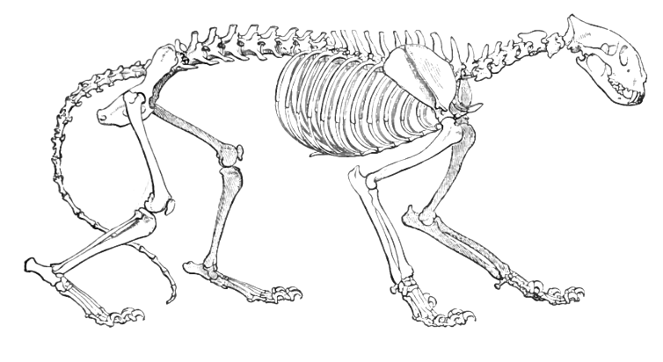
Cat
3
2
5
1
4
Notes:
Caudal vertebrae
Ischium
Ilium
Patella
Mandible

Slide 22
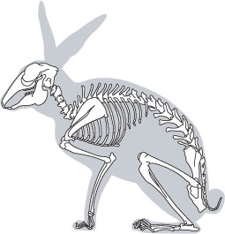
Rabbit
2
1
3
4
5
Notes:
Mandible
Cervical Vertebrae
Lumbar Vertebrae
Femur
Humorous

Slide 23
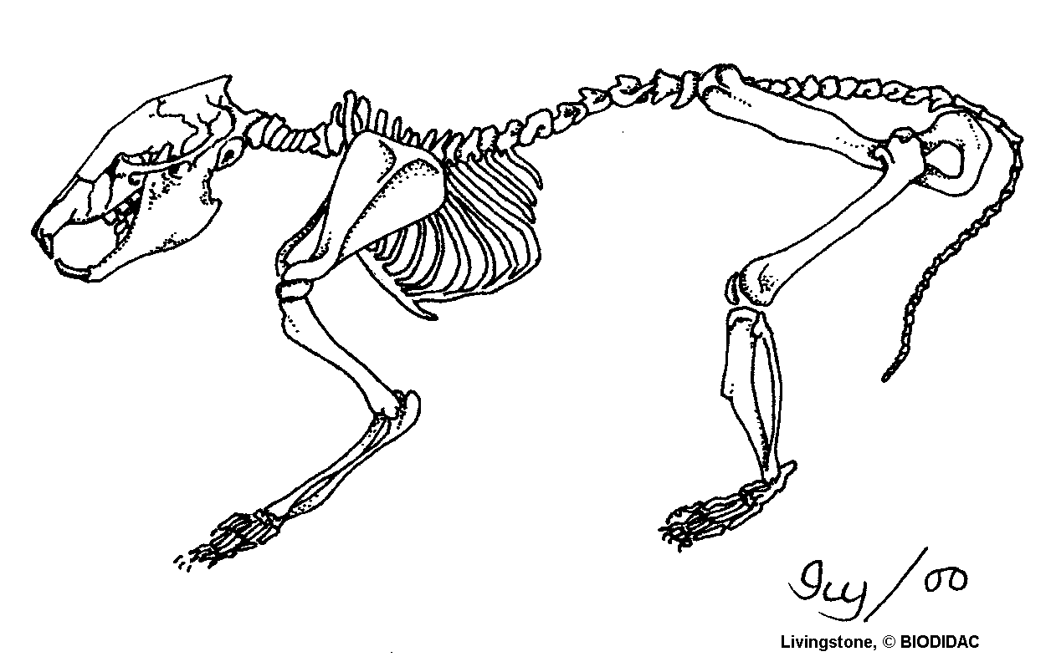
Rat
5
4
1
2
3
Notes:
Sternum
Tibia
Fibula
Thoracic Vertebrae
Pelvis

