Slide 1
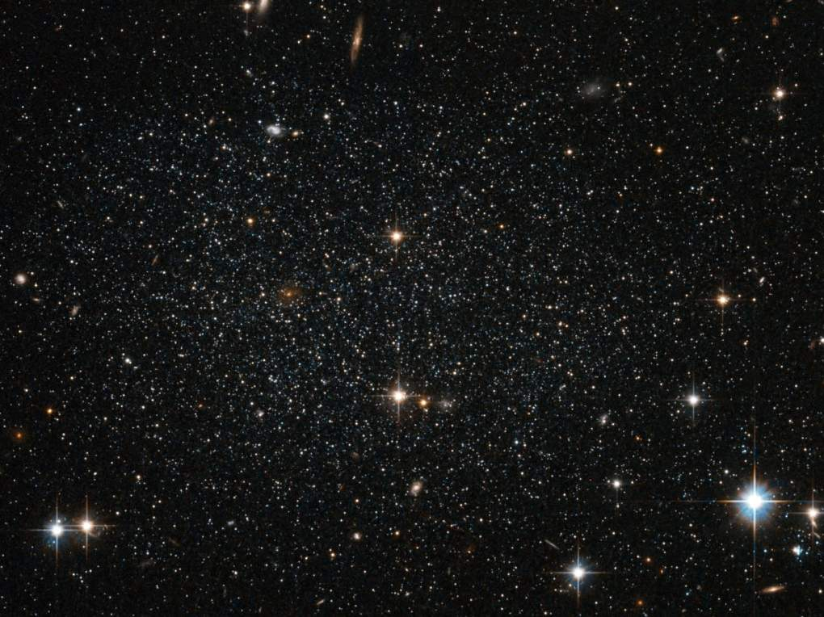
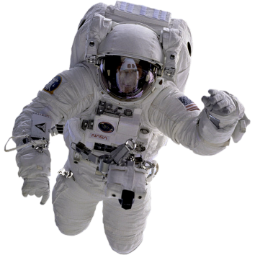
Space Exploration
Notes:
7.9B identifying the accommodations, considering the characteristics of our solar system, that enabled manned space exploration

Slide 2
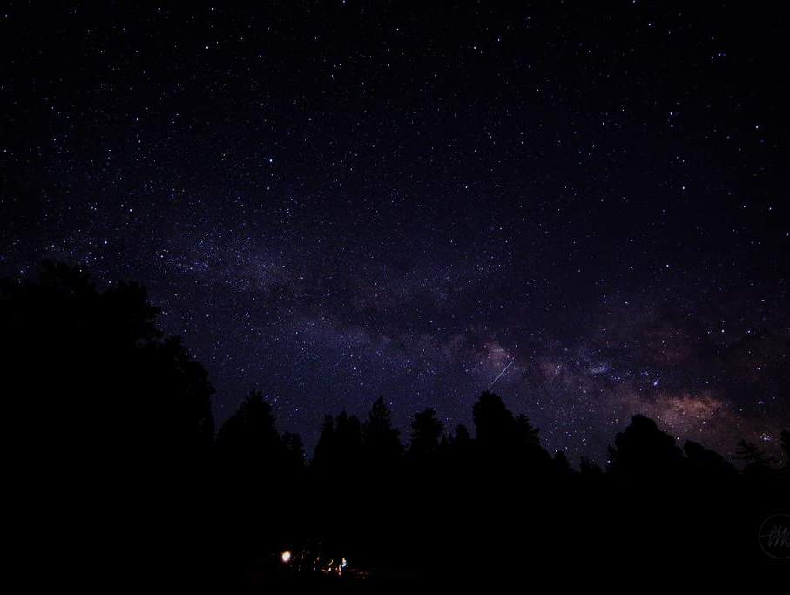
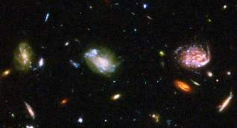
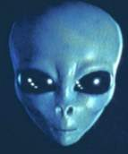
What is out there?
Mankind has always looked up at the moon and stars and wondered about life in the universe.
“The first of these factors is the compelling urge of man to explore and to discover, the thrust of curiosity that leads men to try to go where no one has gone before. Most of the surface of the earth has now been explored and men now turn on the exploration of outer space as their next objective.” – Introduction to Outer Space, pamphlet produced in an effort to garner support for a national space program in the wake of the Sputnik flight.

Slide 3
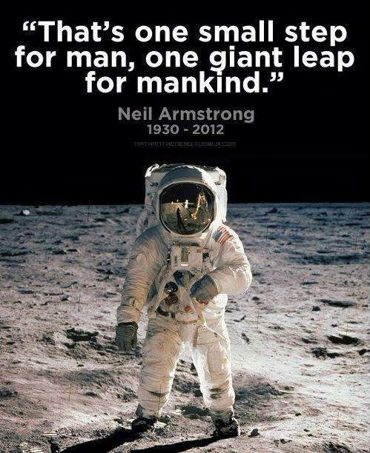
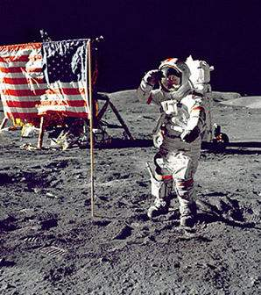
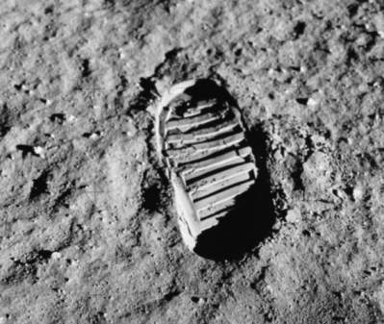

Slide 4
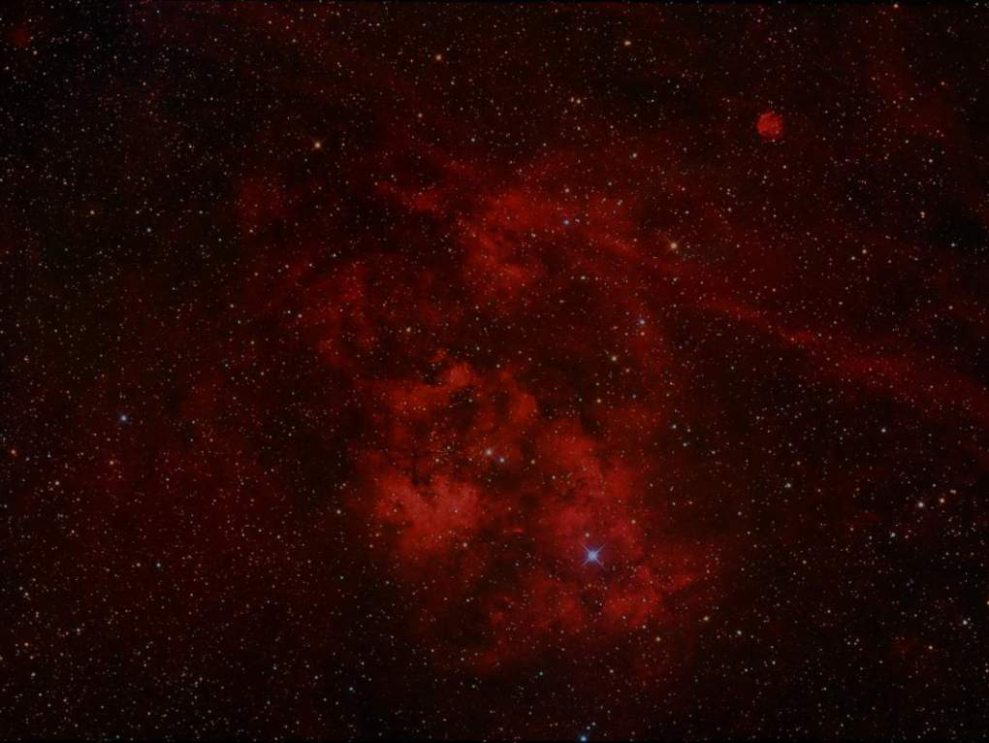
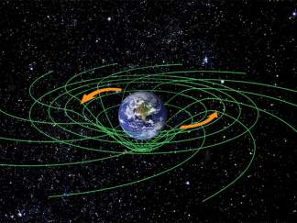
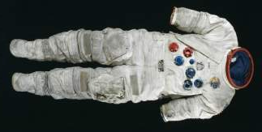
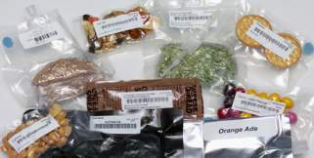
What allows us to explore space?
A combination of characteristics of our solar system
and human accommodations.
Characteristics of our solar system
Gravity
  Slingshot effect
Atmosphere
Distances
Human accommodations
Protective suits
  Pressure
  Temperature
  Effects of microgravity
  Air systems
Food supply
Waste management

Slide 5
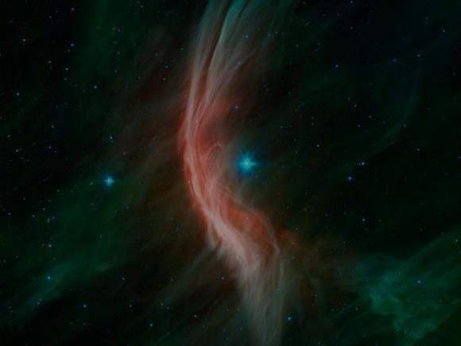
Why can’t we breathe in space?
Earth’s atmosphere has pressure that allows water to exist in liquid form, protects us against harmful radiation from the sun, and allows us to breathe due to nitrogen/oxygen content.
Since space is essentially a vacuum, there is no air at all. The density of oxygen in space is so miniscule that oxygen can be barely detected even with our most sensitive detectors. Due to this, astronauts are equipped with air systems when they leave their spacecraft.

Slide 6
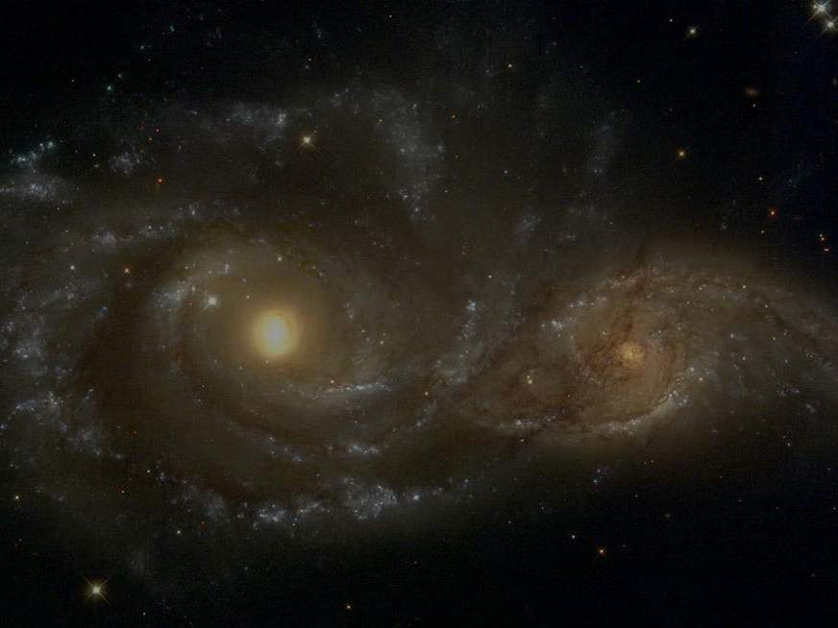
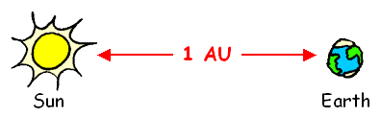
Distance of Earth from Sun: ~93,000,000 miles
Distance of Moon from Earth: ~239,000 miles
The universe is so large that our units of measurement are too small to measure it.
Because of this, we define astronomical unit (AU) as the distance between the Earth and the Sun.
1 AU = ~93,000,000 miles
Light years are also a measure of distance, most often used to express distances to stars.
1 light year = ~63,000 AU
Nearest star is about 4.25 light years from Earth.

Slide 7
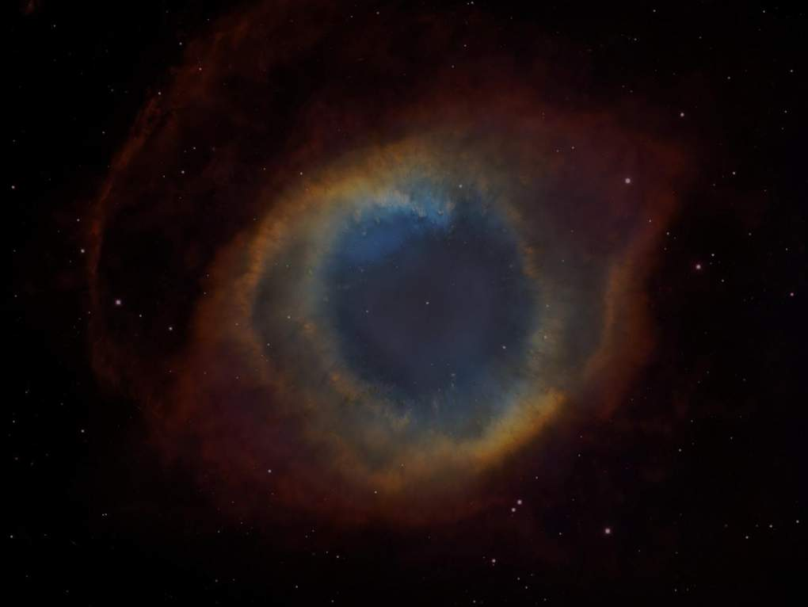
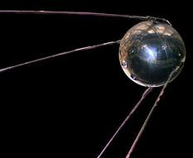
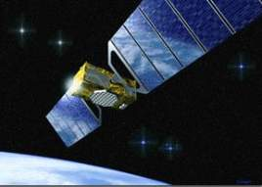
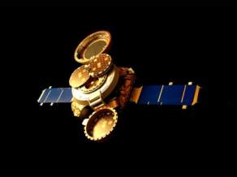
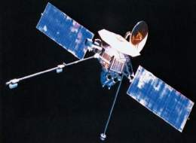
Manned exploration is possible due to satellites and probes.
Before man was sent to space, satellites and probes were launched into space to collect information such as temperature, radiation, objects in space, pictures, gravity fields, and atmospheric density.
Probes also expose material from the earth to the conditions of space, allowing scientists to observe the effects of space on that material.

Slide 8
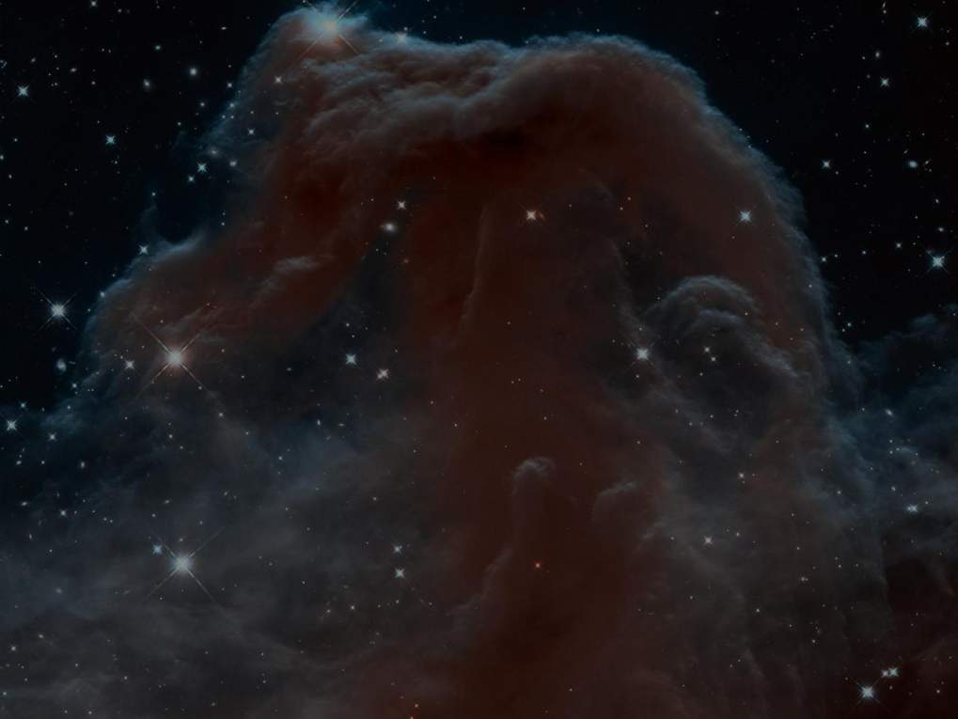
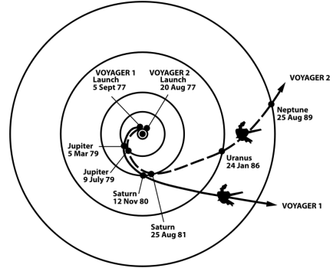
Probes escape the gravitational pull of planets by the slingshot effect.
Voyager 1 is the farthest probe from Earth, at a distance of ~125 AU as of July 2013.
  The slingshot effect acts as a gravitational assist by using energy from gravitational fields of planets or moons to change the speed or shape of a spacecraft’s orbit.
    Passing by planets can result in the spacecraft being accelerated, without firing any thrusters to save fuel during missions.
Voyager 1 & 2 Trajectories
Notes:
YouTube clip 1:18 of Voyager 1 and 2’s Trajectories

Slide 9
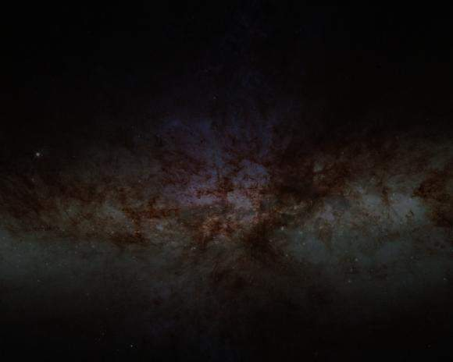
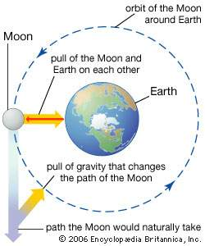
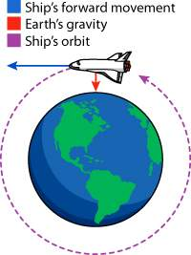
What allows us to remain in orbit around Earth?
Just as gravity allows the moon to orbit around Earth, a spacecraft takes advantage of this same phenomenon to stay in orbit around the Earth.
In space, the effects of gravity are greatly reduced. NASA calls this condition microgravity.
Notes:
Vacuum - A volume of space mostly empty of matter such as oxygen to breathe

Slide 10
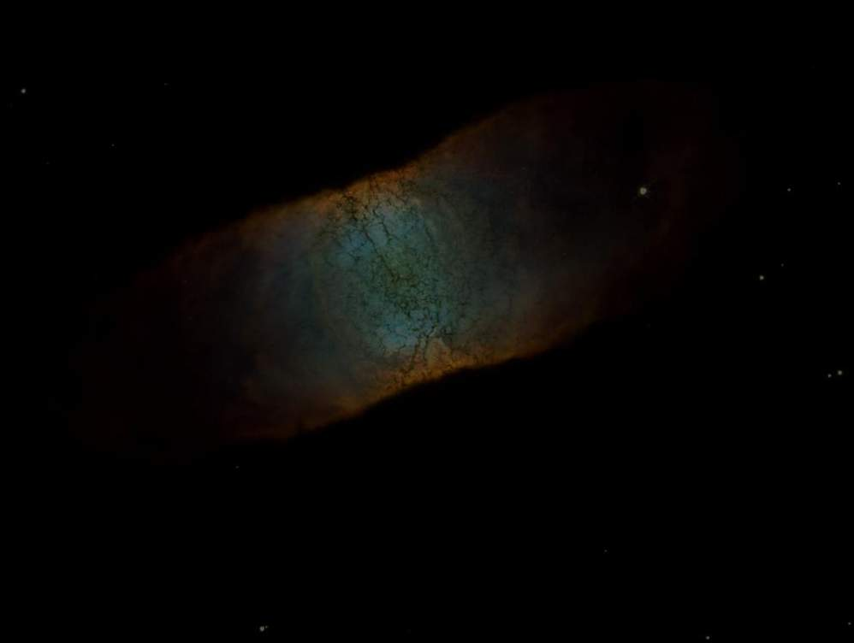
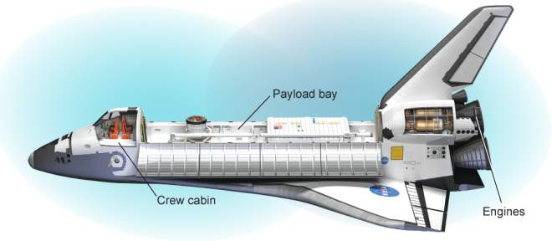
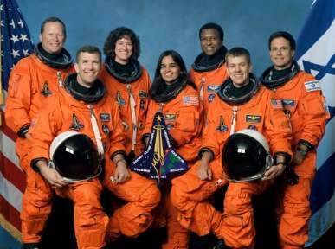
What are space shuttles?
A space shuttle is a reusable spacecraft. A space shuttle carries a crew and equipment into space, returns to Earth, and then is reused for the same purpose. Most shuttle missions last an average of nine days.

Slide 11
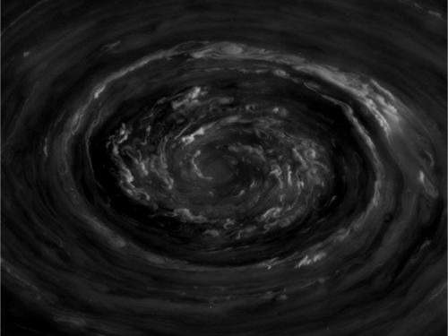
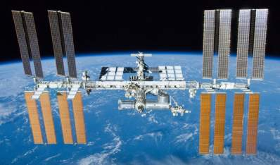
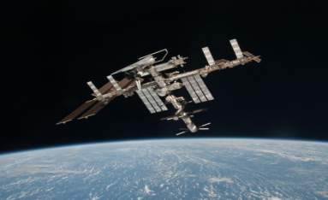
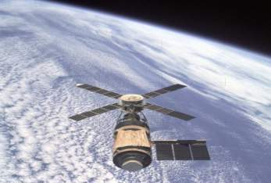
What are space stations?
The International Space Station (ISS) is a joint effort between multiple agencies consisting of US, Russia, Japan, Canada, Brazil, and Europe.
A space station allows long-term observations and experiments to be carried out in space. Space shuttles are used to take people and supplies from Earth to the space station. Most astronauts stay on the space station for four to six months.

Slide 12
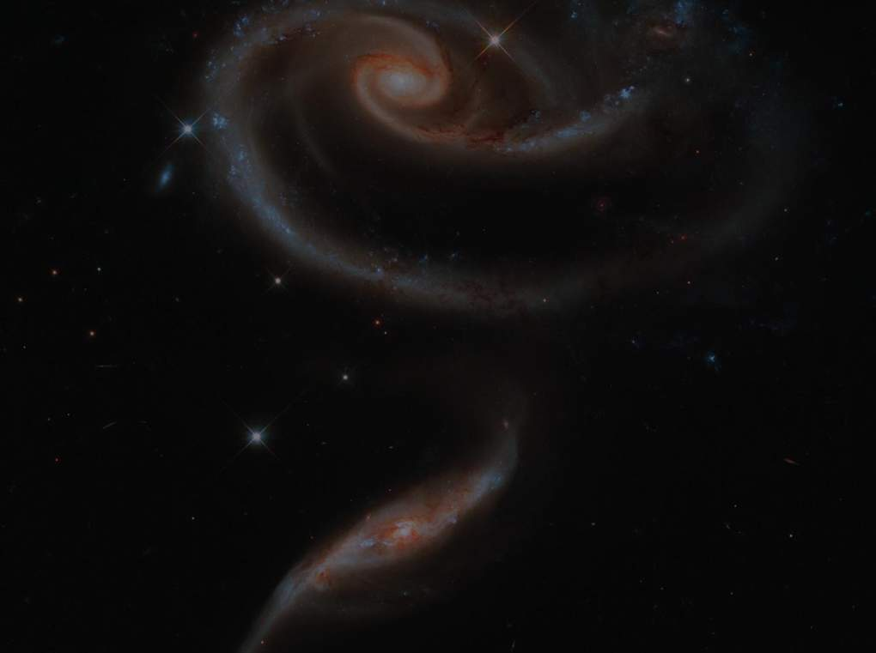
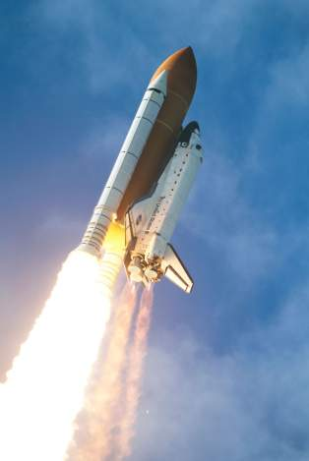
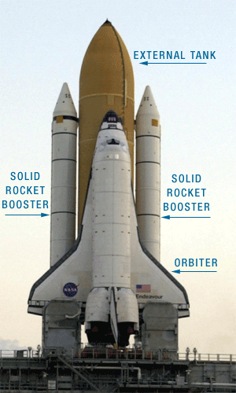
How do shuttles leave the ground?
The Space Shuttle consists of 3 main components; the Orbiter, a large External Tank, and two Solid Rocket Boosters.
The External Tank contains a little over 500,000 gallons of liquid hydrogen and liquid oxygen, which is used as fuel. With the aid of the Solid Rocket Boosters, the External Tank pushes the shuttle off of the Earth and into low Earth orbit. Low Earth orbit is anywhere from 99 to 1,200 miles above Earth.
http://www.youtube.com/watch?v=OnoNITE-CLc

Slide 13
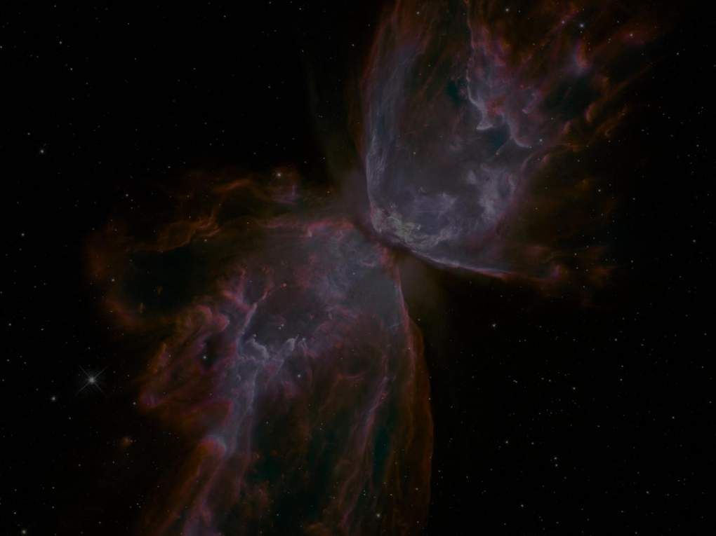

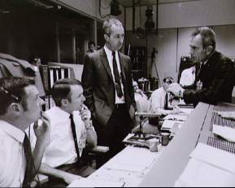
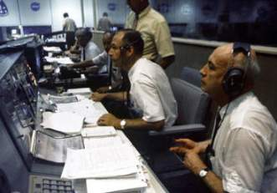
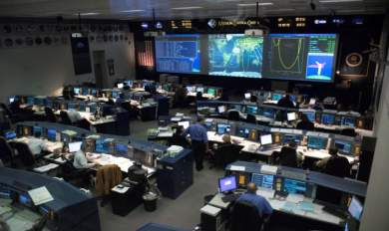
Mission control plays critical role in keeping astronauts safe and helping them complete tasks during spacewalks.
America’s human space program is managed by a facility in the Lyndon B. Johnson Space Center in Houston, Texas.
Teams of experienced engineers and technicians monitor systems and activities aboard spacecraft 24 hours a day during missions from long before lift-off and during touchdown.
  Teams are in charge of tracking the spacecraft, calculating maneuvers, telling astronauts what time to burn, telling astronauts what to do and where to go, etc.

Slide 14
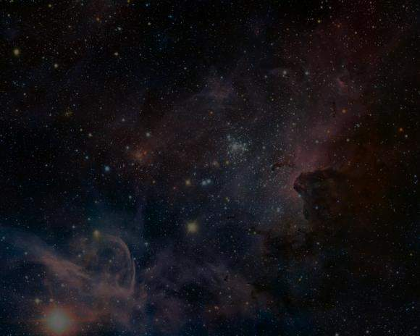
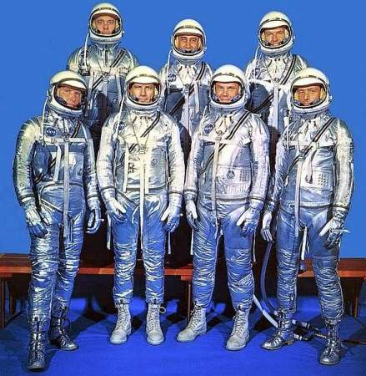
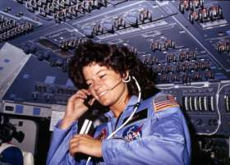
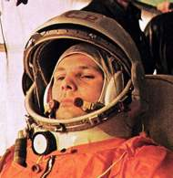
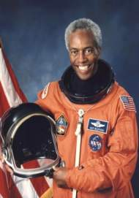
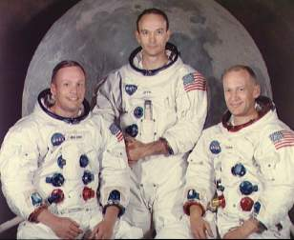
What is an astronaut?
A person trained to be part of a spacecraft crew.

Slide 15
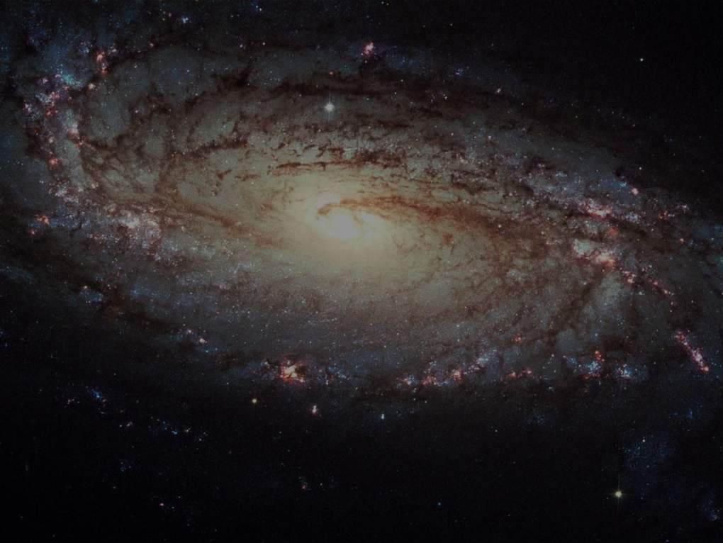
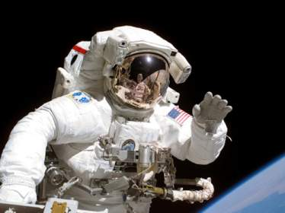
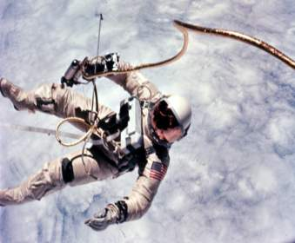
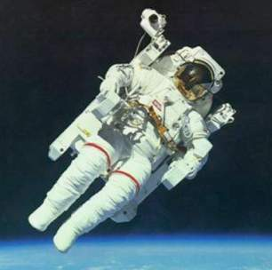
What are space walks?
An activity in which an astronaut moves around and does work outside of the spacecraft while in space.
Spacewalks are also referred to as extravehicular activity (EVA).

Slide 16
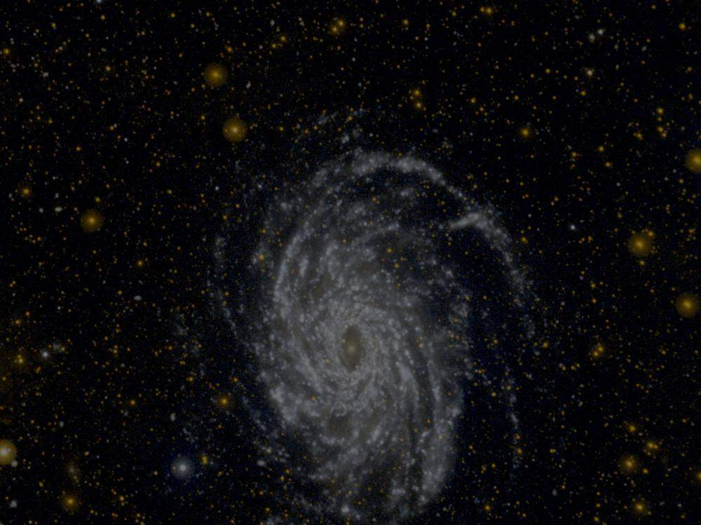





Why do astronauts go on spacewalks?
Astronauts can do science experiments on a spacewalk. Experiments can be placed on the outside of the spacecraft. This lets scientists learn how being in space affects different things.
Spacewalks also let astronauts test new equipment. They can repair satellites or spacecraft that are in space. By going on spacewalks, astronauts can fix things instead of bringing them back to Earth to get fixed.

Slide 17




Space suits protect astronauts during space walks.
Outer space is an extremely hostile place.
Without a suit, you face the following hazards:
Become unconscious due to lack of oxygen.
Blood and bodily fluids could boil and then freeze due to lack of pressure.
Tissues would expand due to boiling fluids.
Extreme changes in temperature.
Exposure to various types of radiation.
Hit by meteoroids or orbiting debris.
Space Suits
Notes:
Space Suits – YouTube clip 5:16

Slide 18





What are space suits?
A complex system of garments that allow astronauts to work safely outside their spacecraft by:
  Regulate pressure, temperature, and the effects of microgravity
  Maintain oxygen through air systems
  Protect from meteoroids, debris, and radiation
  Allow sight and easy mobility
  Keep communication with space shuttle

Slide 19


Suits look inflated because they are pressurized to keep the fluids in an astronauts’ body in a liquid state.
Space suits operate below the normal atmospheric pressure.
Suits provide a pure oxygen atmosphere for breathing because the low pressure would cause dangerously low oxygen concentrations in the lungs and blood if normal air is used.
In the confined space of the suit, carbon dioxide concentrations would build up to deadly levels. Therefore, space suits contain special canisters to remove carbon dioxide.

Slide 20


Temperature of the space suit is regulated by heavy insulation with layers of multiple fabric in conjunction with reflective outer layers to reflect sunlight. Heat produced from an astronaut’s body can be dangerous if it is not removed. Excess heat is removed by using water-cooled garments.
Communication with ground controllers and other astronauts is maintained by radio transmitters/receivers.

Slide 21




Astronauts are protected from collisions with micrometeoroids due to multiple layers of durable fabrics such as Kevlar.
Astronauts are protected from radiation by reflective coatings built into the suits. However, suits are not protection against a solar flare and, thus, spacewalks are planned during periods of low solar activity.
Helmets are made of clear, durable plastic that can reflect sunlight. Tinted visors are also used to reduce glare. Prior to a spacewalk, the inside faceplates of the helmet are sprayed with an anti-fog chemical. Helmets also have mounted lights and cameras.
Space suits are equipped with special joints for easy mobility.
Micrometeoroid
Impact!

Slide 22




There are many types of spacesuits that have been used in the past by astronauts.
Let’s look at America’s Extravehicular Mobility Unit (EMU) currently in use.

Slide 23


Modern EMU
13 layers of material including an inner cooling garment, pressure garment, thermal micrometeoroid garment, and outer cover.

Slide 24



Modern EMU
Multiple parts work together to protect the astronaut from the hazards of space.

Slide 25


Special systems aid astronauts in spacewalk.
The Manned Maneuvering Unit (MMU), a astronaut propulsion unit, was used in 1984 to retrieve faulty communications satellites.
  Fits over life-support system backpack.
  Astronaut used fingertips to manipulate hand controllers at the ends of the MMU’s two arms.
  Deemed as too risky for further use.

Slide 26


MMU’s successor
The Simplified Aid for EVA Rescue (SAFER) is a small propulsive backpack system intended for emergency use only.
Means of self rescue should an astronaut become untethered during a spacewalk.
Worn by every crew member using an EMU.
Notes:
YouTube clip of the trailer for the 2013 film Gravity is hyperlinked to the word “untethered” above. 1:30 minutes
The premise of the movie is an astronaut becomes adrift in space.

Slide 27




Multiple robotic systems aid astronauts in maintaining space craft.
The Mobile Servicing System (MSS) also known as the Canadarm2 is a robotic system equipped on the ISS.
Launched to the ISS in 2001 is a robotic ‘arm’ that can be used to grasp and manipulate objects in space.
It played a key role in space station assembly and maintenance.
Can move equipment and supplies around and support astronauts working in space.

Slide 28




Food
Need to ensure that there is plenty of food.
Some foods can be eaten in their natural form, while others require adding water.
A supplementary food supply pantry exists.
Additional pantry items can be flown to the astronauts incase the flight is unexpectedly extended.

Slide 29




Early Space Food
Early space food consisted of bite-sized cubes, freeze-dried powders, and semi-liquids packaged in aluminum tubes.
This early space food was unappetizing and most astronauts disliked squeezing the tubes.
Freeze-dried foods were hard to rehydrate and crumbs had to be prevented from fouling up instruments.

Slide 30




Current Space Food
Astronauts sample a variety of foods and beverages months before launch.
Astronauts can choose individual meal plans.
Most of the food astronauts eat can be commercially found on grocery store shelves.
Nutritionists ensure the food contain a balanced supply of vitamins and minerals.
Astronauts eat three meals a day plus snacks.
  Salt and pepper are available but only in liquid form.
Types of food available include rehydratable, thermostabilized, irradiated, and natural food items.

Slide 31




Beverages
Come in powdered form.
Include coffee, tea, apple cider, orange juice, and lemonade.
Add a straw after adding water to drink the beverage or…

Slide 32





Food Packaging and Storage
Space food comes in packages that must be disposed in a trash compactor after finished eating.
Food packaging is designed to be flexible and easy to use to minimize space when storing or disposing.
Foil is used to a longer product shelf life.
Velcro on the bottom of food packaging attaches to the meal tray.
All food is precooked or processed so it requires no refrigeration except for any fresh fruit or vegetables.
Meals are stowed in lockers with food packages arranged in the order they will be used.

Slide 33



Proper nutrition plays a critical role in space exploration.
The nutrients astronauts need in space are the same ones we need but in on Earth, but in different amounts.
Sodium and vitamin D influence bone density.
Sodium (Na) is limited because too much can lead to bone loss.
Astronauts have limited sunlight exposure since the spacecraft is shielded to protect astronauts from harmful radiation. Since the body is not able to make vitamin D without sunlight, vitamin D supplements are taken to maintain healthy bones.
Notes:
Na is the chemical symbol for sodium on the periodic table of elements. We get sodium when we eat salt!

Slide 34


Proper nutrition plays a critical role in space exploration.
The nutrients astronauts need in space are the same ones we need but in on Earth, but in different amounts.
Less iron (Fe)!
  Astronauts have fewer red blood cells while in space.
  Red blood cells use iron to help carry oxygen throughout the body.
  Since the astronauts have less red blood cells, the amount of iron we need on Earth would be too much in space.
  Extra iron could build up and cause health problems like liver disease or arthritis.
Notes:
Fe is the chemical symbol for iron on the periodic table of elements.

Slide 35





Why is exercise important in space?
If astronauts don’t exercise, their bodies start losing bone and muscle. Bone and muscle loss mean decreased size and strength.
This would reduce an astronaut’s ability to do work because it makes them weak.
Two and a half hours each day are devoted to fitness.

Slide 36



The weightless environment in space crafts become challenging for waste management.
The collection and retention of liquid and solid waste is directed by the use of air flow.
Solid waste is dried, sealed in a bag, and stored onboard in a trash compactor until landing.
Liquid waste is released into space or recycled through a special water treatment plant and turned back into drinking water.
Notes:
Weightless environment – no force acting on astronauts

Slide 37





Animals in Space
To test the survivability of spaceflight animals were sent to space before humans.
These experiments proved that living passengers could survive being launched into orbit and endure weightlessness.
These animals were space pathfinders for the mutual benefit of man and animals, paving the way for human spaceflight.
Laika, a Soviet space dog, was the first animal in space aboard Sputnik 2 in 1957.
Miss Baker, a squirrel monkey was one of the first animals launched into the space to be recovered alive.
Laika’s monument in Moscow.

Slide 38


Slide 39


