Slide 1
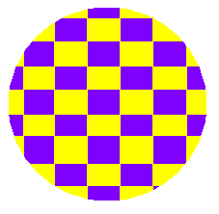
What’s the Matter With Matter?
(And why does it even matter?!)
© Partnership for Environmental Education and Rural Health at
College of Veterinary Medicine & Biomedical Sciences, Texas A&M University
Funding support from the National Institutes of Health Office of Research Infrastructure Programs (ORIP)

Slide 2
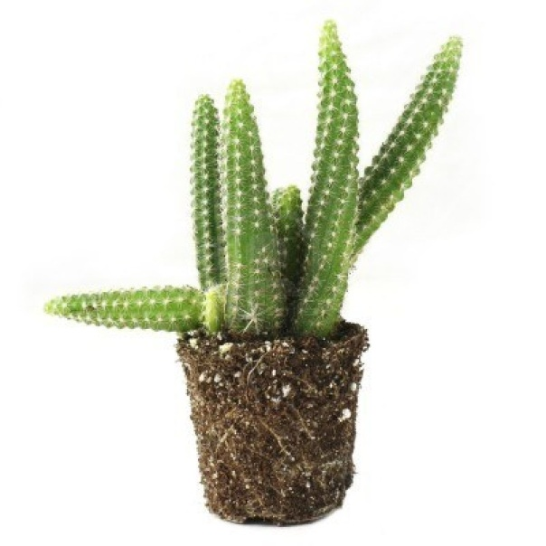
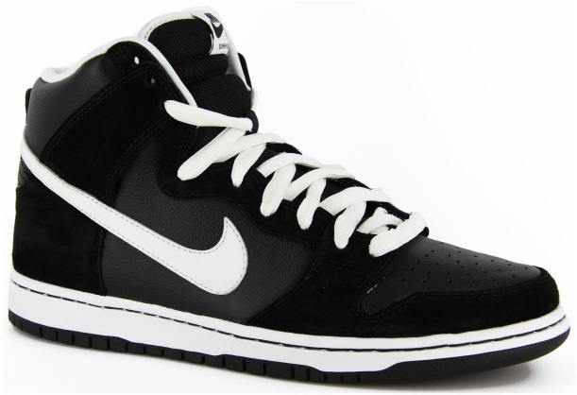
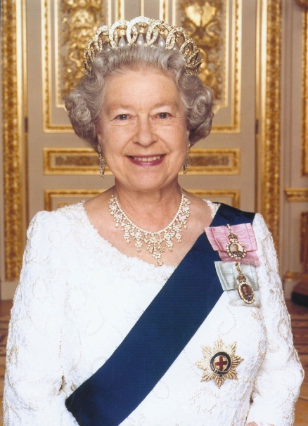
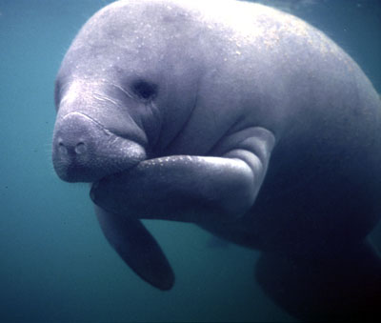
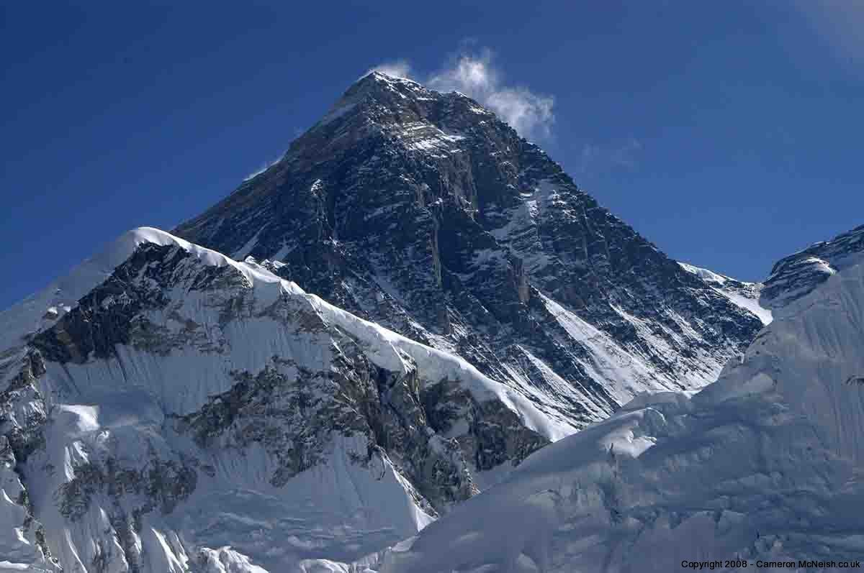
What do you have in common with a cactus, a manatee, a pair of running shoes, Mt. Everest, and the Queen of England?
You and they are all made up of matter!

Slide 3
So, What is “matter”?
Matter is anything that has mass and takes up space.
Matter is made up of tiny, tiny particles called atoms
Atoms of a substance are always moving, even if only slightly
Everything that you interact with every day is made up of atoms….so that’s why it matters!!!
Can you think of anything that is not matter?
Light!
(This is a hint!)

Slide 4
Activity! Part 1
First you will be assigned one of the four “atoms” below
You are now this atom.
Once everyone knows their atom, get up and organize in groups, based on what kind of atom you are.
Everyone in the same group is an atom of the same element.
Now, with your group, come up with a name for your element.
1
2
3
4
> Important to remember: Everyone is an atom. However, you are not all the same. In the same way, all matter is made up of atoms. However, atoms of the same element are alike, but are different from the atoms of other elements.

Slide 5
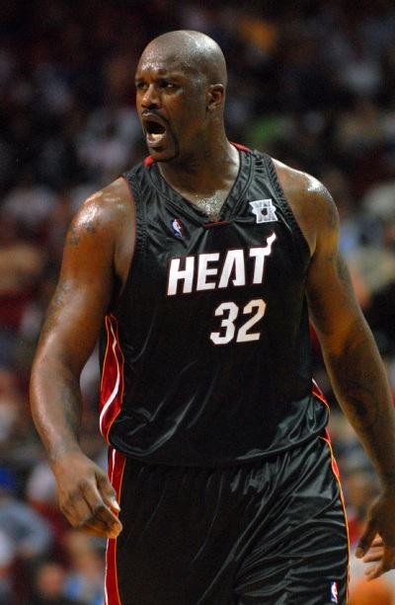
Matter Meets Heat
When you add or subtract heat from a substance, you can change its state of matter. The there are five states of matter: solid, liquid, gas, plasma, and the Bose-Einstein condensate. The state of matter of a substance is determined by how much energy its particles have.
Let’s take a look at how this works. Here is a particle of an unknown substance:
We’ll start out with a solid pyramid of this substance, and then add heat to it…

Slide 6
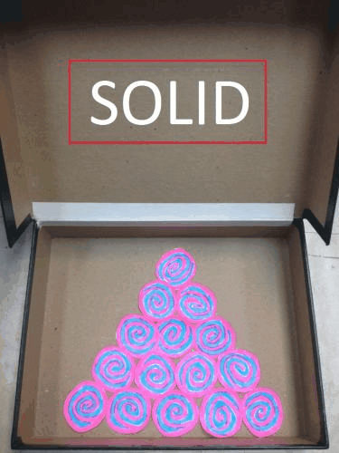
Matter Meets Heat

Slide 7
Matter Meets Heat
State | Description
Solid | particles vibrate in a fixed position, so the solid has a definite shape and volume.
Liquid | particles are moving fast enough to have enough energy to slide past one another, so the liquid takes the shape of it’s container.
Gas | the particles are moving so quickly that they have enough energy to move freely away from other particles. This causes the particles to take up as much space as possible, spreading out to fill any container.
*Plasma | occurs at very high temperatures and is found it fluorescent light bulbs, the atmosphere, and lightning strikes.
*Bose-Einstein Concentrate | the most recently discovered state of matter, and it occurs at a very, very low temperature, where the particles almost stop moving and begin to “clump” together.
* Scientists have always known about solids, liquids, and gases, but there are two other states of matter that are more unfamiliar to us. These are plasma and the Bose-Einstein Condensate. We won’t worry about these as much as the first three.

Slide 8
States of Matter Video
Source: Columbus Museum of Art
Click here to watch video online

Slide 9
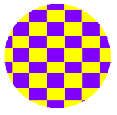
Activity! Part 2
You are going to demonstrate the relationship between heat and the motion of atoms. Remember, you are the atoms now.
We are going to pretend that the classroom is a container, and all of you are a mixture of some sort.
There are 3 categories of temperatures we will have: “hottest,” “middle”, and “coldest”
When the temperature appears, space yourselves around the classroom as a substance would at each temperature.
Important: Be respectful of the students around you as you enact the states of matter.
Ready??

Slide 10
Activity! Part 2
Hottest
(GAS)
Coldest
(Solid)
Middle
(Middle)

Slide 11
Physical Properties of Matter
Physical Property – Any characteristic of a material that can be observed or measured without changing the identity of the material. These are properties that can be observed with our senses.
Examples of Physical Properties:
Dependent on amount:
Shape
Length
Mass
Volume
Weight
Independent of amount:
Melting point
Boiling point
Color
Density
Solubility
Odor
Texture
Notes:
Add activity, have a collection of random things (golf ball, sponge, dish soap in a cup, baggie filled with air, Lego, rock, an egg, etc.)
Give each item to a student and have them describe the object listing all physical properties they can using their senses.

Slide 12
Activity!
Fill out the Physical Properties worksheet for your object.

Slide 13
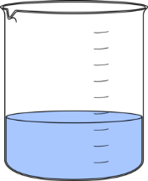
Activity! Part 3
Complete your Properties of Matter worksheet by listing the physical properties of the liquid in the beaker that are listed below under the appropriate category of “dependent or independent on amount.”
Dependent on Amount
Independent of Amount
50mL
1. Color: Blue
2. Melting Point: 0° C
3. Volume: 50 mL
4. Density: 1 g/mL
5. Shape: Beaker
6. Odor: none
7. Mass: 50 g
Notes:
Note: Pause PowerPoint presentation on this slide and hand out Properties of Matter Worksheet to every student or one to each pair of students. Have the students complete part A – answers are animated on this slide so once everyone is finished go over correct answers by clicking.

Slide 14
Activity! Part 3
Click to reveal correct answers!
Dependent on Amount
Independent of Amount
50mL
1. Color: Blue
2. Melting Point: 0° C
3. Volume: 50 mL
4. Density: 1 g/mL
5. Shape: Beaker
6. Odor: none
7. Mass: 50 g

Slide 15
Activity! Part 3
It’s time for you to get creative.
On your worksheet, you are going to create and draw something made out of your element (which you got at the beginning of this lesson).
Then describe its physical properties. Write these down in the appropriate column.
Some students will be chosen to present their element object, so be ready to come up with something really cool!
Ready, go!

Slide 16
Sources
Print:
Glencoe Science: Texas Science Grade 6
Web:
http://www.youtube.com/user/columbusmuseum?feature=watch
http://www.columbusmuseum.org/
http://peer.tamu.edu/
http://www.chem4kids.com/files/matter_intro.html

