Slide 1
The Nitrogen Cycle
How nitrogen changes from one form to another
© Partnership for Environmental Education and Rural Health at
College of Veterinary Medicine & Biomedical Sciences, Texas A&M University
Funding support from the National Institutes of Health Office of Research Infrastructure Programs (ORIP)

Slide 2
In introduction to nitrogen
What is nitrogen and why is it important?

Slide 3
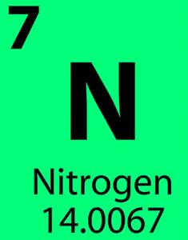
Nitrogen
Nitrogen is the 7th element on the periodic table of elements
Notes:
The periodic table is used to organize all of the known chemical elements. It is categorized in rows (aka periods) and columns (aka groups), keeping similar elements together in “families”. Nitrogen is in the second period and fifteenth group. Each element in a period has the same number of atomic orbitals (Nitrogen has two along with all of the elements in period two) and each element in a group has the same number of electrons in its outer orbital (Nitrogen and all of the elements in group 15 have 5).

Slide 4
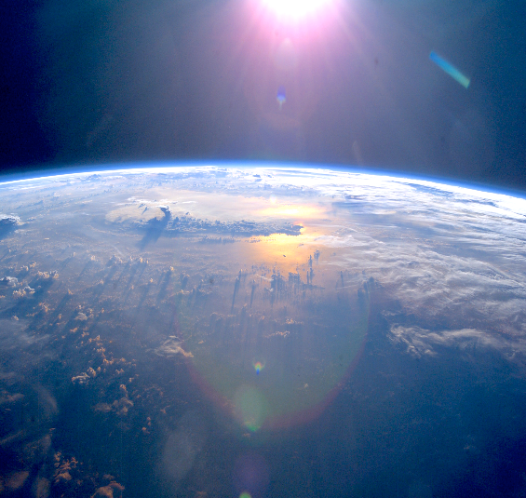
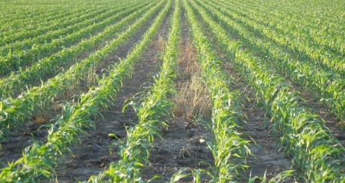
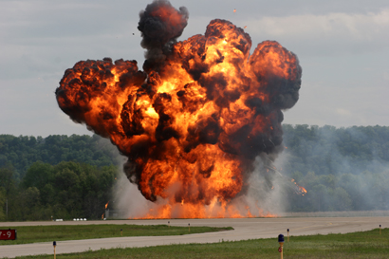
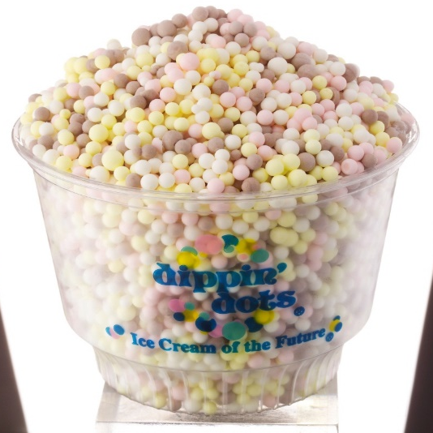
Why does nitrogen matter?
78% of the Earth’s atmosphere is nitrogen gas (meaning more of the air we breathe is made up of nitrogen than oxygen!!!)
Farmers use nitrogen when growing delicious crops for us to eat
Some explosives originate from nitrogen
Even Dippin’ dots ice cream uses nitrogen! YUM!
Notes:
Without the presence of nitrogen we would not exist. There would be no food for us to eat since plants need nitrogen to grow (without plants, our meat sources like beef and chicken would not survive since they are herbivores – plant eaters).

Slide 5
Liquid Nitrogen explosion!!!
BOOM!
Notes:
If the link above does not work, try the following link: Runs approx. 30 seconds https://www.youtube.com/watch?v=Fx6yJGoxLXM

Slide 6
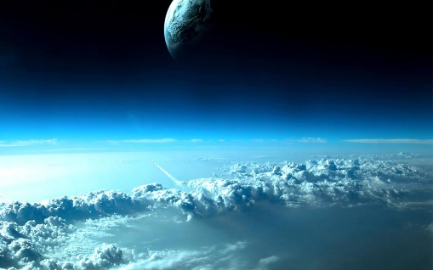
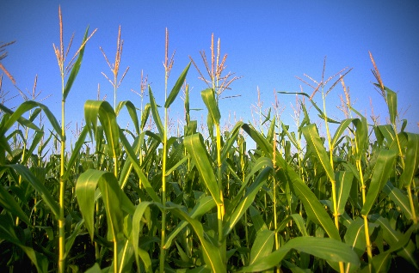
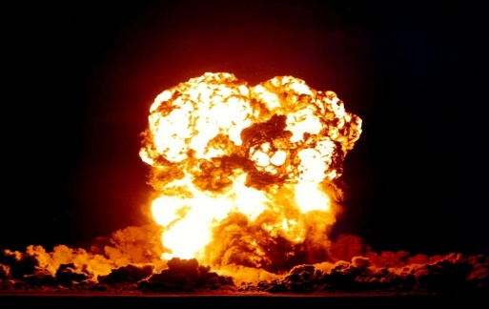
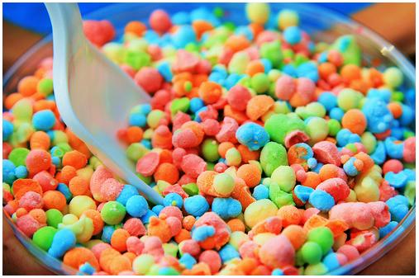
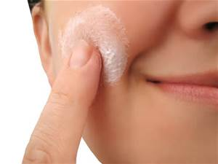
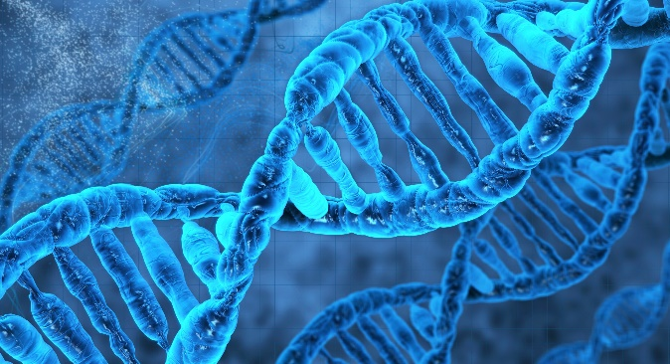
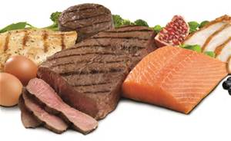
Lets Think For a second…
Where might you find nitrogen? Write down three of your examples in the margin of your notes.
Share your thoughts with a neighbor and listen to what their examples are. (see if you came up with the same things!)
ANSWERS:
Notes:
ANSWERS: air, earths atmosphere, crop fertilizer, explosions, dippin’ dots ice cream, hair (or fur), skin, DNA, protein, many more!

Slide 7
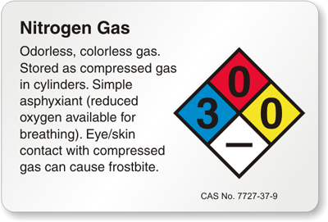
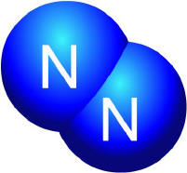
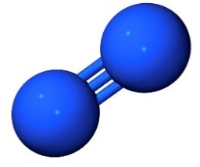
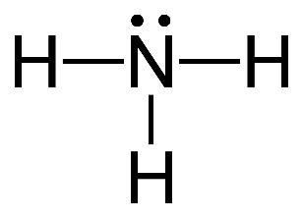
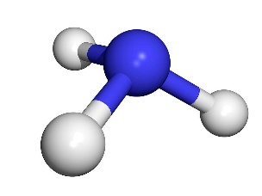
Nitrogen gas (N2)
Nitrogen gas is the most common form of nitrogen present, but when nitrogen is in its gas form, living organisms (that includes us) can’t use it because the bond is too strong.
Nitrogen gas (N₂) has three bonds that hold the two nitrogen atoms together:
Luckily, there are bacteria that easily break N₂ gas in the atmosphere and change it into ammonia (NH₃) through a process called nitrogen fixation.
Notes:
Underneath the second bullet point are three different examples of how chemists might describe what nitrogen gas looks like. Even though they look different, they are all the same molecule (nitrogen gas, or N₂). Nitrogen gas has two nitrogen molecule bound by a triple bond. These three bonds that join the elements are very strong and hard to break apart. Only certain organisms, like some bacteria, can break apart this molecule.
Under the third bullet point is an atom of ammonia, which is one N atom bonded to three H atoms. The bacteria convert nitrogen gas through the process of nitrogen fixation, which we will discuss in more detail later in the powerpoint.

Slide 8
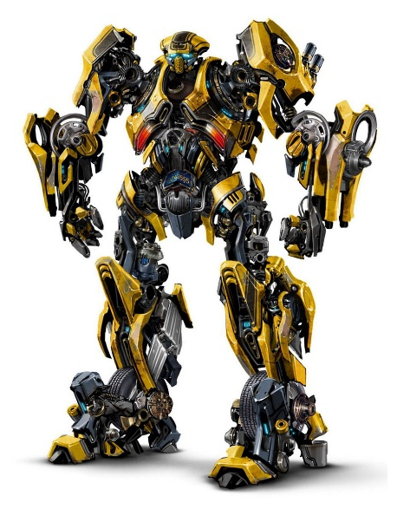
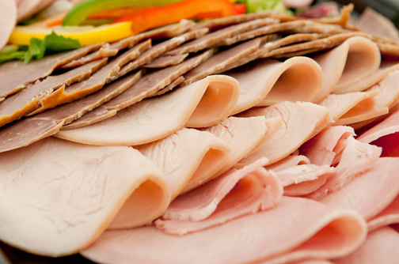
Nitrogen's four forms in the nitrogen cycle:
Nitrogen, like water (and transformers), can change forms.
Nitrogen can appear in four different forms in the nitrogen cycle:
Nitrogen Gas (N₂): most abundant, found in the atmosphere
Ammonia (NH₃): created by living organisms
Nitrites (NO₂⁻)
Nitrates (NO₃⁻)
Used by plants to create amino acids (protein)! They are also used in the meat industry!
Notes:
Nitrates and nitrites are also used in the meat industry to preserve our meats, give them a “cured pink color”, and give added flavor!

Slide 9
Investigate what you learned!
What form of nitrogen is the most common?
What are the four forms of nitrogen that we observe in the nitrogen cycle? (See if the whole class can come up with all four answers!)
ANSWERS:
Nitrogen gas (N₂) is the most common form of nitrogen found
The four forms of nitrogen are:
Nitrogen gas (N₂)
Ammonia (NH₃)
Nitrites (NO₂⁻)
Nitrates (NO₃⁻)
Notes:
ANSWERS:
Nitrogen gas (N₂) is the most common form of nitrogen found
The four forms of nitrogen are:
Nitrogen gas (N₂)
Ammonia (NH₃)
Nitrites (NO₂⁻)
Nitrates (NO₃⁻)

Slide 10
Nitrogen in the body
Where does nitrogen go in the body and what does it do?

Slide 11
Our body is made up of 3% nitrogen!
Notes:
As you can see, nitrogen is the fourth most common element present in our body, so it is very important to life!

Slide 12
Why do humans need Nitrogen?
Nitrogen is a building block of life on this planet…without it, we would not be able to survive!
Nitrogen is used in many ways in the body, including:
DNA
RNA
Protein
Food
Air
This is what makes you special and unique. It also is what made you a human (and not another animal!)
Notes:
DNA and RNA code genes. This is what creates the diversity that we see between species today. If our DNA was changed, then we would not look the way we do! If all of our DNA was the same, then we would all look the same and we wouldn’t have different species of animals.

Slide 13
The nitrogen cycle
Now that you understand what nitrogen is and why it is important… lets look at the nitrogen cycle!

Slide 14
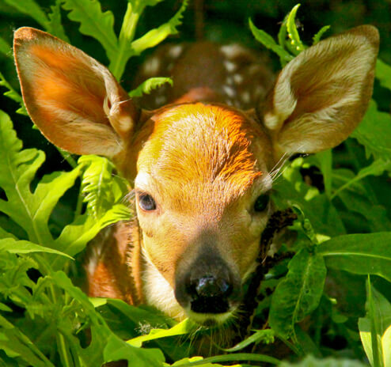
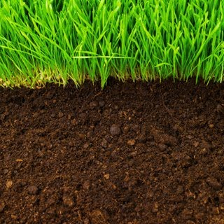
nitrogen Storage pools:
Nitrogen is important for all living things, so it moves around the earth getting passed along food chains to different organisms. It changes forms as it moves from the atmosphere, to biosphere (all the living things), to the lithosphere (earth’s crust and soil).
The nitrogen cycle is the transition of nitrogen from one form to the other through different organisms.
Notes:
Remember that it is a cycle. It can start from any place and it continues to change forms, it is never ending. There is no starting or stopping point.

Slide 15
The nitrogen Cycle: The big picture
Notes:
We are going to focus on 5 stages of the nitrogen cycle:
Nitrogen fixation
Ammonification
Nitrification
Assimilation
Denitrification

Slide 16
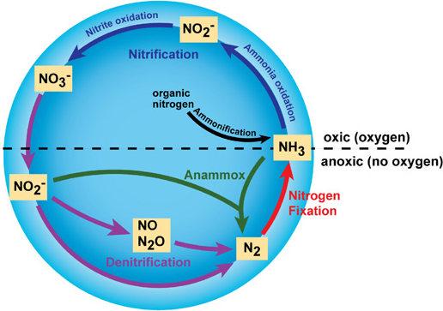
Processes in the Nitrogen Cycle:
Although there are many steps and processes in the nitrogen cycle, we are going to talk about the five major processes:
Nitrogen Fixation
Ammonification
Nitrification
Assimilation
Denitrification
Notes:
Note: We aren’t going to cover anammox in this presentation.

Slide 17
Nitrogen Fixation

Slide 18
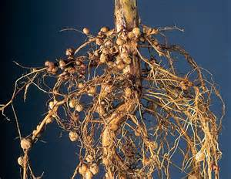
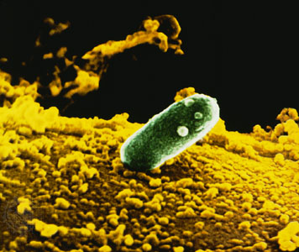
Nitrogen Fixation
Nitrogen fixation is the process of changing unusable and unreactive nitrogen gas (N₂) into ammonia (NH₃)
Remember: The goal of nitrogen fixation is to pull unusable nitrogen from the atmosphere and make it usable!
Nitrogen Fixation occurs in three ways:
Bacterial fixation (the most common way)
Lightning strikes
Industrial fixation - like combustion of fossil fuels
Notes:
1. Bacterial fixation occurs in plant roots. Plants have root nodules that house Rhizobium bacteria. It is these bacteria that change nitrogen gas to ammonia

Slide 19
Ammonification

Slide 20
Ammonification
When an animal, microbe, or plant dies or produces waste, they leave behind nitrogen (especially in the form of amino acids).
Ammonification is the process of converting that stored, organic nitrogen into usable nitrogen in the form of ammonia (NH₃)
This is the nitrogen cycles way of recycling nitrogen
Notes:
Animals contribute to the nitrogen cycle through this process, ammonification. We recycle nitrogen and reuse it. Remember, our body is 3% nitrogen so a lot of nitrogen can be introduced back into the cycle and reused by the soil and plants.
Plants loose their leaves in the fall or die, the dead material is decomposed and introduce nitrogen back into the soil.

Slide 21
But wait, there’s more!
After the bacteria create ammonia (NH₃) in nitrogen fixation, it still isn’t usable by plants or animals… so it must go through another process.
This process is called NITRIFICATION

Slide 22
Nitrification

Slide 23
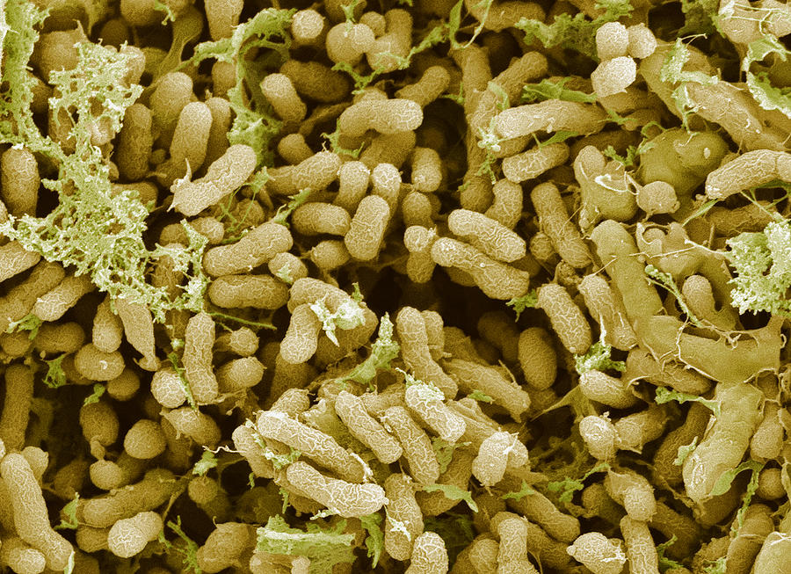
Nitrification
Nitrification is the process that converts ammonia (NH₃) into nitrite (NO₂⁻) and then nitrite (NO₂⁻) into nitrate (NO₃⁻)
This is also most often carried out by nitrifying bacteria in soil
The first step is carried out by ammonia-oxidizing bacteria
The second step is carried out by nitrite-oxidizing bacteria
To complete nitrification, both steps must occur!
Remember: we start with ammonia and end with nitrate
NH₃ → NO₂⁻ → NO₃⁻
Oxidizing = adding oxygen

Slide 24
Nitrification
WHY DOES THIS MATTER?
Nitrification creates the products (nitrates and nitrites) that are used by plants to create the amino acids we discussed earlier!
Remember: amino acids are the building blocks of proteins (which are required for growth!)

Slide 25
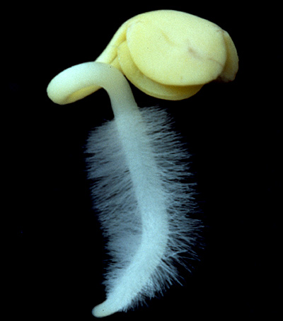
Assimilation
Plants contribution to the nitrogen cycle
Assimilation is the process that plants utilize to “ingest” nitrogen
Plants can only utilize three forms of nitrogen: nitrites (NO₂⁻), nitrates (NO₃⁻), and ammonium ions (NH₄⁺)
The plants root hairs absorb the nitrogen nutrients present in the soil
NO₂⁻
NO₃⁻
NH₄⁺
Root hairs

Slide 26
Denitrification

Slide 27
denitrification
Not all fixed nitrogen is used by living organisms, so…
Denitrification is the process of returning unused nitrogen back into the atmosphere by converting unused nitrates (NO₃⁻) into nitrogen gas (N₂)
Remember: we started with nitrogen gas (N₂) and our product here is nitrogen gas (N₂), its is a cycle!
To begin the cycle again, we must have nitrogen gas (N₂) in the atmosphere to convert in to ammonia (NH₃). What would happen if we continue to deplete nitrogen gas without replenishing it?
ANSWER:
The cycle would not be able to continue!
Notes:
Although we cannot used nitrogen gas as living organisms, it is important that unused nitrogen be converted so that we will have a constant supply of usable nitrogen.
ANSWER:
The cycle would not be able to continue!

Slide 28
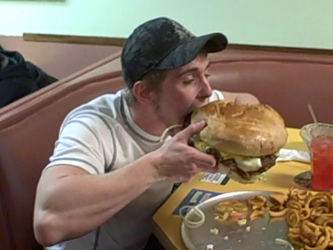
Lets catch our breath!
That was a lot of information, just remember to break it down into smaller pieces. (take small bites!)
Remember that each process has a specific purpose and is important to the cycle as a whole
Since it is a cycle, there is no true beginning or ending, nitrogen is constantly being converted from one form to another
Notes:
Although this is a large, complex cycle it is manageable when it is broken down into its individual pieces!

Slide 29
Put it all together:
Ok, lets work in groups of four and figure it out!
List the names of the 5 main processes in the nitrogen cycle
List the form of nitrogen that is created by three of the processes (can give name or chemical formula)
ANSWERS:
Nitrogen fixation, ammonification, nitrification, assimilation, and denitrification
Ammonia (NH₃), ammonia (NH₃), nitrite (NO₂⁻) and nitrate (NO₃⁻), none (plants ingest nitrogen during assimilation), nitrogen gas (N₂)

Slide 30
One last thing!
We learned about how nitrogen impacts us, but now lets see how we impact this cycle

Slide 31
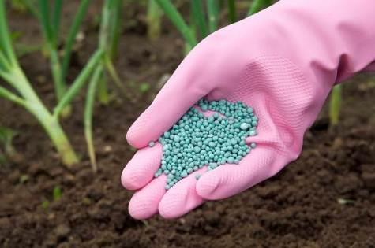
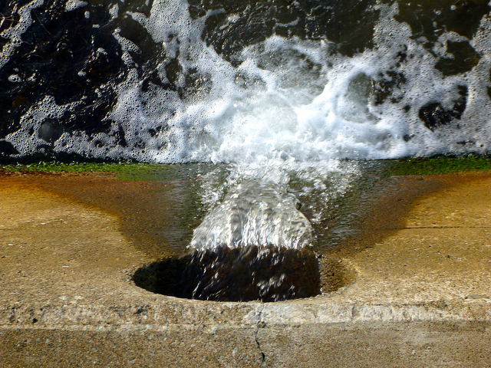
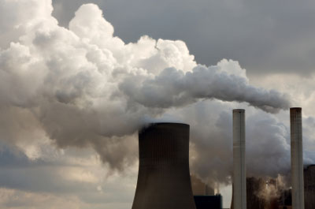
Human impact on the Nitrogen cycle:
We impact the nitrogen cycle in many ways:
The use of nitrogen based fertilizer in agriculture
Sewage runoff into bodies of water
Nitrogen gasses are produced many of our modern creations
Notes:
Nitrogen fertilizer is used to increase the productivity of crops. The limiting factors to crop growth are commonly nitrates and nitrites. Fertilizing the soil with nitrogen helps to prevent this limitation in growth from happening and giving the farmers a greater yield of crop in less time.
Animals produce nitrogen as part of our organic waste, and when this waste is accidently introduced into lakes, rivers, and ponds, we disrupt the natural ecosystem that exists.
Many of our modern creations, including cars, factories, power plants, and chimneys use nitrogen. Burning fossil fuels produces nitrogen as a byproduct.

Slide 32
In conclusion…
Nitrogen is the seventh element on the periodic table of elements
It can be found in many different molecules including: N₂, NH₃, NO₂⁻ and NO₃⁻
Humans and other animals need nitrogen to make up biomolecules, like DNA and protein
Nitrogen cycles through the biosphere, lithosphere, and atmosphere
The five main parts of the nitrogen cycle are: nitrogen fixation, ammonification, nitrification, assimilation, denitrification
Humans play a large role in the nitrogen cycle and must be careful to limit the disruption that we cause

Slide 33
The nitrogen cycle: the big picture
Notes:
Extra video included to solidify the cycle in the students minds. Runs about 7:30 min.
https://www.youtube.com/watch?v=HOpRT8BRGtk
Another, shorter video. Runs approx. 1 min.
https://www.youtube.com/watch?v=ZCogeBk92NA

