Slide 1
TRAITS
You have them! Where did they come from?

Slide 2
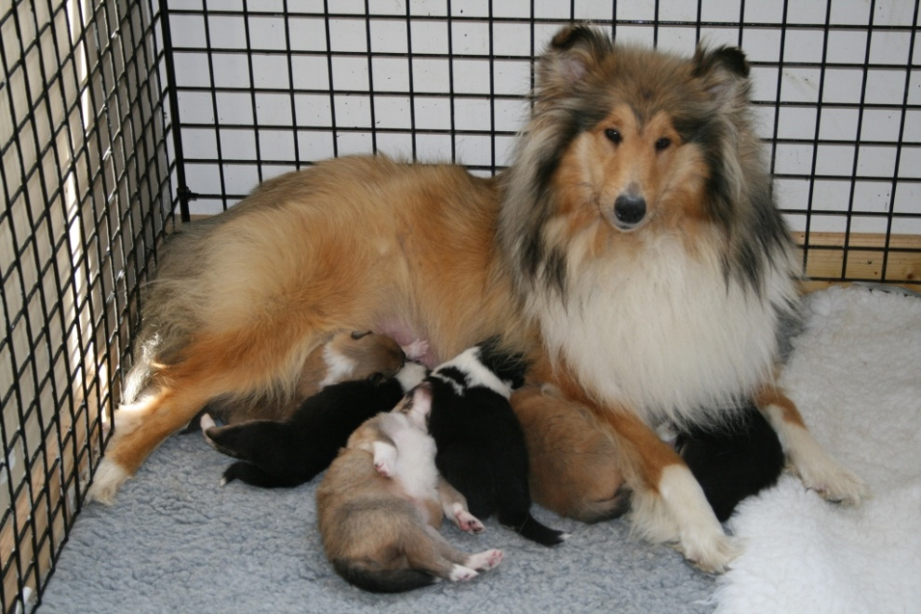
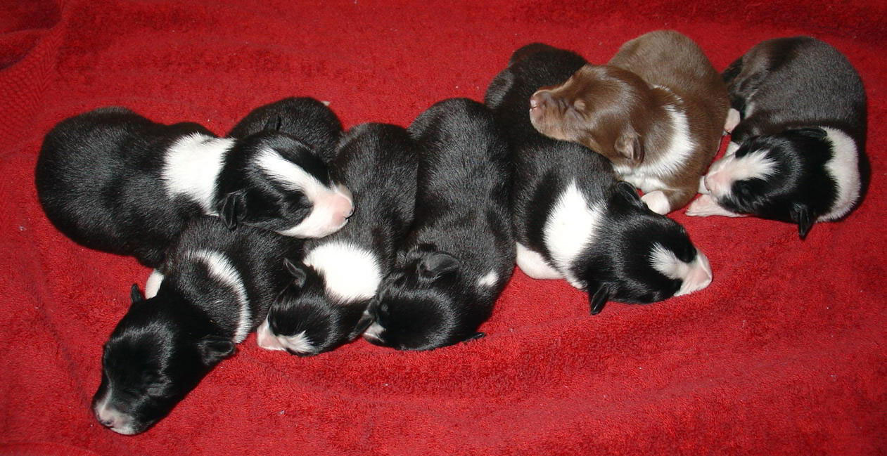
TRAITS : What are they good for?
Passed from parent to offspring
Why do not all offspring with the same parent look the same?
THE GENES on THE CHROMOSOMES

Slide 3
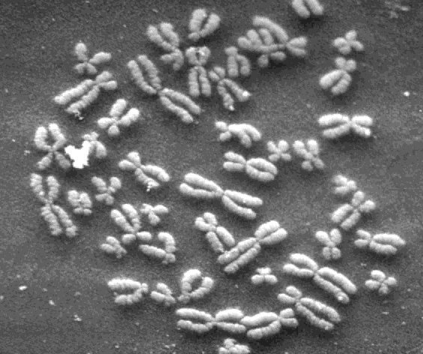
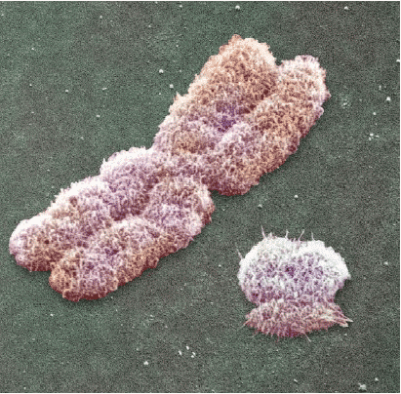
CHROMOSOMES
Chromosomes are structures in the nucleus of cells that consist of DNA.
X
Y
There is a X and Y chromosome. What do you notice?
Notes:
http://biology.unm.edu/ccouncil/Biology_124/Images/chromosomes2.jpg
http://i137.photobucket.com/albums/q215/JolieB_2006/xy.gif

Slide 4
THE X and THE Y
These TWO chromosomes determine gender!
You have to have a combination of 2:
Males are XY
Females are XX
You get one from your mom and one from your dad.
But, what controls the traits?

Slide 5
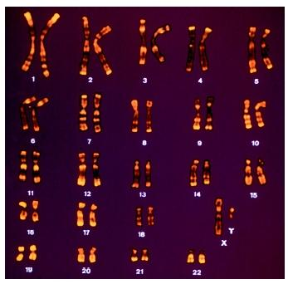
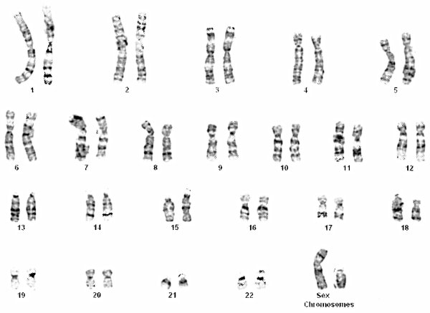
The GENES
Small dark bands mark the chromosomes into sections called genes.
Notes:
http://julianwagner.net/images/chromosomes.jpg
http://www.biologyreference.com/images/biol_01_img0082.jpg

Slide 6
GENES to TRAITS
A gene controls the trait.
Examples of traits are hair color, eye color, and your fingerprint.
What fingerprint do you have?
Everyone is identical, even twins!
If you lose skin on your fingertip, it grows back in the same print.
Let’s see what pattern you have!
Rub pencil over your fingertip and touch it to your paper.

Slide 7
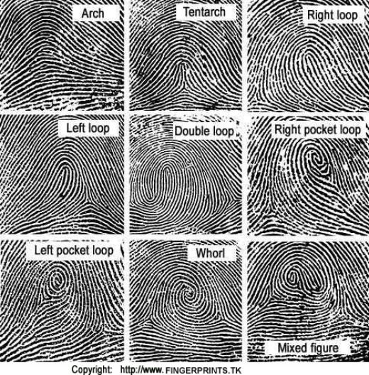
FINGERPRINTING
Notes:
http://z.hubpages.com/u/28932_f520.jpg

Slide 8
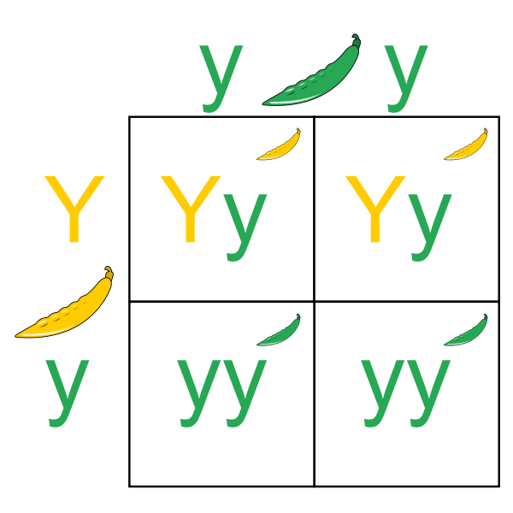
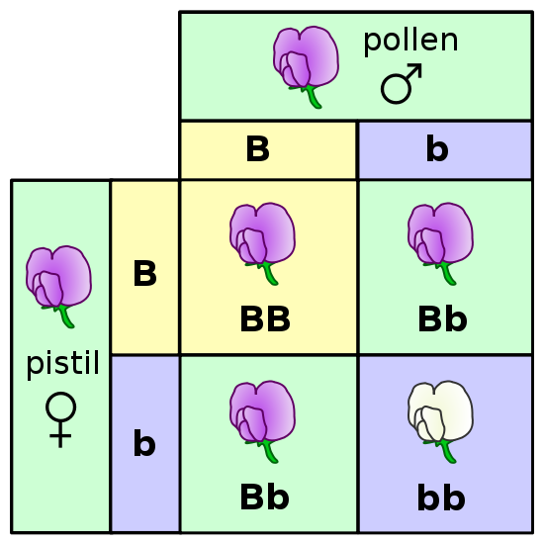
WHAT DO YOU GET?
A trait can be homozygous or heterozygous.
You have a genotype , which has two alleles.
A genotype is written as AA, Aa, or aa.
The letter represents the trait.
A capital letter means the trait is DOMINANT and will always be expressed – AA or Aa
Two lowercase letters mean the trait is RECESSIVE and will show – aa.
Notes:
http://en.wikipedia.org/wiki/File:Punnett_Square.svg
http://commons.wikimedia.org/wiki/File:Punnett_square_mendel_flowers.svg

Slide 9
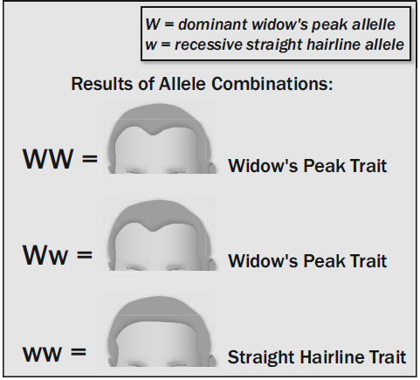
MORE UNIQUE TRAITS
Detached earlobe (DOMINANT)
Widow’s Peak (hairline)
Notes:
http://upload.wikimedia.org/wikipedia/commons/6/68/Earlobes_free_attached.jpg
Dom

Slide 10
