Slide 1
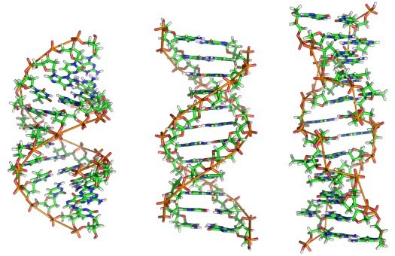
Transmission of Genetic Information
Notes:
http://www.deblois2008.com/2011/04/found-way-to-avoid-transmission-of.html

Slide 2
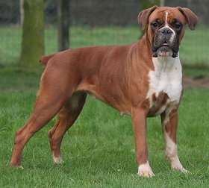
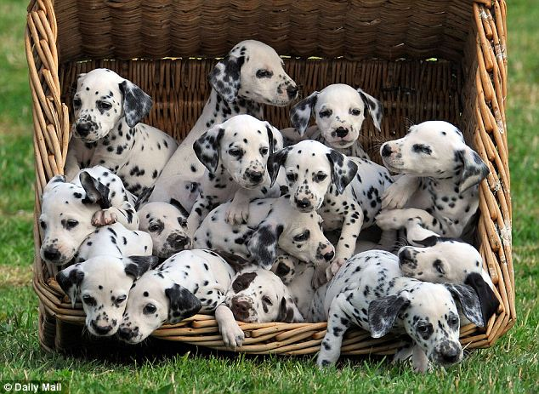
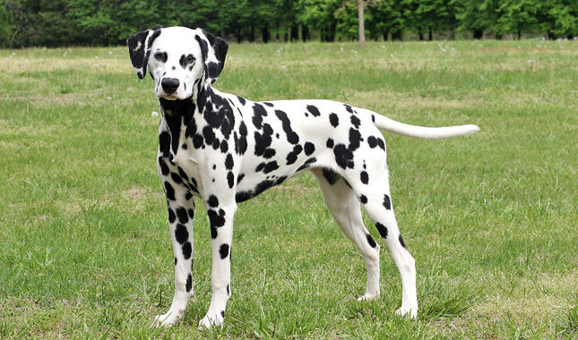
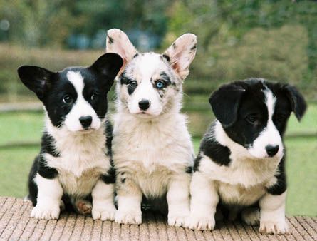
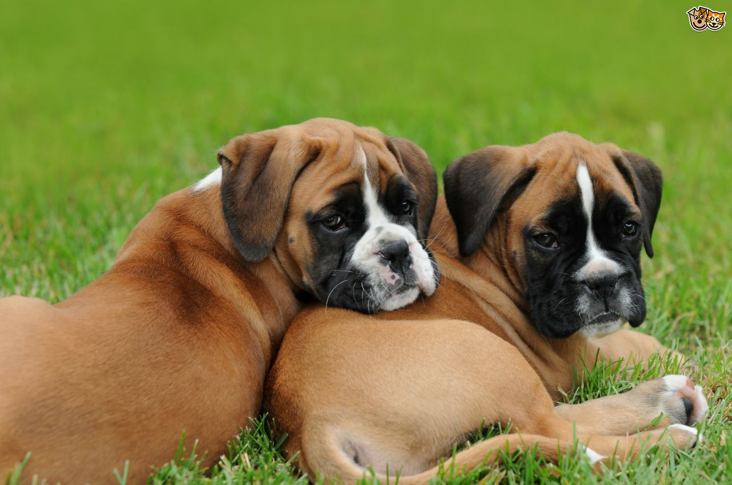
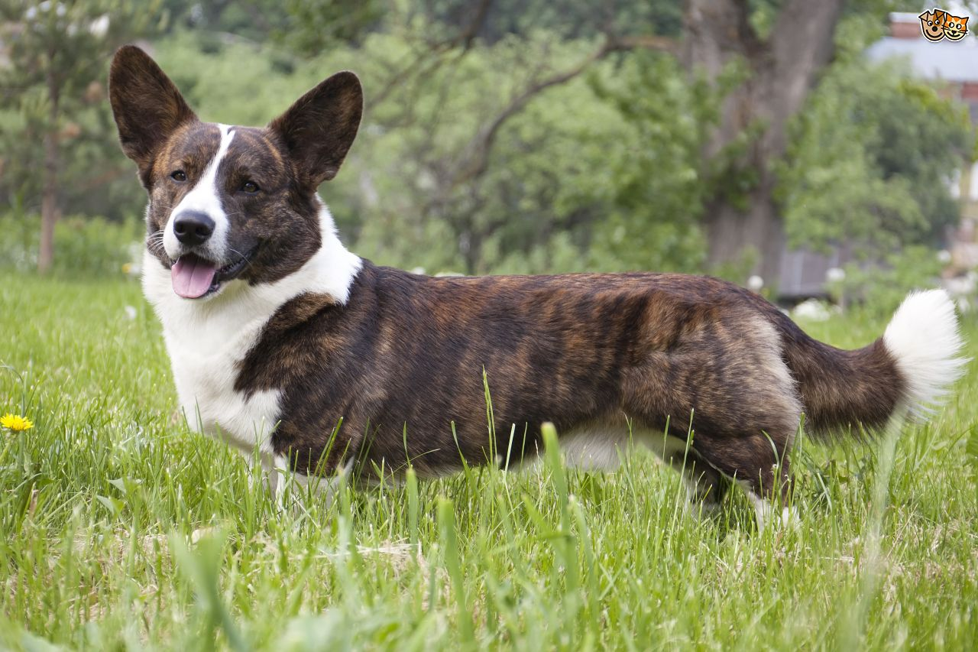
Whose Am I?
Match the parent and offspring (babies)

Slide 3
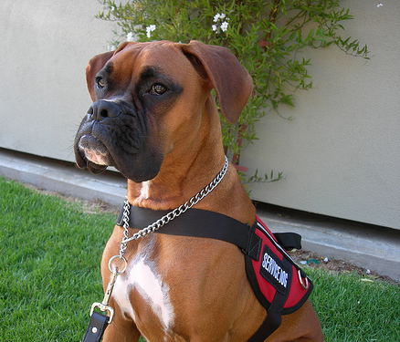
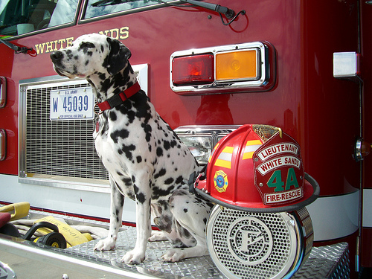
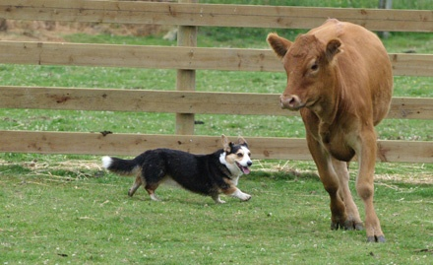
Explain Yourself!
How did you know who belonged to whom?
Traits: a distinguishing characteristic or quality
Physical OR behavioral
Notes:
Boxers are strong, loyal, and affable making good service dogs
Corgis have a strong sense to herd and are short enough to stay clear of flying hooves
Dalmatians originally had an affinity for and could keep pace with the horses that pulled fire wagons. They would clear paths for and protect the horses.

Slide 4
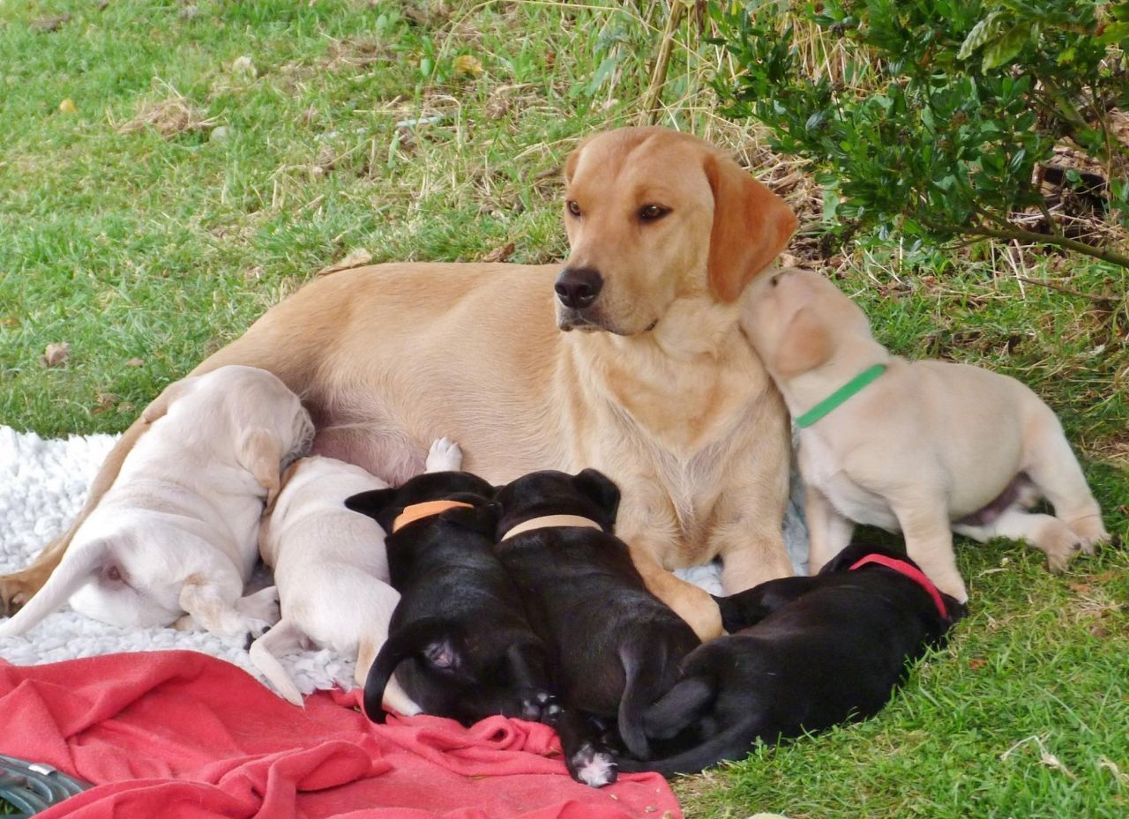
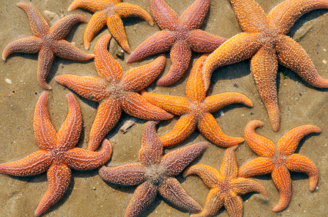
Heredity
The passing of traits from parents to offspring
Are offspring identical to parents?
It depends!
Sexual reproduction
Asexual Reproduction

Slide 5
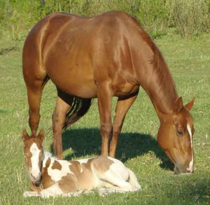
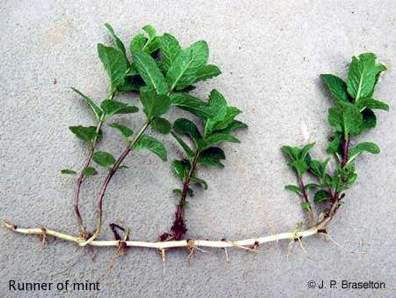
Reproduction
Sexual:
Combination of DNA from two parents
Offspring are different
Asexual:
Only 1 parent
Offspring are genetically identical (same DNA)

Slide 6
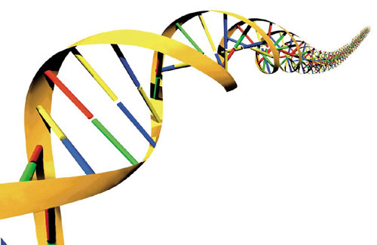
DNA
Deoxyribonucleic acid
The hereditary material in living organisms
Stores and transmits genetic information
Tells cells which proteins to make and when to make them
3 billion miles of DNA inside you!

Slide 7
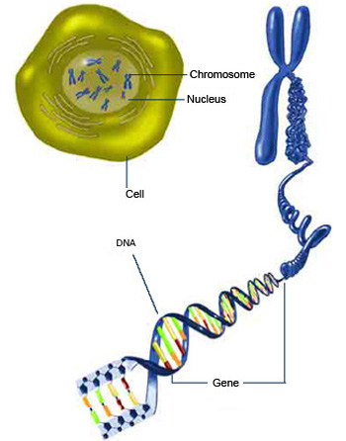
Chromosomes & Genes
Chromosomes- thread-like structure in the nucleus
Contain DNA
Humans have 23 pairs
Genes - segments of DNA on chromosomes
Determine an organism’s traits

Slide 8
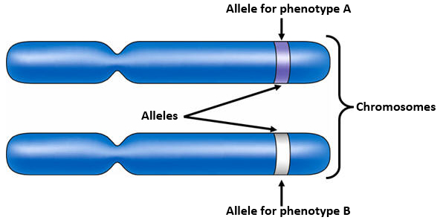
Allele
A version of a gene
Located at a specific position on a specific chromosome
Two alleles for each gene, one from each parent

Slide 9
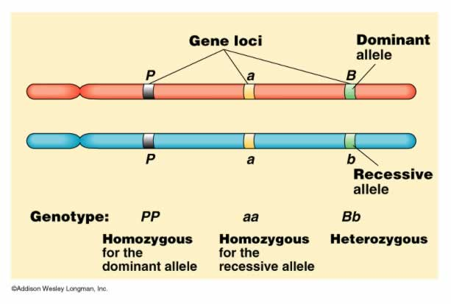
Allele Types
Dominant – trait exhibited even if individual has only one copy
Capital letter
Recessive – trait is only exhibited if two copies are present
Lower case letter

Slide 10
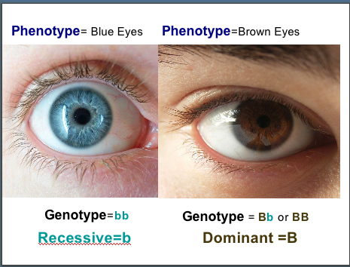
Genotypes and Phenotypes
Genotype- the set of genes in an organism’s DNA
Phenotype- physical appearance of an organism
Genotype codes for phenotype
Phenotype can be influenced environment
Notes:
http://www.brooklyn.cuny.edu/bc/ahp/BioInfo/GP/Definition.html
http://www.brooklyn.cuny.edu/bc/ahp/BioInfo/GP/Relationship.html http://evolution.berkeley.edu/evosite/evo101/IIIA1Genotypevsphenotype.shtml
http://learnscape.org/blog/?p=99

Slide 11
Genotypes
Homozygous – two of the same allele
Dominant or recessive
Heterozygous – one of each allele type
Typically the dominant trait is expressed

Slide 12
Could You Repeat That?
Notes:
Be patient! The embedded video takes a moment to load

Slide 13
So, What Genes Are You Wearing?
Read the description for common traits in the data table and determine your phenotype and possible genotype.
Can you know your exact genotype using this table?
Notes:
A full printable version of this activity is included in the lesson download.
-Answer: No, to determine your exact genotype (without the use of gene mapping) you would also need to know your parents’ genotype for each trait.

Slide 14
Inherited Traits
Coded in DNA
Received from biological parents
Can be passed on to the next generation
Physical or behavioral traits
Examples: hair and eye color, height, blood type, facial features, migration instincts, retrieving, etc.
Notes:
http://utahscience.oremjr.alpine.k12.ut.us/Sciber01/7th/cells/html/inhvsacq.htm
http://www.slideshare.net/brandolina1/acquired-and-inherited-traits
http://kalchurisamaj.com/welfare/

Slide 15
Environmental Variation
Expression of inherited traits (phenotype) can be influenced by environment
Nutrition: poor nutrition may counteract a person or plant’s ability to fully express a tall genotype
Sunlight: amount of exposure impacts skin color or plant growth
Notes:
http://www.centrorisorse.org/factors-affecting-gene-expression.html
http://healthwealthwisdom.blogspot.com/2011/09/lightworkers-as-light-anchors.html
http://climate.uvic.ca/climate-lab/front_page_pics/temperature.html
http://fillyourplate.wordpress.com/

Slide 16
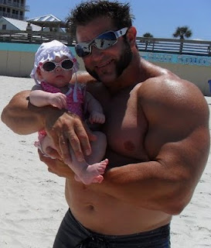
Acquired Traits
Things that are learned/developed during life
NOT in DNA
Can be physical or behavioral
Examples: calluses, large muscles, scars, learning to read, jumping through a hoop, tree bent due to wind, etc...
These traits are NOT passed to offspring.
A body builder will not have a child with giant muscles
Notes:
http://utahscience.oremjr.alpine.k12.ut.us/Sciber01/7th/cells/html/inhvsacq.htm
http://www.slideshare.net/brandolina1/acquired-and-inherited-traits
http://www.superbodybuilders.com/2010/09/bodybuilder-brad-dunn-with-baby-and.html

Slide 17
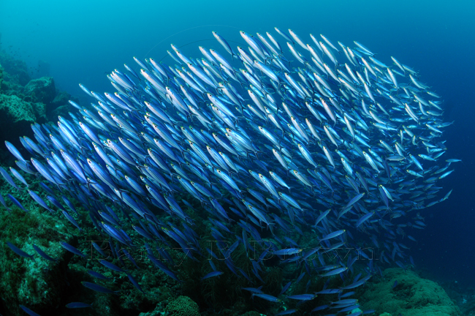
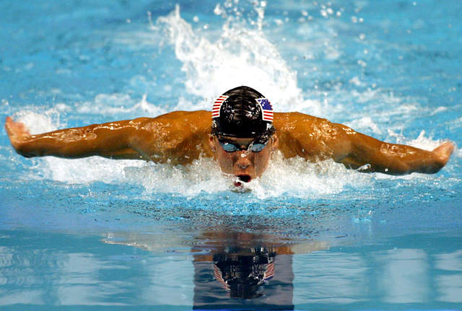
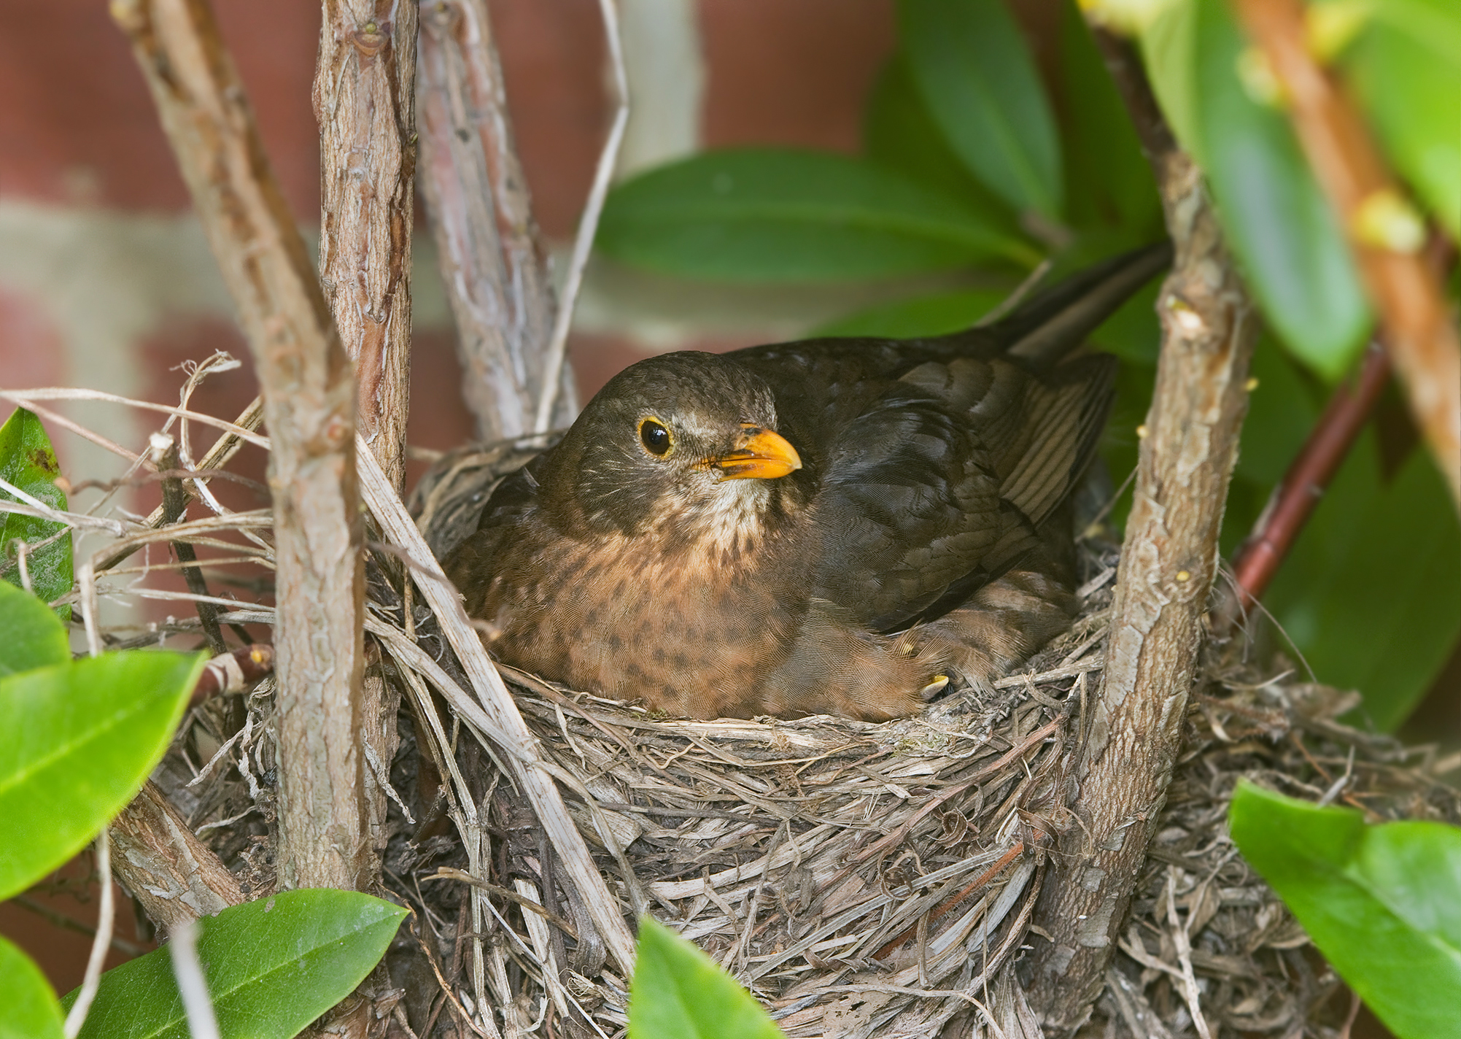
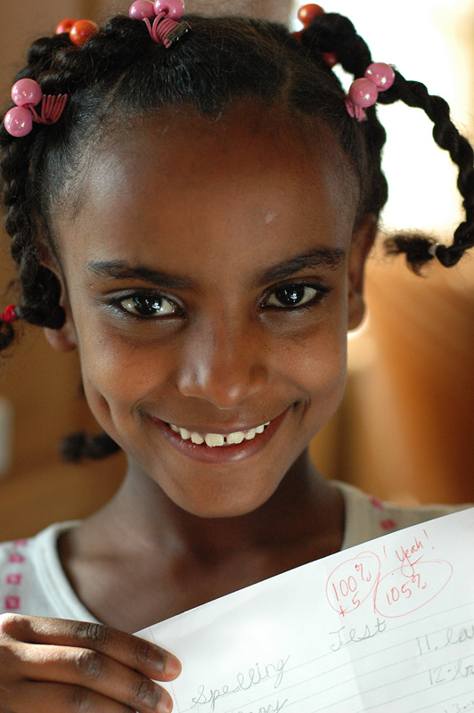
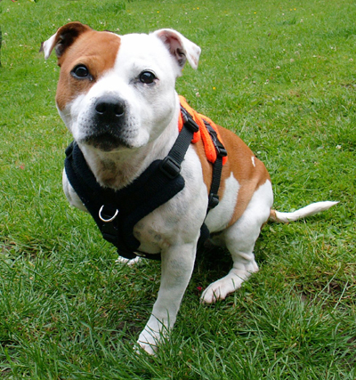
You Tell Me!
Examine each image and determine if it is an inherited (programmed from birth) or acquired (developed during life) trait.
Inherited
Acquired
ACQUIRED
Inherited
Inherited
Three-legged dog
Building nests and sitting on eggs
Knowing how to swim
Schooling Fish
Dimples

Slide 18
Genetic Engineering
Explain genetic engineering to a neighbor; give an example if possible.
Genetic engineering- modification of an organism's genetic composition by artificial means, often involving the transfer of specific genes, from one organism into an organism of an entirely different species.
The resulting product is a genetically modified organism (GMO)
Notes:
http://library.thinkquest.org/CR0215642/ definition
http://www.earthtimes.org/encyclopaedia/environmental-issues/genetic-engineering/

Slide 19
I didn’t quite catch that…
Notes:
Be patient; the video takes a moment to load

Slide 20
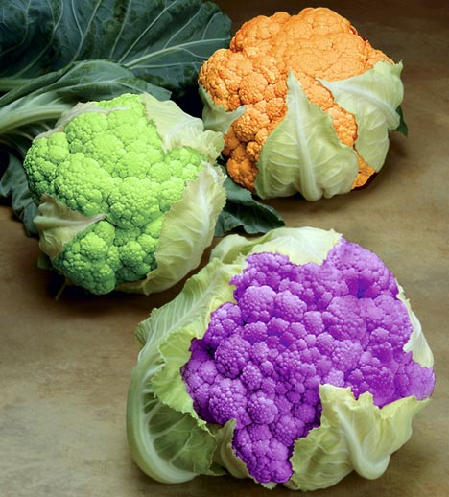
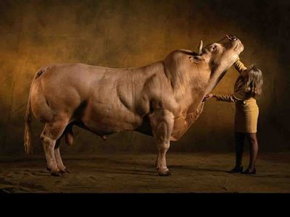
Genetic Engineering
Engineered Plants:
Increase growth rate and crop yield
Produce medicines and vaccines
Engineered Animals
Improve the quality and nutrition of food
Produce medicines & medical transplants
Produce antimicrobial products
Humans
Cure or prevent diseases
Engineered with desired traits before birth
Notes:
http://library.thinkquest.org/CR0215642/
http://realitypod.com/2011/09/top-ten-modern-inventions-of-21st-century/

Slide 21
Pros and Cons of Genetic Engineering
Pros
Cons
Improved growth rate and nutrition
Pest/disease resistant
Extended shelf life
New foods
Prevent and cure diseases
Hamper nutrients/ increase allergens
Introduce pathogens
Genetic problems
Limits genetic diversity
Notes:
http://healthresearchfunding.org/pros-cons-genetic-engineering/

Slide 22
Genetic Engineering Applications
Medical:
Human growth hormone
Insulin
Vaccines
Gene therapy
Agriculture:
Protection from environmental threats (temperature, insects, weeds, disease, etc.)
Increase yield/nutrition
Pharming (producing drugs/vaccines)
Notes:
http://www.biotecharticles.com/Genetics-Article/Genetic-Engineering-Its-Definition-Introduction-and-Applications-733.html
http://www.globalchange.com/geneticengin.htm- has book on genetic engineering and a video on it.
http://www.medicaldaily.com/news/20110224/5545/home-urine-test-measures-insulin-production-in-diabetes.htm image

Slide 23
What’s the Controversy?

Slide 24
What do you think?
What is your opinion about genetic engineering?
Would you eat a meal if you knew the food was all genetically engineered?
Notes:
http://healthresearchfunding.org/pros-cons-genetic-engineering/

