Slide 1
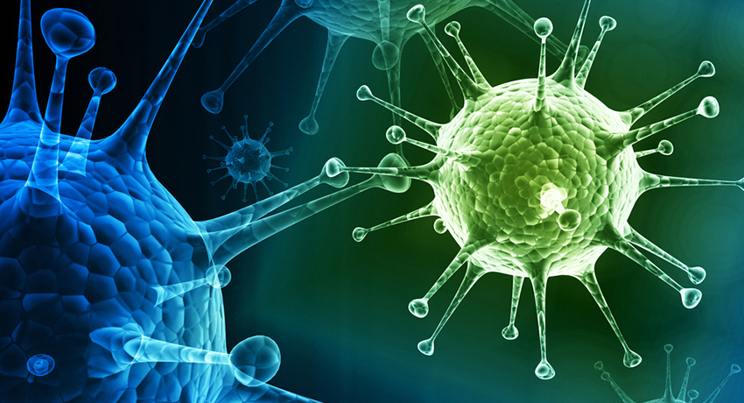
Viruses
INFLUENZA VS EBOLA
http://www.bostonmagazine.com/health/blog/2013/10/24/flu-virus/

Slide 2
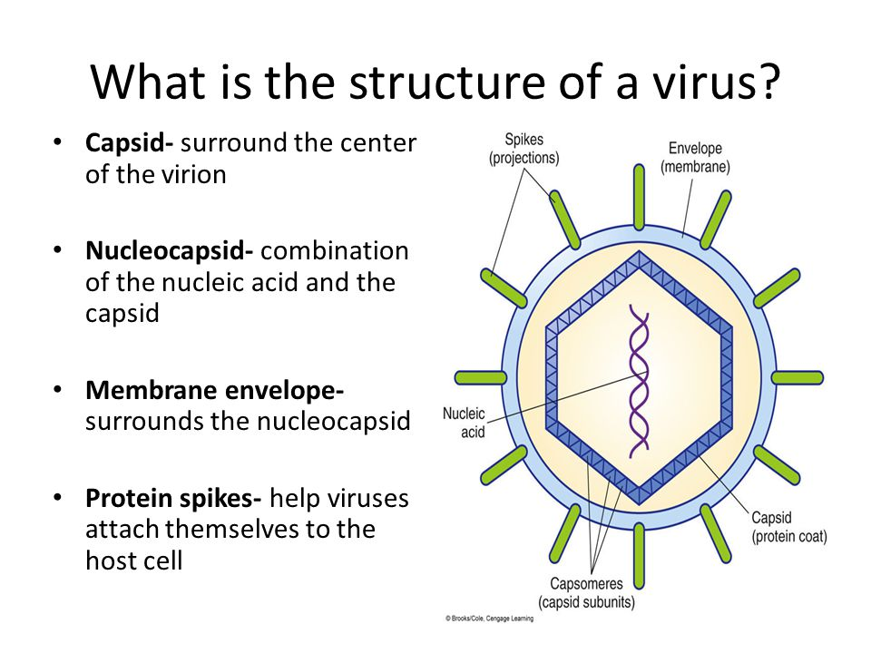
What is a virus?
An infectious agent made up of nucleic acid (DNA or RNA) wrapped in a protein coat called a capsid
No nucleus, organelles, cytoplasm, or cell membrane
Dependent on their host for survival and reproduction
  PARASITES
Smaller than bacteria
Do not grow

Slide 3

Think Break!
Consider what you now know about the structure of a virus. Do you think a virus is living or non-living?

Slide 4
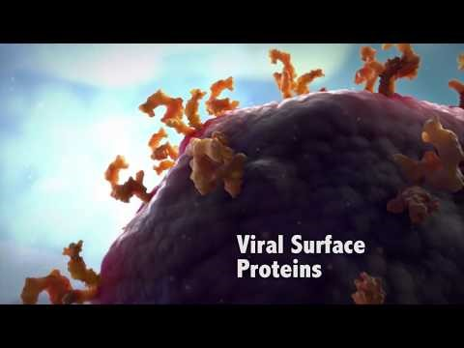
How do they work?
Notes:
You will have to play these videos in YouTube, but they are excellent descriptions and animations of viral processes.

Slide 5
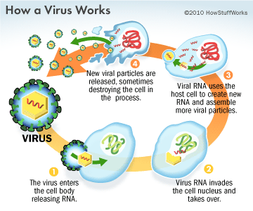
How do they work?
Viruses enter the host’s system via “spikes” - keys to fit specific receptors
The cell then endocytoses (engulfs) them
Goal of a virus is to reproduce!!
  Hijacks the nucleus and ribosomes to produce more virus

Slide 6
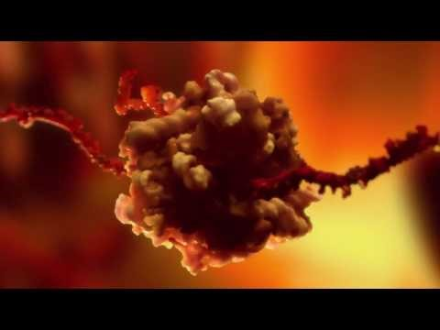
How do they work?

Slide 7

Talk It Out
What is the main goal of a virus?
Explain to a neighbor how it achieves this goal.

Slide 8

Viral Replication
Lytic (ACTIVE) – main form
Lysogenic (LATENT) – only in bacteria
Together

Slide 9
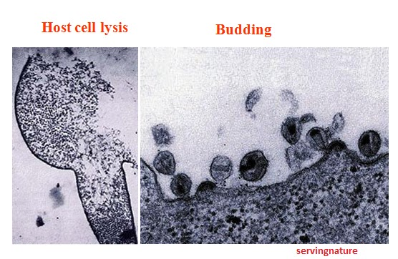
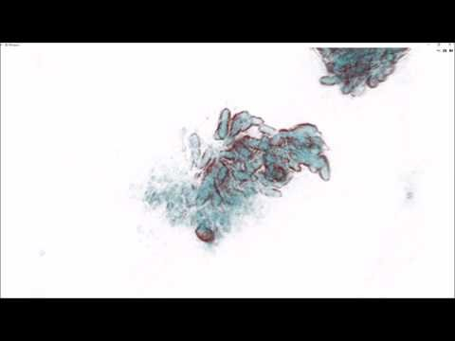
Lytic
When a virus enters a cell it is active
Causes the host cell to make new viruses immediately
Upon release destroys the host cell

Slide 10
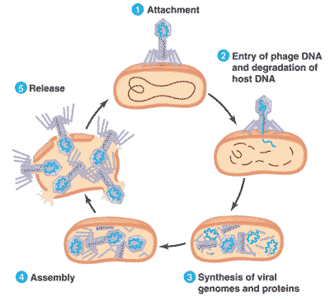
Lytic Cycle
Steps
  1- absorption/attachment
  2- injection/entry
  3- replication of viral parts
  4- assembly
  5- release by lysis or budding
Many forms of the virus are made in the cell and then they are released
Results in host cell death
EX: Influenza, Rabies, Common Cold
http://www.quia.com/jg/1272861list.html

Slide 11
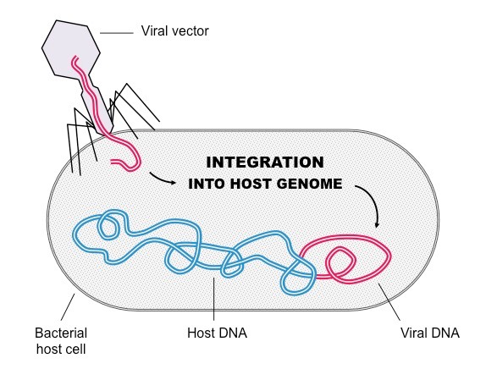
Lysogenic
Virus enters the cell and integrates it’s hereditary material into the cell’s hereditary material
It does not immediately make new viruses and destroy the cell
  Latent
  Can be latent for many years – unsure what triggers activity
As the host cell reproduces, the viral genetic material is copied
  A cold sore is evidence that a latent virus has been activated.

Slide 12
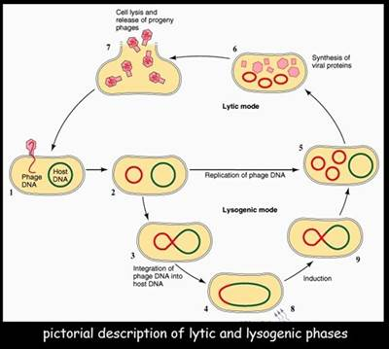
Lysogenic cycle
Steps
  1- absorption/attachment
  2- injection/entry
  3- viral DNA incorporated into the cell’s DNA
  4- viral DNA replicated along with chromosomal material
Result in the cells producing viral DNA
EX: Herpes, Shingles, HIV
http://mol-biol4masters.masters.grkraj.org/html/Prokaryotic_DNA_Replication14-Lambda_DNA_Replication.htm

Slide 13
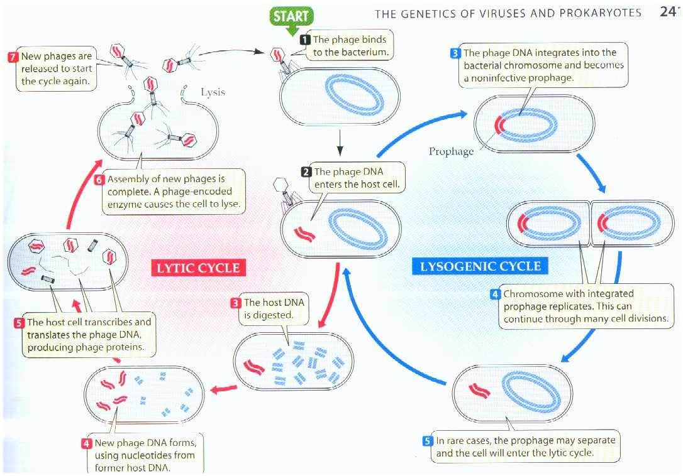
Together
http://www.prism.gatech.edu/~gh19/b1510/virus.htm

Slide 14

Diagram It!
Lytic Cycle
Lysogenic Cycle

Slide 15
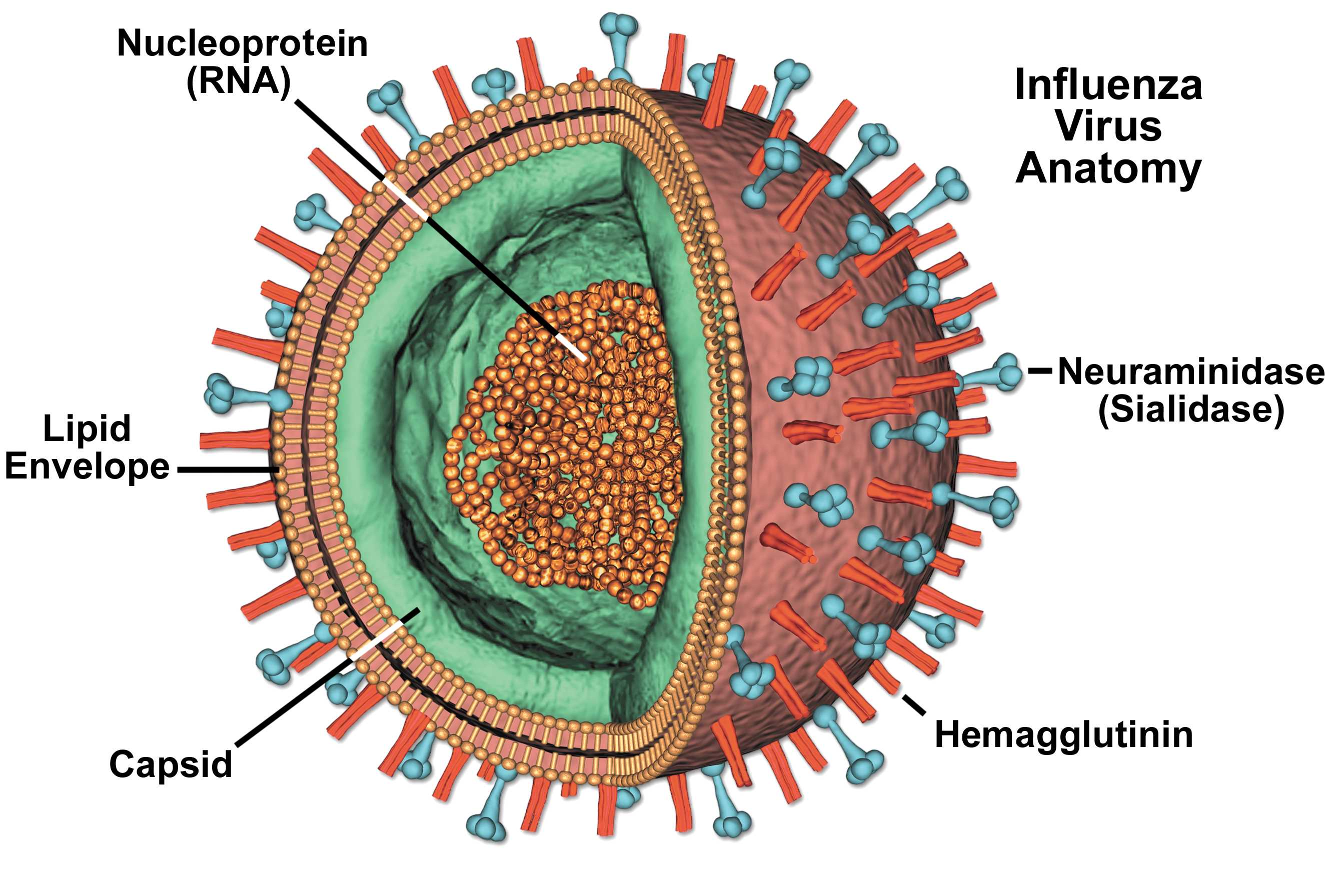
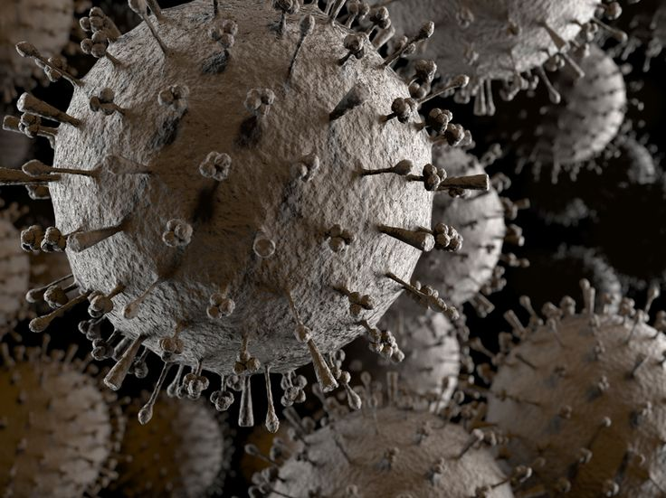
Influenza Virus
Enveloped RNA virus with 8 gene segments
2 types of significance to humans
  A
    Can also affect birds and pigs
  B
Covered with protein projections resembling a grass burr. These proteins are what stick to the cells in your nose, throat, or lungs.
Capable of rapid evolution leading to great variability.
Notes:
The lower image is taken with a scanning electron microscope

Slide 16
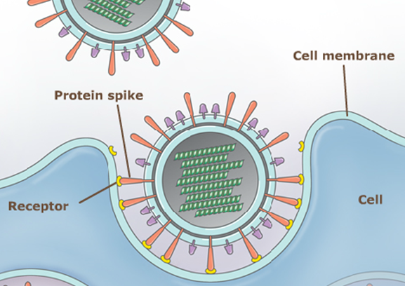
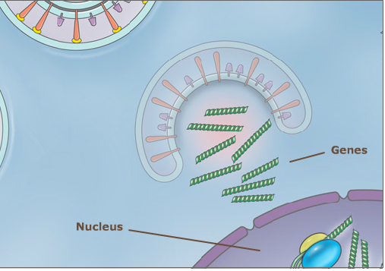
How Influenza Replicates
Protein spikes bind with specific receptors on epithelial cell membranes.
The cell membrane endocytoses (engulfs) the virus and moves it toward the nucleus.
  During this trip the virus breaks apart releasing the RNA and proteins.

Slide 17
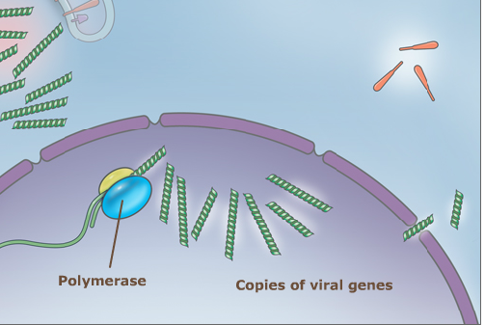
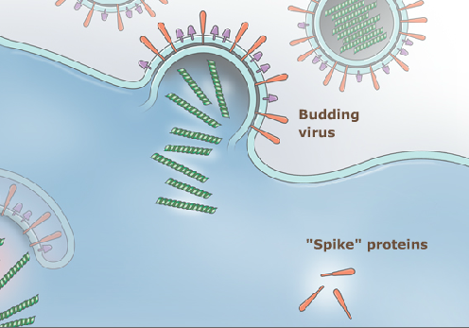
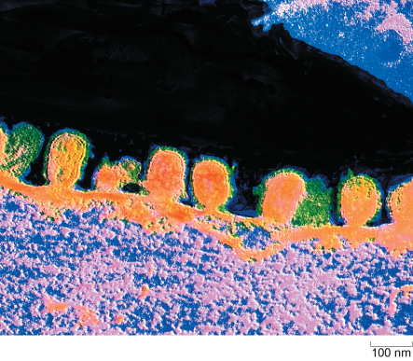
Continued
Inside the nucleus polymerase transcribes the RNA and makes thousands of copies of the virus’ genes.
These copies are then released into the cytoplasm and translated.
They move towards the cell membrane to form new viruses (buds)
The budding viruses get released from the cell and are free to infect other cells
Notes:
Electron microscope image of Influenza virus budding from infected cell

Slide 18
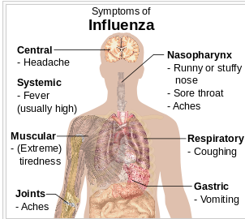
Influenza
Signs and symptoms of flu:
  Fever/chills
  Cough
  Sore throat
  Runny or stuffy nose
  Muscle or body aches
  Headaches
  Fatigue
Aerosol infection - droplets created when coughing, sneezing, or talking.
More than 200,000 people in the United States are hospitalized each year for respiratory and heart conditions illnesses associated with influenza virus.
http://en.wikipedia.org/wiki/Influenza

Slide 19
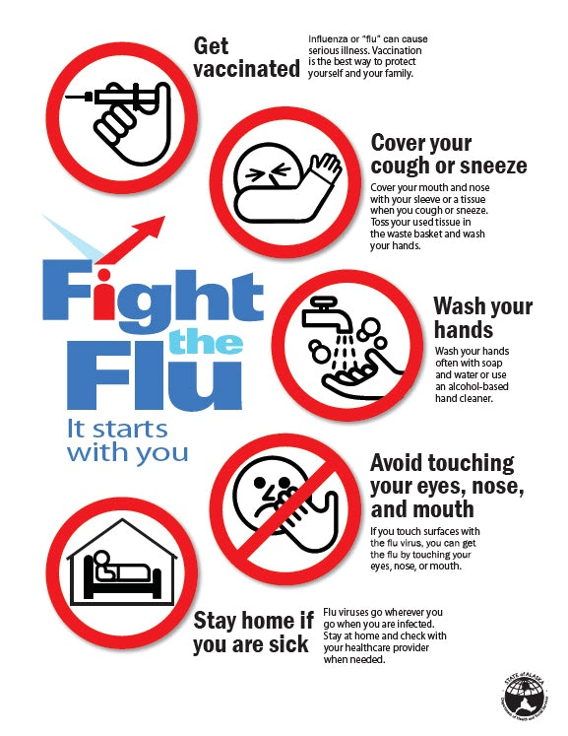

Slide 20

What type of replication does the influenza virus undergo? Explain.
How does this relate to the rapid spread of the flu?

Slide 21
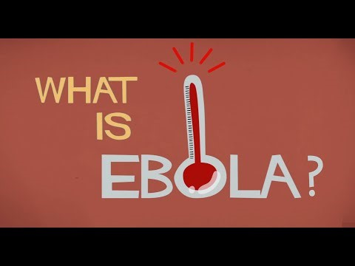

Slide 22
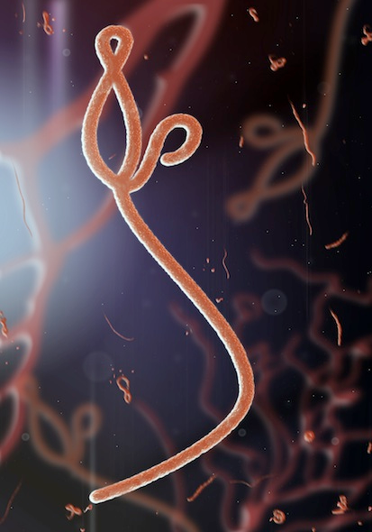
Ebola Virus Disease
Rare and deadly disease in people and primates
Found mainly in sub-Saharan Africa
Spread through direct contact (broken skin or mucous membranes in the eyes, nose, or mouth) by:
  Blood or body fluids (including but not limited to urine, saliva, sweat, feces, vomit, breast milk, and semen) of a person who has Ebola
  Objects (like needles and syringes) that have been contaminated with the virus via body fluids
Ebola Virus

Slide 23
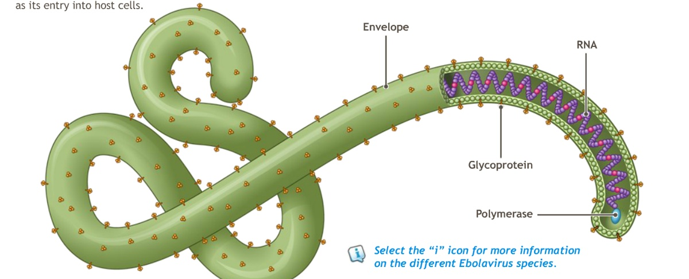
Ebolavirus
Belongs to the family Filovirdae
  Shepherd's crook, "U“, "6," coiled, or branched shapes
Five species of Ebolavirus
  Only 4 affect humans
Enveloped, single-stranded, RNA genome containing seven genes

Slide 24
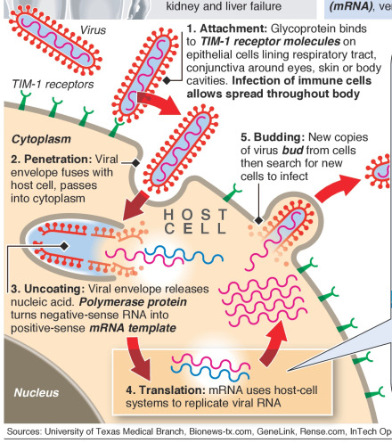
Ebolavirus
Attachment glycoproteins secure the virus to specific cell-surface receptors
  More surface area than Flu virus, leading to more glycoproteins
Fuses with cell membrane and taken into the cytoplasm where it is uncoated
Using host-cell resources the viral RNA is transcribed and translated
New copies of the virus bud using the host’s cell membrane as their capsule.

Slide 25

Which type of replication does Ebola virus undergo? How do you know?

Slide 26
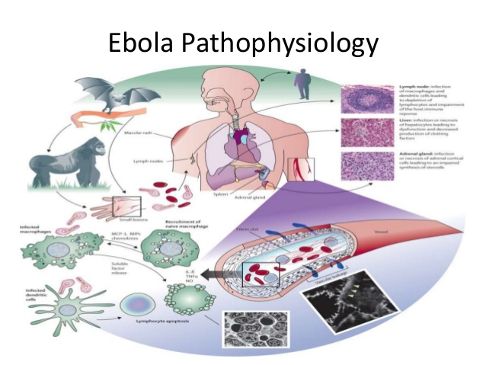
Ebolavirus
Ebola virus enters through mucous membranes or breaks in the skin and infects many cell types
Migrates from the initial infection site to lymph nodes and then the liver, spleen, and adrenal gland.
  Decreased lymphocyte (white blood cell) counts and clotting disorders.
Triggers a large inflammatory reaction
  Vascular leak and impairment of clotting
  Uncontrollable bleeding (though it only happens for about 50 percent of patients and occurs mostly inside the body)
  Ultimately results in multi-organ failure and shock

Slide 27
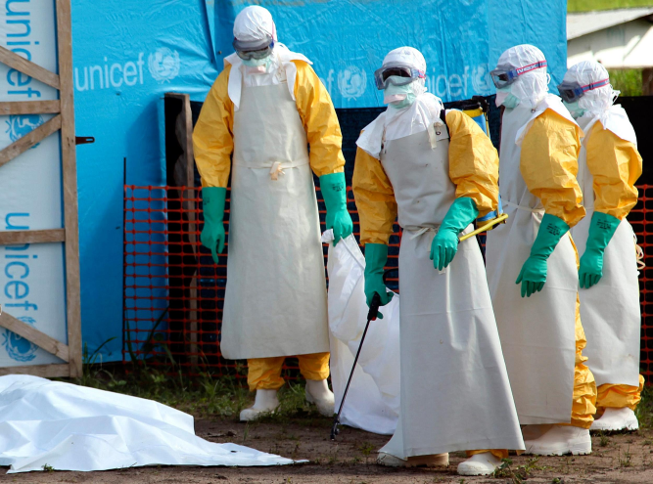
Ebola - Physiology
Symptoms appear 8 – 12 days after exposure
Mortality rate average of 50%
  Ranges from 25-90%
Virus persists after death

Slide 28
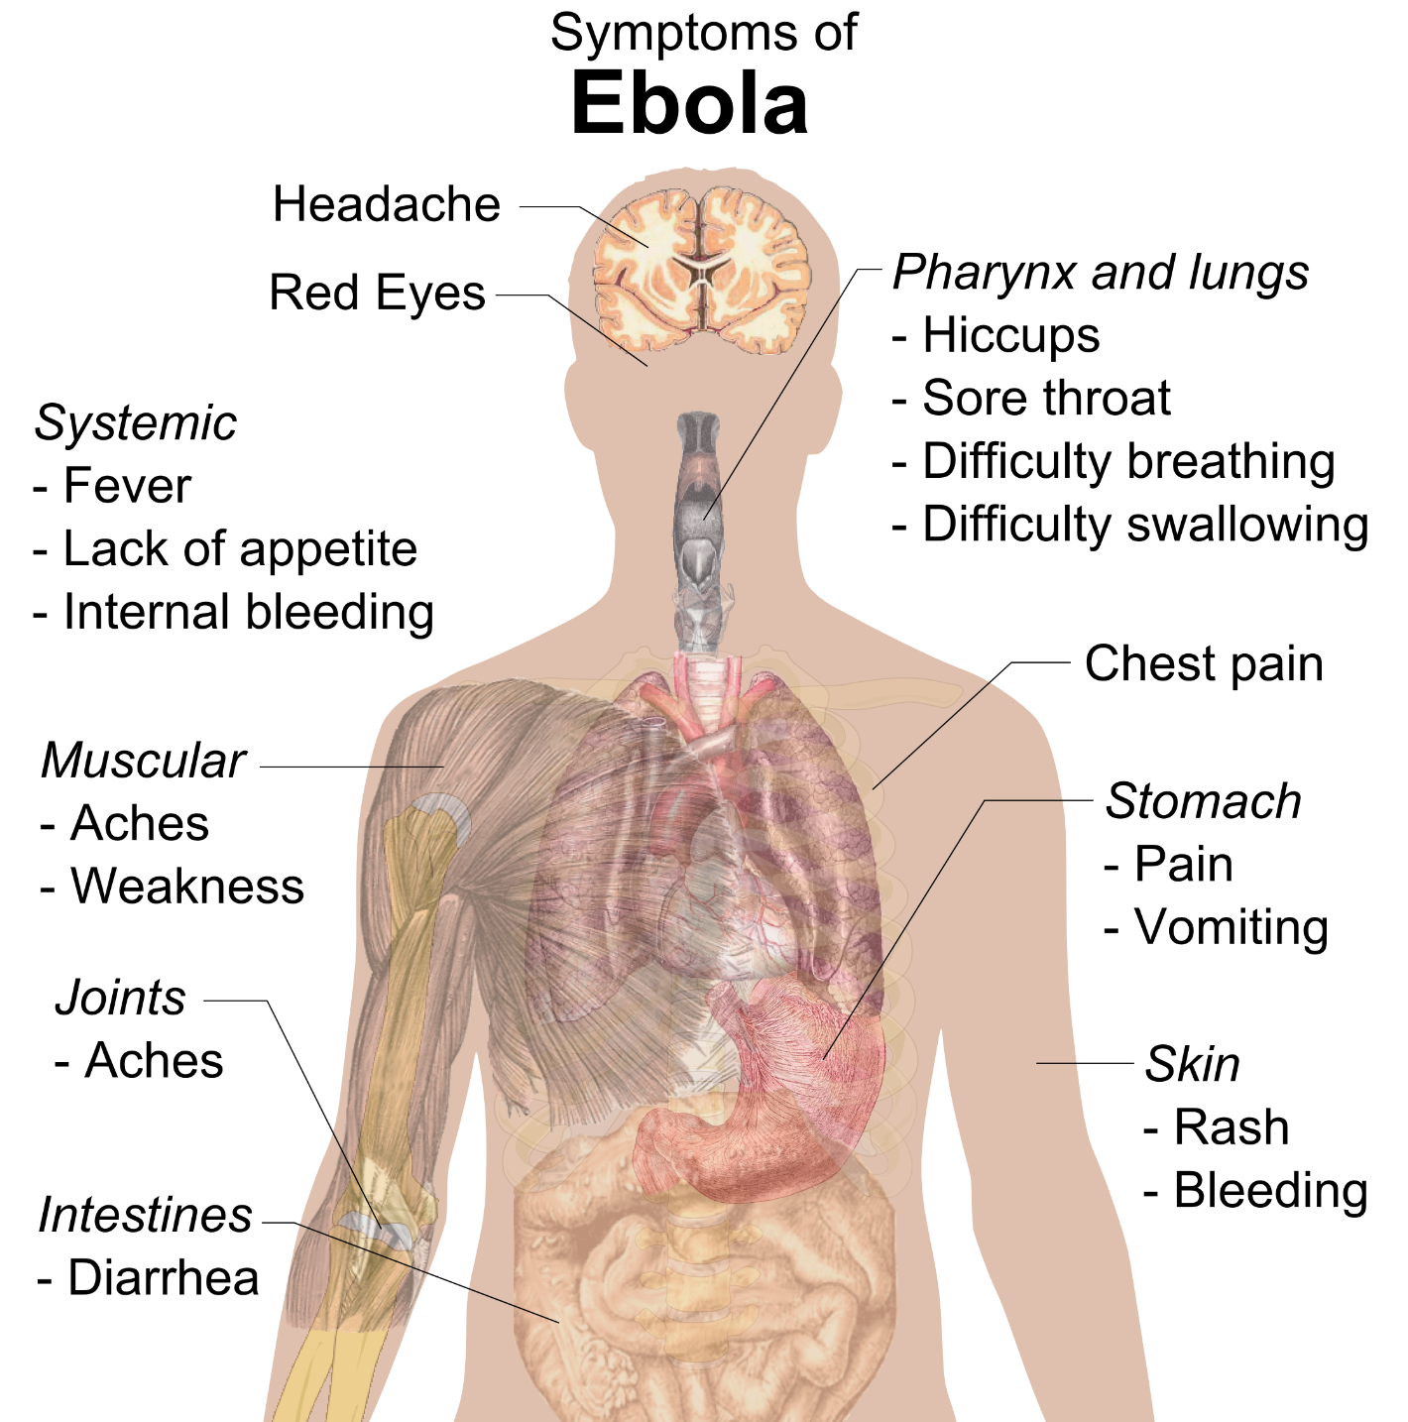

Slide 29
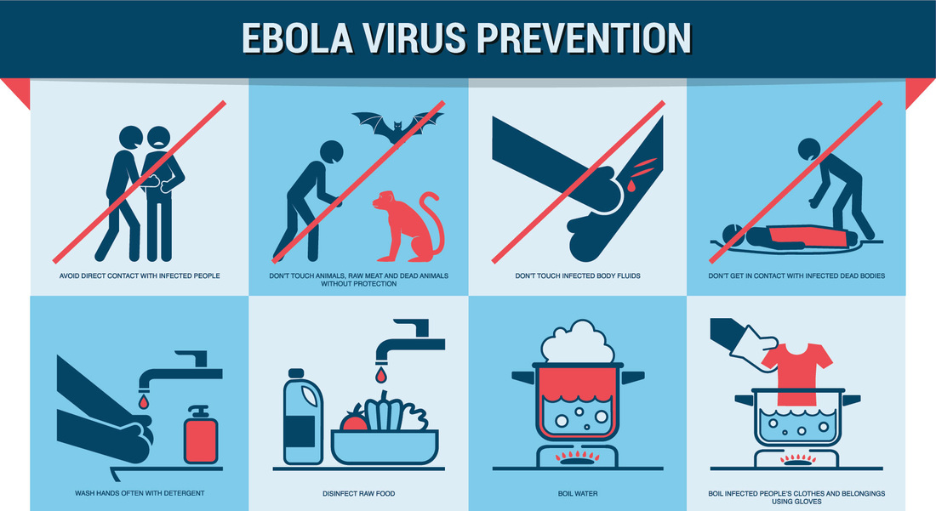
Ebola - Prevention
There is no FDA-approved vaccine
In areas affected by Ebola:
  Practice careful hygiene
  Avoid contact with blood and body fluids
  Do not handle items that may have come in contact with an infected person’s blood or body fluids
  Avoid funeral or burial rituals that require handling the body of someone who has died from Ebola
  Avoid contact with bats and nonhuman primates or blood, fluids, and raw meat prepared from these animals
  Avoid hospitals in West Africa where Ebola patients are being treated.

Slide 30
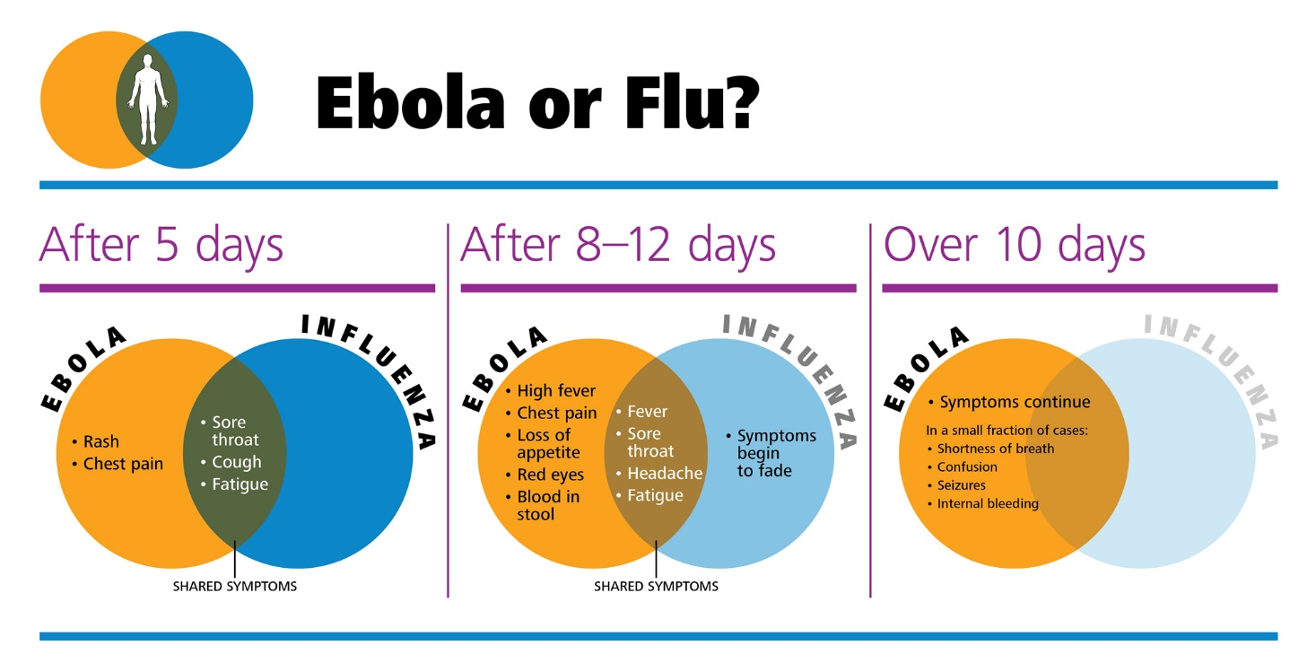
Ebola vs Flu
Use the diagrams to discuss the similarities and differences in Influenza and Ebola.

Slide 31
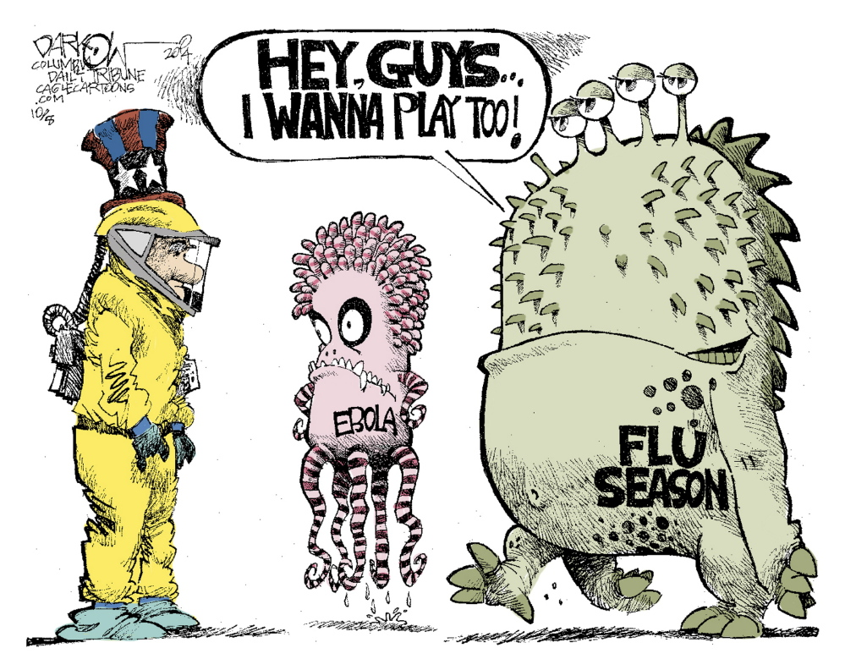
Ebola vs Flu
Flu causes an estimated 250,000 to 500,000 deaths every year
Yearly, 3 million to 5 million people become seriously ill from influenza viruses
Ebola is only a threat to the regions in which it is endemic
In most of the world it is much more difficult to contract Ebola than Flu

Slide 32
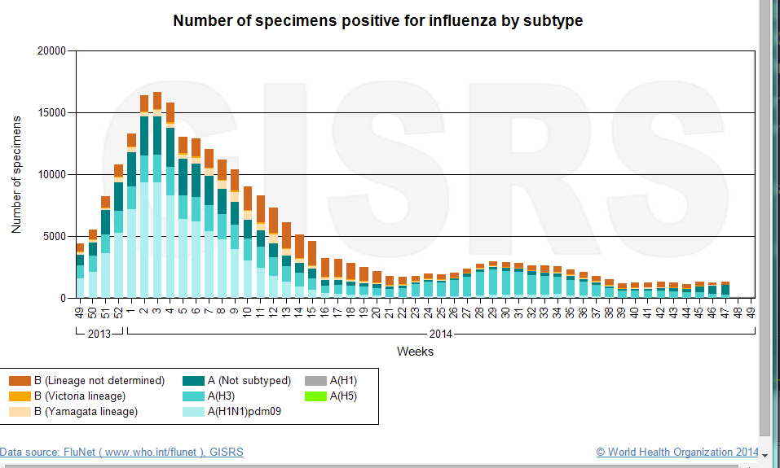
Flu Cases
http://gamapserver.who.int/gareports/Default.aspx?ReportNo=6

Slide 33
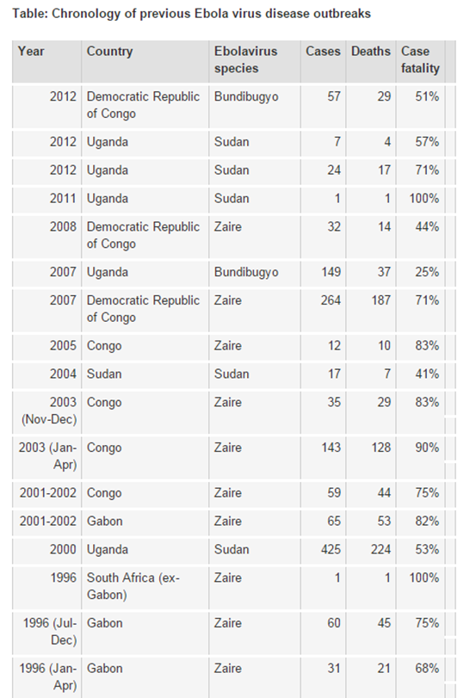
Ebola Cases
http://www.who.int/mediacentre/factsheets/fs103/en/

Slide 34
Discussion
What symptoms do the two have in common?
How are both Flu and Ebola Transmitted?
Which one kills more people yearly?
Which do you think is a greater health threat?
How can we help spread awareness about the topics?

Slide 35
The End
http://www.bostonmagazine.com/health/blog/2013/10/24/flu-virus/

