Slide 1
Work

Slide 2
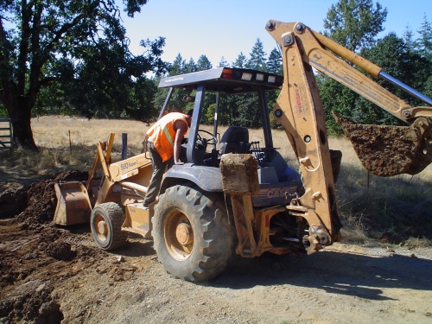
What do you think of when you think of work?
You probably think of…

Slide 3
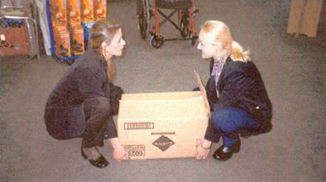
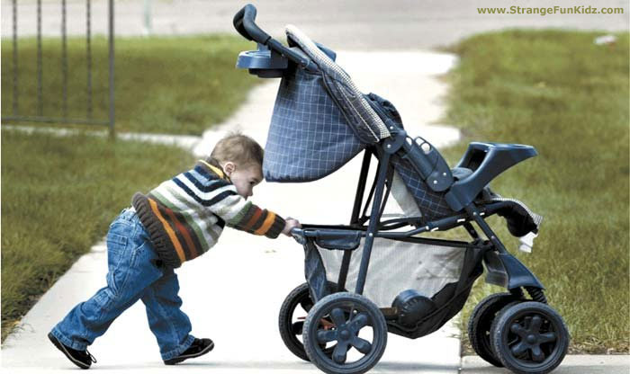
In physics…
Work is performed when a force that is applied to an object moves that object.

Slide 4
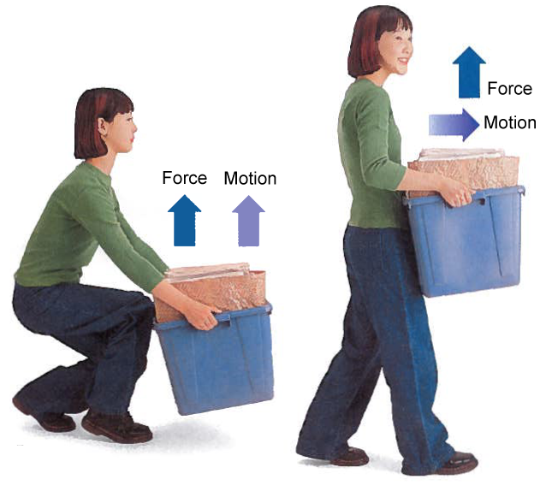
When is work done?
The force and motion of the object have to be in the same direction.
There must be some movement in the direction of the force.
Work is done on the bin because force and motion are in the same direction.
No work is done on the bin because force and motion are in different directions.

Slide 5
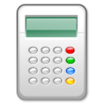
Formula
Work = Force x Distance
The unit of force is Newtons (N)
The unit of distance is meters (m)
The unit of work is Newton-meters (N m)
One Newton-meter is equal to one joule
So, the unit of work is a joule (J)
Work (J) = Force (N) x Distance (m)

Slide 6
Thus, work depends on…
Work = Force x Distance
Force
Distance
Force
The larger the applied force, the more work is being done.
The smaller the applied force, the less work is being done.
Distance
The further an object is moved, the larger the work required.
The shorter the object is moved, the smaller the work required.

Slide 7
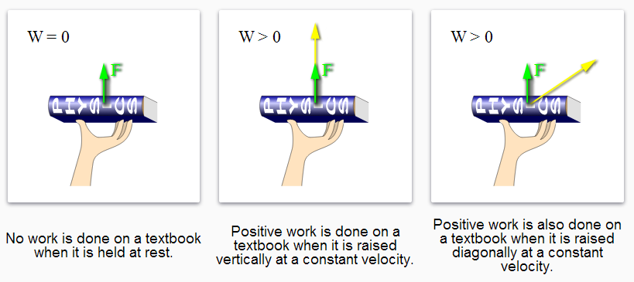

Slide 8
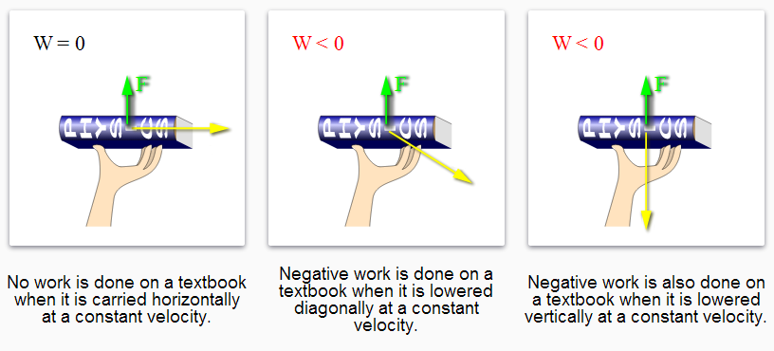

Slide 9
Suppose you want to get to the top of a hill. Which path will require the least amount of work to get to the top?
Path B
Climbing up the steep hill
Path A
Walking up the long hill

Slide 10
If you chose path A… then you are wrong! If you chose path B… then you are also wrong!
Both paths require the same amount of work to get to the top.

Slide 11
How is this possible?
Path A, while longer, requires less force (than B) against gravity to reach the top.
Path B, while shorter, requires more force (than A)against the gravity to reach the top.
Work
Force
Distance
Work
Force
Distance
Both paths require the same amount of work to get to the top.

Slide 12
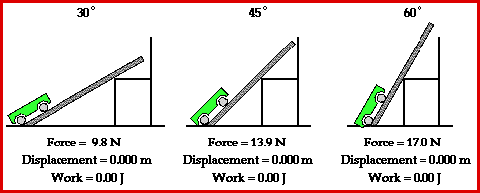
Let’s look at another example.
An inclined ramp at different angles: 30°, 45°, 60°
Observe what happens to work (bottom row) as the car reaches the same height with the different sloped ramps.
The car must use a greater force to move up against gravity.
The greater the incline the less distance the car must travel.

Slide 13
Work Example 1
You are leaning on a box with a force of 20 Newtons (N) but the box doesn’t move. How much work is done?
W = F x D
W= 20 N x 0 m
W= 0 Joules
No work is done on the box!

Slide 14
Work Example 2
You lift a box with 10 Newtons of force onto a moving truck that is 1.5 meters high. How much work did you do?
W = F x D
W= 10 N x 1.5 m
W= 15 Joules

Slide 15
Work Example 3
It takes 5 Newtons of force to push the same box onto a moving truck using a ramp that is 3 meters long. How much work did you do? (Assuming no friction on the ramp)
W = F x D
W= 5 N x 3 m
W= 15 Joules
The same amount of work is done but the ramp makes the work easier due to distribution of force.
Notes:
In presence of friction, the work done in the ramp example would be higher but the force would still be lower since it is distributed over a ramp.

Slide 16
As you saw from the previous examples:
If you move the SAME object to the SAME location, it is the SAME WORK!

Slide 17
Summary
Work is performed when a force applied to an object moves the object.
The force and motion of the object have to be in the same direction for work to be done.
There must be some movement in the direction of the force.
Work depends on force and distance.
No work is done on an object when it is at rest.
Displacing the same object to the same location results in performing the same amount of work.

Slide 18
Calculating Work Tips
Read the question carefully to identify what you need to solve for and what is given to you.
Every answer should have the units included.
The shorthand for the unit meters is written as m and Newtons is N.
Work in a step by step manner by writing each step out.
The Work Equation can be rearranged to solve for different things.
Force x
Work
Work =
Distance
Force =
Distance
Work =
Force x
Distance
Distance =
Work
Force

