Slide 1
3. Cell Volume Density
Print out the Plus Counter on a transparency sheet.
Open the healthy blood image, and set the magnification to 80x.
Hold the Plus Counter transparency over the computer screen. Tape it in place if need be.
Return to
Toolkit

Slide 2
3. Cell Volume Density
Print out the Plus Counter on a transparency sheet.
Set the magnification to 80x.
Hold the Plus Counter transparency over the computer screen. Tape it in place if need be.
Count the number of cells under the center of each cross (one “hit” is scored for each cross) as a random sampling that represents the whole.
Record the numbers in the worksheet and add up totals.
Move to a new area and repeat hit count 5 or more times.
Add up the total hits that land on red blood cells from all repeated counts, divide by the number of possible “hits” (e.g., 5 repeats X 25 pluses per sheet = 125), and multiply that value by 100 to calculate cell volume density.
Repeat for white blood cells.

Slide 3
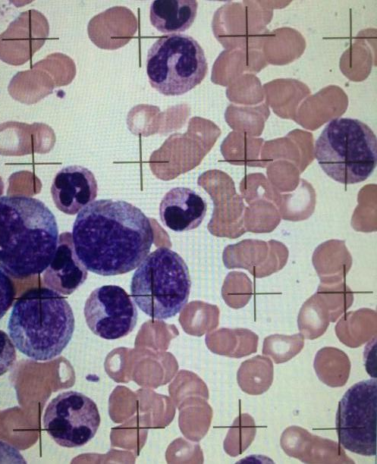
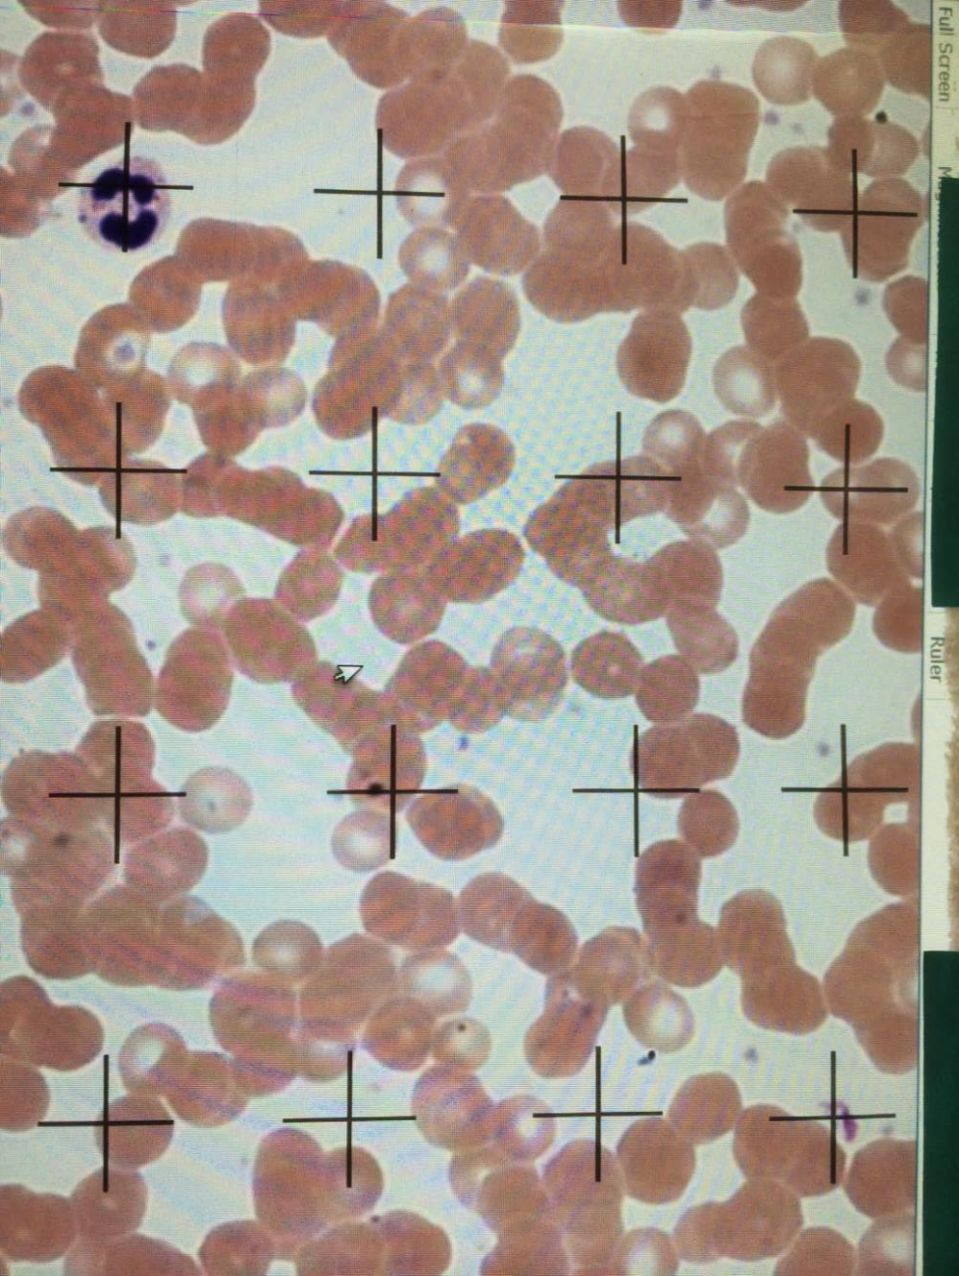
Normal blood
10 RBC vs 1 WBC
Abnormal blood
7 RBC vs 4 WBC
Note: To show cells at higher magnification, only 16 of the 25 crosses are shown here

Slide 4
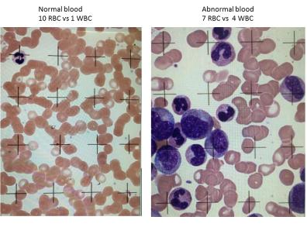
3. Cell Volume Density Example Data
Healthy Blood
Unhealthy Blood
RBC
WBC
RBC
WBC
14
16
20
20
20
…
...
18
0
0
0
0
1
…
...
0
10
7
10
8
10
…
...
5
9
8
4
12
5
…
...
5
Total Hits
274
1
133
92
Ratio of cells
Magnitude of
difference
= .004
1/ 274
92/133 = .692
692/.004 = 189 times
Conclusion : white blood cells occupy 189 times more volume in the abnormal blood.

Slide 5
3. Cell Volume Density Example Data: percentage of whole occupied by each component
Healthy Blood
Unhealthy Blood
Total Hits
274
1
133
92
RBC
WBC
RBC
WBC
Total Cells Counted
274 + 1 = 275 133 + 92 = 225
Healthy Blood
Unhealthy Blood
RBC
RBC
Volume Density of Cells
274
133
x 100 =
99%
WBC
x 100 =
59%
275
225
WBC
1
92
x 100 =
0.003%
275
x 100 =
40%
225

