Slide 1
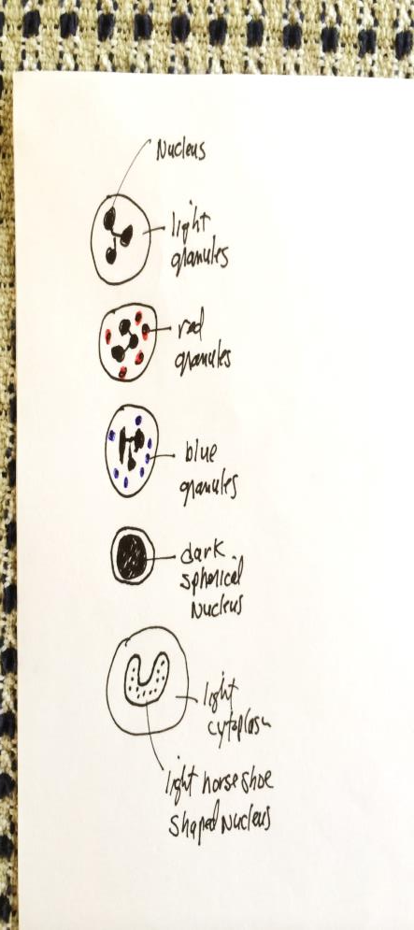
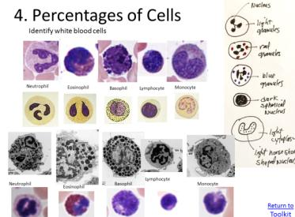
4. Percentages of Cells
Neutrophil
Eosinophil
Open the healthy blood image, and set the magnification to 80x.
Pick at least 50 random white blood cells and classify which type it is based on images below.
Calculate the percentage of each WBC type found in the sample.
Note, some WBC types are rare and you might not
find any of them (e.g., basophils).
Basophil
Lymphocyte
Monocyte
Return to
Toolkit

Slide 2
4. Percentages of Cells Example Data
Number of Cells in Healthy Blood
Neutrophil
Lymphocyte
Monocyte
Eosinophil
Basophil
Counted
46
8
6
2
1
Total
46 + 8 + 6 + 2 + 1 = 63
6
1
46
x 100 =
0.09%
63
x 100 =
Percent
x 100 =
73%
63
63
8
2
0.01%
63
x 100 =
12%
x 100 =
0.03%
63
Conclusion: Neutrophils are the most numerous white blood cell in blood.
Neutrophil

