Slide 1
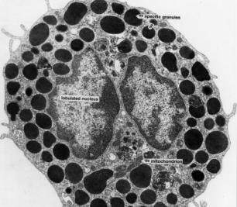
6. Organelle Volume Density
Print out the Plus Counter on a transparency sheet.
Open the electron micrograph to full screen.
Hold the Plus Counter transparency over the computer screen. Tape it in place if need be.
nucleus
granules
Return to
Toolkit

Slide 2
6. Organelle Volume Density
Print out the Plus Counter on a transparency sheet.
Set the magnification to 80x.
Hold the Plus Counter transparency over the computer screen. Tape it in place if need be.
Count the number of organelles under the center of each cross (one “hit” is scored for each cross).
Count the number of crosses that touch nothing outside of the cell – this will be your possible hits total.
Rotate cross transparency 45 degrees to the right and recount. Rotate another 45 and repeat 1-3 more times.
Print out the Plus Counter on a transparency sheet.
Set the magnification to 80x.
Hold the Plus Counter transparency over the computer screen. Tape it in place if need be.
Count the number of organelles under the center of each cross (one “hit” is scored for each cross).
Count the number of crosses that touch nothing outside of the cell – this will be your possible hits total.
Rotate cross transparency 45 degrees to the right and recount. Rotate another 45 and repeat 1-3 more times.
Add up the total hits that land on each organelle from all repeated counts, divide by the number of possible “hits,” and multiply that value by 100 to calculate volume density.

Slide 3
6. Organelle Volume Density –
Example Data
Electron micrograph
Nucleus
Granules
Other
Total Possible
12
10
15
Total Hits
9 22 6 37
Organelle
Volume Density
9
22
6
x 100 =
24%
x 100 =
59%
x 100 =
16%
37
37
37
Conclusion: One forth of this cell was nucleus and 60% of this cell was granules.

Slide 4
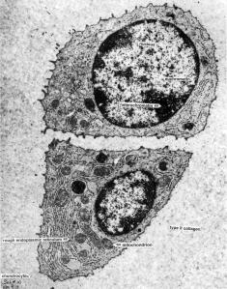
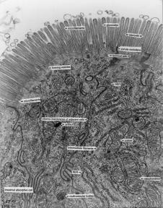
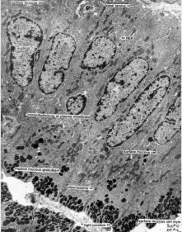
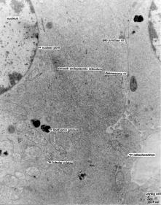
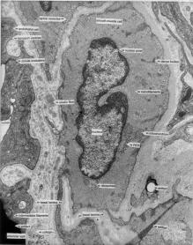
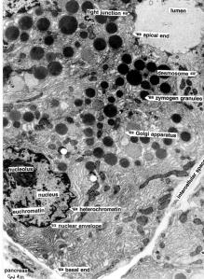
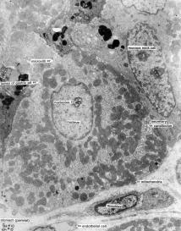
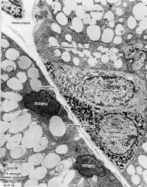
Other electron micrographs that could be enlarged to fill the computer screen and be used to determine the volume density of organelles in different types of animal cells.

