Slide 1
Blood and Lymph Vessels
VIBS 443/602

Slide 2
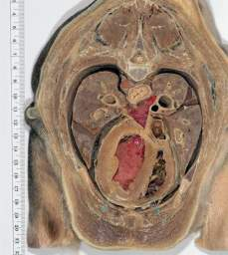
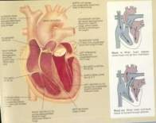
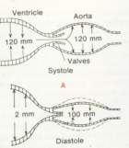
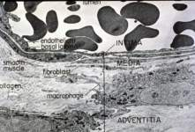
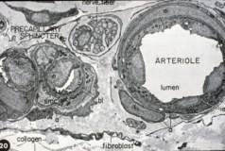
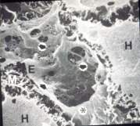
OBJECTIVES
LAYERS IN VASCULAR WALLS
CLASSIFICATION OF VESSELS
VARIATION IN MICROVASCULATURE
LYMPHATIC SYSTEM

Slide 3
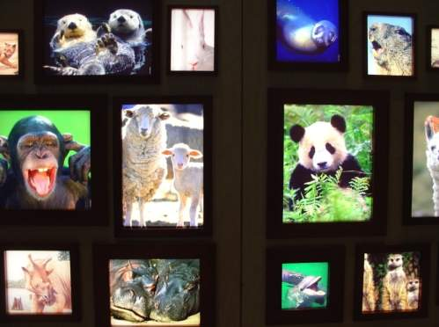
Introduction Multicellular Organisms Need 3 Mechanisms ---------------------------------------------------------------
Distribute oxygen, nutrients, and hormones
Collect waste
Transport waste
to excretory
organs
CARDIOVASCULAR SYSTEM

Slide 4
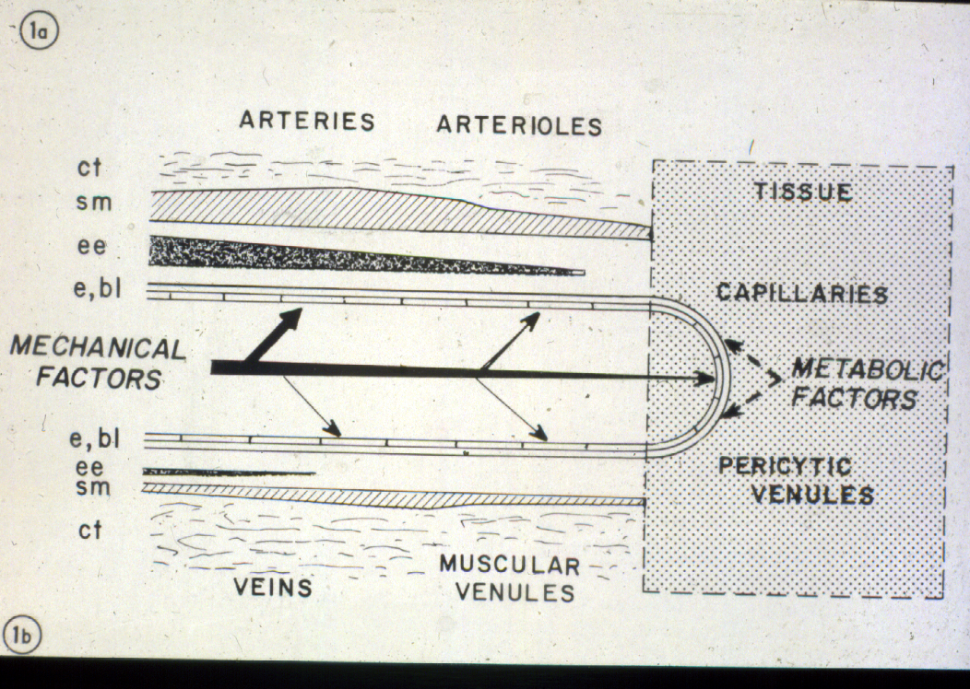
CARDIOVASCULAR SYSTEM
HEART PRODUCES BLOOD PRESSURE (SYSTOLE)
Vessels are structurally
adapted to physical
requirements and
metabolic needs

Slide 5
CARDIOVASCULAR SYSTEM
ELASTIC ARTERIES - CONDUCT BLOOD AND MAINTAIN PRESSURE DURING DIASTOLE

Slide 6
CARDIOVASCULAR SYSTEM
MUSCULAR ARTERIES - DISTRIBUTE BLOOD, MAINTAIN PRESSURE
ARTERIOLES - PERIPHERAL RESISTANCE AND DISTRIBUTE BLOOD
CAPILLARIES - EXCHANGE NUTRIENTS AND WASTE
VENULES - COLLECT BLOOD FROM CAPILLARIES (EDEMA)

Slide 8
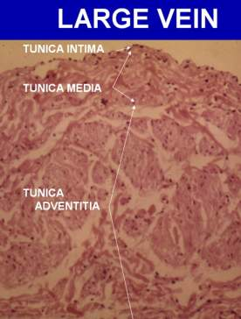
LAYERS IN VASCULAR WALL
LAYER COMPOSITION
TUNICA INTIMA ENDOTHELIUM (SUBENDOTHELIA CT. INTERNAL ELASTIC LAMINA)
TUNICA MEDIA SMOOTH MUSCLE (ELASTIC LAMELLAE, EXTERNAL ELASTIC LAMINA)
TUNICA CONNECTIVE TISSUE ADVENTITIA (LONGITUDINAL SMOOTH MUSCLE, VASA VASORUM)

Slide 9
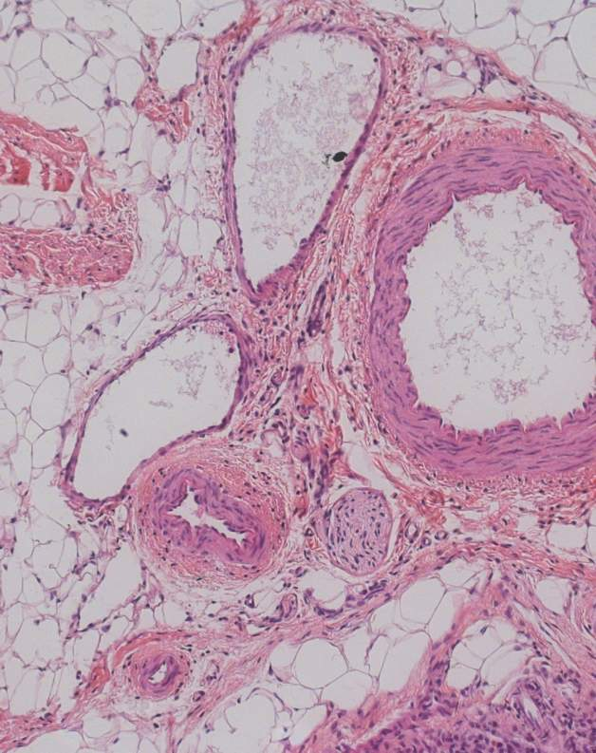
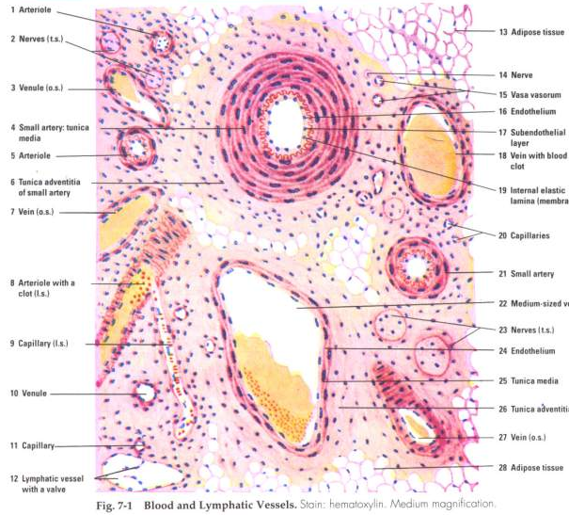
17

Slide 10
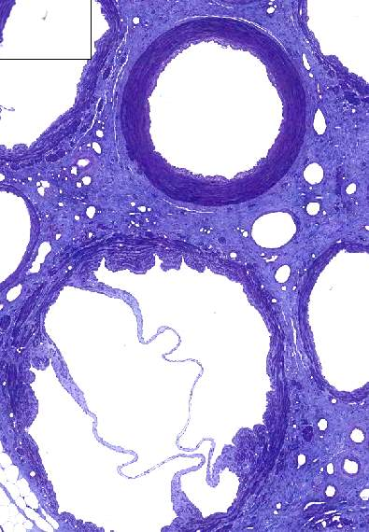
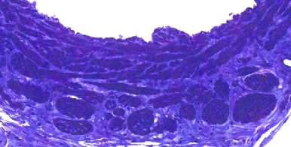

Slide 11
Slide 427 aorta

Slide 12
Slide 427

Slide 13
432 lung

Slide 14
432

Slide 15
472 fallopian tube

Slide 16
426 renal

Slide 17
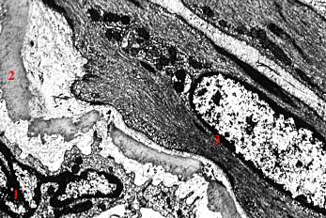
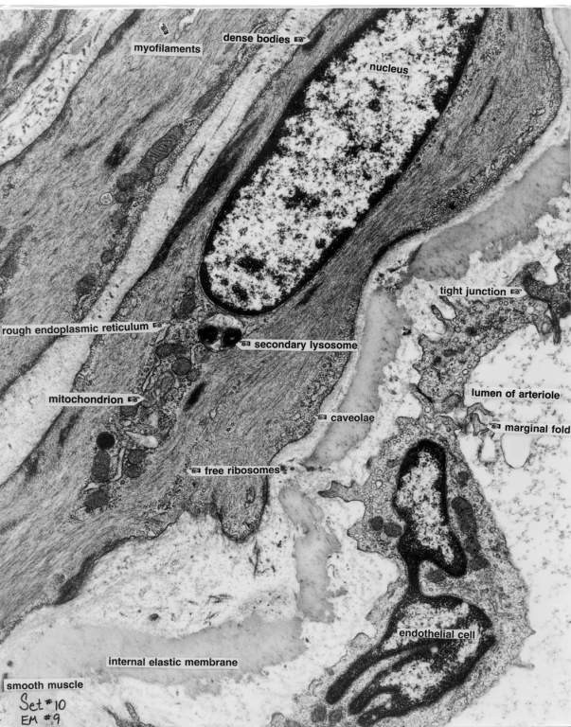
EM 9 of arteriole:
Endothelial cell
Internal elastic membrane
Smooth muscle cell

Slide 18
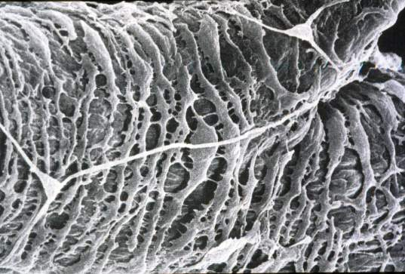
Note difference
in density of
smooth muscle
cells.
VENULE
MUSCULAR
ARTERY

Slide 19
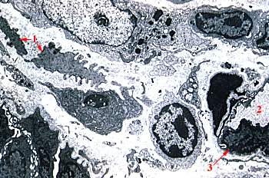
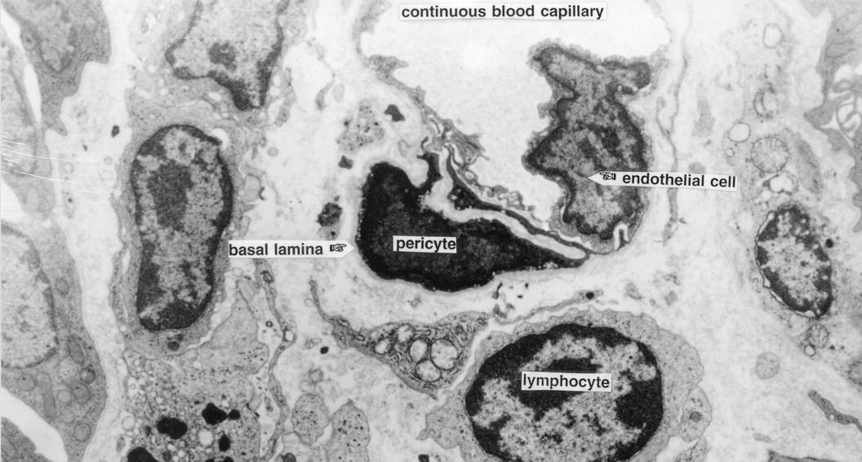
EM 17 of capillary in the lamina propria of the intestine
Smooth muscle cell
Capillary
Endothelial cell

Slide 20
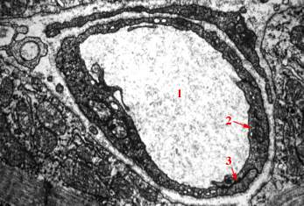
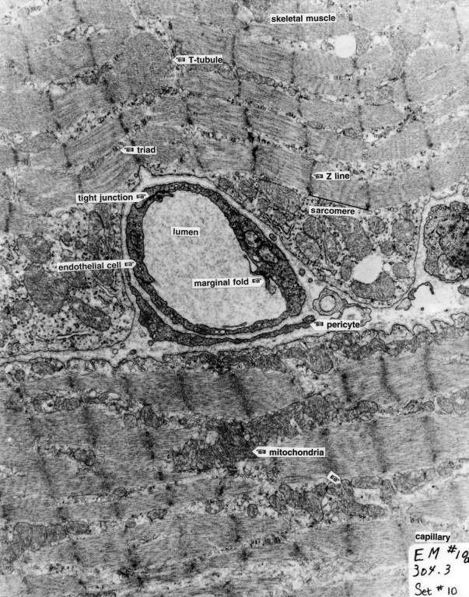
EM 10a: pericyte in vessel wall; 20,000x
Lumen
Endothelial cell
Tight junction

Slide 21
basal lamina
liver
muscle/brain
kidney/adrenal

Slide 22
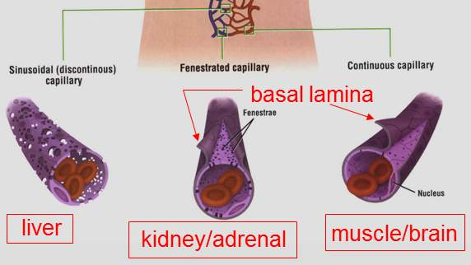
basal lamina
liver
muscle/brain
kidney/adrenal

Slide 23
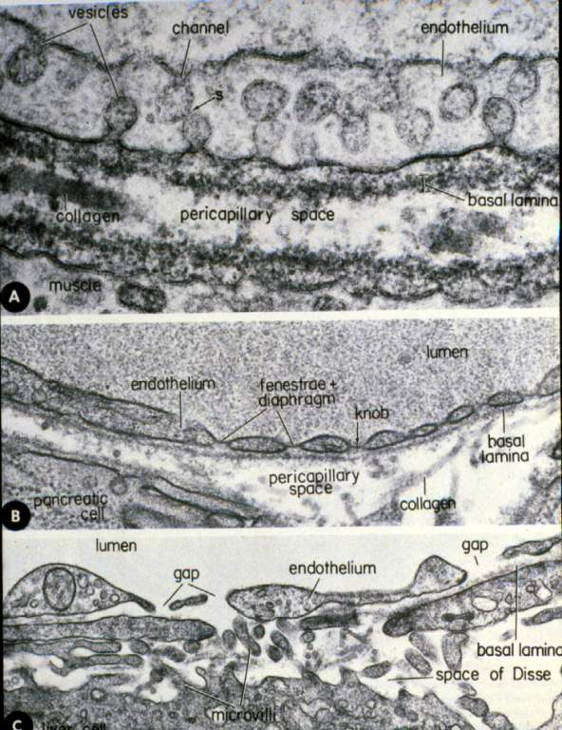
CONTINUOUS
FENESTRATED
SINUSOIDAL

Slide 24
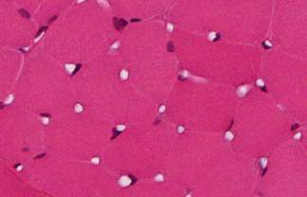
TYPES OF CAPILLARIES & BASAL LAMINA CHARACTERISTICS
CAPILLARIES BASAL LAMINA EXAMPLES OF LOCATIONS
CONTINUOUS COMPLETE MUSCLE, TESTIS, BRAIN,
THYMUS
FENESTRATED COMPLETE GLOMERULUS, ADRENAL
DISCONTINUOUS INCOMPLETE OR LIVER, SPLEEN, BONE
OR SINUSOIDAL LACKING MARROW
MUSCLE
GLOMERULUS
LIVER

Slide 25
Tongue, monkey
136

Slide 26
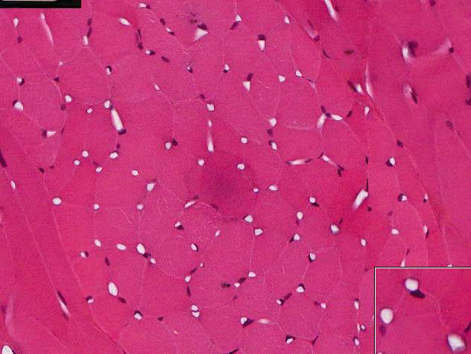
CONTINUOUS capillaries in muscle
Notes:
Slide 136

Slide 27
Adrenal -cortex and medulla
186
FENESTRATED
capillaries

Slide 28
Rib bone marrow
420
SINUSOIDAL
capillaries

Slide 29
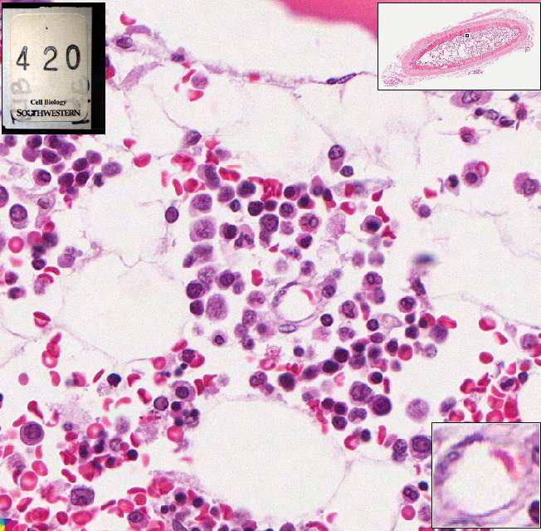
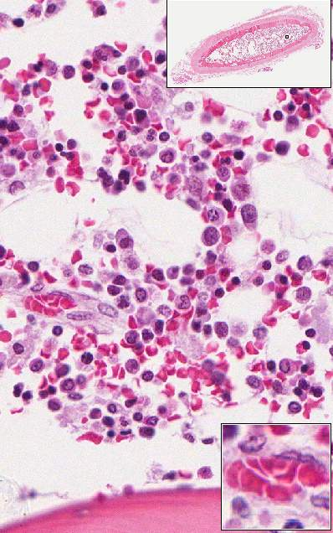
420
SINUSOIDAL
capillaries

Slide 30
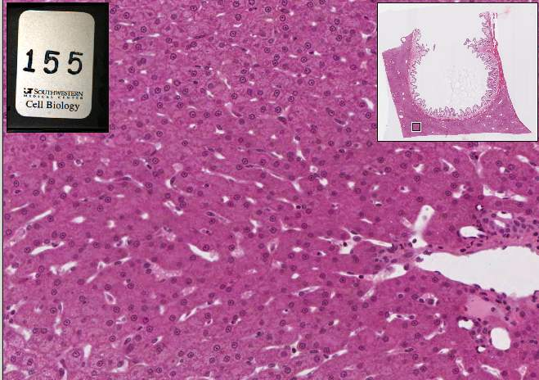
Gall bladder & liver, monkey
155
SINUSOIDAL
capillaries

Slide 31
Bile duct with portal vein, monkey
126

Slide 32
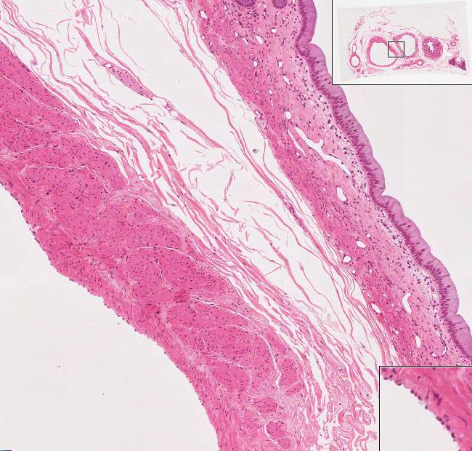
Bile duct with portal vein, monkey
126

Slide 33
Vein of Spermatic cord
196

Slide 34
UT196 valves in large vein of spermatic cord
196

Slide 35
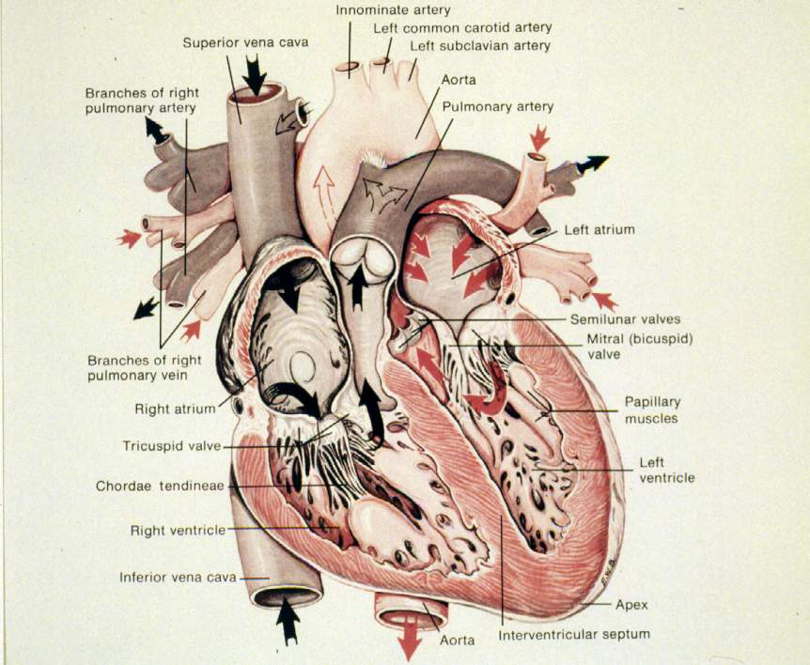

Slide 36
EM 10b

Slide 37
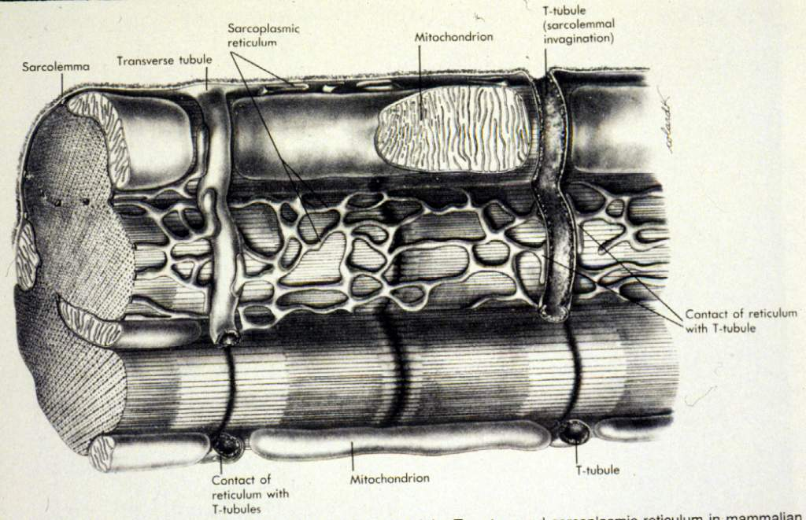
CARDIAC MUSCLE - DIAD

Slide 38
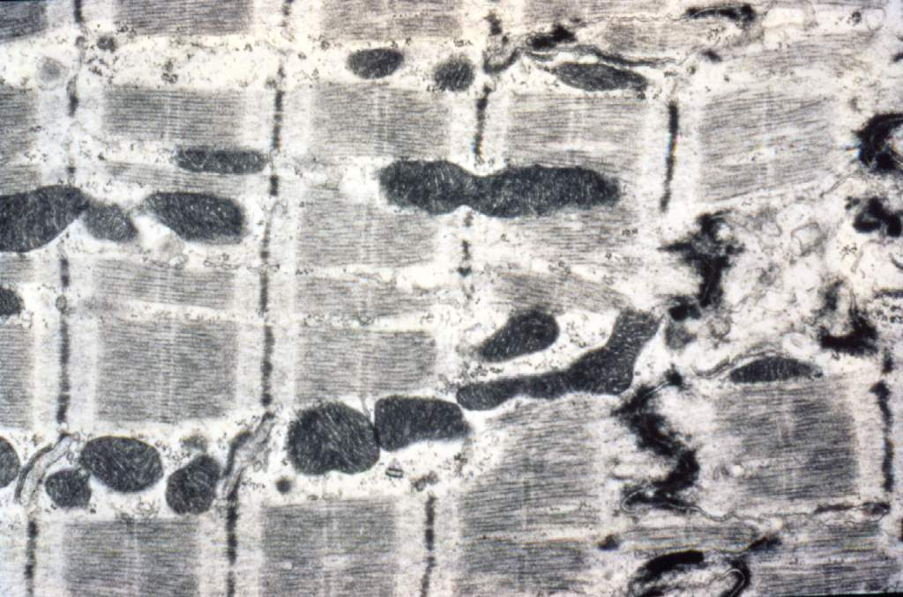
CARDIAC MUSCLE

Slide 39
Opened Interclated disc in cardiac cells of Heart, endocardium
226

Slide 40
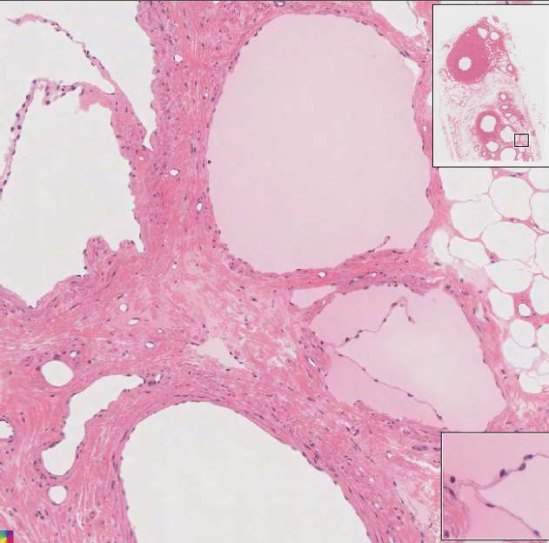
UT196 valve in lymphatic vessel in spermatic cord
196
vein
lymphatic
vessels
artery

Slide 41
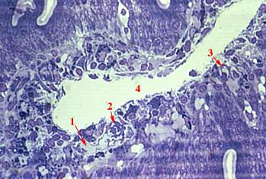
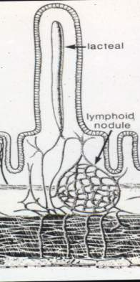
Slide 201 Higher magnification
of intestinal villus:
Lymphatic capillary
Blood capillary
Endothelial cell
Central lacteal
32409

Slide 42
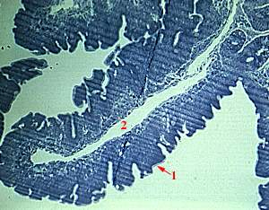
Slide 201 Intestinal villus of duodenum
Brush border
Central lacteal
32409

Slide 43
447

Slide 44
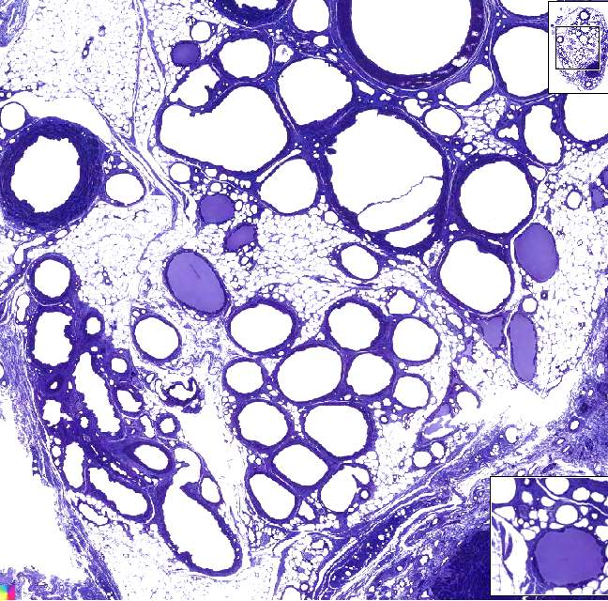
196a
lymphatic vessels in spermatic cord

Slide 45
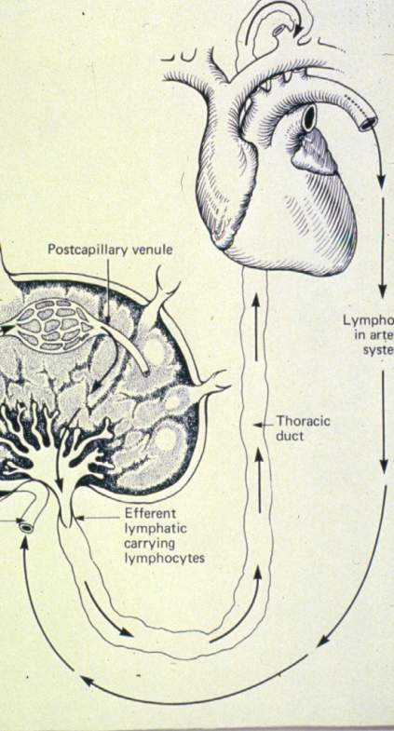
LYMPH VESSELS
FUNCTIONS
RETURN PROTEIN, FLUID, AND
BLOOD CELLS
TRANSPORT SECRETIONS
(HORMONES, ANTIBODIES)
TRANSPORT FAT
(NEUTRAL FAT)

Slide 46
Thoracic duct
128

Slide 47
Thoracic duct
128

Slide 48
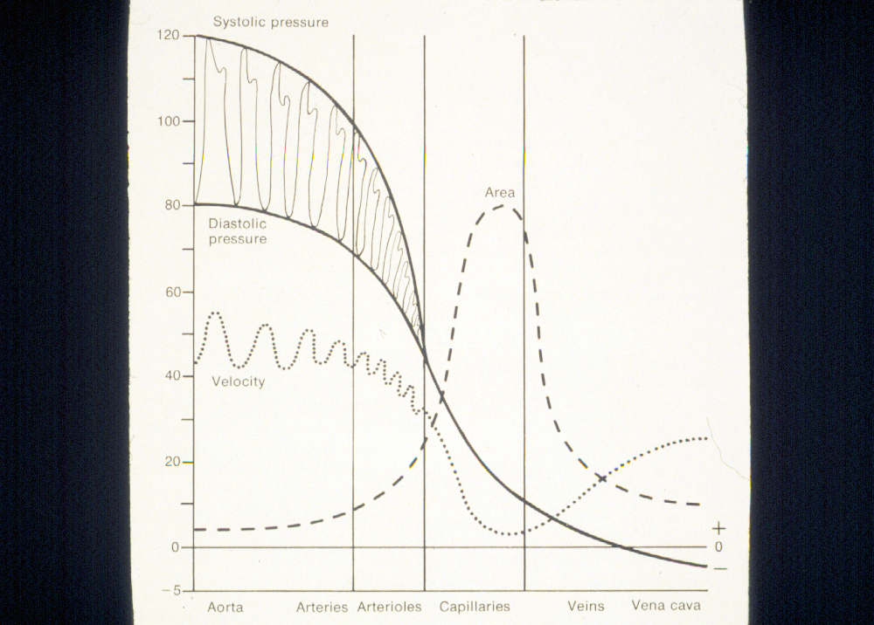
SUMMARY CARDIOVASCULAR SYSTEM
Vessels are structurally
adapted to physical
requirements and
metabolic needs

Slide 49
SUMMARY CARDIOVASCULAR SYSTEM
Vessels are structurally
adapted to physical
requirements and
metabolic needs

