Slide 1
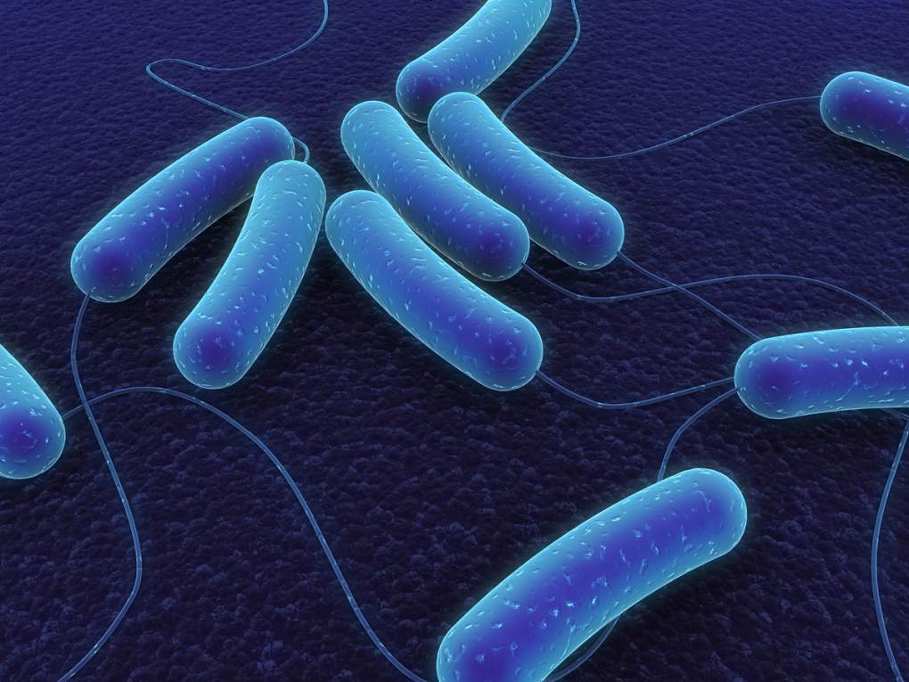
Kingdom Archaebacteria and Kingdom Eubacteria

Slide 2
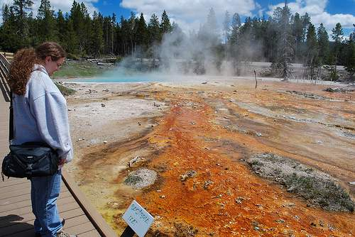
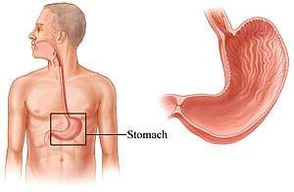
Who would live here?!
Archaebacteria!
OR here?!
Eubacteria!

Slide 3
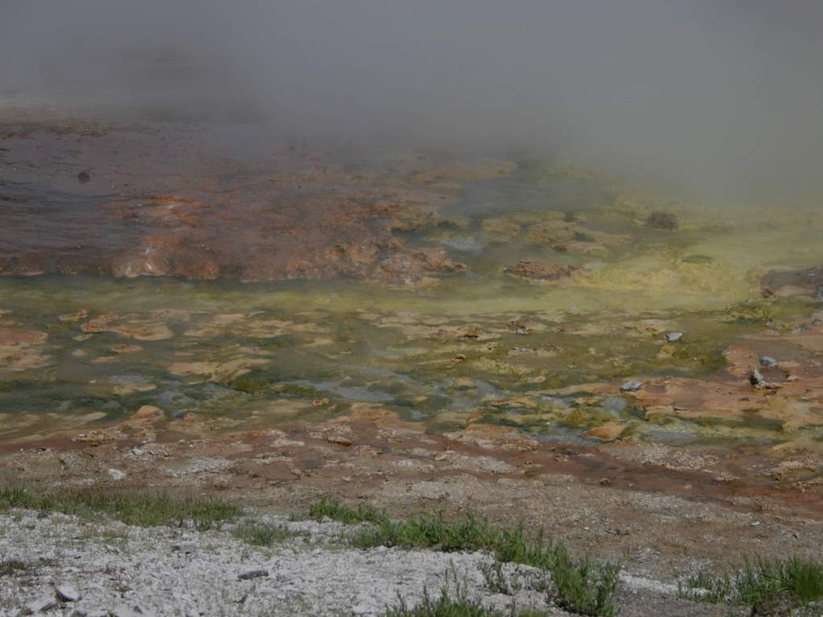
Kingdom Archaebacteria
Archaea comes from Ancient Greek, meaning ancient things—believed to be in existence for around 3.5 BILLION years
Autotrophs, or producers
Some use carbon fixation, a process that converts gaseous carbon dioxide to solid carbon compounds
Live in extremely adverse conditions, like the one pictured from Yellowstone National Park or even in highly acidic environments without oxygen, such as thermal vents on the ocean floor

Slide 4
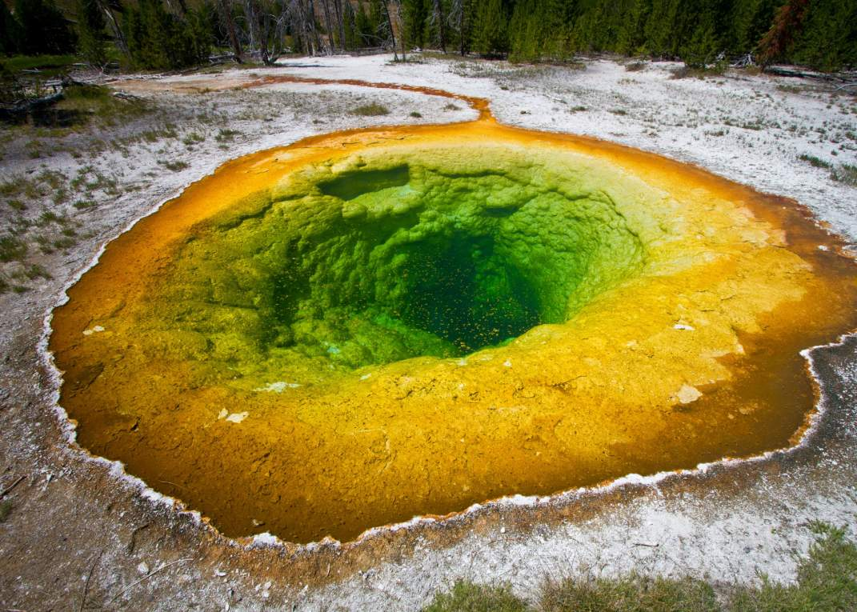
Cellular Characteristics
Archaebacteria have NO peptidoglycan in their cell walls
The cell wall is made up of glycoproteins and polysaccharides.
The cell wall envelopes have a high resistance to antibiotics due to difference in cell wall composition.
They have a very different lipid bilayer making up the cell membranes
16S rRNA and 18S rRNA sequences were totally different in archea from other bacteria

Slide 5
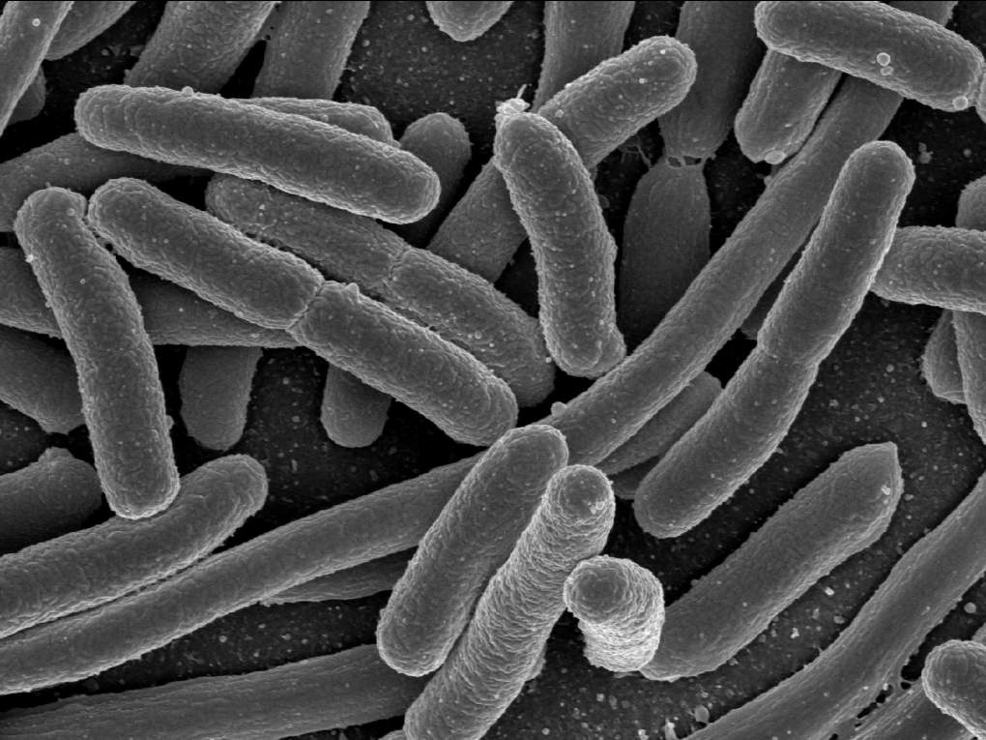
Kingdom Eubacteria
Most common bacteria
Can also live in extreme conditions
Some also use carbon fixation
Reproduce asexually with binary fission
Nearly 5000 species discovered to date!
Some can be pathogenic, like Clostridium tetani, which causes tetanus or Yersinia pestis, which causes the Bubonic plague
Some are “good bacteria,” like lactobacillus, which helps the formation of curd and is good for human health

Slide 6
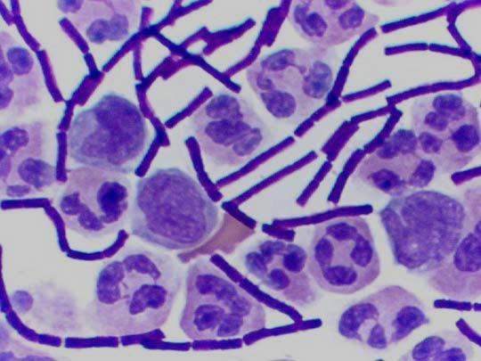
Cellular Characteristics
Eubacteria DO have peptidoglycan in their cell walls
Cell wall surrounds the plasma membrane
Peptidoglycan cell wall surrounded by another layer called the outer membrane
Outer membrane is protected by yet another layer called the capsule
Many have specialized internal membranes, like cyanobacteria which contain chlorophyll

Slide 7
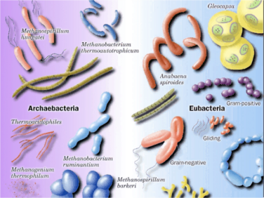
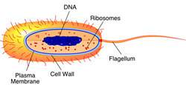
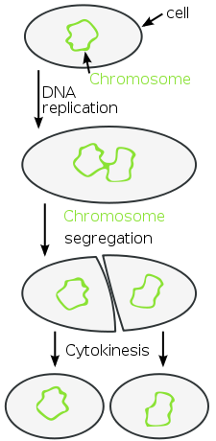
Similarities
Live in extreme environments like intestinal tracts or thermal vents on the ocean floor
Some of both can use nitrogen fixation
Both are prokaryotic organisms —they lack a nucleus and internal organelles such as mitochondria
A bacterium's DNA floats freely within the cytoplasm that is contained by its cell wall
Both reproduce using binary fission
Unicellular organisms
Both can be beneficial; “good bacteria”
Binary fission→

Slide 8
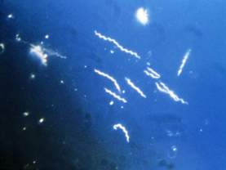
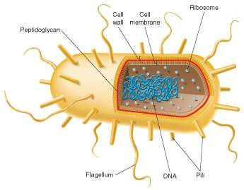
Differences
There are NO pathogenic archaebacteria—only eubacteria can be pathogenic
Only eubacteria have peptidoglycan in their cell walls
Genetically different due to archaebacteria’s ribosomal RNA sequence

Slide 9
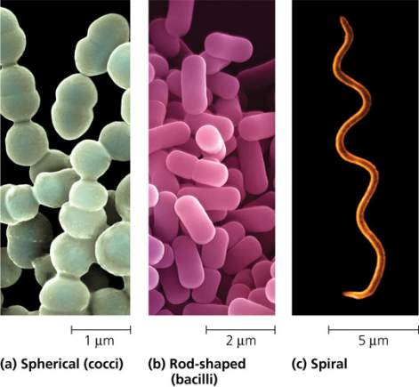
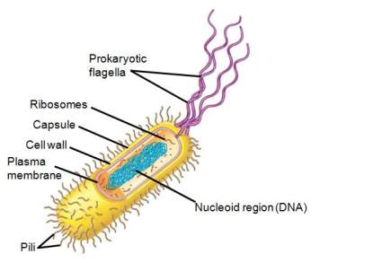
Physical Traits of Bacteria
Can be spherical, spiral or rod-like
Can have flagella (tails)

Slide 10

Fun Quiz and Activity
Take the “Bacteria 500”
http://www.beyondbooks.com/lif72/00071636.asp
“Germ Growth” PowerPoint lab

Slide 11
Important Sites
http://www.buzzle.com/articles/eubacteria-kingdom.html
http://www.buzzle.com/articles/archaebacteria-kingdom.html
http://www.buzzle.com/articles/archaebacteria-and-eubacteria-difference.html
http://www.ric.edu/faculty/ptiskus/six_kingdoms/index.htm
http://www.beyondbooks.com/lif72/2a.asp

