Slide 1
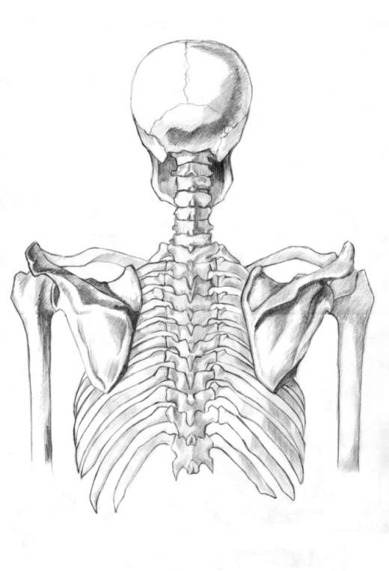
Skeletal System

Slide 2
Functions
Protects our organs (brain, intestines, etc.)
Provides a framework for the movement of our body through our muscles
Stores minerals that our body needs to function properly
Produces blood cells

Slide 3
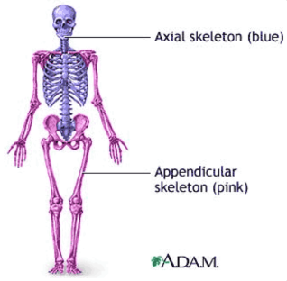
Divisions of Skeleton
Axial Skeleton: consists of the 80 bones that make up the trunk of our body.
Appendicular Skeleton: consists of the other 126 bones in the human body
and make up our limbs.

Slide 4
Shapes of Bones:
Long bones
Short bones
Flat bones
Irregular bones
(Sesamoid bones)

Slide 5
Long
Bones
Longer than wide
Carry most the load of our daily activities
Crucial for skeletal mobility
Examples: thigh bone (femur), tibia, and fibula

Slide 6
Long
Bones
Structure:
Diaphysis: main shaft composed of compact bone
Periosteum: membrane of living cells in diaphysis that allow tendons and muscles to attach themselves to bones
Medullary cavity: hole that contains bone marrow
Bone marrow: stores fat, produces blood cells, and plays an important part in the body’s immune system
Epiphysis (2 portions): part that is composed of cancellous bone and articular cartilage

Slide 7
Diaphysis
Epiphysis
Medullary cavity
Epiphysis
Bone marrow

Slide 8
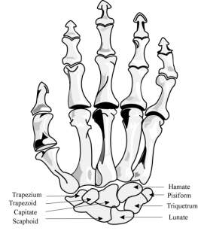
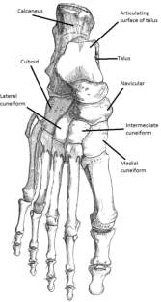
Short
Bones
Approximately about as wide as long
Provide support and stability at vital joint areas of the skeletal system
Examples: wrist/carpal bones and ankle/tarsal bones

Slide 9
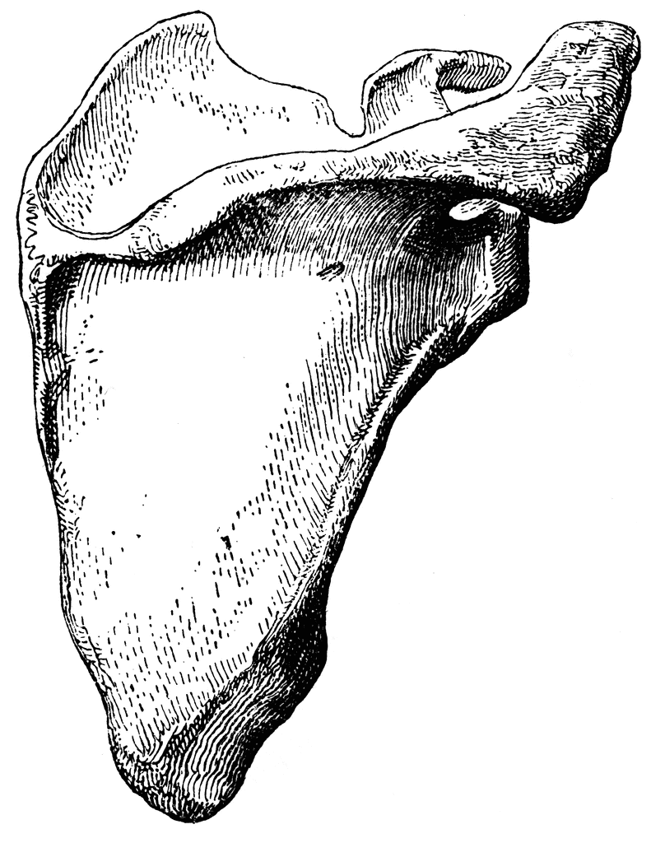
Flat
Bones
Protect vital softer tissues
Provide a surface for muscle attachments

Slide 10
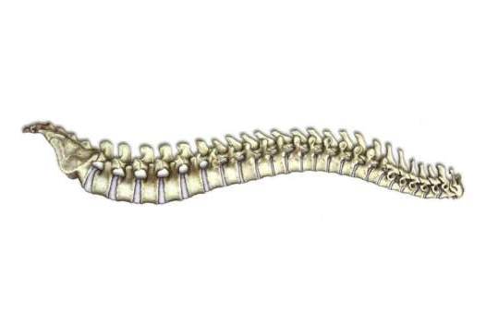
Irregular
Bones
Bones which, from their peculiar form, cannot be grouped/defined like the other types of bones
Protect nervous tissue

Slide 11
Sesamoid
Bones
Found in locations where a tendon passes over a joint, such as the hand, knee, and foot.
Functionally, they act to protect the tendon and to increase its mechanical effect.

Slide 12
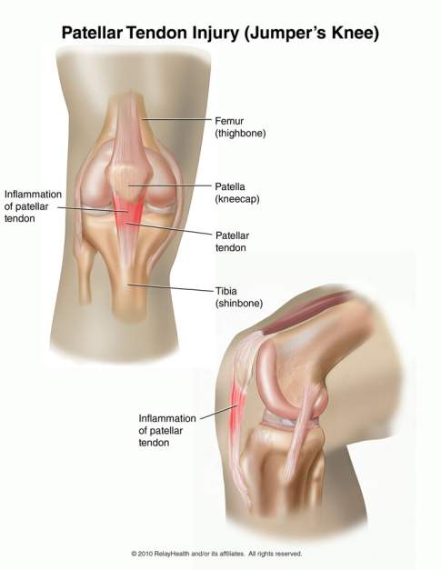
Sesamoid
Bones

Slide 13
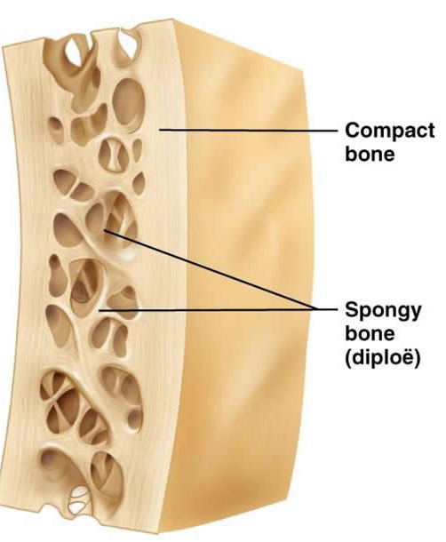
Bones
Bones have two inside parts:
Compact bone
Cancellous, or spongy, bone
So named because of its
holey appearance.

Slide 14
Types of tissue that form bones
Compact bone:
Supports the whole body
Protects organs
Provides levers for movement
Stores and releases chemical elements (calcium)
Dense, smooth and very strong
Contains living cells which help make repairs if a bone is injured or broken.

Slide 15
Types of tissue that form bones
Cancellous/spongy bone:
Typically occurs at the ends of long bones, proximal to joints and within the interior of vertebrae
Spongy and light weight
Also, like compact bone, contains living cells which help make repairs if a bone is injured or broken.

Slide 16
Compact Bone
Cancellous Bone

Slide 17
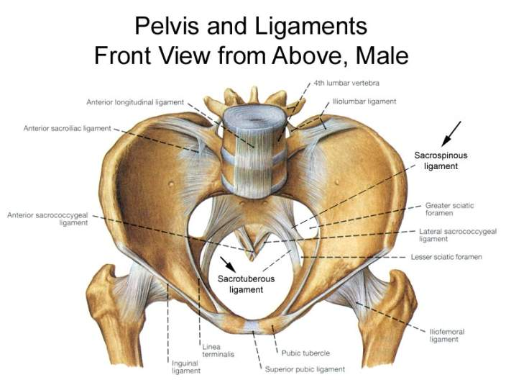
Ligaments
The tissue that connects bones to other bones

Slide 18
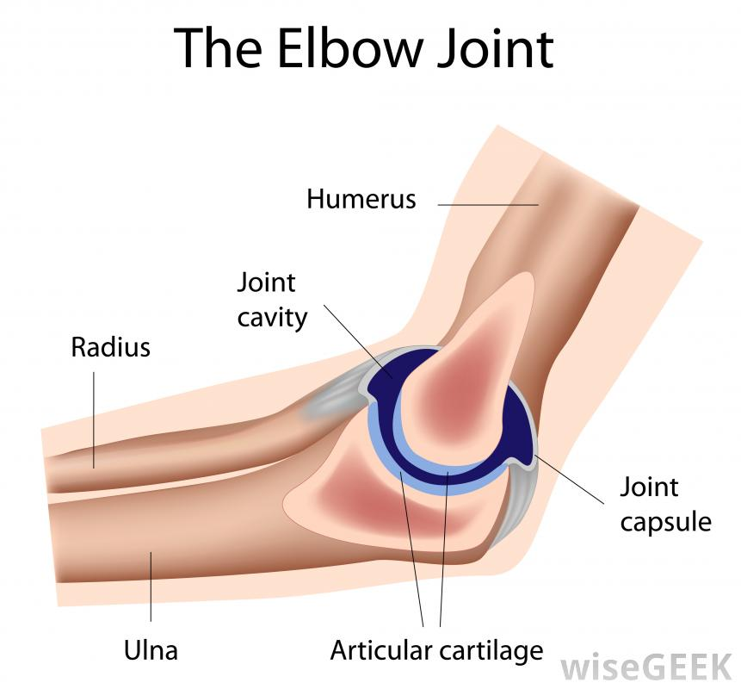
Joints
Joint: location where two or more bones make contact.
Joints allow movement and provide mechanical support.
There is a cartilage cushion in between the bones to keep them from touching directly – which would hurt!

Slide 19
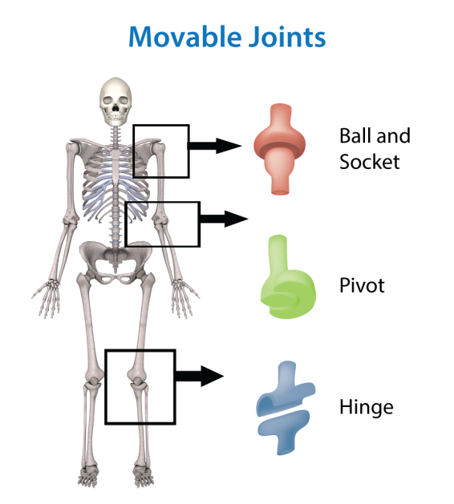
Joints
Examples of Joints

Slide 20
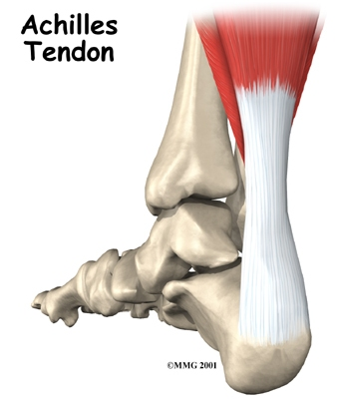
Tendons
Tendons: attach muscles to bone.
They are made out of a tough connective tissue and are capable of stretching to allow for movement.
Muscle
Tendon
Bone

Slide 21
Activity!

Slide 22
Quick Review!

Slide 23
Diaphysis
Epiphysis
Medullary cavity
Epiphysis
Bone marrow

Slide 24
Compact Bone
Cancellous Bone

Slide 25
Ligaments
Notes:
Ask them what these areas are called. Then the ‘Ligaments’ Title will come in.

Slide 26
Joints

Slide 27
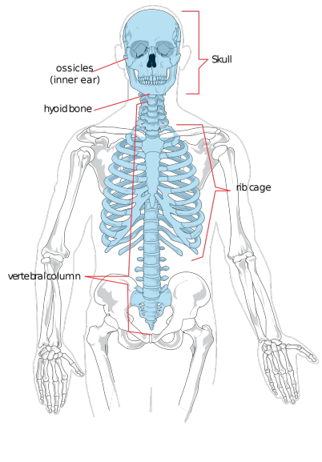
Axial Skeleton
Sections:
Skull
Spine
(vertebral column)
Ribcage

Slide 28
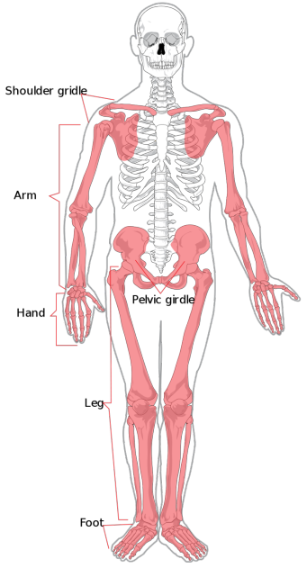
Appendicular Skeleton
Sections:
Arms and hands (upper extremities)
Legs and feet (lower extremities)
Shoulders
Hips (pelvis)

