Slide 1
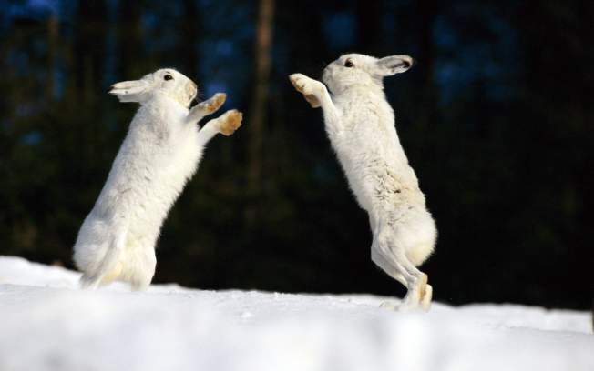
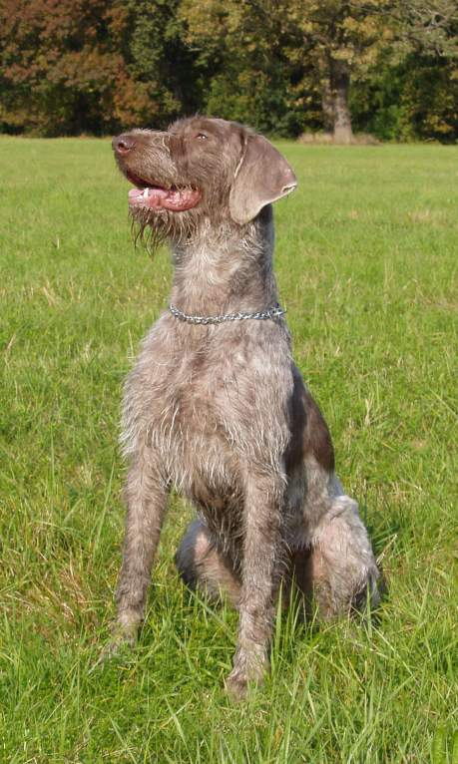
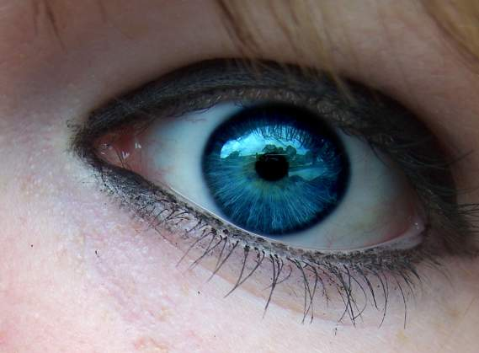
Inherited, Learned or Instinctive?
Notes:
http://wiki.answers.com/Q/What_are_examples_of_learned_behavior_in_animals

Slide 2
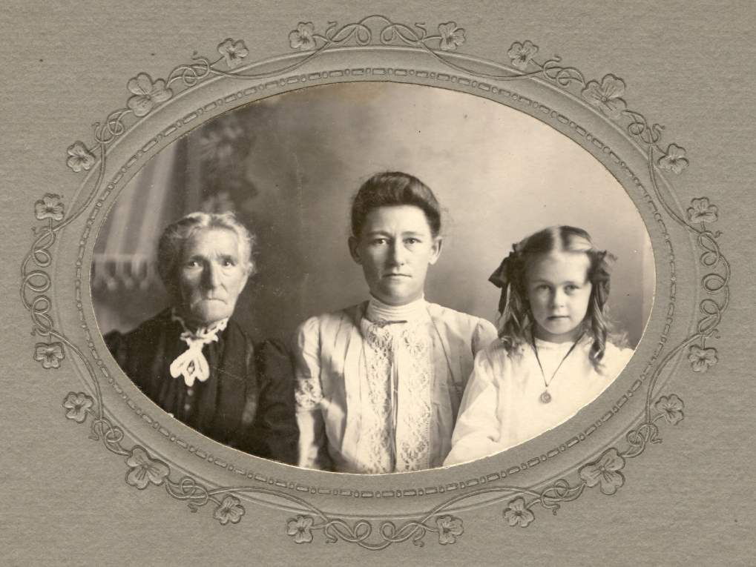
Inherited Traits
Are part of a creature’s genetic structure
We are born with these traits
  They depend on the genetic code of our parents and grandparents
Notes:
http://www.ehow.com/about_6620278_difference-between-inherited-acquired-traits_.html

Slide 3
Make a list of some traits you can think of that are inherited.

Slide 4



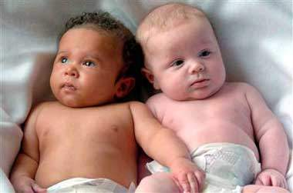
Examples
Hair and eye color, skin color, height and predisposition to some diseases are all inherited traits
Notes:
http://www.ehow.com/about_6620278_difference-between-inherited-acquired-traits_.html

Slide 5
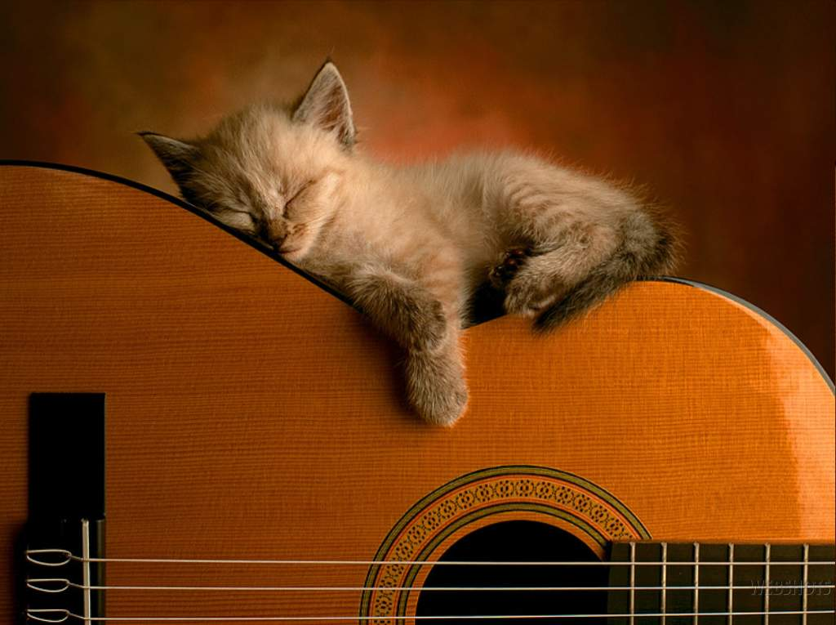
Instinctive Traits
The inborn complex behavior of any given organism that is not learned, but inherited, making them very unique behavior traits
Examples: Behaviors like sleeping and grooming.
Notes:
http://www.ehow.com/about_6171742_inherited-vs_-learned-traits.html

Slide 6
Make a list of instinctive traits you know.

Slide 7
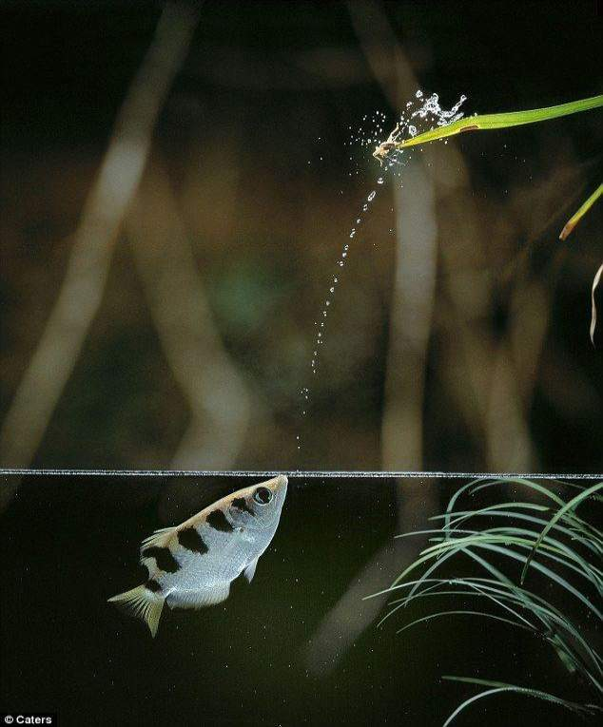
Examples
The archer fish spits streams of water up at insects in overhanging trees causing the insects to fall into the water where they can be consumed

Slide 8
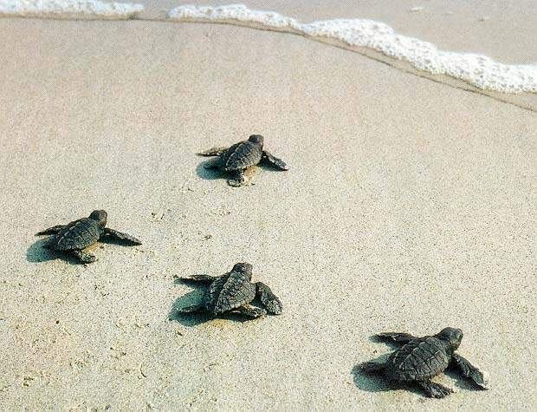
Examples continued
When the leatherback turtles hatch, the hatchlings’ immediately scamper for the ocean.

Slide 9

Learned Traits
Behavioral traits obtained by a given organism to correspond with its environment and its survival needs.
These traits must be learned in the organism’s.
These behaviors are often forced upon the given organism in order to enrich survival

Slide 10
Make a list of learned traits that you know.

Slide 11
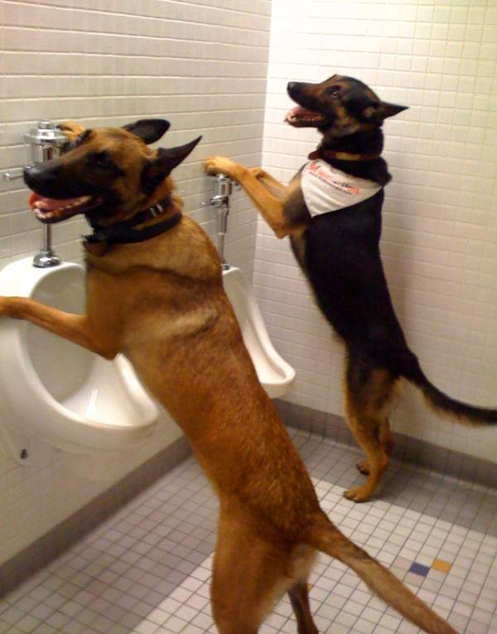
Examples
Some dogs kept as pets are housebroken, it is not a trait or skill with which they are born.
In humans, the instinct to avoid pain or injury is a skill that is learned throughout infancy, which is why human babies can be so vulnerable to hazardous obstacles around the home.
Notes:
http://www.ehow.com/about_6171742_inherited-vs_-learned-traits.html

Slide 12
PAUSE Here!!
This is where the activity starts…

Slide 13
Activity Rules
Students will be shown several images with a little bit of information about the image.
Individually they will jot down (using a PEN) on a piece of paper whether they think the image represents a learned or instinctive trait and why they chose that answer.
They will hand this in at the end of class.
The answers will be shown after every one has put down their PENS.
On some slides the answer will be followed by notes.
OK GO!!!

Slide 14
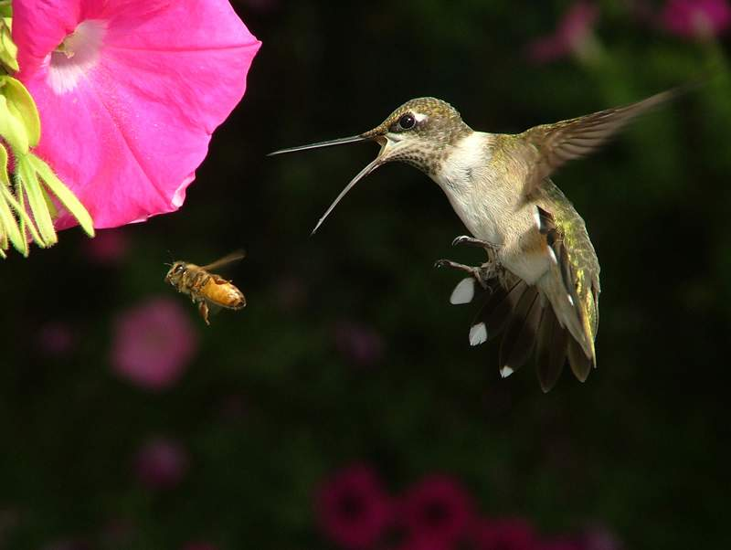
Instinctive or learned?
Birds such as pigeons or hummingbirds, have an innate sense that flying is a natural act.
Does this mean that flight is instinctive or learned?
If you said instinctive, you are right!
Flight in birds is similar to toddlers learning to walk. They both have an instinct that flight and standing upright are natural goals to achieve.
They achieve these goals through practice and their natural instincts.
Notes:
http://www.wisegeek.com/how-do-birds-learn-how-to-fly.htm

Slide 15
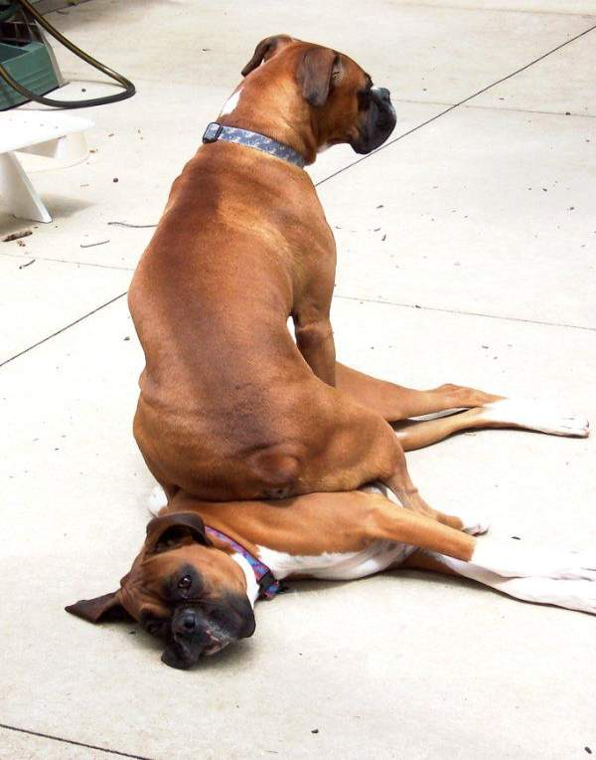
Instinctive or learned?
A dog sitting on command.
Is this instinctive or learned?
Learned! Right!
The dogs owners teach them to sit.
Notes:
http://wiki.answers.com/Q/What_are_Examples_of_learned_behaviors_in_animals

Slide 16
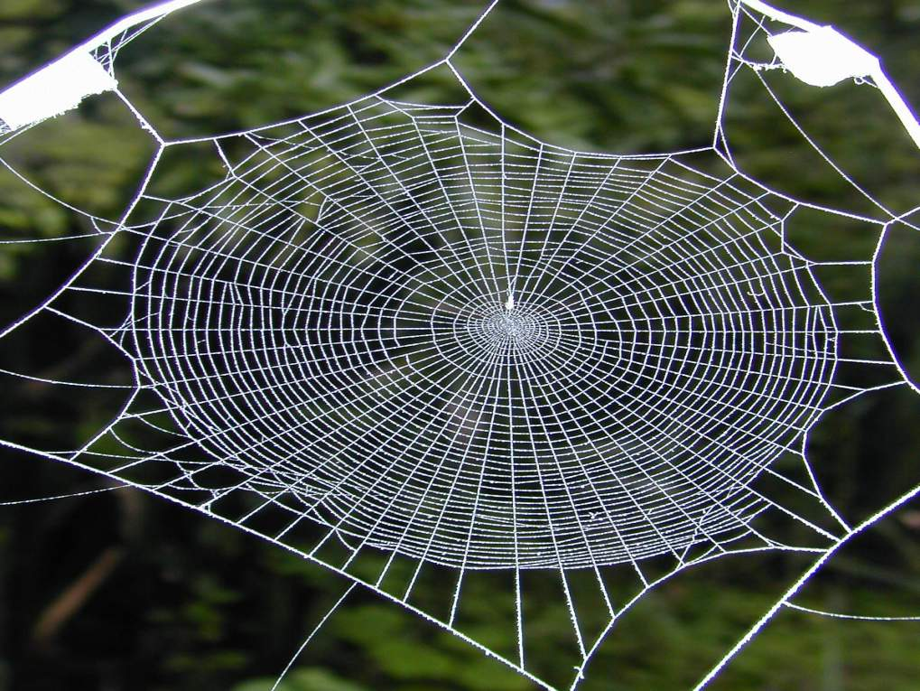
Instinctive or learned?
A spider spins webs to live and catch food.
Is this instinctive or learned?
Instinctive! Good Job
Spiders can produce silk from the moment they are born and it is their instinct to spin a web.
Notes:
http://www.wvpt4learning.org/lessons/pdf_svtc05/instincts.pdf page 2
http://uk.answers.yahoo.com/question/index?qid=20060728024316AAmmt1O

Slide 17
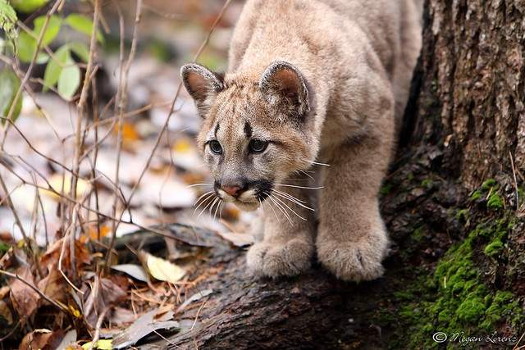
Instinctive or learned?
Cougar cubs hunting.
Instinctive or learned?
Learned and instinctive. Right!
It is instinctive for them to hunt but they fine tune their hunting through learning.
Notes:
http://wiki.answers.com/Q/What_are_examples_of_learned_behavior_in_animals
http://www.peopleforanimalsindia.org/articles-by-maneka-gandhi/234-what-animal-moms-teach-their-young.html

Slide 18

Instinctive or learned?
A beaver cuts down trees and uses those trees to build dams.
Is this instinctive or learned?
Instinctive! You’re awesome!!
Notes:
http://www.wvpt4learning.org/lessons/pdf_svtc05/instincts.pdf page 3

Slide 19
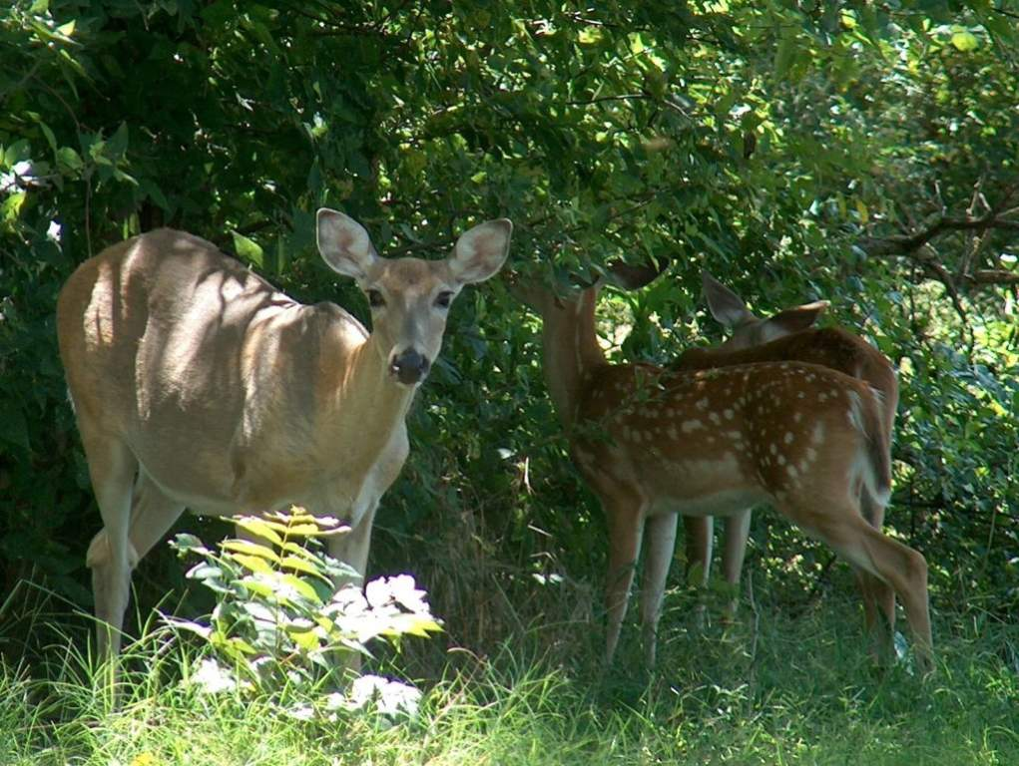
Instinctive or learned?
Fawns being afraid of humans.
Instinct or learned?
Learned. Correct!
A mother deer will teach the fawn to fear man by demonstrating fear at the sight or scent of man.
This type of learning is also seen in wolves. The she-wolf will show great fear the first time she comes near a trap with her cubs. This teachers her babies that traps are to be avoided.
Notes:
http://www.peopleforanimalsindia.org/articles-by-maneka-gandhi/234-what-animal-moms-teach-their-young.html

Slide 20
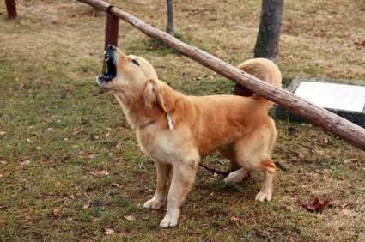
Instinctive or learned?
Dog barking. Instinctive or learned?
You are right if you said instinctive!
Dogs bark because it is instinctive to do so. Dogs bark to communicate. They bark to warn of territory encroachment or danger.
Notes:
http://only-dachshunds.com/tag/instinctive-behavior/

