Slide 1
MACROmolecules
The Big Four

Slide 2
Why are Macromolecules important to the Human Body?
Macromolecules are essential to the functioning of the human body.
Carbohydrates are the body’s main source of energy.
Lipids provide stored energy reserves. This allows us to survive when carbohydrates are not being supplied to the body.
Protein helps us stay strong, by forming new bones and muscles, and helping us fight diseases.
Nucleic acids are responsible for making each person functional and unique; they are the blueprint for our genetic structure.

Slide 3
Objectives
Learn Basic Structure and Function of:
Carbohydrates
Lipids
Protein
Nucleic Acids
…And Learn The Role of Enzyme Catalysts!

Slide 4
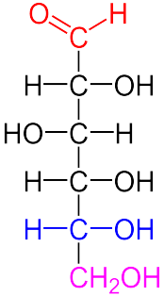
Carbohydrates Are the main energy source of the body!
Carbohydrates are formed of carbon, hydrogen, and oxygen atoms with a ratio of 1:2:1.
The two categories of carbohydrates include sugar and starch.
Glucose is an example of a simple sugar.
Notes:
Image Credit:
http://justingrinnell.files.wordpress.com/2012/11/carbs.jpg
http://en.wikipedia.org/wiki/File:D-glucose_color_coded.png

Slide 5
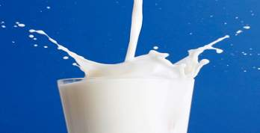
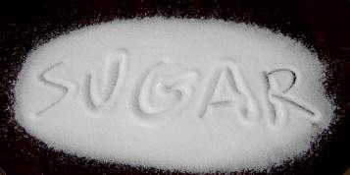
Carbohydrates are composed of saccharides
The smallest unit of saccharides is a monosaccharide. (“Mono” = one) Examples: Glucose & Fructose
Monosaccharides are also referred to as Simple Sugars
Monosaccharides combine together to form disaccharides (“Di” = two) Examples: Lactose & Sucrose
Notes:
http://cache.gawker.com/assets/images/7/2011/04/0404_milk.jpg
http://www.nourition.com/wp-content/uploads/2012/04/Sugar.jpg

Slide 6
Monosaccharides can also form larger carbohydrates such as:
Oligosaccharides are chains of 3-10 monosaccharides. (“Oligo” = few)
Polysaccharides are the largest unit of carbohydrates (“Poly” = many)
Polysaccharides are referred to as complex carbohydrates
Starches are polysaccharide chains made from 300 - 1000 glucose units
Notes:
http://www.mansfield.ohio-state.edu/~sabedon/071amylo.gif

Slide 7
Carbohydrate Breakdown
Enzymes in the mouth, stomach, and small intestine, breakdown the carbohydrate molecules.
These large complex carbohydrate molecules breakdown into simple sugars.
Notes:
Image Credit: http://www.chem4kids.com/files/bio_carbos.html

Slide 8
How Does The Breakdown Occur?
Our bodies use special protein molecules called enzymes to break the larger molecules into smaller pieces.
Enzymes Are Catalysts
[Catalysts are chemicals that quicken a chemical reaction without undergoing any change themselves]

Slide 9
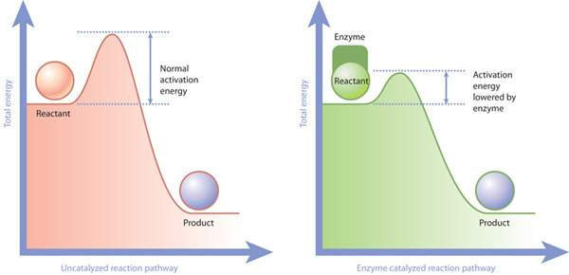
The Role of Enzymes
Activation Energy is the energy needed to start a reaction.
An enzyme is a protein catalyst that speeds up biological reactions by lowering the activation energy!
Some life processes are too slow when they occur on their own, but enzymes help speed them up!
Notes:
http://www.nature.com/scitable/content/ne0000/ne0000/ne0000/ne0000/14711476/U2CP5-2_EnzymeActivation_ksm.jpg

Slide 10
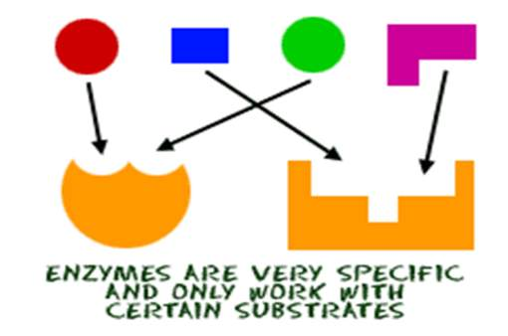
The Role of Enzymes
Each enzyme is very specific and only attaches to one type of molecule.
The molecule the enzyme acts upon is called its substrate.
Variables that impact enzyme activity:
Temperature
pH
Notes:
Image Credit: http://www.chem4kids.com/files/art/bio_enzyme1.gif

Slide 11
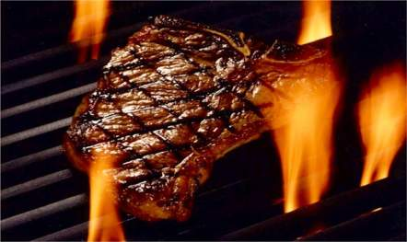
Protein
Proteins are nutrients which contain materials the body uses for growth and repair.
Proteins are made of Carbon, Hydrogen, Oxygen and Nitrogen.
Proteins are large molecules made up of combinations of amino acids.
Notes:
http://blog.rumorssteakhouse.com/files/2011/05/steak1.jpg

Slide 12
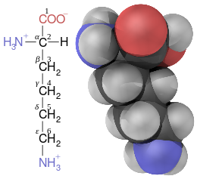
Amino Acids Peptides Polypeptides Protein
Lysine is an example of an Amino Acid
Amino acids are the building blocks of proteins.
These building blocks bond together to form chains that are called peptides.
Proteins are formed of combinations of large peptides chains, this is referred to as polypeptides.
Notes:
Image Credit: http://vibrantsexystrong.com/wp-content/uploads/2011/02/amino-acids.jpg
http://upload.wikimedia.org/wikipedia/commons/thumb/5/5f/Lysine_fisher_structure_and_3d_ball.svg/260px-Lysine_fisher_structure_and_3d_ball.svg.png

Slide 13
In order for the body to use protein, enzymes in the stomach and small intestine break the polypeptides down into individual amino acids.
Notes:
Image Credit: http://www.bbc.co.uk/bitesize/ks3/science/images/protein_molecules.gif

Slide 14
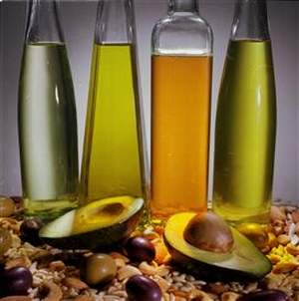
Lipids
Lipids function as stored energy, insulation for the body, and assist absorption of certain vitamins.
Lipids are large molecules that can be categorized as fats or oils.
Lipids are composed of triglycerides.
These molecules are made up of carbon, hydrogen, and oxygen atoms.
Notes:
http://i1-news.softpedia-static.com/images/news2/What-Do-We-Really-Know-about-Fats-Are-All-Fats-Bad-2.bmp

Slide 15
Glycerol + 3 Fatty Acids → Triglyceride Chain of Triglycerides → Lipid
Triglycerides
Notes:
http://www.bodyrecomposition.com/wp-content/uploads/2009/05/triglyceride.gif

Slide 16
Lipid Breakdown
Bile and enzymes in the small intestine break lipids down into small molecules of fatty acids and glycerol.
Notes:
Image Credit: http://www.bbc.co.uk/bitesize/ks3/science/images/fat_molecules.gif

Slide 17
Nucleic Acids
Stores and Carries Genetic Information
Composed of Nucleotides
Unlike the other macromolecules, nucleic acids are not obtained from food
Deoxyribonucleic Acid (aka DNA)
Is a Nucleic Acid!
Notes:
http://images.sciencedaily.com/2011/07/110721142408-large.jpg

Slide 18
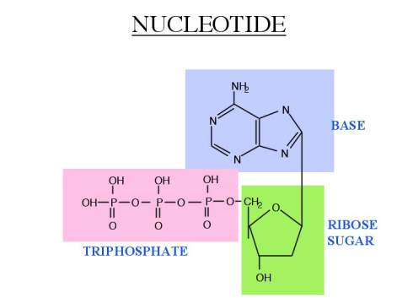
All nucleic acids are made from combinations of nucleotides.
Nucleotides
There are five nucleotides: uracil, cytosine, thymine, adenine, and guanine
Nucleotides are made of three parts: 1. A five-carbon sugar 2. A base that has nitrogen (N) atoms 3. An ion of phosphoric acid known as phosphate (PO4³⁻)
Notes:
http://www.ucl.ac.uk/~sjjgsca/nucleotide.jpg

Slide 19
YOUTUBE Break!
Molecules Gone Wild (Bio Style!)

