Slide 2
Livestock Production
Cattle ranching and farming
Dairy farming
Hog and pig farming
Sheep and goat farming
Poultry and egg production
Animal aquaculture

Slide 3
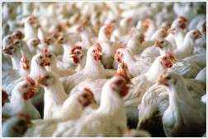
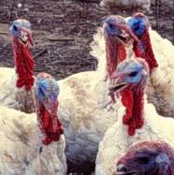
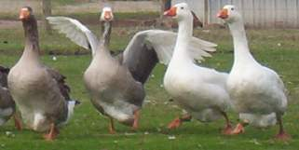
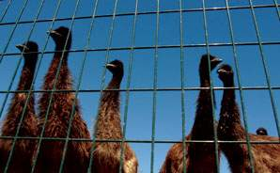
What is Poultry?
Poultry: domesticated fowl raised for meat or eggs
Chicken
Turkey
Ducks
Geese
Emus
Ostriches
Game birds

Slide 4
Poultry Production
Egg production
Meat production
Broilers
Turkeys
Ducks/geese
Importance of Poultry Industry

Slide 5
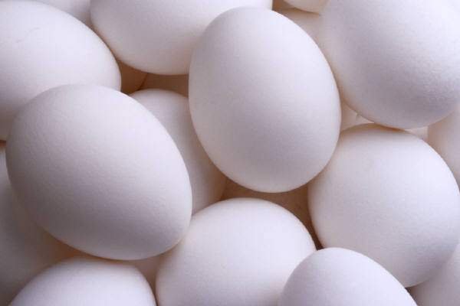
Egg Production
In the U.S. alone, there are over 6 billion eggs produced each month
There are different systems for egg production:
Caged egg production
Cage-free production (free-range)

Slide 6
Caged Egg Production System
Hens are kept in cages with a sloped floor that allows eggs to roll to the front of the cage to be collected
Cages are typically the size of a filing cabinet drawer and holds up to 10 hens
Caged egg production has caused major controversy between animal rights activists and industrial egg producers

Slide 7
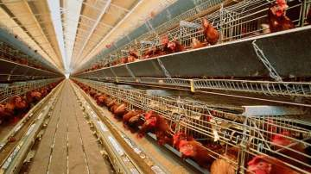
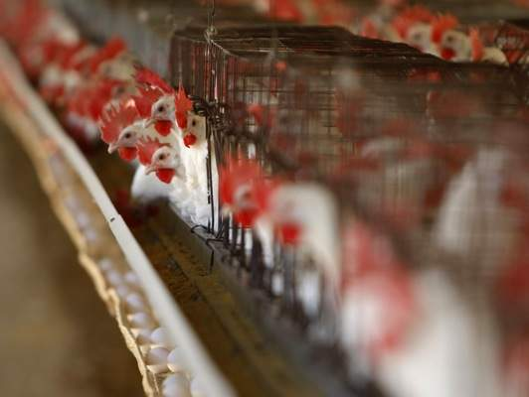
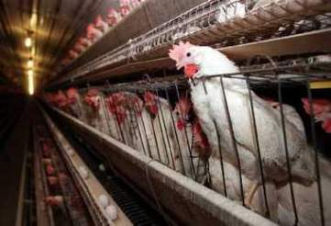
Caged Egg Production

Slide 8
Cage-Free Production System
Sometimes called ‘free range’, this system allows hens to live outside of cages, and many have access to the outdoors
Allows for more natural behavior such as nesting
Also cause for concern from animal rights activists: hens are kept in crowded (stressful) conditions that often affects the hens’ health

Slide 9
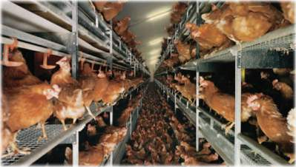
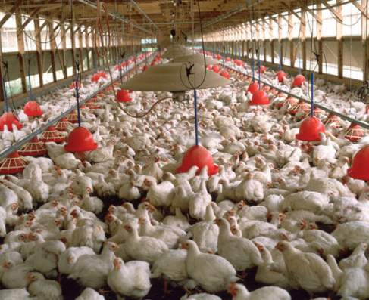
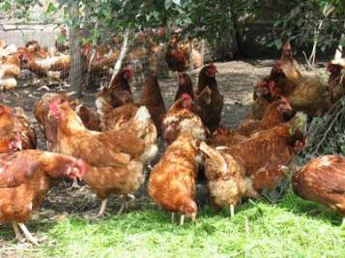
Cage-Free Egg Production

Slide 10
Meat Production
Chickens raised for meat are called broilers
Other poultry raised for meat include turkey, ducks, and geese
Meat chickens, turkeys, and fowl are generally kept in poultry houses to prevent predation, enhance feed efficiency, and facilitate bird management

Slide 11
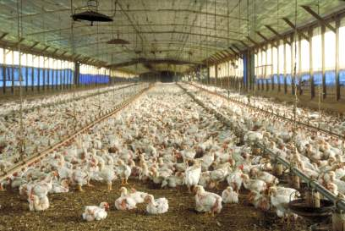
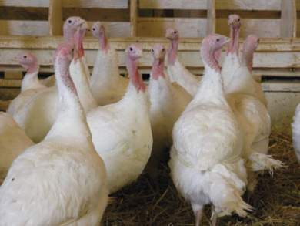
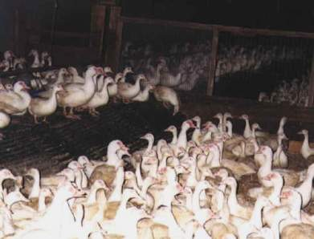
Meat Production

Slide 12
Production Process
Breeding
Incubation
Brooding and rearing
Feeding and nutrition
Processing

Slide 13
Breeding
Meat poultry is bred for:
Good meat type
Fast growth
Disease resistance
Good conversion of feed to meat
Different strains of chickens are used for egg production and bred for:
Egg production
Large egg size
Small body weight for good conversion of feed to eggs

Slide 14
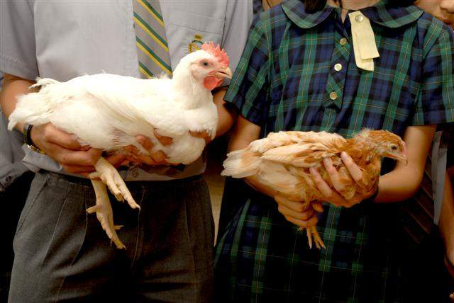
Breeding
Broiler and layer side by side

Slide 15
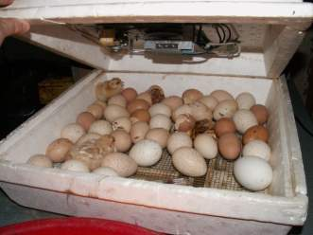
Incubation
Eggs are placed in trays in incubators that automatically rotate the eggs
Eggs are transferred to hatching trays 3 days before expected hatch
After hatch, chicks are placed onto conveyor belt for chick servicing:
Sexing
Vaccination
Beak trimming

Slide 16
Brooding and Rearing
Day-old chicks need warmer temperatures; typically kept at 85-87 degrees with a radiant brooding heater
Chicks are kept on floors with litter made of soft materials such as pine shavings or rice hulls
Chicks are fed from trays of water and feed until they learn to eat from timed food and water delivery systems

Slide 17
Food and Nutrition
Poultry diets consist of:
Grains like corn, wheat, oats, and barley
Protein supplements
Mineral supplements
Protein supplements include:
Meat meal, fish meal, safflower meal, feather meal, and canola meal

Slide 18
Processing
After rearing, chickens are moved to either processing plants or laying houses
At processing houses, chickens are removed from transport racks and processed:
hung on shackles, rendered unconscious in an electric bath, bled, and scalded for easier feather removal
After feathers are removed, carcasses are moved to a different line for processing and packaging

Slide 19
Poultry Industry
Increase in processing efficiency:
Industry requires increase in processing speed and technology
Modern poultry plants have streamlined operations to increase processing efficiency
Integration of the broiler industry:
Vertical integration (the control of two or more stages of production by one management company)
80% of all commercial broilers are produced by the top 10 production companies

Slide 20
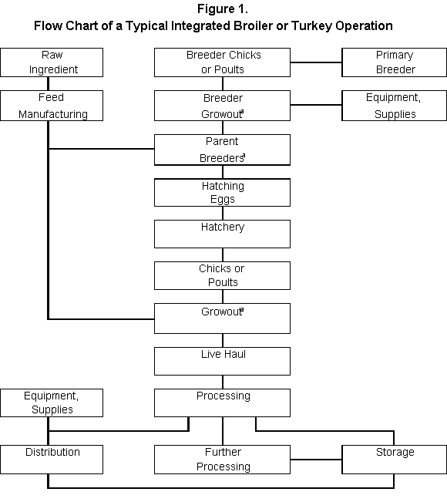
Vertical Integration of the Poultry Industry

Slide 21
