Slide 1
Gaming Knowledge
Partnership for Environmental Education and Rural Health
College of Veterinary Medicine & Biomedical Sciences, Texas A&M University

Slide 2
PEER One Health Mobile Curriculum Intro
The PEER Program’s new, standards-based, mobile-friendly curriculum frames middle school science and biology in the context of “One Health” (the interconnection of humans, animals, and the environment).
The One Health Curriculum is composed of Student-centered, Online Learning Modules for Middle School Science & Biology Students that would be useful for STEM at home, summer learning, or home schooling as one could use our LMS.

Slide 3
The Practice Section
Within the One Health Curriculum Modules we have created a practice section with mnemonic advice to help students remember the information presented in the various learning activities.
There are also engaging digital games to reinforce learning of essential knowledge.

Slide 4
Types of Games and Interactive Pieces
Quizlet
WISC Knowledge Checks
Online Games

Slide 5
Learning by Repetition - Quizlet
Great resource for making online flashcards
Free to create an account
Sets can be made public or private
Can add pictures/diagrams
Easy to learn
Portable
Many ways to test your knowledge
Learn - Click on diagrams to find cell structures, mu
Flashcards - Like traditional handwritten flashcards, but online!
Write - Makes you type in the term
Spell - Plays an audio version of the term and you have to spell it correctly
Test - Creates a test with different types of question formats

Slide 6
A Fun Side of Quizlet
Within Quizlet, you can also use the Play options:
Match - Matching game using the terms in the set
Gravity - Space themed game using the terms as well
Live - a collaborative classroom game using an electronic device that splits students into teams
Note: Clicking the options button will allow you to choose which question formats you want. There are True/False, Multiple Choice, and Written.
Additionally, there is an option to say whether you want to answer with the term, definition, or it will alternate between the two if both are checked

Slide 7
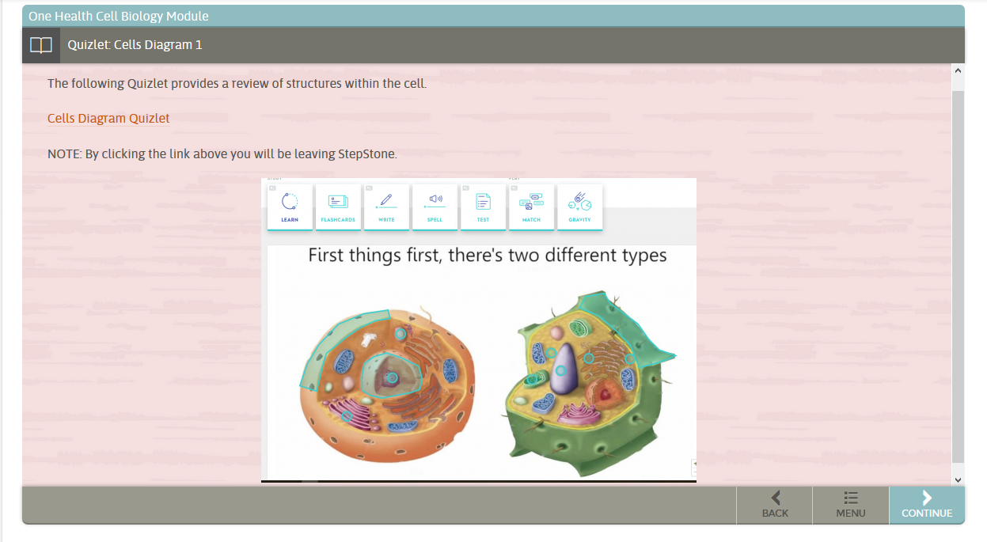
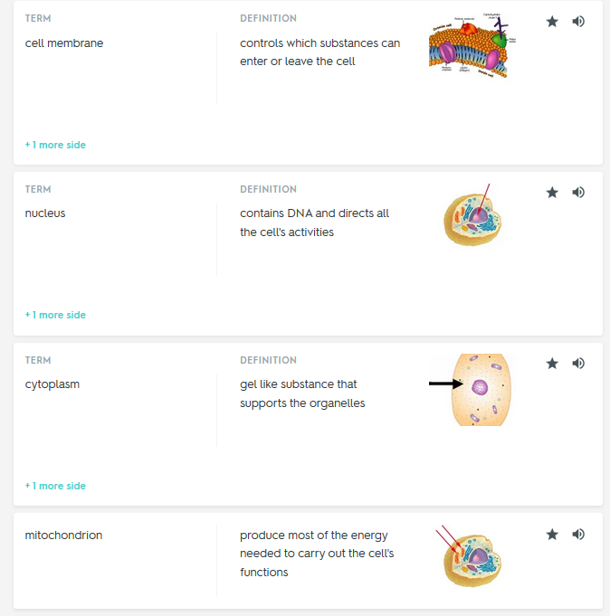
Quizlet in Action!
Here is an example of using Quizlet in our One Health Cellular Biology module!
By using this Quizlet, students will be able to learn the different cell structures using diagrams depicting each structure.
Students can also see which terms they have mastered and which ones they still need to work on.

Slide 8
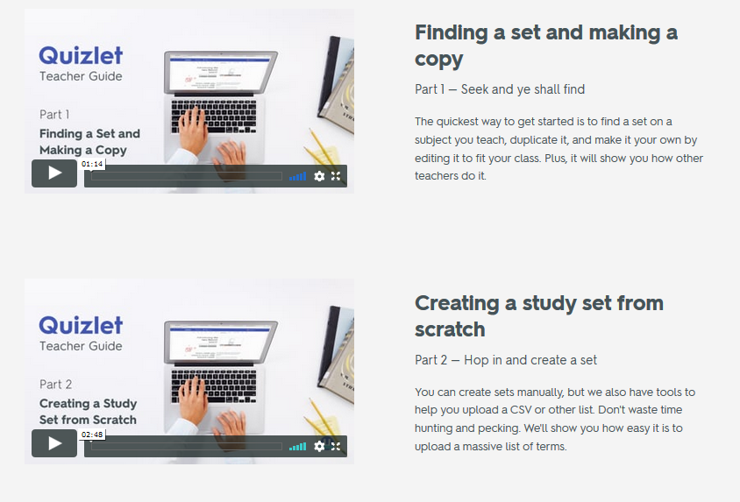
Quizlet: How To
https://quizlet.com/features/quizlet-teacher-guide-getting-started
Quizlet has put together a series of videos that focus on using its resources as a teacher. From finding a set to showing all seven of Quizlet’s learning modes, this teacher guide will give you everything you need to help students succeed using Quizlet.

Slide 9
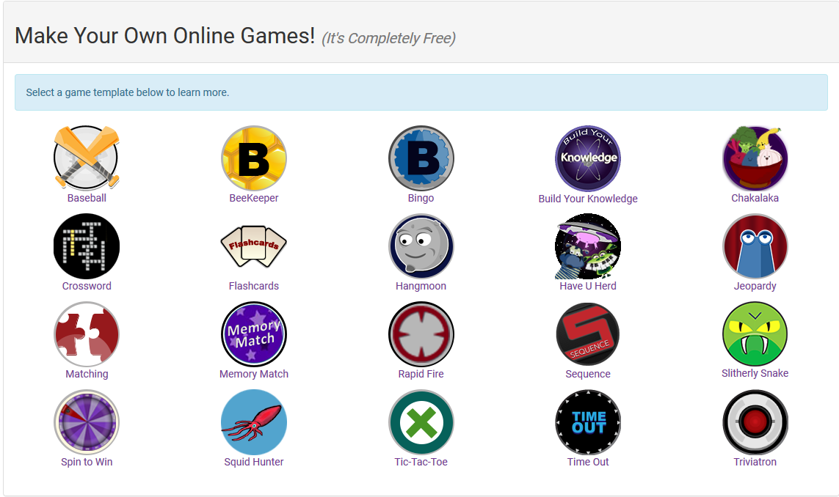
WISC Knowledge Check Games
https://www.wisc-online.com/
Allows you to input your own questions into 20 different types of games and it’s completely free!

Slide 10
Why WISC?
Reinforce learning by having students quiz themselves on their own time.
Build excitement by having students cooperate or compete with each other as individuals or teams.
Students receive immediate feedback and can play the game as often as they wish.
You decide how long the game should be by the number of questions you enter.
Depending on the game you choose, you can enter questions that require answers that are multiple choice, true/false, matching, or essay.
Students can play from any computer, tablet, or smartphone.

Slide 11
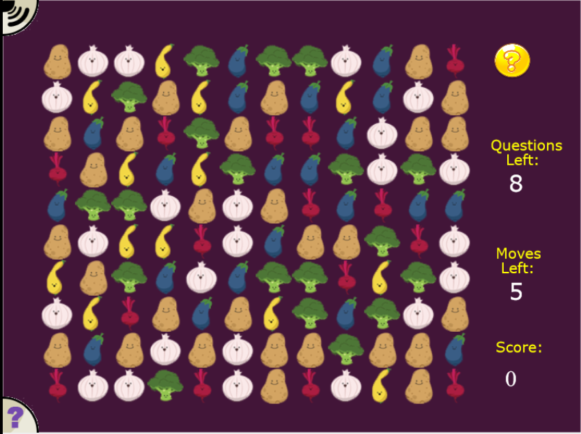
WISC Knowledge Check Games Example

Slide 12
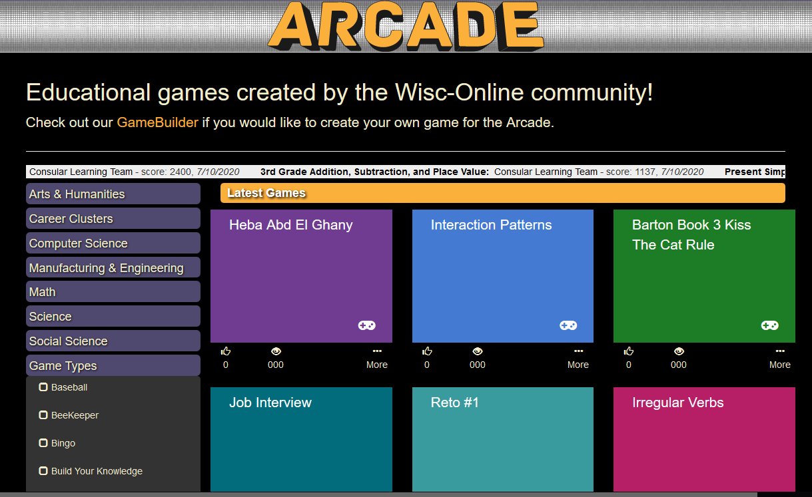
WISC Online Arcade
Not only can you create games on WISC, but you can play games that others have created as well!
Choose from a variety of subjects including:
Arts and Humanities
Career Clusters
Computer Science
Manufacturing and Engineering
Math
Science
Social Studies

Slide 13
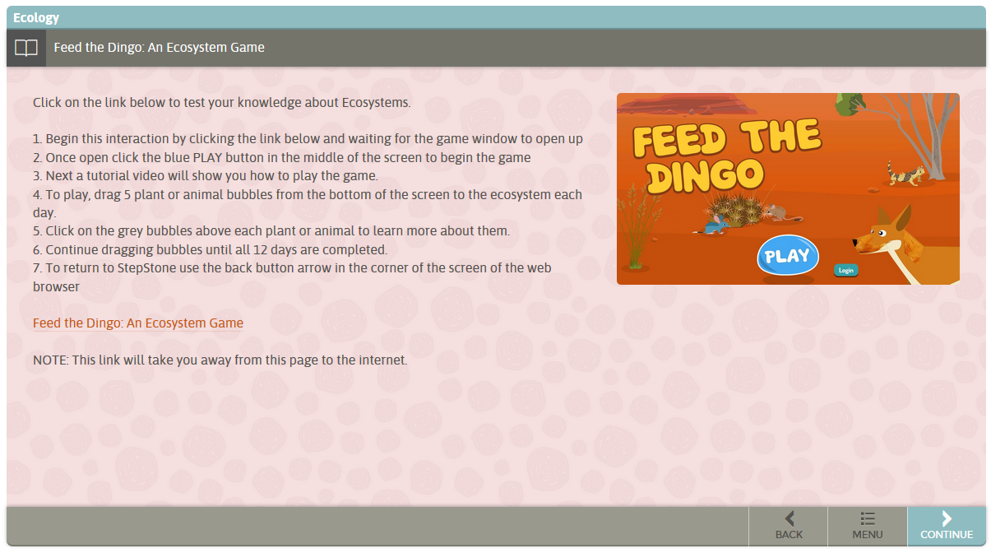
Online Games
We have also utilized online games such as this Feed The Dingo game where students learn about the importance of maintaining balanced ecosystems.
Using online games can greatly benefit students as this gives them another unique way to learn content.
For this game, we Google searched for ecology online games and this one popped up!

Slide 14
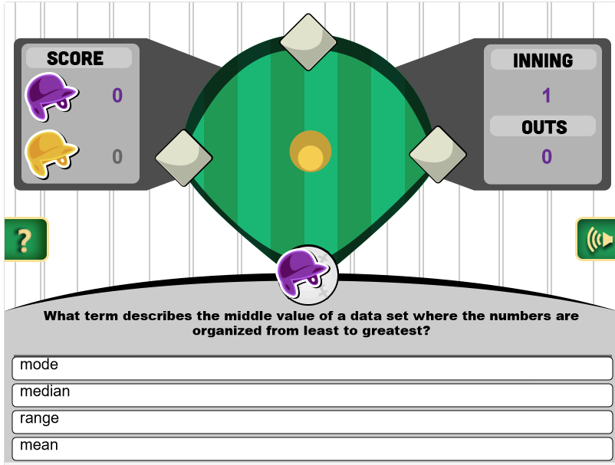
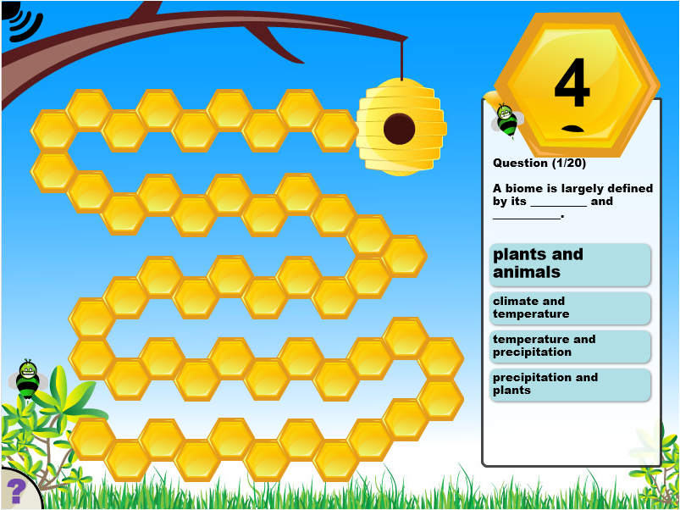
Same Type Used for Different Modules
Within the One Health curriculum modules, we wanted to use the same game formats in order to keep the app uniform
All of the methods we have shown you are easy to incorporate into the classroom
Having a couple different formats will help the material stay interesting and motivate students to want to learn

Slide 15
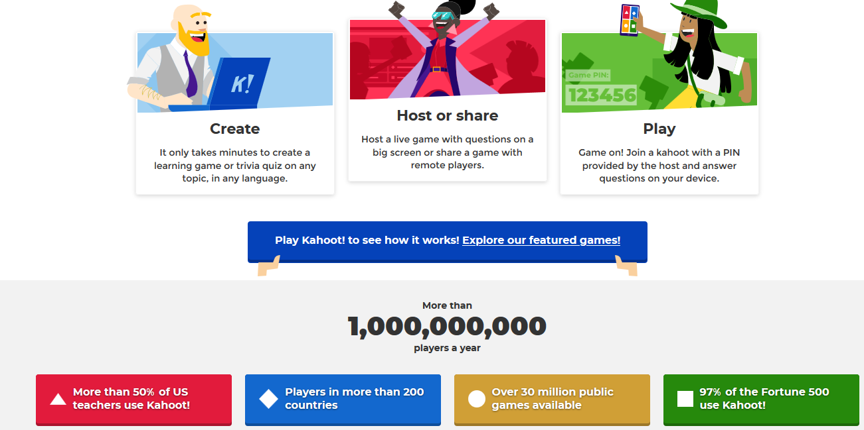
Kahoot!
www.kahoot.com
Interactive learning game that allows students to answer questions straight from their mobile device
Millions of ready-to-play games
You can create one from scratch, use Kahoot’s question bank to mix and match questions, edit a template, or reuse existing games

Slide 16
Why Kahoot?
Kahoot has been a huge success when we have done veterinary presentations across the state
Positive feedback from both students and facilitators
Students love being able to use technology to answer questions
Makes the presentation interactive
Kahoot has a leaderboard for each game and students can see how they are doing compared to others

Slide 17
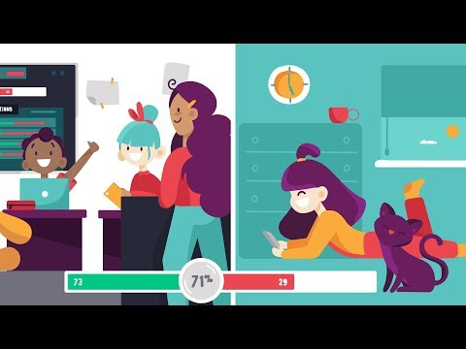
Quizizz
www.Quizizz.com
Play millions of teacher-created quizzes or create your own
Students can see the question on their own screen
Live quizzes and polls
Create student-paced assignments
Share flashcards
Homework Mode
Quizizz YouTube Channel with various How-To videos

Slide 18
Games! Why use them?
Games often revolve around utilization of memorization and problem solving!
Allows students to think quickly and utilize logic to work through the task the games hold
Provides immediate feedback over understanding
Allows a student to grasp topic that they understand without the wait of grading papers
Help keep students engaged
Utilizes intrinsic motivation to win that keeps them tuned in to the lesson and learning throughout the activity
Beneficial for children who experience attention disorders
Research in Nottingham University has show that students with attention disorders are better able to pay attention to information formatted in a form of entertainment
Notes:
References: https://www.teachthought.com/technology/6-basic-benefits-of-game-based-learning/ttps://www.brighthubeducation.com/teaching-methods-tips/129304-advantages-of-game-based-learning/
https://www.brighthubeducation.com/teaching-methods-tips/129304-advantages-of-game-based-learning/

Slide 19
Thank you for joining us!
Questions?

