Slide 1
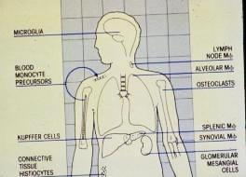
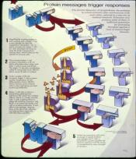
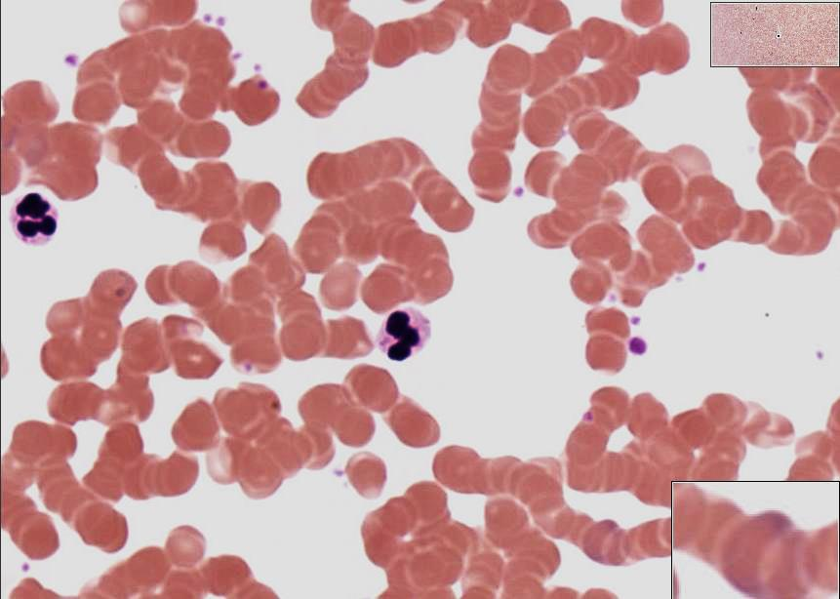
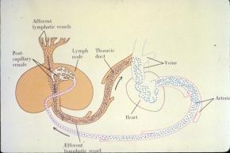
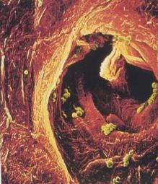
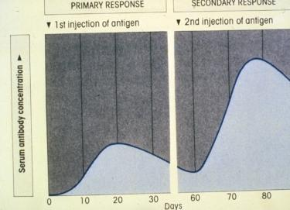
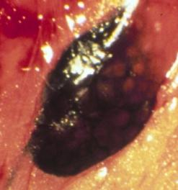
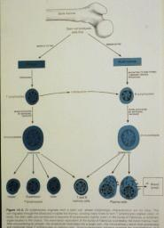
Overview of the Immune System
Undergraduate – Graduate
Histology Lecture Series
Larry Johnson, Professor
Veterinary Integrative Biosciences
Texas A&M University
College Station, TX 77843

Slide 2
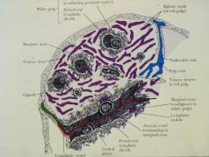
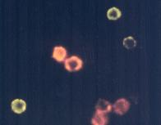
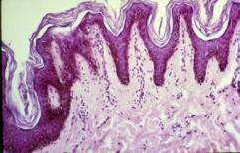
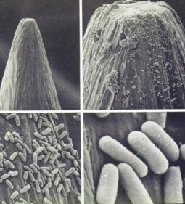
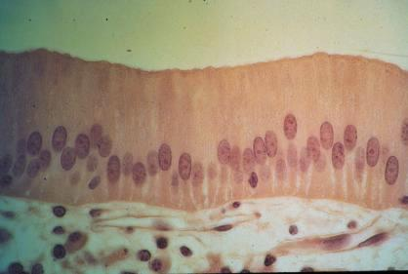
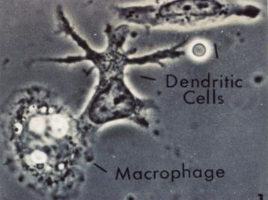
Objectives
Purpose of the immune system
Cellular basis of immunity
Induction of response
Effectors of response
Ontogeny

Slide 3
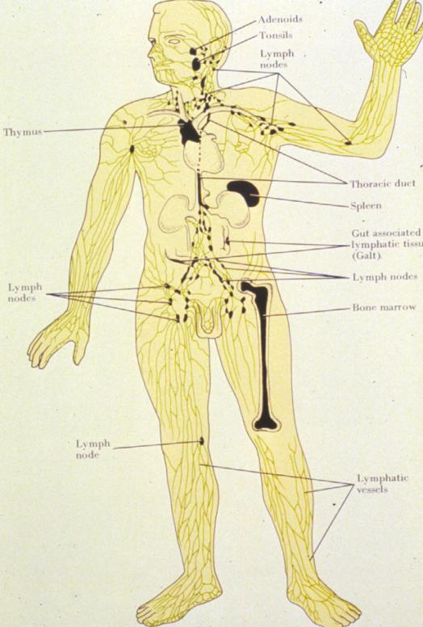
Functions of the Immune System
Protection against foreign invaders into body
Produce / protect germ free environment of the body

Slide 4
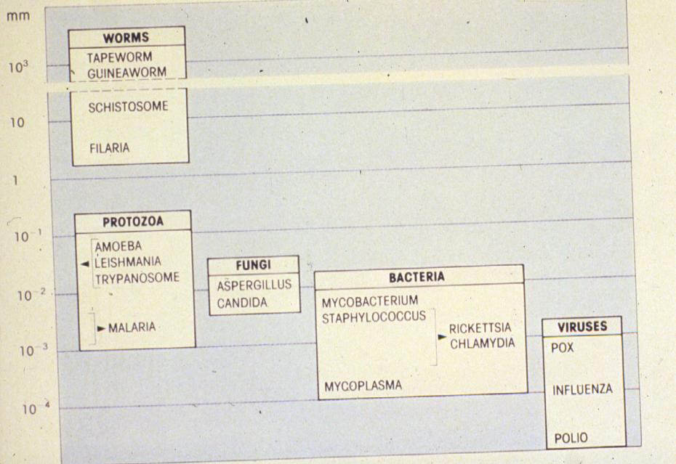
Foreign Invaders

Slide 5
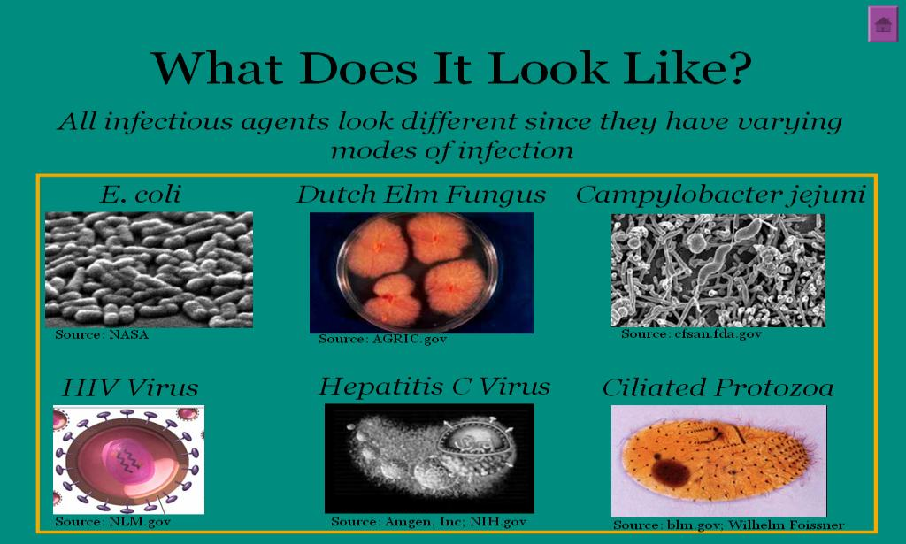
Protection Against Foreign Invaders Into Body

Slide 6
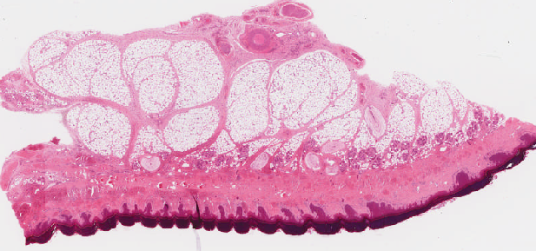
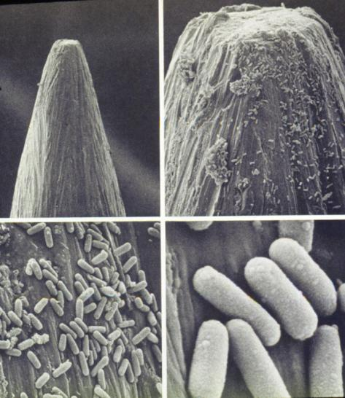
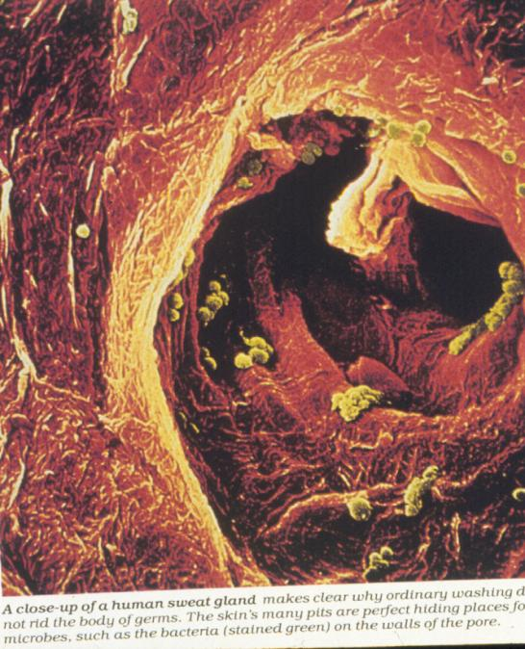
Foreign Invaders
Into Body

Slide 7
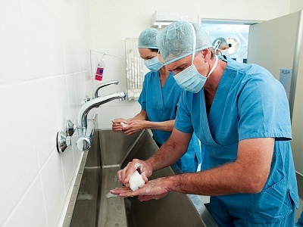
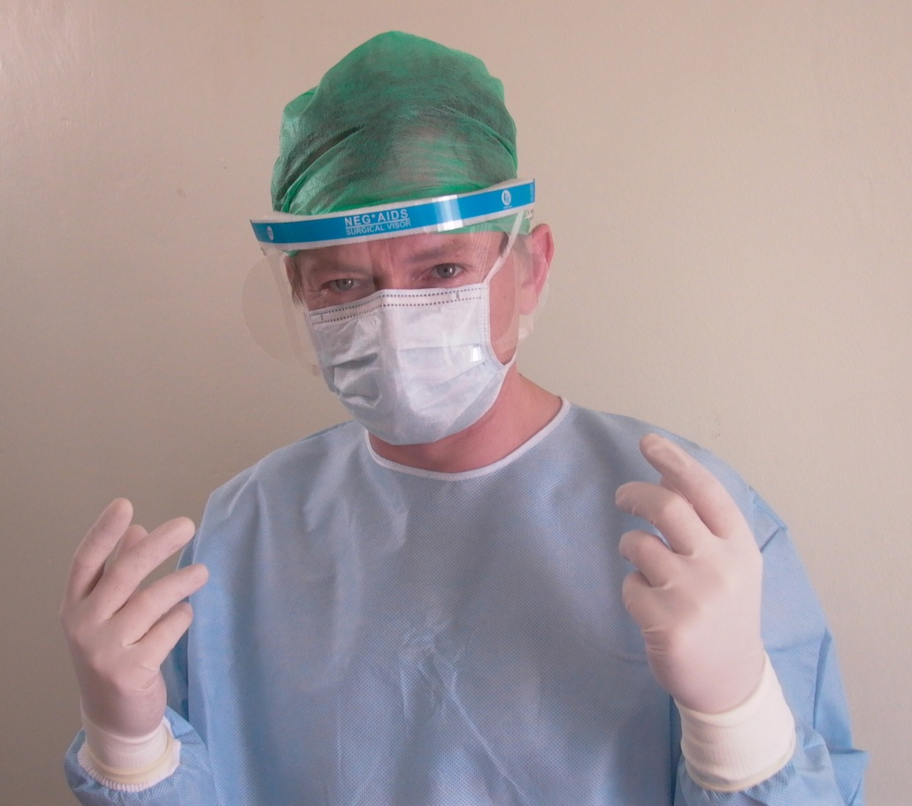
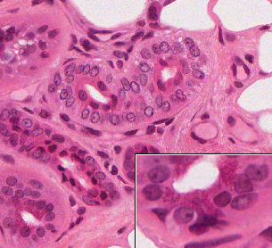
Why use gloves for surgery
if your hands have been washed?

Slide 8
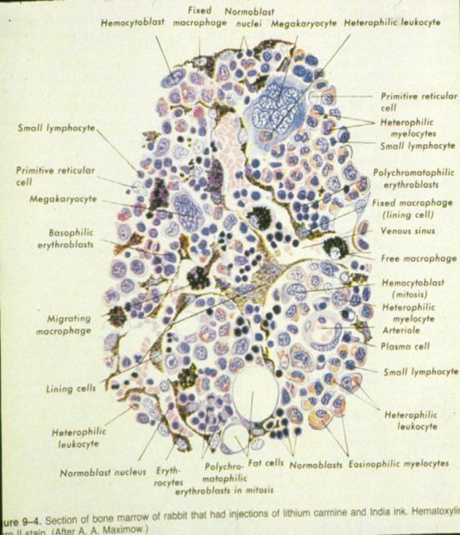
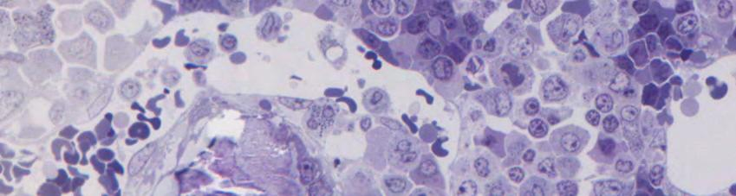
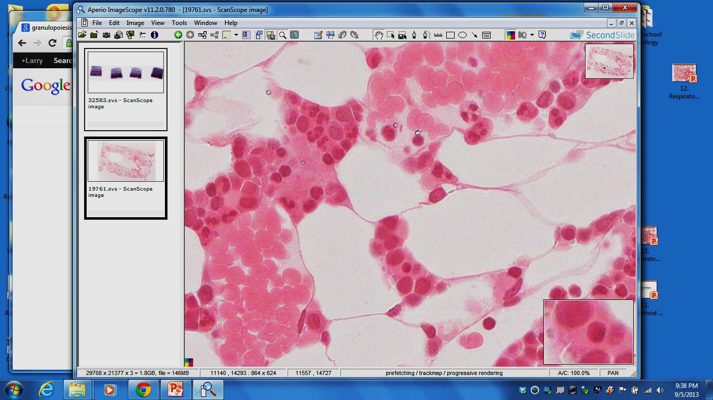
Produce / Protect Germ Free
Environment
32583
19761

Slide 9
Produce / Protect Germ Free Environment

Slide 10
Three Key Steps of Combating Infections
reak the cycle of transmission
ill the infectious agent
ncrease host resistance
e.g., increase immunity
of host

Slide 11
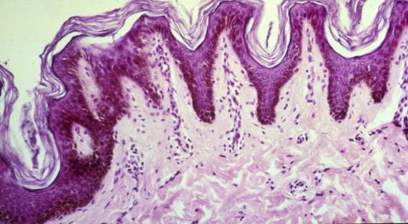
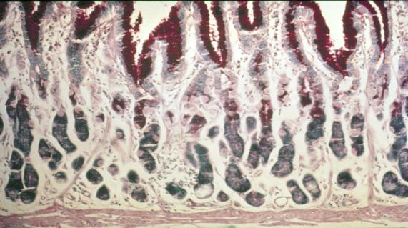
Lines of Defense
First Line: Physical Barrier
  Skin: Stratum Cornium
  HCl In Stomach
  Mucus In Intestines
reak the cycle
of transmission

Slide 12
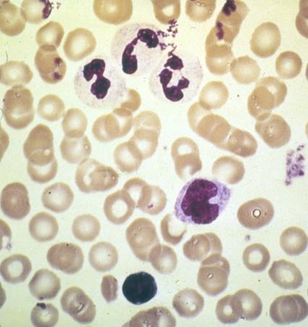
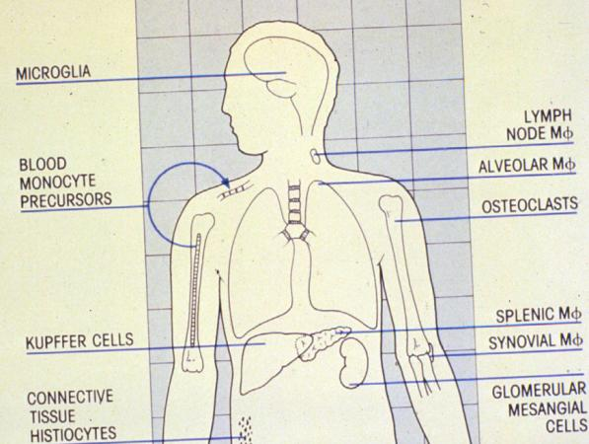
Lines of Defense
Second line: Phagocytes at work
Neutrophils to ill the infectious agent
  Monocytes - macrophage

Slide 13
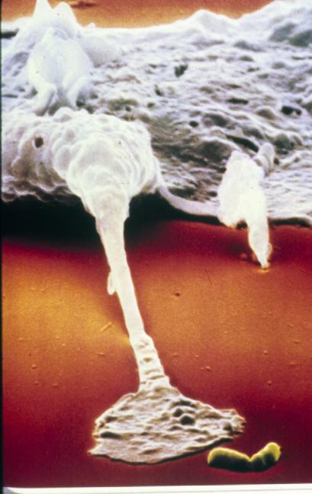
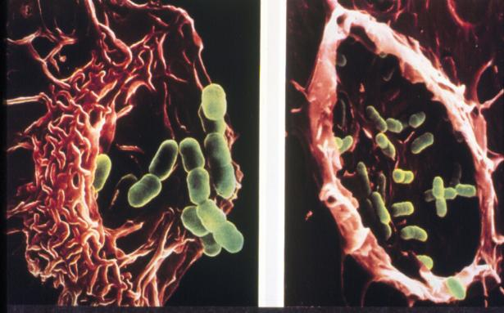
Lines of Defense
Phagocytes at work
  Neutrophils
  Macrophages

Slide 14
Characteristics of Immunity
ncrease host resistance
through Immunity
Acquired - requires exposure to antigens
Specificity - response is unique to exposure
Memory - remembers previous exposure

Slide 15

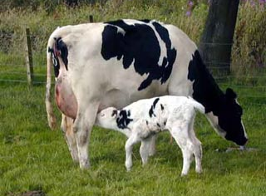
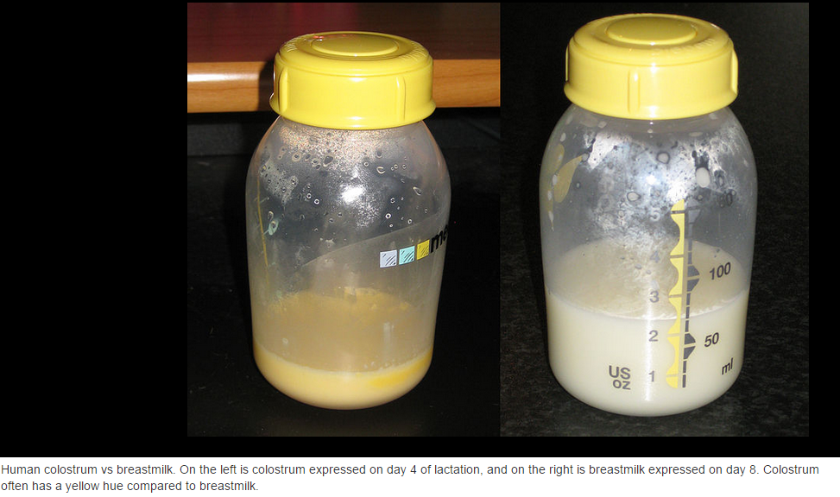
Characteristics of Immunity
Acquired -
Must be developed

Slide 16

Colostrum
Colostrum is known to contain immune cells (as lymphocytes)^{[4]} and many antibodies such as IgA, IgG, and IgM. These are the major components of the adaptive immune system. Inter alia IgA is absorbed through the intestinal epithelium, travels through the blood, and is secreted onto other Type 1 mucosal surfaces^{[citation needed]}. Other immune components of colostrum include the major components of the innate immune system, such as lactoferrin,^{[5]} lysozyme,^{[6]} lactoperoxidase,^{[7]} complement,^{[8]} and proline-rich polypeptides (PRP).^{[9]} A number of cytokines (small messenger peptides that control the functioning of the immune system) are found in colostrum as well,^{[10]} including interleukins,^{[10]} tumor necrosis factor,^{[11]} chemokines,^{[12]} and others.
http://en.wikipedia.org/wiki/Colostrum

Slide 17
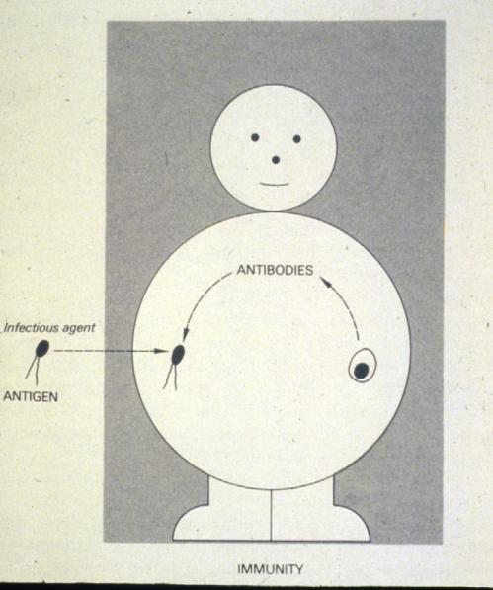

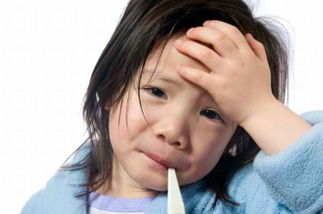
Characteristics of Immunity
Acquired -
Must be developed
Specificity -
Antibodies made are specific to specific molecules on the antigen of exposure

Slide 18
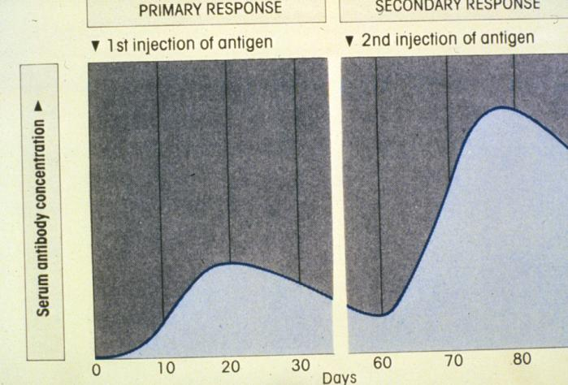
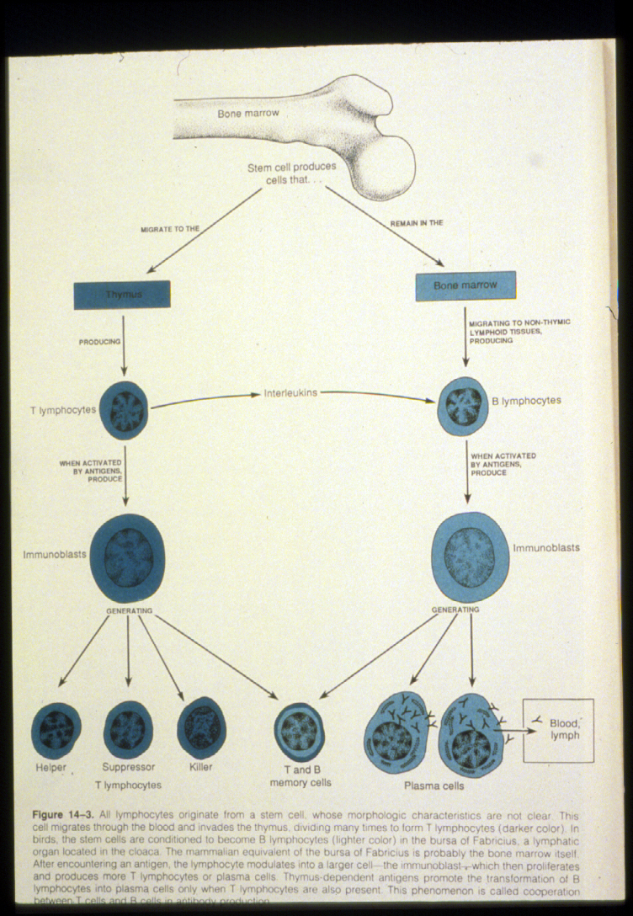
Characteristics of Immunity
Memory: quick second response
  Long lived cells
Acquired
Specificity
Memory

Slide 19

Types of Immune Response
Antibody: mediated
  Glycoproteins recognize and bind to antigens
Cell: mediated
  Specifically active cells recognize cell - bind antigens

Slide 20
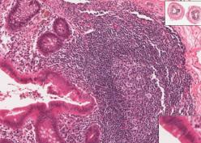

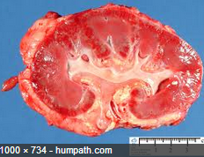
EXAMPLES OF IMMUNE RESPONSE
REACTION AGAINST MICROORGANISMS: BACTERIA, VIRUSES, PARASITES
REACTION AGAINST TUMOR CELLS
ALLERGIC REACTIONS: HAY FEVER, POISON IVY
AUTOIMMUNE REACTION: ARTHRITIS, TYPE I DIABETES
GRAFT REJECTION
Appendix
http://www.greenlifestyle.be

Slide 21
Organs of the
Immune System
Primary organs
  Bone marrow
  Thymus
Secondary organs
  Spleen
  Lymph nodes
  Lymphoid tissue: Peyer’s patches

Slide 22
Organs of the Immune
System
Primary organs
  Bone marrow
  Thymus

Slide 23
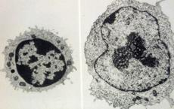
Three Notable Characteristics of
Lymphocytes the Primary Immune Cells
Specificity
  Unique receptor on cell surface
  Actual and only immunoglobulin that the cell is capable of making
Clonality
  One cell gives rise to others with same receptor
  Group of cells with the same unique receptor
Activation

Slide 24
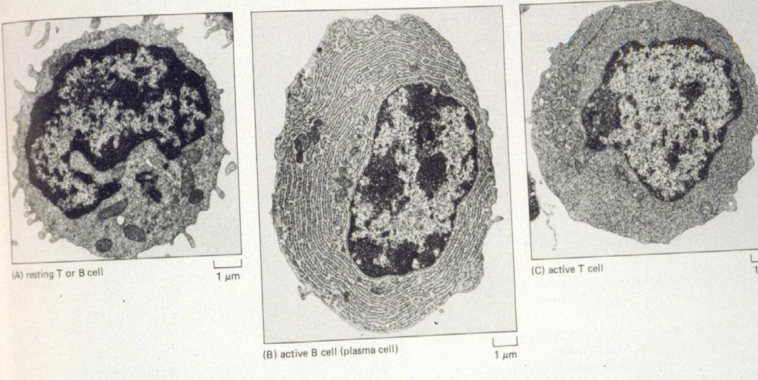
Activation
  Triggered when lymphocyte encounters the antigen that matches its receptor
  Cell enlarges, produces DNA, divides, and differentiates
Notable Characteristics of Lymphocytes
Specificity, Clonality, and Activation

Slide 25
Molecules on surfaces of B & T lymphocytes
B cells: immunoglobulin
T cells: developmental antigens and specific receptors
  Antigens related to cell function
  T4 positive cells
    Antigen makes cells prone to viral infection by the HIV virus that causes aids – depletion of this subset of t cells
  T8 positive cells - suppressor cell ratio increases
  (Macrophage - taxi for HIV)

Slide 26
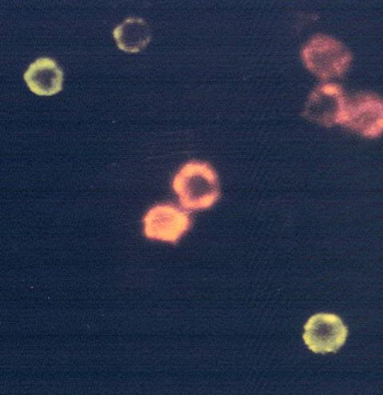
Molecules on Surfaces of B & T Lymphocytes
B cells – immunoglobulin
T cells - developmental antigens and specific receptors
B CELLS
T CELLS

Slide 27
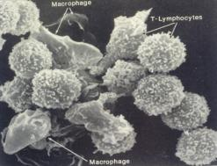
Induction of response
Accessory cells are required
  Macrophage, dendritic cells, Langerhans’ cells
Cell interactions with regulatory cells
  Helper or suppressor T lymphocytes

Slide 28
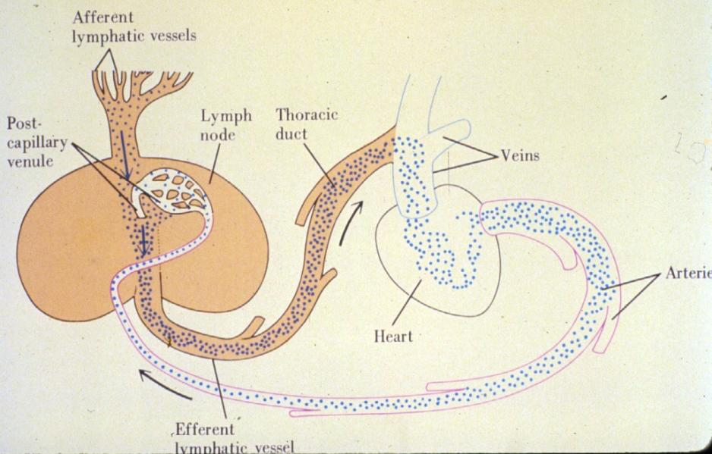
Induction of Response
Peripheral organ needed to get antigen and responsive cell to interact
  Lymphocyte recirculating
  Appropriate context

Slide 29
Effectors - B cells
Dissemination of plasmablasts
Antibody structure – specificity
Switching of antibody classes
How antibodies work?

Slide 30
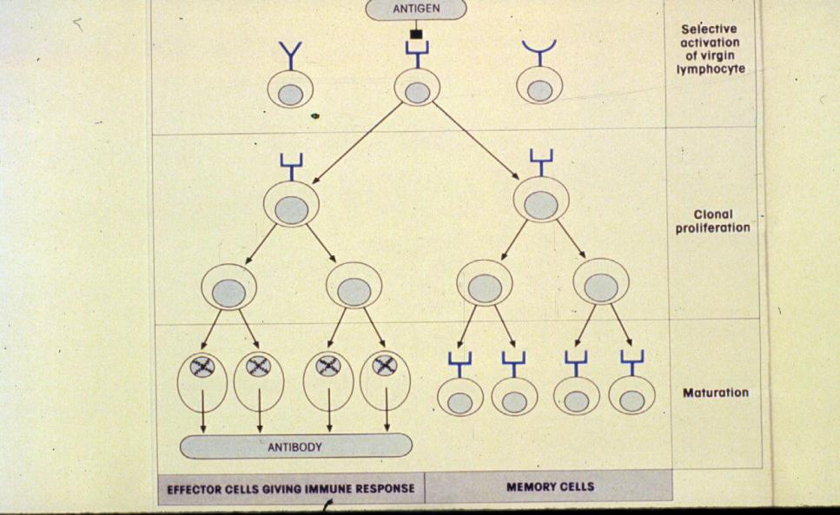
Dissemination of Plasmablasts
Clonality
  One cell gives rise to others with same receptor
  to make a group of cells with the same unique receptor

Slide 31
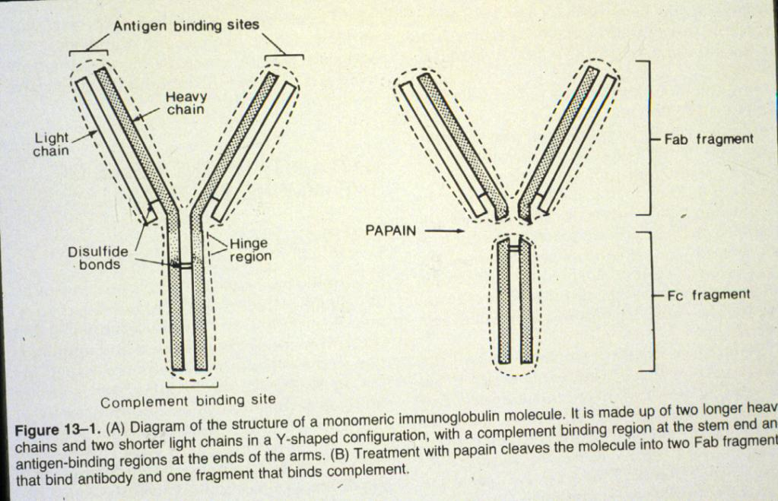
Antibody structure - specificity

Slide 32
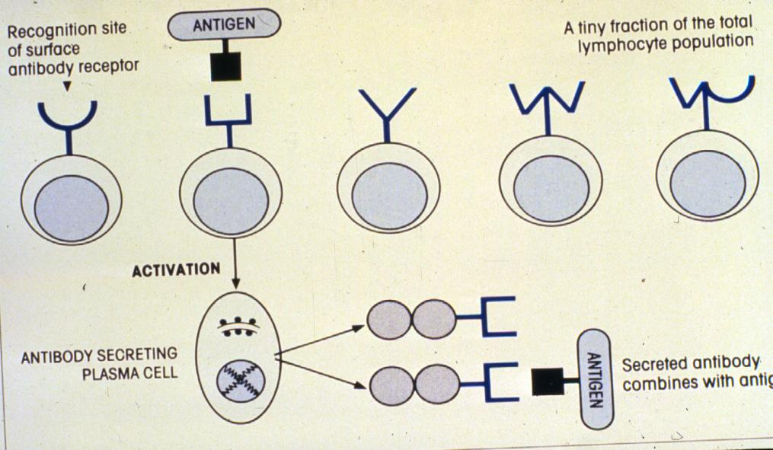
Antibody structure - specificity
  Unique receptor on cell surface
  Actual and only immunoglobulin that the cell is capable of making

Slide 33
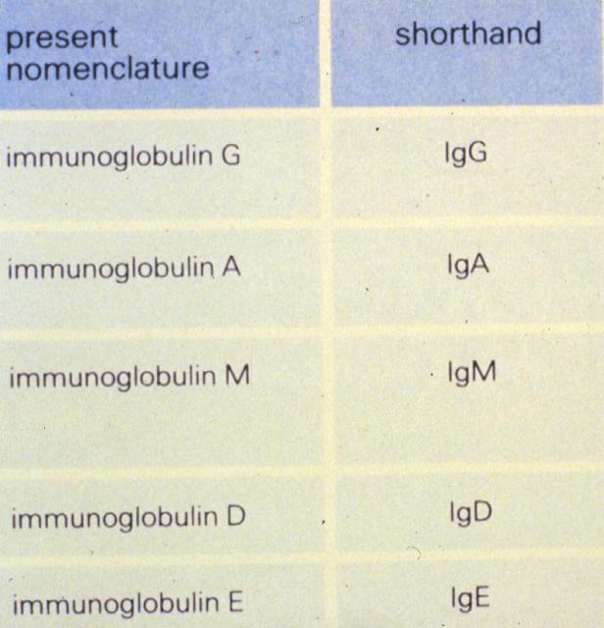
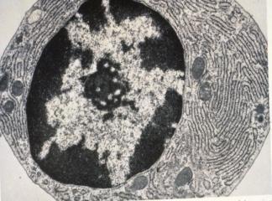
Switching of Antibody Classes

Slide 34

Effectors - B cells
How antibodies work?

Slide 35

Roles and Specific Actions of Antibodies in Immunity
Complement - mediated lysis
Opsonization - promote phagocytosis
Toxin neutralization
Prevention of microbial binding to mucosal surface
Virus neutralization - interferes with cell penetration
Degranulation of mast cells

Slide 36


Antibodies in Immunity
Mast cells - allergic response

Slide 37



Induced
Degranulation
of
Mast cells

Slide 38
Effector T cells
Cytotoxic (killer) T cells
Delayed - type hypersensitivity T cells
Amplification
  Factors (lymphokines)
  Other cell types involved

Slide 39

Effector T cells
Cytotoxic (killer) T cells

Slide 40



Effector T cells
Cytotoxic (killer) T cells

Slide 41

Effector T cells
Delayed - type hypersensitivity T cells
Amplification
  Factors (lymphokines)
  Other cell types involved

Slide 42
Lymphocytes
Type Function
B Plasma cells - antibodies
Memory B cells
T lymphocyte T cell receptors
specialized to recognize
surface antigens of cells
Memory Sensitive to previous antigens
Cytotoxic cells Destroys transplanted organs
Helper cells Secretes substances that
help T & B respond
Suppressor cells Dampens response to
foreign antigens and self antigens

Slide 43

Macrophages Enhance the Immune Response

Slide 44

Macrophages Enhance the Immune Response

Slide 45

Lymph Nodes Filter Lymph
Induction of the
immune response
requires:
Peripheral organ needed to get antigen and responsive cell to interact
Lymphocyte recirculating
Appropriate context

Slide 46



Lymph Nodes Filter Lymph

Slide 47
Lymphocyte Recirculating

Slide 48


Lymph Nodes Filter Lymph

Slide 49


Lymph Nodes Filter Lymph

Slide 50



Lymph Nodes Filter Lymph

Slide 51

Lymph Nodes Filter Lymph

Slide 52
Amplification of the Immune Response - factors (Lymphokines) and other cell types involved

Slide 53
1. Engulfing an invading organism and coupling with a helper T cell, a macrophage secretes the lymphokine interleukin (IL-1), which activates the helper T cell. IL-1 also stimulates the brain to raise the body’s temperature, causing fever, which enhances the activity of immune cells.
2. The activated helper T cell produces interkeukin-2 (IL-2), which stimulates other helper and killer T cells to grow and divide. The helper T’s secrete a lymphokine called B-cell growth factor (BCGF) which causes B cells to multiple.

Slide 54
3. As the number of B cells increases, helper T cells produce another lymphokine, B-cell differentiation factor (BCDF), which instructs some of the B cells to stop replicating and start producing antibodies.
4. Helper T cells also produce a lymphokine called gamma interferon (IF), which has multiple effects. Like IL-2, it helps to activate killer T cells, enabling them to attack the invading organism. Like BCDF, it increases the ability of B cells to produce antibodies. It also effects macrophages, keeping them at the site of the infection and helping them to digest the cells they have engulfed.

Slide 55


Slide 56

Ontogeny
Stem Cells: bone marrow
Primary Lymphoid Organs
Secondary Lymphoid Organs
Differentiation
to mature antigen:
reactive cells

Slide 57




Next Time: Lymphoid System Components

Slide 58







Structure of Lymphoid System Components
Next time

Slide 59

Many illustrations in these VIBS Histology YouTube videos were modified from the following books and sources: Many thanks to original sources!
Bruce Alberts, et al. 1983. Molecular Biology of the Cell. Garland Publishing, Inc., New York, NY.
Bruce Alberts, et al. 1994. Molecular Biology of the Cell. Garland Publishing, Inc., New York, NY.
William J. Banks, 1981. Applied Veterinary Histology. Williams and Wilkins, Los Angeles, CA.
Hans Elias, et al. 1978. Histology and Human Microanatomy. John Wiley and Sons, New York, NY.
Don W. Fawcett. 1986. Bloom and Fawcett. A textbook of histology. W. B. Saunders Company, Philadelphia, PA.
Don W. Fawcett. 1994. Bloom and Fawcett. A textbook of histology. Chapman and Hall, New York, NY.
Arthur W. Ham and David H. Cormack. 1979. Histology. J. S. Lippincott Company, Philadelphia, PA.
Luis C. Junqueira, et al. 1983. Basic Histology. Lange Medical Publications, Los Altos, CA.
L. Carlos Junqueira, et al. 1995. Basic Histology. Appleton and Lange, Norwalk, CT.
L.L. Langley, et al. 1974. Dynamic Anatomy and Physiology. McGraw-Hill Book Company, New York, NY.
W.W. Tuttle and Byron A. Schottelius. 1969. Textbook of Physiology. The C. V. Mosby Company, St. Louis, MO.
Leon Weiss. 1977. Histology Cell and Tissue Biology. Elsevier Biomedical, New York, NY.
Leon Weiss and Roy O. Greep. 1977. Histology. McGraw-Hill Book Company, New York, NY.
Nature (http://www.nature.com), Vol. 414:88,2001.
A.L. Mescher 2013 Junqueira’s Basis Histology text and atlas, 13th ed. McGraw
Internet images and videos on biological presentations

Slide 60

Wyoming/Montana

Slide 61

Wyoming

Slide 62

Wyoming/Montana

