Slide 1
Drug Cost Calculations

Slide 2
Background
Calculation of the cost of veterinary prescriptions
Information needed for calculation
Total prescription quantity (# of tablets, volume of liquid, etc.)
Cost per unit of drug
Quantity/strength of drug available
Read the problem carefully to determine what you will be calculating and how.
Make sure the units in your calculations match!

Slide 3
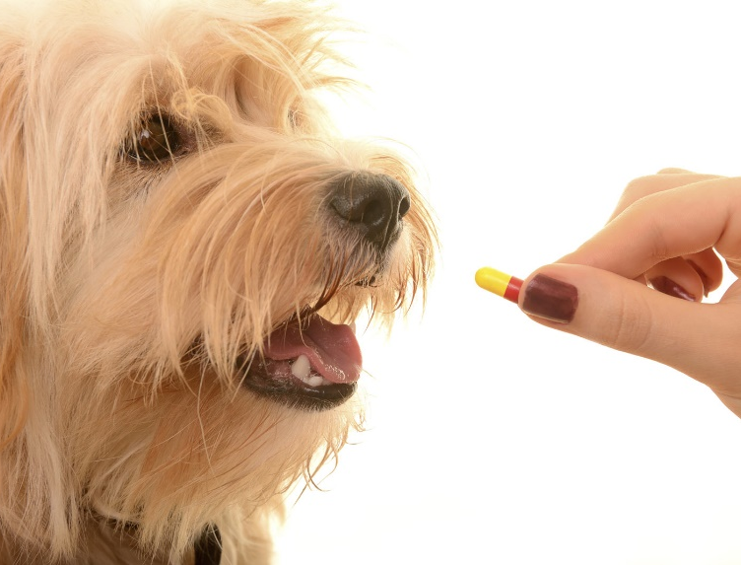
Scenario 1
A 33 lb. dog needs 100 mg/kg of amoxicillin daily; administered in 3 doses for 5 days. The drug is available in 500 mg tablets at a cost of .20 per tablet. Calculate the cost for the entire prescription.
Step one – determine the total daily dose
Note that the dog’s weight is in pounds and the dosage instructions are in kilograms!

Slide 4
Solution
Convert to like units
1 kg = 2.2 lbs
Determine the total dosage required to fill the prescription
100 mg/kg x 5 days
Let’s look at the problem again!
Notes:
Remind students that if conversions were required it would be best to use dimensional analysis.

Slide 5
Scenario 1
A 33 lb. dog needs 100 mg/kg of amoxicillin daily; administered in 3 doses for 5 days. The drug is available in 500 mg tablets at a cost of .20 per tablet. Calculate the cost for the entire prescription.
Convert – 33 lbs x 1 kg__
2.2 lbs
= 15 kg
Determine total dosage
100 mg/kg/day x 15 kg
= 1500 mg/day
1500 mg/day x 5 days
7500 mg

Slide 6
Solution
Determine the type and cost of drug available
500 mg tablets
$ .20/tablet
Let’s look at the problem again!
Notes:
Remind students that if conversions were required it would be best to use dimensional analysis.

Slide 7
Scenario 1
A 33 lb. dog needs 100 mg/kg of amoxicillin daily; administered in 3 doses for 5 days. The drug is available in 500 mg tablets at a cost of .20 per tablet. Calculate the cost for the entire prescription.
Determine number of tablets –
7500 mg
500 mg/tab
= 15 tablets
Determine cost of prescription –
15 tablets x $.20/tablet
= $ 3.00

Slide 8
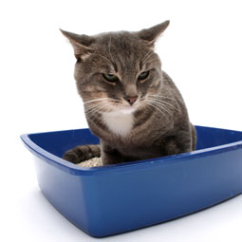
Scenario 2
The doctor prescribes 100 mg of Baytril for 10 days to treat Einstein’s urinary tract infection. The clinic has 50 mg tablets for $.75/tablet or 200 mg for $2.25/tablet. What is the least expensive way to fill this prescription?
Step one – determine the total daily dose
100 mg/day x 10 days
= 1000 mg

Slide 9
Scenario 2
The doctor prescribes 100 mg of Baytril for 10 days to treat Einstein’s urinary tract infection. The clinic has 50 mg tablets for $.75/tablet or 200 mg for $2.25/tablet. What is the least expensive way to fill this prescription?
Step two – determine the total number of tablets needed to fill the prescription
1000 mg
50 mg/tab
= 20 tablets
1000 mg
200 mg/tab
= 5 tablets

Slide 10
Scenario 2
The doctor prescribes 100 mg of Baytril for 10 days to treat Einstein’s urinary tract infection. The clinic has 50 mg tablets for $.75/tablet or 200 mg for $2.25/tablet. What is the least expensive way to fill this prescription?
Step three – determine the cost of both options
20 tablets x .75/tablet
= $15.00
5 tablets x $2.25/tablet
= $11.25

Slide 11
Questions?

