Slide 1
CELLS ARE US
BUILDING PROTEINS

Slide 2
NAVIGATION TABLE
Cells Are Us: Building Proteins
Pre-Test
Introduction
Why It Matters
What We Know
How We Know
Story Time
Common Hazards
Activities
Self-Study Game
Post-Test
Glossary

Slide 3
Building Proteins
Pre-Test
Cells Are Us: Building Proteins
Pre-Test
Introduction
Why It Matters
What We Know
How We Know
Story Time
Common Hazards
Activities
Self-Study Game
Post-Test
Glossary
Google assessment

Slide 4
Building Proteins
Cells Are Us: Building Proteins
Pre-Test
Introduction
Why It Matters
What We Know
How We Know
Story Time
Common Hazards
Activities
Self-Study Game
Post-Test
Glossary
Introduction

Slide 5
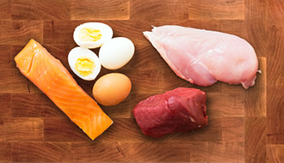
WE NEED PROTEIN
Introduction
Building Proteins
Cells Are Us: Building Proteins
Pre-Test
Introduction
Why It Matters
What We Know
How We Know
Story Time
Common Hazards
Activities
Self-Study Game
Post-Test
Glossary
You’ve probably heard about how important proteins are for your health. Certain foods like eggs, chicken, fish, and beef are very rich in protein.
Have you ever thought about what proteins really are? Proteins are large size molecules called macromolecules. Proteins are made up of amino acids that join together to form long chains. You can think of a protein as a string of beads in which each bead is an amino acid. There are 20 amino acids that help form the thousands of different proteins in your body.
Proteins do most of their work in the cell and perform various jobs. Proteins are needed to make structures in the cell and to serve in a variety of ways as signaling molecules. The building of protein is directed by the genes on chromosomes inside the cell nucleus.

Slide 6
Building Proteins
Objectives
Cells Are Us: Building Proteins
Pre-Test
Introduction
Why It Matters
What We Know
How We Know
Story Time
Common Hazards
Activities
Self-Study Game
Post-Test
Glossary
After completing this lesson, each student should be able to:
Examine and explain the structure of proteins.
Summarize various functions of proteins.
Recognize common hazards that affect normal protein functions in the body.

Slide 7
Building Proteins
Cells Are Us: Building Proteins
Pre-Test
Introduction
Why It Matters
What We Know
How We Know
Story Time
Common Hazards
Activities
Self-Study Game
Post-Test
Glossary
Why It Matters

Slide 8
INFORMATION CODING
Why It Matters
Building Proteins
Cells Are Us: Building Proteins
Pre-Test
Introduction
Why It Matters
What We Know
How We Know
Story Time
Common Hazards
Activities
Self-Study Game
Post-Test
Glossary
Why is the information coding job of proteins important?
Proteins come in many sizes and shapes. You could say that they have an information code determined by DNA sequences. Think of it like a language vocabulary. When you were a baby, and you only knew four or five words, it was very frustrating trying to tell your parents what you wanted. But as your vocabulary increased, so did the range of possible ways of expressing yourself to your parents and to others. Because proteins come in so many varieties, proteins can code for and control many different cell functions.
Proteins that are embedded in the cell membranes function in several ways. First, they function to recognize adjacent cells and thus help maintain organization of tissues. They also recognize chemicals outside of the cell and thus helps cells respond appropriately to hormones, drugs, and chemicals used to send signals in the nervous system.

Slide 9
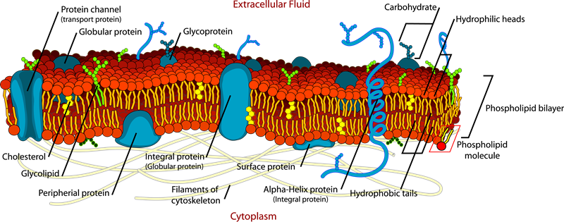
INFORMATION CODING
Why It Matters
Building Proteins
Cells Are Us: Building Proteins
Pre-Test
Introduction
Why It Matters
What We Know
How We Know
Story Time
Common Hazards
Activities
Self-Study Game
Post-Test
Glossary
Typical cell membrane structure showing proteins in the membrane.
Proteins that are inside of cells act as enzymes to help chemical reactions occur. They also help turn genes on and off. Some small proteins (peptides) can be secreted to act as hormones and chemicals used to send signals in the nervous system.

Slide 10
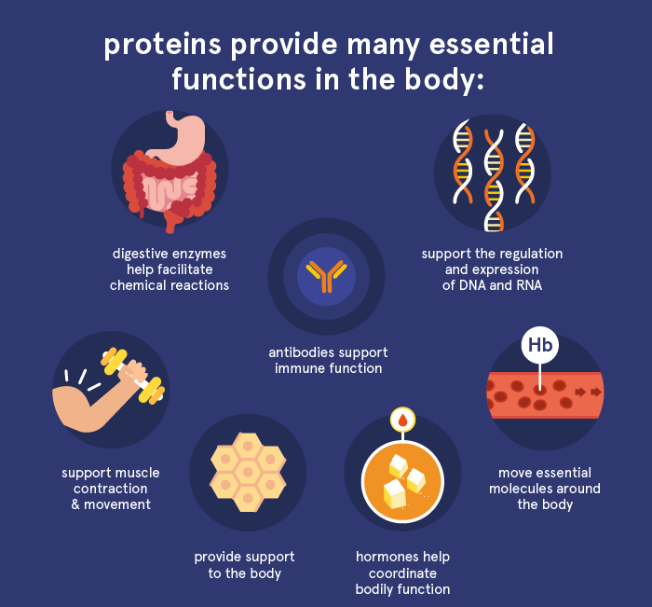
HEALTH AND MEDICINE
Why It Matters
Building Proteins
Cells Are Us: Building Proteins
Pre-Test
Introduction
Why It Matters
What We Know
How We Know
Story Time
Common Hazards
Activities
Self-Study Game
Post-Test
Glossary
Normal Proteins are required for good health.
Life as we know it would not exist without proteins. Everybody knows how important genes are, but genes get their importance from the fact that they direct the creation of proteins. Normal health depends on normal proteins. Disease almost always involves damage to certain proteins and interference with their normal function.
Functions of proteins in the body. Figure from European Food Information Council. https://www.eufic.org/en/whats-in-food/article/what-are-proteins-and-what-is-their-function-in-the-body

Slide 11
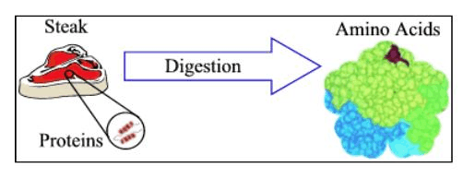
HEALTH AND MEDICINE
Why It Matters
Building Proteins
Cells Are Us: Building Proteins
Pre-Test
Introduction
Why It Matters
What We Know
How We Know
Story Time
Common Hazards
Activities
Self-Study Game
Post-Test
Glossary
What about proteins that you eat? Meat has lots of proteins. What happens to meat that you eat?
It gets digested, of course.
And what does digestion mean? .... broken down (to amino acids). So any proteins you eat get broken down.
Then the pieces get taken into your cells and are used as building blocks to make new protein
If you know why proteins are medically important, what they do, and how they are made by instructions from the genes, there is the possibility that you can control the inside-the-cell production of proteins. Thus, there is the possibility of correcting genetic disorders or treating a variety of medical conditions. This is the whole idea of "gene therapy."

Slide 12
Building Proteins
Cells Are Us: Building Proteins
Pre-Test
Introduction
Why It Matters
What We Know
How We Know
Story Time
Common Hazards
Activities
Self-Study Game
Post-Test
Glossary
What We Know

Slide 13
WHAT ARE THE TWO MOST IMPORTANT FUNCTIONS OF PROTEINS?
What We Know
Building Proteins
Cells Are Us: Building Proteins
Pre-Test
Introduction
Why It Matters
What We Know
How We Know
Story Time
Common Hazards
Activities
Self-Study Game
Post-Test
Glossary
Proteins are very large molecules that make up more than half of the dry matter of cells. They are some 2 to 20 times bigger than other molecules in cells. Proteins often determine the shape and structure of cells, and they also have two very important functions:
Recognizing and interacting with other molecules
Promoting reactions between other chemicals

Slide 14
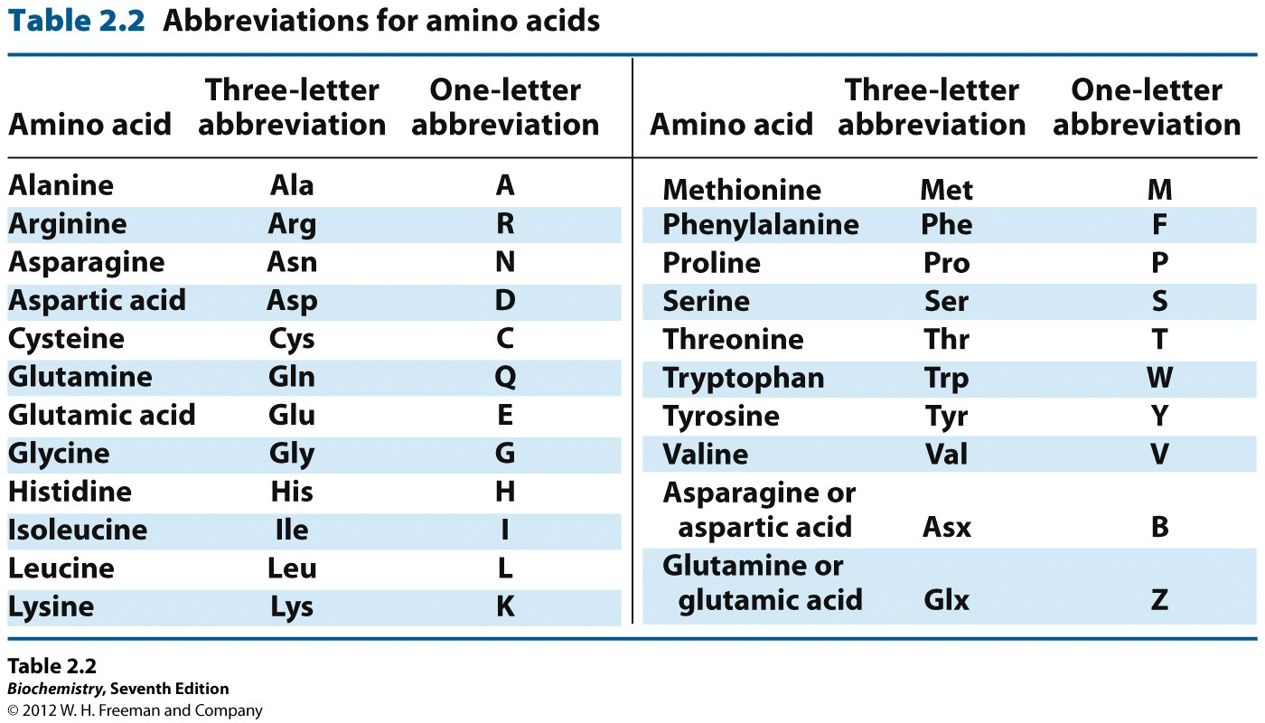
WHAT ARE PROTEINS MADE OF?
What We Know
Building Proteins
Cells Are Us: Building Proteins
Pre-Test
Introduction
Why It Matters
What We Know
How We Know
Story Time
Common Hazards
Activities
Self-Study Game
Post-Test
Glossary
Much like a string of pearls, a protein is built up from repeating units - in this case smaller molecules called "amino acids." There are 20 such amino acids in the body. Nine of these amino acids cannot be made in the human body. These nine have to be acquired through eating certain foods, such as meat and certain vegetables.
Proteins differ in the number and sequence of amino acids that they contain. That's where the information code is.

Slide 15
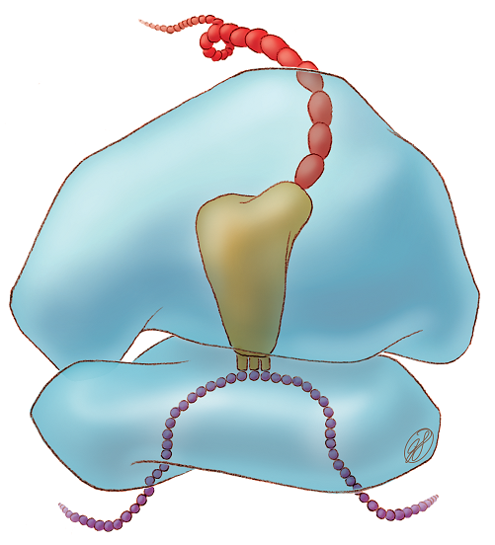
HOW ARE PROTEINS MADE?
What We Know
Building Proteins
Cells Are Us: Building Proteins
Pre-Test
Introduction
Why It Matters
What We Know
How We Know
Story Time
Common Hazards
Activities
Self-Study Game
Post-Test
Glossary
As discussed in our “From Genes to Proteins” unit, genes, made up of DNA found in in the cell nucleus, direct protein synthesis. These genes are transcribed from DNA to messenger RNA (mRNA). mRNA then leaves the nucleus and goes to the cytoplasm where it connects to an organelle called a ribosome.
The ribosome (seen in blue) is made up of two subunits and houses a process called translation, illustrated in the image to the right. In this process a large complex called transfer RNA or tRNA (tan in the image) has three nucleotide bases that complement the mRNA sequence (purple chain) one codon, or three nucleotides, at a time. Each codon codes for a specific amino acid. Each tRNA complex has an amino acid (red) that corresponds to its codon, so as each mRNA codon is read, a new tRNA adds a new amino acid to the chain.
Source: Judith Stoffer. Image: 1281 via National Institute of General Medical Sciences

Slide 16
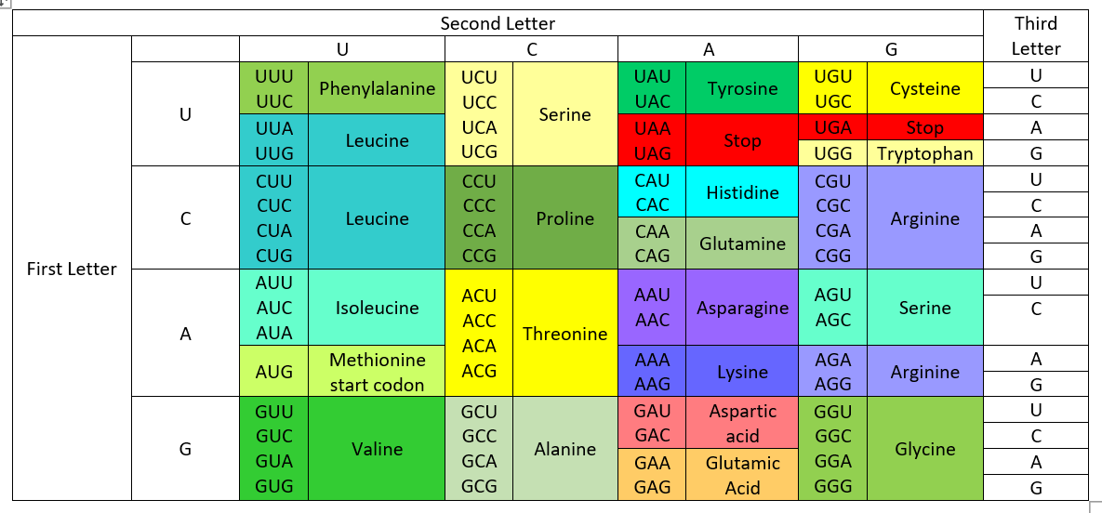
HOW ARE PROTEINS MADE?
What We Know
Building Proteins
Cells Are Us: Building Proteins
Pre-Test
Introduction
Why It Matters
What We Know
How We Know
Story Time
Common Hazards
Activities
Self-Study Game
Post-Test
Glossary
The table below show what mRNA codons code for what amino acids. As you can see, some amino acids are coded for by multiple codon sequences. Most of these redundant codons share one or two bases, and the third base is usually the one that changes. This makes it more difficult for DNA mutations to change the amino acid and therefore the shape of the protein.

Slide 17
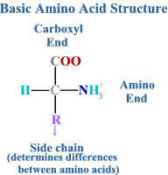
WHY IS THE NUMBER OF AMINO ACIDS IN A PROTEIN IMPORTANT?
What We Know
Building Proteins
Cells Are Us: Building Proteins
Pre-Test
Introduction
Why It Matters
What We Know
How We Know
Story Time
Common Hazards
Activities
Self-Study Game
Post-Test
Glossary
How many different proteins could you make if you used 4 amino acids per protein? There are 20 amino acids, and each could be positioned any place in the chain. This would create 20⁴ (that's 20 x 20 x 20 x 20) number of patterns.
But because proteins have many more amino acids than just four, on the order of 300 amino acids or so, the total possibilities are huge (20³⁰⁰)(that's 20 times itself 300 times). Thus, if you want molecules that contain a lot of "information," proteins are ideal molecules. All cells, of all plant and animal species, depend on proteins to carry information and to do the many kinds of jobs that cells have to do.
Differences in the number and order of amino acids present create different proteins.

Slide 18
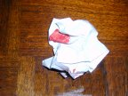
WHAT DO PROTEIN STRUCTURES LOOK LIKE?
What We Know
Building Proteins
Cells Are Us: Building Proteins
Pre-Test
Introduction
Why It Matters
What We Know
How We Know
Story Time
Common Hazards
Activities
Self-Study Game
Post-Test
Glossary
Protein structure is very complex because the different amino acids cause coiling and folding in different ways.
Primary structure: simple chain of amino acids.
Secondary structure: chains that are coiled or form pleated sheets.
Tertiary structure: coiled or pleated chains that are folded.
Quaternary structure: folded protein consisting of more than one amino acid chain.
One way to get the idea is to cut a sheet of paper in half, lengthwise. Mark a couple of colored spots on it, to represent "hot spots" or active regions of the protein.
This paper represents amino acids laid out lengthwise. Red spots represent small regions of amino acid "hot spots" that can attract and bind things like drugs or hormones.
Now crumple the paper up in different ways.
Depending on how the paper folds, the hot spots are in different positions. Looking at the picture on the left, a drug or hormone that needs to bind to two hot spots has to have a compatible shape that can bind. But that same drug could not bind if the protein were folded as on the right.
When clusters of different proteins clump together as sub-units of a much larger glob, this creates what is called quaternary structure.

Slide 19
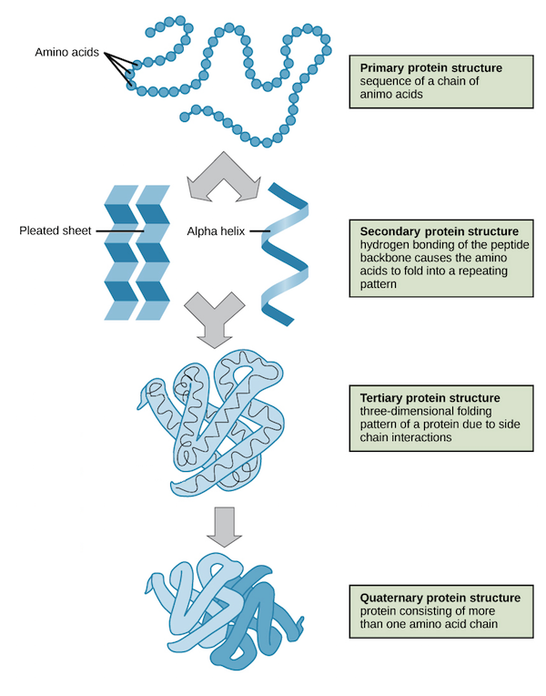
WHAT DO PROTEIN STRUCTURES LOOK LIKE?
What We Know
Building Proteins
Cells Are Us: Building Proteins
Pre-Test
Introduction
Why It Matters
What We Know
How We Know
Story Time
Common Hazards
Activities
Self-Study Game
Post-Test
Glossary
Some parts of a protein may be strongly bonded because of atomic bridges that link two regions. Sulfur-sulfur bonds commonly create such bridges in proteins. (These are the same bridges that get broken and reformed during a hair perm. They're what causes part of the hair perm smell too.)
Certain toxins damage cells because they impose extra bridges that do not normally occur (see our discussion of the hazards of hexane).
Image modified from OpenStax Biology's modification of work by the National Human Genome Research Institute.

Slide 20
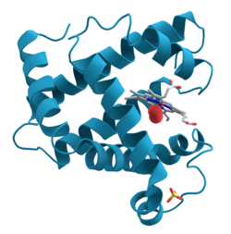
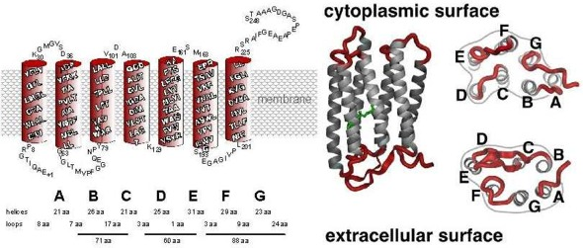
HERE’S HOW SCIENTISTS VISUALIZE HIGHER-ORDER STRUCTURES
What We Know
Building Proteins
Cells Are Us: Building Proteins
Pre-Test
Introduction
Why It Matters
What We Know
How We Know
Story Time
Common Hazards
Activities
Self-Study Game
Post-Test
Glossary
Amino acids that have no electric charge avoid water and are attracted to lipids and to each other. As a result, they form a coil. So, to simplify the representation of those sections of a protein, they are shown as a coiled ribbon (see diagram on right).
The illustration below represents the combined result of coiling and folding of a protein when it gets embedded in a membrane.
This picture shows two ways of drawing a membrane protein. Left: secondary coiled structure, with the coiled part buried in the membrane. The small letters are the first letter of names of the amino acids, showing the sequence as we explained at the top of this page. Middle: a "ribbon" diagram" of the same thing, with the red parts representing uncoiled amino acid strands that are outside of the membrane. Far right: diagrams showing how the structure might look if you were looking down on the membrane rather than looking at it from the side.
Image courtesy of Dr. Fillipp Oesterhelt, University of Munich, Germany.

Slide 21
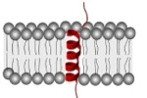
WHY ARE PROTEINS’ STRUCTURES IMPORTANT?
What We Know
Building Proteins
Cells Are Us: Building Proteins
Pre-Test
Introduction
Why It Matters
What We Know
How We Know
Story Time
Common Hazards
Activities
Self-Study Game
Post-Test
Glossary
Think about how molecules recognize each other. Proteins that fit well with other molecules, like a hand in a glove, or a key in a lock, can participate in reactions with those molecules. Whether or not a good fit occurs depends on the structure of the protein and of the molecules with which it encounters either inside the cell or on the cell surface.
A protein's function is established by its structure.
Remember the illustration of the crumpled sheet of paper?
In membranes, protein structure affects function in two ways:
non-charged parts coil in the membrane, acting like an anchor
portions of the protein that are attracted to water, stick out both sides of the membrane, available to interact with other molecules

Slide 22
WOULD EVEN A SMALL CHANGE IN STRUCTURE AFFECT A PROTEIN?
What We Know
Building Proteins
Cells Are Us: Building Proteins
Pre-Test
Introduction
Why It Matters
What We Know
How We Know
Story Time
Common Hazards
Activities
Self-Study Game
Post-Test
Glossary
Proteins are so precisely built that a change in only a few amino acids can radically change the structure of proteins and cause major changes in the function. Many of the genetic diseases are caused by miscoding of the sequence of only a few amino acids. Structure of proteins, particularly those in the cell membrane that have signaling functions, can be changed by interaction with molecules in the environment, and their functions become temporarily altered. This may affect how they bind with hormones or drugs or with other molecules.
For more on neat views of 3-D protein structure, click here. When you arrive at the Web page, pick a protein of interest, hit "Visualize", and then Hit "Quick PDB". Use the tool bar to the right of the image to manipulate image. Image can be rotated, measured, and analyzed.
Now you have a good idea of what proteins are, their structure, and how they function in your body! Next time someone says that it’s good to eat foods with plenty of protein, you will know why! Let’s read about a scientist who had a key role in helping us understand proteins, and we will take a look at some toxic substances that cause our protein production process to go haywire!

Slide 23
Building Proteins
Cells Are Us: Building Proteins
Pre-Test
Introduction
Why It Matters
What We Know
How We Know
Story Time
Common Hazards
Activities
Self-Study Game
Post-Test
Glossary
How We Know

Slide 24
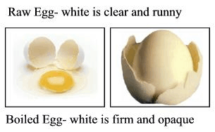
YOU CAN’T SEEN PROTEINS, SO HOW DO YOU STUDY THEM?
How We Know
Building Proteins
Cells Are Us: Building Proteins
Pre-Test
Introduction
Why It Matters
What We Know
How We Know
Story Time
Common Hazards
Activities
Self-Study Game
Post-Test
Glossary
If you can't see it with the naked eye, you have to find ways to make it visible. First, many cell proteins are not visible to the eye because they are dissolved in the water that is inside and outside of cells. You can often see these proteins if you change them so they no longer dissolve in water. One way to make a protein insoluble (not dissolvable) is to change its structure by denaturing it so that it precipitates out of solution.
Cells are made up of more than just proteins, so how do you separate the proteins to study them?
Heat denatures egg-white protein and makes it more visible
Cells contain mixtures of proteins and a large number of other chemicals. You need to have a way to separate proteins from all the other stuff inside of cells. Lipid and salts are the main chemicals that need to be removed in order to study pure proteins. After removing lipid and salts, the different kinds of proteins have to be separated from one another.
Cells are made up of more than just proteins, so how do you separate the proteins to study them?
Centrifuge
Remove the lipids
Remove the salts
Separate and purify
Determine the amino acid sequence
Determine the 3D structure

Slide 25
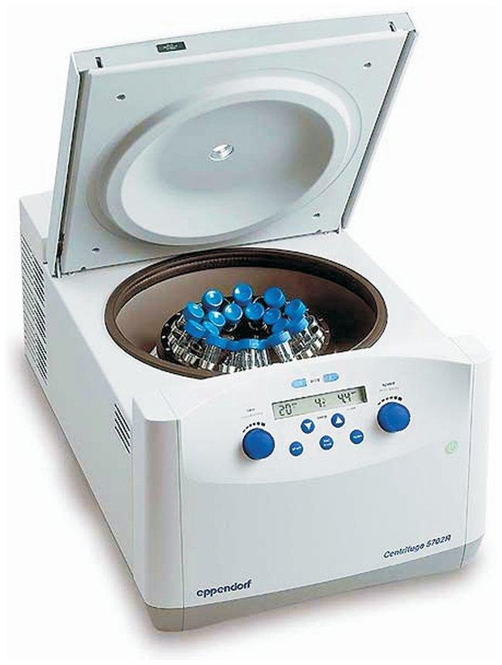
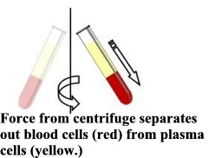
STEP 1: CENTRIFUGE
How We Know
Building Proteins
Cells Are Us: Building Proteins
Pre-Test
Introduction
Why It Matters
What We Know
How We Know
Story Time
Common Hazards
Activities
Self-Study Game
Post-Test
Glossary
The first step in many protein studies is to separate cellular parts first, so that you can study the proteins in specific parts of the cell, such as proteins in the nucleus, for example.
One popular approach is to centrifuge cells at high speeds. This is like those rides in amusement parks that spin you around and around in a horizontal plane. To get the best separation of cell parts, you must use centrifuges that spin at enormous speeds. This separates the components of the cells according to their weight. For example, chromosomes are heavy, so they would be forced down toward the bottom of the tube. Lighter weight organelles would be located toward the top.
Centrifugation works best if cells are broken up and put in a liquid that can suspend the cell parts in different layers. A gradient of different organelles and concentrations is a very popular solvent system for separating different parts of a cell (mitochondria spin down in one layer of a solvent, membranes in another, chromosomes in another, and so on).

Slide 26
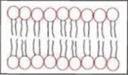
STEP 2: REMOVE THE LIPIDS
How We Know
Building Proteins
Cells Are Us: Building Proteins
Pre-Test
Introduction
Why It Matters
What We Know
How We Know
Story Time
Common Hazards
Activities
Self-Study Game
Post-Test
Glossary
Lipids are a major component of cells. Lipids can be separated from many proteins rather easily, because lipid does not dissolve well in water. Lipid removal is desired before protein purification processing, because lipids would interfere with the separation of the different kinds of proteins.
Fats tend to self organize like this in water, rather than dissolving. But they do dissolve in organic solvents, whereas proteins do not.
Separation of the lipid from the protein can be done by first gently mashing the cells to release their lipids and proteins. Then, the cellular debris is stirred into a mixture of two different solvents that do not dissolve in each other. The mashing does not break the basic atomic bonding in lipids and proteins, so proteins can be recovered intact from the solvent that contains the protein. The solvent with the lipid fraction can be thrown away.
U.S. Department of Agriculture scientist extracting cellular components

Slide 27
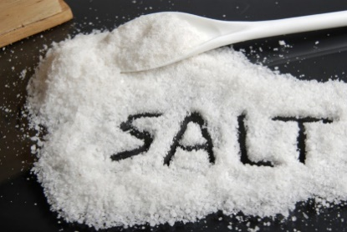
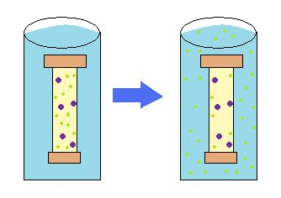
STEP 3: REMOVE SALTS
How We Know
Building Proteins
Cells Are Us: Building Proteins
Pre-Test
Introduction
Why It Matters
What We Know
How We Know
Story Time
Common Hazards
Activities
Self-Study Game
Post-Test
Glossary
If you had a bag of cell contents containing proteins, salts, and water, can you think of a way to get some of the salt removed? What if I tell you that the bag is plastic and that very small molecules, like salts, can get out?
In this case, what would happen if you set your plastic bag in a tub of pure water that contained no salts? These ideas are discussed also in the unit on cell membranes. The salts inside the bag would move outside the bag until a balance ("equilibrium") was reached between the amount of salt molecules inside the bag and the amount of salt in the water outside the bag? This is the process known as dialysis.
But we only have half of the salt out. How would we get some more out? We just put the bag in a fresh tub of pure water and repeat the process over and over until we get the protein pure enough for our purposes.
Over time, solutes originally in high concentration inside the bag move to the solution surrounding the membrane.
Dialysis. By Gjk003 https://commons.wikimedia.org/wiki/File:Dialysis.jpg

Slide 28
STEP 4: SEPARATE AND PURIFY
How We Know
Building Proteins
Cells Are Us: Building Proteins
Pre-Test
Introduction
Why It Matters
What We Know
How We Know
Story Time
Common Hazards
Activities
Self-Study Game
Post-Test
Glossary
A good method of separating substances in a mixture is called chromatography. Here are several different methods of chromatography. Which one would you pick to separate proteins?
Column Chromatography – Method 1
This type of chromatography is called "column," because you use a long glass tube to do the separations. The idea here is that if you pack a long glass tube, open at both ends, with powdered packing material of the right kind, it can adsorb the salt and let the water and proteins pass through. Then you could separate proteins of different sizes by pouring them through columns in which the packing material would only let certain-size molecules get through.

Slide 29
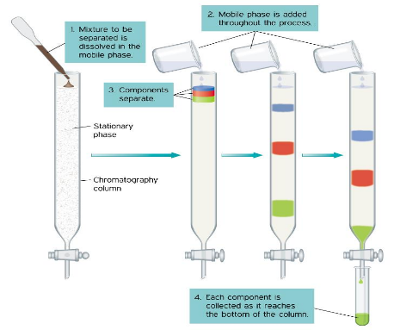
STEP 4: SEPARATE AND PURIFY
How We Know
Building Proteins
Cells Are Us: Building Proteins
Pre-Test
Introduction
Why It Matters
What We Know
How We Know
Story Time
Common Hazards
Activities
Self-Study Game
Post-Test
Glossary
The idea is that certain packing materials will adsorb some substances better than others. So, for example, when you pass through the packing a water solution (loaded at the top in this picture), some molecules will stick to the packing material as it flows through the tube and out the bottom. Then, a follow-up step involves flushing the packing with an appropriate liquid that can dissolve the adsorbed chemicals and carry them out with the liquid (drained at the bottom of this picture).
This process is called "elution". Proteins come in different sizes and different sized proteins come off the column at different rates, thus achieving separation of proteins. Thus, if you collect the wash liquid for 10 seconds, for example, you may get one kind of protein, a collection of wash liquid for the next 10 seconds would get another protein, and so on.

Slide 30
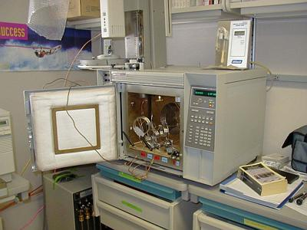
STEP 4: SEPARATE AND PURIFY
How We Know
Building Proteins
Cells Are Us: Building Proteins
Pre-Test
Introduction
Why It Matters
What We Know
How We Know
Story Time
Common Hazards
Activities
Self-Study Game
Post-Test
Glossary
Gas Chromatography – Method 2
Another kind of chromatography is called "gas" chromatography. Note the diagram on the right. The cell chemicals are injected onto a heated column. The column may be many feet long and coiled so that you have a huge surface area for adsorption of dissolved substances. A gas (usually helium) carries the substances through the column, where they pass by an electronic detector at different rates.
Gas chromatograph instrument. Door opens to the oven, which contains the coiled metal column. Injection port for samples is on top right of the cabinet, above the electronic control panel. Flow of carrier gas is fed in through the back.

Slide 31
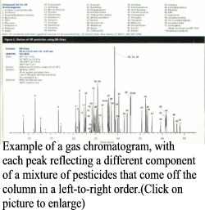
STEP 4: SEPARATE AND PURIFY
How We Know
Building Proteins
Cells Are Us: Building Proteins
Pre-Test
Introduction
Why It Matters
What We Know
How We Know
Story Time
Common Hazards
Activities
Self-Study Game
Post-Test
Glossary
What causes the dissolved particles to separate?
Because different chemicals have different adsorption properties, they separate over time. One chemical, for example, that does not stick well to the column will rush right through and the detector produces a spike in a graph to reveal its presence. Then, at later times other more sticky solutes will come off the column and produce delayed peaks. The tracing of the various peaks is called a chromatogram. If you carefully time when the peaks occur, you can actually collect the solutes at the other end.
Gas chromatography is not very useful for proteins. Know why? It is the heat, which denatures and changes proteins.

Slide 32
STEP 4: SEPARATE AND PURIFY
How We Know
Building Proteins
Cells Are Us: Building Proteins
Pre-Test
Introduction
Why It Matters
What We Know
How We Know
Story Time
Common Hazards
Activities
Self-Study Game
Post-Test
Glossary
Paper Chromatography and Gel Electrophoresis – Method 3
Another simple way to separate proteins is to use paper chromatography. What happens to a piece of paper if you turn it on edge and dip it into some water? The water migrates up the paper, right? Scientists use this same principle to get a solution of proteins and water to migrate up a piece of paper. This will separate proteins!

Slide 33
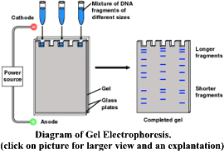
STEP 4: SEPARATE AND PURIFY
How We Know
Building Proteins
Cells Are Us: Building Proteins
Pre-Test
Introduction
Why It Matters
What We Know
How We Know
Story Time
Common Hazards
Activities
Self-Study Game
Post-Test
Glossary
Why does this separate the proteins?
The proteins separate on the paper because some proteins are bigger and heavier than others. They are not dragged as far by the water. Then, if you let the paper dry, the separated proteins are just sitting there, and you can spray a stain on them. The stain makes them appear like spots, each at a different location along the paper.
Still, this is a little crude, and better results can be had if you use an electric current to help pull proteins apart. While the proteins are migrating, an electric current can separate the proteins based on their electrical charge. A more protein that has a negative charge would be pulled toward the positive source of current. An electropositive protein would be pulled toward the negative source of current. If a semi-solid substrate, instead of water, is used, the substrate can be dried and stained after the proteins are separated to reveal where each one is concentrated. This is exactly the technique commonly used today. It is called Gel Electrophoresis, because the substrate is a Jell-O-like gel (semi-solid) that has microscopic pores that let proteins migrate through.

Slide 34
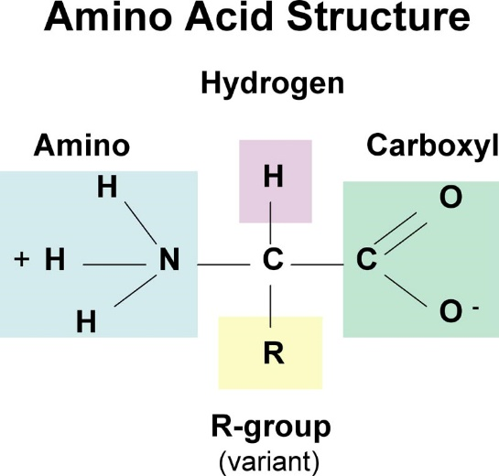
STEP 5: DETERMINE THE AMINO ACID SEQUENCE
How We Know
Building Proteins
Cells Are Us: Building Proteins
Pre-Test
Introduction
Why It Matters
What We Know
How We Know
Story Time
Common Hazards
Activities
Self-Study Game
Post-Test
Glossary
First, the proteins have to be "digested" into their amino acid pieces. Then chemical reactions can determine what amino acids are present. This used to be a time-consuming and laborious process. Nowadays, laboratory instruments perform this function automatically, identifying not only what amino acids are present but also their sequence (order).
The diagram on the right shows how atoms in an amino acid are arranged. Carbon atoms are represented by the letter C, oxygen atoms by O, Nitrogen by N, and hydrogen by H. The R stands for the rest of the molecule which is different for each kind of amino acid.
The instruments use a chemical reaction that strips off one amino acid at a time, starting at the end with a Nitrogen group. By lopping off one amino acid at one end, the next amino acid has an exposed Nitrogen group, and it in turn can be lopped off and identified.

Slide 35
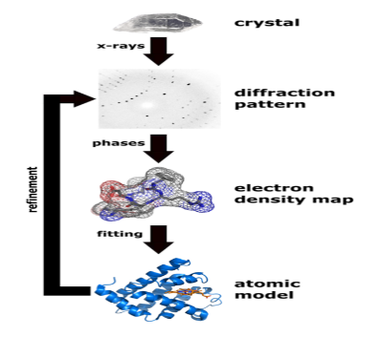
STEP 6: DETERMINE THE 3D STRUCTURE
How We Know
Building Proteins
Cells Are Us: Building Proteins
Pre-Test
Introduction
Why It Matters
What We Know
How We Know
Story Time
Common Hazards
Activities
Self-Study Game
Post-Test
Glossary
The final step needed to identify different kinds of proteins is to determine the protein's three-dimensional structure. One common approach is to expose a purified protein to x-rays, and then examine the pattern of radiation scatter. As x-rays pass through protein, they get deflected, and that can produce a visual pattern if the scattered x-rays hit a photographic film placed behind the protein target.
However, this only works if the proteins are made into crystals of repeating units of protein molecules.
Why does anyone care about the 3D structure of proteins? The answer is that this structure helps scientists understand how the protein binds and interacts with other molecules. It can help develop new drugs that specifically target a given protein.
Flow chart showing the major steps in X-ray protein crystallography

Slide 36
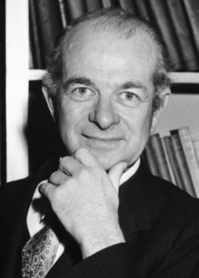
LINUS PAULING (1901-1994)
Building Proteins
Story Time
Cells Are Us: Building Proteins
Pre-Test
Introduction
Why It Matters
What We Know
How We Know
Story Time
Common Hazards
Activities
Self-Study Game
Post-Test
Glossary
A British journal included only Linus Pauling and Einstein from the 20th Century in their list of the greatest scientists in the history of the world. As you will see, Linus made major discoveries about chemical bonding and the structure of proteins―pretty heady stuff for a high-school dropout. He didn’t drop out because school was too hard. For him, it was too easy.
Source: Nobel Prize

Slide 37
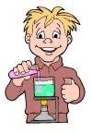
LINUS PAULING (1901-1994)
Story Time
Building Proteins
Cells Are Us: Building Proteins
Pre-Test
Introduction
Why It Matters
What We Know
How We Know
Story Time
Common Hazards
Activities
Self-Study Game
Post-Test
Glossary
Some scientists are born with a silver spoon in their mouth. But not Linus Pauling. From age 4 to 9, Linus lived in a small Oregon town, which was like an outpost in the Old West. The town had one street, lined by stores with false fronts on many of the buildings, as you see on cowboy movie sets today. Real cowboys lounged in front of the general store, and real Indians camped on the edge of town. His father, Herman, was a self-taught pharmacist and "medicine man." He ran a drug store in town. Maybe that is why Linus developed a lifelong interest in chemistry. The family was very poor. In fact, they had to move to town in order to get help from his mother's family. But Linus was happy. For him, life was cowboys and Indians.
But Linus's happy childhood came to an end at age nine when his father died. His mother struggled alone to raise Linus and his two younger sisters. Linus found comfort in reading and collecting insects and minerals. By age nine, he had already read the entire Bible and Darwin's book, Origin of Species. His father had made certain that Linus read important books. However, in those days good books were hard to find in a frontier town.
Linus's interest in chemistry apparently came from his childhood experiences with a chemistry set that a playmate had. They spent many hours tinkering with it. They also spent many happy hours collecting rocks and minerals in a creek bed near town. Linus wondered about the internal structure of rocks and minerals. Many years later, he answered some of those questions in his research lab.

Slide 38
LINUS PAULING (1901-1994)
Story Time
Building Proteins
Cells Are Us: Building Proteins
Pre-Test
Introduction
Why It Matters
What We Know
How We Know
Story Time
Common Hazards
Activities
Self-Study Game
Post-Test
Glossary
Unlike many scientists who go to prestigious universities like Harvard, Oxford, and Caltech, Linus went to his local college, Oregon State Agricultural College (now Oregon State University), where he majored in chemical engineering. He supported himself by working at all sorts of jobs. He chopped wood, butchered cattle, and mopped floors for a quarter an hour. He even provided much of his family's financial support in addition to completely supporting himself. The college courses were not very challenging for Linus. He took the most difficult courses they had and still found time to join a fraternity, to participate in varsity track, and to work 25 hours a week. In his third year of college, he temporarily stopped classes in order to work full time.
In the summer, Linus worked as a paving inspector, checking the blacktop and later analyzing it in the lab. This work yielded $125 per month and stimulated his interest in chemistry. He sent this money to his mother to place in the bank for him to use to return to school for the fall term. However, when it came time to go back to school, Linus discovered that his mother had become ill with pernicious anemia and had spent all the money. But he was such a good student that the college gave him a job helping to teach. At age 18, he was teaching the sophomore class that he had taken the year before.
In the fall of his senior year, Linus met the girl of his dreams. She was a home economics major taking the chemistry class he was teaching. He met her by calling out the simplest name on the class roster: "Miss Miller, will you please tell us what you know about ammonium hydroxide?" Miss Miller, it turned out, knew quite a bit about ammonium hydroxide, and it did not take long for her to know about Linus. In a few months, they became engaged.

Slide 39
LINUS PAULING (1901-1994)
Story Time
Building Proteins
Cells Are Us: Building Proteins
Pre-Test
Introduction
Why It Matters
What We Know
How We Know
Story Time
Common Hazards
Activities
Self-Study Game
Post-Test
Glossary
When he graduated as a chemical engineer, Linus' mother wanted him to come home and make money, perhaps as a secondary school teacher. However, from reading some of the textbooks in college, Linus realized that he wanted to do research. His abilities and test scores were good enough to get him admitted to a PhD program at Caltech (California Institute of Technology). He obtained his PhD at age 24.
One reason he chose Caltech was because they had a professor, Alfred Noyes, who specialized in the study of bonding of atoms. After graduation, Linus went to Europe for three years to conduct research in laboratories that were at the cutting edge of research on atomic structure. He then went back to Caltech as a faculty member and rose to the rank of full professor in only three years. He was a science superstar.

Slide 40
LINUS PAULING (1901-1994)
Story Time
Building Proteins
Cells Are Us: Building Proteins
Pre-Test
Introduction
Why It Matters
What We Know
How We Know
Story Time
Common Hazards
Activities
Self-Study Game
Post-Test
Glossary
Linus became interested in atomic bonding and quickly became the leading authority. In the same year in which he was promoted to professor, Pauling published the paper that made him famous: "The Nature of the Chemical Bond." At age 32, Linus was inducted into the National Academy of Science, becoming the youngest person ever to be admitted. In his research, Pauling used the latest ideas about atoms to explain how atoms share electrons and how this sharing formed a bond to make a molecule. This is common knowledge today, but we forget that we owe these ideas largely to Linus. This work was the basis for Linus receiving the Nobel Prize in Chemistry in 1954.
Pauling pioneered discoveries of the hydrogen bond. In water, for example, hydrogen loosely holds on to the oxygen atom by sharing its sole electron with an electron of oxygen. It can similarly bond with some other atoms. For other atoms, like carbon, for example, hydrogen bonding is very strong (such bonds are called covalent).

Slide 41
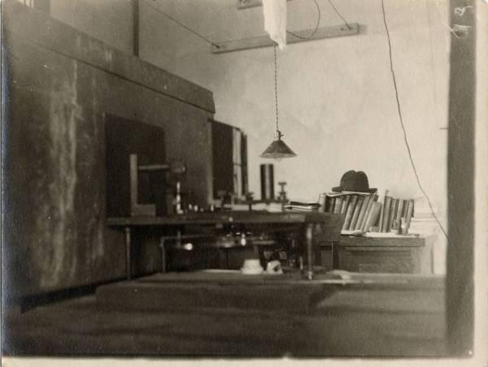
LINUS PAULING (1901-1994)
Story Time
Building Proteins
Cells Are Us: Building Proteins
Pre-Test
Introduction
Why It Matters
What We Know
How We Know
Story Time
Common Hazards
Activities
Self-Study Game
Post-Test
Glossary
Linus showed scientists how to study molecules and how to measure the angles, bond energies, and distances between the atoms in a molecule. One of his key ideas was to make a "footprint" of the structure of molecules from the pattern formed by a stream of x-rays as it passes between atoms in the molecules of a sample. The technique is called x-ray diffraction. Atoms in a molecule affect the path of the x-rays in such a way that the pattern reveals the inner structure of the molecule.
Before he was 40 years old, Linus had made many major discoveries in chemistry. He showed how molecules participate in chemical reactions, how magnetic fields affect molecules, how atoms attract extra electrons, and how atoms become polarized with negative and positive regions.
Figure 1. Linus Pauling x-ray apparatus
Early on, Linus's main interest was in the structure of proteins. He knew that the structure of any given protein depended on its environment. For example, consider the egg-white protein of eggs. When you break a fresh egg, do you see any whiteness? No. But when it starts to fry, all but the yolk turns white. What is happening here? The answer is that heat breaks certain bonds to change the structure so that it reflects a white color to your eyes. This process is called "denaturation“ --- that is, the natural structure of the protein is changed. Linus was interested in natural structure of proteins because it is that natural structure that governs protein functions.

Slide 42
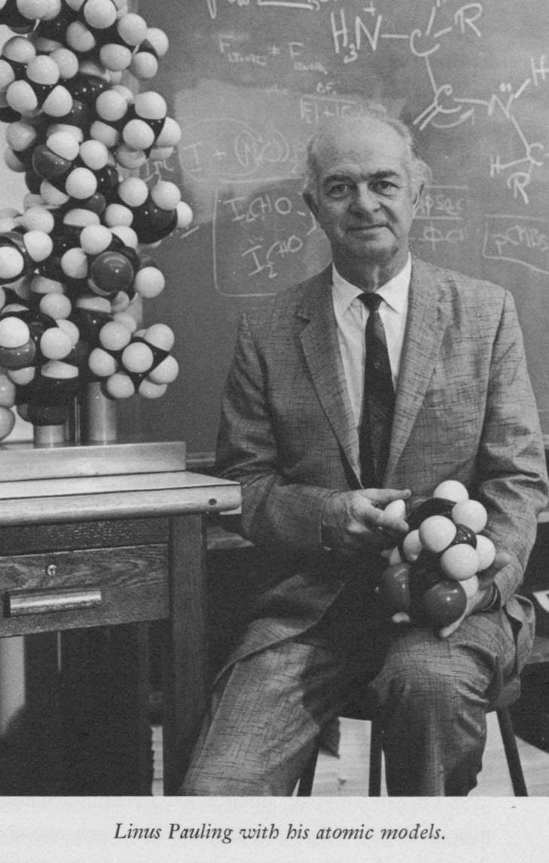
LINUS PAULING (1901-1994)
Story Time
Building Proteins
Cells Are Us: Building Proteins
Pre-Test
Introduction
Why It Matters
What We Know
How We Know
Story Time
Common Hazards
Activities
Self-Study Game
Post-Test
Glossary
Once he had mastered understanding of the hydrogen bond, Linus was poised to pursue his other interest: the structure of proteins.
Proteins interested Pauling also because they controlled most everything happening inside the cell. For example, biochemical reactions are promoted by proteins that we call enzymes. In mitochondria of eukaryotic cells, for example, a variety of enzymes control the various reactions, known as the Krebs cycle, that harvest much of chemical bond energy from a break-down product of glucose. These enzymes also exist in prokaryotes, but the reactions occur in the cytoplasm.
Linus was especially interested in the chemical bonding of atoms within proteins. Originally, this interest was because he knew that enzymes attached in very specific ways to influence chemical reactions either to join molecules together or break them apart. He wondered what created the specificity of binding.
There were other reasons why Linus knew proteins were really important. For example, certain proteins interact with hormones and neurotransmitters to mediate their actions on cells. They do this by selectively binding to certain proteins in the cell membrane. You might think of these "receptors" as corks floating in the sea of the membrane’s lipid bilayer.
Figure 2. Linus Pauling worked with ball-and-stick models of atoms to illustrate the three-dimensional structure of molecules.

Slide 43
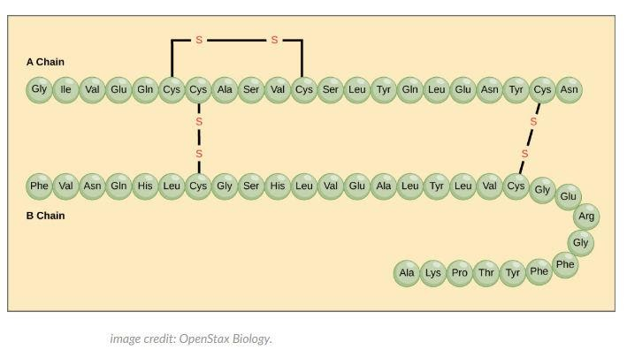
LINUS PAULING (1901-1994)
Story Time
Building Proteins
Cells Are Us: Building Proteins
Pre-Test
Introduction
Why It Matters
What We Know
How We Know
Story Time
Common Hazards
Activities
Self-Study Game
Post-Test
Glossary
Proteins are even involved in the function of genes. One class of proteins, histones, forms a coating around DNA to influence which genes are turned on or off. Finally, other kinds of proteins are anchored in eukaryotic cell membranes and influence cell-to-cell interactions.
In 1951, Pauling reported that some 15 years of experiments in his lab on the structure of proteins indicated that proteins had complex three-dimensional structure. In the simplest, primary form, other investigators had shown that proteins contained chains of amino acids bonded together. Think of it like a string of beads, with some strings attached to other strings by Sulphur bonds (S in Fig.3).
Figure 3. Components of a protein. All proteins are made of many amino acids (shown here with abbreviated names: Ala, Lys, Pro, etc.) linked together in a chain. Some of the amino acids in one chain get tied with amino acids in another chain by sharing bonds with sulfur atoms (S).

Slide 44
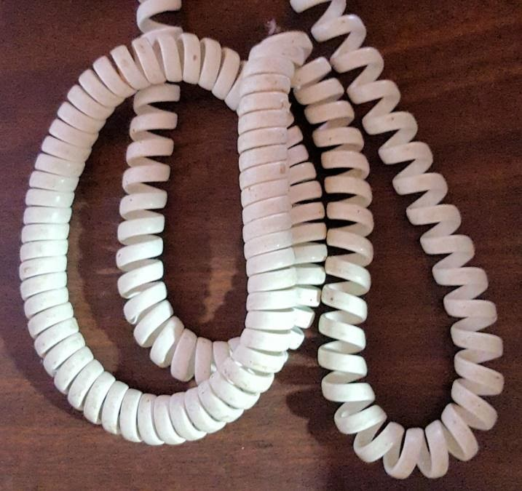
LINUS PAULING (1901-1994)
Story Time
Building Proteins
Cells Are Us: Building Proteins
Pre-Test
Introduction
Why It Matters
What We Know
How We Know
Story Time
Common Hazards
Activities
Self-Study Game
Post-Test
Glossary
All that was known at the time was that proteins had a chain-like structure shown in the previous slide. Linus and a colleague, Robert Corey, showed how the amino acids were constructed and how hydrogen bonds forced the chain into coils, appearing much like the way a telephone cord coils (Fig. 4). What they showed was that the hydrogen atom in one amino acid would form a weak bond with another amino acid four down the chain. This bonding twists the chain into a coil, like a coiled telephone wire. The twist is right to left, creating a secondary structure that is called an alpha helix.
A further change in three-dimensional structure is imposed when sections of a coil line up against each other to form sheet-like structure. Finally, a tertiary structure is imposed when certain amino acids that are electrically charged and others that lack a charge caused stacking and folding to create a glob-like structure (Fig.5). The three-dimensional tertiary structure has pockets and protrusions of various surface electrical charges that govern how the protein interacts with other molecules. Still further, quaternary structure, is imposed if the protein consists of more than one amino acid chain. This complex structure dictates how hormones, neurosecretions, and drugs act on cells, by binding at specific locations in the protein.
Figure 5. Folding and stacking to create tertiary structure.
Figure 4. Telephone-cord analogy of protein structure. Helix coiling to form secondary structure.

Slide 45
LINUS PAULING (1901-1994)
Story Time
Building Proteins
Cells Are Us: Building Proteins
Pre-Test
Introduction
Why It Matters
What We Know
How We Know
Story Time
Common Hazards
Activities
Self-Study Game
Post-Test
Glossary
These monumental discoveries were not enough for Pauling. By now, everybody knew that hydrogen bonds had to play a role in DNA structure and function. Linus took on the challenge from a British team consisting of James Watson and Francis Crick. All of them used Pauling’s bond-length data and ideas of coiling induced by hydrogen bonding and the approach of x-ray diffraction to decode the structure of DNA. The problem for Linus was that his resounding success with protein structure made him too optimistic about his prowess for solving the DNA problem. In a few months he dashed off his conclusion that DNA was a triple helix—a serious mistake. He apparently forgot that it took him some 15 years to unravel protein structure. He would not have made this mistake if he had seen the DNA x-rays taken by Rosalind Franklin. He had asked to see them, but they would not share their pictures with him.
In their famous book, The Double Helix, Watson and Crick describe the race to be the first to understand DNA structure and, in the process, genes. They freely admit that the race was with Linus, and they used his explanation of chemical bonding as the basis for arriving at the correct structure of DNA. Linus came very close to winning a second Nobel Prize in chemistry. One of the students that Linus trained, William Lipscomb, also won a Nobel Prize.
One reason for Linus Pauling's lifetime of success is explained by an exchange he had with a high school student: "How do you get so many great ideas?" the student asked. Linus replied, "To get good ideas, the important thing is to have lots of ideas." He believed that if you were wrong, some smart scientist would soon show the idea to be wrong. This, of course, happened to him, because he was wrong about the structure of DNA. But if you are right, you may have an idea that nobody else would have thought of. Pauling got that right for protein structure.

Slide 46
REFERENCES
Story Time
Building Proteins
Cells Are Us: Building Proteins
Pre-Test
Introduction
Why It Matters
What We Know
How We Know
Story Time
Common Hazards
Activities
Self-Study Game
Post-Test
Glossary
Author: W. R. Klemm
Photos:
The Double Helix, 1968, New York: Authenum (Linus Pauling, p.37)
Discover Magazine, Nov. 2018 (protein structures, p. 57)
Oregon State University, http://scarc.library.oregonstate.edu/coll/pauling/bond/pictures/1925i.63.html (Pauling lab).
Linus Pauling – Biographical. NobelPrize.org. Nobel Media AB 2019. Mon. 26 Aug 2019. <https://www.nobelprize.org/prizes/chemistry/1954/pauling/biographical/>

Slide 47
Building Proteins
Cells Are Us: Building Proteins
Pre-Test
Introduction
Why It Matters
What We Know
How We Know
Story Time
Common Hazards
Activities
Self-Study Game
Post-Test
Glossary
Common Hazards

Slide 48
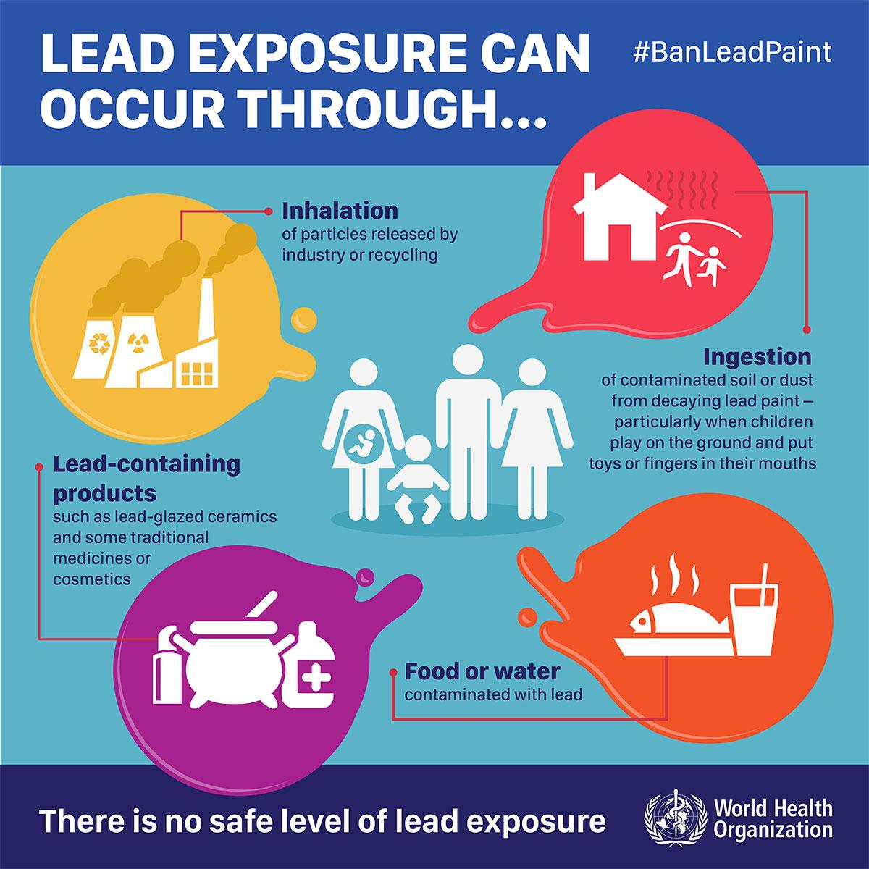
A TOXIC SUBSTANCE - LEAD
Common Hazards
Building Proteins
Cells Are Us: Building Proteins
Pre-Test
Introduction
Why It Matters
What We Know
How We Know
Story Time
Common Hazards
Activities
Self-Study Game
Post-Test
Glossary
How are we exposed to lead?
Although lead does not occur naturally in the body, everyone has acquired some lead in their body from the environment. The CDC cites the major source of lead exposure among U.S. children is lead-based paint and lead-contaminated dust found in deteriorating buildings. Lead-based paints were banned for use in housing in 1978. However, approximately 24 million housing units in the United States have deteriorated leaded paint and elevated levels of lead-contaminated house dust. More than 4 million of these dwellings are home to one or more young children. Lead interferes with red blood cell formation. It can cause brain damage, slowed growth and development, learning and behavior problems, and hearing and speech problems. At very high levels, it can cause seizures, coma, and even death. The effects on mental development are especially severe in young children. Click here and here to learn more about childhood lead poisoning.

Slide 49
A TOXIC SUBSTANCE - LEAD
Common Hazards
Building Proteins
Cells Are Us: Building Proteins
Pre-Test
Introduction
Why It Matters
What We Know
How We Know
Story Time
Common Hazards
Activities
Self-Study Game
Post-Test
Glossary
How does lead make us sick?
Lead is a true poison that has no necessary role in the body. Scientists have only an incomplete understanding of how lead acts as a poison. One thing seems clearly established: lead damages many body systems, but especially the brain and cardiovascular system, by inhibiting a range of enzymes, particularly those involved in making the non-protein part of hemoglobin (heme) and anti-oxidant chemicals. Lead generates reactive oxygen molecules and intensifies oxidative stress and cellular inflammation. The mechanism often involves a distortion of protein three-dimensional structure when lead binds to proteins.

Slide 50
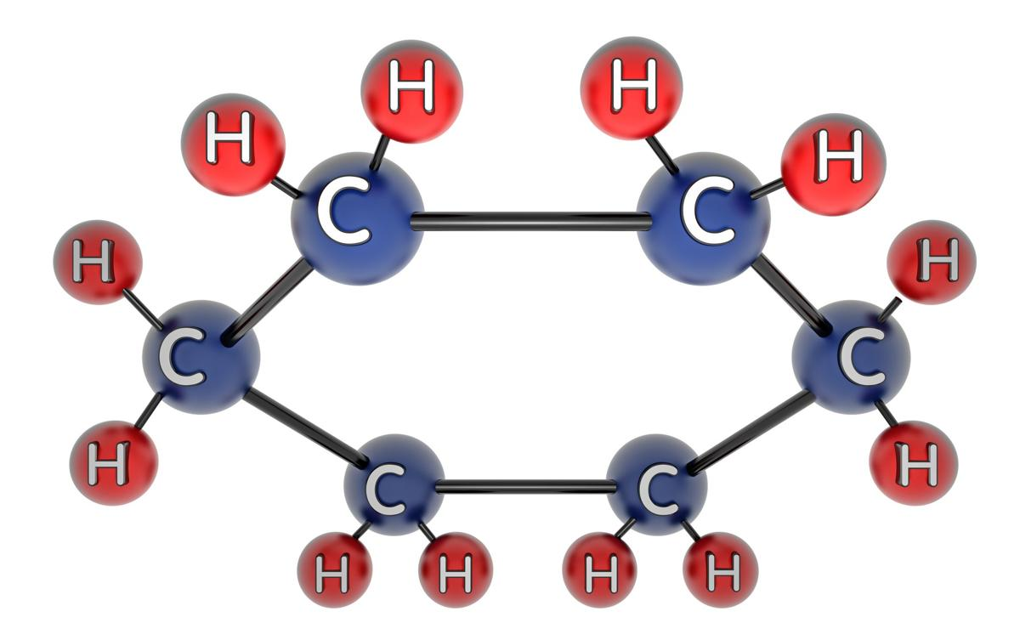
A TOXIC SUBSTANCE - HEXANE
Common Hazards
Building Proteins
Cells Are Us: Building Proteins
Pre-Test
Introduction
Why It Matters
What We Know
How We Know
Story Time
Common Hazards
Activities
Self-Study Game
Post-Test
Glossary
Why is hexane dangerous?
Hexane, a molecule with six carbon atoms, each bonded to hydrogen, is very toxic. The damage caused by hexane includes liver damage and a wasting away of both sensory and motor nerve fibers, especially in the nerves of the limbs (this is called peripheral neuropathy).
Hexane is a hydrocarbon (contains mostly carbon and hydrogen). It is an industrial solvent and also occurs in airplane glue, which some uninformed people sniff in order to get "high."

Slide 51
A TOXIC SUBSTANCE - HEXANE
Common Hazards
Building Proteins
Cells Are Us: Building Proteins
Pre-Test
Introduction
Why It Matters
What We Know
How We Know
Story Time
Common Hazards
Activities
Self-Study Game
Post-Test
Glossary
Two main things happen in nerves as a result of hexane:
Glial cells, found in brain and spinal cord, are killed.
Filaments inside of nerve fibers become clustered and clumpy.
Normally, these filaments are lined up in straight parallel lines inside nerve fibers, and they help transport materials down the nerve fiber. Remember, for example, that a nerve to your toe has the cell body in the spinal cord. Only the cell body can make all the proteins and many of the other compounds needed by all parts of the cell. These materials have to be shipped down the nerve fiber to the terminals. This is a long and difficult transportation process, involving a meter or more, and many substances are transported along normal filaments only at a few millimeters per day. How tall are you? That will give you a better idea of how long transport takes under normal conditions.
Anything that disrupts this transport problem obviously makes a difficult situation much worse. In the case of hexane, one of its breakdown products causes nerve cell filament proteins to cross-link. This cross-linking distorts the proteins and causes them to clump. The clumping physically disrupts the normal flow of materials, much like a dam stops the flow of water.
How do you get exposed to hexane? Usually it is from breathing organic solvents that contain it, like glues. If hexane gets on the skin, it causes marked irritation (imagine what it is doing to your delicate lungs). Once in the body, it seeks out the brain and makes you feel dizzy, silly, and sleepy. But the damage it is doing to your brain is not funny.
Click here for more information on hexane. For more information on the effects of sniffing solvents, such as hexane, Click Here.

Slide 52
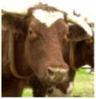
ANOTHER HAZARD: PRIONS AND MAD COW DISEASE
Common Hazards
Building Proteins
Cells Are Us: Building Proteins
Pre-Test
Introduction
Why It Matters
What We Know
How We Know
Story Time
Common Hazards
Activities
Self-Study Game
Post-Test
Glossary
Have you heard of "mad cow" disease? This fatal disease, also called Creutzfeldt-Jakob Disease (CJD), can come from eating beef or sheep that have been infected with an unusual infectious agent called a "prion." A prion is a type of protein that can trigger normal proteins in the brain to fold abnormally. Prion diseases can affect both humans and animals and are sometimes spread to humans by infected meat products. Prions are an odd form of protein and contain no nucleic acid (DNA or RNA), yet they are still infectious.
So how do prions reproduce without having DNA to provide instructions? Prions reproduce by converting certain cellular proteins into an infectious form. You might say that it makes the cell infect itself (and other cells that get exposed from a person eating prion-contaminated meat). The infectious prion is a changed structural form, dominated by conversion of protein helix structure into flat sheets. The infectious prion is extremely insoluble and resistant to protein-digesting enzymes, heat or other denaturing agents.

Slide 53
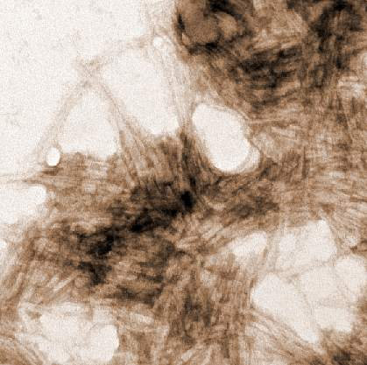
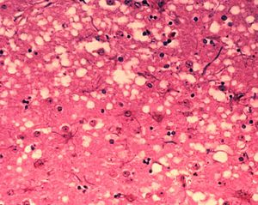
ANOTHER HAZARD: PRIONS AND MAD COW DISEASE
Common Hazards
Building Proteins
Cells Are Us: Building Proteins
Pre-Test
Introduction
Why It Matters
What We Know
How We Know
Story Time
Common Hazards
Activities
Self-Study Game
Post-Test
Glossary
The prions attack nervous tissue, especially the brain. That is why the disease is called "mad cow." Affected cows stagger around with muscle stiffness and a change of gait. They may run into things or fall and tremble. When you examine the brain of such cows, the brain is full of holes, like a sponge. That is why they call it a Spongiform Encephalopathy ("enceph" refers to the head and "pathy" refers to "diseased").
More detail can be found at: https://www.cdc.gov/prions/
This image, magnified 100,000 times using a transmission electron microscope, shows thread-like structures of prion protein. NIAID/RML.
Microscopic "holes" are characteristic in prion-affected tissue sections, causing the tissue to develop a "spongy" architecture. This causes deterioration of that "spongy" tissue in the brain.

Slide 54
Building Proteins
Cells Are Us: Building Proteins
Pre-Test
Introduction
Why It Matters
What We Know
How We Know
Story Time
Common Hazards
Activities
Self-Study Game
Post-Test
Glossary
Activities

Slide 55
CLICK TO DOWNLOAD AN ACTIVITY
Activities
Building Proteins
Cells Are Us: Building Proteins
Pre-Test
Introduction
Why It Matters
What We Know
How We Know
Story Time
Common Hazards
Activities
Self-Study Game
Post-Test
Glossary
Student Activity Sheet #1 – Modeling the Structure of Protein
Student Activity Sheet #2 – The Denaturing of Proteins

Slide 56
Building Proteins
Cells Are Us: Building Proteins
Pre-Test
Introduction
Why It Matters
What We Know
How We Know
Story Time
Common Hazards
Activities
Self-Study Game
Post-Test
Glossary
Self-Study Game

Slide 57
CLICK BELOW TO PLAY A GAME!
Self-Study Game
Building Proteins
Cells Are Us: Building Proteins
Pre-Test
Introduction
Why It Matters
What We Know
How We Know
Story Time
Common Hazards
Activities
Self-Study Game
Post-Test
Glossary
Quizizz

Slide 58
Building Proteins
Post-Test
Cells Are Us: Building Proteins
Pre-Test
Introduction
Why It Matters
What We Know
How We Know
Story Time
Common Hazards
Activities
Self-Study Game
Post-Test
Glossary
Google assessment

Slide 59
A-DE
Building Proteins
Glossary
Cells Are Us: Building Proteins
Pre-Test
Introduction
Why It Matters
What We Know
How We Know
Story Time
Common Hazards
Activities
Self-Study Game
Post-Test
Glossary
Adsorb - to form a thin layer of molecules of a substance on the surface of a solid or liquid. Return to How We Know
Centrifuge - a machine that rotates (spins) rapidly and uses centrifugal force to separate substances of different densities. You've used a centrifuge before. Have you ever watched a washing machine on spin cycle? A washing machine uses centrifugal force in the spin cycle to separate the water from your clothes. Return to How We Know
Chromatography - a way of finding out which substances a mixture contains by passing it through or over something that absorbs the different substances at different rates. Return to How We Know
Debris - parts or fragments of something that has been broken down. Return to How We Know
Denaturing - a protein is said to be denatured if it unfolds or uncoils so that its function is abolished even though the primary string of amino acids remains intact. Return to How We Know

Slide 60
DI-M
Building Proteins
Glossary
Cells Are Us: Building Proteins
Pre-Test
Introduction
Why It Matters
What We Know
How We Know
Story Time
Common Hazards
Activities
Self-Study Game
Post-Test
Glossary
Dialysis - a process designed to separate particles in a liquid, using a concentration gradient and semipermeable membrane, so that some particles can pass from high to low concentration while others are left behind. Return to How We Know
Elution - to remove one substance from another by washing it out with a solvent. For example, rinsing an adsorbed material from the surface it is attached to. Return to How We Know
Gel electrophoresis - a laboratory procedure that uses a gel “filter” and electrodes to separate charged particles like DNA, RNA, and protein by size. Return to How We Know
Hexane - a colorless and odorless hydrocarbon made up of 6 single bonded carbon atoms. Return to What We Know
Macromolecules - A molecule containing a large number of atoms. The four main biological macromolecules are carbohydrates, proteins, lipids, and nucleic acids. Return to Introduction

Slide 61
P-S
Building Proteins
Glossary
Cells Are Us: Building Proteins
Pre-Test
Introduction
Why It Matters
What We Know
How We Know
Story Time
Common Hazards
Activities
Self-Study Game
Post-Test
Glossary
Peripheral neuropathy - when peripheral nerves (nerves that carry messages from the body and outside world to the spinal cord and brain) are diseased or damaged. Return to Common Hazards
Solvents - a material (usually a liquid) in which other substances are dissolved. Return to How We Know
Substrate - fluid or solid in which an item is placed, or environment in which something may function. For example, a fish's substrate is water. In this case, the substrate that the protein is placed into is a jello-like gel. In chemistry, the substrate is also whatever is acted upon, for example, and antibody's substrate is the part of the germ it attacks. Return to How We Know

