Slide 1
Life Science
Cells Are Us Building Proteins
Post-Test

Slide 2
Which of the following does NOT describe a role of proteins in the body?
A. Send and receive signals in the endocrine system
B. Form the filaments in nerve cells to transport materials to the nerve terminal
C. Make up the pigment melanin in skin cells
D. Allow muscles to contract and produce movement

Slide 3
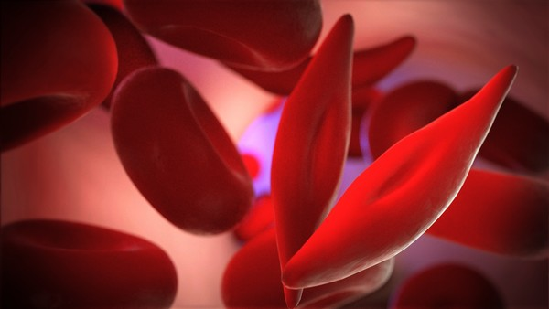
Hemoglobin is a protein complex found in red blood cells and is responsible for carrying oxygen throughout the body. The replacement of a few amino acids in this protein results in a disease called sickle cell anemia in which red blood cells are misshapen and have decreased ability to carry oxygen. What conclusion can be taken from this?
A. Amino acid sequence affects protein shape and function
B. Amino acid sequence affects protein shape but not function
C. Amino acid sequence does not affect protein shape or function
Image from NIH Library of Medicine Genetics Home Reference Sickle cell disease
D. Amino acid sequence affects protein function but not shape

Slide 4
How do proteins contribute to the structure/function of the nucleus?
A.They form histones which control what sequences of DNA can or cannot be read
B. They form the nuclear membrane
C. They make up the genetic material DNA
D. They form the phosphate backbone of DNA

Slide 5
Which of the following does NOT describe how proteins aid in the function of the cell membrane?
A. They create channels for molecules that cannot pass through the lipid bilayer
B. They can recognize molecules on the surface of other cells
C. They can receive and transmit signals from molecules like hormones
D. They are the main structure that forms the cell membrane

Slide 6
Which of the following lists the organization of proteins from simplest to most complex?
A. I, II, III, IV
B. II, IV, I, III
C. III, I, IV, II
D. IV, III, II, I

