Slide 1
Life Science- Ecosystems: Natural Selection
Pre-Test

Slide 2
The passing of genetic information from one generation to the next generation is:
Natural Selection
Evolution
Sexual reproduction
Heredity

Slide 3
2. For centuries, humans have intentionally bred animals and plants with desirable traits to try to increase the frequency of those traits in subsequent generations. Which of the following is an example of selective breeding/artificial selection?
Bees randomly pollinating flowers
Two feral cats mating
Breeding a Labrador retriever with a poodle to make a Labradoodle with a certain coat and disposition
Planting seeds from a wild blackberry

Slide 4
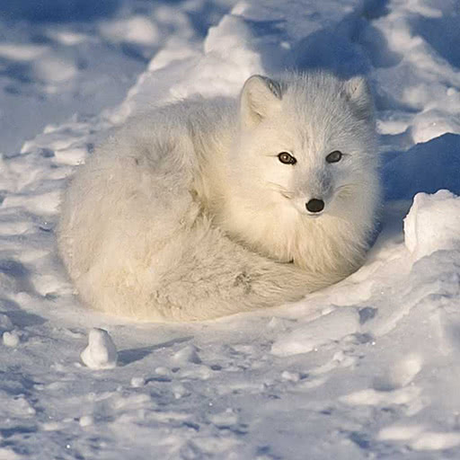
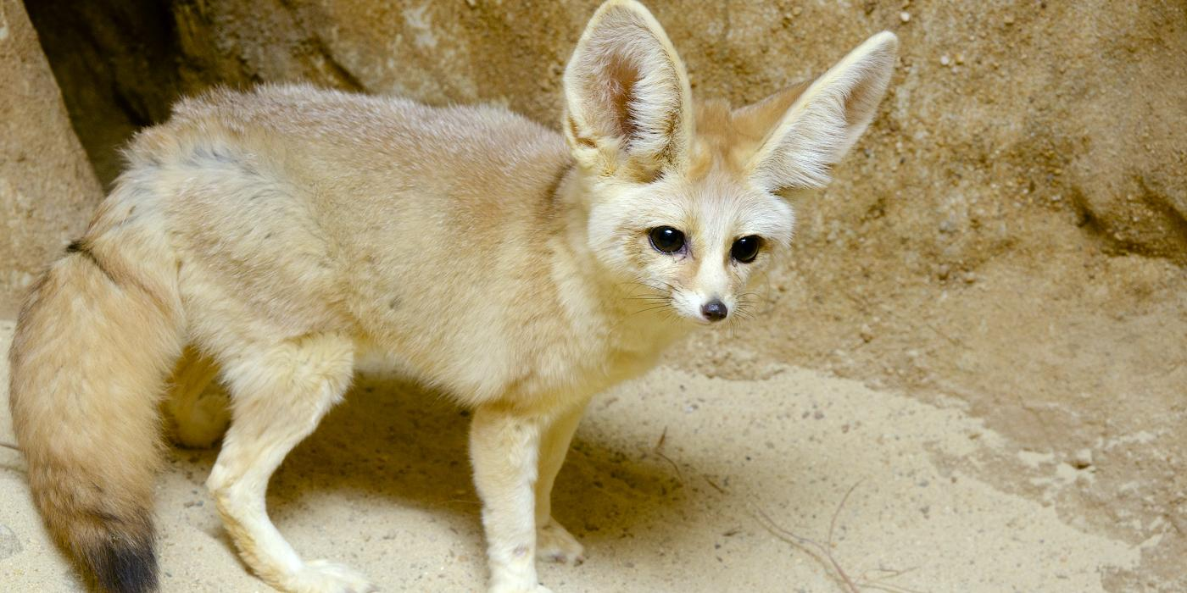
3. Arctic foxes (top) live in the freezing arctic tundra whereas the Fennec fox (bottom) lives in the sandy deserts of Northern Africa and Arabia. Which of the following describes unique adaptations specific to the niche in which the foxes live.
Source: NPS
The Fennec Fox has larger ears body temperature by releasing excess heat whereas the Arctic Fox has shorter ears to conserve body heat
Both foxes have furry soles to go over rocky terrain
Both foxes have bushy tails for balance
The Fennec Fox hibernates for long winters whereas the Arctic Fox is active year round
Source: Smithsonian’s National Zoo & Conservation Biology Institute

Slide 5
4. Lately, more and more Western Rattlesnakes who don’t have the ability to rattle have been found in South Dakota. Which of these is the best explanation for the change of rattle frequency among rattlesnakes:
The rattling rattlesnakes warn people where they are so they can easily be avoided without being killed
The rattling rattlesnakes are killed more because they are noticed more which leads to the selection of snakes that don’t rattle
The rattlesnakes that don’t rattle are overall healthier than the snakes that do rattle
The rattlesnakes that don’t rattle are less dangerous and therefore have made more mutualistic relationships

Slide 6
5. Which of the following best describes the differences between sexual vs asexual reproduction?
Offspring of asexual reproduction has some similarities and some differences from the parent organism whereas offspring of sexual reproduction are identical to the parent organisms
Sexual reproduction results in less genetic variation than asexual reproduction
Sexual reproduction occurs only in bacteria and asexual reproduction occurs in eukaryotes
Offspring of sexual reproduction show traits from both parents whereas asexual reproduction results in an organism identical to the parent

