Slide 1
Water’s the Matter
Measuring pH

Slide 2
Navigation Table
Water’s the Matter: Measuring pH
Pre-Test
Introduction
Lesson
Activity
Post-Test

Slide 3
Measuring pH
Pre-Test
Google Assessment

Slide 4
Measuring pH
Introduction
Introduction

Slide 5
Measuring pH
Introduction
What is so important about pH?
Did you know that pH stands for the "power of Hydrogen" and measures the concentration of hydrogen ions in a solution, such as water? Another word that is commonly used to describe pH is “acidity.” It is a chemical property of water and is one of the key factors in assessing water quality. The pH of water tells us how acidic or basic (more about that later) the water is.

Slide 6
Measuring pH
Introduction
What is so important about pH?
Many aquatic organisms are very sensitive to seemingly small changes in pH. Fundamental bodily processes such as respiration, calcification (shell/skeleton building), photosynthesis, and reproduction have been shown to respond to small changes in the pH of water. A change in pH can disrupt the life cycles of all organisms (animals and plants) and lead to their deaths if the change is hydrogen ion concentration is too extreme. Not only does the pH of water affect organisms living in the water, a changing pH in water can also be an indicator of increasing pollution or other environmental factors. Humans, who use water for recreation or fishing, can also be affected by pH. High acidity can damage our skin and eyes. Also, water that is very acidic can corrode pipes that deliver water to our homes. Remember, our definition of water quality is a measure of the suitability of water for a particular use based on selected physical, chemical, and biological characteristics. So, you see, pH is a very important component of water quality.
Water quality is important for both natural aquatic life and humans. This is Hamilton Pool in the hill country of Texas. Image from: https://www.tourtexas.com/articles/56/10-beautiful-texas-swimming-holes--to-cool-off-at-this-summer

Slide 7
Measuring pH
Introduction
What is so important about pH?
What happens to organisms when pH changes? What causes a change in pH? In this unit, you will discover answers to these questions.

Slide 8
Measuring pH
Objectives
After completing this module, you will be able to:
• Define pH.
• Calculate the pH of a solution using the hydrogen ion concentration.
• Recognize how pH can affect the organisms that live in water.
• Describe the factors that can change the pH of a body of water.
• Model the effects of human activity on the pH of ground water and surface water in a watershed.

Slide 9
Measuring pH
Lesson
Lesson

Slide 10
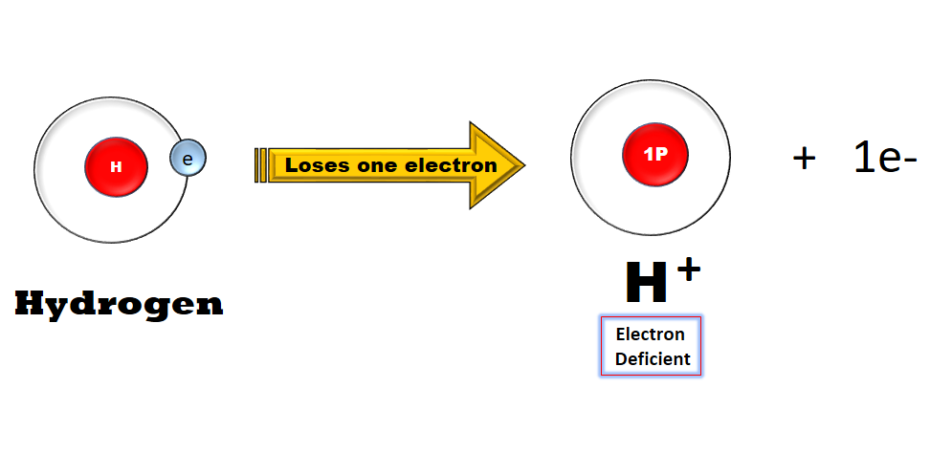
Measuring pH
Lesson
What is pH?
pH and Water (usgs.gov)
pH stands for the “potential of Hydrogen” or the "power of Hydrogen" and is a measure of the concentration of hydrogen ions in a solution, such as water. What is a hydrogen "ion?" It is an atom of hydrogen that has lost its electron. It is designated by the symbol H+. In water, hydrogen automatically gives up its electron to form ions.

Slide 11
Measuring pH
Lesson
What is pH?
Although the pH scale is from 0-14, pH varies over an enormous range of values. It has to be measured on a scale that is different from other measurement scales. Thus, the pH scale is logarithmic, meaning that an increase or decrease of an integer value changes the concentration by a tenfold.
For example, a pH of 3 is ten times more acidic than a pH of 4. Likewise, a pH of 3 is one hundred times more acidic than a pH of 5. This logarithmic type of scale is commonly used in chemistry and physics to specify the value of numbers that have an extreme range of values.

Slide 12
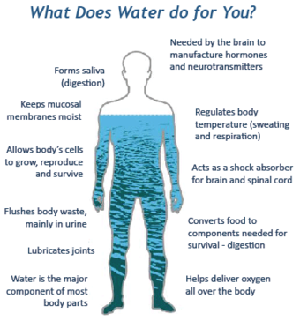
Measuring pH
Lesson
What is the composition of water?
We are generally very familiar with water. We observe it as rain and snow and can see it in the oceans, lakes, rivers, and streams. Although the water in our bodies is not as apparent, recognize that most of our weight is made up of water. We have learned that the normal adult is made up of approximately 60% water. Water is essential for life.
Image from: https://www.usgs.gov/special-topic/water-science-school/science/water-you-water-and-human-body?qt-science_center_objects=0#qt-science_center_objects

Slide 13
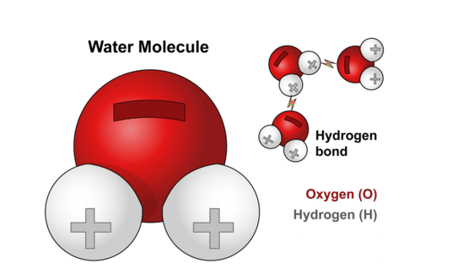
Measuring pH
Lesson
What is the composition of water?
Water is made up of hydrogen ions (H⁺) linked to hydroxyl ions (OH⁻) to form H₂O. The molecular formula for water is H₂O. From this formula and the atomic weights for hydrogen and oxygen you can calculate that the molecular weight of water is approximately 18 grams. Note: The atomic weight of hydrogen (H) is 1 gram and the atomic weight of oxygen (O) is 16 grams.

Slide 14
Measuring pH
Lesson
What is the composition of water?
18 grams of water can also be referred to as being 1 mole of water. A mole of a substance (e.g. water) contains a particular number of molecules.
That number is 6.02 x 10²³ and is often referred to as Avogadro's number; named after Amedeo Avogadro, an Italian physicist.
Recognize that 6.02 x 10²³ is in scientific notation and represents a huge number: 602 billion trillion. Written in standard form, this number is: 602,000,000,000,000,000,000,000. Thus, a mole of water which weighs 18 grams contains a huge number of water molecules.
18 grams or 1 mole of water occupies a volume of 18 milliliters. Therefore, 1000 milliliters (1 liter) of water contains 55.6 moles of water (1000 milliliters / 18 milliliters per mole).

Slide 15
Measuring pH
Lesson
What is the composition of water?
Water molecules exist in the form of H₂O; hydrogen ions (H⁺) linked to hydroxyl ions (OH⁻). A few of these water molecules split apart to create free H⁺ and OH⁻ ions. Pure, deionized water contains the same number of H⁺ ions and OH⁻ ions. One liter of pure, deionized water contains 1 x 10⁻⁷ moles of H⁺ and
1 x 10⁻⁷ moles of OH⁻ ions.
This is still a very large number of free hydrogen ions, namely: 6.02 x 10¹⁶ or 60,200,000,000,000,000.
For more about scientific notation, click here or here.
For more detail about pH, click here.

Slide 16
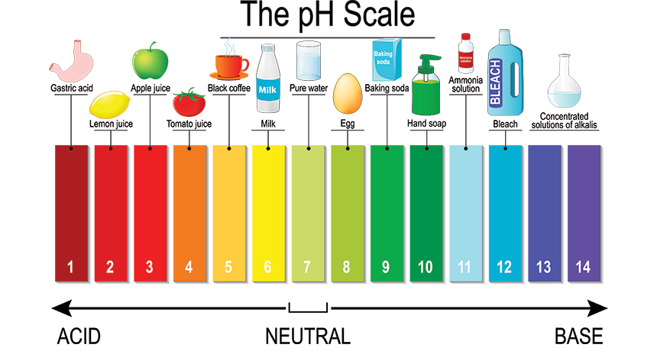
Measuring pH
Lesson
The Basics: What is the difference between an acidic, basic and neutral pH?

Slide 17
Measuring pH
Lesson
The Basics: What is the difference between an acidic, basic and neutral pH?
A solution having a low pH is said to be acidic, what this means is that it has a higher concentration of hydrogen ions than a neutral solution. For example, stomach acid has a pH of around 2.0, this is equal to a concentration of hydrogen ions equal to 1 x 10⁻² mol/L. Any solution having a pH less than 7.0 is said to be acidic.
A basic solution, such as a household cleaner usually has a pH of around 11. This translates to a concentration of hydrogen ions equal to 1 x 10⁻¹¹ mol/L. This would be considered a lower concentration of hydrogen ions. Recall from scientific notation that as the exponent becomes a larger negative number, the numerical value of the expression is less. Any solution having a pH greater than 7.0 is said to be basic.
A pH of 7.0 means that a solution is neutral, having a medium concentration of hydrogen ions. Solutions such as distilled water have a neutral pH and thus a concentration of 1 x 10⁻⁷ mol/L of hydrogen ions in solution. Neutral solutions have pH values of 7.0 (or very close to 7.0).

Slide 18
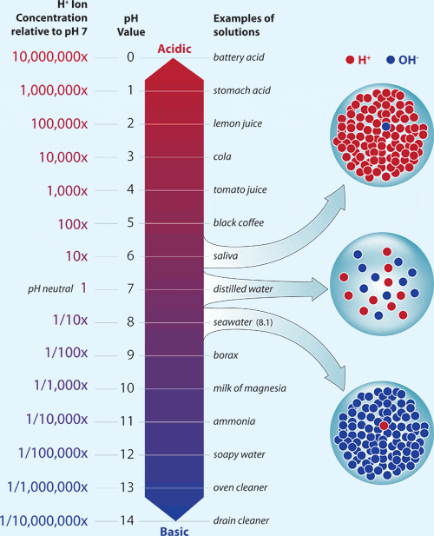
Measuring pH
Lesson
More Advanced: What is the relationship between the concentration of hydrogen ions and pH?
As discussed previously, pH is a measure of the number of H⁺ ions in water. Pure water (as described previously) contains an equal number of hydrogen ions and hydroxyl ions (1 x 10⁻⁷ moles per liter or M).
Image from Woods Hole Oceanographic Institution: https://www.whoi.edu/oceanus/feature/small-drop-in-ph-means-big-change-in-acidity/

Slide 19
Measuring pH
Lesson
More Advanced: What is the relationship between the concentration of hydrogen ions and pH?
pH can be calculated using the following formula:
pH = - log [H⁺]
where the brackets [ ] represent the concentration of hydrogen ions in a liter of water or in a solution containing water.
Therefore, the pH of pure water can be calculated as:
pH = - log [H⁺] = - log [1 x 10⁻⁷] = -[-7] = 7
A solution with a pH of 7, like pure water, is considered to have a neutral pH.

Slide 20
Measuring pH
Lesson
More Advanced: What is the relationship between the concentration of hydrogen ions and pH?
Would a solution that contains 1 x 10⁻⁵ moles of hydrogen ions per liter contain more or fewer hydrogen ions than pure water? (Remember pure water contains 1 x 10⁻⁷ moles of hydrogen ions per liter.)
1 x 10⁻⁵ = 0.00001 1 x 10⁻⁷ = 0.0000001
If you answered more, you are correct! The pH of such a solution could be calculated to be:
pH = - log [H+] = - log [1 x 10-5] = -[-5] = 5
A solution that has more hydrogen ions per liter than pure water is referred to as being acidic. A solution with a pH less than 7 is called an acidic solution; therefore, the pH of 5 indicates the solution acts like an acid.

Slide 21
Measuring pH
Lesson
More Advanced: What is the relationship between the concentration of hydrogen ions and pH?
Would a solution that contains 1 x 10⁻⁹ moles of hydrogen ions per liter contain more or fewer hydrogen ions than pure, deionized water? (Remember pure water contains 1 x 10⁻⁷ moles of hydrogen ions per liter.)
1 x 10⁻⁹ = 0.000000001 1 x 10⁻⁷ = 0.0000001
If you answered fewer, you are correct! The pH of such a solution could be calculated to be:
pH = - log [H⁺] = - log [1 x 10⁻⁹] = -[-9] = 9
A solution that has fewer hydrogen ions than pure water is referred to as being basic. A solution with a pH greater than 7 is called a basic solution; therefore, the pH of 9 indicates the solution acts like a base.

Slide 22
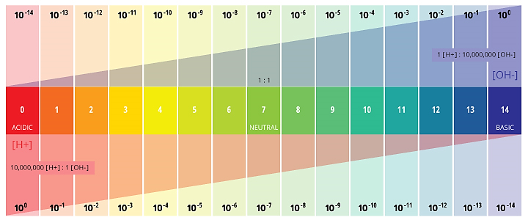
Measuring pH
Lesson
More Advanced: What is the relationship between the concentration of hydrogen ions and pH?
Big Idea: pH is normally measured on a scale from 0 to 14, 0 being the most acidic and 14 the most basic. This scale is called a logarithmic scale. Note that a change of 1 pH unit represent a 10-fold change in hydrogen ion concentration. A solution that has a pH = 5 has 10 times more hydrogen ions per liter than a solution with a pH = 6 and 100 times more hydrogen ions per liter than a solution with a pH of 7.
The logarithmic scale of pH means that as pH increases, the H⁺ concentration will decrease by a power of 10. Thus, at a pH of 0, H⁺ has a concentration of 1 M (M=moles per liter). At a pH of 7, this decreases to 0.0000001 M. At a pH of 14, there is only 0.00000000000001 M H⁺. Image from: https://www.fondriest.com/environmental-measurements/parameters/water-quality/ph/

Slide 23
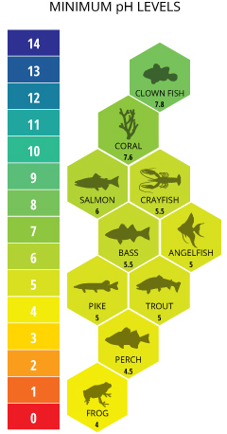
Measuring pH
Lesson
How can pH affect the organisms that live in water?
Aquatic organisms have adapted over time to survive and reproduce in a certain pH range, or range of tolerance. The majority of aquatic creatures prefer a pH range of 6.5-9.0, though some can live in water with pH levels outside of this range. Oceanic organisms like clownfish and coral require higher pH levels. pH levels below 7.6 will cause coral reefs to begin to collapse do to the lack of calcium carbonate. Sensitive freshwater species such as salmon prefer pH levels between 7.0 and 8.0, becoming severely distressed and suffering physiological damage due to absorbed metals at levels below 6.0. Some bacteria can withstand environments that have high hydrogen ion concentrations (pH = 2 or 3); other bacteria can live at very low hydrogen ion concentrations (pH = 12 or 13).
Image from: https://www.fondriest.com/environmental-measurements/parameters/water-quality/ph/

Slide 24
Measuring pH
Lesson
How can pH affect the organisms that live in water?
In general, more acidic conditions tend to cause animals to become less excitable. At pH 5, most fish eggs cannot hatch. At lower pH levels, some adult fish die. More basic conditions can lead to animals becoming hyper excitable (over excited).
Click here to see how acid rain affects certain aquatic organisms.

Slide 25
Measuring pH
Lesson
What are some things that can change the concentration of hydrogen ions (pH) in water?
Information from: EPA http://bcn.boulder.co.us/basin/data/COBWQ/info/pH.html
There are many factors that can affect pH in water, both natural and man-made (anthropogenic). Natural changes can occur due to weathering of rock (particularly carbonate forms) and other materials by water. In addition, CO₂ concentrations can influence pH levels. pH can also fluctuate with precipitation (especially acid rain) and wastewater or mining discharges.

Slide 26
Measuring pH
Lesson
What are some things that can change the concentration of hydrogen ions (pH) in water?
Rocks and Soils in the Watershed
Acidic and alkaline (basic) compounds can be naturally released into water from different types of rock and soil. When calcite (CaCO₃) is present, carbonates (HCO₃, CO₃⁻²) can be released, increasing the alkalinity of the water, which raises the pH. When sulfide minerals, such as pyrite, or "fool’s gold," (FeS₂) are present, water and oxygen interact with the minerals to form sulfuric acid (H₂SO₄). This can significantly drop the pH of the water. Drainage water from forests and marshes is often slightly acidic, due to the presence of organic acids produced by decaying vegetation.
Water at Havasu Falls has a turquoise color that comes from the suspended minerals from rocks that the water flows over. Image from Wikipedia Commons

Slide 27
Measuring pH
Lesson
What are some things that can change the concentration of hydrogen ions (pH) in water?
Concentration of Carbon Dioxide in the Water
Carbon dioxide (CO₂) enters a water body naturally from a variety of sources, including the atmosphere, runoff from land, release from bacteria in the water, and respiration by aquatic organisms. This dissolved CO₂ forms a weak acid. Natural, unpolluted rainwater can be as acidic as pH 5.6, because it absorbs CO₂ as it falls through the air. Because plants take in CO₂ during the day and release it during the night, pH levels in water can change from daytime to night.

Slide 28
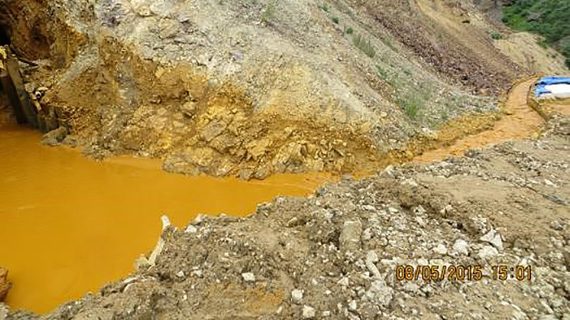
Measuring pH
Lesson
What are some things that can change the concentration of hydrogen ions (pH) in water?
Drainage from Mine Sites
Mining for gold, silver, and other metals often involves the removal of sulfide minerals buried in the ground. When water flows over or through sulfidic waste rock or tailings exposed at a mine site, this water can become acidic from the formation of sulfuric acid. In the absence of buffering material, such as calcareous rocks, streams that receive drainage from mine sites can have low pH levels.
Contaminated wastewater is seen at the entrance to the Gold King Mine in San Juan County, Colo., in 2015. The mining waste accidentally released by the Environmental Protection Agency. Image from: https://www.npr.org/sections/thetwo-way/2015/08/10/431223703/epa-says-it-released-3-million-gallons-of-contaminated-water-into-river

Slide 29
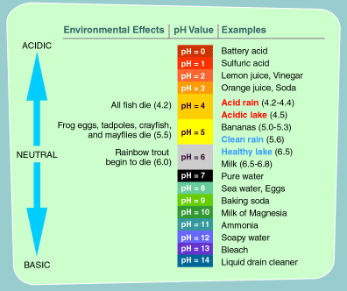
Measuring pH
Lesson
What are some things that can change the concentration of hydrogen ions (pH) in water?
Acid Rain
Rain water normally has a pH of approximately 5.0-5.5. However, airborne pollutants generated from industrial plants and automobiles burning fossil fuels create nitrous oxides and sulfur dioxides. These airborne ions can combine with water vapor to form nitric acid and sulfuric acid. In the presence of such pollution, rain water will become more acidic; as low as pH = 4.0. This acid rain has more than 10-fold greater concentrations of hydrogen ions than normal rain water. When this acid rain runs into lakes, river, or streams, the pH of these bodies of water can be changed to levels that are not compatible with aquatic life.
Image from EPA: https://www3.epa.gov/acidrain/education/site_students/phscale.html#:~:text=Normal%2C%20clean%20rain%20has%20a,a%20pH%20value%20of%204.0.

Slide 30
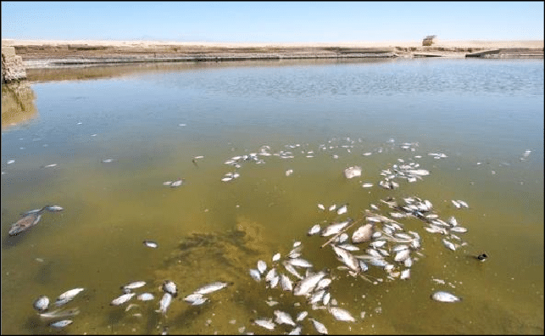
Measuring pH
Lesson
What are some things that can change the concentration of hydrogen ions (pH) in water?
Acid Rain
Fish killed by acidic water caused by acid rain.
Click here learn more about acid rain.
For more information on pH and water quality, click here.

Slide 31
Measuring pH
Activity
Activity

Slide 32
Measuring pH
Activity
Click on the Link to see this unit’s activity
Activity – Where Does it Rank?

Slide 33
Measuring pH
Post-Test
Google Assessment

