Slide 1
Toxic or Not
WHO ARE SAM AND ELLA?
INGESTED ENVIRONMENTAL HAZARDS

Slide 2
Navigation Table
Toxic or Not: Who are Sam and Ella?
Introduction
Pre-Test
Lesson
Activity
Post-Test

Slide 3
Introduction
Who are Sam and Ella?
Introduction

Slide 4
Who are Sam and Ella?
Introduction
In the first lesson in the module, Welcome to Your World, we learned that an environmental hazard is a substance, state or event which has the potential to threaten the surrounding natural environment or adversely affect people's health. We also learned how the risk of a hazard is determined by this formula:
Risk = Hazard x Exposure
People can be exposed to environmental hazards in three ways:
Entry through the digestive system in the food we eat
Absorption through the skin
Inhalation (entry through the respiratory system)

Slide 5
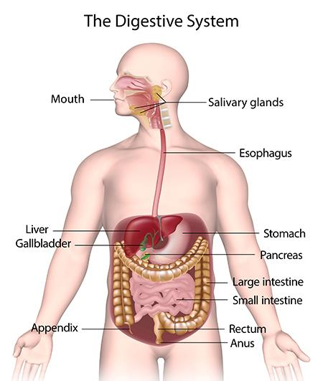
Who are Sam and Ella?
Introduction
In this lesson, we will see how we are exposed to environmental hazards through the food we eat.
Substances or organisms in or on our food and water enter the digestive system and may cause serious problems throughout the body.

Slide 6
Who are Sam and Ella?
Introduction
In this lesson you will learn about substances (such as food additives and chemicals), and organisms (such as bacteria and viruses), and the problems they can cause in the body.
So, who are Sam and Ella? You'll find out if you read the lesson carefully.

Slide 7
Objectives
Who are Sam and Ella?
Introduction
By the end of this lesson, you will be able to:
• Identify the rules for food safety
• Identify sources of food-borne illnesses and contaminants

Slide 8
Pre-Test
Who are Sam and Ella?
Click here for Google Pre-Test Assessment!

Slide 9
Lesson
Who are Sam and Ella?

Slide 10
The Digestive System
Who are Sam and Ella?
Lesson
The digestive system is one of three ways hazardous substances can enter the body. The digestive system is the system in the body that breaks down food and absorbs nutrients. That's why food safety is very important!
There are a few rules of food safety that will minimize our risk of allowing the things we eat or drink to make us sick. These rules are the 3 C’s of Food Safety.

Slide 11
The Digestive System: 3 C’s of Food Safety
Who are Sam and Ella?
Lesson
Clean | Always wash your hands after using the bathroom, handling uncooked foods and handling trash or waste of any kind. Wash your utensils, cutting board, and countertops with hot, soapy water. Thoroughly clean raw fruits and vegetables by rinsing under running water. Trim fat from meats (pesticides are often found in fat).
Cold | Cold food should be stored below 40˚F. Refrigerate perishable foods within 2 hours. If outdoor temperature is above 90˚F, refrigerate within 1 hour. Thaw frozen food safely in the refrigerator, cold water, or in the microwave. Never thaw foods on the counter because bacteria multiply quickly in the parts of the food that reach room temperature first.
Cooked | Food is safely cooked when the internal temperature gets high enough to kill germs that can make you sick. The only way to tell if food is safely cooked is to use a food thermometer. Here is a guide of safe internal temperatures: 145°F for whole cuts of beef, pork, veal, and lamb (then allow the meat to rest for 3 minutes before carving or eating) 160°F for ground meats, such as beef and pork 165°F for all poultry, including ground chicken and turkey 165°F for leftovers and casseroles 145°F for fresh ham (raw) 145°F for fin fish or cook until flesh is opaque

Slide 12
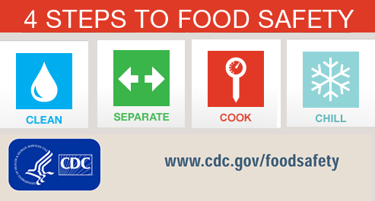
The Digestive System
Who are Sam and Ella?
Lesson
In addition to the 3 C’s, the Centers for Disease Control (CDC) also recommend separating raw meat, poultry, seafood, and eggs from other foods when you are preparing meals. Raw meat, poultry, seafood, and eggs can spread germs to ready-to-eat foods. Using a separate cutting board and plates, keeping these products in separate bags when shopping, and keeping these products separate from others in the refrigerator are all part of this.
Observing the 3 C’s of Food Safety and separating your foods will help protect you from eating things that might be hazardous to your health.

Slide 13
Food Additives
Who are Sam and Ella?
Lesson
Food additives are any ingredients added to foods. They are commonly used to enhance the appearance or taste of food (like coloring and flavoring), to enhance the food’s nutritional content (like vitamins and minerals), or to act as a preservative to reduce spoilage. Some people can have adverse reactions to food additives. Adverse reactions are any undesirable reaction from a food or additive other than the nourishment the food is supposed to provide to the body. They can range from getting the “jitters” from caffeine in coffee (pharmacologic effect), getting indigestion after drinking milk (food intolerance), or getting hives and swelling from eating peanuts (allergic reaction).
Listed on the next two slides are some common additives and symptoms you could have if you are sensitive to the additive.
For more information on food additives, click here.

Slide 14
Food Additives Table
Who are Sam and Ella?
Lesson
Name | Symptoms | Prevention
Tartrazine-yellow food coloring found in beverages, candy, ice cream, desserts, cheese, canned vegetables, hot dogs, salad dressing, seasoning salts, and ketchup. | Adverse reactions can include hives or swelling, and possibly a trigger for asthma symptoms; however, studies have not documented this relationship. Even though many studies have been done, it has been difficult to find children who consistently adversely react to tartrazine or other food dyes. | Avoid foods and medicines colored with tartrazine if you are sensitive to it.
Monosodium Glutamate (MSG)-flavor enhancer in packaged meats and foods. | Adverse reactions can cause headache, a burning sensation on the back of the neck, chest tightness, nausea, diarrhea, and sweating. There are rare reports that people with asthma who have consumed MSG have more severe asthma episodes. “Chinese Restaurant Syndrome”—sudden adverse reactions to eating food from Chinese restaurants—is often attributed to use of MSG in these prepared foods. | It is safe for most people to consume, but avoid eating large amounts.

Slide 15
Food Additives Table Continued
Who are Sam and Ella?
Lesson
Name | Symptoms | Prevention
Sulfites-preservative that prevents food from turning brown when exposed to air. Some are naturally occurring while most are added artificially. | Symptoms of adverse reactions to sulfites include: tightness in the chest, breathing difficulty, hives, stomach cramps, diarrhea, and sometimes, anaphylactic shock. Sulfites can cause mild to life- threatening symptoms in some people with asthma. | It is safe for most people to consume, but avoid eating large amounts.
Aspartame (NutraSweet)-calorie free sweetener used in many foods and beverages. | People with phenylketonuria, a rare inherited disease that prevents phenylalanine from being properly metabolized, should not consume aspartame because it contains phenylalanine. May trigger migraines. Many other types of adverse reactions have been reported in relationship to aspartame but these reactions have not been adequately verified to conclude that they are truly caused by aspartame. | Avoid if you have phenylketonuria.

Slide 16
Metals and Chemicals
Who are Sam and Ella?
Lesson
Metals such as lead, mercury and arsenic and chemicals such as nitrates from fertilizers are important sources of environmental health hazards.

Slide 17
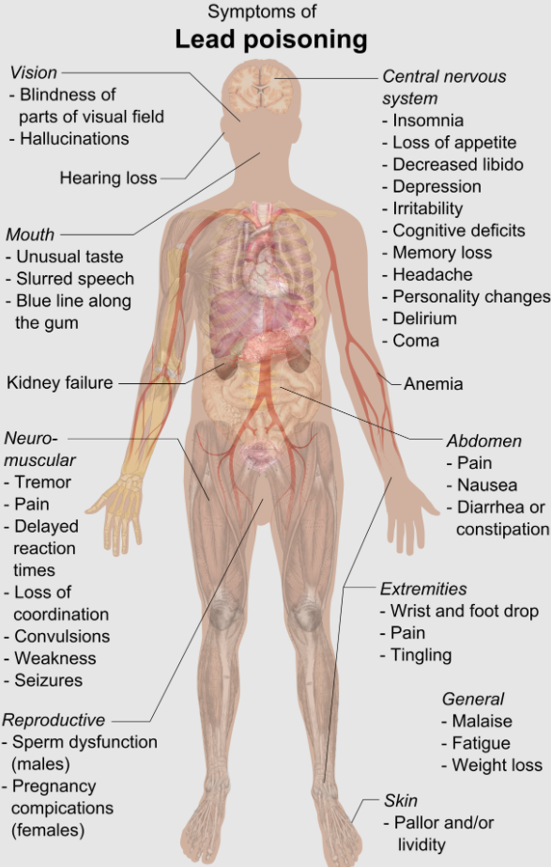
Metals and Chemicals
Who are Sam and Ella?
Lesson
Lead poisoning can cause symptoms that range from a vague feeling of ill health (malaise) to vomiting, stupor and convulsions. Recent studies suggest that long-term exposure to lead may cause hypertension. Lead also affects behavior and academic performance in school. Extremely high levels of lead may cause headaches, abdominal pain, loss of appetite, constipation and decreased activity. The main route of poisoning is through the digestive system though lead can enter the body through the respiratory system.
The next slide shows a table of sources of lead exposure, as well as some prevention strategies.
Image: Wikipedia Commons https://en.wikipedia.org/wiki/Lead_poisoning#/media/File:Symptoms_of_lead_poisoning_(raster).png

Slide 18
Metals and Chemicals: Lead Poisoning
Who are Sam and Ella?
Lesson
Sources of Lead Exposure | Prevention Strategy
Air pollution | Use unleaded gasoline
Paint | Remove any lead-based paints
Soil | Wash hands frequently
Dust | Mop floors often
Drinking water | Run water for 2 minutes every morning
Old ceramic or pewter cookware | Avoid use
Some imported toys, crayons, cosmetics | Avoid use
Hobbies | Use and store properly
Parental occupations | Change close at work
Poor nutrition | High iron & calcium, low-fat diet

Slide 19
Metals and Chemicals
Who are Sam and Ella?
Lesson
Mercury poisoning is most likely to occur as a result of eating methyl mercury-contaminated fish. Large marine (ocean) fish such as tuna, swordfish and shark are most likely to have elevated levels of methyl mercury because they eat other fish who may be contaminated. Symptoms of mercury poisoning vary widely, depending on the source and exposure however the nervous system and kidneys are usually affected.

Slide 20
Metals and Chemicals
Who are Sam and Ella?
Lesson
Arsenic poisoning may occur not only through ingestion (eating or drinking it), but also by direct contact (touching it) or by inhalation (breathing it). A major use of arsenic is as a wood preservative. It is often found mixed with zinc and other metals during mining operations and is also a common ingredient in pesticides and other poisons. Some of the common health effects of arsenic poisoning are nausea, vomiting, stomach pain, diarrhea, dizziness, weakness, excess salivation and listlessness. Arsenic can also cause Blackfoot disease, skin cancer, bladder cancer and lung cancer.

Slide 21
Metals and Chemicals
Who are Sam and Ella?
Lesson
Nitrates themselves are not toxic to people, but infant's digestive systems are much more likely to contain bacteria that can transform nitrates into nitrites. Nitrites change the oxygen-carrying component of blood called hemoglobin into methemoglobin, a substance that does not carry oxygen. The result is methemoglobinemia or blue-baby syndrome where the infant turns blue and is deprived of oxygen. It is often fatal. The most common way for babies to ingest nitrates is through being fed formula that has been mixed with fertilizer-contaminated well water.

Slide 22
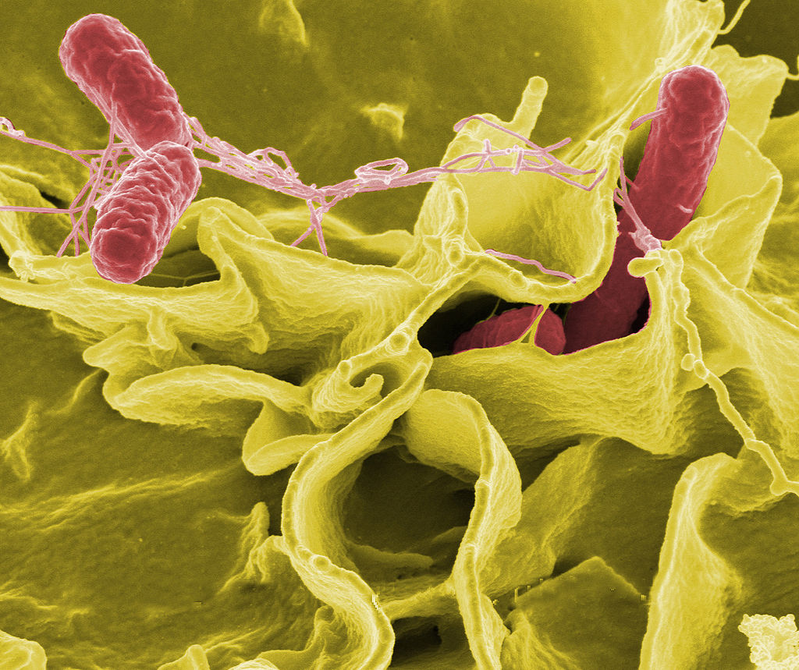
Bacteria
Who are Sam and Ella?
Lesson
Bacteria, which are single-celled organisms, are blamed for causing many different diseases. Not all bacteria are bad however. Remember that bacteria can multiply rapidly if left at room temperature or in the “Danger Zone” between 40°F and 140°F. Never leave perishable food out for more than 2 hours (or 1 hour if it’s hotter than 90°F outside).
Listed on the next few slides are some of the more common bacteria that cause illness and how to avoid them.
Color-enhanced scanning electron micrograph showing Salmonella typhimurium (red) invading cultured human cells
By NIAID: Public Domain, https://commons.wikimedia.org/w/index.php?curid=450281

Slide 23
Common Bacteria Table
Who are Sam and Ella?
Lesson
Name | Symptoms | Prevention
Salmonella (OK, so it's not really "Sam and Ella") | May experience mild or severe diarrhea, fever, and occasionally vomiting. Blood stream infections can be serious to the very young or to the elderly. | Avoid contaminating food with knives, cutting boards or utensils which have been in contact with raw meat, poultry, eggs, fish or dairy products. Some fruits and vegetables may also contain salmonella.
Shigella | Occurs mostly in summer or early fall as single cases or outbreaks. Recognized more often in young children. Symptoms are mild or severe diarrhea, often with fever and traces of blood or mucous in the stool. | Spread by eating or drinking contaminated food or water or by direct contact with infected person.
Campylobacter | Occurs mostly in summer months as single cases or outbreaks. May cause mild or severe diarrhea, often with fever and traces of blood in the stool. | Spread by eating or drinking contaminated food or water, or occasionally by direct contact with infected people or animals.

Slide 24
Common Bacteria Table Continued
Who are Sam and Ella?
Lesson
Name | Symptoms | Prevention
Escherichia coli (E. Coli) | Causes toxins that can cause diarrhea. Bacteria itself is mostly harmless. Severe diarrhea and abdominal cramps can occur with blood seen in the stool. | Naturally present in feces. Acquired by eating food containing the bacteria. Avoid eating meat that is rare or inadequately cooked. Person to person transmission can occur if people do not wash their hands after using the toilet.
Vibrio cholera | Affects the intestinal tract. Mild to severe diarrhea, vomiting, and dehydration can occur. | Spread by eating or drinking contaminated food or water or by direct contact with infected person.
Yersinia enterocolitica | Usually occurs as a single isolated event. Occasional outbreak may occur due to common exposure. Mild or severe diarrhea, fever, and abdominal cramps. Sometimes infection may mimic appendicitis. | Spread by eating or drinking contaminated food or water or by direct contact with an infected person or animal.

Slide 25
Common Bacteria Table Continued
Who are Sam and Ella?
Lesson
Name | Symptoms | Prevention
Listeria | Generally, infect specific locations within the human body, but may infect many different sites as well. Symptoms vary depending on where in the body parts. In most cases, Listeria infection causes fever and influenza. | Spread by several different methods. Ingestion of unpasteurized milk and contaminated vegetables. Transmitted from mother to fetus in- utero or directly to the fetus at the time of birth. Direct contact on the hands or arms, or sexual contact can also spread the bacteria.
Giardia lamblia | Occurs more often in institutional settings such as day care centers. May experience severe diarrhea, and fever is rarely present. Chronic diarrhea with significant weight loss occasionally. | Good hand washing practices is a way to prevent the bacterial disease. Beaver may be the potential source of Giardia in lakes and rivers.
Staphylococcus aureus | Food poisoning. Nausea, vomiting, diarrhea, retching, abdominal cramping, and prostration are the most common symptoms. Headache, muscle cramping, and transient changes in blood pressure and pulse rate may occur in more severe cases. | It is contained in many food or food equipment that are not kept hot enough (60 C or above) or cold enough (7.2 C or below). Also, food handlers are usually the main source of contamination. The foods that are usually contaminated are meat and dairy products.

Slide 26
Common Bacteria Table Continued
Who are Sam and Ella?
Lesson
Name | Symptoms | Prevention
Bacillus cereus | There are two types of illness: diarrhea type and the vomiting type. Diarrhea type: basic symptoms are watery diarrhea, abdominal cramps, and pain occurs 6-15 hours after consumption of contaminated food. Emetic type: nausea and vomiting with abdominal cramps or diarrhea occasionally | Avoid food mixtures such as sauces, pudding, soups, casseroles, pastries, and salads. The diarrhea type generally associated with meats, milk, and vegetables. The vomiting type generally associates with rice products.
Clostridium perfringens | Diarrhea and gas pains which begin between 6- and 24-hours ingestion and last approximately 24 hours. | Caused frequently by poor temperature control. Also cause by small numbers of the organism that are usually present in foods
Clostridium botulinum | Produce symptoms that affect the nervous system of an infant. Other symptoms include blurred or double vision, general weakness, poor reflexes, difficulty swallowing and sometimes death. Symptoms usually appear 12-36 hours after ingestion, but may take up to several days. | Avoid improperly processed canned foods that causes toxin formed in food.

Slide 27
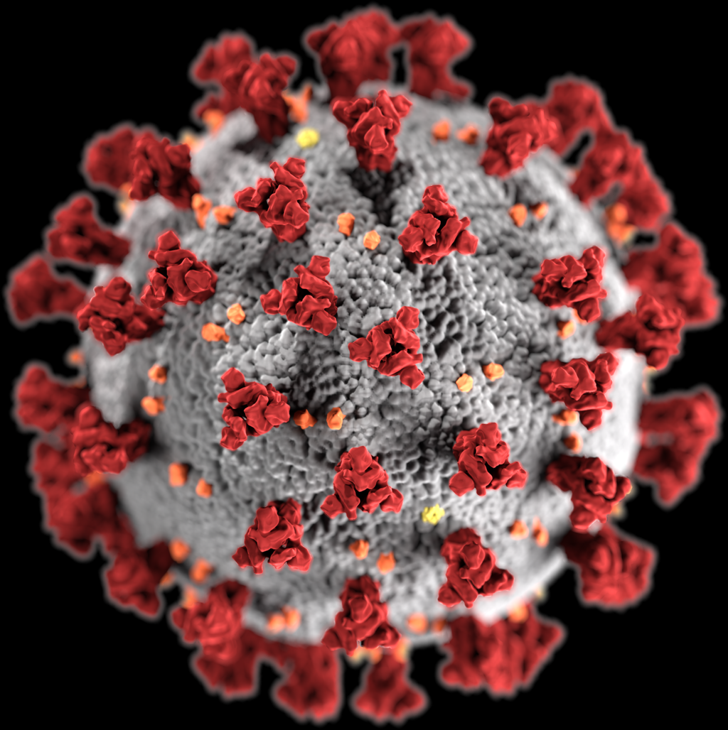
Viruses
Who are Sam and Ella?
Lesson
Viruses are the smallest known disease-causing microorganisms. Viral infections can be spread in many different ways. Following the rules of food safety will help prevent infection by some viruses but not by others.
The list on the following slides shows how to minimize your risk of being infected by some common viruses.
SARS-CoV-2, the virus that causes COVID-19
By Alissa Eckert, MS; Dan Higgins, MAM - This media comes from the Centers for Disease Control and Prevention Public Health Image Library (PHIL), with identification number #23312. This file was derived from: SARS-CoV-2 (CDC-23312).png:, Public Domain, https://commons.wikimedia.org/w/index.php?curid=86444014

Slide 28
Viruses Table
Who are Sam and Ella?
Lesson
Name | Symptoms | Prevention
SARS-CoV-2 Coronavirus that causes COVID-19 | Wide range of symptoms ranging from mild symptoms to severe illness. These include fever or chills, cough, shortness of breath or difficulty breathing, fatigue, muscle or body aches, headache, new loss of taste or smell, sore throat, congestion or runny nose, nausea or vomiting, diarrhea. | Take vaccine. Avoid people who have the disease
Chicken pox | Characterized by an itchy rash, forming blisters that dry and become scabs. Fever and listlessness are also common. | Avoid affected individuals. It is highly contagious. A vaccine is available.
Epstein-Barr | Fatigue, fever, sore throat, and swelling of the lymph nodes and spleen. | Avoid oral contact (kissing) with affected persons. A vaccine is available.
Hepatitis A | Jaundice (yellowing of the skin), weakness, brownish urine, lack of appetite, and low-grade fever. | Avoid fecal-contaminated water due to poor sanitation and/or poor hygiene and poorly cooked food. No vaccine is available but a shot of gamma globulin increases resistance.

Slide 29
Viruses Table Continued
Who are Sam and Ella?
Lesson
Name | Symptoms | Prevention
Hepatitis B | May have the virus without having any symptoms. Common symptoms include fatigue, loss of appetite, weakness, fever, nausea and vomiting. Can cause liver failure and death | Avoid contact with the blood of or any sexual contact with infected persons. A vaccine is available.
Herpes | There are two strains of this virus: one causes cold sores around the mouth and the other causes blisters in the genital region; usually accompanied by flu-like symptoms. | Avoid direct contact with a cold sore or contact with infected fluid from the genitalia.
HIV | Causes AIDS (Acquired Immune Deficiency Syndrome), a condition where the body’s immune system is impaired. Can cause death. | Avoid sexual contact with or contact with the blood of an infected person.
Influenza | There are many strains of influenza but common symptoms include fatigue, loss of appetite, weakness, fever, nausea and vomiting. Influenza is sometimes fatal. | Highly contagious. Spreads through the air or by direct contact. Vaccines are available.

Slide 30
Viruses Table Continued
Who are Sam and Ella?
Lesson
Name | Symptoms | Prevention
Measles | Causes a rash and high fever. In severe cases it leads to death through pneumonia, diarrhea or malnutrition. | Avoid the coughing or sneezing of an infected person. A vaccine is available.
Norwalk | Symptoms include nausea, vomiting, diarrhea and abdominal pain. May also cause low grade fever and headache. | Avoid contaminated water, foods and/or persons already infected. Avoid eating raw or partially cooked clams and oysters.
Polio | It can cause paralysis. | Take the polio vaccine.
Rabies | Attacks the nervous system causing general malaise, restlessness and inability to swallow. It is almost always fatal once symptoms have begun. | Avoid bites of an infected animal. It is suspected that transmission through the air is possible. A vaccine is available.

Slide 31
Viruses Table Continued
Who are Sam and Ella?
Lesson
Name | Symptoms | Prevention
Rubella | Rash, slight fever, enlarged lymph nodes and headache. It can cause birth defects such as heart problems and deafness if contracted by a pregnant woman during the first 3 months of pregnancy. | Avoid afflicted individuals. A vaccine is available.
Yellow Fever | Symptoms include yellow skin and black vomit. It is often fatal. | Get vaccinated if traveling abroad. Spread by mosquitoes living close to populated areas.

Slide 32
Activity
Who are Sam and Ella?

Slide 33
Who are Sam and Ella?
Activity
Activity will be Assigned by Teacher

Slide 34
Post-Test
Who are Sam and Ella?
Click here for Google Post-Test Assessment

