Slide 1
PROPERTIES OF HAZARDS
Life Savers or Rat Poisons

Slide 2
NAVIGATION TABLE
Properties of Hazards: Life Savers or Rat Poisons
Introduction
Pre-Test
Lesson
Post-Test

Slide 3
INTRODUCTION
Life Savers or Rat Poison
Introduction
This lesson was written by Charles C. Farnsworth, Sowmya Ramesh, Nathan Shepard, and W. R. Klemm

Slide 4
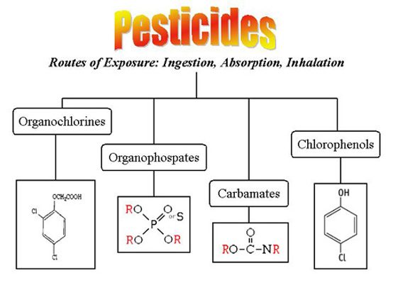
Life Savers or Rat Poison
Introduction
Pesticides are any substance or mixture of substances intended for controlling pests. Pests can be insects, mice and other animals, or weeds.

Slide 5
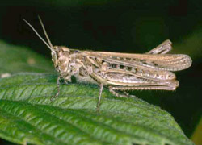
Life Savers or Rat Poison
Introduction
While pesticides are used mainly in agriculture, home use is rapidly increasing. Home-use products include cockroach sprays, insect repellents, rat poisons, tick sprays, and powders, kitchen, laundry, and bath disinfectants and sanitizers, lawn and garden products, such as weed killers, and some swimming pool chemicals. Pesticides are found everywhere in the world, contaminating soil, air, groundwater, surface water, rain, snow, fog, and even the Arctic ice.

Slide 6
Life Savers or Rat Poison
Introduction
Pesticides are useful to society because of their ability to control insects, weeds, and other pests, but they may cause serious health problems for humans.
In this lesson you will learn about different types of pesticides, source of exposure, and what it does to your body.

Slide 7
OBJECTIVES
Life Savers or Rat Poison
Introduction
By the end of this lesson, you should be able to:
•Describe how some pesticides (organophosphate and carbamates) inhibit the normal functions of the nervous system.
•Recognize the symptoms of pesticide poisoning.
•Understand the importance of immediate treatment for pesticide poisoning
•Understand how to decrease your risk of being exposed to pesticides.

Slide 8
PRE-TEST
Life Savers or Rat Poison
Pre-Test
Click here for Google Forms Pre-Test

Slide 9
LESSON
Life Savers or Rat Poison
Lesson

Slide 10
WHAT HAPPENS WHEN PESTICIDES ENTER THE BODY?
Life Savers or Rat Poison
Lesson
Most people are aware of the potential dangers of pesticide use. However, understanding that pesticides can be harmful to human health is one thing; knowing how they work is another!

Slide 11
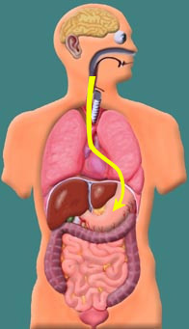
WHAT HAPPENS WHEN PESTICIDES ENTER THE BODY?
Life Savers or Rat Poison
Lesson
1. Most pesticides can enter the body through the skin, lungs or mouth. If pesticides are eaten the muscular action of the esophagus carries them to the stomach.

Slide 12
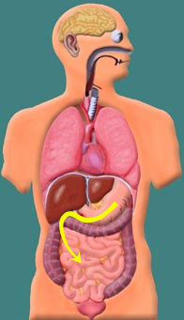
WHAT HAPPENS WHEN PESTICIDES ENTER THE BODY?
Life Savers or Rat Poison
Lesson
2. From the stomach, the pesticide enters the small intestine. It then enters the blood through the villi of the small intestine. Regardless of how a pesticide enters the body, it always winds up in the blood.

Slide 13
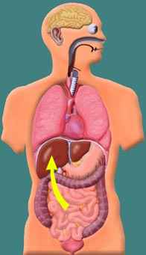
WHAT HAPPENS WHEN PESTICIDES ENTER THE BODY?
Life Savers or Rat Poison
Lesson
3. Blood from the small intestine is carried to the liver. Liver cells change the chemical nature of foreign chemicals, and this often has the effect of reducing the toxicity. These chemical reactions are called metabolism. During metabolism the chemical structure of the pesticide is changed and the modified pesticide is then called a metabolite.
In the case of some pesticides, the process of metabolism actually causes a nontoxic pesticide to become a toxic metabolite.

Slide 14
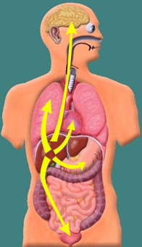
WHAT HAPPENS WHEN PESTICIDES ENTER THE BODY?
Life Savers or Rat Poison
Lesson
4. Pesticide metabolites enter the bloodstream after leaving the liver and are then transported to the rest of the body.
The effect of these metabolites varies with the type of pesticide. Some pesticides produce their toxic effects by interrupting the normal function of acetylcholinesterase in the nervous system.
Let's look at how the nervous system is affected.

Slide 15
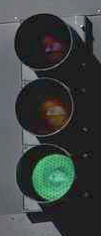
WHAT HAPPENS WHEN PESTICIDES ENTER THE BODY?
Life Savers or Rat Poison
Lesson
Acetylcholine is a special chemical manufactured by the body called a neurotransmitter. It transmits nerve impulses from one nerve to the next. It acts much like a green light telling certain functions of the body to begin.

Slide 16
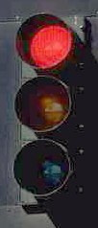
WHAT HAPPENS WHEN PESTICIDES ENTER THE BODY?
Life Savers or Rat Poison
Lesson
Acetylcholinesterase is another type of chemical produced by the body. It tells the nervous system to stop the functions started by acetylcholine. The body functions started by acetylcholine do not stop until they are stopped by acetylcholinesterase.

Slide 17
WHAT HAPPENS WHEN PESTICIDES ENTER THE BODY?
Life Savers or Rat Poison
Lesson
So what happens to the body when the normal function of acetylcholinesterase is inhibited? Acetylcholine continues to send "go" messages to various part of the body. The symptoms produced by leaving the green light on depends on how much pesticide was taken into the body (the dose).

Slide 18
SYMPTOMS
Life Savers or Rat Poison
Lesson
The following slides describe the symptoms that will occur based on the dose of the pesticide. Note that the first slide's symptoms are for pesticides that inhibit the function of acetylcholinesterase, such as organophosphates and carbamates. Other types of pesticides will produce different symptoms as shown in slides two and three.
(Victims of high dose exposure suffer from low dose symptoms as well)

Slide 19
EFFECTS OF EXPOSURE TO ORGANOPHOSPHATE AND CARBAMATE PESTICIDES (LISTED IN ORDER FROM LOW DOSE TO MODERATE TO HIGH DOSE)
Life Savers or Rat Poison
Lesson
Brain - Headache & dizziness, coma
Eyes - Excess tears, constricted pupils (won't dilate)
Mouth - Increased salivation, slurred speech
Trachea - Constriction, increased mucus
Muscles - Tremors, clumsiness, convulsions
Heart - Decreased heart rate
Respiration - Difficulty breathing, bluish skin tint
Bladder - No bladder control
Digestive organs - Nausea, vomiting & diarrhea, no control over bowel movements
* Death occurs because of respiratory failure when the dose is too high.
NOTE: "nerve gas" is a weapon of mass destruction that is chemically like organophosphate pesticides, only much more potent. More on these poisons can be found in the Hazards section of Organ Systems.

Slide 20
EFFECTS OF EXPOSURE TO ORGANOCHLORINE PESTICIDES (LISTED IN ORDER FROM LOW DOSE TO MODERATE TO HIGH DOSE)
Life Savers or Rat Poison
Lesson
Brain - Headache and dizziness, confusion, hyperexcitable state, violent seizures, coma
Muscles - Convulsions, paresthesia of face and extremities, tremors, violent seizures
Heart - Increased blood pressure, cardiac arrhythmia
Respiratory - Respiratory depression / failure
Digestive organs - Nausea, vomiting

Slide 21
EFFECTS OF EXPOSURE TO CHLOROPHENOLS (LISTED IN ORDER FROM LOW DOSE TO MODERATE TO HIGH DOSE)
Life Savers or Rat Poison
Lesson
Brain - Headache, dizziness, tremors, restlessness, seizures, coma, death
Eyes - burning, irritation
Skin - burning, irritation
Muscles - Fatigue, muscle weakness
Nose, Throat, and Lungs - Burning, coughing, wheezing, laryngitis, shortness of breath
Digestive organs - damage liver and kidneys

Slide 22
TREATMENT FOR PESTICIDE POISONING
Life Savers or Rat Poison
Lesson
If you are exposed to pesticides it is important to receive medical treatment as soon as possible. If you have received a high dose of a pesticide death can occur within 24 hours. In most cases, a physician can administer drugs that can counteract the effects of the pesticide.
Another important thing to remember about pesticide poisoning is that it takes a while for acetylcholinesterase to return to its normal levels in the blood. If you are exposed to a second dose of pesticide (even if it is a low dose) shortly after being exposed to a previous low dose, the second dose will affect your body in the same way as a high dose of pesticide.

Slide 23
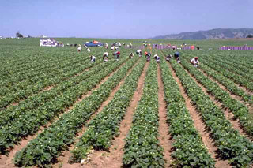
DECREASING YOUR RISK OF EXPOSURE TO PESTICIDES
Life Savers or Rat Poison
Lesson
It is important to remember that you can be exposed to pesticides by eating fresh fruits and vegetables that have been sprayed with pesticides. Always wash or peel fresh fruits and vegetables before you eat them.

Slide 24
DECREASING YOUR RISK OF EXPOSURE TO PESTICIDES
Life Savers or Rat Poison
Lesson
Also, be aware that many pesticides can enter the body just as easily through the lungs and skin as they can through the digestive system. If you must use pesticides (as an adult -- young people and pets should never be exposed to pesticides) remember to cover your skin and wear an approved breathing device. Remove all your clothes carefully and shower immediately after applying any pesticide.

Slide 25
POST-TEST
Life Savers or Rat Poison
Post-Test
Click here for Google Forms Post-Test

