Slide 1
Livestock Anatomy

Slide 2
What is Anatomy?
Form and Structure:
What parts look like
Where they are located

Slide 3
Anatomical Directions
Dorsal
Caudal
Cranial
Proximal
Ventral
Distal

Slide 4
Ventral Body Cavity
Dorsal Body Cavity
Contains most of the soft organs; divided by the diaphragm
Thoracic cavity- heart, lung, esophagus, blood vessels
Abdominal cavity- digestive tract
Pelvic cavity- urinary organs, reproductive organs
Contains the brain and spinal cord
Cranial cavity- brain
Spinal cavity- spinal cord

Slide 5
Body Cavities

Slide 6
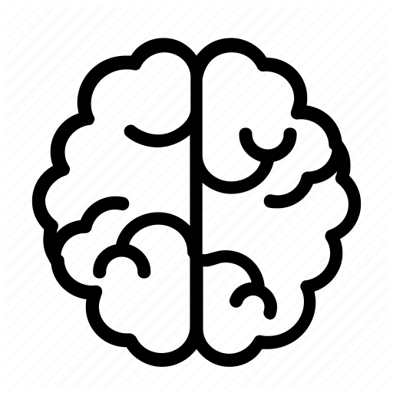
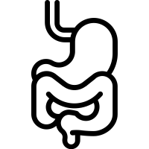
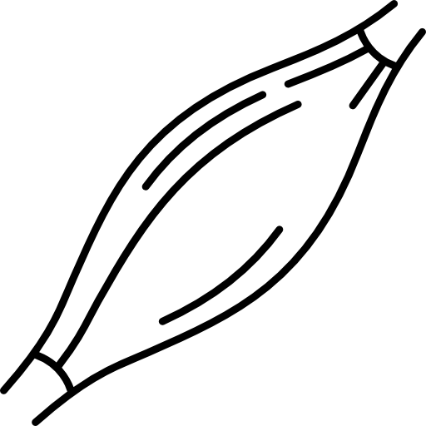
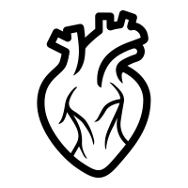
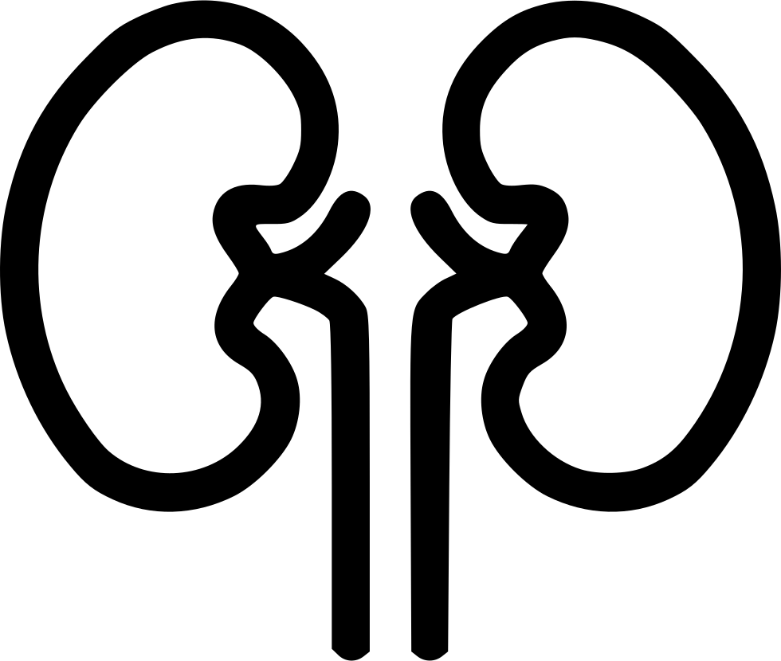
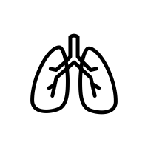
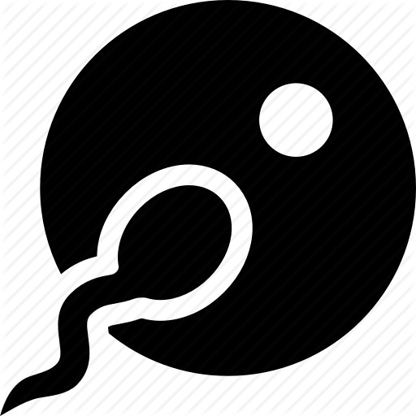
Bodily Systems
SKELETAL
NERVOUS
MUSCULAR
REPRODUCTIVE
DIGESTIVE
Protect vital organs and gives structure
Messaging and control
Absorb and digest feed
CIRCULATORY
URINARY
Support and movement
Carrying substances throughout
Dispose of waste and poisons
RESPIRATORY
If one bodily system fails, can animals stay healthy?
Breathing
Produce and feed young
Notes:
Generally, no – the whole body must work harmoniously in order to maintain optimal health.

Slide 7
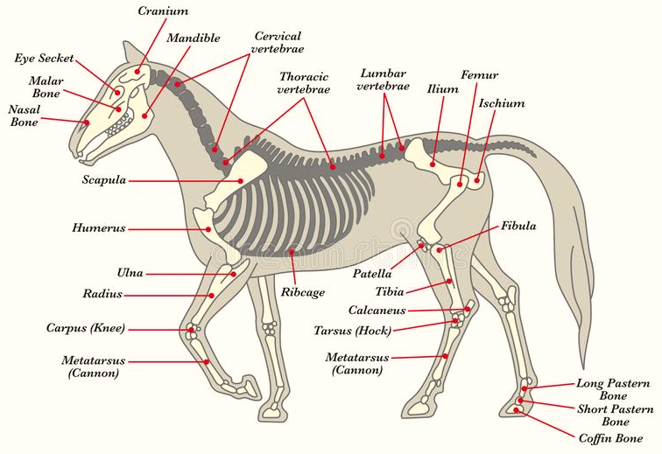
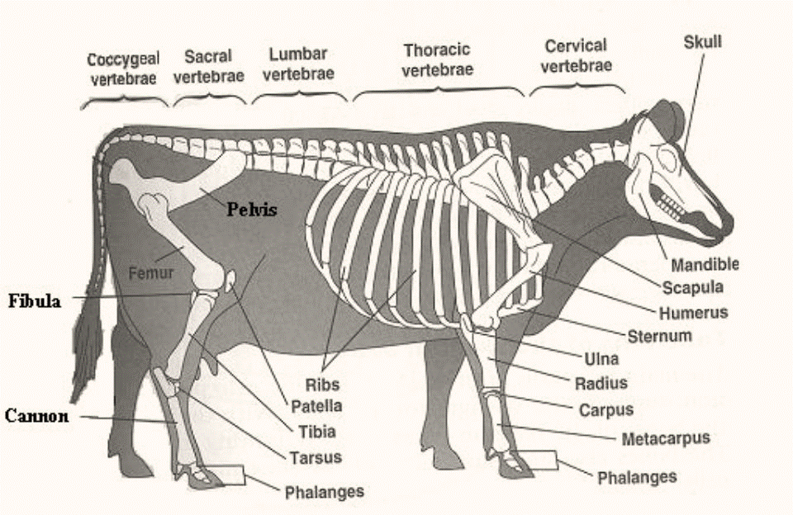
Skeletal System
Bony Tissue
Framework for the body
The size and shape of the animal is determined by its skeleton
The thickest and strongest bones are in the animal’s legs, why is this?
Notes:
The body must be supported by the legs, so they must be strong!

Slide 8
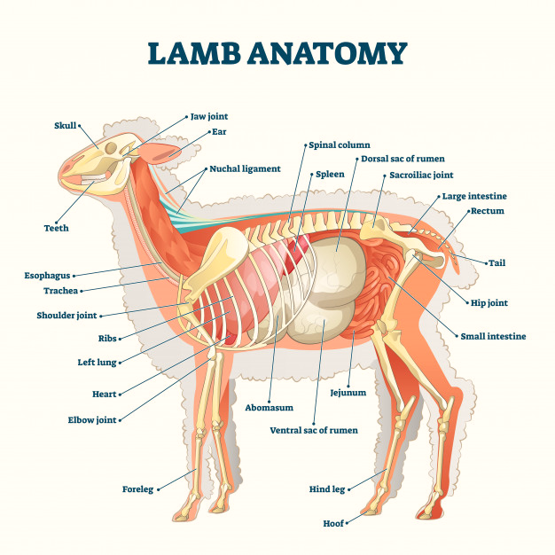
Skeletal System Function
Protects vital organs
Helps keep organs properly arranged in body
If the ribcage extended down further, what advantages and disadvantages would this give to the animal?
Notes:
Advantage – better protection for the digestive tract, Disadvantage – body is less agile and the animal could not twist as well.

Slide 9
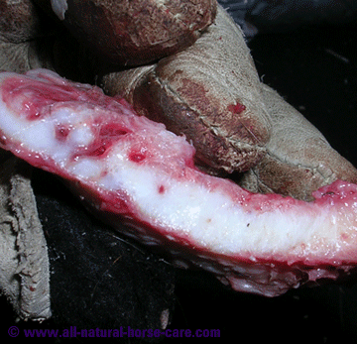
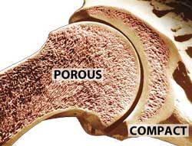
Skeletal Components
Cartilage
Compact Bone
Spongy Bone
Porous
Soft, inside
Bony tissue
Flexible
Lubricates joints and cushion shocks
Located at the end of bones
Honeycombed
Hard, outside
Bony tissue made of Calcium & Phosphorus

Slide 10
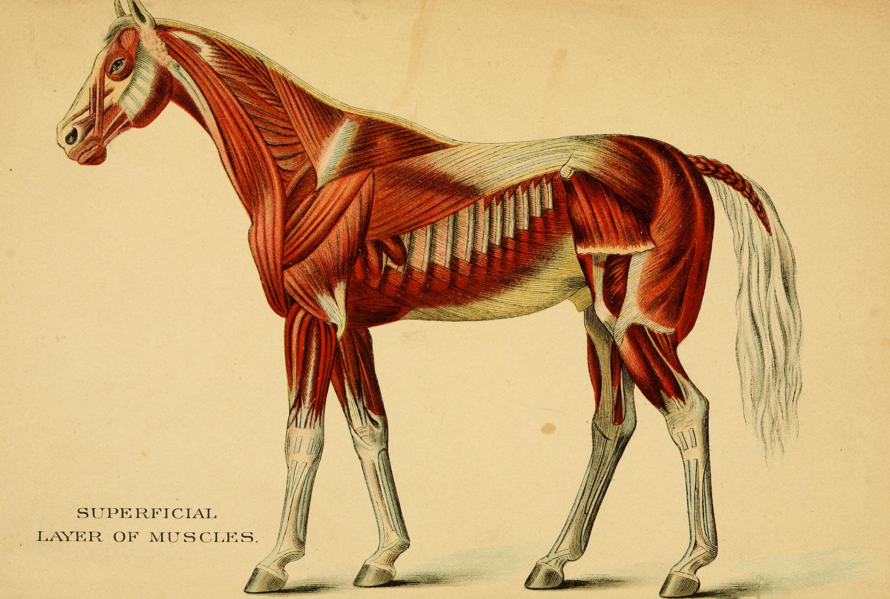
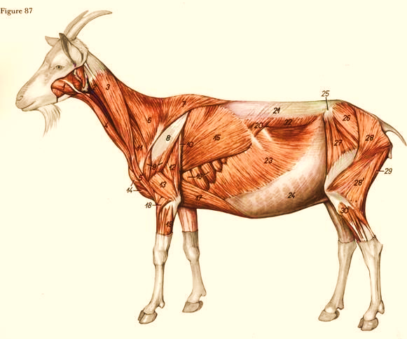
Muscular System
Lean meat of animals
The largest system: makes up 45% of the weight of hogs, cattle, and chickens
Meat scientists study “Myology” – the study of musculature

Slide 11
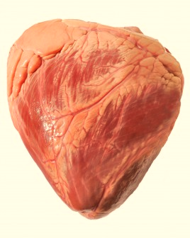
Muscular System Function
Crucial for movement
Aids in circulation, digestion, breathing, among many other bodily functions

Slide 12
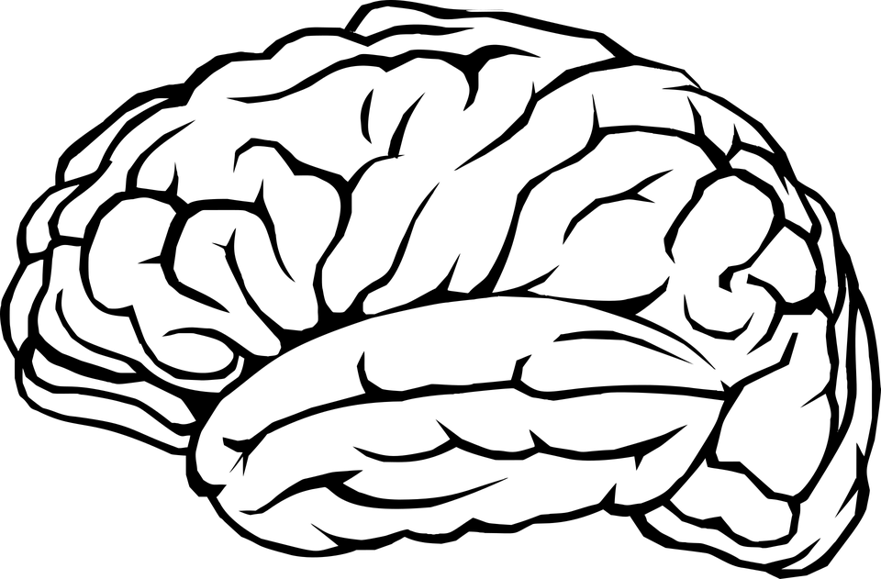
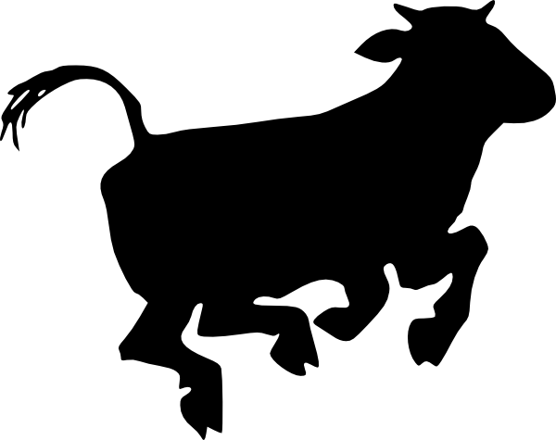
Muscular Control Types
Involuntary
Voluntary
Controlled by a lower part of the brain that cannot be changed by thought
Controlled by the
“thinking” part of the brain
If we could stop our digestion and heartbeat by thought, would this be advantageous?
Notes:
Stopping these processes would be harmful because we would not be able to regulate our entire body without wasting our energy and time.

Slide 13
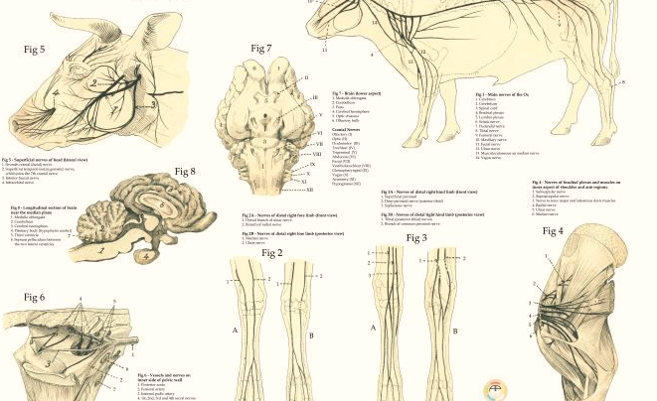
Nervous System
Pathways for the senses
Helps with physical activity
Provides animals with the ability to react or adjust to different situations

Slide 14
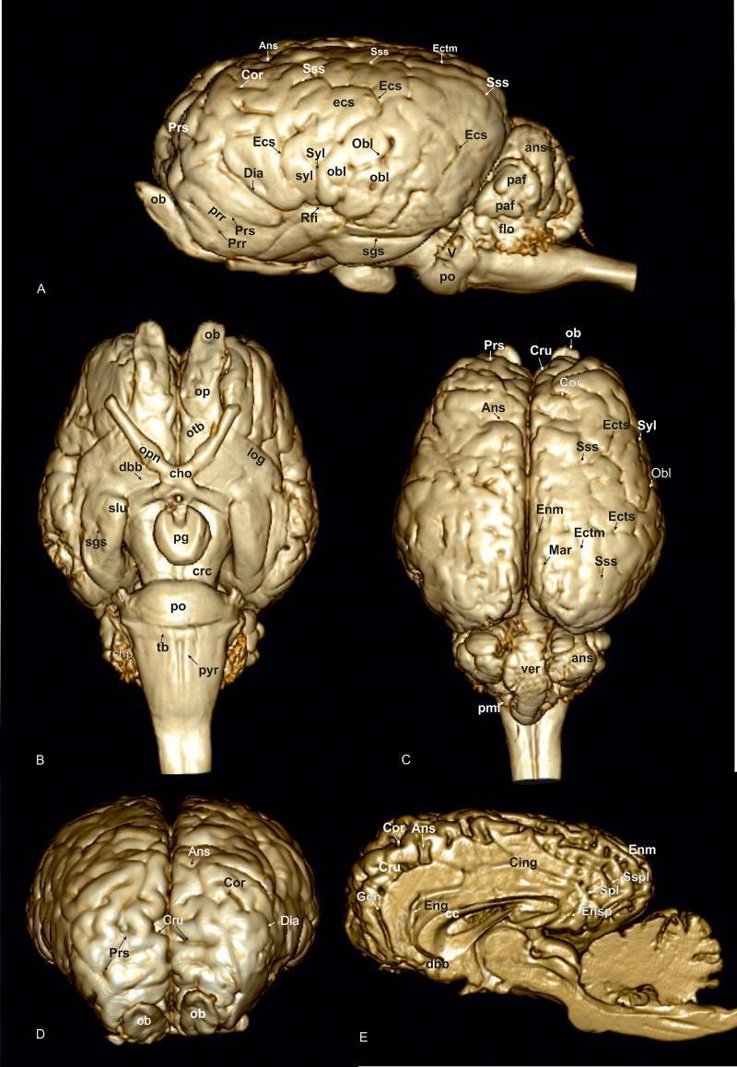
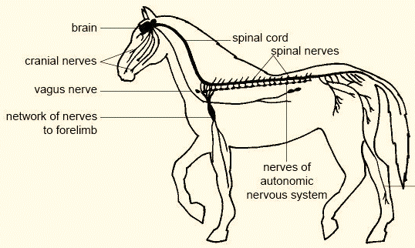
Central Nervous System
Peripheral Nervous System
Nervous Components
The brain and the spinal cord
Composed of somatic nerves such as muscle and skin
&
Composed of autonomic nerves such as the visceral organs

Slide 15
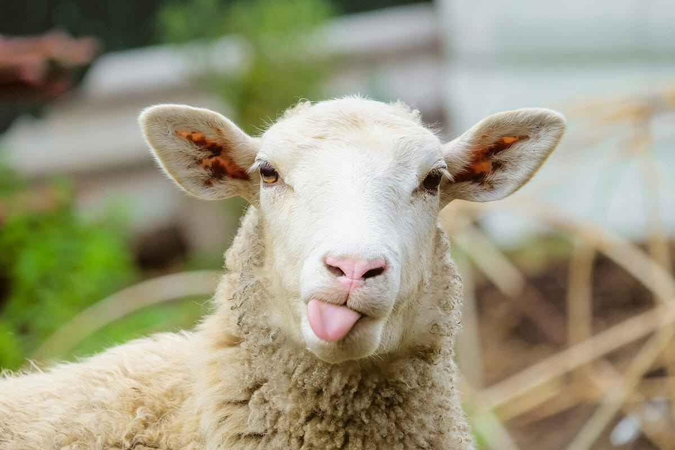
NERVOUS SYSTEM SENSES
Controlled by the brain
Eyes – sight
Ears – hearing
Nose – smell
Tongue – taste
Skin - touch
Why does the sheep have such large ears and eyes but smaller nostrils?
Notes:
The sheep has these traits because it relies on sight and hearing to detect predators and stay with their herd. The sheep relies on scent to detect poisons in food but does not need to have an extensive smell ability or a large breathing capacity.

Slide 16
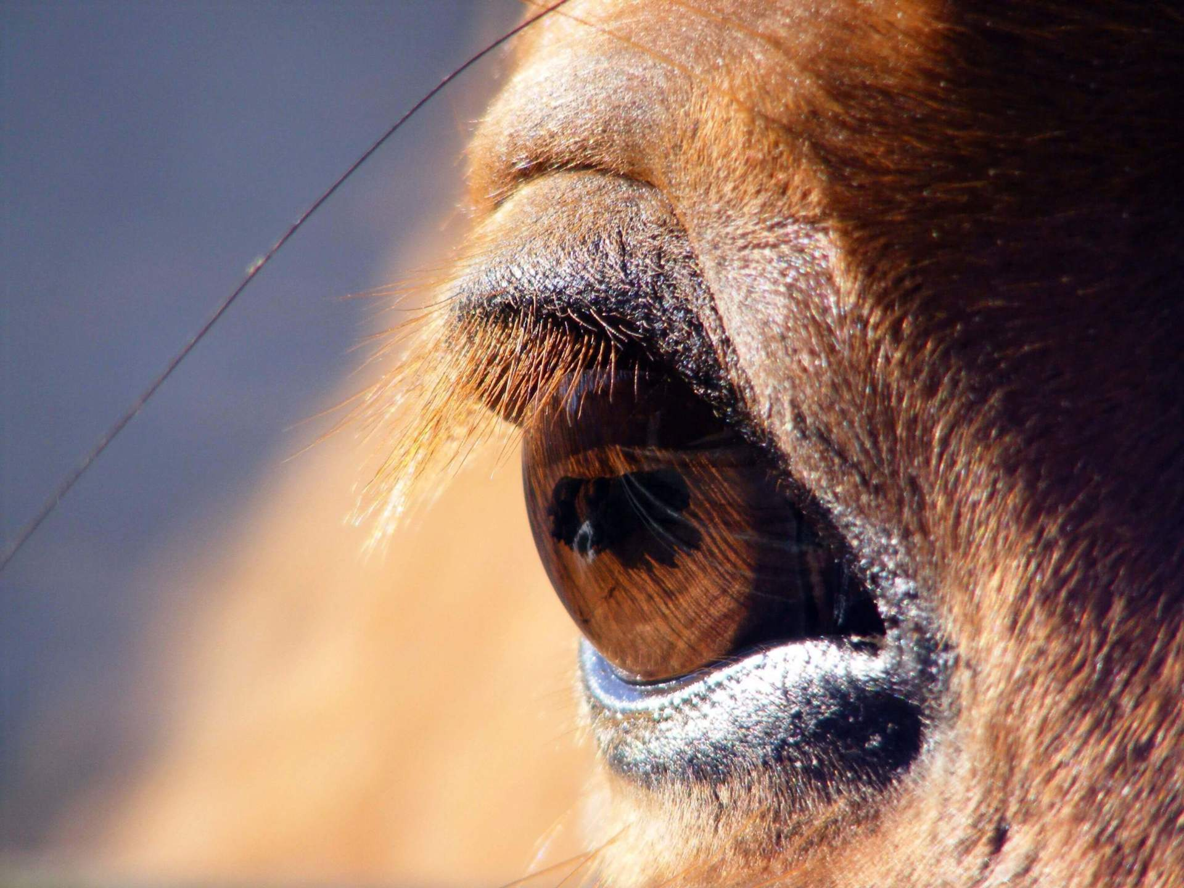
Sensory function
Why do certain animals have sensory organs such as fingers while others have whiskers?
Crucial for transporting stimuli
Crucial for the “fight or flight” response & recognizing changes in the internal/external environment and allowing the body to react

Slide 17
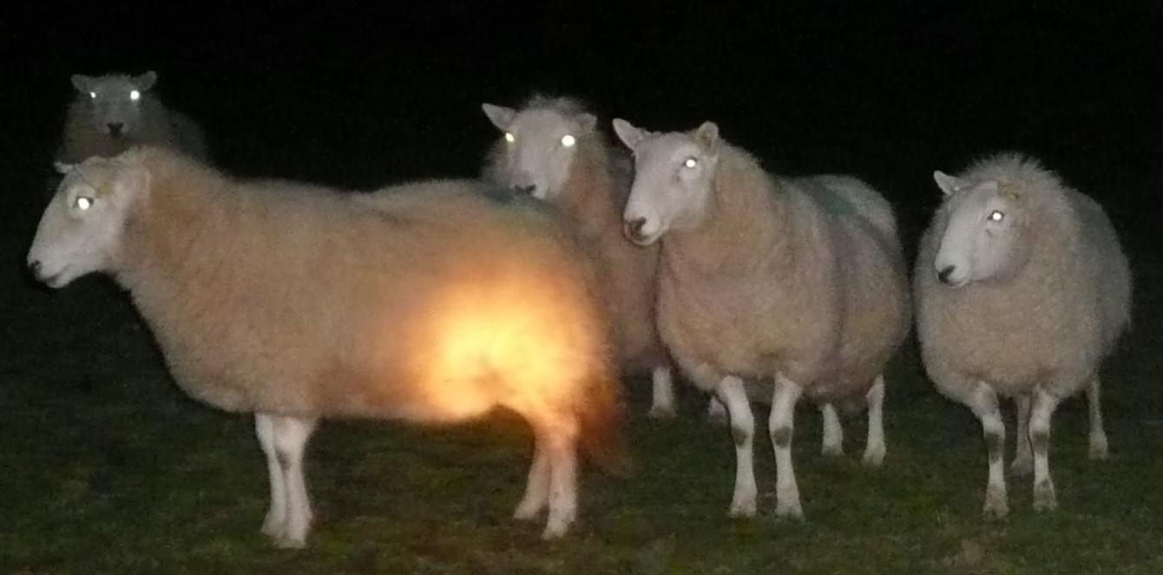
Why do animal’s eyes glow at night?
https://youtu.be/maCfDcldZV8

Slide 18
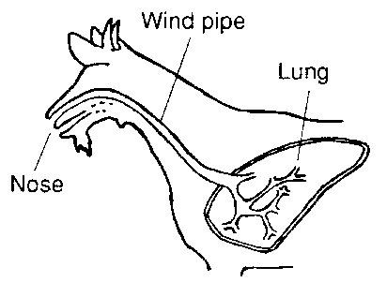
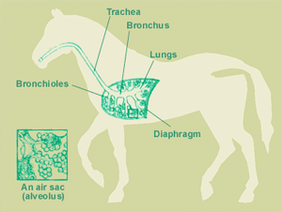
RESPIRATORY SYSTEM
Internal Respiration: exchanges of gases between the blood and the atmosphere
Moves gases to and from the circulatory system
External Respiration: exchanges of gases between the cells and the blood between the body

Slide 19
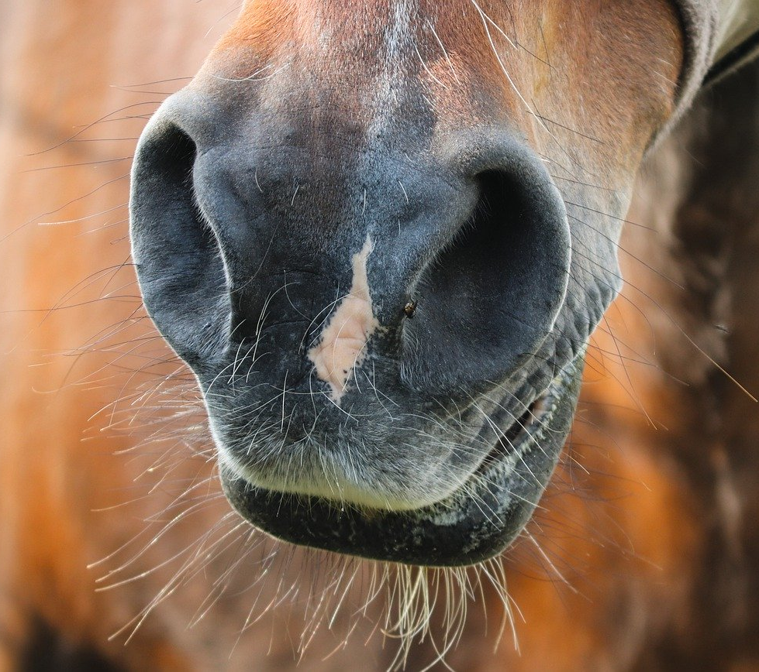
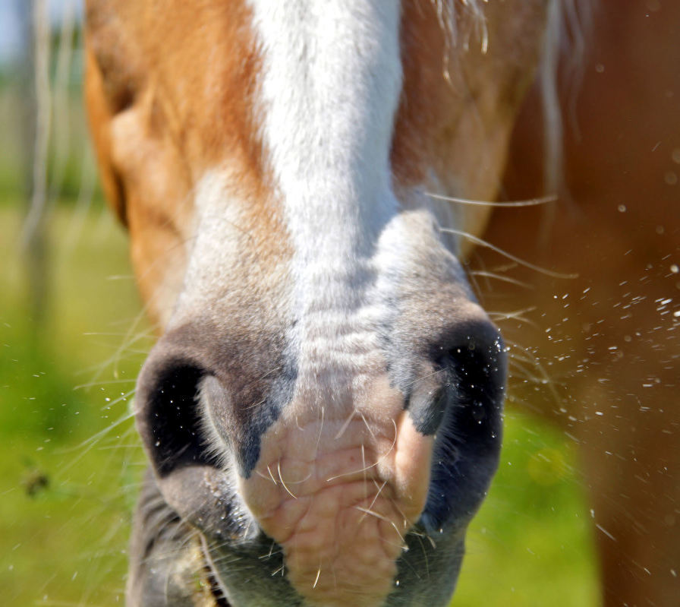
INSPIRATION
EXPIRATION
Process of taking air into the lungs
Process of moving air out of the lungs
Steps of Breathing

Slide 20
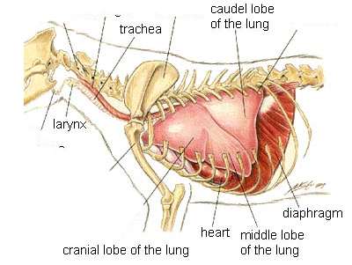
PARTS OF THE RESPIRATORY SYSTEM
The diaphragm is a voluntary and involuntary muscle. Why would this be advantageous?
Nostrils: openings near the mouth through which gases enter and leave the body
Pharynx: connects the nose area with the mouth
Larynx: often called the voice box
Trachea: known as the windpipe; connects the pharynx with the lungs
Lungs: where gas is exchanged between the atmosphere and the blood
Notes:
The diaphragm helps the lungs with exhalation and inhalation. Involuntary means that we stay breathing even when not thinking about it, freeing up our time. But the voluntary ability allows us to hold our breath or slow our breathing if we are in danger or trying to relax, like when swimming under water or trying to sleep.

Slide 21
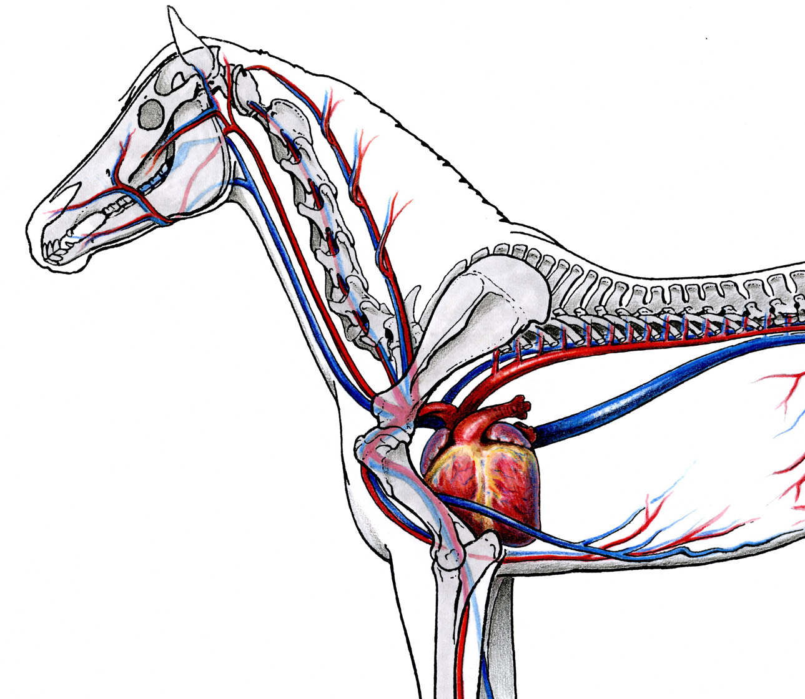
CIRCULATORY SYSTEM
Responsible for Internal Movement
Moves digested food, oxygen, waste, and other materials
Circulation is the movement of blood throughout the body

Slide 22
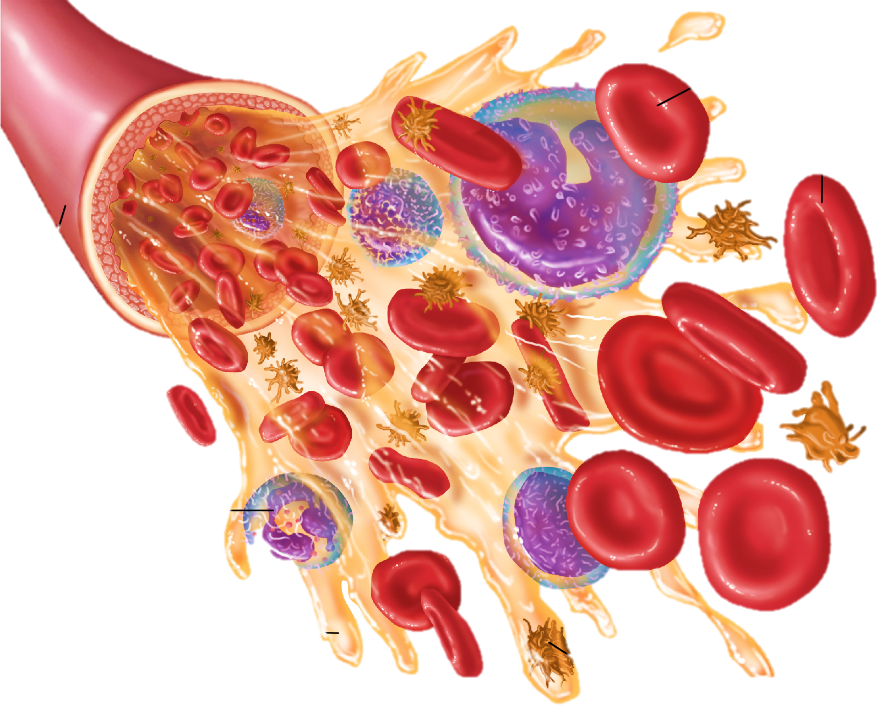
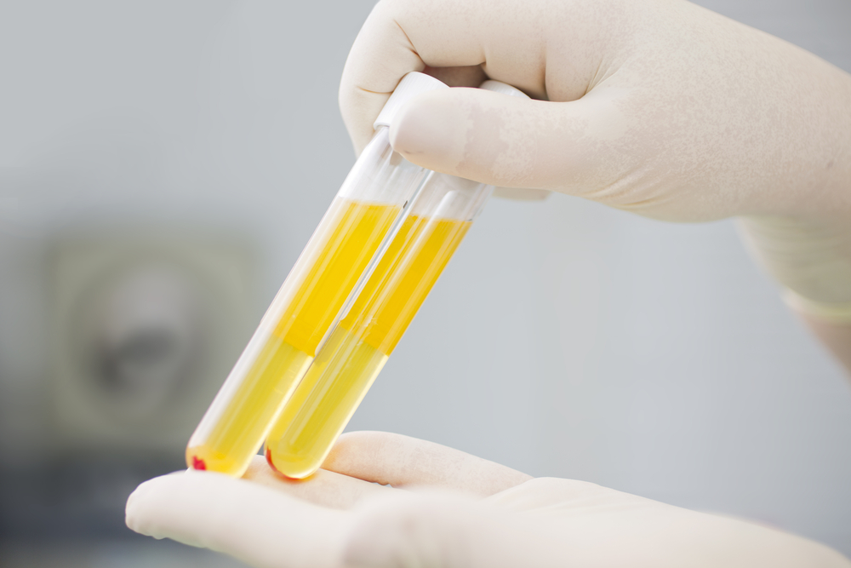
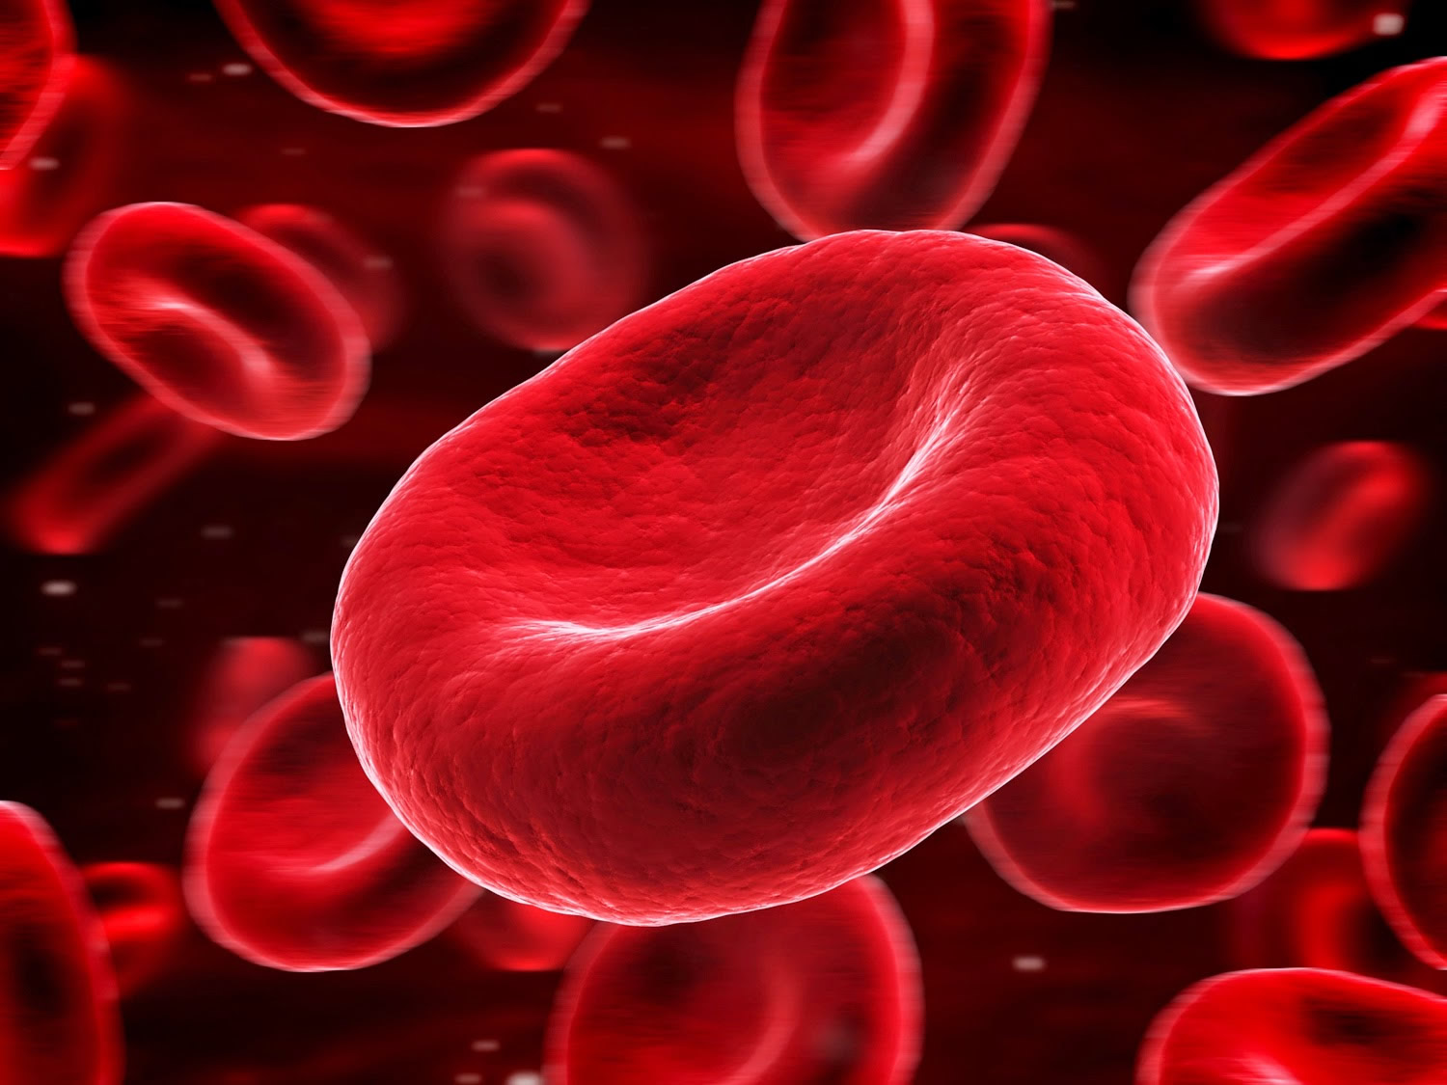
PLASMA – 90% water
Blood: liquid of the circulatory system
Why is hydration so important for animal health?
remaining solids – glucose, vitamins, minerals, proteins

Slide 23
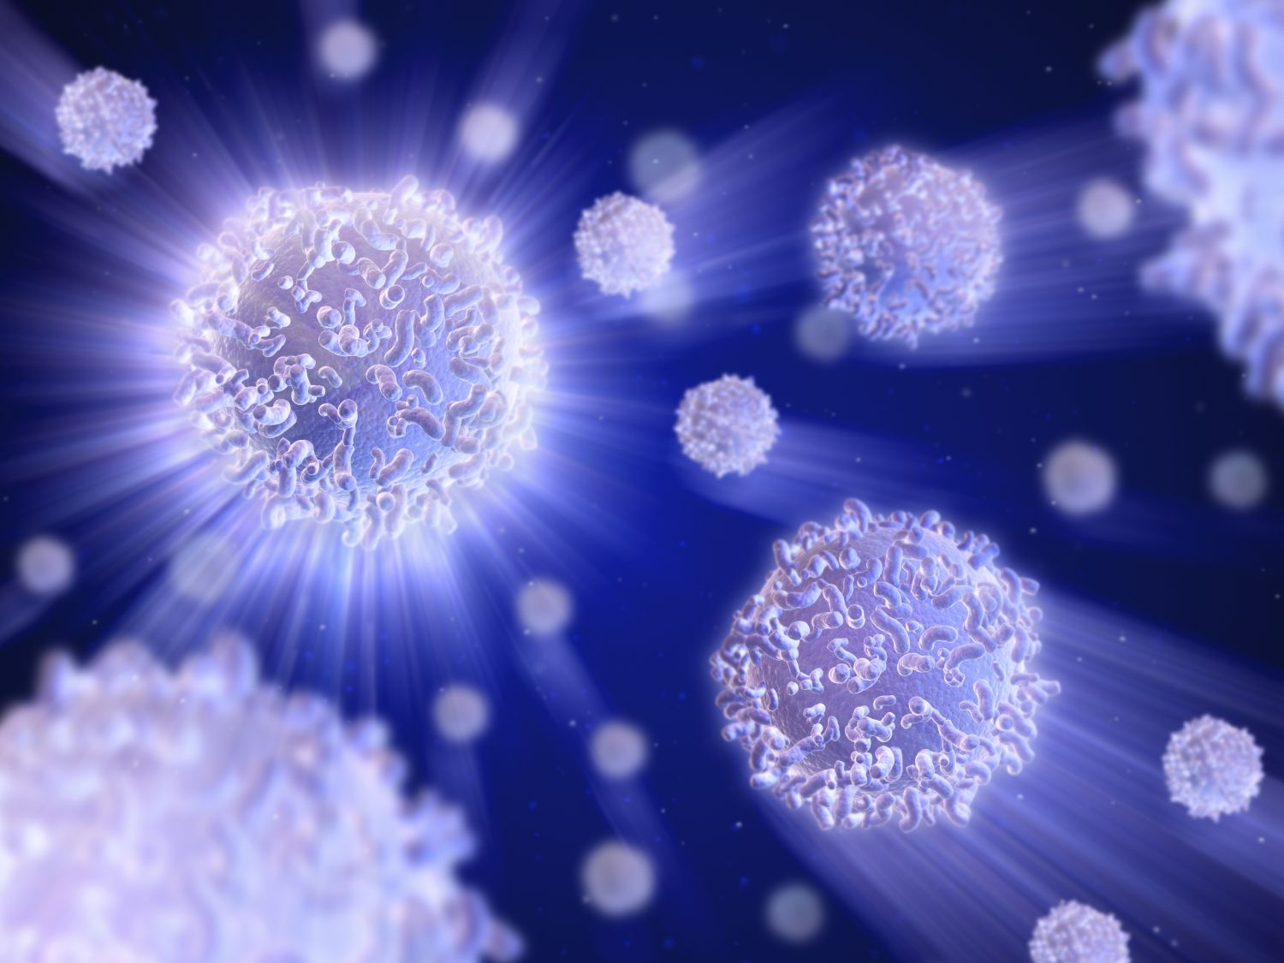
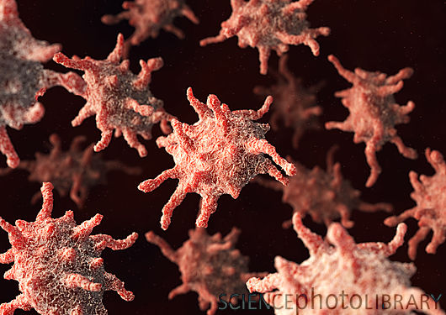
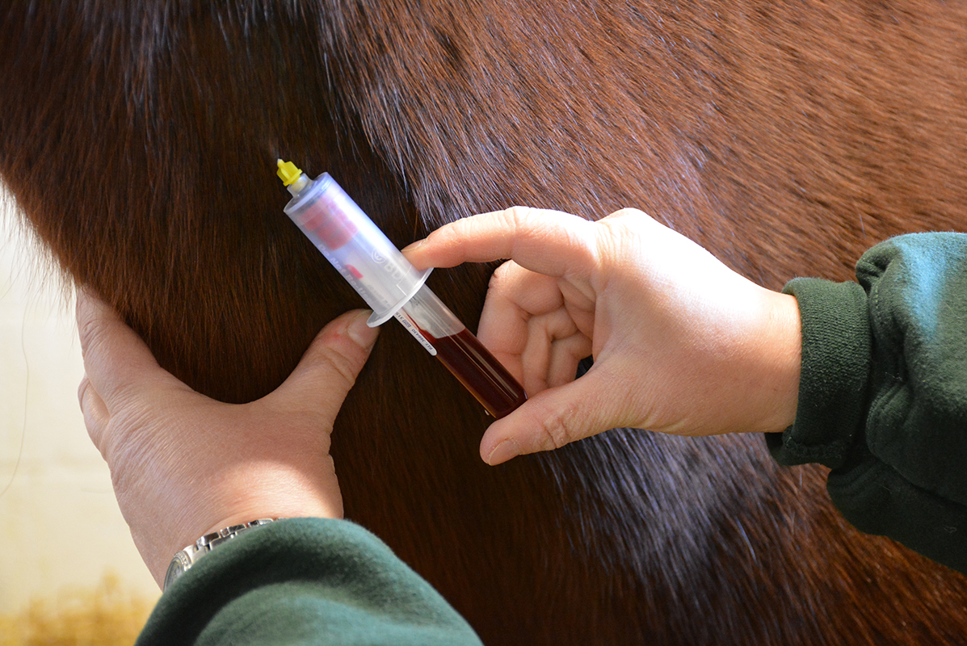
Solids of the Blood
Red Blood Cells
White Blood Cells
Platelets
Contain hemoglobin
Made in the bone marrow
Helps fight disease
Component of the pus that forms at wounds
Essential for blood clotting
Why would disease fighting be an advantage at wound sites?
Notes:
Disease fighting white blood cells would prevent harmful diseases from entering the body and from infection beginning

Slide 24
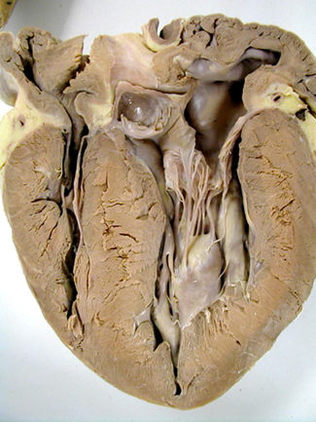
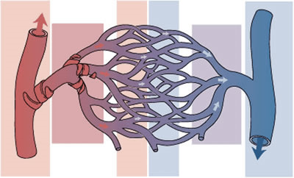
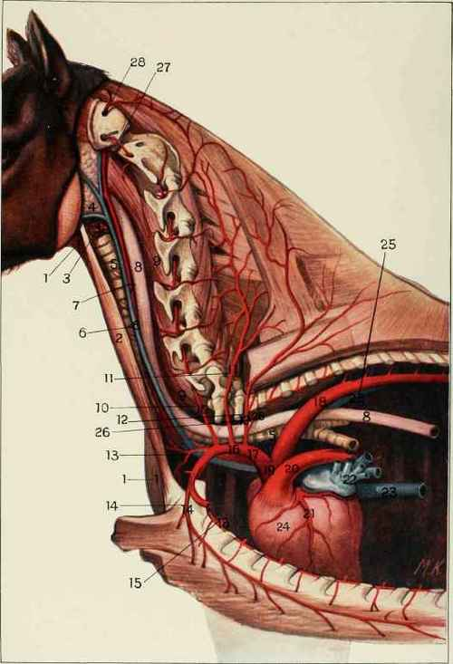
Arteries
Heart
Veins
Why do larger animals need larger hearts but not larger brains?
Vessels that carry the blood from the heart
Vessels that carry the blood to the heart
Capillaries
Small branches from the arteries that carry blood to the cells
Pump that sends blood throughout the system
Notes:
Larger animals need more blood because their bodies are larger but may not have a larger brain because the size of the brain is not related to ability or intelligence. A pig is more intelligent in many ways than an elephant.

Slide 25
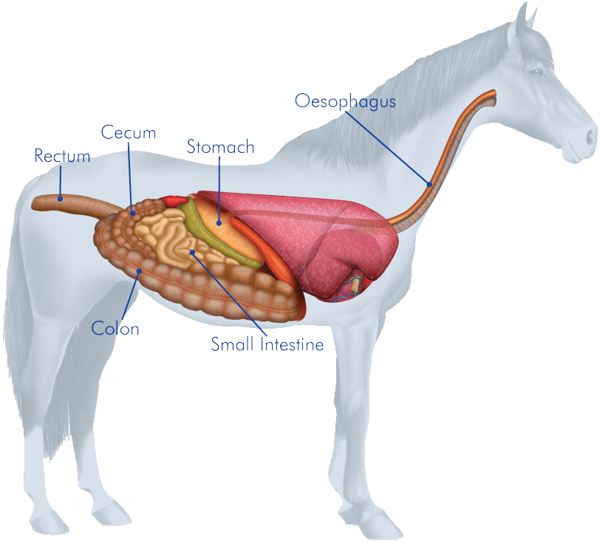
Digestive System
Responsible for ingesting and breaking down food
Consists of teeth, mouth, esophagus, stomach, intestine, liver, pancreas, and rectum

Slide 26
PROCESS OF DIGESTION
Ingestion
Intestines
Stomach
Rectum
Where bile from liver and pancreatic juices breaks down ingesta, and moves to the…
Through the mouth, food is broken down mechanically and moved to the…
where it is mixed with juices to form a paste. It passes then through the…
Where waste is passed through the anus

Slide 27
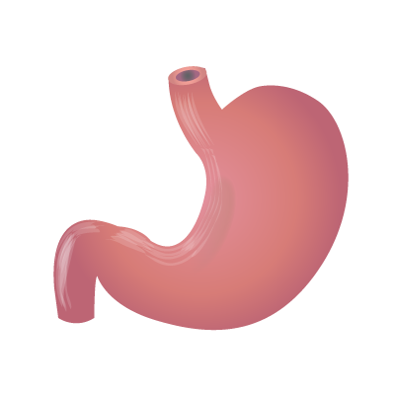
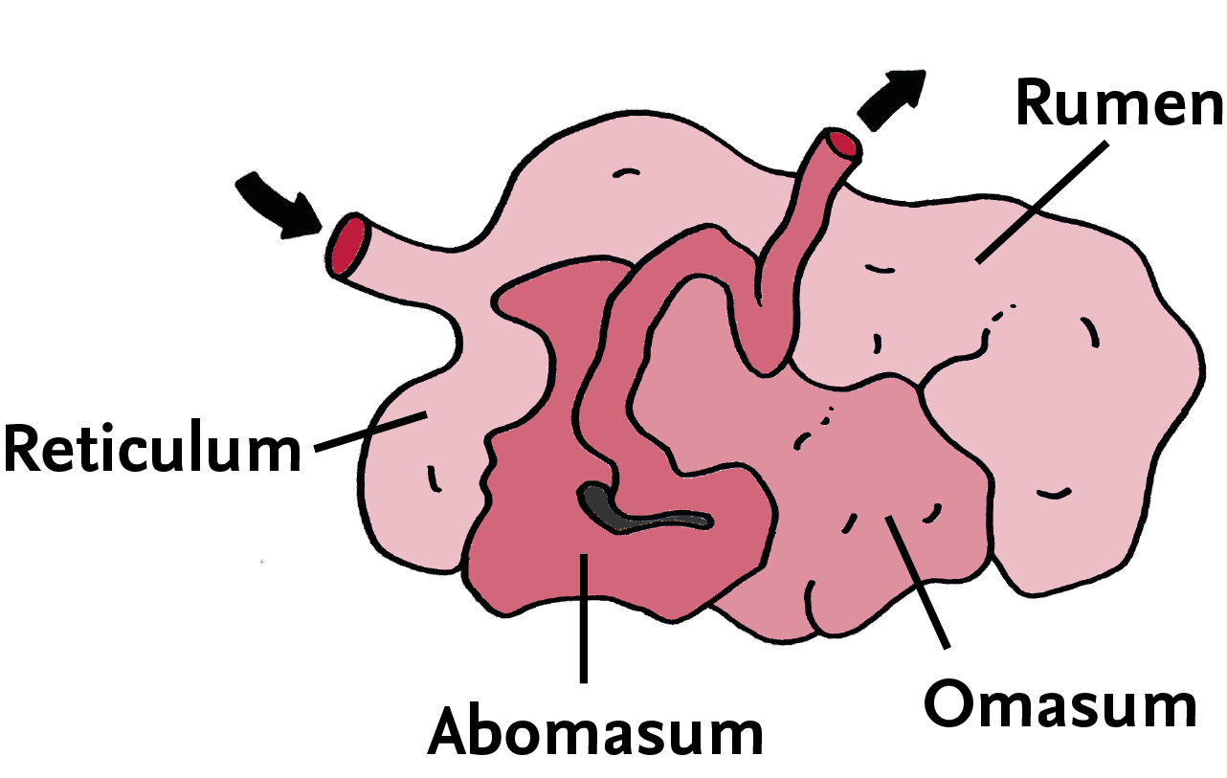
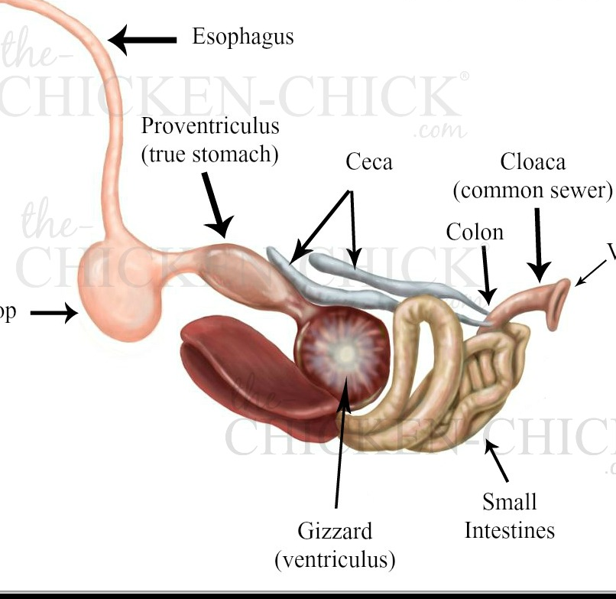
DIGESTIVE TYPES
MONOGASTRIC
RUMINANTS
AVIAN - POULTRY
Different livestock species have different digestive systems!
pigs, horses, dogs, cats, (birds), humans
cattle, sheep, goats, deer buffalo
chickens, turkeys, ducks, geese

Slide 28
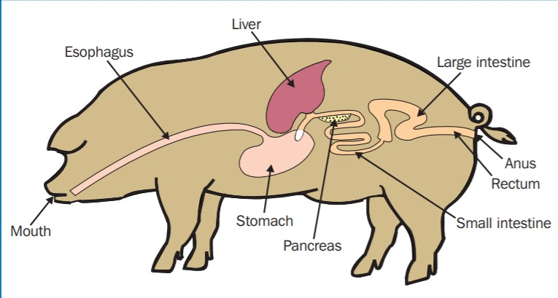
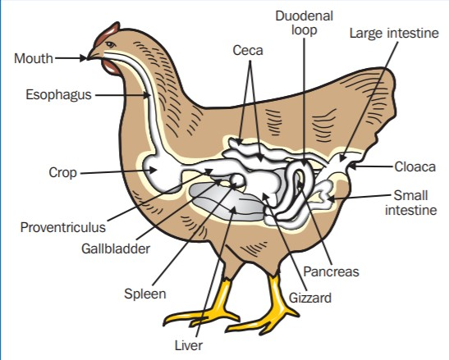
MONOGASTRICS
Simple stomach with one compartment
POULTRY
The crop grinds food mechanically, why must poultry do this? What body structure does he lack?
Simple stomach including a crop, proventriculus and ventriculus
Notes:
The crop of a chicken is analogous to the mouth of a monogastric

Slide 29
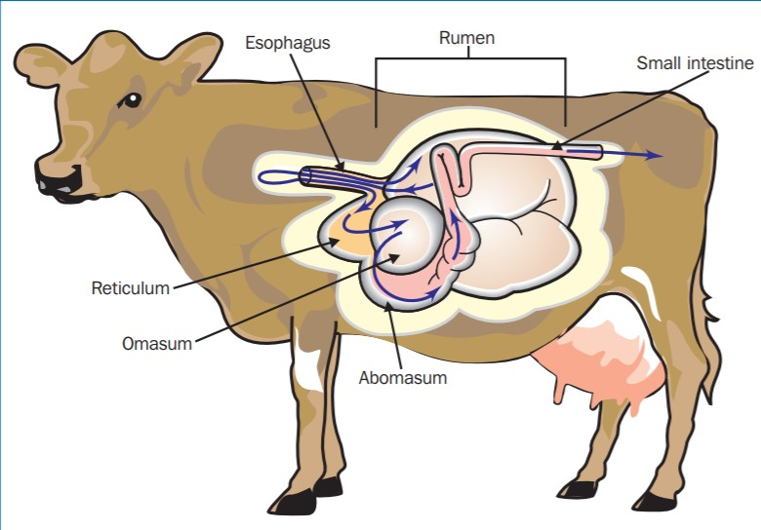
RUMINANTS
Ruminants have four compartments in their stomach
Why do ruminants have a more complex stomach system? What do they eat?
Notes:
Ruminants have a more complex stomach in order to best extract nutrients from foods that are more protected, like grains and grasses. Ruminants rely on plants for their fuel.

Slide 30
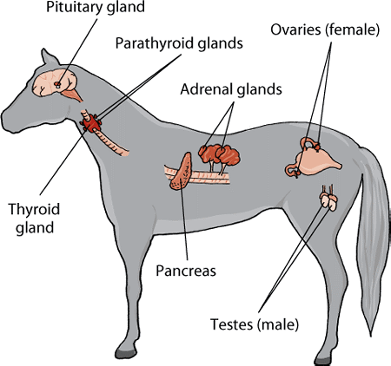
ENDOCRINE SYSTEM
Reproduction
growth & the shape of the animal
Feed Efficiency
The gland system that produces hormones to maintain homeostasis and other bodily functions
What body system do hormones use to move around the body?
Heat
Lactation
Birth
Notes:
Circulatory

Slide 31
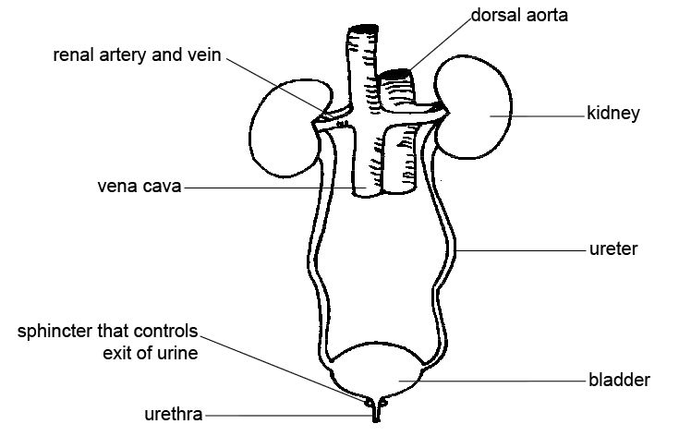
Filters, collects, and excretes waste materials and excess water from the body
URINARY SYSTEM
Kidneys are the primary organs of this system, they lie against the backbone and the bladder and filter the blood
Urine is formed by the output of the kidney and collects in the bladder where it will exit the body

Slide 32
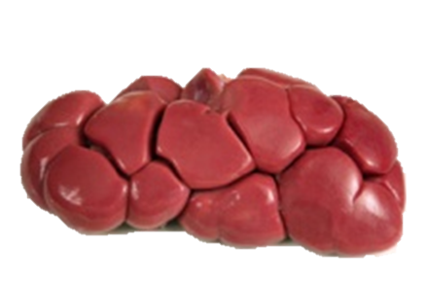
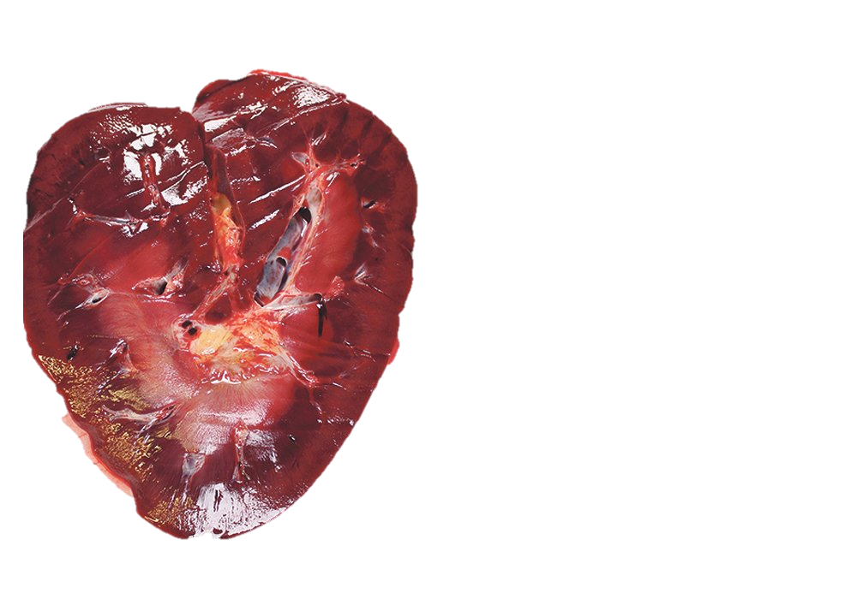
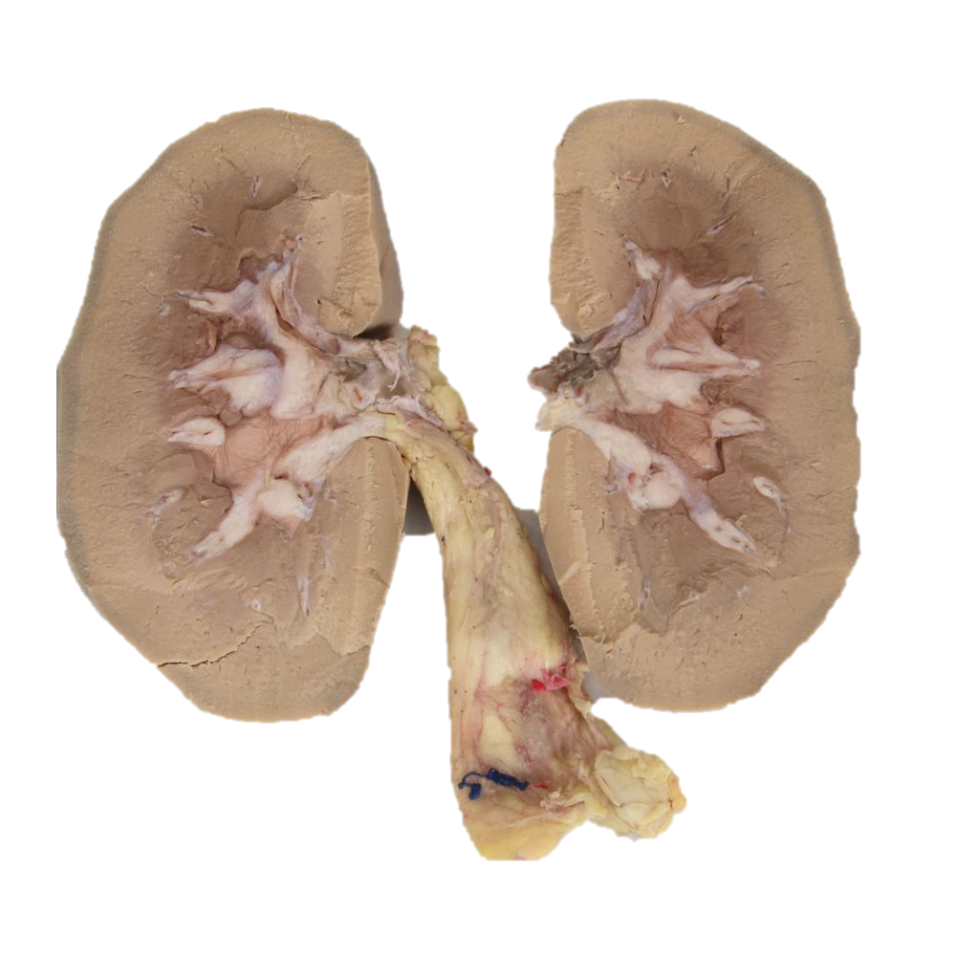
KIDNEY SHAPES
Lobulated
Heart Shaped
Bean Shaped
Cattle, Chicken
Horses
Pigs, sheep, humans

Slide 33
REPRODUCTION
Females produce eggs from ovaries and give birth.
Males produce sperm from testis and fertilize the egg

Slide 34
FEMALE REPRODUCTION
Consists of two ovaries, one on each side of the abdomen
Ovaries produce eggs which pass into the uterus
Below the uterus is the vagina which opens to the outside. The opening is called the vulva
Are udders part of the reproductive system?
Notes:
Yes – udders and the mammary glands can be considered part of the female reproductive system since they aid in the nourishment of offspring

Slide 35
MALE REPRODUCTION
Testicles produce the sperm of the semen
The testicles lie in the scrotum behind the penis
In the bird, the testicles are inside the body

Slide 36
One more time…
System | Organs in the body | Job or function
Skeletal | bones | Protects vital organs
Muscular | Muscle(meat) | Support and move body
Sensory | Eyes, ears, nose, skin | Sense and detect things outside the body
Nervous | Brain, nerves spinal cord | Pass messages around the body, control the body
Circulatory | Heart, blood vessels | The blood carries substances around the body
Respiratory | Muzzle, windpipe, lungs | Breathing
Digestive | Stomach, liver, intestine, pancreas | Digest and absorb feed
Urinary | Kidneys, bladder | Gets rid of poisons and waste
Reproductive | Testes, penis, ovaries, uterus, vagina, vulva, udder | To produce and feed young

Slide 37
References
www.lsu.edu/lata/L3-1.doc
http://www.fao.org/docrep/t0690e/t0690e04.htm
https://slidesgo.com/slidesgo-school

