Slide 1
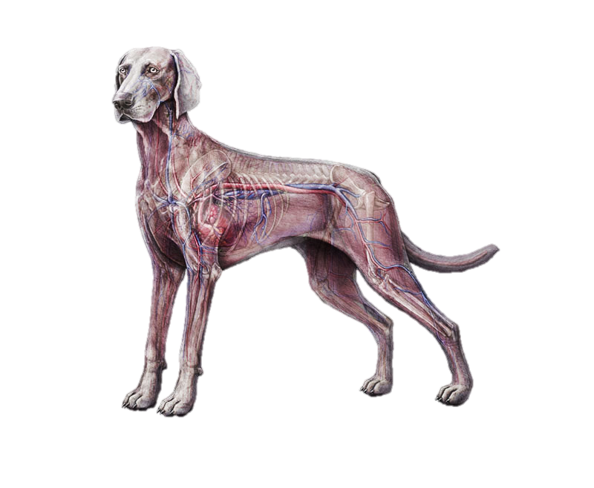
Animal Circulatory Systems
Notes:
TEKS:
130.3 Livestock Production 4A
130.6 Veterinary Medical Applications 6A-B

Slide 2
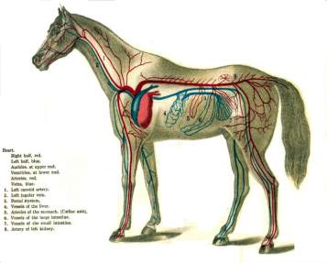
What is the Circulatory System?
An animal’s body system concerned with the transport of blood through the heart, blood vessels and lungs.
Helps move digested nutrients, oxygen, waste, and other materials around the body.

Slide 3
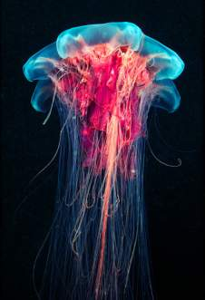
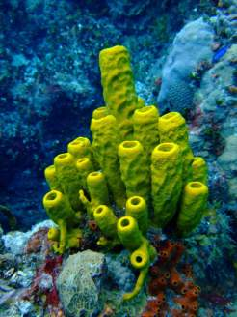
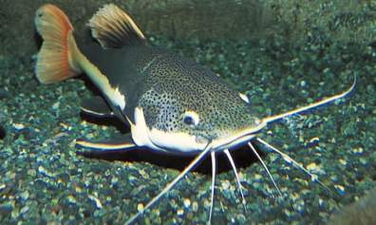
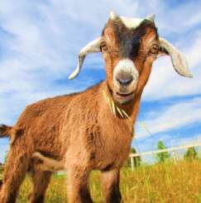
Do all Animals have a Circulatory System?
We don’t! →
We DO →
Notes:
Sponges and jellyfish ARE animals but they DO NOT have circulatory systems.
Fish and mammals DO have circulatory system

Slide 4
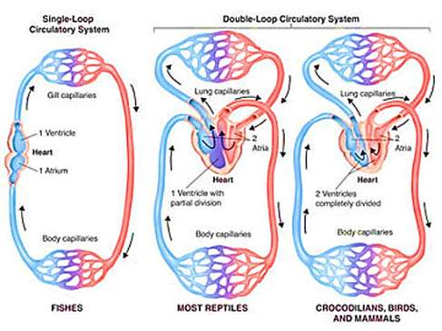
Are all Circulatory Systems the Same?
NO! There are 3 primary types of Circulatory Systems:
Single loop circulation with 2 Chamber hearts
Double loop circulation with 3 chamber hearts
Double loop circulation with 4 chamber hearts

Slide 5
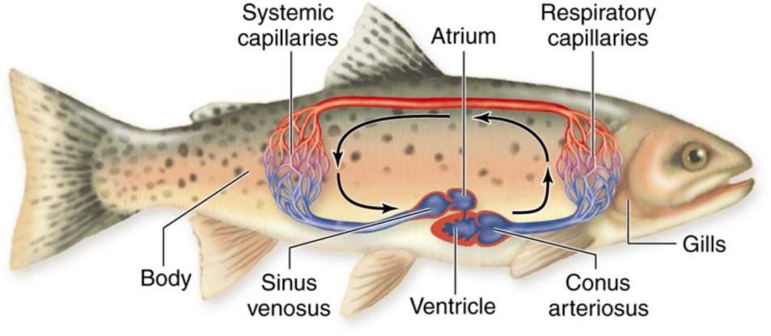
Are all Circulatory Systems the Same?
Single loop circulation with 2 Chamber heart
Fish have this type of circulatory system!

Slide 6
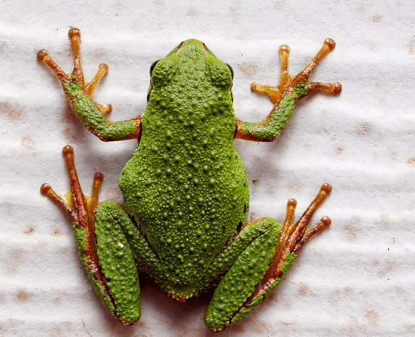
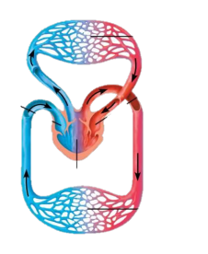
Are all Circulatory Systems the Same?
Double loop circulation with 3 Chamber heart
Amphibians have this type of circulatory system!

Slide 7
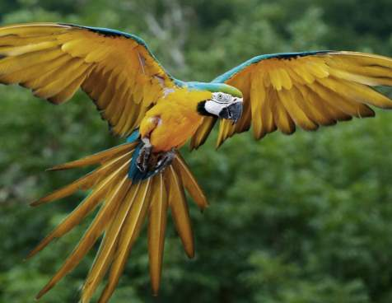
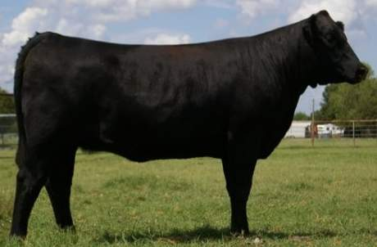
Are all Circulatory Systems the Same?
Double loop circulation with 4 Chamber heart
Mammals and Birds have this type of circulatory system!
Notes:
REPTILES may have a 3 chamber heart, 4 chamber heart or a modified 3 chamber heart that is a combination of the two. Depending on the species, they type of system may vary.

Slide 8
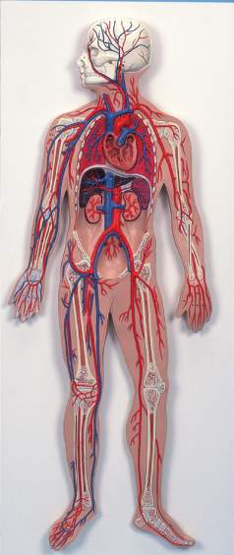
How do Humans Compare to Animals?

Slide 9
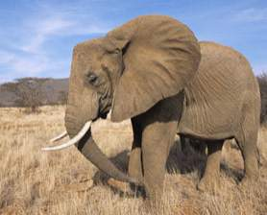
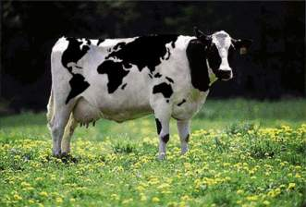
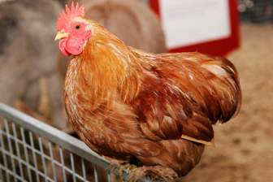
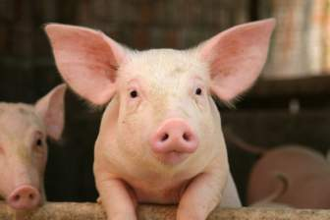
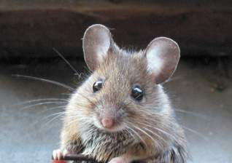
Remember, we are ANIMALS!
Humans are mammals, just like cats, dogs and cows.
Our system is the same as birds and other mammals.

Slide 10
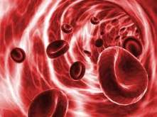
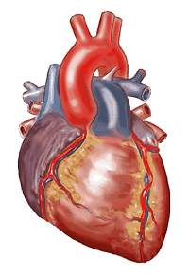
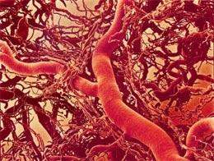
The Parts of the Circulatory System
Blood
Heart
Blood Vessels

Slide 11
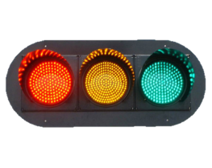
Think of it like a Highway
Blood – transports cells just like a bus transports people
Heart – controls the flow of blood like street lights control the flow of traffic
Blood Vessels– lead the flow of blood through the body like a road leads the flow of traffic

Slide 12
Blood
The liquid that circulates in the blood vessels, transporting oxygen, carbon dioxide, waste, etc. around the body.
What is blood made of?
Red blood cells
White blood cells
Platelets
Plasma

Slide 13
Blood
Blood is made in the bone marrow of the bones
Solid components:
Red blood cells (erythrocytes) -
White blood cells (leukocytes) -
Platelets (thrombocytes) -
Liquid component:
Plasma -
transport oxygen
defense against
infections
assist with blood clotting
Liquid that suspends proteins and
the solid components of blood

Slide 14
Blood
Notes:
The full video can be found at this link: http://www.youtube.com/watch?feature=player_embedded&v=R-sKZWqsUpw

Slide 15
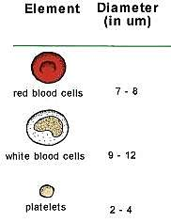
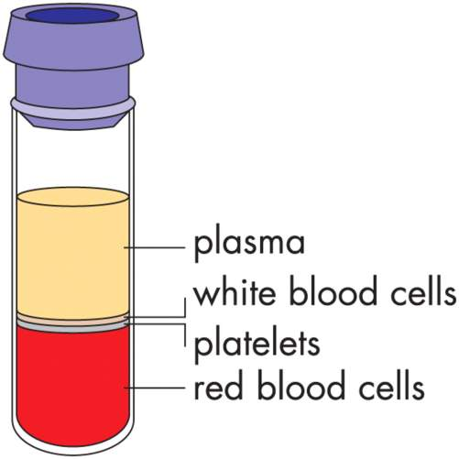
Blood

Slide 16
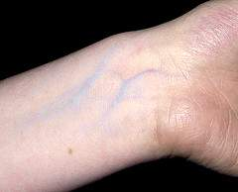
Why does the Blood in my arm look Blue?
Actually, blood is always red! Veins look blue because light has to penetrate the skin to illuminate them, the color that your eyes see is blue.
Notes:
Blue and red light (being of different wavelengths) penetrate with different degrees of success.
This is why veins are represented with the color blue.

Slide 17
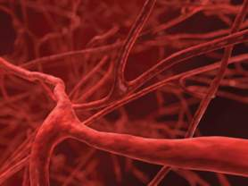
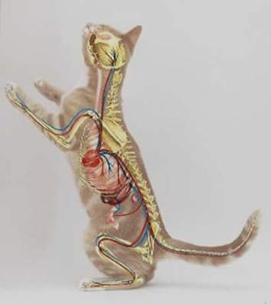
Blood Vessels
Veins:
the pathway of oxygenated blood to the heart.
Arteries:
the pathway of oxygenated blood from the heart to the body.
Capillaries:
the small pathways that connect arteries to veins.

Slide 18
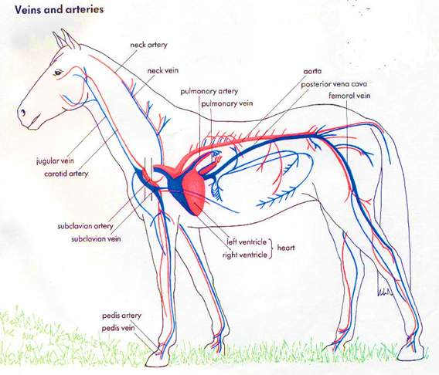
Blood Vessels
An animal’s blood vessels are located all over the entire body.
They lead oxygenated blood to tissues and organs.
They also lead de-oxygenated/waste filled blood away from these tissues.

Slide 19
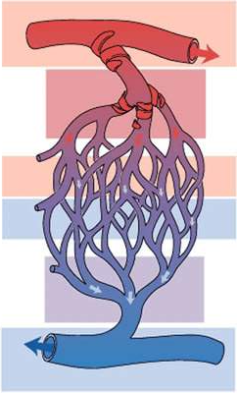
Blood Vessels- Capillaries
Oxygen rich blood travels from the heart, through arteries.
In the capillaries, Oxygen is transferred to the tissues.
Waste from the tissue cells is then transferred into the blood.
Non-Oxygenated blood returns to the heart to collect oxygen
again.

Slide 20
Blood and Blood Vessels

Slide 21
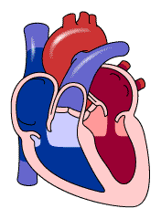
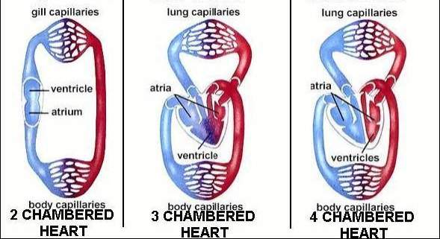
The Heart
This is the muscle involved in pumping blood
What are the parts of the heart?
Ventricle Chamber(s)
Atrium Chamber(s)
Valves

Slide 22
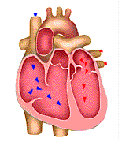
Heart
LA
Ventricle Chamber(s)- the chamber(s) that pump the blood out of the heart, to the lungs or body
Atrium Chamber(s)- the chamber(s) that pump the blood into the ventricle chamber(s)
Valves- Moving flaps between each chamber that keep the blood flowing in one direction; prevents backwards flow
RA
LV
RV

Slide 23
The Chambers of a Heart
2 Chamber hearts have 1 atrium and 1 ventricle
3 chamber hearts have divided atriums, giving them 2 atriums and 1 ventricle
4 chamber hearts have divided atriums and ventricles, giving them 2 atriums and 2 ventricles
V

Slide 24
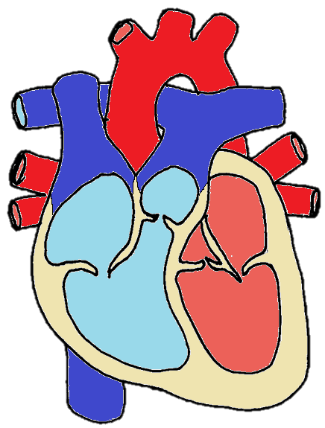
Lets Focus on 4 Chamber Hearts!
Aorta
Parts to Know:
4 Chambers
4 Valves
5 Blood Vessels
3 Major Veins
2 Major Arteries
Pulmonary Artery



Right Atrium
Left Atrium

Mitral Valve
Pulmonary Valve

Left Ventricle
Pulmonary Veins
Superior Vena Cava
Right Ventricle
Aortic Valve
Tricuspid Valve
Inferior Vena Cava

Slide 25
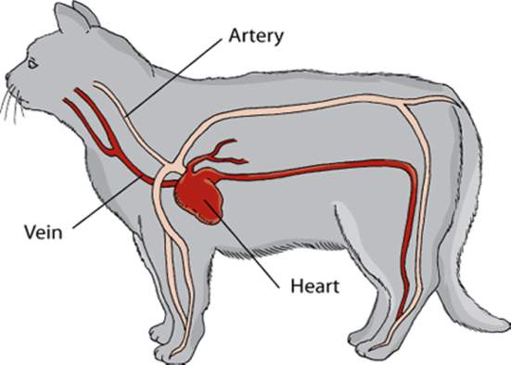
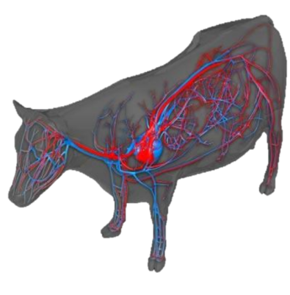
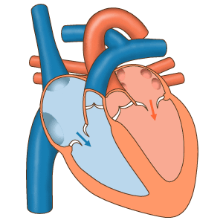
4 Chamber Hearts
Feline Circulatory System
Bovine Circulatory System
Notes:
Cats and cattle are both mammals, they have double loop circulatory systems with 4 chamber hearts

Slide 26
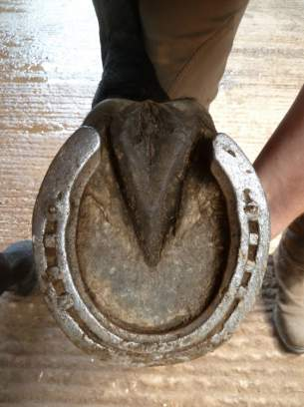
Did You Know?!
What Animal has what is known as the “second heart”?!
THE HORSE!
The frog is an important part of the horse's circulatory system—it pumps blood up the horse's leg each time the horse takes a step.
The blood flows down the horse's leg, the horse's weight then compresses the frog on the ground, pushing the blood back up the horse's legs.

Slide 27
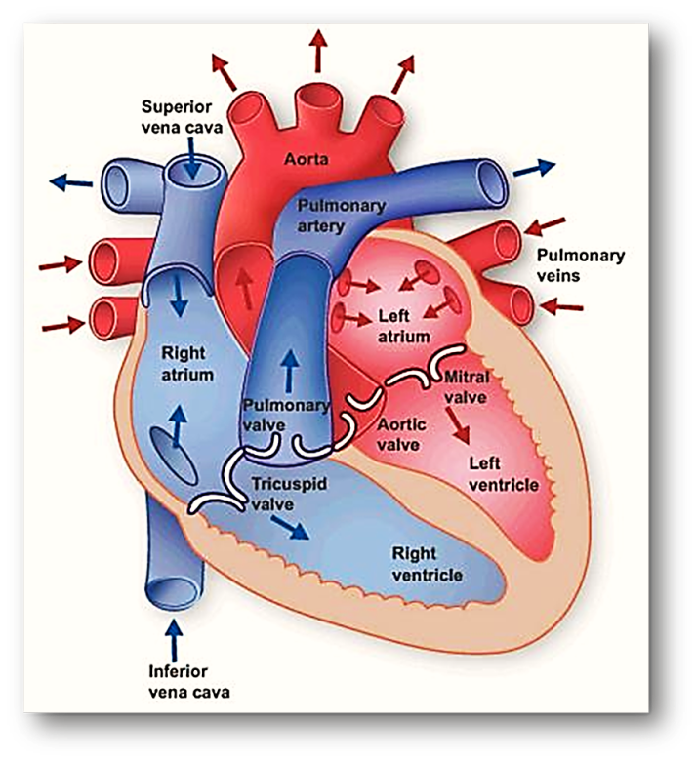
Notes:
Notice how the blood moves through the right atrium and right ventricle first. This blood then goes to the lungs and collects oxygen before returning to the heart. The blood next moves through the left atrium and left ventricle.

Slide 28
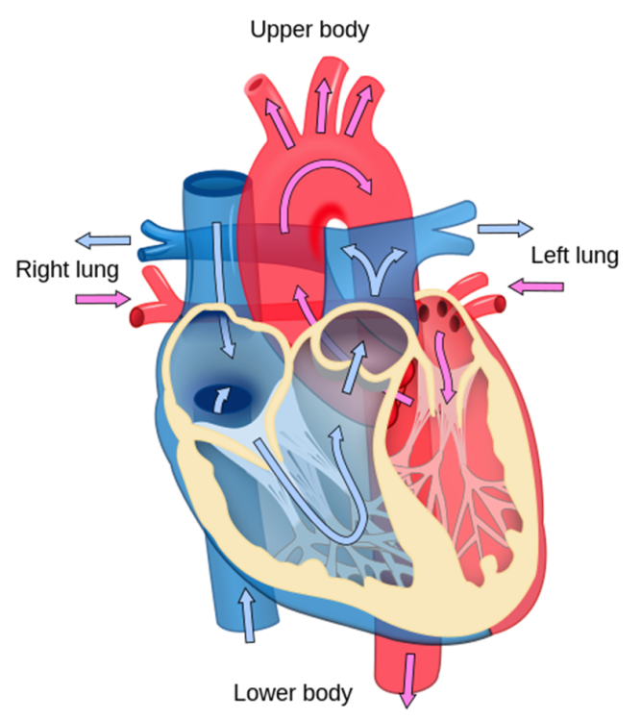
Notes:
Notice how the heart pumps blood to and from all parts of the body.

