Slide 1
Beef EPDs

Slide 2
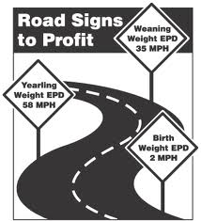
What are EPDs?
Expected Progeny Difference
Predict differences in performance between future offspring of individuals of the same breed when each is mated to animals of the same average genetic merit
The purpose is to compare the genetic merit of an animal as a parent

Slide 3
Traits used for EPD
Birth weight (BW)
Weaning weight (WW)
Yearling weight (YW)
Milking ability (MA)
Total maternal traits
Carcass cutability
Carcass quality
Gestation length
Scrotal circumference
Pelvic area (PA)
*The traits in bold are the most commonly referenced traits with regard to beef cattle.*

Slide 4
Selecting Cattle with EPDs
It is important to understand and use EPDs when they are provided.
However, EPDs should be combined with visual appraisal to improve decision making accuracy.

Slide 5
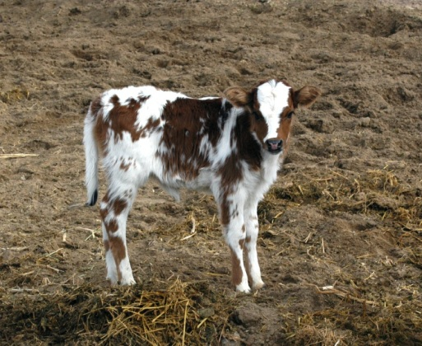
Birth Weight (BW)
Major contributing factor associated with calving difficulties
The higher the BW, the greater chance of calving difficulty

Slide 6
Birth Weight Scenario
If these bulls were to be mated to first calf heifers, which bull would you chose to breed to the heifers?
Bull C
He has the lowest BW; meaning his calves will average 5 pounds lighter than bull B’s & 10 pounds lighter than bull A’s
Bull | Birth Weight EPD
A | +5.0
B | 0
C | -5.0

Slide 7
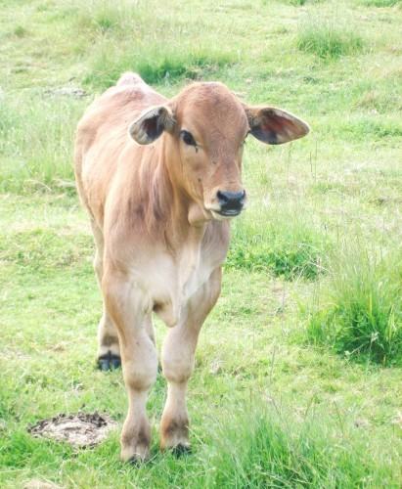
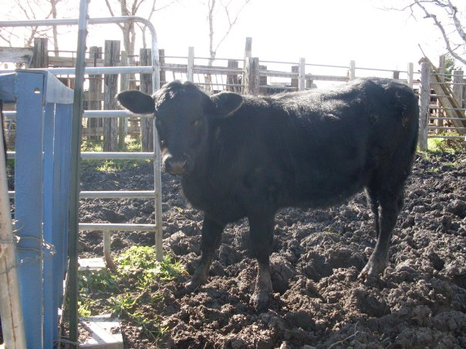
Weaning(WW) & Yearling Weight (YW)
Commonly referred to as growth data
Important because cattle are sold by weight
A positive growth rate means a profitable investment
WW and YW have positive economic impact on selection

Slide 8
WW and YW Scenario
Which bull is most desirable if offspring are sold at WW?
Bull A
His offspring average 6 lbs heavier than bull B
Which is most desirable if they are marked as finished cattle?
Bull A
He has the highest YW
Bull | Weaning Weight EPD | Yearling Weight EPD
A | +12.0 | +23.0
B | +6.0 | +10.0
C | -8.0 | -4.0

Slide 9
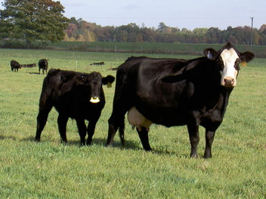
Milking Ability (MA)
Measuring the additional pounds of weaning weight from daughters due to genes for milking ability.

Slide 10
Milking Ability Scenario
Bull | Milking Ability EPD
A | +8.0
B | -2.0
The difference in MA EPD is 10 lbs
This does not mean daughters from bull A produce 10 lbs more milk, but that bull A daughters would wean calves that are on average 10 lbs heavier than bull B

Slide 11
Milking Ability Scenario
Bull | Milking Ability EPD
A | +8.0
B | -2.0
Which bull has a more desirable MA EPD?
It depends on the scenario. If higher milking ability is desired, bull A would be chosen. If the scenario says forage is low quality then bull B would be chosen because the daughters of bull A would need higher quality grasses to reach expected values.

Slide 12
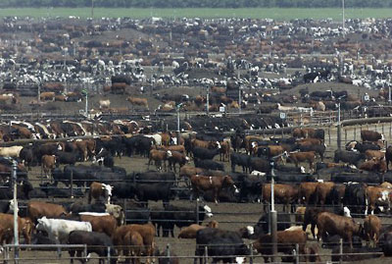
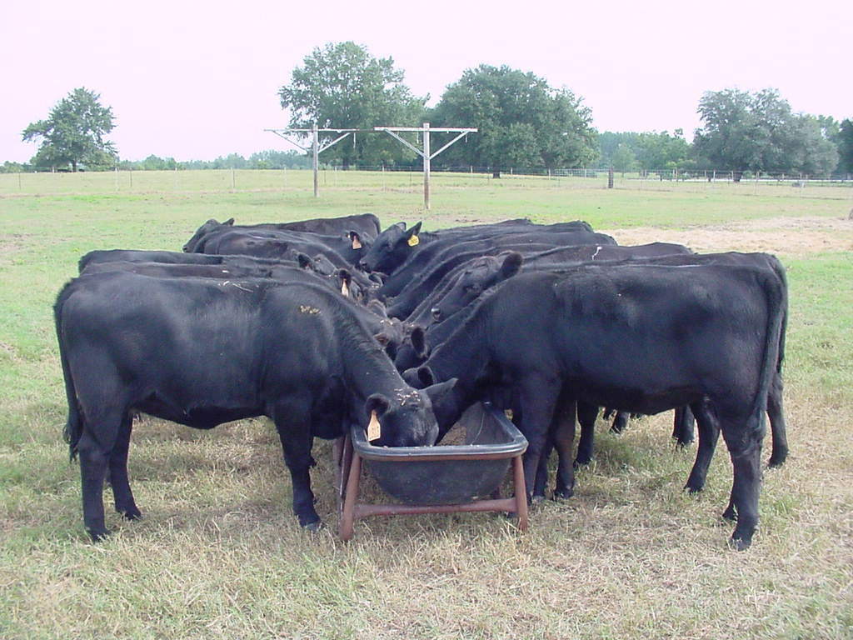
Selection Scenario
This is the situation or environment that cattle are going to be placed into upon completion of the selection process.
ALWAYS READ THE SCENARIO OR SITUATION FIRST!
It determines what traits to emphasize when evaluating the EPDs.

Slide 13
Example Statements
The ranch labor is limited
This means no one is there to pull calves, so you should select a low birth weight.
All offspring are sold at weaning.
This indicates that the weaning weight should be emphasized heavily
The producer is retaining ownership through the feedlot.
This indicates that the producer won’t sell the calves until they are fed in the feedlot and go to harvest. Yearling weight is the most important.

Slide 14
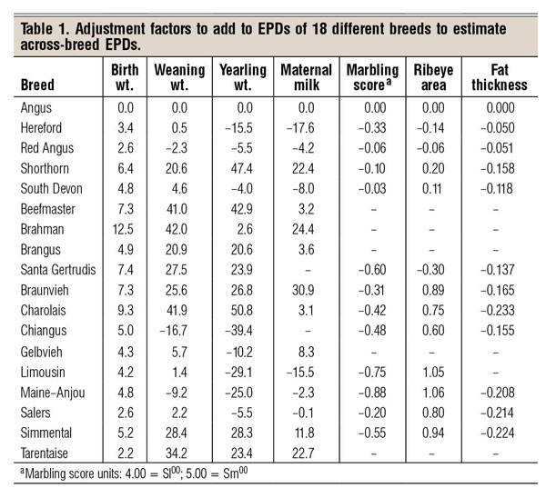
Other Important Information
Each beef breed has different breed averages for all EPDs.
EPDs should prepare you to understand genetic performance profiles.

Slide 15
References
http://www.cals.ncsu.edu/an_sci/extension/animal/4hyouth/Livestock%20Judging/usingepd.html

