Slide 1
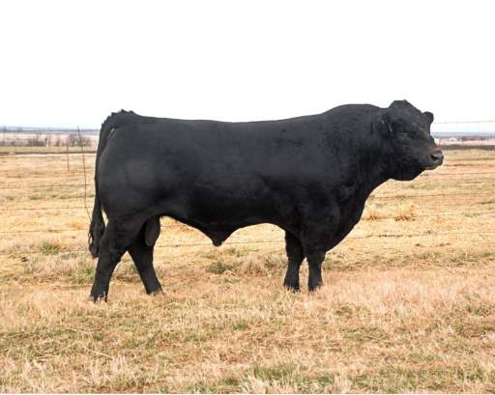
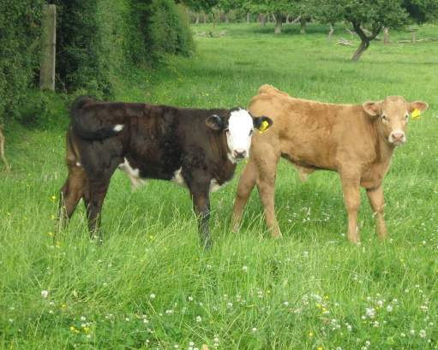
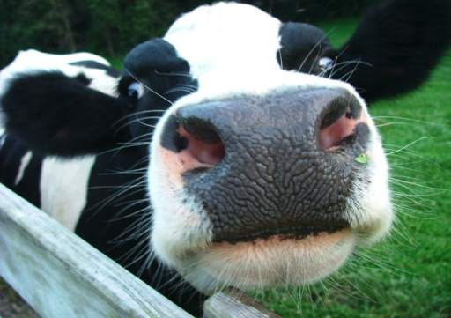
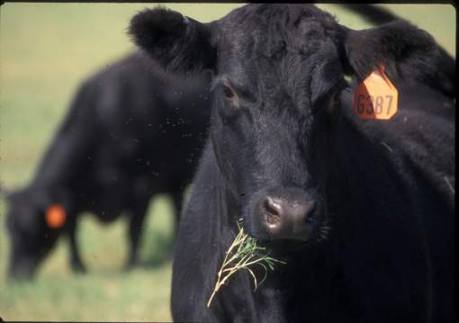

Slide 2
Objectives
Key Terms
Cattle Terminology
Breeds
Management Practices and Facilities
Feeding Heifers and Steers
Animal Behavior
Animal Growth and Development
Animal Health
Evaluation

Slide 3
Key terms

Slide 4
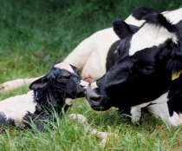
Parturition
The action or process of giving birth to offspring.
Holstein

Slide 5
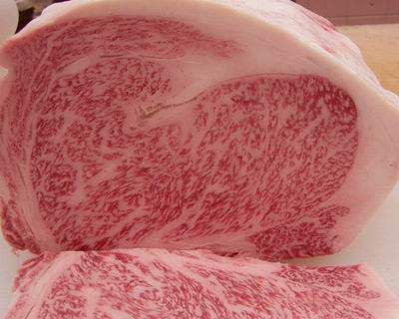
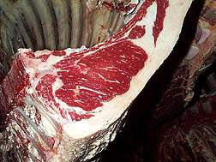
Finishing
Usually refers to the final feeding stage when the animals are fed high concentrations of grain to add fat (marbling) to the meat.

Slide 6
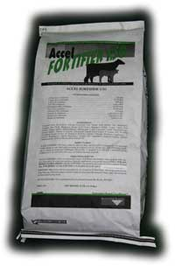
TMR
Total Mixed Ration
Most show feeders use this.

Slide 7
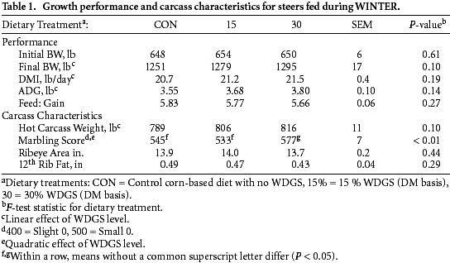
AGD
Average Daily Gain

Slide 8
Cattle Terminology

Slide 9
Bull
Sexually mature male
Angus

Slide 10
Cow
A female that has produced a calf
Red Angus

Slide 11
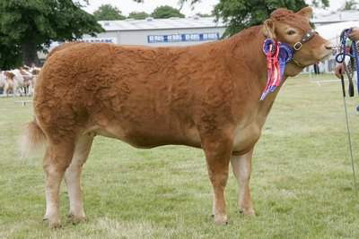
Heifer
A female that has not produced a calf
Limousin

Slide 12
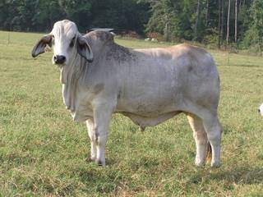
Steer
Castrated male
Brahman

Slide 13
Calf
A young animal (less than a year old) of either sex

Slide 14
Breeds

Slide 15
Dairy Cattle

Slide 16
Ayrshire
Originated in Scotland
Medium sized breed
Medium to dark red and white in color
Average lactation 305 days of 14,534 lbs. milk

Slide 17
Brown Swiss
Originated in Switzerland
Large docile breed
Hair is brown of various shades
Average lactation 305 days of 16,135 lbs. of milk

Slide 18
Guernsey
Originated on the Isle of Guernsey
Medium size breed know for gentle nature
Various shades of fawn with white markings and a white switch
Average lactation 305 days of 13, 109

Slide 19
Holstein
Originated in the Netherlands
Dominant breed of dairy cattle
Black and white color pattern (red and white exist)
Average lactation 305 days of 20,121 lbs. of milk

Slide 20
Jersey
Originated on the Isle of Jersey
A small, refined animal of unsurpassed femininity
Vary from light tan to dark fawn with darker shading around the head and lower legs
Average milk yield of 13,358

Slide 21
Beef Breeds

Slide 22
British

Slide 23
Angus
Originated in Scotland
Black, naturally polled
Largest number of annual registrations in the United States

Slide 24
Hereford
Originated in England
Red and white, also white on underline, legs, switch etc.
Found in all 50 states

Slide 25
Polled Hereford
Developed in the United States
Red with white face, also white on underline, legs, switch, etc.
Naturally hornless

Slide 26
Red Angus
Developed in the United States
Red and naturally polled
Developed from a recessive gene found in black Angus cattle

Slide 27
Shorthorn
Originated in England
Three main colors: red, white and roan
Used for milk and meat

Slide 28
Continental Breeds

Slide 29
Chianina
Originated in Italy
White hair coat with black pigmentations
One of the world’s oldest breeds
Extremely large framed

Slide 30
Charolais
Originated in France
White, off-white to cream coloration
Produce lean, muscular carcasses
Below average maternally

Slide 31
Gelbvieh
Originated in Germany
Reddish gold to russet colored hair
Resulted from government controlled breeding program (W. Germany)
Dual purpose breed

Slide 32
Limousin
Originated in France
Reddish gold in color, can also be black
Fastest growing breed in country (percentage increase in registrations)

Slide 33
Maine Anjou
Originated in France
Deep red in color with white underline and patches, can also be black
Largest continental breed in terms of weight

Slide 34
Simmental
Originated in Switzerland
Range in color from straw colored through light red and dark red, also black
Heaviest milking continental breed

Slide 35
Texas Longhorn
Developed in Texas, of Spanish origin
Long, distinctive horns, many colors including speckled and spotted

Slide 36
Bos Indicus

Slide 37
Brahman
Originated in India
Red and grey strands
Noted for heat tolerance, disease and insect resistance and crossing ability

Slide 38
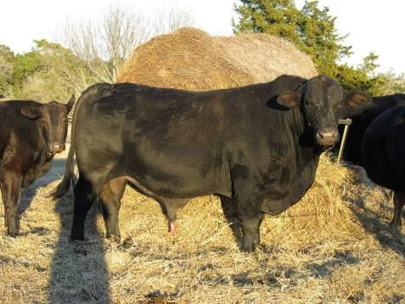
Brangus
Developed in the United States
5/8 Angus and 3/8 Brahman, black and naturally polled

Slide 39
Simbrah
Developed in the United States
5/8 Simmental and 3/8 Brahman

Slide 40
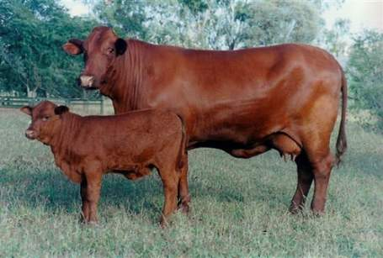
Santa Gertrudis
Developed in the United States
5/8 Shorthorn and 3/8 Brahman
Dark red, both horned and polled

Slide 41
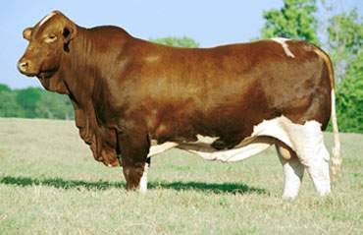
Beefmaster
Developed in the United States
About 50% Brahman, 25% Shorthorn and 25% Hereford
No set color pattern

Slide 42
Management Practices

Slide 43
Methods of Identification
Combination of tattoo and ear tag
Hot or Fire branding
Freeze branding
Electronic ear tags

Slide 44
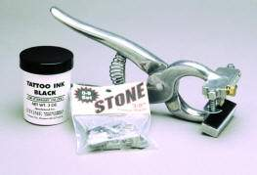
Tattoo and Ear Tag
Tattoo is permanent set of digits placed in the ear by using ink
Ear tags are placed on the outside of the ear
Tattoo’s are better than ear tags because they are on the animal permanently.

Slide 45
Hot or Fire branding
Branding the hide with hot irons
One of the oldest and most permanent methods of Identification!
Branding is usually the best method because it can never fade away!

Slide 46
Freeze Branding
Branding cattle with super chilled irons
Hair is discolored on branded spot due to the extreme cold.
Great on black cattle

Slide 47
Electronic Ear tags
Very new and very expensive
Allows animal or carcass to be traced back to place of origin

Slide 48
Why Castrate?
Steers are more docile in temperament
Steers produce a carcass with finer texture of lean and more marbling
Steers will usually finish in a little less time (fatten quicker)
Steers can be mixed with females
Castration eliminates the possibility of genetically inferior bulls breeding cows

Slide 49
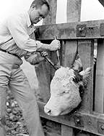
Why Dehorn?
Losses from horn bruises are eliminated at slaughter time or in marketing
Reduces injury to men and horses when working cattle
Cattle without horns sell for higher prices
Less shed and feeding space required
Look more uniform in groups

Slide 50
Facilities

Slide 51
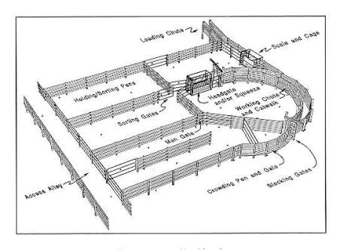
Size of Facility
Provide 75 square feet of shelter for each calf
If feed and water troughs are outside then 45 square feet is fine
Usually a 100 x 200 foot lot is big enough for two calves

Slide 52
Additional Specifications
Clean and dry with good drainage.
Area should be free of rocks, junk and exposed nails or sharp edges
Clean bedding
Adequate ventilation
Electricity
Clean feeding area and feed storage area
Access to catch pen and head chute
Fence of wood planks, metal, cable or woven wire preferable to barbed wire

Slide 53
Feeding Heifers and Steers
The following slides are just suggestions, always consult with your veterinarian or extension agent for specific feeding instructions

Slide 54
What type of feed do They need?
There is no “wonder” feed or other product that is going to guarantee your animal to win.
Every calf requires the same nutritional components – protein, energy, minerals, vitamins, and water– whether that animal costs $1,000 or $10,000.00.
You have to determine what works the best for you, your management style and the type of animal(s) you are feeding.

Slide 55
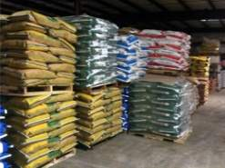
How much should be fed?
One of the most important aspects of feeding animals is determining the amount to feed.
Growing cattle should consume 2 1/2 - 3% of body weight.
Feed needs to be weighed for optimal nutrition.

Slide 56
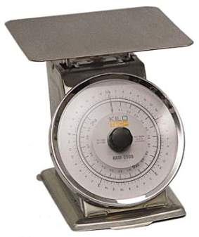
Weigh a coffee can full of corn and a coffee can full of oats.
Is their weight the same?

Slide 57
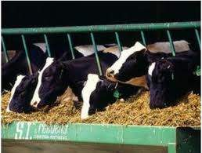
How often should they be fed?
The total amount of daily feed should be divided into at least 2 meals.
Feed as close to 12 hours apart as possible.
It is also important to feed at the same time everyday.

Slide 58
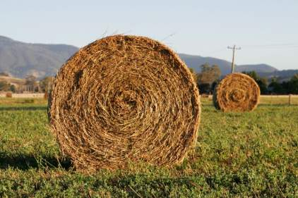
How much roughage do they need?
Feed at least 4-5 pounds of hay daily.
Feeding high quality alfalfa may cause gastric distress. A good quality grass hay will be a better choice or blend 2 pounds of alfalfa with 2 to 3 pounds of grass hay.

Slide 59
Can I feed heifers and steers the same feed?
Heifers require the same nutrients as steers except that growth is desired as opposed to fattening.
A like feed could be used for the entire program fed at about 2 percent of body weight.
Most producers feed grower products to heifers to minimize on the amount of fat they gain.

Slide 60
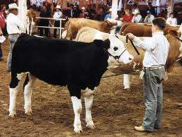
Is feeding different at shows?
You should not feed and water your animals immediately upon arrival at the show but rather allow then time to rest. This is particularly true of hauls longer than 1-2 hours.

Slide 61
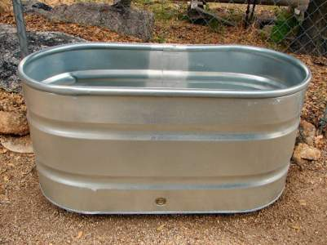
Water
Clean, fresh water should be available at all times.
Dry feed intake is closely associated with how much water an animal consumes.
Water sources should be cleaned at least weekly.

Slide 62
Animal Behavior

Slide 63
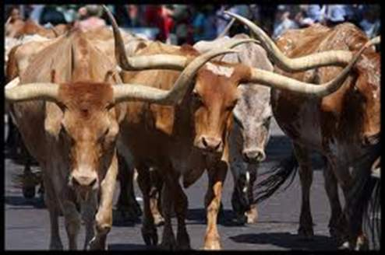
Types of behavior
Allelomimetic behavior – herd behavior, when animals do the same thing at the same time
Allelomimetic behavior is the primary type of behavior exhibited by beef cattle
This type of behavior is useful to producers because the entire herd often eats and travels as a unit

Slide 64
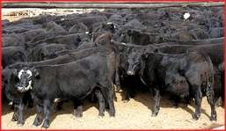
Herd behavior
Major part of how cattle minimize adverse weather conditions.
In cold they crowd together to block wind, in rain and heat they go together to find shelter.

Slide 65
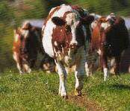
Dominance
There tends to be one dominant animal in a herd.
The dominant animal eats and drinks first and leads the rest of the herd.
Submissive animals will avoid dominant ones.

Slide 66
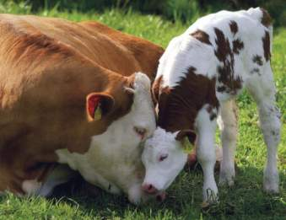
Care giving behavior
Evident shortly after parturition
There is an instant recognition between a mother and her offspring. Care soliciting behaviors occur when the calf requests the mother's attention.
Young animals vocalize if disturbed, distressed, or hungry.

Slide 67
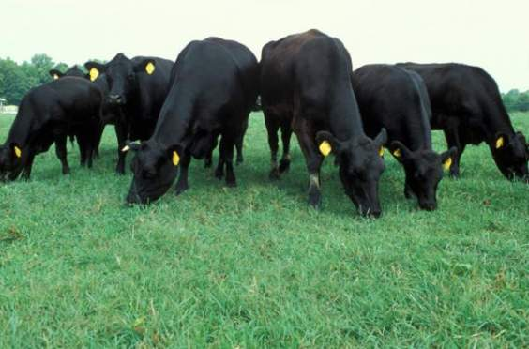
Ingestive Behavior
Cattle are herbivores and are strictly grazing animals
They typically graze four to nine hours per day

Slide 68
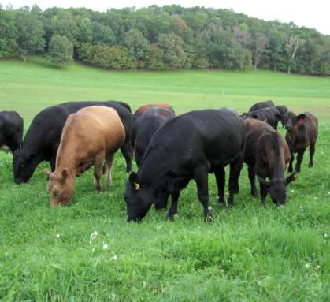
crepuscular
A crepuscular animal is most active at sunrise and sunset
Cattle graze primarily in the early morning and just before nightfall

Slide 69
Animal Growth and Development

Slide 70
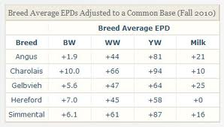
Measures of Growth
Birth weight
Weaning weight
Yearling weight
Feedlot ADG
Mature weight

Slide 71
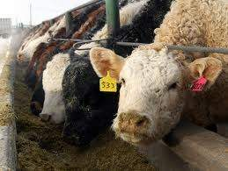
Efficiency of Growth
In animal production efficiency is defined as units of feed per unit of gain.
Feed conversion values for cattle are typically 7:1 which means 7 pounds of feed equals one pound of weight gain.

Slide 72
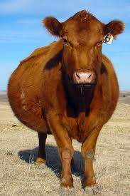
Puberty and Gestation period
Bulls and heifers each reach puberty at about 10 months.
Gestation length is 283 days

Slide 73
Breed Influences
An important parameter of growth rate, reproductive efficiency, maternal ability, and end-product specifications.
British breeds are generally smaller in mature size, reach mature size at an earlier age, have less growth potential, and excel in fertility and calving ease.
Continental breeds are generally larger in mature size, later maturing, and have more calving difficulty

Slide 74
Animal Health

Slide 75
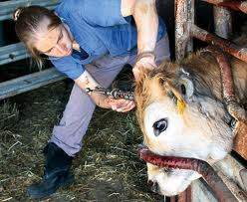
Animal health
Involves proper management and husbandry as well as veterinary care.

Slide 76
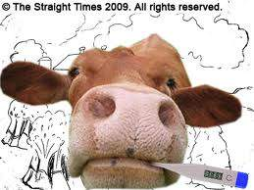
Describing Diseases
Clinical- observable and diagnosable symptoms
Subclinical- the stage in the course of a disease before the symptoms are first noted
Acute- arising suddenly and manifesting intense severity
Chronic- continuing a long time or recurring frequently
Zoonotic- can be spread from animals to people

Slide 77
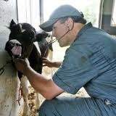
What’s Normal?
Temperature- 101.5°F
Heart Rate- 48-84 beats/minute
Respiratory rate- 26-50 breaths/minute

Slide 78
Tuberculosis
chronic, debilitating disease of cattle caused by the bacterium Mycobacterium bovis.
primarily a respiratory disease affecting lungs and chest lymph nodes
Symptoms can include progressive weight loss, chronic cough, and unexplained death losses.

Slide 79
Brucellosis or “Bangs” disease
a contagious disease of cattle and other ruminant animals that can also affect humans.
can cause decreased milk production, weight loss, loss of young, infertility, and lameness.

Slide 80
Trichomoniasis
a venereal disease transmitted to cows through breeding.
Cows may abort early in the pregnancy and become temporarily infertile

Slide 81
Evaluation of Cattle

Slide 82
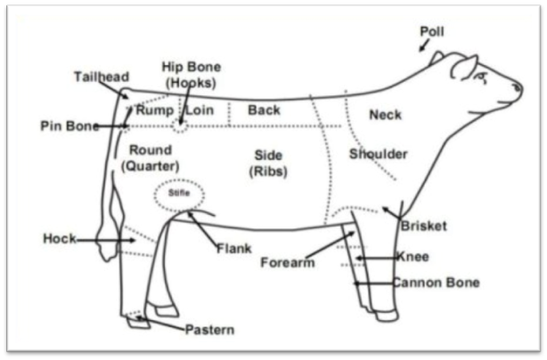
Areas to Evaluate
Muscle- forearm, shoulder, back, loin, stifle, quarter
Fat Cover- brisket, shoulder, rear flank, 12th rib, cod/udder, pones

Slide 83
Soundness
It is important to choose an animal that is very sound, which means it has ease when moving around.
Look for long, deep-bodied, long fronted, well-balanced steers with level, muscular tops.
High-quality calves walk easily and stand wide when viewed from behind. Look for well balanced steers that are attractive from a side view.

Slide 84
Frame size
taller, larger-framed animals tend to finish at heavier weights—sometimes too heavy to fall into the preferred weight range of 1100 to 1350 pounds when ideally finished.
short, small-framed steers may be ideally finished at less than 1100 pounds. To avoid either extreme, you should select calves of “average” frame size for their age.

Slide 85
References
http://beef.osu.edu/library/show.html
http://animalscience.tamu.edu/images/pdf/beef/beef-feeds-and-feeding.pdf
http://www.cattletoday.com/archive/2004/September/CT351.shtml
http://animalscience.tamu.edu/ansc/beef/ANSC406/SEpps.pdf
http://pubs.ext.vt.edu/400/400-803/400-803.html
http://downloads.cas.psu.edu/4h/4HMarketSteer.pdf

