Slide 1
Dairy Cattle Jeopardy!
A product of the Partnership for Environmental Education and Rural Health at
College of Veterinary Medicine & Biomedical Sciences, Texas A&M University
Funding support from the National Center for Research Resources, National Institutes of Health

Slide 2
What am I?
Got milk?
What’s wrong?
Milking Parlors
Miscellaneous
10
10
10
10
10
20
20
20
20
20
30
30
30
30
30
40
40
40
40
40
50
50
50
50
50

Slide 3
What am I? questions follow

Slide 4
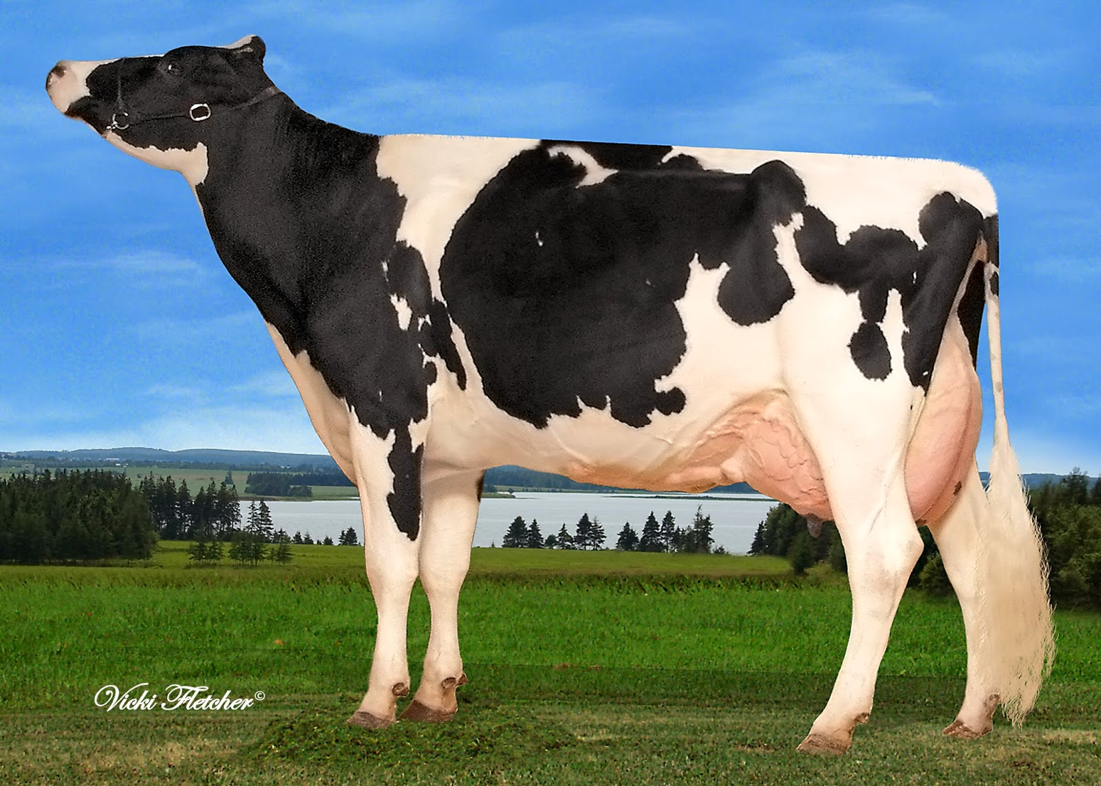
Category 1
What’s black and white and milked all over?
Holstein!
10

Slide 5
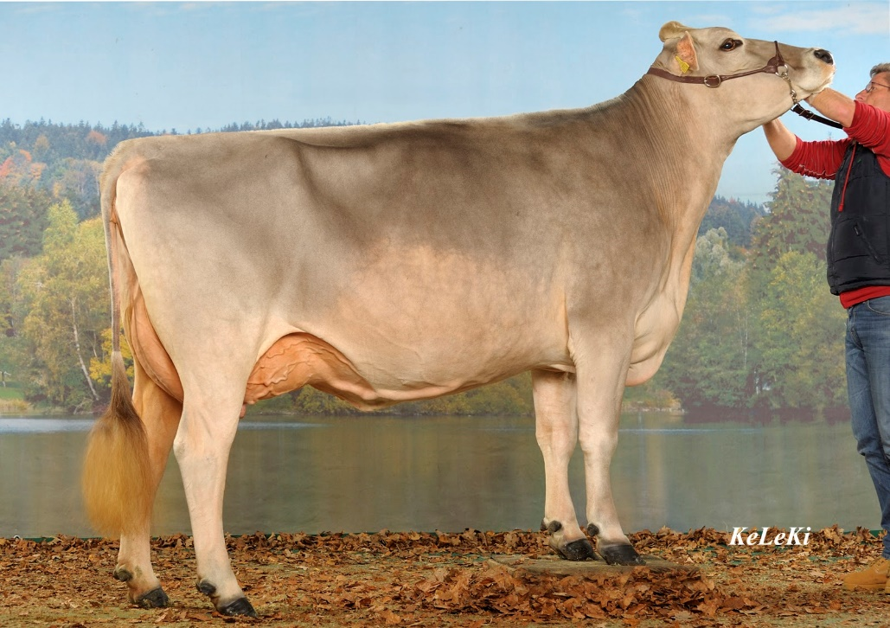
Category 1
1. What breed am I?
2. From what country did I originate? (10pts each)
Brown Swiss
Switzerland
20

Slide 6
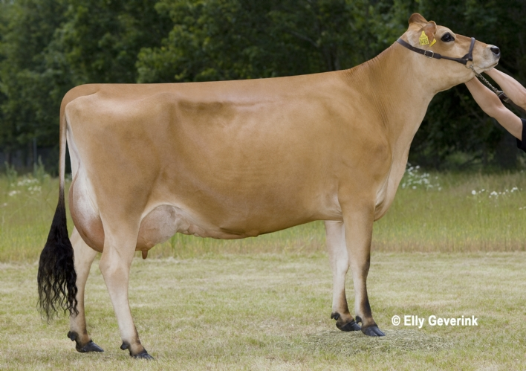
Category 1
1. What breed am I?
2. What am I known for (15pts each!)
Jersey
Feminine characteristics or high butterfat content in milk
30

Slide 7
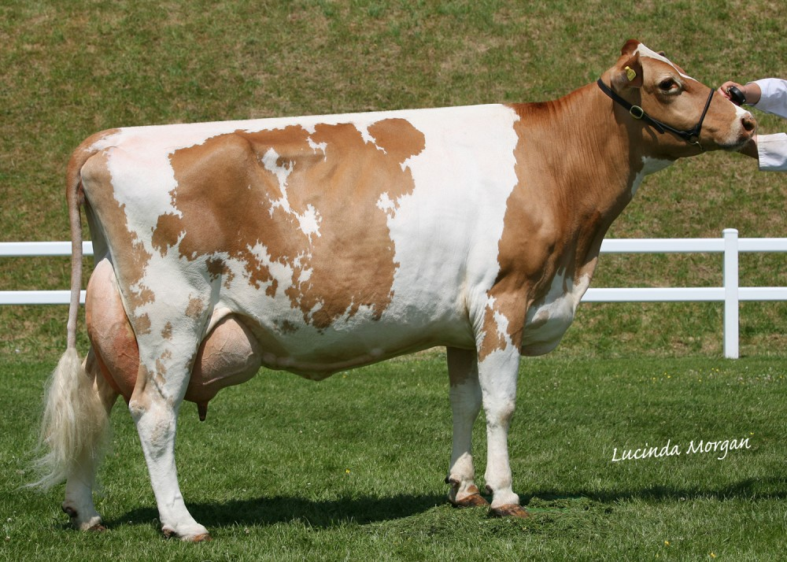
Category 1
1. What breed am I?
2. What am I known for? (20pts each)
Guernsey
Golden milk
40

Slide 8
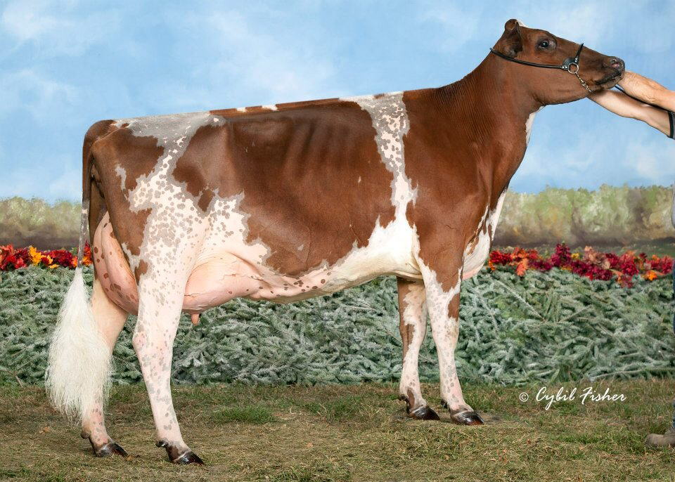
Category 1
What am I known for?
Excellent grazing
50

Slide 9
Got milk? questions follow

Slide 10
Category 2
What initiates the milk ejection process?
Either a calf suckling or wiping the teat when milking
10

Slide 11
Category 2
What part of the brain receives the neural message from the spinal cord in the milk ejection process?
The hypothalamus
20

Slide 12
Category 2
What hormone is released by the pituitary gland?
Oxytocin
30
Notes:
Root hairs is also acceptable.

Slide 13
Category 2
What are alveoli?
They are sacs in the mammary tissue that hold milk before it is ejected
40

Slide 14
Category 2
What is oxytocin’s target tissue in the mammary system and what does it do?
Alveoli, it makes them contract and eject milk!
50

Slide 15
What’s wrong? questions follow

Slide 16
Category 3
The number one cause of economic loss in the dairy industry is…
Mastitis
10

Slide 17
Category 3
What is a likely cause of a cow loosing weight after she has had a baby?
Lactating! It takes a lot of energy
20

Slide 18
Category 3
Cows with this have a hard time standing, usually have a fast heartbeat, and can go into a coma
Milk fever (Hypocalcaemia)
30

Slide 19
Category 3
What are three symptoms of Ketosis?
Weight loss, reduced milk yield, reduced appetite, dull coat, fever, low blood sugar, smell of acetone in milk/breath, nervousness
40

Slide 20
Category 3
What is mastitis?
Mastitis is inflammation of the udder due to a bacterial infection
50

Slide 21
Milking Parlor questions follow

Slide 22
Category 4
What is one type of milking parlor we discussed?
Parallel, herringbone, or rotary
10

Slide 23
Category 4
Which milking parlor is circular and moves?
Rotary
20

Slide 24
Category 4
Which milking parlor has cows at a 90 degree angle from each other?
Parallel
30

Slide 25
Category 4
Which milking parlor has cows slightly slanted?
Herringbone
40

Slide 26
Category 4
Why do cows teats often drip with milk before being milked?
It is a neural response. She is conditioned and she knows that she is about to be milked.
50

Slide 27
Miscellaneous questions follow

Slide 28
Category 5
What kind of animals produce milk (Hint: we are one of them!)
Mammals
10

Slide 29
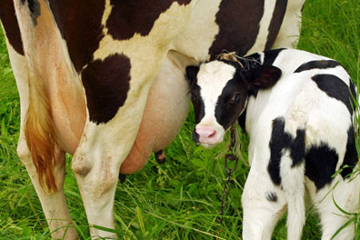
Category 5
How long does a cow produce milk (months)?
10 months
20

Slide 30
Category 5
What is the “dry off” period?
The dry off period is a time where no milk is produced (after stopping lactation and before the next calving)
30

Slide 31
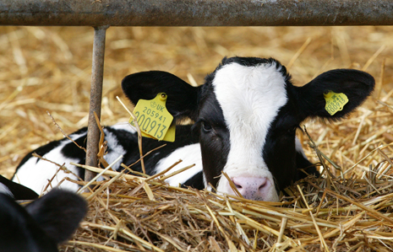
Category 5
How many pounds of milk will an average Holstein cow produce in 305 days?
20,000lbs!
40

Slide 32
Category 5
Describe one LOGICAL reason why we should or should not utilize hormones or antibiotics in the diary industry…
DON’T use emotional reasoning!!!
Varies…
50

