Slide 1
Dairy Cattle: Got milk?
© Partnership for Environmental Education and Rural Health at
College of Veterinary Medicine & Biomedical Sciences, Texas A&M University
Funding support from the National Institutes of Health Office of Research Infrastructure Programs (ORIP)

Slide 2
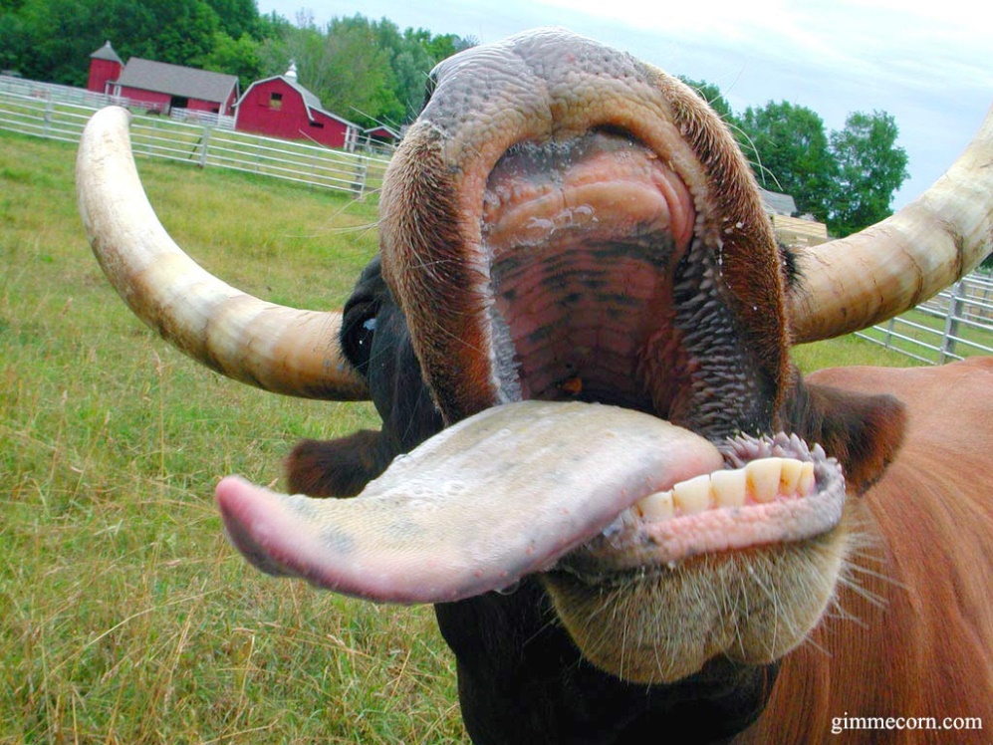
Fun facts about dairy cattle!
There are approximately 9 million dairy cows in the United States
Produce around 21 billion gallons of milk each year (U.S)
One cow produces around 350,000 glasses of milk during her milking career!!!
Cattle don’t have any teeth on the top of their mouth
The toothless skin on the top of their mouth is called a pad
AHHHH!!!
Notes:
http://aipl.arsusda.gov/kc/cowfacts.html
http://www.ansc.purdue.edu/faen/dairy%20facts.html

Slide 3
Breeds of Dairy Cattle

Slide 4
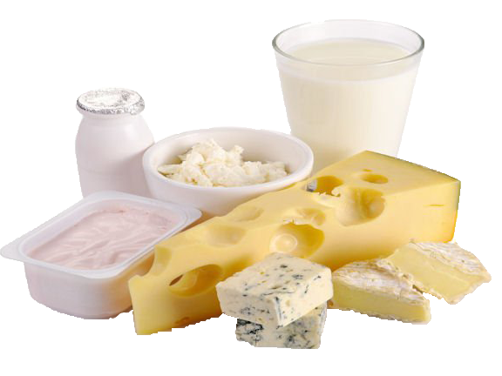
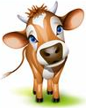
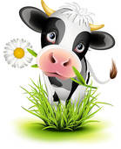
Lets talk about dairy breeds…
There are five major breeds of dairy cattle used in the United States…
Holstein
Jersey
Brown Swiss
Guernsey
Ayrshire
The two most popular breeds in the U.S.
Jersey cows make up about 5.5% of the total U.S. dairy population!
Yeah? Well us Holsteins make up about 93% of the total U.S. dairy population!

Slide 5
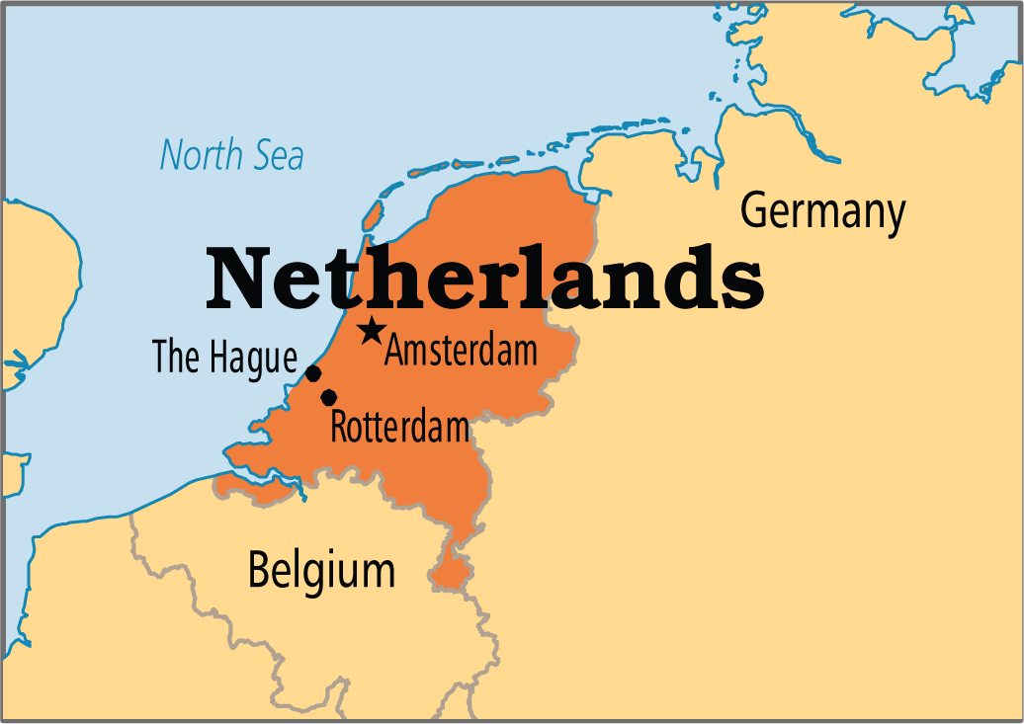
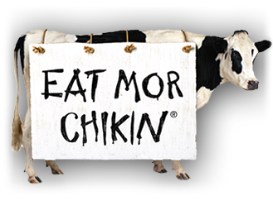
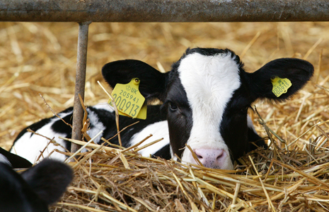
Holstein (Netherlands)
Holsteins are the black and white cows that you typically think of
Like the chick-fil-a cow!
Spotted with a unique pattern (like a thumbprint!)
Most popular milking cow
Known for volume of milk produced
approx. 20,000lbs in 305 days
Notes:
Holsteins produce more gallons of milk on average than any other breed of cattle!

Slide 6
Holstein (Netherlands)

Slide 7
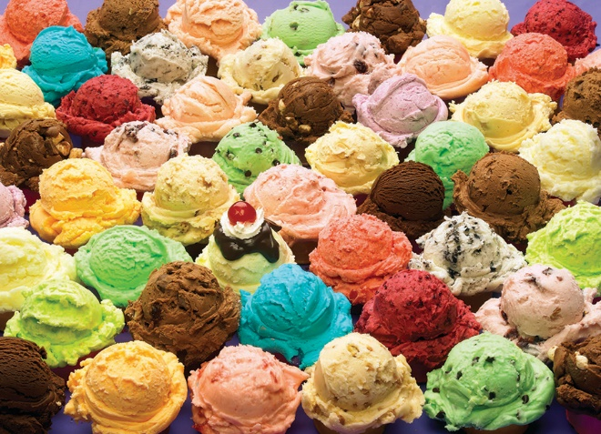
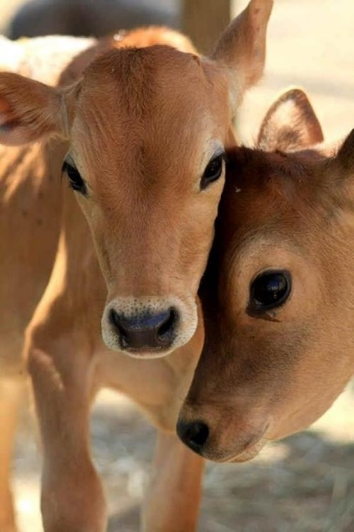
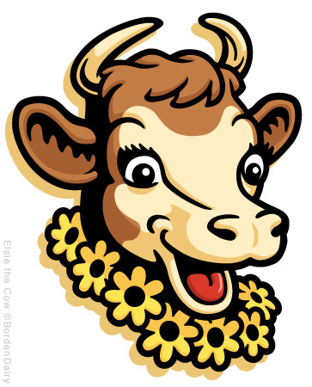
Jersey (Isle of Jersey - England)
Jersey cows are brown (light tan to dark fawn) with darker points around the head and legs
Like Borden’s Elsie!
Adapted for a warmer climate (popular in the south)
Smaller frame and feminine features (ex. big eyes)
Known for producing high butterfat content in milk (approx. 5%)
Butterfat is desirable for flavor
My high butterfat helps your ice cream taste good!

Slide 8
Jersey (Isle of Jersey)

Slide 9
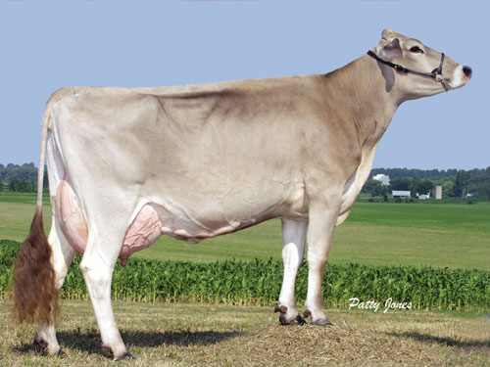
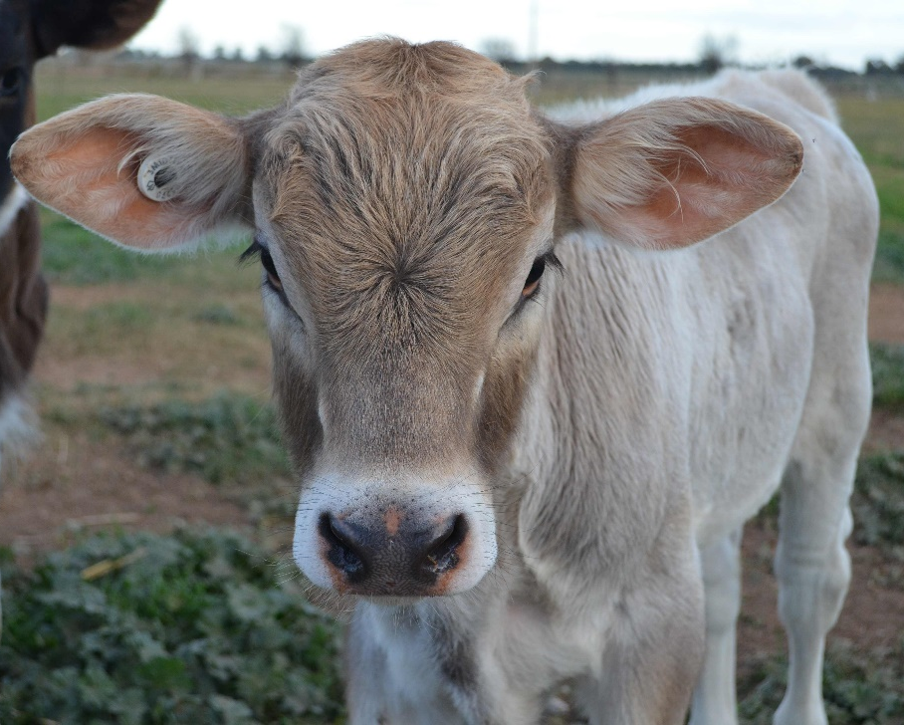
Brown Swiss (Switzerland)
Brown Swiss cows have a brown coat of various shades, often with a silvery tone (don’t have dark points like Jersey)
Large frame
Average volume produced
Approx. 16,000lbs in 305 days
Known for longevity
Long life expectancy
Strong legs and hooves

Slide 10
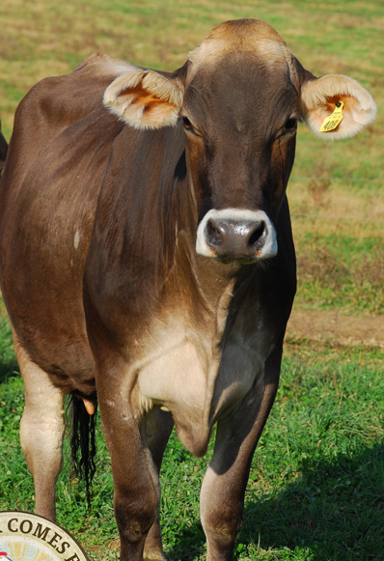
Brown Swiss (Switzerland)

Slide 11
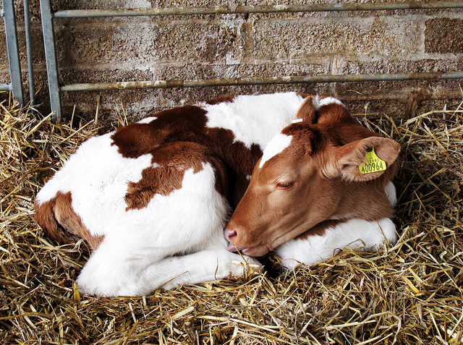
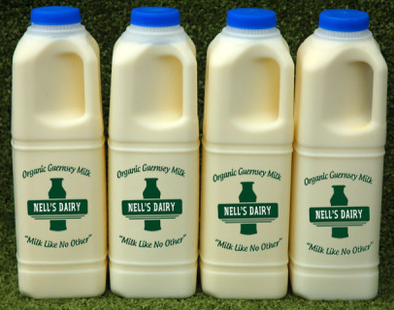
Guernsey (Isle of Guernsey – England)
Guernsey are various shades of fawn and have white markings with a white switch (lighter than Ayrshire)
Medium frame
Second highest butterfat percentage
Average lactation
Approx. 13,000lbs in 305 days
Known for golden colored milk
Notes:
The golden color is due to high beta-carotene concentrations (like carrots!)

Slide 12
Guernsey (Isle of Guernsey – England)

Slide 13
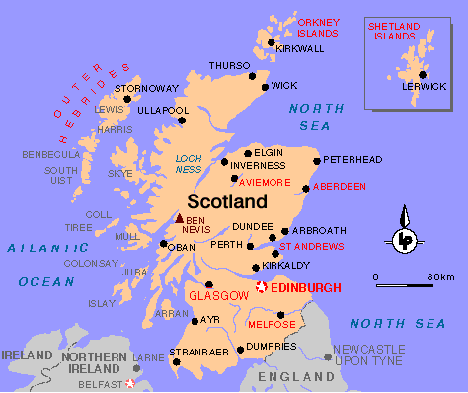
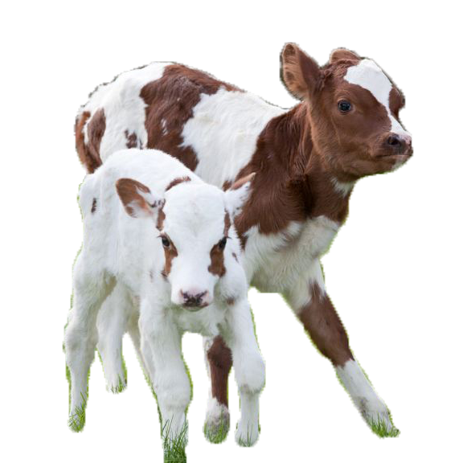
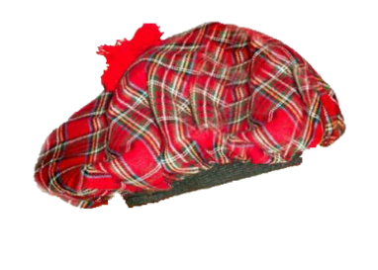
Ayrshire (Scotland)
Medium/dark red and white (darker than Guernsey)
Medium sized breed
Average lactation
Approx. 14,500lbs in 305 days
Known for being excellent grazers
Can be used on pasture dairy’s

Slide 14
Ayrshire (Scotland)

Slide 15
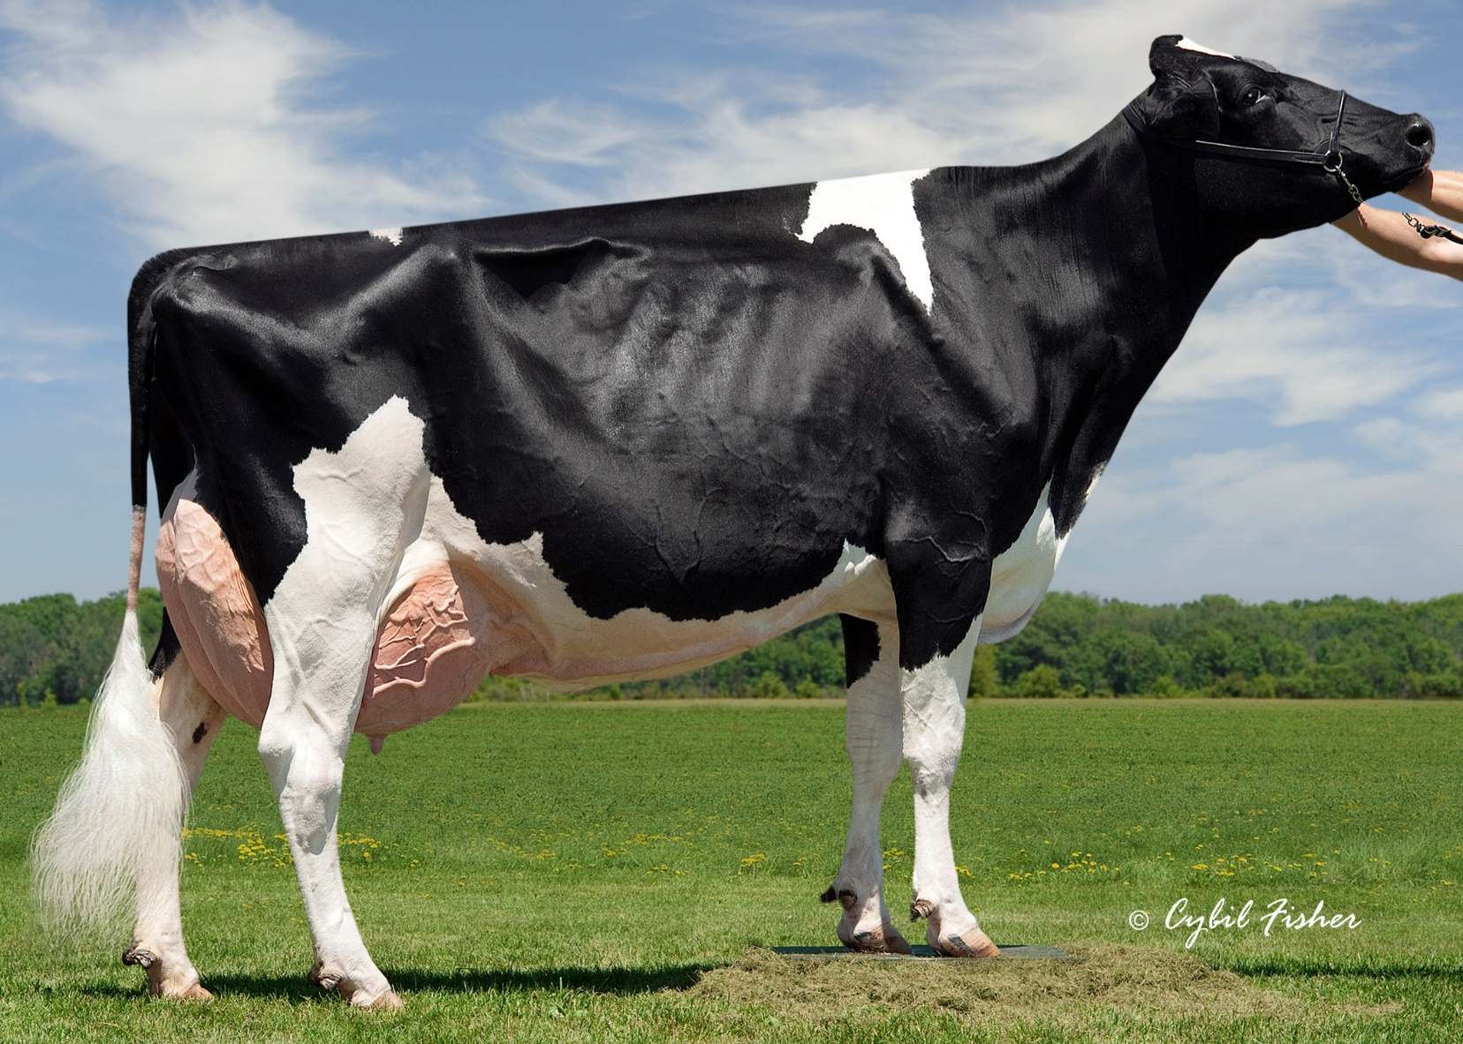
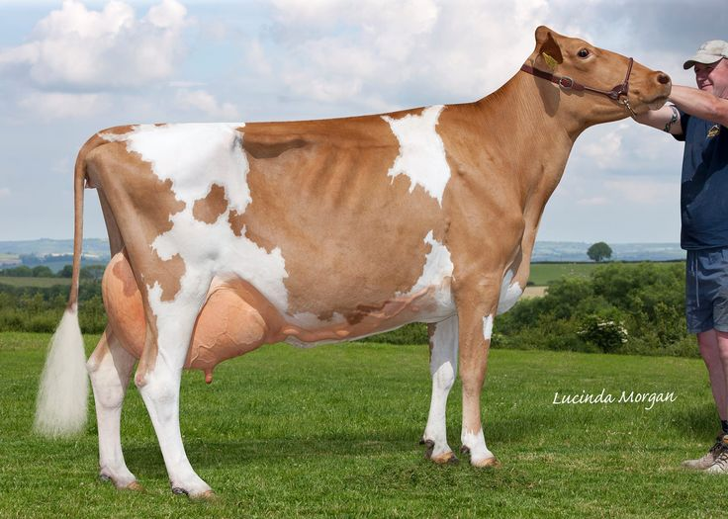
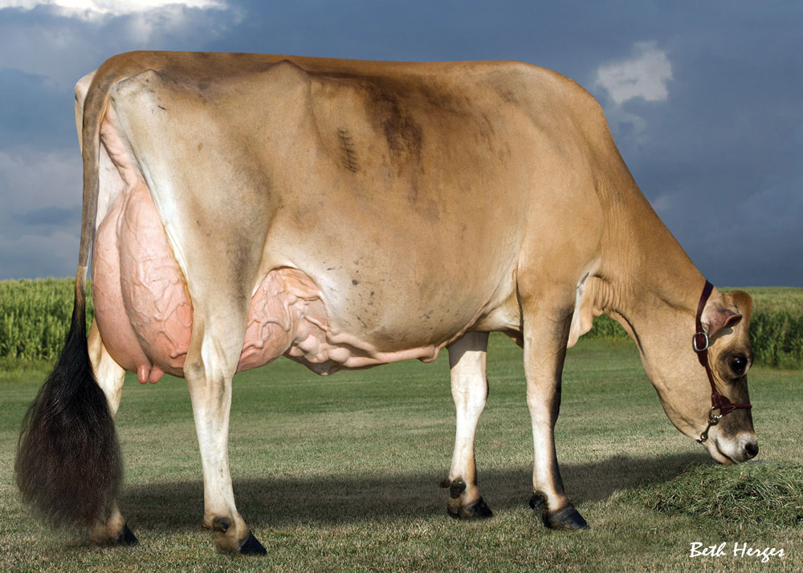
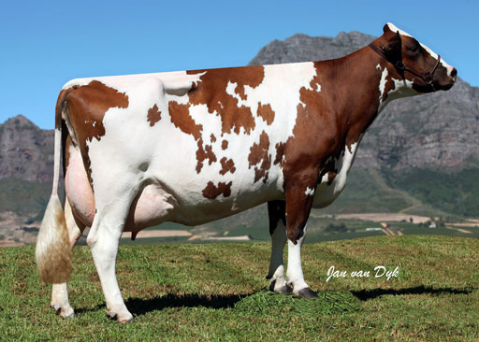
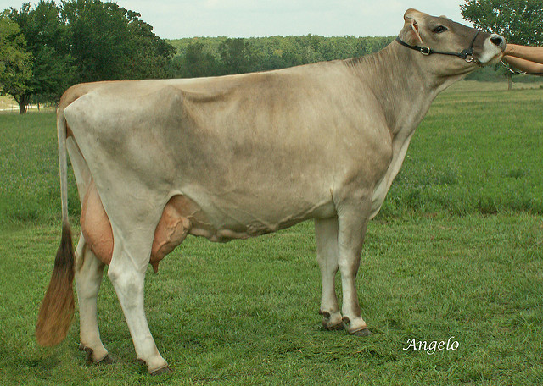
Lets review…
What breeds are these cows?
Notes:
Ayrshire
Holstein
Jersey
Guernsey
Brown Swiss

Slide 16
How do we get milk from the cow to our milk glass?

Slide 17
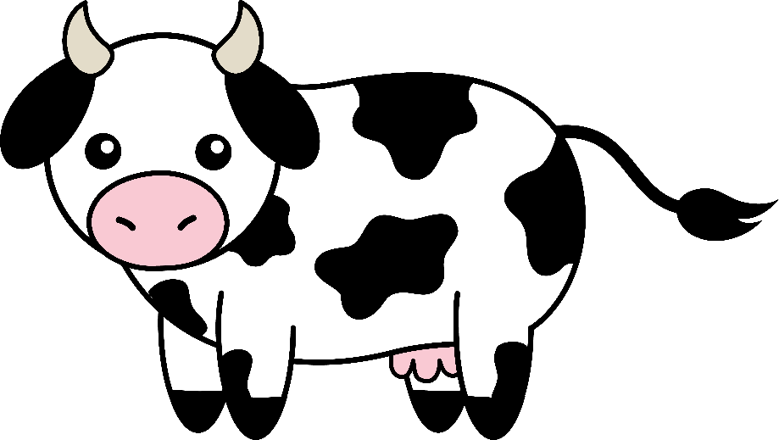
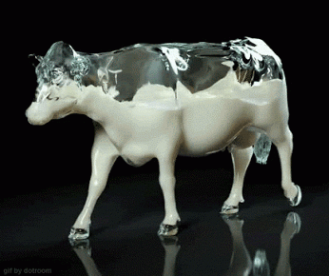
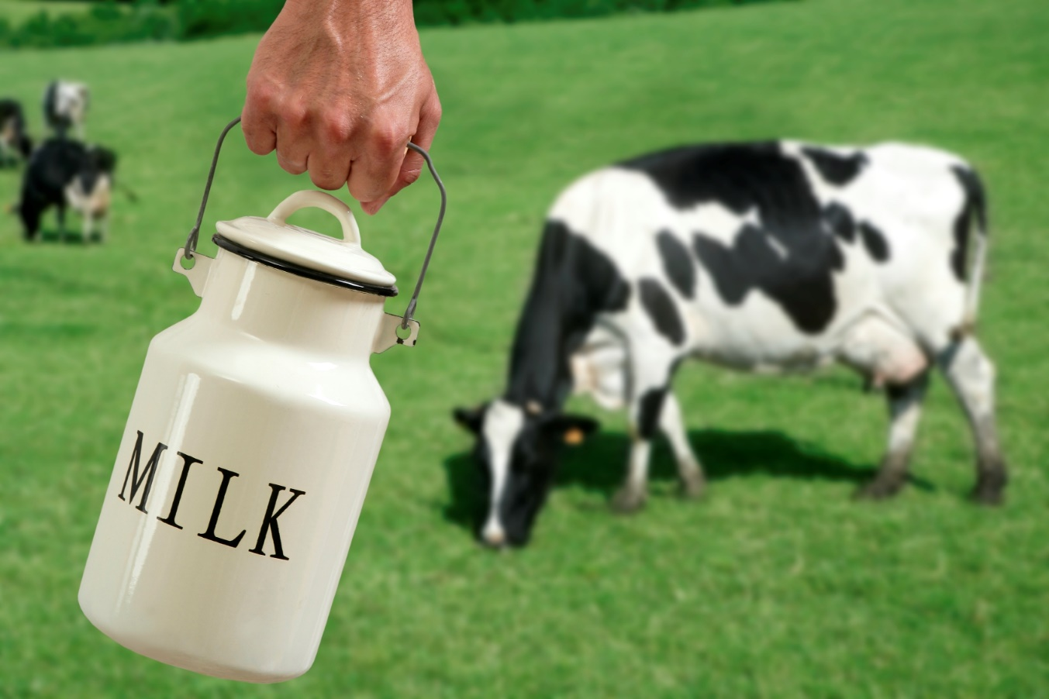
Lets think for a second…
Do both male and female dairy cattle get milked?
Do cows always produce milk?
If no: What stimulates milk production and how long is milk produced?
If yes: Why do they always produce milk?

Slide 18
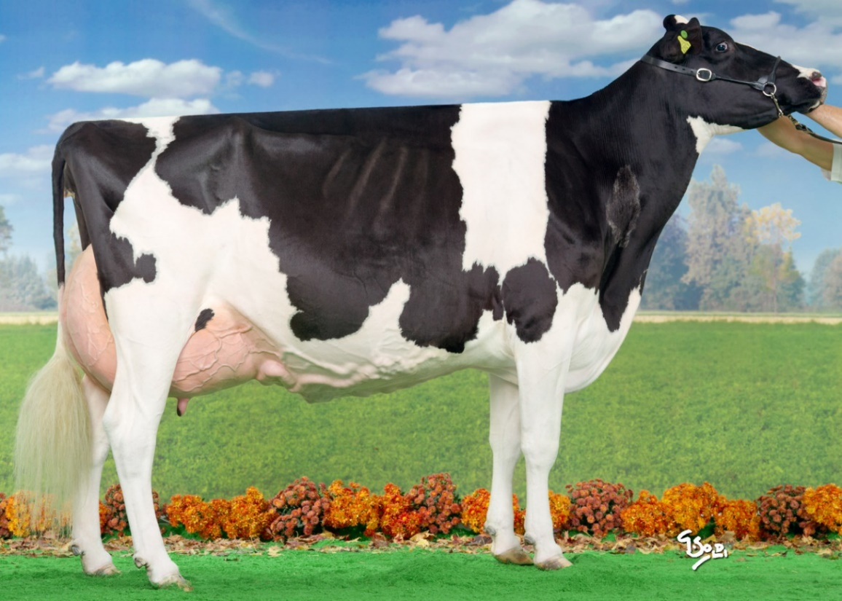
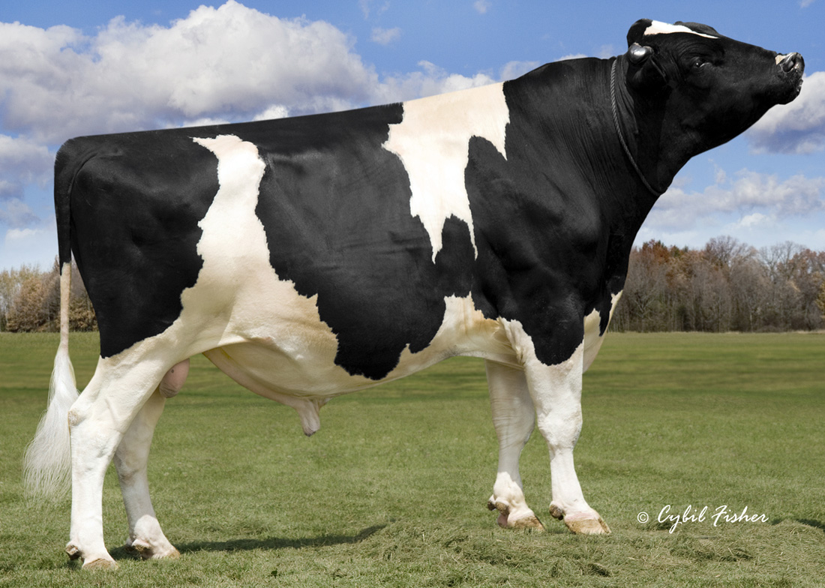
Do both male and female dairy cattle get milked?
Cow: female
Bull: unaltered male
No! Only the female cows are milked
So... Females are much more valuable to dairy’s than males! (in large numbers)
A bulls main purpose in the dairy industry is for reproduction
Cow
Bull
Udder!!
No Udder!!
Notes:
Sperm sexting is a method that producers can utilize that separates the male and female sperm. This would be very beneficial for dairy’s because they have a much higher demand for cows than they do bulls. This method has ~ 90% success rate.

Slide 19
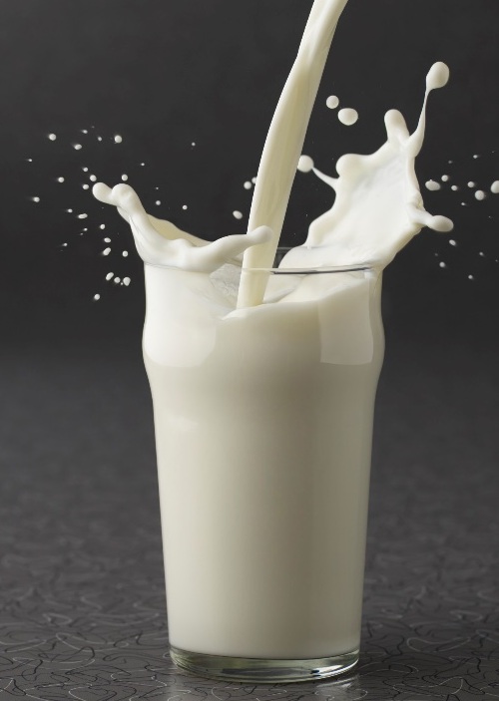
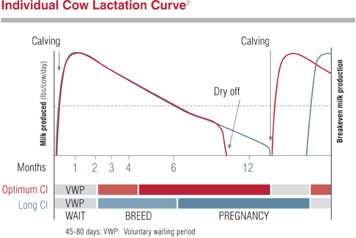
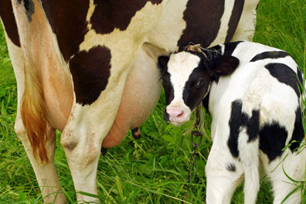
Do cows always produce milk?
No! Cows produce milk for the same reason other mammals do, because they had a baby!
Cows will produce milk for about 10 months after calving
The highest production of milk is during the first 2 months after calving
Dry off = no milk
Notes:
Between the dry off and calving period, no milk is produced by the cow
The red line indicates milk production.

Slide 20
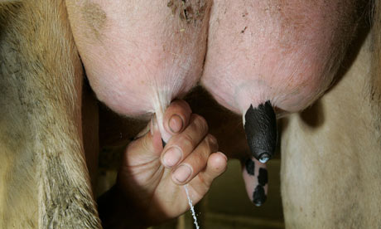
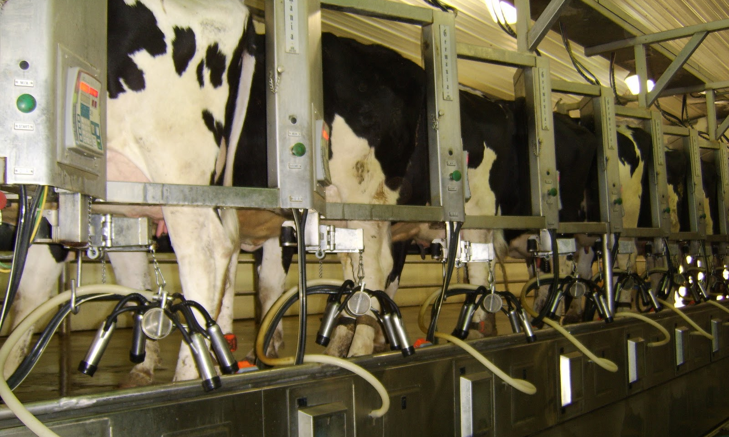
Popular milking parlors:
There are three major kinds of milking parlors used:
Parallel
Herringbone
Rotary
Milking parlor: an area of the dairy where the cows are milked
DID YOU KNOW…
some cows teats drip with milk before they are even milked? Certain stimuli can cause the neural response in the cow to prepare for milking.
(We will discuss this more later!)
Think about your favorite food… now imagine eating it! Do you feel more saliva in your mouth? This is a conditioned response, just like the dairy cows premature milk let down!

Slide 21
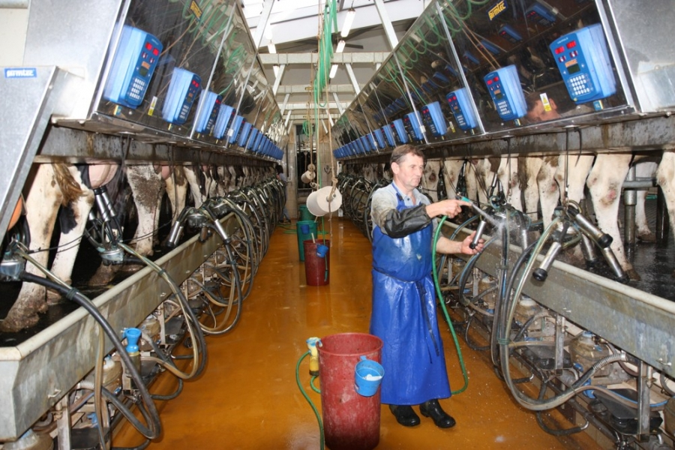
Parallel Parlor
Two rows of cows line a central isle, with the hindquarters facing the isle. The cows are completely parallel to each other, with a 90 degree angle to the isle, similar to this kind of parking lot.
COWS
ISLE
COWS

Slide 22
Parallel Parlor
Notes:
https://www.youtube.com/watch?v=1Y3zuXvwXvc
This video also covers how to milk a cow and what happens with the calves!

Slide 23
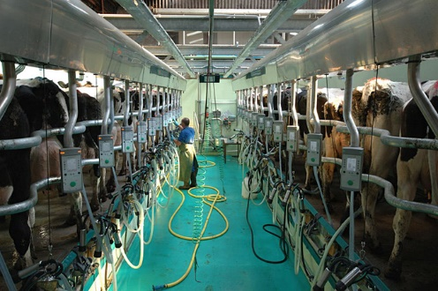
Herringbone Parlor
Similar to the parallel parlor. The cows line up in two rows, with their hindquarters facing a central isle. Their bodies are slanted in the same direction, like the parking lot below.
COWS
ISLE
COWS

Slide 24
Herringbone Parlor
Notes:
https://www.youtube.com/watch?v=eI_Mz6i-NiY

Slide 25
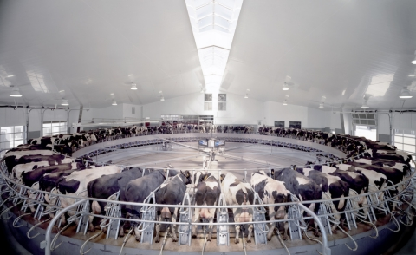
Rotary Parlor
A rotary parlor is a circular parlor that slowly moves, allowing cows to get on and off at appropriate times.

Slide 26
Rotary Parlor
Notes:
https://www.youtube.com/watch?v=GoLfKSKX244

Slide 27
Lets review…
What type of milking parlor has cows on a circular moving device?
Answer: Rotary
What type of milking parlor has two rows of cows slanted slightly on either side of a central isle?
Answer: Herringbone
What type of milking parlor has two rows of cows at a 90 degree angle down a central isle?
Answer: Parallel

Slide 28
The milk ejection process

Slide 29
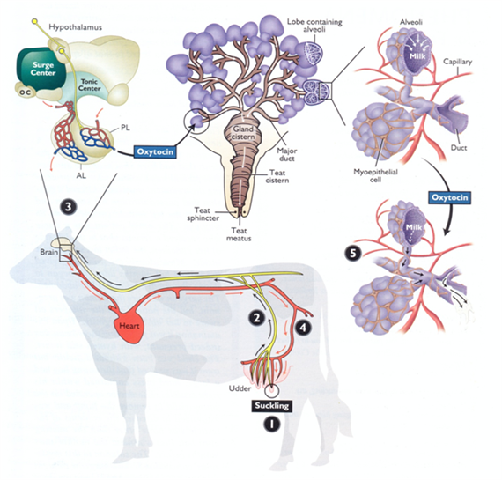
Milk ejection process:
Brain
Calf suckles the teat
Neural response sent through nerves in the spinal cord to the brain (hypothalamus)
The hypothalamus causes a hormone, oxytocin, to be released from the pituitary gland
Oxytocin travels through the bloodstream back to the teat and causes contraction of the alveoli
Milk is ejected
Mammary Tissue
Lets discuss this one step at a time…

Slide 30
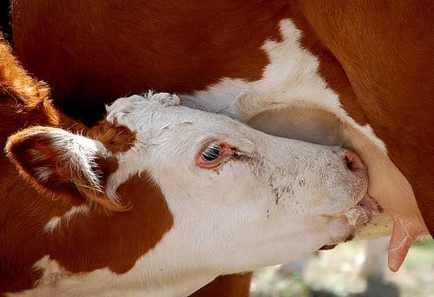
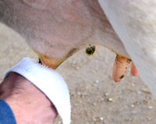
1. Calf suckles the teat
In dairy production, this action is simulated when the workers clean off the pre-dip
This is the initial action that starts the entire process of milk ejection, or milk let down

Slide 31
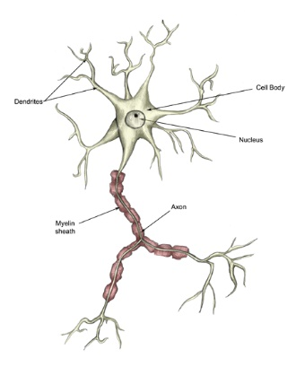
2. Neural Response
Nerves help us transfer stimuli our body receives, either internally or externally
Neural response sent through nerves in the spinal cord to the brain (hypothalamus)
Neuron

Slide 32
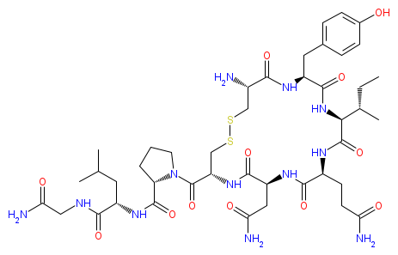
3. The hypothalamus and oxytocin
When the neural response reaches the brain, the hypothalamus causes the hormone oxytocin to be released
Oxytocin: a hormone that is released from the posterior pituitary gland, it causes milk ejection by contracting alveoli
Hormone: a substance that is transported by blood to elicit an effect on a specific (target) tissue
Oxytocin Molecule
What is the target tissue for oxytocin?
Answer: alveoli in mammary tissue

Slide 33
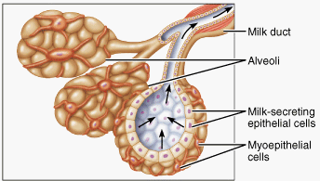
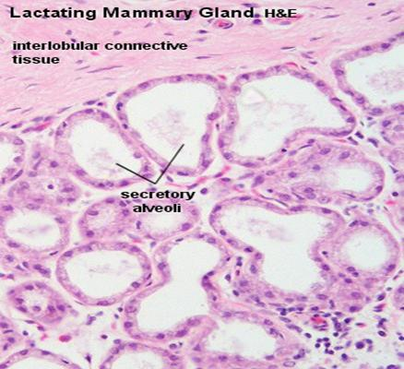
4. Bloodstream and target tissue
Oxytocin travels through the bloodstream back to the mammary tissue and causes contraction of the alveoli
Alveoli: hollow sacs within mammary tissue that hold milk until it is ready to be ejected (alveoli are also in your lungs and allow the exchange between O₂ and CO₂)
Each of these white bubbles are alveoli, they hold the milk!

Slide 34
5. Milk is ejected!

Slide 35
Discuss as a class!
Using the picture to the right, describe the process of milk ejection.
The 5 steps are already labeled.
Name the part of the body that is involved with each step and the hormones (if any) that are used
Notes:
1. The calf suckles the teat on the udder, stimulating a neural response
2. The neural response is transmitted to the spinal cord via nerves
3. The brain (specifically hypothalamus) receives the message and causes the posterior pituitary gland to release oxytocin
4. Oxytocin, a hormone, is transmitted through the bloodstream back to the alveoli (sacs that contain milk) in the mammary tissue
5. Oxytocin contracts the alveoli and milk is ejected!

Slide 36
Common dairy cow health issues

Slide 37
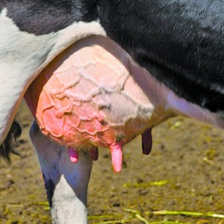
Mastitis
Mastitis: inflammation of the udder due to a bacterial infection
This is one of the reasons why dipping is so important!!!
The number one cause of economic loss in the dairy industry!
Symptoms include: redness, swelling, tenderness, warmth, or discharge of the bag, fever, and depression
Each teat has its own quarter of the udder, so if one part of the udder has mastitis, the other three may not have it!

Slide 38
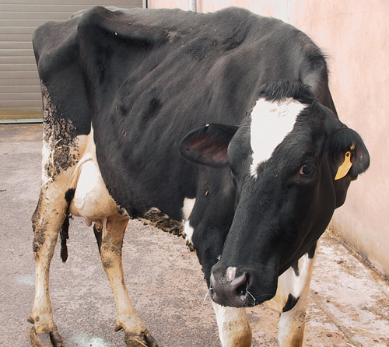
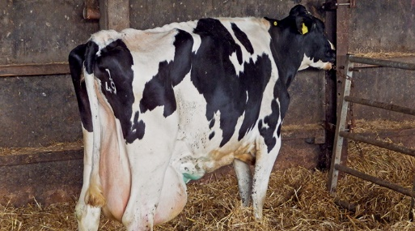
Ketosis
Ketosis: energy shortage due to metabolic problems
Usually seen 4-6 weeks after giving birth (when most of the milk is being produced!)
Symptoms include: weight loss, reduced milk yield, reduced appetite, dull coat, fever, low blood sugar, smell of acetone in breath/milk, nervousness

Slide 39
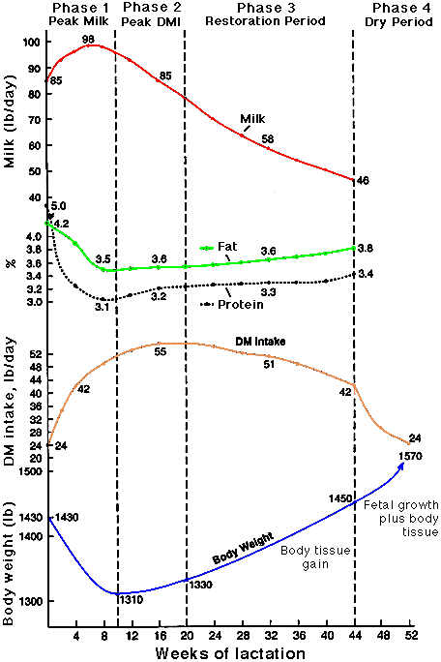
Ketosis continued
Weight loss does not always = Ketosis
Dairy cows commonly loose weight during the first 3 months of lactation because their energy requirements to maintain their weight and lactate outweigh their energy intake.
During lactation, cows are fed a TMR (total mixed ration) which allows the cows to get the maximum amount of nutrients
Dairy cows usually can eat over 100 pounds a day!
Lactating dairy cows usually eat 5X their normal ration!
Even a healthy cow that eats more food during early lactation still looses weight in the first three months (as much as 1.5lbs/day)!
Notes:
http://smallfarms.oregonstate.edu/sites/default/files/feeding_milking_cow.pdf

Slide 40
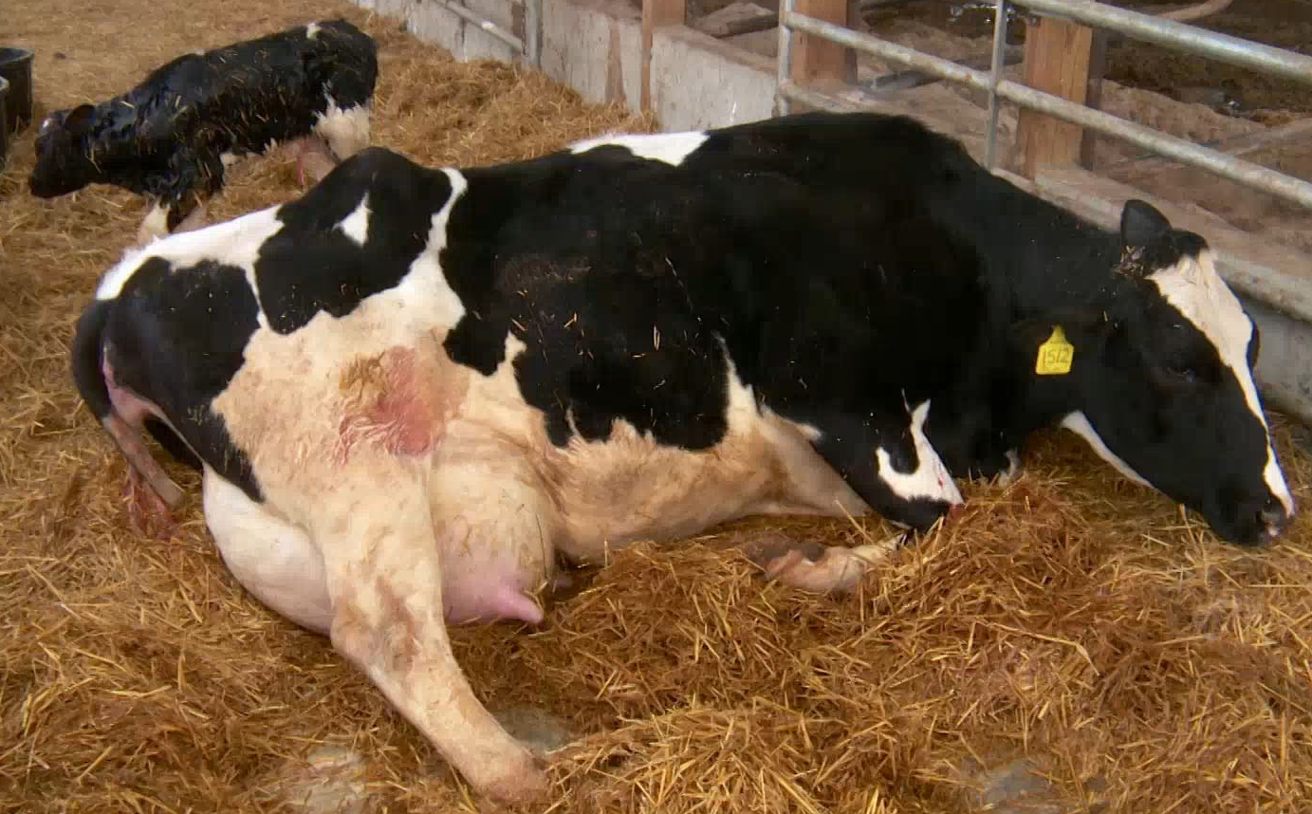
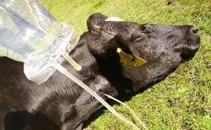
Milk Fever (Hypocalcaemia)
Colostrum: milk produced just after birth that contains antibodies and a high amount of protein
Milk Fever: low blood calcium, causing muscle weakness during or just after calving when calcium is needed to produce colostrum.
Symptoms include: reduced appetite, quivering muscles, constipation, tachycardia (fast heart rate), recumbency (laying down), coma, reduced temperature
Notes:
Colostrum is important for the calf to receive because it helps the calf fight against disease.

Slide 41
A quick review…
Parturition: act of giving birth
Mastitis is the inflammation and infection of the udder
biggest economic loss in the dairy industry
Ketosis is a lack of energy due to metabolic problems
Usually 4-6 weeks after parturition
Milk fever is caused by low blood calcium levels
Often right after a cow has given birth
Can you match the pictures below with its associated health issue?

Slide 42
Genetic Selection in the Dairy Industry

Slide 43
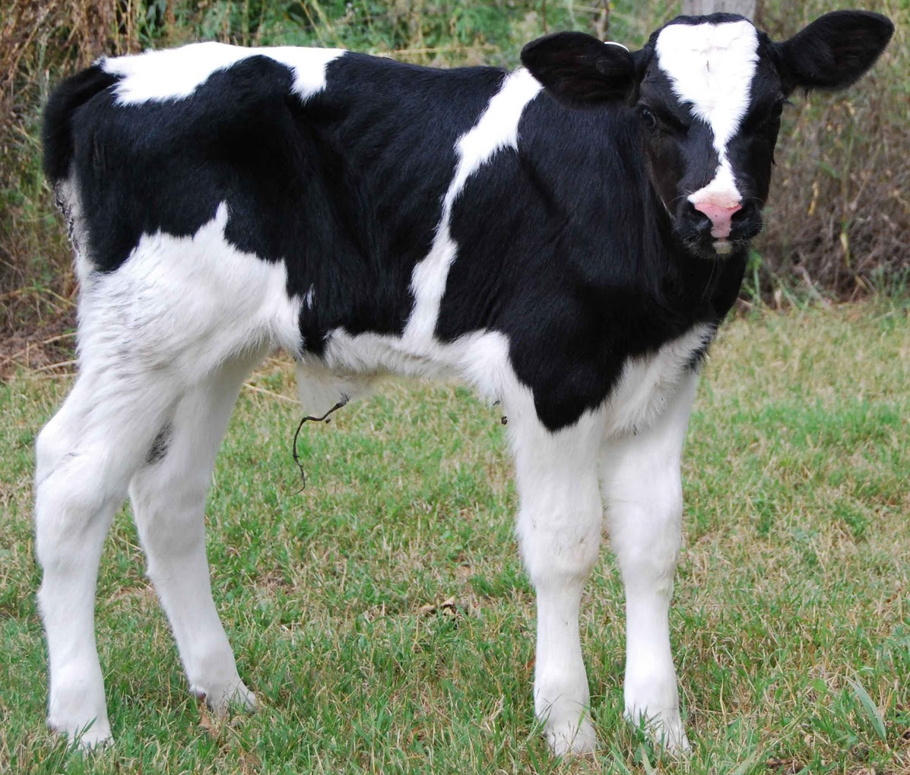
Genetic Selection
THINK… What are some traits dairy farmers would want to select for in their cattle?
Higher milk production
Longevity (produce milk for a longer time period)
Higher fertility rates
More female offspring than males
Sperm sexing: separates the female sperm from the male sperm
Notes:
Higher fertility rates: produces offspring every time she is bred, needs less time to recover between calves,
Sperm sexing is a method that producers can utilize that separates the male and female sperm. This would be very beneficial for dairy’s because they have a much higher demand for cows than they do bulls. This method has ~ 90% success rate.

Slide 44
Sexed Sperm:
Notes:
The sperm cell decides the sex of the fetus. Males have XY chromosomes where females have XX. Each parent gives the fetus one of their chromosomes, so the female must give the fetus an X since that is all that she has. The male dictates the sex of the baby because sperm either carry an X chromosome or a Y chromosome. If a sperm cell with an X chromosome reaches the egg first then the offspring will be a girl (XX). If a sperm cell with a Y chromosome reaches the egg first then the offspring will be a boy (XY).
Sexing sperm allows the sperm cells to be separated by which gender they will produce. This is possible because X chromosomes are heavier than Y chromosomes. This small difference in weight is detected by a machine that then applies a charge to the cells, allowing them to be separated.

Slide 45
Hormone and antibiotic use in the dairy industry

Slide 46
Hormones used in the dairy industry (bST):
What consumers say:
What farmers say:
“Injecting growth hormones (rbST) in dairy cows causes rbST to be transferred to humans through drinking milk”
“The growth hormone injected in cows to increase milk production (rbST) is not a natural hormone produced by cows”
“bST and rbST are not safe for human consumption because they are hormones and will cause negative side effects in us when we drink it”
“Natural bST is present in milk whether the cow is injected or not (approximately 1 part hormone per billion parts milk), and cows injected with rbST show only slightly increased hormone levels (3 parts hormone per billion parts milk)”
“No, it is an artificial hormone, but it has the same biological activity in the cow at bST (a natural hormone produced by cows)”
“Studies show that bST and rbST are inactive in humans. Additionally, the Food and Drug Administration (FDA), World Health Organization (WHO), and National Institutes of Health (NIH) have all said that dairy products that use rbST are safe to consume”
VS.
What do you think? – There is no right or wrong answer!
rbST: recombinant bovine somatotropin
Notes:
This is an ongoing discussion among consumers, farmers, professionals, the media, etc. Many consumers are concerned about their welfare and the media has chosen to spotlight production agriculture multiple times. Everyone is entitled to their opinion and beliefs. However, discussing each sides arguments and thoughts is beneficial to better educate both sides. This is a complicated issue and there are advantages and disadvantages to both sides of the issue.
Discuss with your class this topic and ask them if they have any thoughts/beliefs/opinions/experiences to add to these few points that you have already discussed with them. Teach your students about how to politely discuss topics such as this by being respectful of each persons thoughts. Additionally, statements based on fact rather than emotion or opinion are generally more effective when discussing controversial topics like this with two opposing views.
rbST = recombinant bovine somatropin (it is a synthetic version of bST)
http://www.cancer.org/cancer/cancercauses/othercarcinogens/athome/recombinant-bovine-growth-hormone
http://agricultured.org/hormone-use-in-dairy-cows/
http://www.biotech.iastate.edu/publications/biotech_info_series/Bovine_Somatotropin.html
http://foodsci.wisc.edu/news/2001/bst_qa.php
http://articles.extension.org/pages/11810/safety-of-bovine-somatotropin-bst
http://www.fda.gov/AnimalVeterinary/SafetyHealth/ProductSafetyInformation/ucm055435.htm
http://www.ansc.purdue.edu/anissue/AI7.pdf

Slide 47
Antibiotics used in the dairy industry:
What the consumers say:
What the farmers say:
“Using antibiotics in the dairy industry contributes to the amount of antibiotic-resistant bacteria”
“Residues from these antibiotics that are used on dairy cows will be consumed by people through their milk and cause negative side-effects”
“All milk should be organic, not utilizing any antibiotics or hormones during its production”
“Studies have shown that antibiotic resistance has not been found in the dairy industry, although it has been observed in the food-production industry”
“Every load of milk is tested for antibiotic residues to ensure consumer safety”
“Antibiotics used on dairy cows will not become present in milk. Organic milk can be twice the cost of regular milk due to decreased cow efficiency and increased production costs, it is appropriate for a niche market, but all milk should not be organic”
VS.
What do you think? – There is no right or wrong answer!
Notes:
This is an ongoing discussion among consumers, farmers, professionals, the media, etc. Many consumers are concerned about their welfare and the media has chosen to spotlight production agriculture multiple times. Everyone is entitled to their opinion and beliefs. However, discussing each sides arguments and thoughts is beneficial to better educate both sides. This is a complicated issue and there are advantages and disadvantages to both sides of the issue.
Discuss with your class this topic and ask them if they have any thoughts/beliefs/opinions/experiences to add to these few points that you have already discussed with them. Teach your students about how to politely discuss topics such as this by being respectful of each persons thoughts. Additionally, statements based on fact rather than emotion or opinion are generally more effective when discussing controversial topics like this with two opposing views.
http://online.liebertpub.com/doi/full/10.1089/fpd.2010.0730
http://www.nytimes.com/2011/01/26/business/26milk.html?_r=0
http://www.emeraldinsight.com/doi/full/10.1108/00070700210434570

Slide 48
Now you are a more educated dairy consumer!!!

