Slide 1
Attention Getter
http://www.youtube.com/watch?v=LOsU86KfIWU

Slide 2
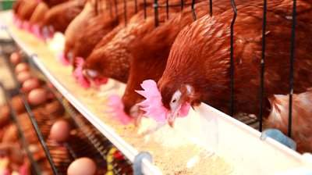
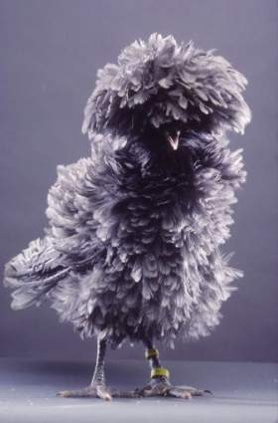
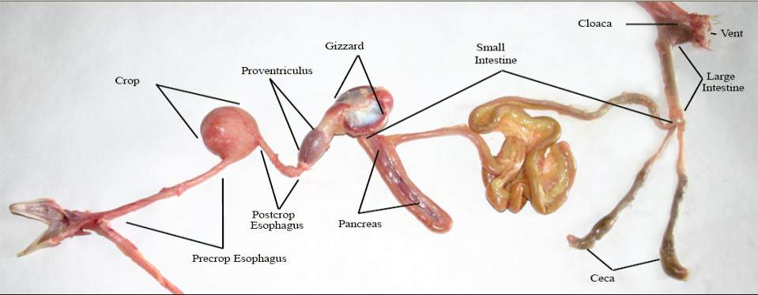
Digestive System in Poultry

Slide 3
Important Terms
Enzymes: Specialized protein that disassemble or assemble organic materials and are water soluble (dissolve in water)
Lipid: fatty or waxy organic compound involved in energy storage (e.g., cholesterol)
Carbohydrates: complex sugar molecule, broken down into glucose
Glucose: simple sugar that is a main source of energy
Bile: produced by the liver and breaks down ingested fats
Protein: broken down into amino acids to be used as building blocks for the body

Slide 4
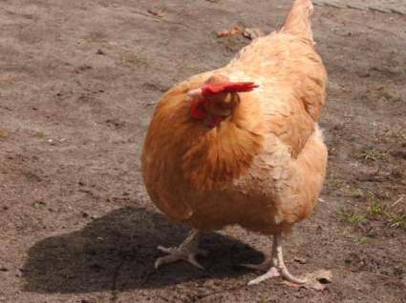
Did You Know?
Digestive system is 75% of the abdominal cavity!
Birds visually inspect possible food sources.
Unlike other species of livestock, chickens must stick their head in the air to swallow their food.

Slide 5
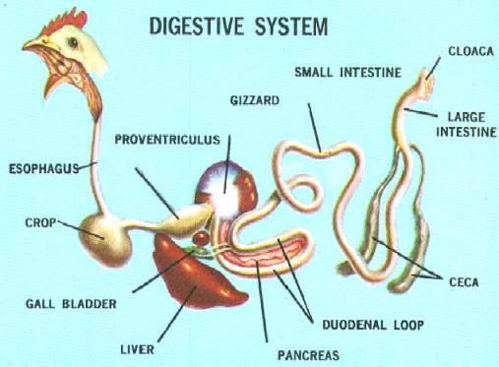
Important Organs
Mouth
Esophagus
Crop
Stomach
Proventriculus
Ventriculus “Gizzard”
Liver and Gall Bladder
Pancreas
Small Intestine
Ceca
Large Intestine
Cloaca and Vent

Slide 6
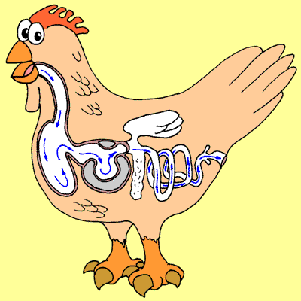
Digestive System
Function of the Digestive System:
Breaks down feed to utilize the nutrients for growth and maintenance of the animal and excrete wastes not needed by the animal.

Slide 7
Trace the Digestive System
Traveling down chicken’s digestive track food goes through:
Mouth
Esophagus
Crop
Stomach
Proventriculus
Ventriculus “Gizzard”
Liver
Gall Bladder
Pancreas
Small Intestine
Ceca
Large Intestine
Cloaca
Vent

Slide 8
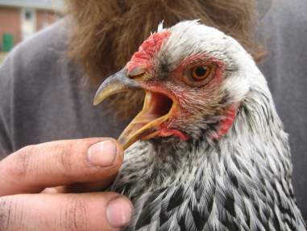
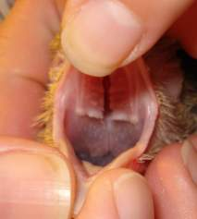
Mouth
Consists of:
Beak
Tongue
Salivary Glands
Production of saliva
NO Lips
NO Teeth
Function:
Ingest nutrients and swallow food through the esophagus.
Beak
Tongue
Salivary Glands

Slide 9
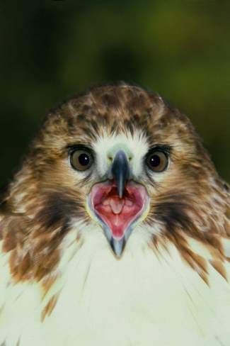
Importance of Saliva
Acts as a Lubricant
Low ability to taste
Low enzymatic activity
Low ability to break down food

Slide 10
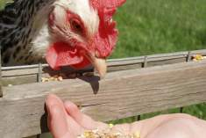
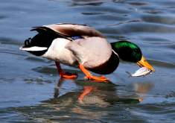
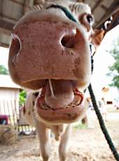
Species Differences of the Mouth
Poultry:
Low taste ability
Highly developed salivary glands, produce more saliva than aquatic birds
Aquatic Birds (non domesticated)
Ex: ducks
Poorly developed salivary glands
Eat many foods that are wet that replace the need for salivary glands
Livestock Species
High taste ability
Produce high amounts of saliva
Ex: cattle produce 15-20 gallons of saliva a day

Slide 11
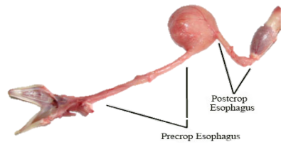
Esophagus
Connects the mouth to the crop and connects the crop to the Proventriculus.
Function: transports food and water to the crop or the Proventriculus.

Slide 12
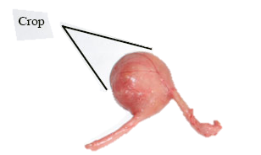
Crop
Connects to the Proventriculus
Function:
Store undigested food
Moisten and soften the ingested food
Birds can eat food, store it here, and digest it later
Species Differences:
Migratory birds use the crop to store days worth of food so that when migrating they do NOT need to find food.

Slide 13
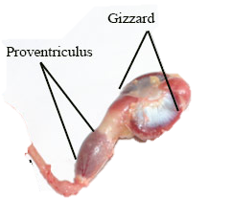
Stomach
Birds have 2 stomachs
Proventriculus:
“Glandular stomach”
Digestion begins here
Proteins are digested here
Similar to the human stomach
Ventriculus “Gizzard”
Muscular stomach
Reduces the particle size of food

Slide 14
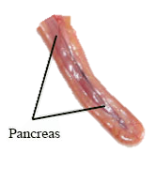
Pancreas
Digestive Function:
Helps digest starches, sugars, and fats
Endocrine Function:
Produces insulin

Slide 15
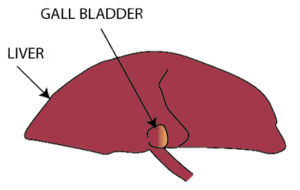
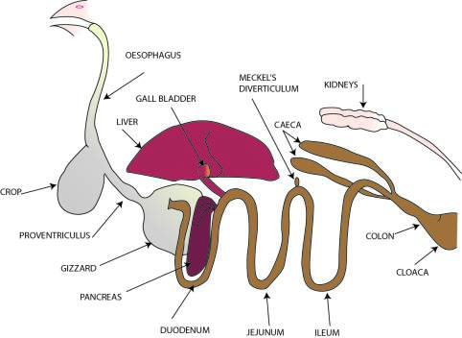
Liver and Gall Bladder
Liver Digestive Function
Produce bile (MOST IMPORTANT)
Bile is important because it breaks down ingested fats.
Gall Bladder Digestive Function
Stores excess bile produced by the liver.
Empties this bile into the small intestines whenever fats enter it.

Slide 16
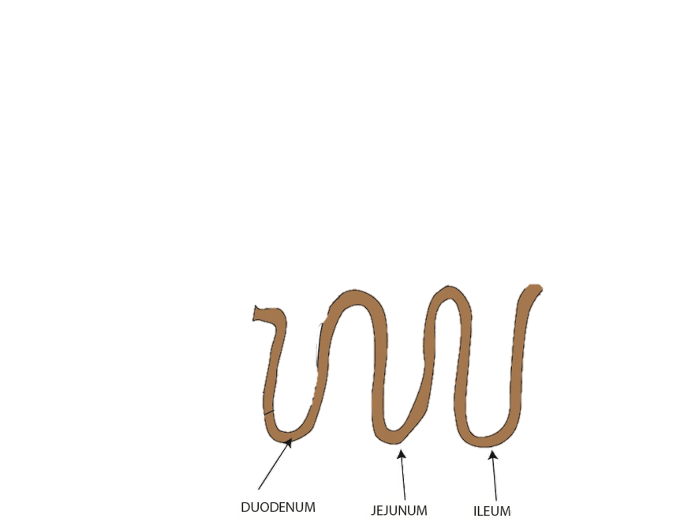
Small Intestine
Completes the digestion and absorption process
Long
4 feet
3 segments make up the small intestine
Duodenal Loop
Jejunum
Ileum

Slide 17
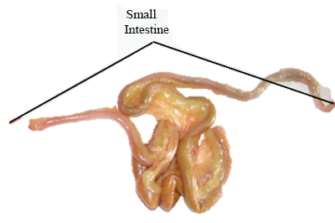
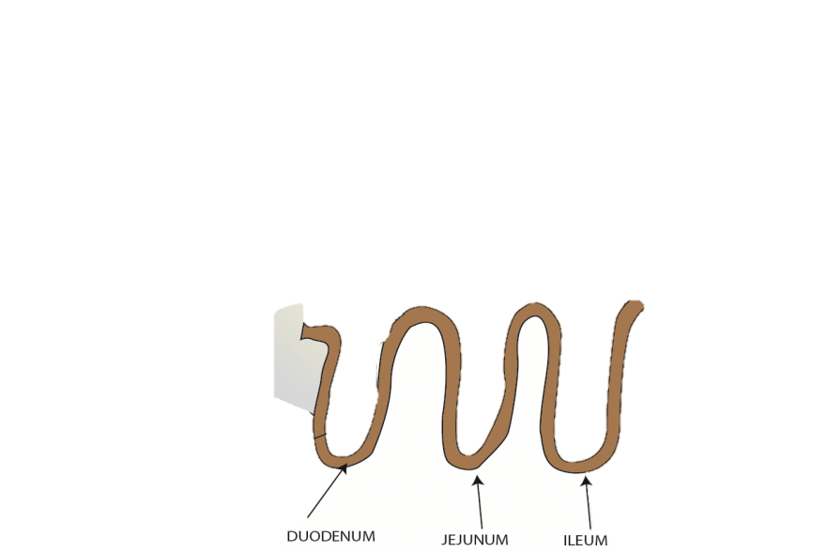
Small Intestine Cont.
Duodenal Loop:
Extends from the Ventriculus “Gizzard” to the Jejunum
Pancreas, Liver and Gall Bladder branch off the Duodenal Loop
Enzymes convert digested food into amino acid and glucose
Jejunum:
Connects from Duodenal Loop to Ileum
Receives bile from Liver or Gall Bladder to break down fats
Ileum:
Connects to Jejunum to the Large Intestine
Digestion ends here and end products (amino acids and fats) are absorbed for use by the blood stream

Slide 18
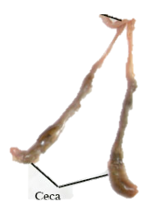
Ceca
2 pouches located where the Ileum joins with the large intestine
Digests fiber here
Like the cattle rumen
Salmonella levels are the highest here
NOT all poultry have salmonella inside them

Slide 19
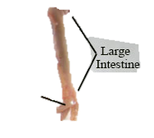
Large Intestine
Connected to the Ileum and ends at the Cloaca
Cloaca: collects and mixes feces and urine
Short in length compared to small intestine
4 inches
Digestive function:
Reabsorb water and salts from the undigested mass(feces)
Pass the partially dehydrated digested mass to the cloaca

Slide 20
Large Intestine Length Vs. Small Intestine Length
4 feet
About the length of 10.5 IPhones
4 inches
About the length of 1 IPhone
Vs.

Slide 21
Cloaca and Vent
Cloaca:
Connects to the end of the large intestine and ends at the vent
Collects and Mixes feces and urine
Vent:
Common exit point of feces and urine

Slide 22
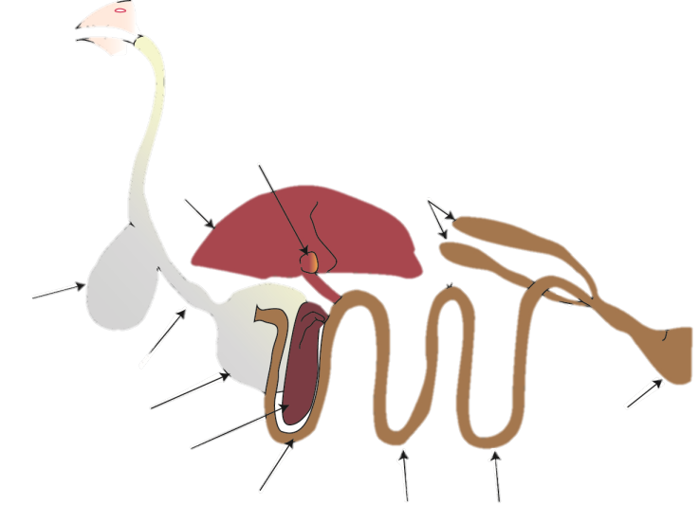
Label the Digestive System
1. _________
Mouth
2.___________
Esophagus
Gall Bladder
11.__________
10._____
Liver
12._______
Ceca
3._______
Crop
14._____
Vent
4._________
Proventriculus
Ventriculus
5. _________
13._________
Cloaca
6. ___________
Pancreas
7. ________
Duodenal Loop
Ileum
Jejunum
9. _________
8. __________

Slide 23
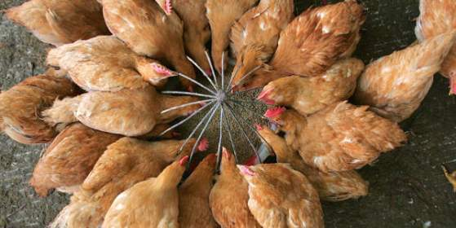
3 Required Nutrients in Poultry Diets
Carbohydrates:
Turn into Sugars
Via enzymes
Fats:
Lipids
NOT water soluble
Proteins:
Turn into Amino Acids
Via enzymes

Slide 24
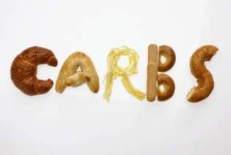
3 Required Nutrients in Poultry Diets
1. Carbohydrates: (sugars)
A Carbohydrate is a complex sugar molecule
Broken down in the pancreas
Carbohydrates are turned into glucose
Absorbed by the bloodstream and used for energy
Examples of Carbohydrates: bread, pasta, or grains

Slide 25
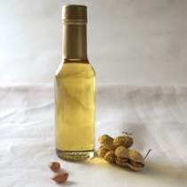
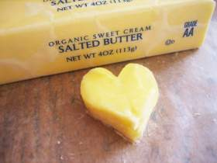
3 Required Nutrients in Poultry Diets
2. Fats: (lipids)
Are NOT water soluble
Bile produced, by the liver, specifically break down fats
Fats are turned into fatty acids and glycerol which are absorbed and used as an energy source and energy reserve
Examples: Peanut oil or butter
Peanut Oil
Butter

Slide 26
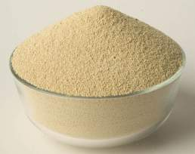
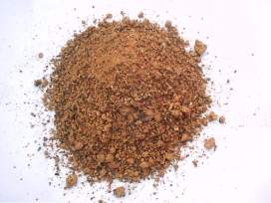
3 Required Nutrients in Poultry Diets
3. Proteins: (amino acids)
Broken down in the proventriculus
Absorbed in the small intestine
Can be used for energy
Broken down into amino acids that are used to build and repair tissue (e.g., muscle tissue)
Examples: Soybean meal or cottonseed meal
Soybean Meal
Cottonseed Meal

Slide 27
Reference Websites
http://www.cattlepages.com/facts/
http://www.thepoultryconsultancy.com/index.php?option=com_content&view=article&id=55&Itemid=62
http://www.geauga4h.org/poultry/poultry_feed.htm
http://www.poultryhub.org/physiology/body-systems/digestive-system/

