Slide 1
Environmental Science
In the Agriculture Industry

Slide 2
What are some environmental concerns in your community?

Slide 3
What is Environmental Science?
Environmental science is a multidisciplinary academic field that integrates physical, biological and information sciences, to the study of the environment, and the solution of environmental problems.
This area of study and development has grown drastically in recent decades.

Slide 4
History
Notes:
Timeline not pertinent to lesson, merely additional information leading up to sustainable agricultural practices.

Slide 5
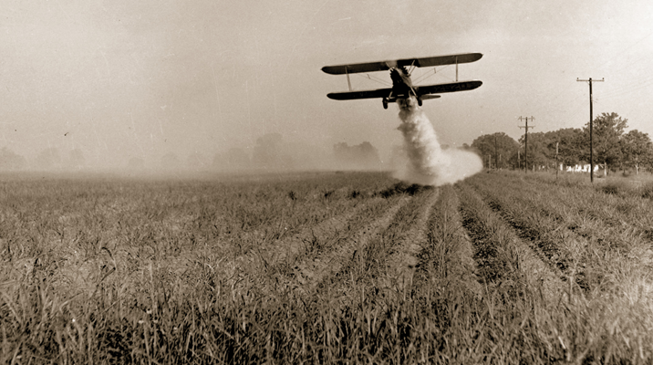
Growth of an Industry
Chemical Agriculture: Environmental Science came alive as a substantive, active field in the 1960s and 1970s driven by:
The need for a multi-disciplinary approach to analyze complex environmental problems
The arrival of sustainable environmental laws
Growing public awareness
The Green Revolution
Biotechnology

Slide 6
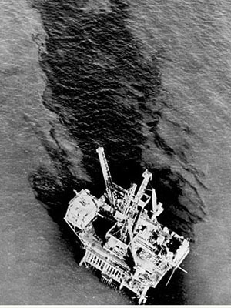
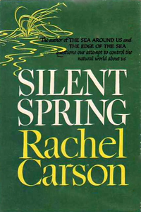
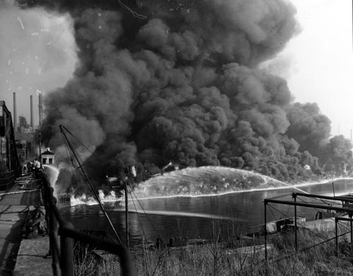
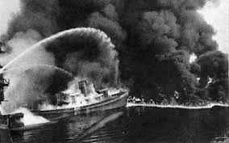
Awareness climbed quickly with…
1969 Santa Barbara oil spill
Racheal Carson’s environmental book Silent Spring, 1962
1969 Cuyahoga River of Cleveland, Ohio “catching fire”

Slide 7
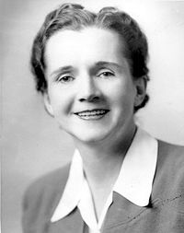
Rachel Carson’s Silent Spring 1962
The book:
Documented the detrimental effects of pesticide use.
Carson accused the chemical industry of spreading inaccurate information which public officials trusted unquestioningly.
Effects:
Spurred a reversal in national pesticide policy, which led to a nationwide ban on DDT for agricultural uses.
Inspired a grassroots environmental movement that led to the creation of the U.S. Environmental Protection Agency.

Slide 8
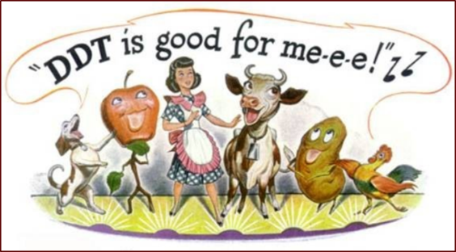
DDT – “insecticide” discovered in 1939
In WWII, disease killed fewer people than hostile action for the first time in history
DDT was sprinkled in sleeping bags and dusted on entire towns
This “miracle chemical” decreased death by disease such as typhus and malaria
Farmers started using DDT to replace arsenic containing compounds that had been used
Cheap, easy to apply, “safe”
Persistent – does not break down in environment (low reapplication)
Insoluble – does not wash away in water
What might be some advantages/disadvantages of DDT in a agricultural setting?
Notes:
DDT was found to be harmful for people, animals, and the environment. In the 50s-60s the USDA put regulatory actions to limit DDT uses. In 1972, the EPA discontinued DDT use: findings included adverse environmental effects, potential human health risks, causation between DDT and reproductive effects, classified as probable human carcinogen. DDT is very persistent in the environment, accumulates in fatty tissues, and can travel long distances in the upper atmosphere.

Slide 9
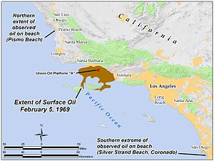
Santa Barbara Oil Spill 1969
The Spill:
Occurred in January and February 1969 in the Santa Barbara Channel, near the city of Santa Barbara in Southern California
This was the largest oil spill in the United States waters at the time, and now ranks 3rd in history.
The source of the spill was a blow-out on a Platform with 80,000-100,000 barrels of crude oil spilled
Effects:
Marine life: killed thousands of sea birds and marine animals
Public outrage resulted in environmental legislation within the next several years that created the framework for the modern environmental movement in the U.S.

Slide 10
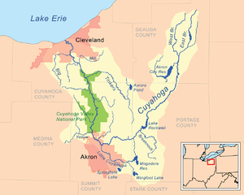
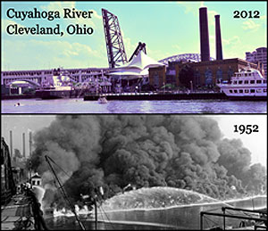
Cuyahoga River Cleveland Ohio 1969
The Fire:
One of the most polluted rivers
Has caught fire at least 13 times, the first occurring in 1868
The Effect:
Spurred water pollution control activities including:
Clean Water Act
Great Lakes Water Quality Agreement
Environmental Protection Agency
Songs such as Randy Newman’s “Burn On”, R.E.M.’s “Cuyahoga” and Adam Again’s “River on Fire” were inspired by the fire.

Slide 11
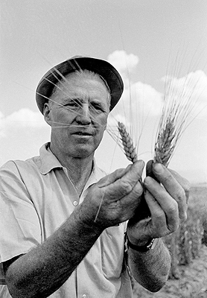
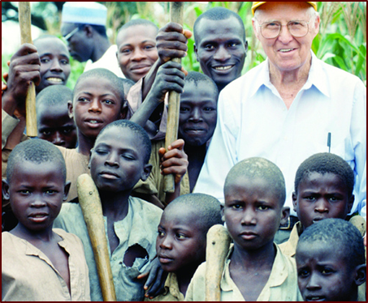
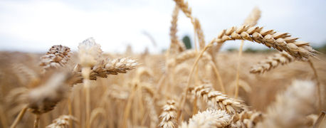
The Green Revolution 1960s
Initiated by Norman Borlaug(1914-2009), “Father of the Green Revolution”, “The Man Who Saved a Billion Lives”
Developed semi-dwarf, high-yield, disease-resistant wheat varieties
This advancement spread modern technology to non-industrialized nations and increased global food security, but decreased biodiversity

Slide 12
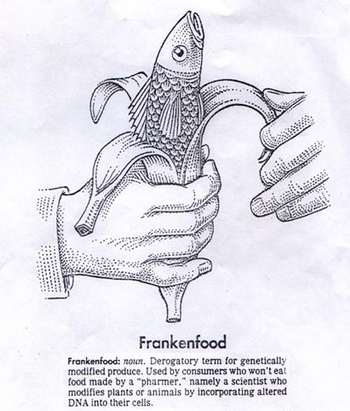
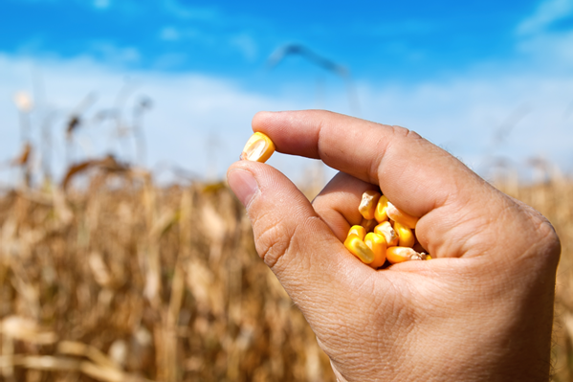
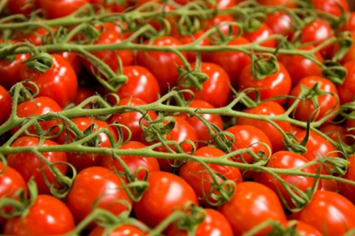
Biotechnology
The science of modifying the genetic composition of plants, animals, and microorganisms
Allows a single gene to be changed; examples include human insulin(1978), a cheese enzyme(1990), and plants (1990s)
This process allows a reduction of chemical use, increase in yields, and sustainability.

Slide 13
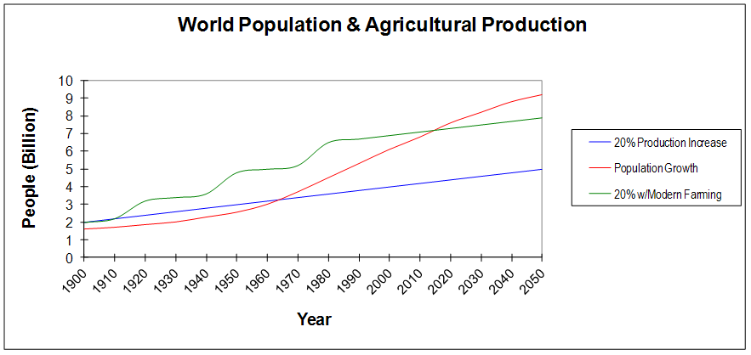
What will happen as population continues to grow at a geometric rate and food supply grows at an arithmetic rate?
Biotechnology
The Green Revolution
Chemical Agriculture
Notes:
Modern farming practices closes the gap between population growth and food needs. However, the gap will continue to grow as population increases at a geometric rate and food supply increases at an arithmetic rate.

Slide 14
Agriculture and the Environment

Slide 15
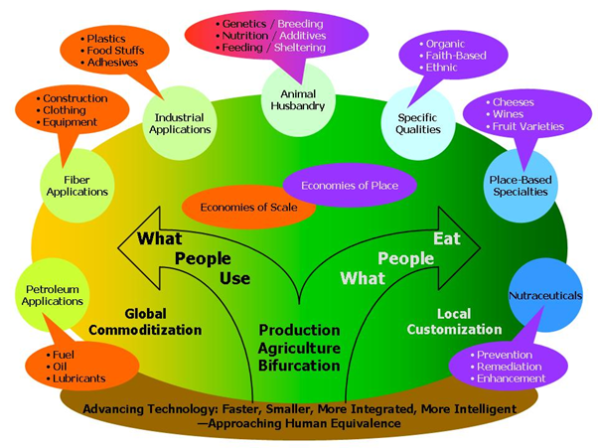
What do you use everyday that originates from the natural environment or agriculture?

Slide 16
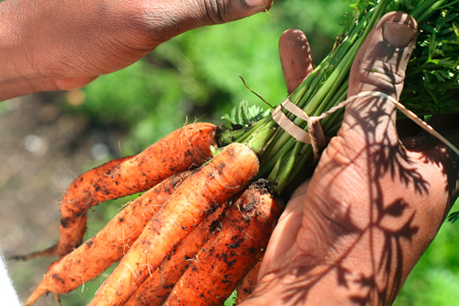
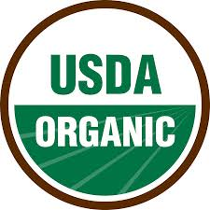
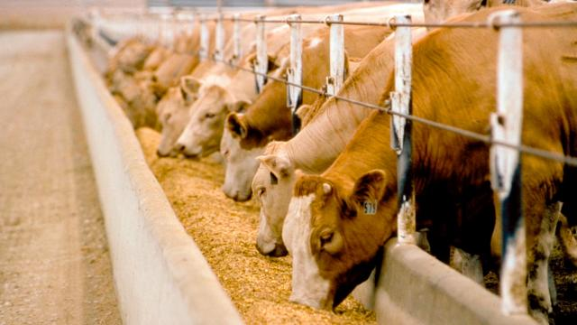
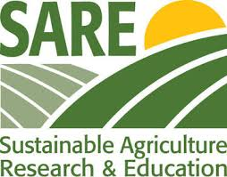
Agricultural Production Methods
Conventional
GMO
Organic
Local (& Natural)
Sustainable

Slide 17
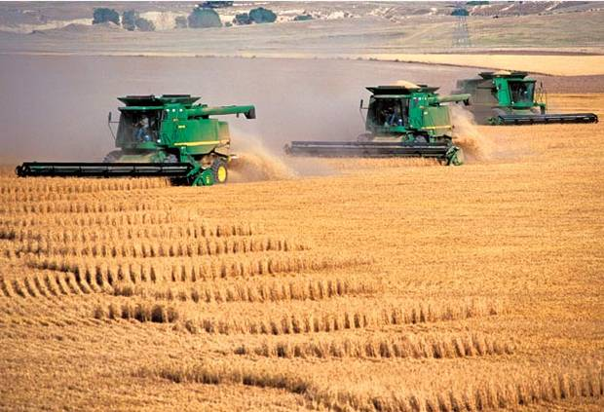
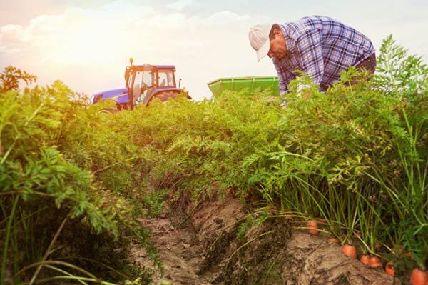
Conventional Farming
2.2 Million farms owned by less than 2% of the U.S. population
The agricultural industry employs 15% of the U.S. workforce
Most farmers are over 50 years old
Primarily utilize chemical agriculture

Slide 18
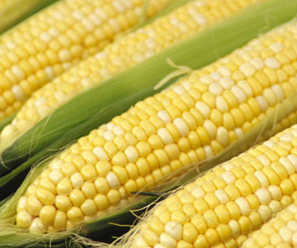
Farming with GMO’s
GMO = Genetically Modified Organism
In 2000, the U.S. began using biotech crops
53% of Soybeans
65% of Cotton
26% of Corn
Since the 1980’s, GMO’s have been used to enhance animals with lean muscle mass, enhanced resistance to disease, and improve dietary use of phosphorous to lesson manure pollution to the environment.

Slide 19
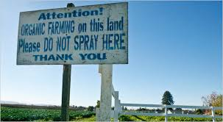
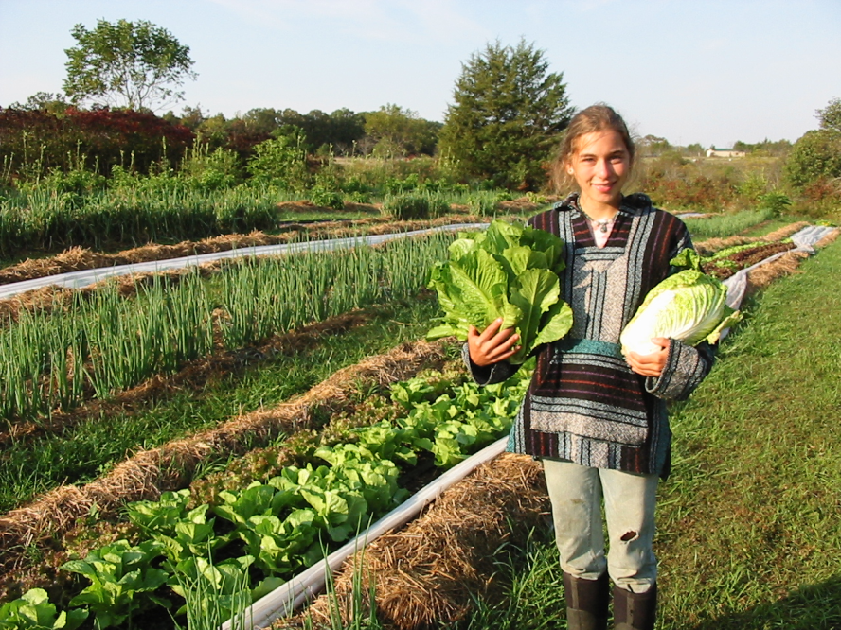
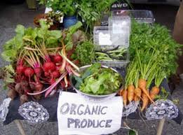
Organic Farming
Less than 1% of cropland is certified organic
In order to be certified organic you must:
Have safe soil
No modifications – No GMO’s
Separate from conventional
No synthetic pesticides
No petroleum based fertilizers

Slide 20
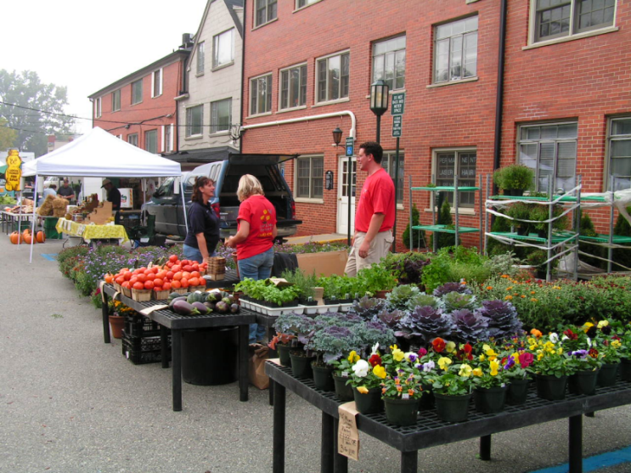
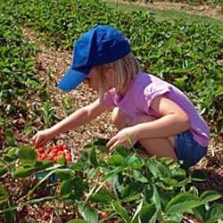
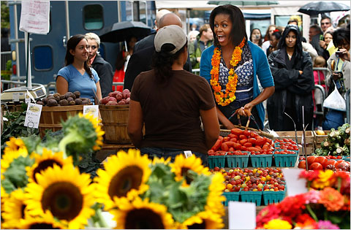
Local and Natural Farming
The 2008 Farm Act identified “local or regionally produced” as a total of 400 mile transportation distance or within the same state
Local food can be bought from:
Farmers’ Markets
Community Supported Agriculture – individual buys share of farm’s expected harvest and receives crops on a regular basis
Pick-Your-Own Operations

Slide 21
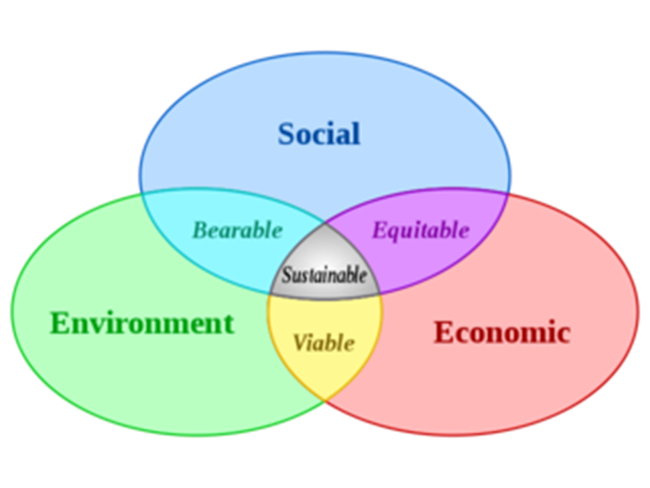
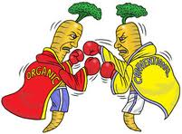
Sustainability
Definition: Capable of maintaining productivity and usefulness to society indefinitely
Resource-conserving
Socially supporting
Commercially competitive
Environmentally sound
What farming methods listed above are the most sustainable in your opinion? Why?

Slide 22
Things to Think About…

Slide 23
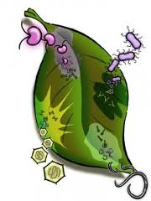
Pros of Agricultural Technology (Biotechnology)
Microbes
Plants
Improved enzymes
Improved bacteria
Disease and pest resistance
Removal of allergens and fats
Reduces chemical need
Increase yield with existing resources

Slide 24
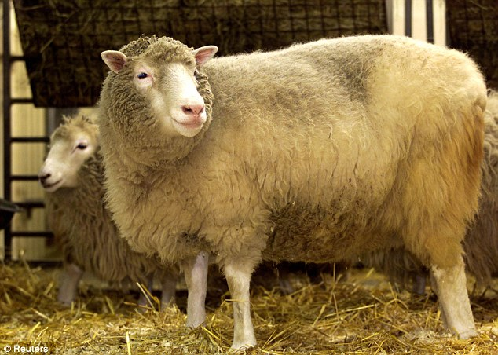
Pros of Agricultural Technology (Biotechnology)
Animals
Humans
Disease resistance
Health benefits
Determine genetic factors contributing to wellness or disease

Slide 25
Cons of Agricultural Technology
Ecological Concerns
Economic and Social Concerns
Decline in soil productivity due to erosion, compaction, salinization
Groundwater pollution due to pesticides, fertilizers; scarcity due to irrigation/runoff
Insect and pathogen resistance; threat to natural species, genetic diversity
Climate Change
Increasing federal expenditure, government involvement in planting and investment decisions
Widening disparity among farmer incomes
Concentration of agribusiness to few industry giants
Large-scale farm loss
Notes:
Although many of these Cons can be found as positive aspects of agricultural technology, much work is still to be done to mitigate the overall effect. Many of the ecological concerns can be addressed with the use of biotechnology.

Slide 26
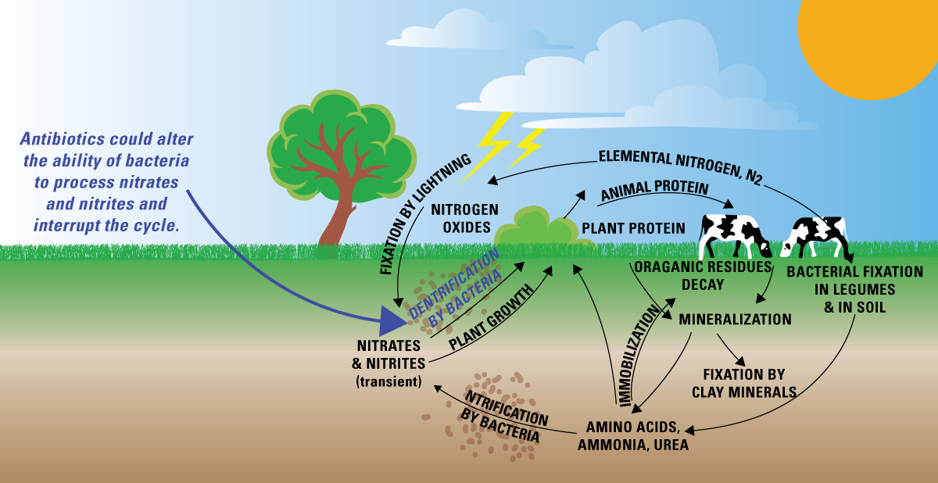
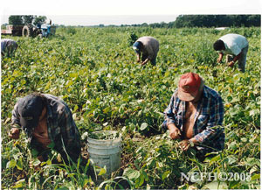
Cons of Agricultural Technology
Impacts on Human Health
Pesticide and Nitrate contamination of water and food
Farm worker health

Slide 27
Any Questions???
Environmental Science in the Agriculture Industry

