Slide 1
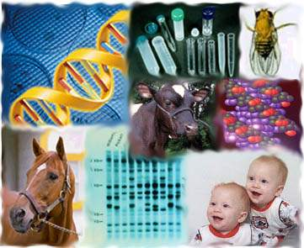
Genetics:
Building Blocks of Life

Slide 2
What is Genetics?
Heredity: the passing of traits from parents to offspring
Biological Inheritance
  Genotype – genetic makeup of an organism
  Phenotype – physical attributes determined by genotype
Gene: Unit of heredity that determines trait
  DNA products
  RNA products
  Protein products
Alleles: different forms of a gene
  Dominant allele – only one copy is required to be expressed
  Recessive allele – both copies are required to be expressed
Chromosome: strand of DNA containing genome of organism

Slide 3
Law of Segregation
Gregor Johann Mendel, 1865
First Law of Mendelian Genetics
  For every allele, you receive one maternal and one paternal allele to have a full pair
  Each allele is randomly selected
Gametes: sex cells of sexually reproducing organism
  are haploid cells
  two gametes fuse together to produce diploid cell during fertilization
Haploid: having only one of a pair of each chromosome
Diploid: having two of a pair of each chromosome

Slide 4
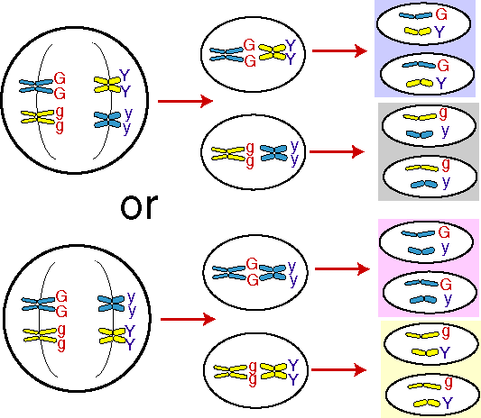
Law of Independent Assortment
Second Law of Mendelian Genetics
  Each trait that goes with an allele is independent from other alleles and traits
  Alleles of different genes sort independently of each other during gamete formation

Slide 5
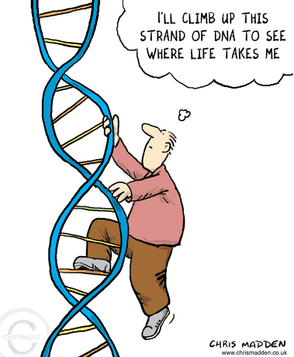
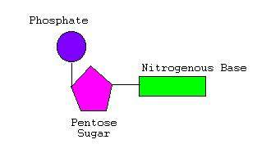
What are Nucleic Acids?
DNA: Deoxyribose Nucleic Acid
RNA: Ribose Nucleic Acid
Nucleotide: Base, Sugar, Phosphate
Why two different Nucleic Acids?
Notes:
http://learn.genetics.utah.edu/content/begin/tour/

Slide 6
All about Nucleic Acids
3 components
  Backbone made of ribose sugar for RNA or deoxyribose for DNA and a phosphate group
  Base determined by carbon and nitrogen rings
    Purine and Pyrimidine
    Bases: Adenine, Guanine, Cytosine, Thymine, Uracil
    The order of the bases in the DNA strand determines the genetic code
Functions
  Store genetic information
  Transmit genetic information
  Encode protein products

Slide 7
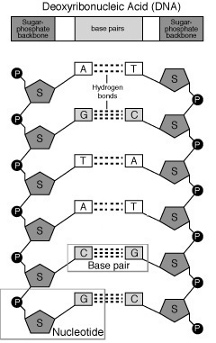
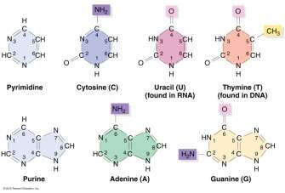
Nucleic Acids Stick Together
Nucleotides have Hydrogen bonds that pair them together to make complementary strands
  Pyrimadines: 1 ring of carbon and nitrogen
    Adenine has two bonds to Thymine
  Purines: 2 rings of carbon and nitrogen
    Guanine has three bonds to Cytosine
In RNA, Adenine has two bonds to Uracil

Slide 8
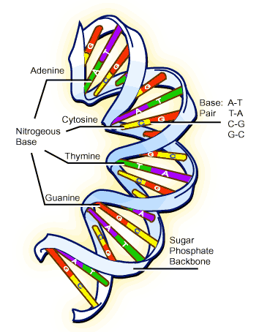
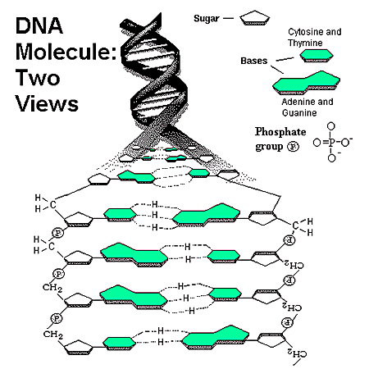
DNA Structure
Double helix prevents damage to genetic information
Notes:
http://learn.genetics.utah.edu/content/begin/dna/builddna/

Slide 9
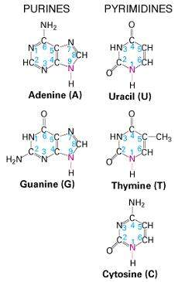
DNA vs. RNA
DNA
  Hard copy of Genetic Code
    Stays inside cell nucleus
  Mutations can become permanent
RNA
  Temporary working copy of Genetic Code
    Transports into cytoplasm to ribosomes
  Less stable molecules do not last as long
    Ribose sugar not as stable as deoxyribose
    Single strand not as stable as double helix

Slide 10
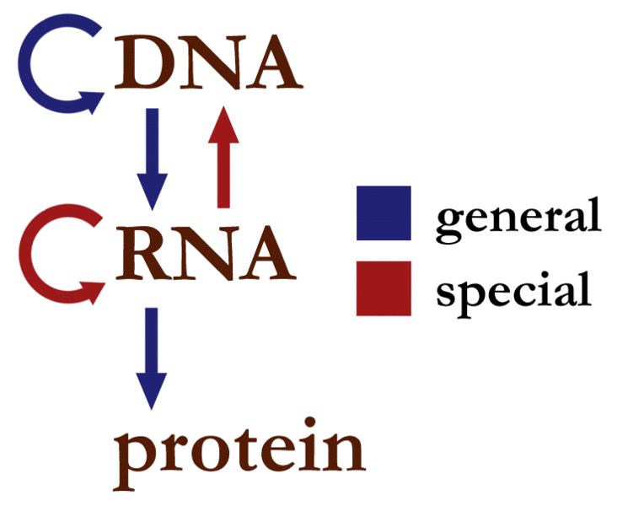
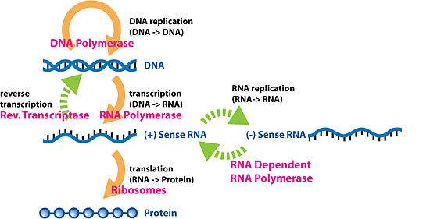
The Central Dogma
DNA and RNA and Protein
  DNA replication: semi-conservative replication producing two identical double helices
  Transcription: DNA directed production of RNA
  Translation: RNA directed production of protein

Slide 11
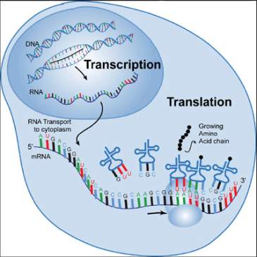
Transcribe vs. Translate
Transcription: RNA Polymerase uses the complementary strand of DNA to make a copy of the template DNA into a strand of RNA
Translation: Ribosomes use the message strand of RNA to make a protein chain of amino acids

Slide 12
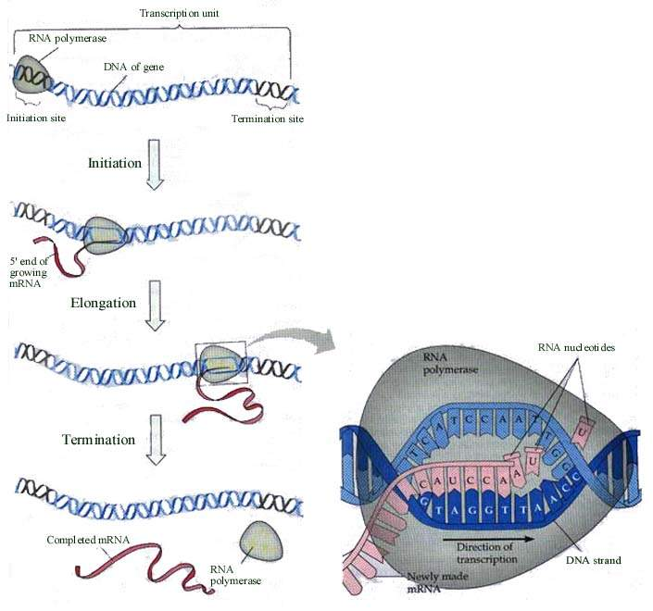
Transcription

Slide 13
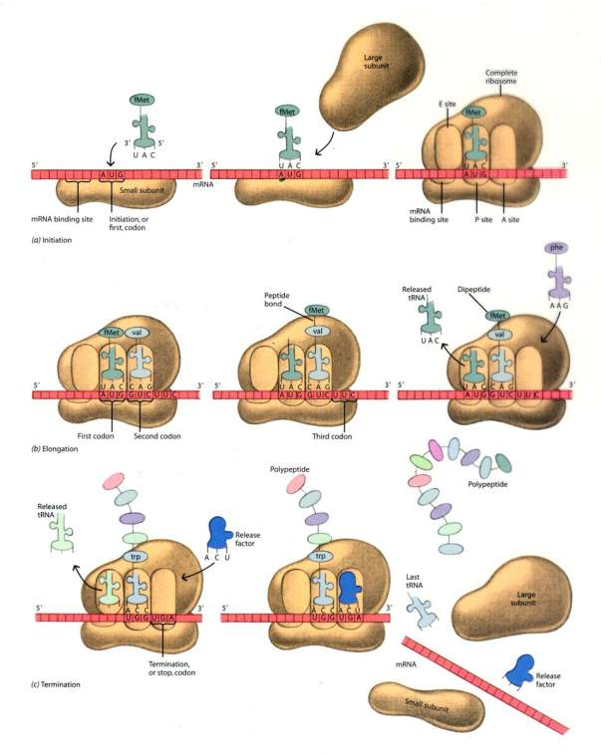
Translation

Slide 14
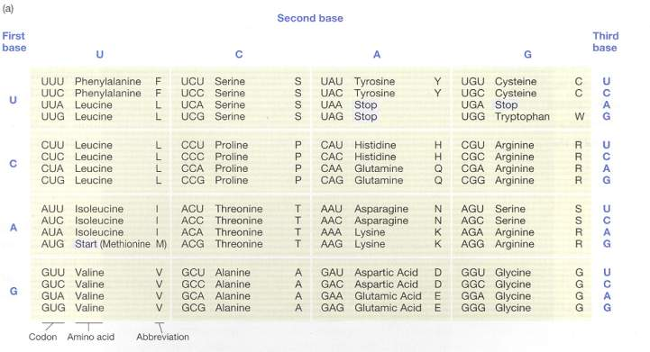
The Genetic Code
3 bases of RNA make up a Codon
  Codon of messenger RNA pairs with Anti-codon of transfer RNA during transcription to determine amino acid sequence
Genetic code is redundant, but not ambiguous
Notes:
http://learn.genetics.utah.edu/content/begin/dna/transcribe/

Slide 15
Expressing your Genes
Copy Number: increased number of RNA messages increases gene product
  Determined by strength of Transcription promoter sequence
Regulatory Genes: repress or activate expression of other genes
Transcriptional Regulation: regulatory molecules activate or repress transcription through promoter sequence
Post-Transcriptional Regulation:
  Translation: regulatory molecules activate or repress translation through degradation, phosphorylation, methylation or other methods
  Feedback inhibition: product of pathway inhibits pathway
Notes:
http://learn.genetics.utah.edu/content/variation/newtricks/

Slide 16
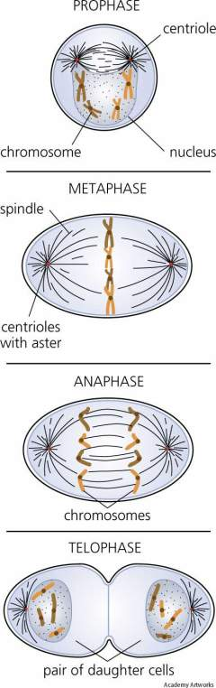
Mitosis
Cellular Division: one cell copies all genetic material and divides into two separate identical cells
Diploid cell with one copy of the chromosomes replicates to -> diploid cell with two copies of the chromosomes divides to -> two diploid cells with one copy of the chromosomes
Notes:
http://www.cellsalive.com/mitosis.htm

Slide 17
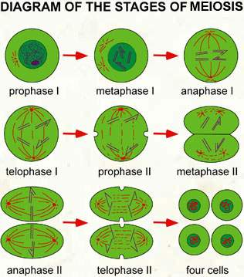
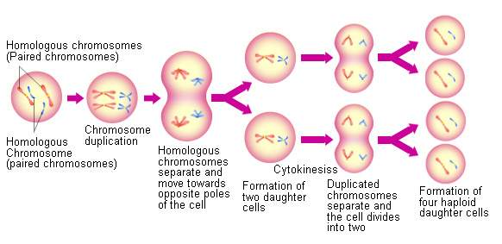
Meiosis
Gamete Formation: Cell division involved in production of gametes
2 cellular divisions resulting in four haploid daughter cells
Diploid cell with one copy of the chromosomes replicates to -> diploid cell with two copies of the chromosomes divides to -> two diploid cells with one copy of the chromosomes divides to -> four haploid cells with one copy of chromosomes
Notes:
http://www.cellsalive.com/meiosis.htm

Slide 18
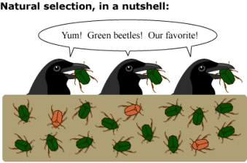
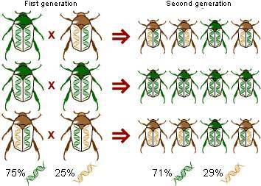
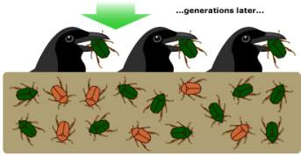
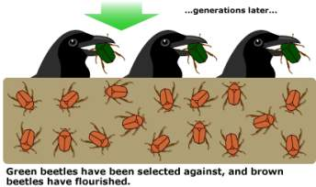
Why sexual reproduction?
Asexual reproduction can only produce identical copies
Sexual reproduction allows variation in offspring
  Multiple phenotypes in offspring ensures the survival of some offspring if one of the phenotypes is selected against

Slide 19
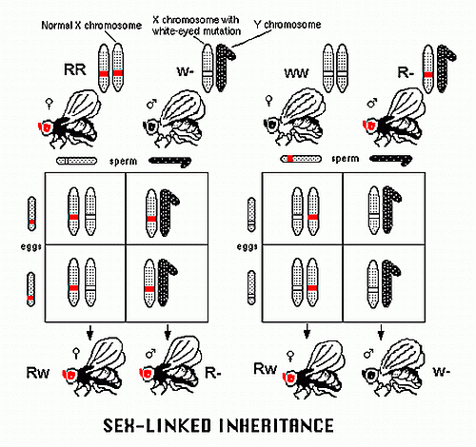
Linkage
The joint inheritance of genes or alleles due to physical linkage on the same chromosome during meiosis
Sex linkage: expression of an allele that is related to the chromosomal sex of an individual
  typically more X-linked traits inherited than Y-linked traits in humans
Notes:
http://www.mhhe.com/biosci/genbio/virtual_labs/BL_15/BL_15.html

Slide 20
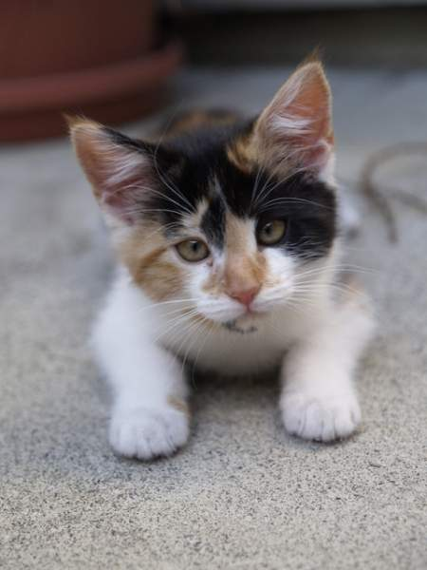
Examples of Sex Linked Characteristics
In Humans: Hemophilia on X chromosome
In Cats: Calico Coat Color on X chromosome
In Cattle: Streaked Hairlessness in Holsteins on X chromosome

Slide 21
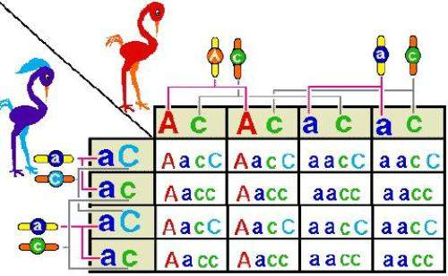
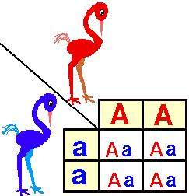
How to: Punnett Squares
Monohybrid cross – looking at one pair of alleles controlling one trait to determine possible progeny
Dihybrid cross – looking at 2 pairs of alleles for a total of two traits to determine all possible progeny
Notes:
http://www.mhhe.com/biosci/genbio/virtual_labs/BL_05/BL_05.html
http://www2.edc.org/weblabs/Punnett/punnettsquares.html

Slide 22
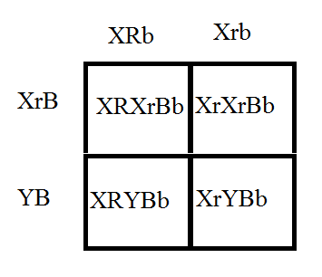
Example Punnett Square
Dihybrid Sex-Linked Cross
The mother cat has Calico coat color (Black and Orange) and blue eyes; her genotype is X^{R} X^{r} bb
Father cat has a Black coat and green eyes: X^{r} Y BB
Progeny:
  Calico coat, green eyed female: 25%
  Orange coat, green eyed female: 25%
  Black coat, green eyed male: 25%
  Orange coat, green eyed male: 25 %
  Total Offspring:
    50% orange coat, green eyes
    25% black coat, green eyes
    25% calico coat, green eyes

Slide 23
Example Punnett Square
Dihybrid Cross
Assume a species of Angus cattle has two different alleles for a gene conferring body color and two different alleles for horn length. Allele “B” when inherited gives an black body coat, and is dominant to allele “b”, which gives a red body coat when inherited. Allele “H” when inherited gives an long horn, and is dominant to allele “h”, which gives a short horn when inherited. If a heterozygous black-colored long horn male (BbHh) mates with a red-colored long horn female (bbHh), what will be the phenoytpes of their progeny and what is the ratios?

Slide 24
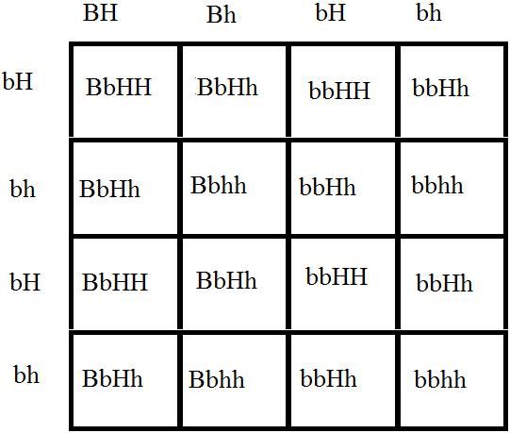
Punnett Square Answers
6 black coat long horn :
2 black coat short horn :
6 red coat long horn :
2 red coat short horn

Slide 25
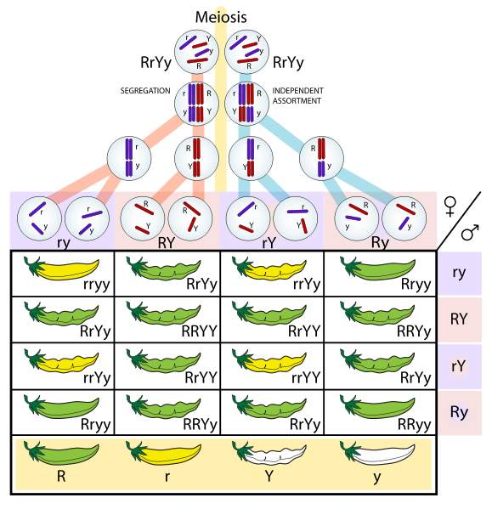
Punnett Squares
Notes:
Pause Here to go over handout examples.

Slide 26
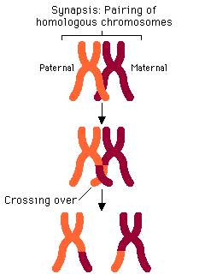
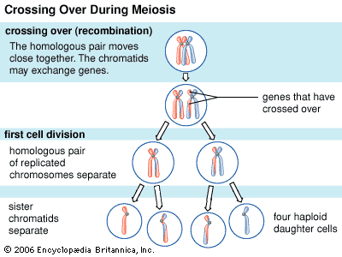
Genetic Recombination
Homologous recombination of DNA during Meiosis
  This allows for even more genetic variation in a population by moving genes onto different chromosomes
  The order and the linkage of genes can change on a chromosome
Notes:
http://www.blackwellpublishing.com/trun/artwork/Animations/Recombination/recombination.html

Slide 27
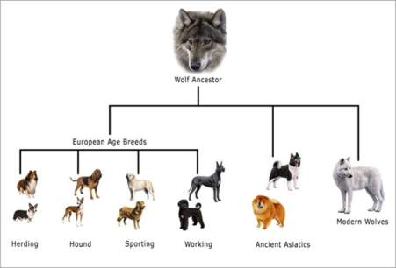
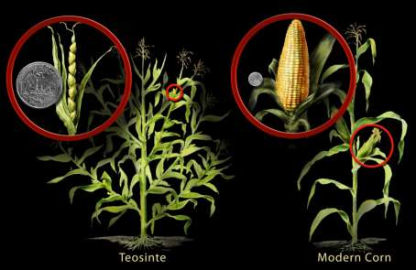
Genetic Variation
Genetic Variation in a population allows traits to be specifically selected for a desired outcome
Notes:
http://learn.genetics.utah.edu/content/variation/artificial/

Slide 28
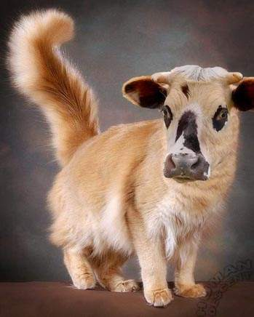
Mutants all around
Single Nucleotide Polymorphisms: one base pair in the DNA sequence is changed
  Silent Mutations – no change to the codon
  Missense Mutations – changes the codon resulting in loss or change of function of the protein product
  Nonsense Mutations – changes the codon into a stop codon resulting in a shorten protein
Frame-shift Mutations
  A base pair is removed or added, changing the entire sequence of amino acids
Notes:
http://www.nature.ca/genome/04/0413_e.cfm
http://molo.concord.org/database/activities/102.html

Slide 29
Non-Mendelian Inheritance
Any effect to the inheritance that does not fit in with the two laws of Mendel
  Linkage and recombination are two examples of effects that change the expected offspring ratio
  Extra chromosomal inheritance is another example, from DNA in the mitochondria or chloroplasts

Slide 30
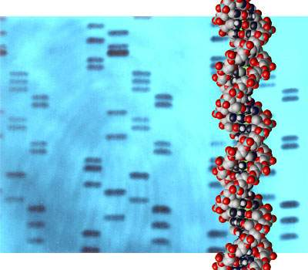
Learn Techniques:
DNA fingerprinting
A sample of DNA is used to determine if another sample is from the same organism, a related organism, or a non-related organism
Repeating patterns of DNA are analyzed for similarities
Notes:
http://learn.genetics.utah.edu/content/labs/gel/
http://learn.genetics.utah.edu/content/labs/gel/forensics/
http://www.teachersdomain.org/asset/tdc02_int_creatednafp2/

Slide 31
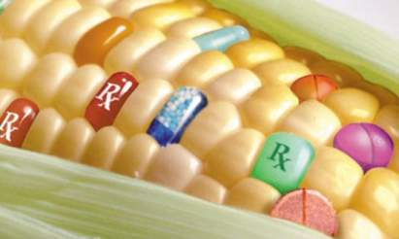
Learn Techniques: Genetically Modified Organisms
Direct manipulation of DNA to change the phenotype of an organism
  Genes that are synthetically made or obtained from other organisms are used to produce the desired phenotype through recombination
This can be used for practice in Medicine, Research, Industry, and Agriculture
Notes:
http://www.teachersdomain.org/asset/tdc02_vid_btcorn/
http://www.teachersdomain.org/asset/tdc02_vid_breeding/
http://www.pbs.org/wgbh/harvest/engineer/transgen.html

Slide 32
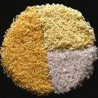
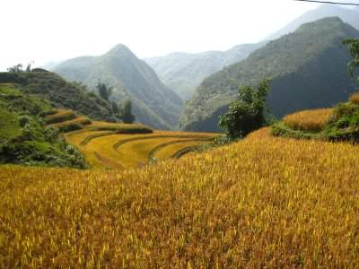
Golden Rice 2: Spring 2005
Used phytoene synthase gene from corn to increase beta-carotene 20X
  Can realistically prevent vitamin A deficiency by consumption of rice

Slide 33
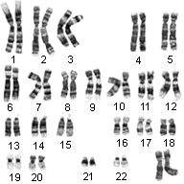
Learn Techniques: Chromosomes
Chromosomal Analysis: studying the number and structure of the chromosomes
  Also called Karyotyping
Notes:
http://learn.genetics.utah.edu/content/begin/traits/karyotype/

Slide 34
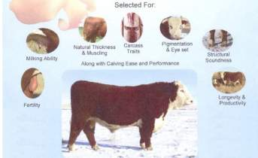
Learn Techniques: Directed Selection
Cattle are typically bred for either milk production or meat production
  Traits for each purpose will be selected for to produce the best quality offspring for that purpose
    E.g. A good cow for milk production will be bred if she has superior qualities of milk production, udder structure, and docility in hopes that her offspring will carry these traits as well
Cattle Traits
Trait | Heritability
Growth to weaning | Moderate
Post weaning growth | High
Efficiency of gain | High
Carcass quality | Very High
Milk production | High
Udder structure | Moderate
Height | High
Fertility | Low
Calving ease | Moderate
Docility | Moderate
Mature size | High
Notes:
http://www.pbs.org/wnet/nature/lessons/the-perfect-cow/video-segments-holy-cow/1536/
http://www.ansi.okstate.edu/breeds/cattle/
http://75.101.149.73/wnet/nature/files/2008/09/cattle-breeding-student-organizer.pdf
http://75.101.149.73/wnet/nature/files/2008/09/cattle-breeding-student-organizer-answer-key.pdf
http://75.101.149.73/wnet/nature/files/2008/09/traits-of-ankole-and-holstein-cattle-student-organizer.pdf
http://75.101.149.73/wnet/nature/files/2008/09/traits-of-ankole-and-holstein-cattle-student-organizer-anse280a6.pdf
http://75.101.149.73/wnet/nature/files/2008/09/finding-the-balance-student-organizer.pdf
http://75.101.149.73/wnet/nature/files/2008/09/finding-the-balance-student-organizer-answer-key.pdf

