Slide 1
Poultry Science
Breeds
Management
Industry

Slide 2
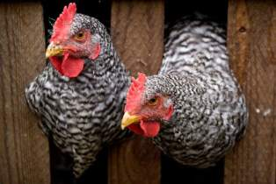
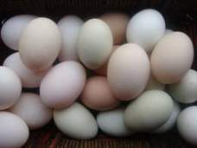
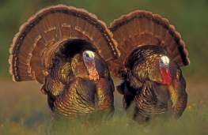
What is poultry?
Domesticated fowl raised for meat and/or eggs
Primary species used in US Poultry industry:
  Chickens (meat and eggs)
  Turkeys (meat)
Other species include:
  Ducks
  Geese
  Quail
  Phesant
  Emus
  Ostriches

Slide 3
Poultry Science
Breeds
Management
Industry

Slide 4
Classes of Chicken breeds
American
  Clean legged; no feathers on shanks
  Yellow legs and beaks
  Red earlobes
  Lay brown eggs
English
  White skin (Cornish has yellow)
  Red ear lobes
  Lay brown eggs
Mediterranean
  Smaller bodied birds
  Clean legged
  White earlobes
  Lay white eggs
Asiatic
  Large bodies
  Feathered shanks; feathers on legs
  Red earlobes
  Lay brown eggs

Slide 5
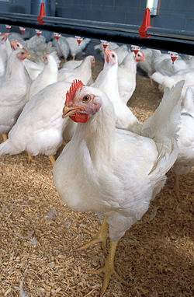
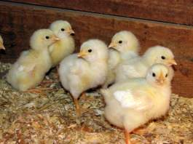
Meat producing chicken breeds
Cornish Cross Chicken
Cross breed of chicken
(White Cornish and commonly White Plymouth Rock )
White feathers
Heavy musculature and broad breasted
These birds are called Broilers

Slide 6
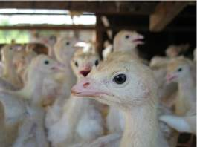
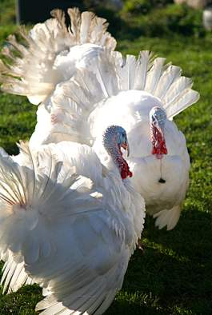
Meat Producing Turkey Breeds
Broad Breasted White Turkey
Originated as a cross breed
(White Holland & Broad Breasted Bronze)
White feathers
Most commonly used in commercial operations
Very emphasized muscularity and growth rate
Large breast prevents natural reproduction; must be artificially inseminated.

Slide 7
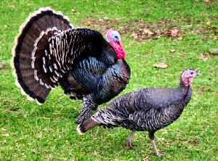
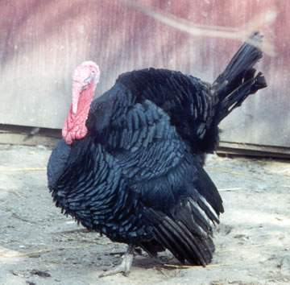
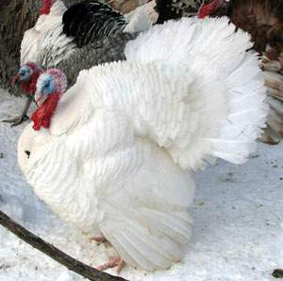
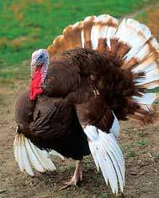
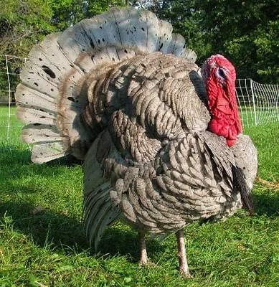
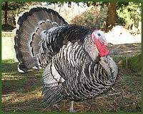
Meat Producing Turkey Breeds
Broad Breasted Bronze
Bourbon Red
Slate
White Holland
Narragansett
Black

Slide 8
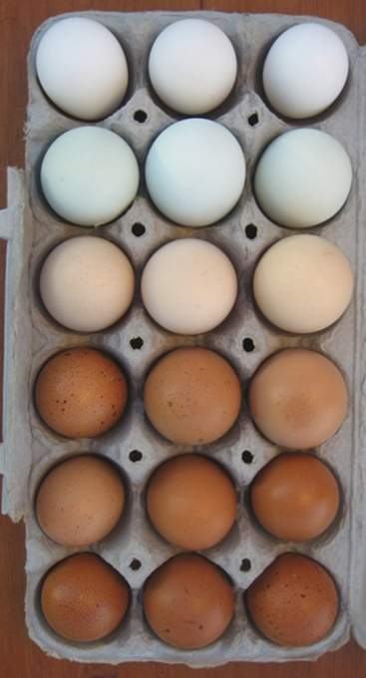
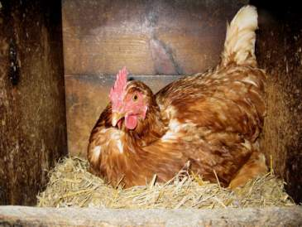
Egg Production Breeds
Female chickens called LAYERS
Hens only lay eggs during their laying cycle
Typically begin to lay around 4-6 months of age

Slide 9
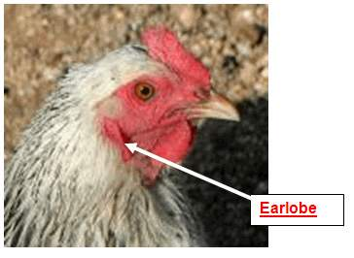
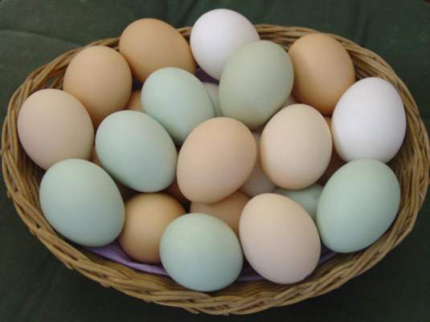
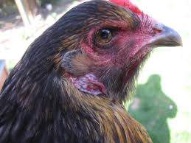
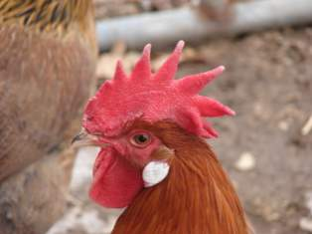
How can you tell what color eggs a chicken may produce?
Feather color
A white lobed hen will lay white eggs, while a red lobed hen will lay brown eggs….
Feet color
Earlobe color

Slide 10
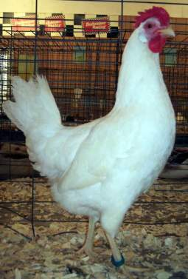
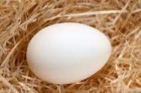
Breeds in Egg Production
Leghorn
(Mediterranean)
Most abundant egg laying breed
White feathered, small hens (smaller than broilers)
Lays large white eggs
Used in commercial egg production

Slide 11
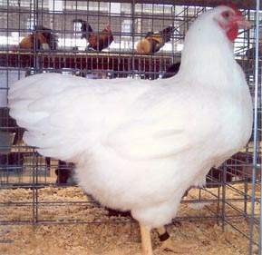
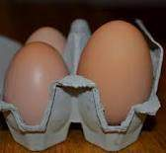
Breeds in Egg Production
White Plymouth Rock
(American)
White feathered, large hens
Lays brown eggs
Not as efficient as Leghorn

Slide 12
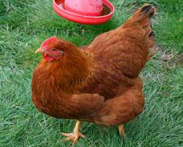
Dual Purpose Breeds
Used for both meat and eggs
New Hampshire
(American)
Red feathered
Heavy bodied hens
Lays large brown egg
Not quite as efficient in meat or egg production as other breeds

Slide 13
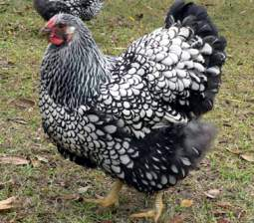
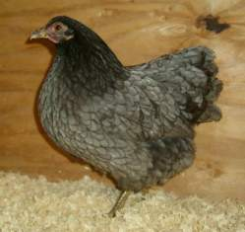
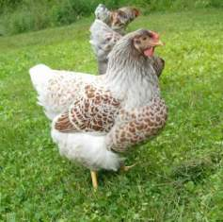
Dual Purpose Breeds
Wyandotte
(American)
Round Bodied birds
Come in several different varieties : White, Buff, Silver-Laced, Colombian, Black
Lay brown eggs
Not quite as efficient in meat or egg production as other breeds

Slide 14
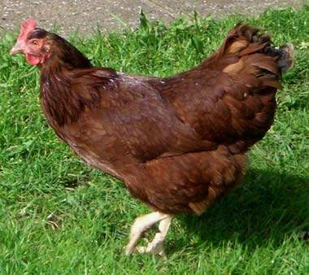
Dual Purpose Breeds
Rhode Island Red
(American)
Long Rectangular body
Deep red feathers
Lay brown eggs
Not quite as efficient in meat or egg production as other breeds

Slide 15
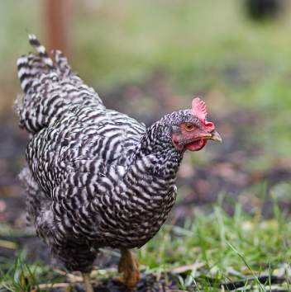
Dual Purpose Breeds
Barred Plymouth Rock
(American)
“Barred” refers to the variety of Plymouth Rock. (notice the barred feathers)
Feathers have sharply defined dark lines
Large bodied birds
Lays brown eggs
Not quite as efficient in meat or egg production as other breeds

Slide 16
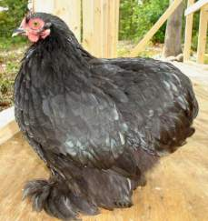
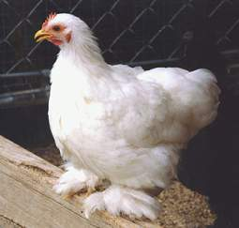
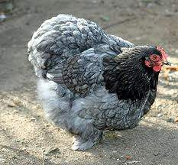
Dual Purpose Breeds
Cochin
(Asiatic)
Massive appearance with breast carried low
Long feathering and abundantly feathered shanks
Come in several different varieties
(Buff, Partridge, White, Black)
Lays brown eggs
Not quite as efficient in meat or egg production as other breeds

Slide 17
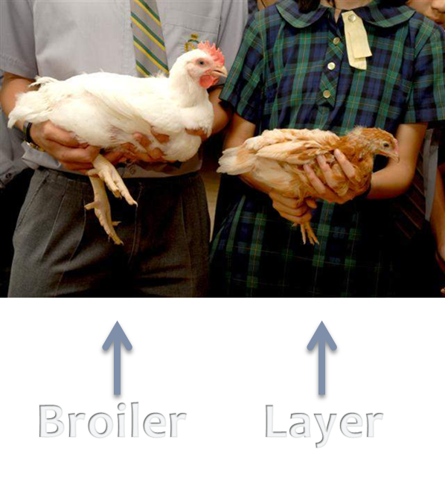

Slide 18
Poultry Science
Breeds
Management
Industry

Slide 19
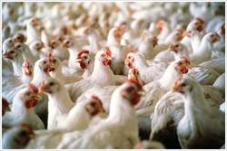
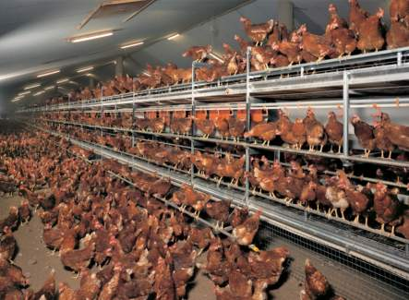
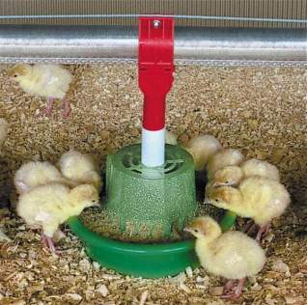
General Poultry Management
Housing
Feeding/ Watering
Maintenance

Slide 20
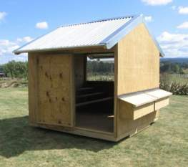
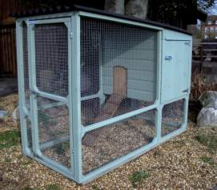
Housing
Size of coop should correlate with the size of flock
  As flock numbers increase coop size should increase
HOUSING DESIGN SHOULD:
  Accommodate for birds’ purpose
  Provide shelter and adequate ventilation
  Protect poultry from predators
  Keep litter dry and safe from weather

Slide 21
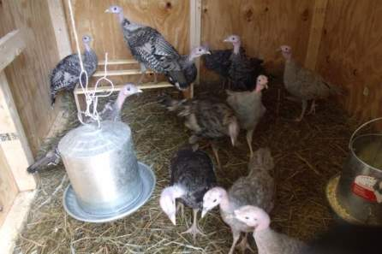
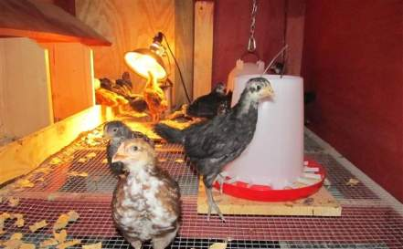
Housing continued
BASIC EQUIPMENT NEEDED:
  Water and feeders
  Litter (wood shavings or hay)
  Appropriate lighting
  Brooder (when needed)

Slide 22
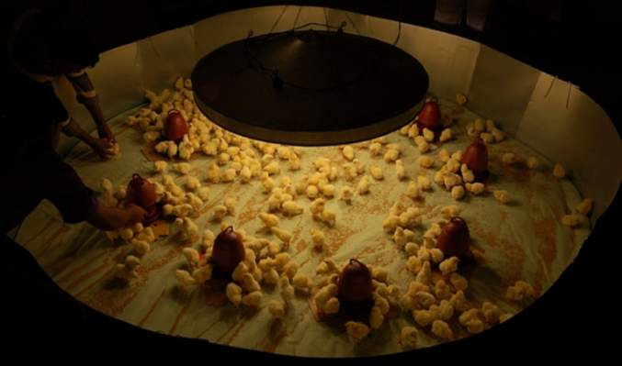
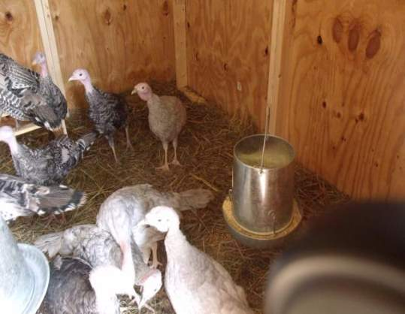
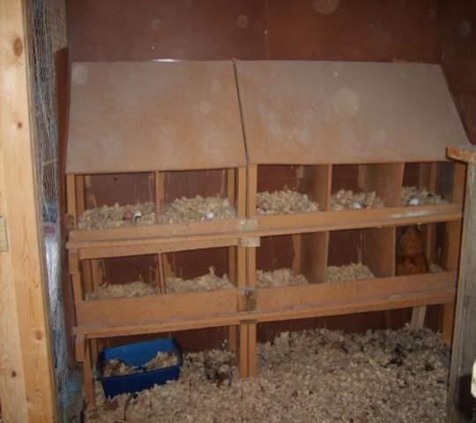
Types of Housing
Brooder: young birds
kept at a consistent 90 -91°F temp. in first few week(s) of life.
Grower house: meat producers
Contains abundant feed and water
Layer house: laying hens
Contains nest boxes for layers

Slide 23
feeding/ watering
Poultry receive diets with different levels protein and energy
All poultry should be fed ad libitum: having feed available at all times
LAYER HENS
GROWER BIRDS
Excess protein causes rapid development and hens laying too early
Layer feed: 16% protein +Calcium (to produce egg shells)
  Different feeds provide different levels of protein
    Starter feed: 22-24% protein
    Grower feed: 15-18% protein
    Finisher feed: 16% protein

Slide 24
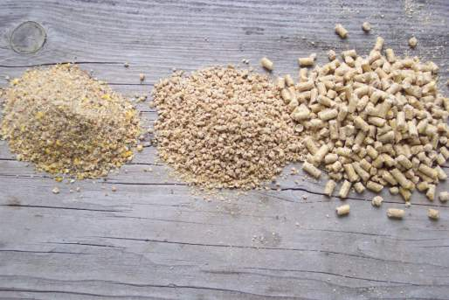
feeding/ watering
Mash- ingredients mixed together but each ingredient remains separate; best for layers
Crumbles- chopped up pellets; best for young meat birds
Pellets- ingredients finely ground then mixed and compressed into larger pellets; best for mature meat birds
Mash
Crumbles
Pellets

Slide 25
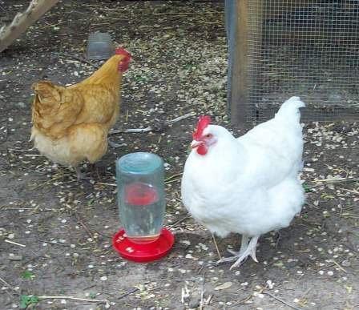
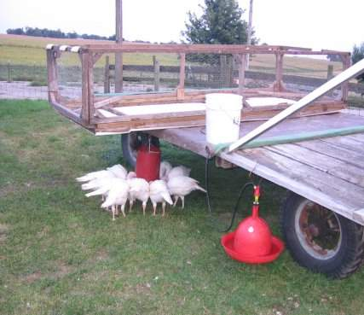
feeding/ watering
Growth rate of meat birds is directly related to clean water intake
Clean water should be available ad libitum
Sanitizing containers cuts down on bacteria

Slide 26
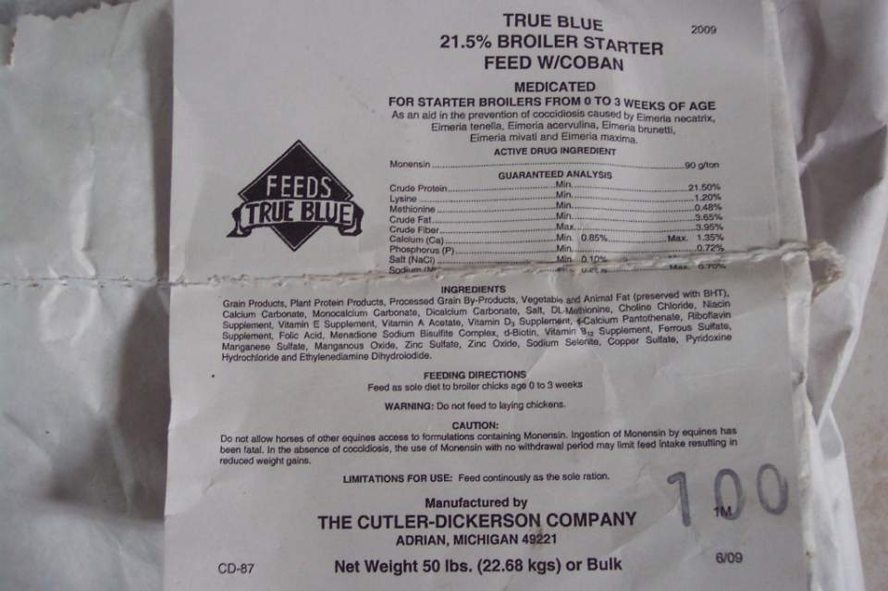

How do I know what I’m feeding???
Read the LABLE!

Slide 27
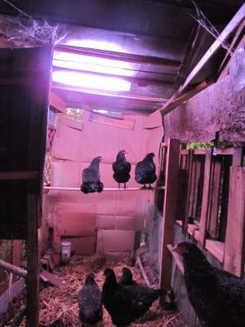
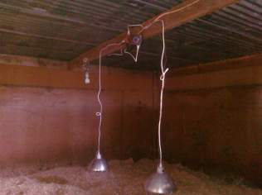
maintenance
Lighting Programs:
LAYERS
  Approximately 14 hrs of light per day required to stimulate a hen to lay
  Artificial lighting in winter (short- days) meet a laying hen’s photoperiod requirement for laying
GROWERS
  Heat lamps maintain a warm environment for young birds
  Heat lamps are raised to lower temperature
  Timed lights used to stimulate activity for idle birds

Slide 28
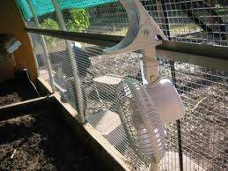

maintenance
Ventilation/ humidity
  Fans and windows reduce humidity and temperature
  Dry living environment promotes good health and reduces ammonia levels
  Ammonia causes blisters
Human interaction
  Important to interact with birds; feed and water, collect eggs, check on birds, clean pen interior and litter…

Slide 29

maintenance
Culling: selecting the best birds by reducing the population of undesirable birds
  Small, sick, stunted or deformed birds should be removed when detected
  Remove smaller and poorer fleshed birds at 4 wks of age
  Uniformity of birds and body quality improves with the increase in floor and feeder space

Slide 30
Poultry Science
Breeds
Management
Industry

Slide 31
Industry
Vertical integration: all aspects of the industry are owned by the same company
  For example: Tyson or Sanderson Farms will own its own feed mill, hatchery, and processing plants, trucking fleet, veterinarians...etc.
  No middle man; reduces costs of paying a third party
  Did you know: over 90% of poultry raised for human consumption in the US are produced by independent farmers working under contract with integrated companies

Slide 32


Slide 33

Egg Production
Caged Egg production:
Hens kept in cages with sloped floors allowing eggs to roll to the front of the cage for collection
Waste products continually and automatically removed to maintain a clean living environment

Slide 34

Egg Production
Over 6 billion eggs produced commercially each month in US
Each hen lays ~250 eggs per year
Iowa and Ohio produce the most commercial eggs

Slide 35



Meat Production
Virtually all commercial meat birds are white feathered
Raised in environmentally controlled houses with ad libitum access to feed and water to promote growth
Broilers are raised to ~ 4.25 – 7 lbs
Turkeys are raised to ~ 18 – 45 lbs
10% sold as whole carcass
90% are further processed (lunch meat, pizza toppings..)

Slide 36


Slide 37

Some things to think about…
Why do most commercial meat birds have white feathers?
Why would it be important to vertically integrate the industry?
Why would the industry mix breeds?

