Slide 1
Poultry Science
Breeds
Management
Industry

Slide 2
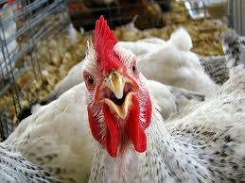
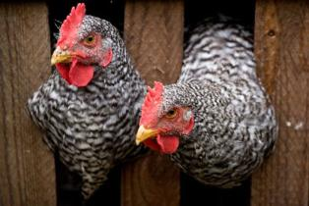
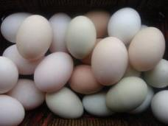
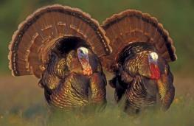
What is poultry?
domesticated fowl raised for meat and/or eggs
Primary species used in US Poultry industry:
Chickens (meat and eggs)
Turkeys (meat)
Other species include:
Ducks
Geese
Quail
Phesant
Emus
Ostriches

Slide 3
Poultry Science
Breeds
Management
Industry

Slide 4
Classes of Chicken breeds
American
Clean legged; no feathers on shanks
Yellow legs and beaks
Red earlobes
Lay brown eggs
English
White skin (except Cornish has yellow)
Red earlobes
Lay brown eggs
Mediterranean
Smaller bodied birds
Clean legged
White earlobes
Lay white eggs
Asiatic
Large bodies
Feathered shanks; feathers on legs
Red earlobes
Lay brown eggs

Slide 5
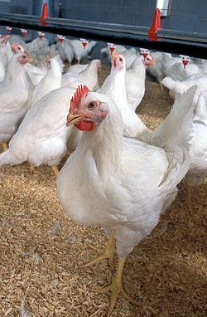
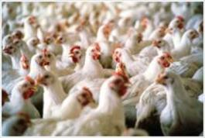
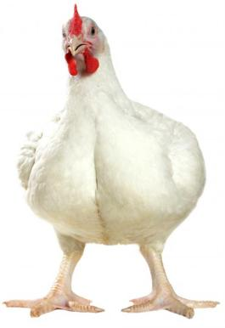
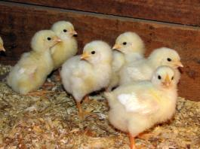
Meat producing chicken breeds
Cornish Cross Chicken
Cross breed of chicken (White Cornish and commonly White Plymouth Rock )
White feathers
Heavy musculature and broad breasted
These birds are called Broilers

Slide 6
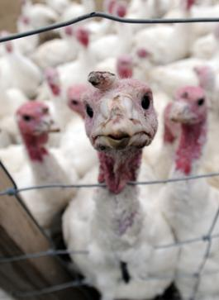
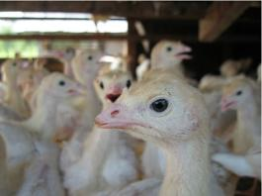
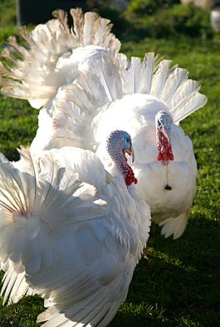
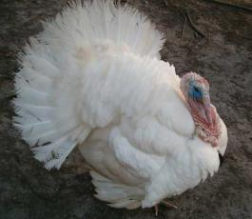
Meat Producing Turkey Breeds
Broad Breasted White Turkey
Originated as a cross breed (White Holland & Broad Breasted Bronze)
White feathers
Most commonly used in commercial operations
Have very emphasized muscularity and growth rate
Have such large breasts are unable to reproduce naturally. Instead, they must be artificially inseminated.

Slide 7
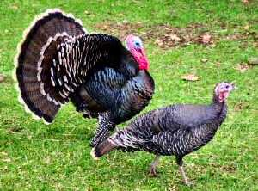
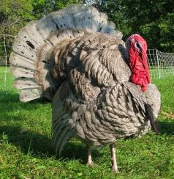
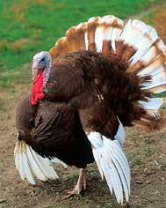
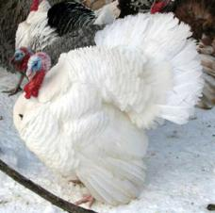
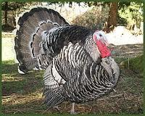
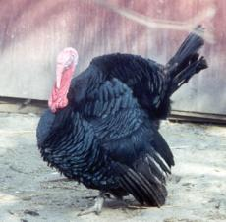
Meat Producing Turkey Breeds
Turkeys are used primarily for meat production.
There are several different varieties of turkey.
Broad Breasted Bronze
Slate
Bourbon Red
White Holland
Narragansett
Black

Slide 8
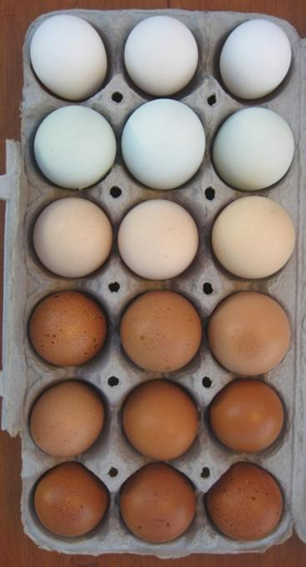
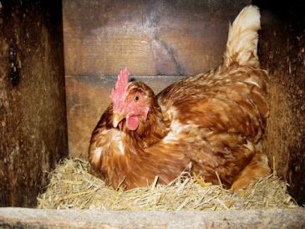
Breeds in Egg Production
These female chickens are called LAYERS
Hens will only lay eggs during their laying cycle
Most hens start to lay around 4-6 months of age

Slide 9
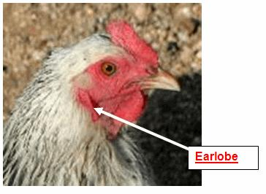
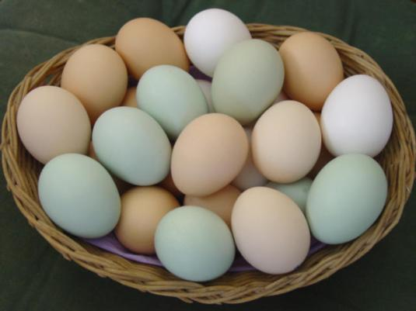
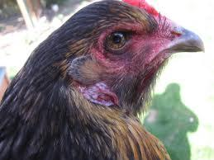
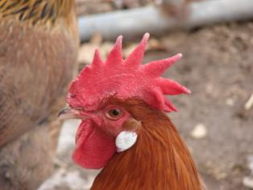
How can you tell what color eggs a chicken may produce?
Feather color
Feet color
A white lobed hen will lay white eggs, while a red lobed hen will lay brown eggs….
Earlobe color

Slide 10
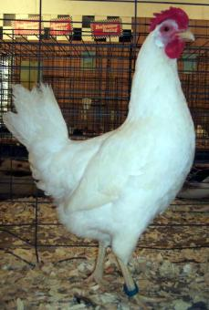
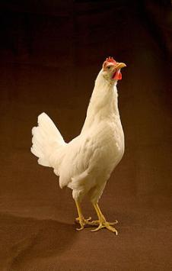
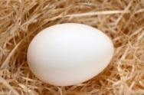
Breeds in Egg Production
Leghorn (Mediterranean)
Most abundant egg laying breed
White feathered, small hens (smaller than broilers)
Lays large white eggs
Used in commercial egg production

Slide 11
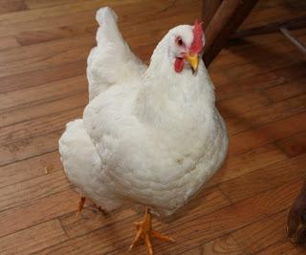
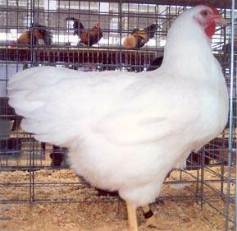
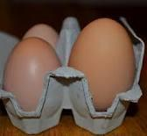
Breeds in Egg Production
White Plymouth Rock (American)
White feathered, large hens
Lays brown eggs
Not as efficient as Leghorn

Slide 12
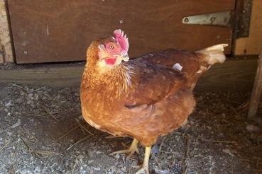
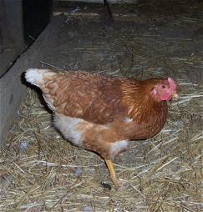
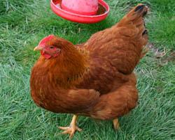
Dual Purpose Breeds
These birds are use for both meat and eggs.
New Hampshire (American)
Red feathered
Heavy bodied hens
Lays LARGE brown eggs
Not quite as efficient in meat or egg production as other breeds

Slide 13
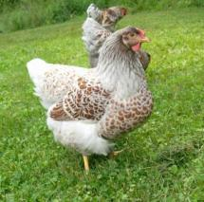
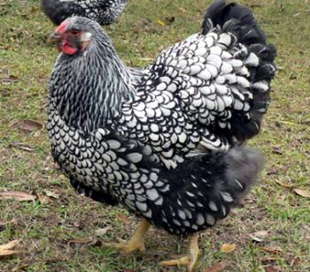
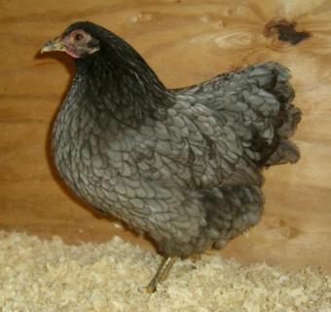
Dual Purpose Breeds
Wyandotte (American)
Round Bodied birds
Come in several different varieties (White, Buff, Silver-Laced, Colombian, Black…)
Lay brown eggs
Not quite as efficient in meat or egg production as other breeds

Slide 14
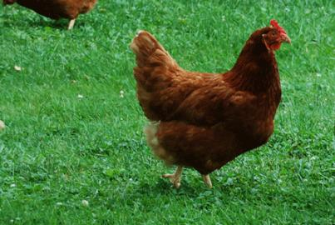
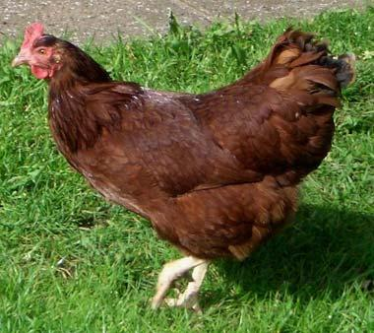
Dual Purpose Breeds
Rhode Island Red (American)
Long Rectangular body
Deep red feathers
Lay brown eggs
Not quite as efficient in meat or egg production as other breeds

Slide 15
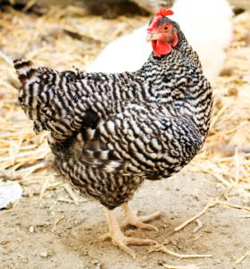
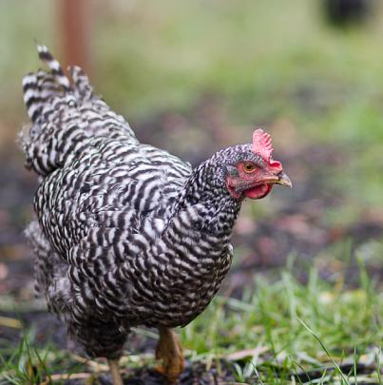
Dual Purpose Breeds
Barred Plymouth Rock (American)
“Barred” refers to the variety of Plymouth Rock. (notice the barred feathers)
Feathers have sharply defined dark lines
Large bodied birds
Lays brown eggs
Not quite as efficient in meat or egg production as other breeds

Slide 16
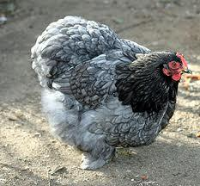
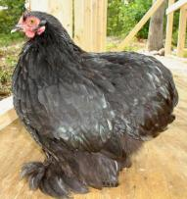
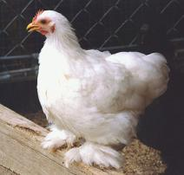
Dual Purpose Breeds
Cochin (Asiatic)
Massive appearance with breast carried low
Long feathering and abundantly feathered shanks
Come in several different varieties (Buff, Partridge, White, Black)
Lays brown eggs
Not quite as efficient in meat or egg production as other breeds

Slide 17
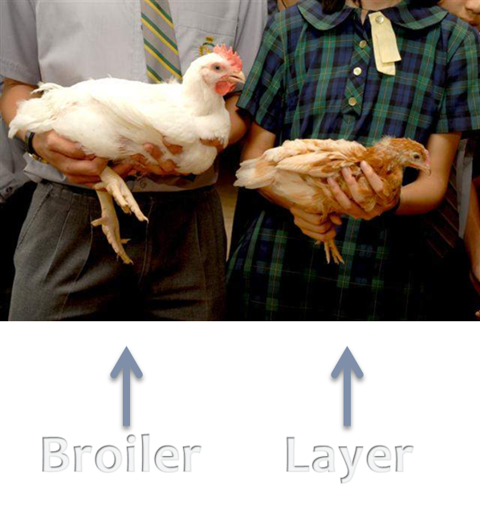

Slide 18
Poultry Science
Breeds
Management
Industry

Slide 19
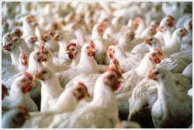
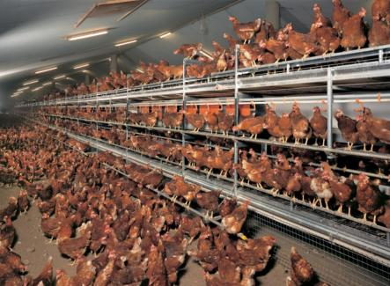
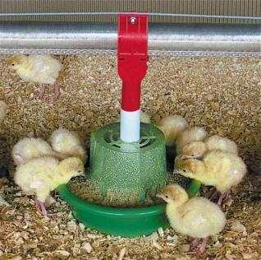
General Poultry Management
Housing
Feeding/ Watering
Maintenance

Slide 20
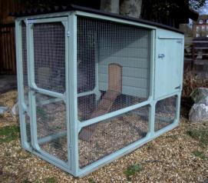
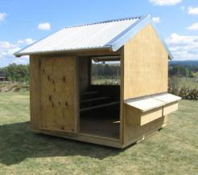
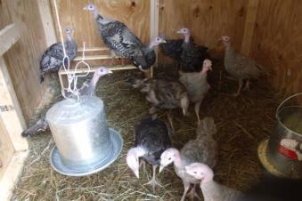
1. Housing
Size of coop should correlate with the size of flock (↑the flock numbers=↑coop area)
HOUSING DESIGN SHOULD:
Accommodate for birds’ purpose
Provide shelter and adequate ventilation
Protect poultry from predators
Keep litter dry and safe from weather
BAISIC EQUIPMENT NEEDED:
Water and feeders
Litter (wood shavings or hay)
Appropriate lighting
Brooder (when needed)

Slide 21
Types of Housing
Brooder: young birds kept at a consistent 90 -91°F temp. in first few week(s) of life.
Grower house: meat producers Contains abundant feed and water
Layer house: laying hens Contains nest boxes for layers

Slide 22
2. feeding/ watering
receive diets with different levels protein and energy (Corn and Soybean)
All poultry should be fed ad libitum: having feed available 24/7
GROWER BIRDS
Different feeds provide different levels of protein
Starter feed: 22-24% protein
Grower feed: 15-18% protein
Finisher feed: 16% protein
LAYER HENS: if protein is too high, development happens too fast and hens will lay too early
Layer feed: 16% protein + Calcium (to produce egg shells)
Mash- ingredients mixed together but each ingredient remains separate; best for layers
Crumbles- chopped up pellets; best for young meat birds
Pellets- ingredients finely ground then mixed and compressed into larger pellets; best for mature meat birds
Mash
Crumbles
Pellets

Slide 23
How do I know what I’m feeding???
Read the LABLE!

Slide 24
2. feeding/ watering
Growth rate of meat birds is directly related to clean water intake
Clean water should always be available ad libitum
Sanitizing containers will cut down on bacteria

Slide 25
3. maintenance
Lighting Programs:
LAYERS
approximately 14 hours of light per day is required to stimulate a hen to lay an egg
Artificial lighting in the winter (short-day days) meet a laying hen’s photoperiod requirement for laying eggs
GROWERS
Heat lamps maintain a warm environment for young birds
Heat lamps can be raised higher to lower temp
Timed lights can be used to stimulate activity for idle birds

Slide 26
3. maintenance
Ventilation/ humidity
Fans and windows reduce humidity and temperature
need a dry living environment to promote good health and reduce ammonia levels
Ammonia will give blisters
Respond positively to human interaction
(Important to periodically be around birds; feed and water, collect eggs, check on birds, clean pen interior and litter…)

Slide 27
3. maintenance
culling: to select the best birds by reducing the population of undesirable birds
Small, sick, stunted or deformed birds should be removed when detected
Reduce flock size by removing the smaller and poorer fleshed birds at 4 wks of age
Uniformity of birds and body quality will improve by the increase in floor and feeder space

Slide 28
Poultry Science
Breeds
Management
Industry

Slide 29
Industry
Vertical integration: all aspects of the industry are owned by the same company
For example: Tyson or Sanderson Farms will own its own feed mill, hatchery, and processing plants, trucking fleet, veterinarians...etc.
No middle man; reduces costs of paying a third party
Did you know: over 90% of poultry raised for human consumption in the US are produced by independent farmers working under contract with integrated companies

Slide 31
Egg Production
Caged Egg production:
Hens are kept in cages with sloped floors that allow eggs to roll to the front of the cage to be collected
waste products are continually and automatically removed to maintain a clean living environment.
Over 6 billion eggs produced commercially each month in US
Each hen lays ~250 eggs per year
Iowa and Ohio produce the most commercial eggs

Slide 32
Meat Production
90% are further processed (lunch meat, pizza toppings..)
10% sold as whole carcass
Broilers are raised to ~4.25-7lbs
Turkeys are raised to ~18-45lbs
Virtually all commercial meat birds are white feathered
Meat birds are raised in environmentally controlled houses with ad libitum access to feed and water to promote growth

Slide 34
Some things to think about…
Why do most commercial meat birds have white feathers?
Why would it be important to vertically integrate the industry?
Why would the industry mix breeds?

