Slide 1
Introduction to Ruminant Digestion
© Partnership for Environmental Education and Rural Health at
College of Veterinary Medicine & Biomedical Sciences, Texas A&M University
Funding support from the National Institutes of Health Office of Research Infrastructure Programs (ORIP)

Slide 2
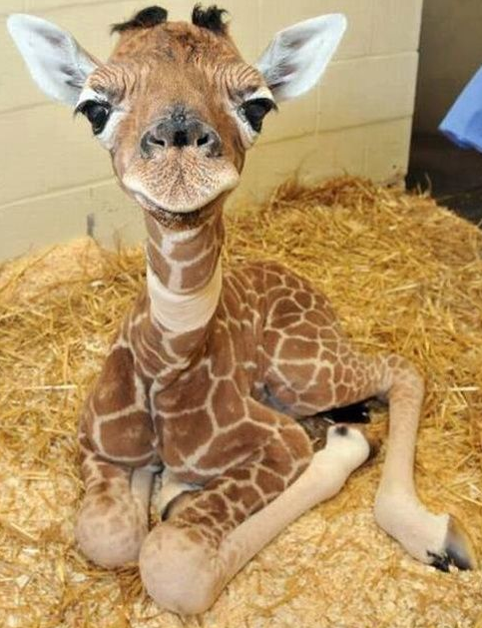
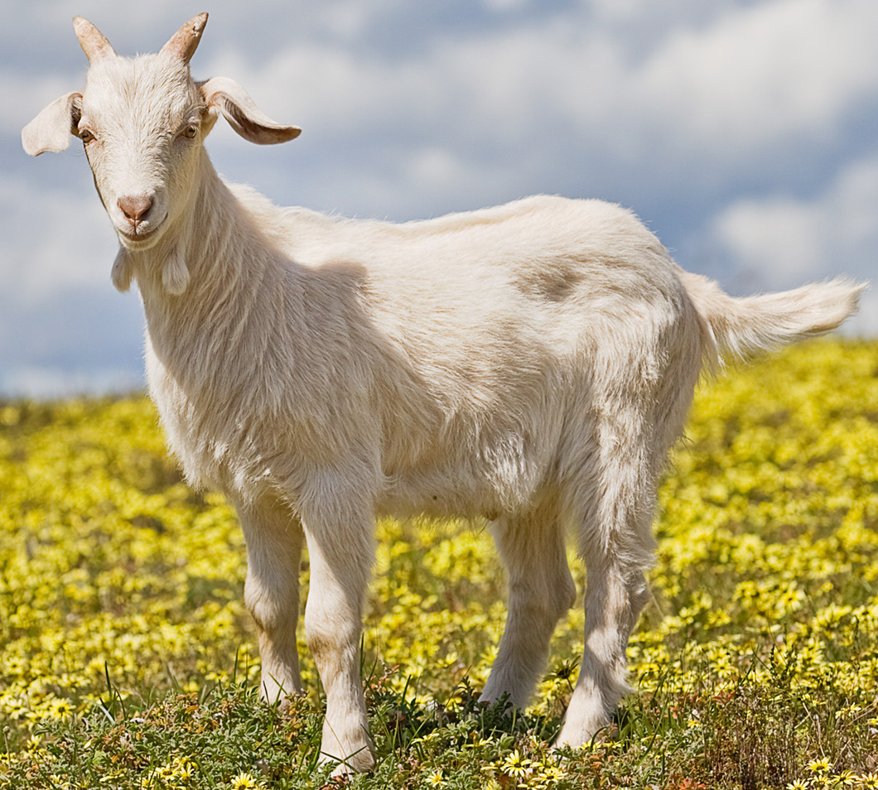
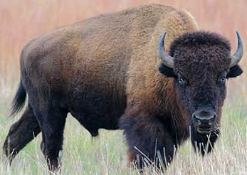
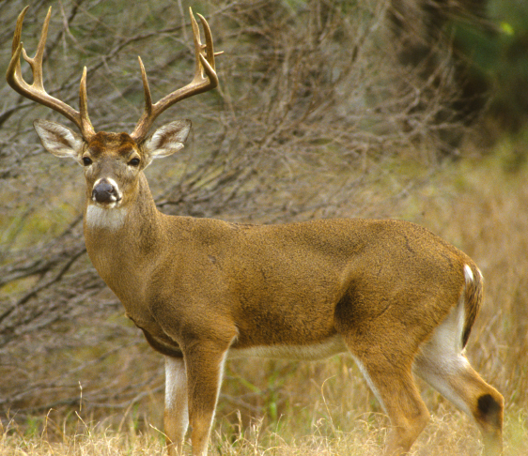
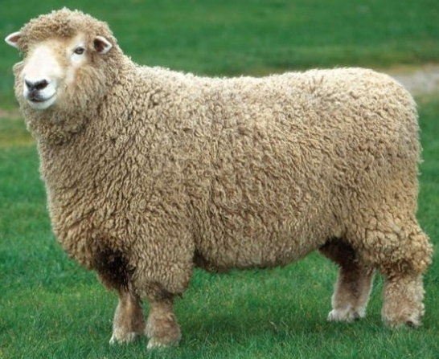
What is a ruminant animal?
Ruminant animals share the following characteristics:
Four chambered stomach
Regurgitates cud (food)
Even number of toes (i.e. 2, 4, 6)
There are many more, but for the purposes of this lecture we are going to focus on cattle!
Based upon the above requirements, discuss three species that you think might be ruminant animals, then share with the class!
Notes:
All of the animals pictured on this slide are good examples of ruminant animal species!

Slide 3
Prehension and Mastication

Slide 4
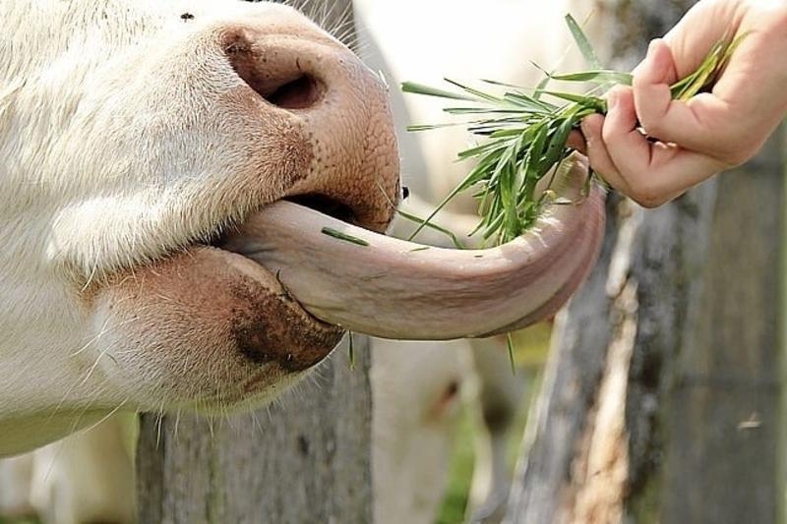
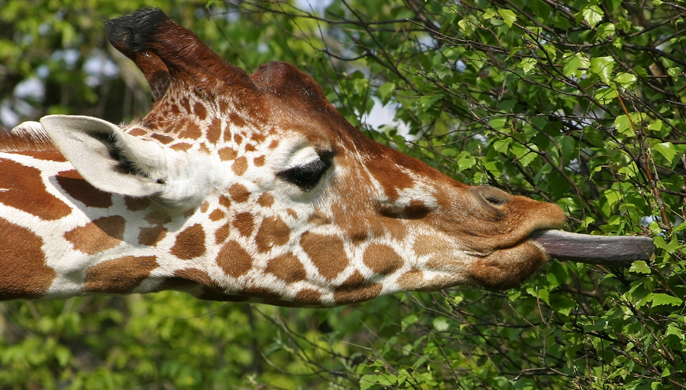
Prehension and Mastication
Prehension: gather food and move it into the mouth
In ruminant animals, this is their tongue and lips
Mastication: Chewing food into smaller particles
Occurs when an animal grinds and chews with teeth
Enzymatic digestion in the mouth by salivary amylase
Ruminant animals do not secrete enzymes in their saliva like most monogastrics
Mastication: mechanical digestion of food by chewing
Notes:
Prehension: the act of gathering food and moving it into the animals mouth
Mechanical digestion: the process of breaking down food through physical means (ex. Chewing).

Slide 5
Esophagus

Slide 6
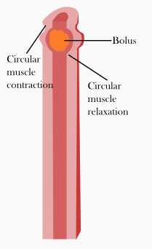
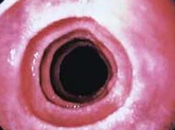
Esophagus
Connects the mouth and the stomach of the animal
Smooth-muscle contractions allow the food to be transported from the mouth to the stomach
Peristaltic waves: muscular contractions that move objects from one area to another
Bidirectional in ruminant animals, allowing them to regurgitate cud for rumination
Esophageal lining
Fun Fact: cattle produce about 100 liters of saliva a day, that’s enough to fill a bathtub!

Slide 7
Ruminant Stomach

Slide 8
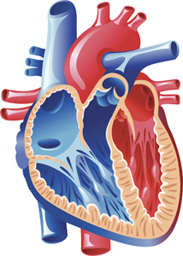
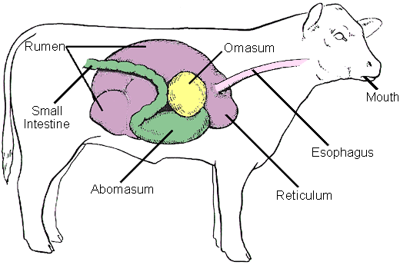
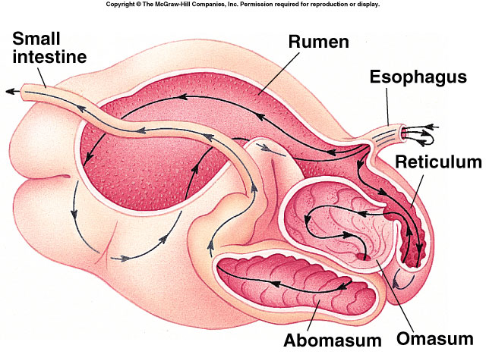
Ruminant stomach
Ruminant animals have a 4 chambered stomach! (Like a mammalian heart!)
Reticulum
Rumen
Omasum
Abomasum
The stomach takes up ¾ of the abdominal cavity in ruminant animals!
Notes:
Many students say that ruminant animals have 4 stomachs, this is inaccurate. Rather, they have 4 chambers (or compartments) to their stomach, similar to a mammalian heart!!! Food flows from one compartment to the next like blood through the heart.

Slide 9
Reticulum

Slide 10
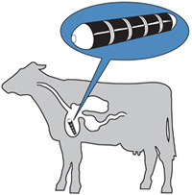
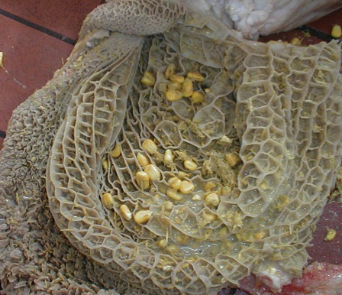
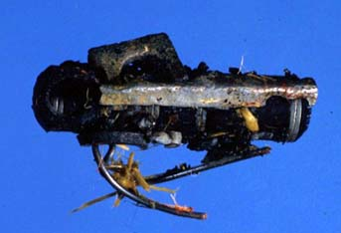
1. Reticulum
The reticulum is a pouch on the anterior the rumen
Smallest compartment (~5%)
Not completely separated from the rumen
Site for hardware disease, dense or heavy objects sink here and can get stuck
Many cattle have a magnet in their reticulum to collect any metal that is ingested
Reticulum lining
Reticulum lining is honeycomb-like
Magnet
Notes:
Hardware disease occurs when a cow eats metal and it gets stuck in the reticulum. The metal can then pierce the stomach lining, which is very close to the heart. This can be very dangerous. Magnets are fed to the animal to prevent stray metal from piercing the lining.
Bee is there to remind students that the reticulum lining looks like a honeycomb!!!

Slide 11
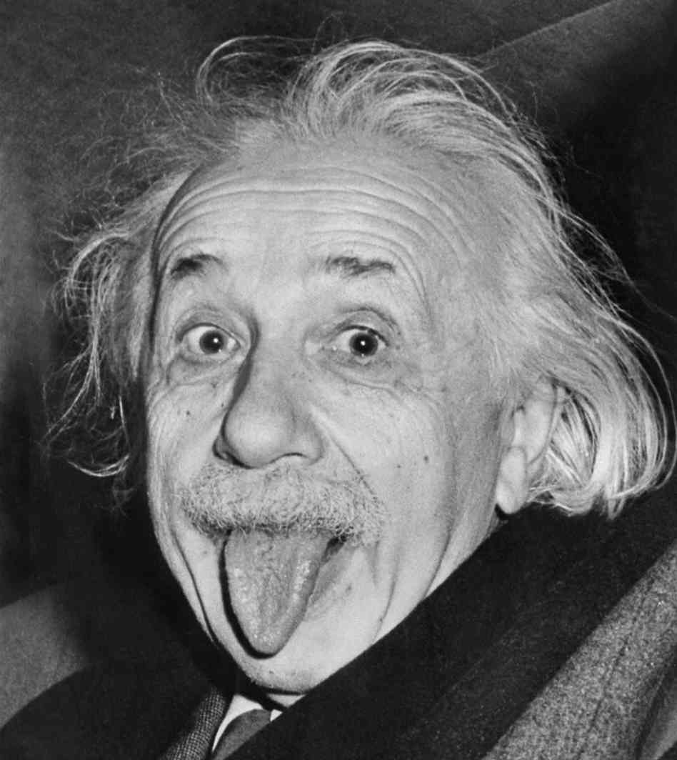
Think about it! (Reticulum)
What does the lining of the reticulum look like in ruminant animals?
ANSWER: like honey-comb
What is hardware disease in cattle?
ANSWER: when cattle eat dense or metal objects, they can settle in the reticulum and cause irritation or even piercing of the lining
How do we prevent hardware disease?
ANSWER: by placing a magnet in the cows reticulum
About what percentage of a cows stomach is the reticulum?
ANSWER: about 5%, it is the smallest compartment

Slide 12
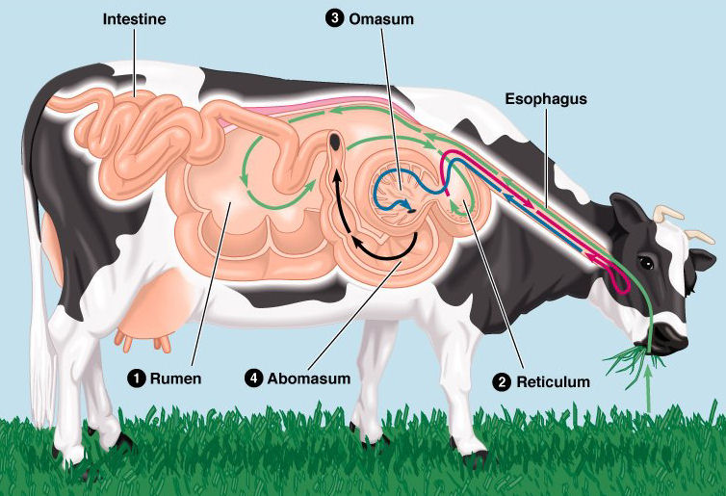
Rumen

Slide 13
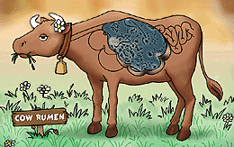
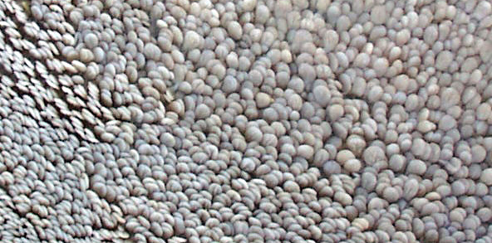
2. Rumen
Rumens Job: store and ferment food
Largest compartment (~80%)
Located on the left side of the animal
Can hold up to 25 gallons in a cow!
Does NOT secrete enzymes, fermentation occurs
Fermentation = microbes present!
Rumen lining
Rumen lining has papillae: small, rounded projections
Notes:
http://www.extension.umn.edu/agriculture/dairy/feed-and-nutrition/feeding-the-dairy-herd/ruminant-anatomy-and-physiology.html
Papillae: small round projections, like on your tounge!

Slide 14
Rumen (Microscopic!)
Do you see all of the papillae in this microscopic section of rumen?
Notes:
For more cool microscopic slides, visit http://peer.tamu.edu/vetschool.asp

Slide 15
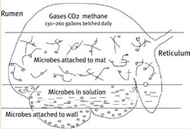
Layers of nutrients in the rumen
There are three layers of nutrients in the rumen:
Gas phase: top layer
If this gas cant be released, then bloat results
Fiber mat: roughage that floats on top of the liquid layer, middle layer
Some microbes live here and help digest food
Itches the wall of the rumen, causing the cow to ruminate (regurgitate cud)
Liquid phase: bottom layer
Where most of the microbes live
Bloat: when the gas produced during fermentation is blocked from leaving the animal, producing a buildup of gas in the rumen
Notes:
See how the left side of this bull is much larger than the right side? The rumen takes up most of the left side of cattle, this is why bloat can be observed with this symptom.

Slide 16
Layers of nutrients in the rumen
Gas Layer
Fiber Mat
Liquid Layer

Slide 17
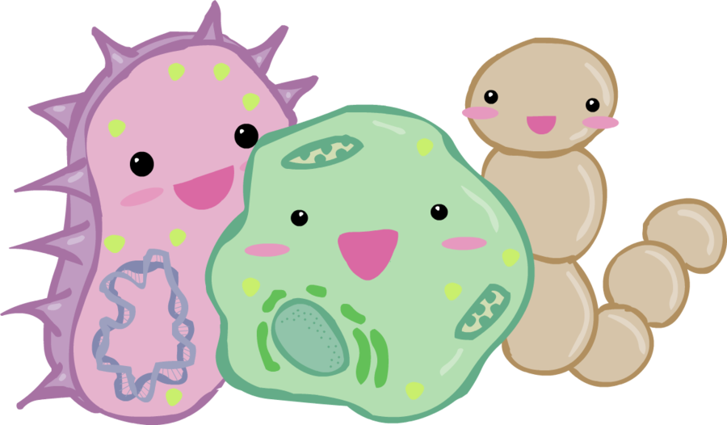
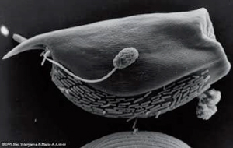
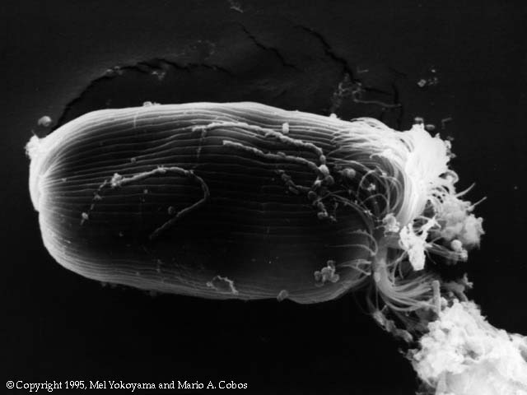
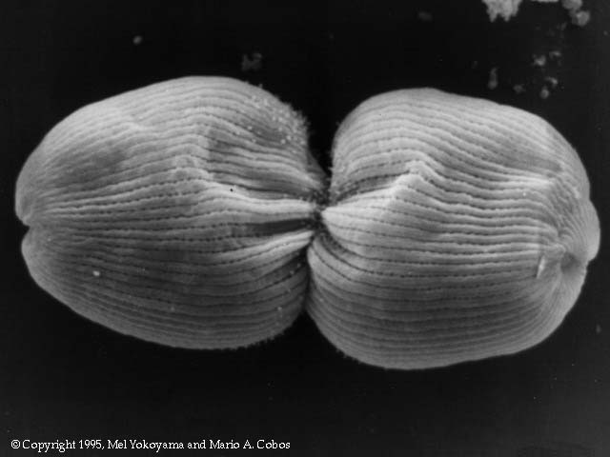
Microbes!
Fun Fact: There can be 1,000,000,000,000 microbes in an ounce of rumen fluid!!!
Three main types of microbes are used in the rumen:
Bacteria
Protozoa
Fungi
Vertebrates cant digest fiber, but microbes can! So microbes in the rumen break down fiber for ruminant animals. So, ruminant animals are more efficient at digesting fiber than monogastric animals.
Microbes are also a good source of protein for ruminants
When microbes die they are digested by the host animal for protein!
Notes:
http://www.ars.usda.gov/sp2UserFiles/Place/36553000/px-based_v3.2/educ-matrls/pdfs/FS_rumen-microbes.pdf

Slide 18
Microbes from Rumen Fluid!

Slide 19
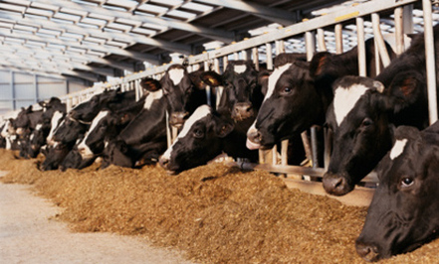
Fermentation
Anaerobic: no oxygen!
Digestion process utilized by the rumen
Occurs in anaerobic environments
Microbes (bacteria, protozoa, and fungi) break down food
The cow does not break down food with fermentation, the microbes do!
Symbiotic relationship
Cow gets nutrients from microbes
Microbes get a nice place to live!
Microbes break down molecules that enzymes cant
This is why cows can eat lower quality feed than horses or pigs!
We will discuss enzymes later!

Slide 20
Fistulated Steer
A hole is surgically placed in the rumen of a cow to allow scientists to study it!
Notes:
Fistulated (or cannulated) cows are used in digestive trials to see how cattle digest different feeds. This allows us to pull feeds and microbes from a living cow! Some animal hospitals keep fistulated cows so that sick animals can be given some of the juice present in the healthy, cannulated cow to help heal the sick cow! COOL!!!!

Slide 21
Think about it! (Rumen)
How is food digested in the rumen?
ANSWER: fermentation
What do microbes do in the rumen?
ANSWER: they help break down food that the animal cant!
What are the three layers in the rumen?
ANSWER: gas layer, fiber mat, and liquid layer
What are the projections on the lining of the rumen called?
ANSWER: papillae

Slide 22
Omasum

Slide 23
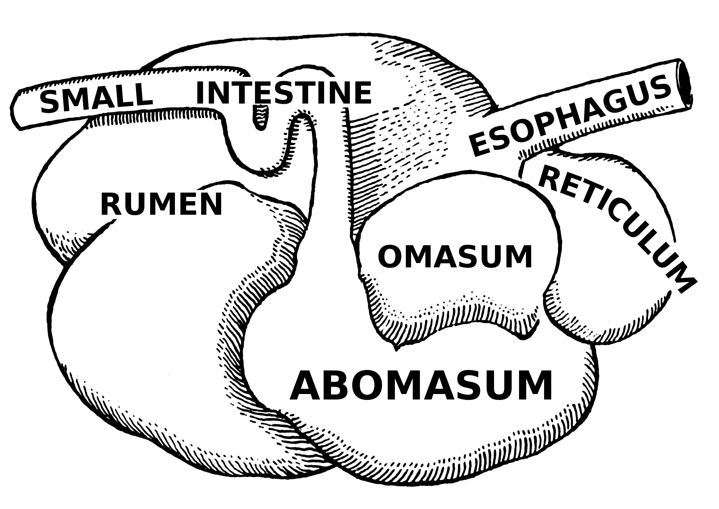
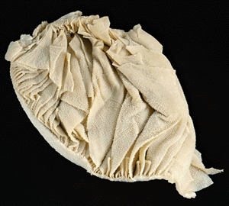
3. Omasum
Omasums Job: absorb water
Second smallest compartment (~7-8%)
Also known as the “Butchers bible” or “manyplies” because it has many folds
The folds increase surface area, allowing it to absorb more water!
Also has small papillae, like the rumen
Omasum lining
Omasum lining has many folds and small papillae

Slide 24
Think about it! (Omasum)
What percentage of the stomach is the omasum?
ANSWER: Approximately 7-8%
What is the primary job of the omasum?
ANSWER: absorb water
What is a common name for the Omasum?
ANSWER: butchers bible or “manyplies”

Slide 25
Abomasum

Slide 26
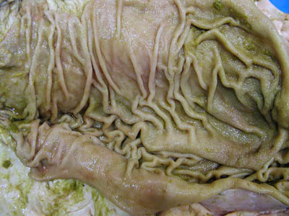
4. Abomasum
Monogastric: one compartment stomach Ex. Humans, pigs
Second largest compartment (~8-9%)
Known as the “true stomach”, most similar to monogastrics
First glandular portion of the ruminant digestive tract (enzymatic digestion)
Abomasum lining
Abomasum lining has glands that secrete enzymes

Slide 27
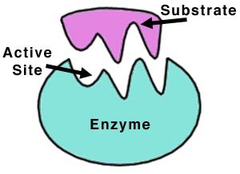
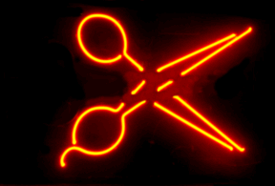
Enzymes
Produced and secreted by the animal to aid in digestion
Proteins that speed up reactions
Help break down big molecules into smaller ones
Large molecules (like big Mario) cant be absorbed through the digestive lining, so enzymes break big molecules into multiple smaller molecules (like small Mario) so that they can be absorbed!!!
Enzymes: molecules made by animals to digest food, they are like scissors!
Enzymes
Notes:
Enzymes are the way that monogastric animals digest most of their food

Slide 28
Think about it! (abomasum)
How does the abomasum digest food?
ANSWER: through enzymatic digestion
What does the lining of the abomasum being “glandular” mean?
ANSWER: that it can secrete enzymes
Why are enzymes important?
ANSWER: they break down food particles into smaller pieces that can be absorbed by the animal

Slide 29
Intestines

Slide 30
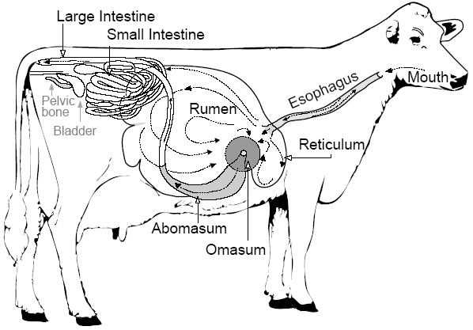
Small Intestine
After the stomach, nutrients move into the small intestine
20% of a cows digestive tract is small intestine
Three parts:
Duodenum
Continues enzymatic digestion
Enzymes released from liver and pancreas
Jejunum
Absorbs nutrients
Covered in villi (similar to papillae)
Ilium
Continues nutrient absorption
Villi: small finger-like projections
Notes:
The villi increase the surface area of the small intestine 600x!!!

Slide 31
Small Intestine (Microscopic!)
Can you see the villi?
Notes:
For more cool microscopic slides, visit http://peer.tamu.edu/vetschool.asp

Slide 32
Villi (Microscopic!)
Notes:
http://imageshack.us/photo/my-images/42/picture7v.jpg/

Slide 33
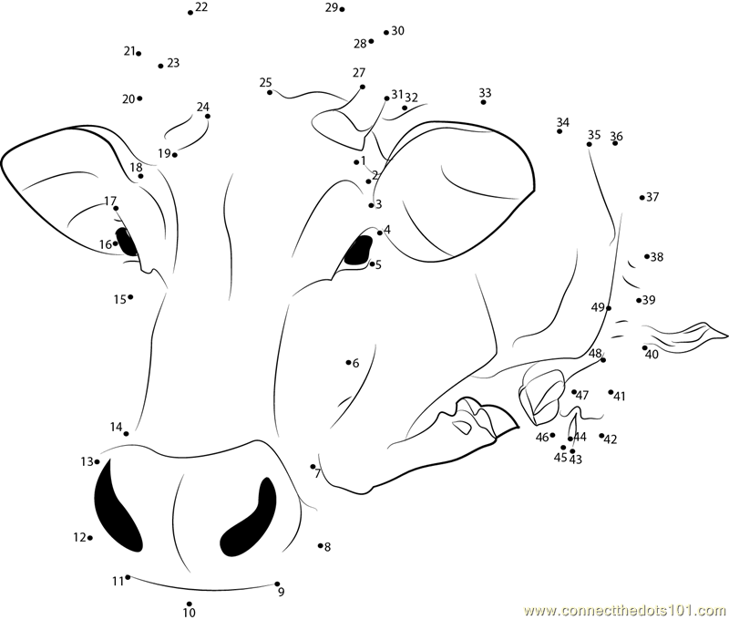
Connect the dots!!!
WHY would the jejunum be covered in villi?
Hint: what is the function of the jejunum and what do villi do?
ANSWER: the villi increases the surface area of the jejunum, allowing more contact with nutrients which allows for more absorption!

Slide 34
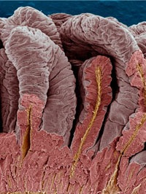
Large Intestine
After the small intestine, the nutrients move into the large intestine
12% of a cows digestive tract is large intestine
Three parts:
Cecum (blind pouch)
Pouch where microbes live
Fermentation of food
Digest nutrients (last chance)
Colon
Absorbs water/nutrients
Rectum
Wastes leave the body
LI lining: folded but no villi
Don’t be confused: the large intestine is shorter, but has a larger diameter than the small intestine
Notes:
The epithelium of the LI appears smooth because it has no villi but it has some folds in it to increase surface area.
Just to clarify: fermentation in the large intestine is utilized in most animal species (monogastric animals and hindgut fermenters too). However, due to the unique ability of ruminant animals to ferment food in the stomach in addition to the large intestine, they are able to utilize the process two places rather than in just one, making them more efficient than monogastric animals or hindgut fermenters. More nutrients can be absorbed through ruminant digestion.

Slide 35
Large Intestine (Microscopic!)
NO Villi!
Notes:
For more cool microscopic slides, visit http://peer.tamu.edu/vetschool.asp

Slide 36
Summary of Ruminant Digestion
Location | Digestion Method | Lining Features
Reticulum | Fermentation (microbes) | Honeycomb-like
Rumen | Fermentation (microbes) | papillae
Omasum | Fermentation (microbes) | Small papillae, many folds
Abomasum | Enzymatic | glandular
Small Intestine | Enzymatic | Villi, glandular
Large Intestine | Fermentation (microbes) | Folded (no villi)

Slide 37
Animated ruminant digestive tract
Notes:
https://www.youtube.com/watch?v=SVNNJf_28KE
While watching: ask the students if they can see the peristaltic contractions in the esophagus. In the rumen, they should see the papillae and the contractions happening in the rumen to mix the contents. They should also be able to recognize the gas layer, fiber mat, and liquid layer. In the reticulum they can see the honey-comb like lining, and in the omasum a lot of water is lost.

Slide 38
Gross anatomical view of ruminant digestive anatomy
Notes:
https://www.youtube.com/watch?v=JSlZjgpF_7g

Slide 39
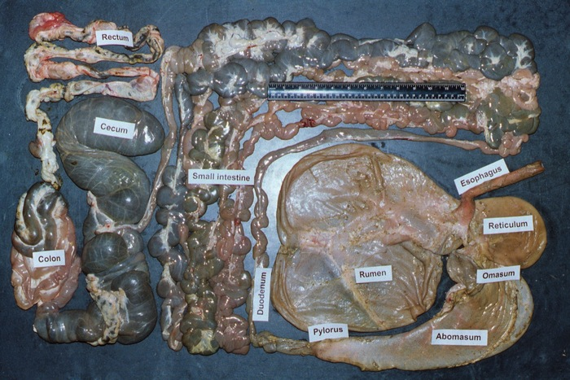
Let’s wrap it up!
What could be one reason for why ruminant animals evolved to have such a different digestive tract than monogastric animals?
ANSWER: Microbes allow ruminant animals to digest cellulose, a major component in roughages (like hay). This enables ruminants to get more nutrients from the same quality and quantity of hay than a non-ruminant animal, like a horse. They have become more efficient at digesting forages!

