Slide 1
Safety with Animals

Slide 2
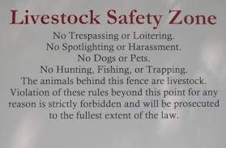
Livestock Safety
Farm animals are responsible for many disabling injuries costing producers time, money, and productivity.

Slide 3
Guidelines for Safety
Care for animals with kindness and respect
Wear sturdy, closed-toe shoes
Speak softly and kindly when approaching an animal
Use adequate restraining and handling facilities when working with animals
Always leave yourself an escape route when working with animals
Do not handle livestock when you are alone

Slide 4
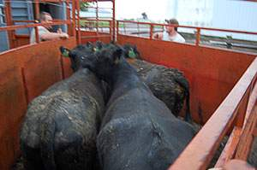
Safe Practices When Dealing With Animals

Slide 5
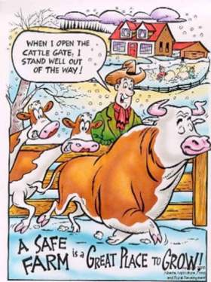
Beef Cattle
Easily spooked by loud, sudden noises and movements
Tend to kick forward and then backward
Visual field is almost 360⁰
Their size and weight can be dangerous

Slide 6
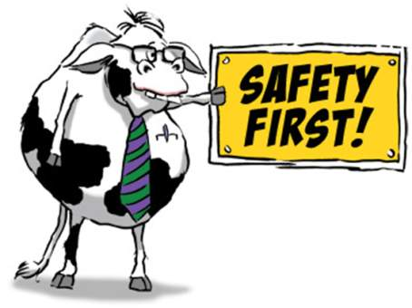
Dairy Cattle
Tend to be more docile than beef cattle
Handled more often so less fearful of people and activity
Can still be easily startled
Use particular caution when milking cows with teat or other injuries

Slide 7
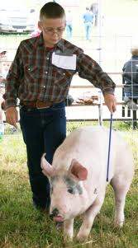
Swine
Can bite with enough force to cause serious injury
Can push and shove forcefully
Children and older persons should not enter pens with large numbers of swine
Tusks, when allowed to grow, can cause serious damage
Animals should be de-tusked

Slide 8
Horses
May spook at loud noises or sudden movements
Extremely quick
Defend themselves by running, striking, biting, and/or kicking

Slide 9
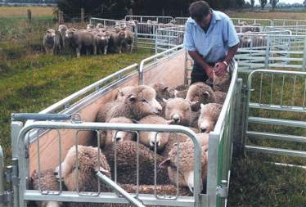
Sheep
Flock animals and may feel threatened if separated
Rams may charge or butt with enough force to knock a person down
Warning signs include stomping feet or shaking head up and down
Sheep can jump with enough force to break handlers' legs and cause head or shoulder injuries by knocking the handler down

Slide 10
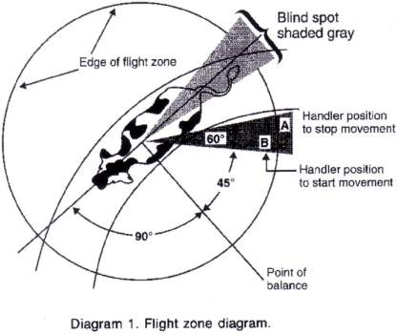
Animal Sight
Horses and cattle can see color
All prey/grazing animals have wide angle vision because their eyes are located on the sides of their heads.
They have a small blind spot behind and directly in front of them

Slide 11
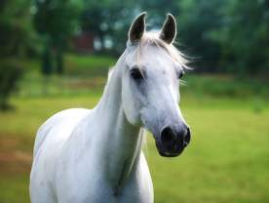
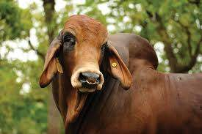
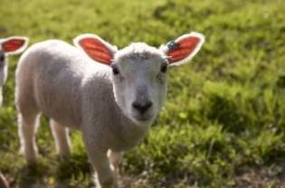
Animal Hearing
Horses and cattle are more sensitive to high-pitched sound than people
speak softly with a low tone of voice when working around animals
Yelling may result in an animal becoming fearful, and attempting to kick, charge, or run
Animals can detect noises that humans cannot hear
Animals will adapt to reasonable levels of continuous sound

Slide 12
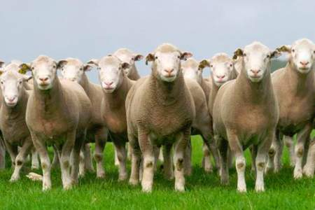
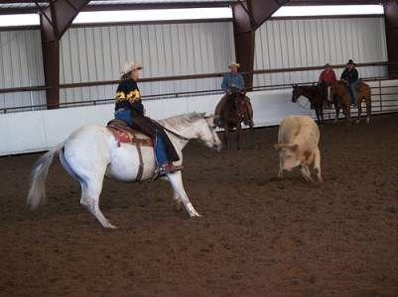
Behavior Patterns
Herd animals often become agitated and fearful when a lone animal is separate from the herd
Animals will make every effort to return to the herd.

Slide 13
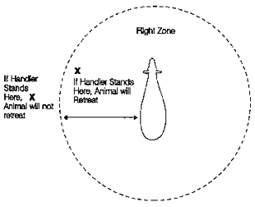
Flight Zone
An animals safety zone
Size varies depending on the degree of tameness
A show steer or riding horse will eventually have no flight zone, but cattle that rarely see people would have a large flight zone.

Slide 14
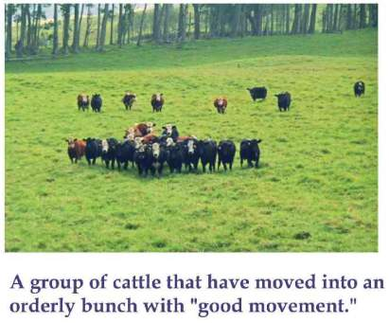
Moving Livestock
Handling is safer when animals are moved quietly
Yelling or flapping arms or excessive use of electric prods can increase agitation
It can take up to 20 minutes for an animal’s heart rate to return to normal after being agitated

Slide 15
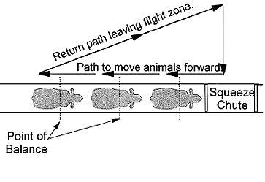
Point of balance
Imaginary line at the animal’s shoulder
For the animal to move forward, the handler must be behind the point of balance
For the animal to move backward, the handler must be in front of the point of balance.
Grazing animals move forward when a handler walks past the point of balance in the opposite direction of desired movement

Slide 16
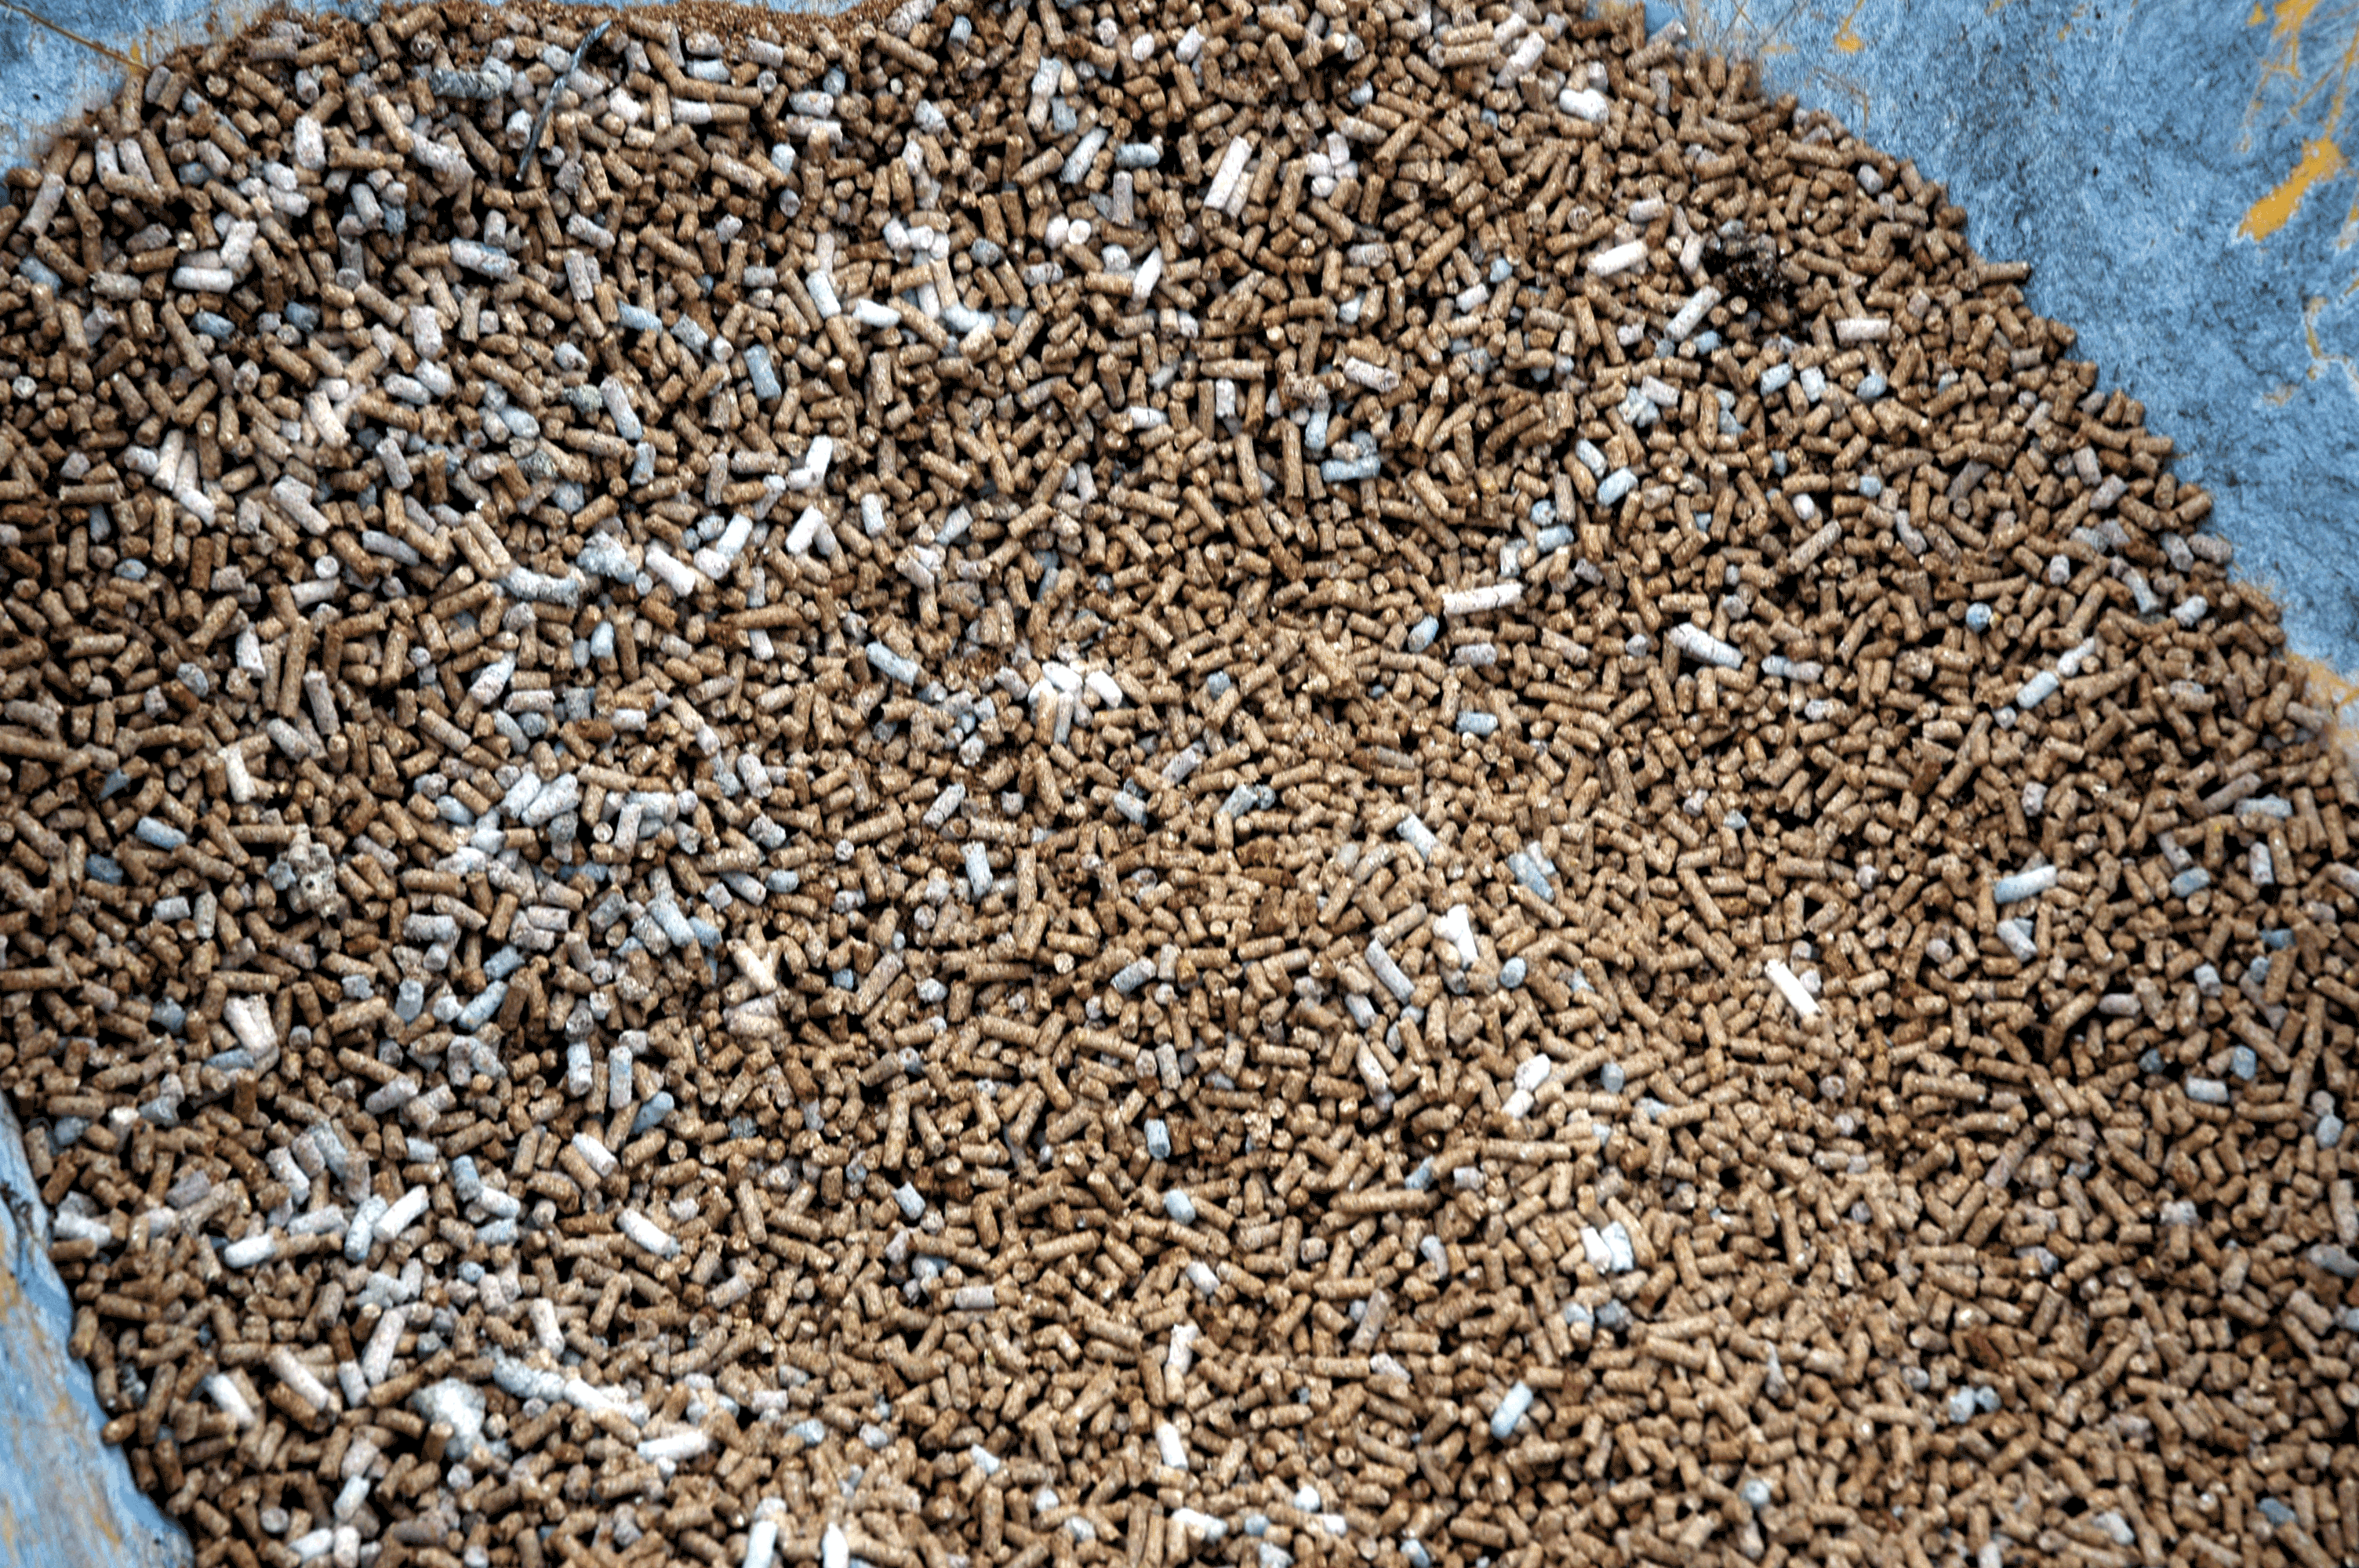
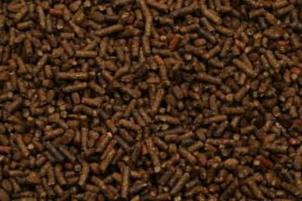
Health and Hygiene
Vital to good livestock management
Maintain a clean, dry environment
Minimize dust with ventilation
Inspect feeds for mold which can cause respiratory and digestive problems
Bad
Good

Slide 17
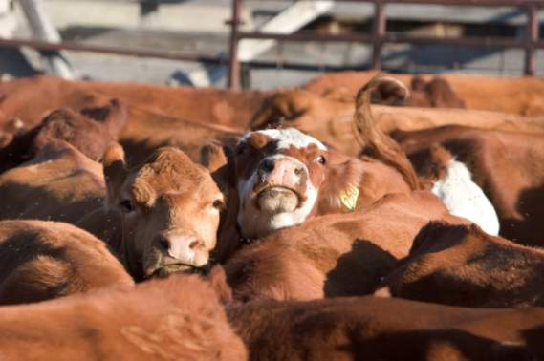
Crowded Pens
Having too many animals in a pen is the number one mistake when handling livestock
Handlers are more susceptible to injuries such as trampling or crushing

Slide 18
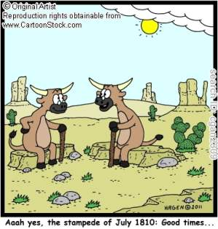
Previous handling effects
Livestock have excellent memories
Painful or aversive experiences may result in reluctance to be handled subsequent times
Abused animals can be very dangerous.
More likely to panic when it sees a person similar to the abuser

Slide 19
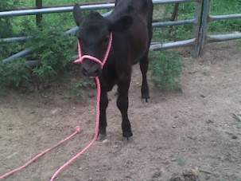
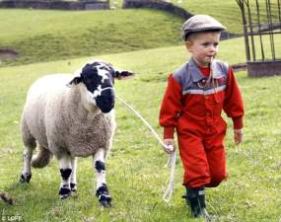
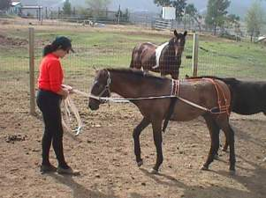
Training
Training animals to cooperate with handling procedures helps reduce stress and accidents
Animals with a flighty, excitable temperament must be trained slowly, over many days
Animals with a placid temperament can be trained more quickly
Training periods should be short and animals should be allowed to relax between training sessions.

Slide 20
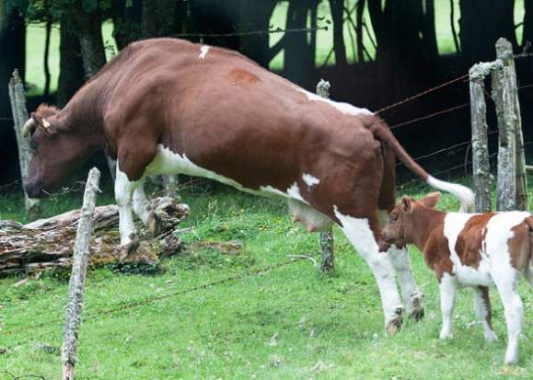
Genetic Effects
Cattle and horse breeds with excitable temperaments are more likely to be difficult to handle in new surroundings

Slide 21
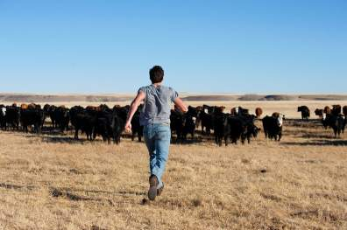
Escaped animals
Allow experienced livestock people to handle escaped animals
An escaped animal that is not an immediate threat to people should not be chased
Allow it to calm down for 30 minutes and then calmly try to retrieve it
A lone animal often returns on its own to a herd of other animals

Slide 22
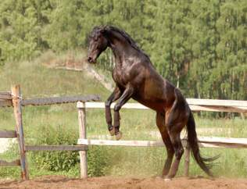
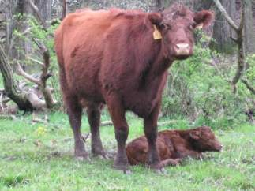
Aggression
Maternal Aggression
Male Aggression
Males will fight other males or people to establish dominance
Castrate any males not intended for breeding
Even typically docile animals can be very protective and defensive of their young
Be alert to warning signals

Slide 23
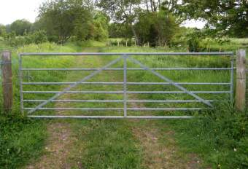
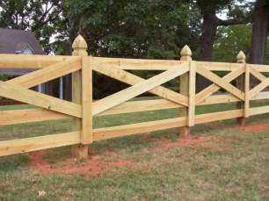
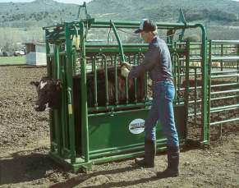
Facilities

Slide 24
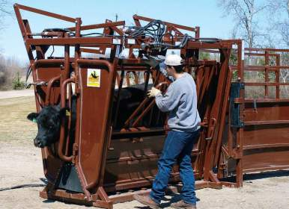
Equipment
Fences and gates should be strong enough to contain crowded livestock
Alleys and chutes should be wide enough to allow animals to pass, but not to turn around
Lighting should be even and diffused
Squeeze chutes should have non-slip floors and animals should never be left unattended

Slide 25
Tips to improve Facility Safety
Panels should have solid sides
Pens should have escape routes or man Gates
Areas holding animals should have nonslip floors
Reduce the noise in facilities
Maintain facility
Remove distractions
Handrails
Anti-back-up Gates
Diffuse lighting

Slide 26
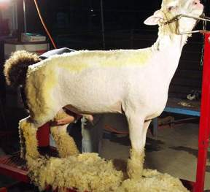
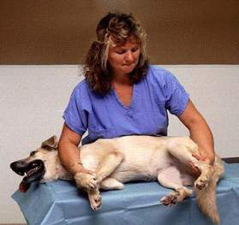
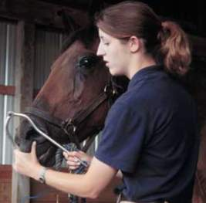
Restraint Techniques

Slide 27
Types of restraints
There are 4 types of restraints routinely used on animals:
Non-Contact: voice, eye contact, gesture
Manual or physical: using body or devices
Chemical: using tranquilizers or anesthetics
Combination Method: using two or more of the previous methods

Slide 28
Effects of Restraints
Restraints are stressful to some degree. The effects can be grouped in 4 areas:
Physical- including such things as bruising, hypoxia, hyperthermia and even fractures
Physiological- including increased heart rate, respiration, temperature and blood pressure
Changes related to laboratory values- increased number of white blood cells, decrease number of white blood cells, decreased clotting time
Psychological- An enduring fear of the veterinary hospital and medical treatment or aggressive/defensive behavior

Slide 29
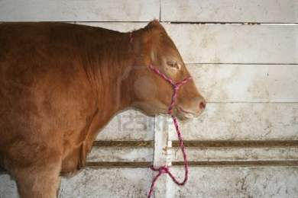
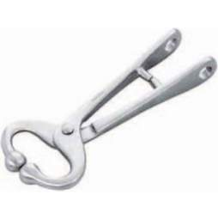
Cattle Restraints
Tools
Rope Halter - basic tool for restraining cattle
Important to place the halter on the cow correctly. Once the animal is haltered, the rope should be tied to a secure object.
Nose Tongs- a clamp used to grasp the very sensitive nasal septum and can severely restrict activity

Slide 30
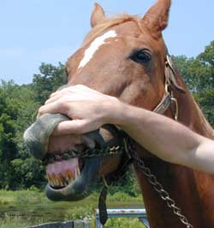
Horse Restraints
Halter and lead rope
Rope or chain - over nose, under chin, or through mouth
Twitch – grasp sensitive areas such as ear, neck skin, or nose
Lifting a limb- may be useful to allow examination of weight bearing limbs
Stocks- useful for rectal exams and reproductive evaluations

Slide 31
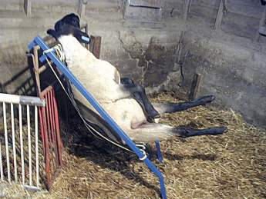
Sheep restraints
Halter
Press against a wall or straddle it to limit movement
Tipping a sheep- setting it on its rump
Sheep “chair” holds a sheep on its rump
Trimming or blocking stand - sheep held in place by a neck piece
Turning cradle squeezes the sheep and turns it on its side or upside down

Slide 32
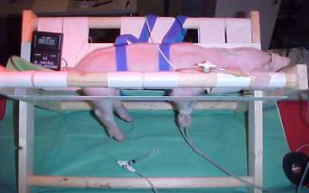
Pig Restraints
Transport Cart- cage on wheels
Hog board- a portable wall to coax or trap pig in a desired area
Panepinto sling- hammock with four holes, hung on a metal frame. The legs are placed onto the four holes and are tied loosely to the frame.
Bucket or blindfold over the head stops forward movement
The pig will retreat and can be backed to desired location

Slide 33
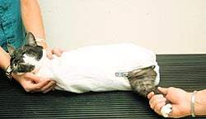
Cat Restraints
Cat stretch - Hold the scruff of the neck with one hand and the hind legs with the other hand stretch the cat and press it’s back or side against the table or your outstretched arm
A fractious cat may have to be wrapped in a heavy towel or cat bag with any needed limb carefully withdrawn

Slide 34
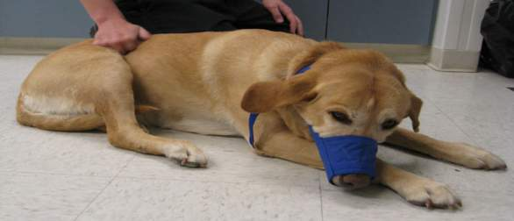
Dog Restraints
Sternal or lateral recumbency or in a sitting position for injections and minor procedures
Muzzles - nylon, leather, or a single loop of a long piece of bandage passed over the dogs muzzle, tied under the mouth, and tied behind the ears
Capture stick - highly aggressive dogs

Slide 35
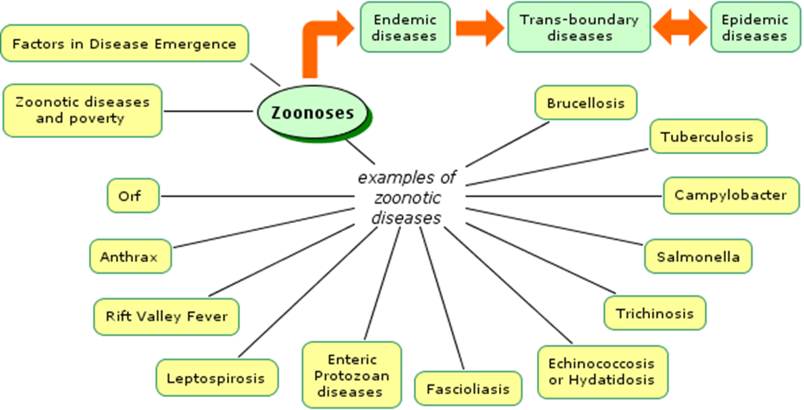
Zoonotic Diseases
Diseases that can be transmitted between animals and people
Person may become infected indirectly(through flies, mosquitoes, ticks, fleas) or directly

Slide 36
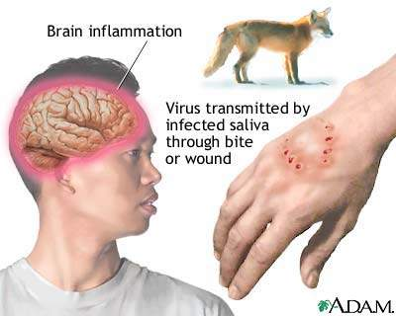
Rabies
Deadly virus that affects the central nervous system
Can be transmitted by saliva from an infected animal through a bite, open wound or sore

Slide 37
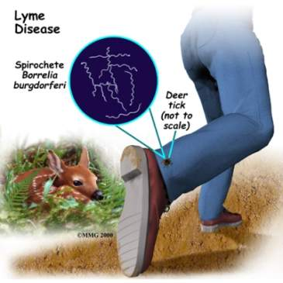
Lyme Disease
Spread through bite of infected tick
There is no evidence that has supported that you can get Lyme disease from other humans or animals that have it, but you can get the disease from the same tick that the animal or person got it from.

Slide 38
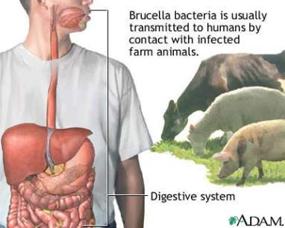
Brucellosis(Bangs Disease)
Affects cattle, goats and swine
Transmitted to people in unprocessed milk, infected carcasses, or by an aborted fetus or afterbirth from the affected animal
Good sanitation practices reduce chances that a herd will be affected
Animals should be tested periodically

Slide 39
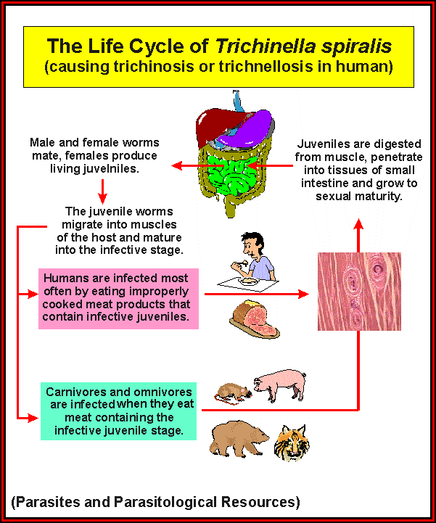
Trichinosis
Caused by parasites
Can be painful and sometimes fatal in humans
Transmitted by consumption of uncooked or partially cooked pork
Thorough cooking is the best prevention

Slide 40
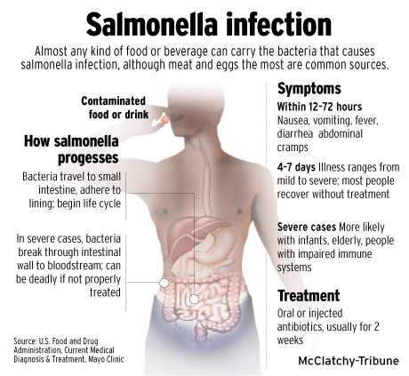
Salmonella
Organisms are found in poultry and in wild and domestic animals
Transmitted to people through contaminated food or water
Prevention includes proper storage and cooking of animal-derived foods.

Slide 41
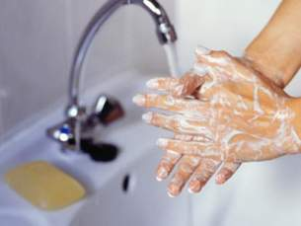
Ways to prevent spreading disease
Wash your hands
Practice food safety
Use biosecurity measures
Pay attention to animal health
Take precautions when handling and caring for animals
Clean and disinfect to kill disease causing germs

Slide 42
Inherent Danger
It is impossible to make handling large and small animals completely safe
Follow all safety precautions, be aware of the surroundings, and prepared to respond to any change in situation.

Slide 43
References
http://www.fss.txstate.edu/ehsrm/safetymanual/agsafe/livestock.html
http://www.grandin.com/references/safe.html
http://extension.missouri.edu/p/G1931
http://ohioline.osu.edu/atts/PDF-English/Stock-Facilities.pdf
http://www.ag.auburn.edu/~schmisp/safety/
http://fazd.tamu.edu/files/2010/05/Prevent-the-spread-of-zoonotic-diseases.pdf
http://www.thejudgingconnection.com/pdfs/Biosecurity_in_Livestock_Shows.pdf
http://www.vetmed.wsu.edu/cliented/dog_restraint.aspx
http://www.doctordog.com/catbook/cathand.html
http://www.lar.iastate.edu/index.php?option=com_content&view=article&id=127&Itemid=150
http://web.jhu.edu/animalcare/procedures/restraint.html
http://www.sheep101.info/201/handling.html
http://www.lar.iastate.edu/index.php?option=com_content&view=article&id=132&Itemid=155

